Slide 1

Unit Test Examples
Eamonn de Leastar (edeleastar@wit.ie)
Produced
by:
Department of Computing and Mathematics
http://www.wit.ie/

Slide 2
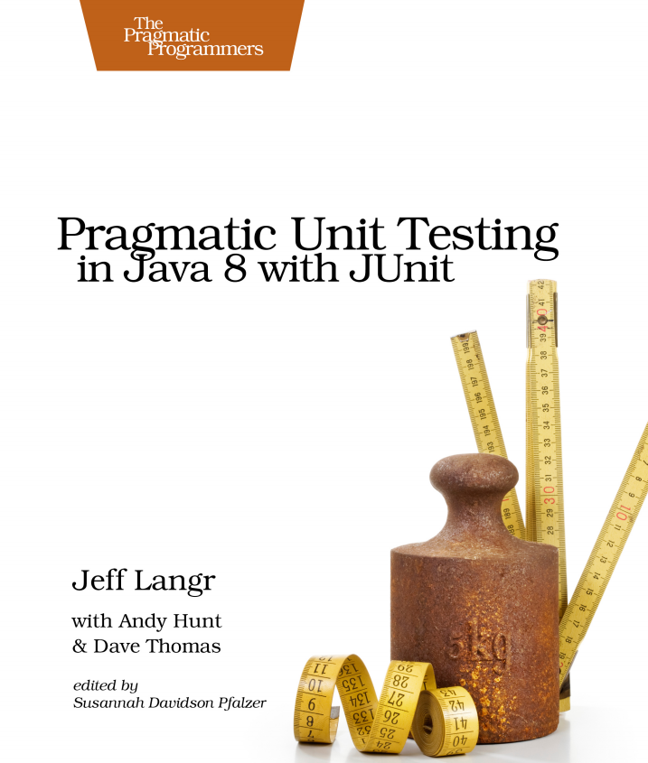
Excellent Unit Testing Resource
Published 2015.
Some excellent “New School” testing approaches.
Source code used in the book is available at: https://pragprog.com/titles/utj2/source_code

Slide 3
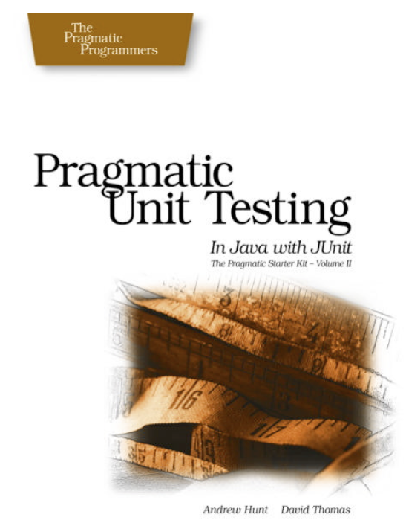
Simple Unit Test Examples
Stack

Slide 4
Stack Interface
public interface Stack
{
public String pop ();
public void push (String item);
public String top ();
public boolean isEmpty ();
}

Slide 5
ArrayStack
public class ArrayStack implements Stack
{
private int next_index;
private String[] stack;
public ArrayStack()
{
stack = new String[100];
next_index = 0;
}
public String pop ()
{
if (next_index == 0)
{
throw new RuntimeException("empty stack");
}
return stack[--next_index];
}
public void delete (int n)
{
next_index -= n;
}
public void push (String aString)
{
stack[next_index++] = aString;
}
public String top ()
{
if (next_index == 0)
{
throw new
RuntimeException ("empty stack");
}
return stack[next_index - 1];
}
public boolean isEmpty ()
{
return next_index == 0;
}
}
the System Under Test (SUT)

Slide 6
StackTest
public class StackTest
{
private Stack testStack;
@Before
public void setUp()
{
testStack = new ArrayStack();
}
@After
public void tearDown()
{
testStack = null;
}
Test Fixture

Slide 7
Test Specifications
Starting with an empty stack, call push() to push a test string onto the stack. Verify that top() returns that string several times in a row, and that isEmpty() returns false.
For a brand-new stack, isEmpty() should be true, top() and pop() should throw exceptions.
Call pop() to remove the test string, and verify that it is the same string. isEmpty() should now be true. Call pop() again verify an exception is thrown.
Now do the same test again, but this time add multiple items to the stack - each of them strings which have the same value (say all "test"). Make sure you get the rights ones back, in the right order (the most recent item added should be the one returned). In this case, assertEquals() isn't good enough; you need assertSame() to ensure it's the same object.
Push a null onto the stack and pop it; confirm you get a null back.
Ensure you can use the stack after it has thrown exceptions.

Slide 8
1.
Starting with an empty stack, call push() to push a test string onto the stack.
Verify that top() returns that string several times in a row.
Verify isEmpty() returns false.
@Test
public void top()
{
testStack.push("Item 1");
assertEquals("Item 1", testStack.top());
assertEquals("Item 1", testStack.top());
assertEquals("Item 1", testStack.top());
assertFalse(testStack.isEmpty());
}

Slide 9
2.
For a brand-new stack: isEmpty() should be true (case 1) top() and pop() should throw exceptions (case 2)
Junit 3
Junit 4
public void testEmptyStack ()
{
assertTrue(testStack.isEmpty());
try
{
testStack.top();
fail("should throw empty stack exception");
}
catch (Exception e)
{
assertTrue(true);
}
try
{
testStack.pop();
fail("should throw empty stack exception");
}
catch (Exception e)
{
assertTrue(true);
}
}
// Case 2
@Test
public void emptyStack()
{
assertTrue(testStack.isEmpty());
}
// Case 2
@Test(expected = Exception.class)
public void testTopException()
{
testStack.top();
}
// Case 2
@Test(expected = Exception.class)
public void testPopException()
{
testStack.pop();
}

Slide 10
3.
Call pop() to remove a test string, and verify that it is the same string.
isEmpty() should now be true.
Call pop() again verify an exception is thrown.
@Test
public void testPop() throws Exception
{
String testStr = new String ("test");
testStack.push(testStr);
assertEquals(testStr, testStack.pop());
assertTrue(testStack.isEmpty());
try
{
testStack.pop();
fail("Pop should throw exception");
}
catch (Exception e)
{
assertTrue(true);
}
}

Slide 11
4.
Now do the same test again, but this time add multiple items to the stack - each of them strings which have the same value (say all "test").
Make sure you get the right ones back, in the right order (the most recent item added should be the one returned).
In this case, assertEquals() isn't good enough; you need assertSame() to ensure it's the same object
@Test
public void testPopDuplicate()
{
String test1 = new String ("test");
String test2 = new String ("test");
String test3 = new String ("test");
testStack.push(test1);
testStack.push(test2);
testStack.push(test3);
assertSame(test3, testStack.pop());
assertSame(test2, testStack.pop());
assertSame(test1, testStack.pop());
}
Note: two String objects can contain the same characters but be different objects (i.e. different memory locations). assertSame() checks to see that two references are pointing to the same object, but the assertEquals() method checks the characters are the same.

Slide 12
5.
Push a null onto the stack and pop it; confirm you get a null back.
@Test
public void testNull()
{
testStack.push(null);
assertEquals (null, testStack.pop());
}

Slide 13
6.
Ensure you can use the stack after it has thrown exceptions
@Test
public void testException()
{
try
{
testStack.pop();
fail("Pop should throw exception");
}
catch (Exception e)
{
assertTrue(true);
}
testStack.push("test");
assertEquals ("test", testStack.top());
assertFalse (testStack.isEmpty());
}

Slide 14
CollectionStack
Completely replace the
System Under Test (SUT)
public class CollectionStack implements Stack
{
private java.util.Stack<String> stack;
public CollectionStack()
{
stack = new java.util.Stack<String>();
}
public boolean isEmpty ()
{
return stack.isEmpty();
}
public String pop ()
{
return stack.pop();
}
public void push (String item)
{
stack.push(item);
}
public String top ()
{
return stack.peek();
}
}
public class StackTest
{
private Stack testStack;
@Before
public void setUp()
{
//testStack = new ArrayStack();
testStack = new CollectionStack();
}
//as before…
The same tests can
verify the behaviour of this new SUT

