Slide 1
Agile Software Development
Eamonn de Leastar (edeleastar@wit.ie)

Slide 2
Pacemaker Tests
Model
API
Serializer

Slide 3
pacemaker
model
public class User
{
static Long counter = 0l;
public Long id;
public String firstName;
public String lastName;
public String email;
public String password;
public Map<Long, Activity> activities = new HashMap<>();
//...
}
public class Activity
{
static Long counter = 0l;
public Long id;
public String type;
public String location;
public double distance;
public List<Location> route = new ArrayList<>();
//...
}
public class Location
{
static Long counter = 0l;
public Long id;
public float latitude;
public float longitude;
//...
}

Slide 4
pacemaker
model -
equals/toString/hashCode
public class User
{
//...
@Override
public String toString()
{
return toStringHelper(this).addValue(id)
.addValue(firstName)
.addValue(lastName)
.addValue(password)
.addValue(email)
.addValue(activities)
.toString();
}
@Override
public boolean equals(final Object obj)
{
if (obj instanceof User)
{
final User other = (User) obj;
return Objects.equal(firstName, other.firstName)
&& Objects.equal(lastName, other.lastName)
&& Objects.equal(email, other.email)
&& Objects.equal(password, other.password)
&& Objects.equal(activities, other.activities);
}
else
{
return false;
}
}
@Override
public int hashCode()
{
return Objects.hashCode(this.id, this.lastName, this.firstName, this.email, this.password);
}
}

Slide 5
pacemaker
fixtures
public class Fixtures
{
public static User[] users =
{
new User ("marge", "simpson", "marge@simpson.com", "secret"),
new User ("lisa", "simpson", "lisa@simpson.com", "secret"),
new User ("bart", "simpson", "bart@simpson.com", "secret"),
new User ("maggie","simpson", "maggie@simpson.com", "secret")
};
public static Activity[] activities =
{
new Activity ("walk", "fridge", 0.001),
new Activity ("walk", "bar", 1.0),
new Activity ("run", "work", 2.2),
new Activity ("walk", "shop", 2.5),
new Activity ("cycle", "school", 4.5)
};
public static Location[] locations =
{
new Location(23.3, 33.3),
new Location(34.4, 45.2),
new Location(25.3, 34.3),
new Location(44.4, 23.3)
};
}

Slide 6
UserTest (1)
public class UserTest
{
User homer = new User ("homer", "simpson", "homer@simpson.com", "secret");
@Test
public void testCreate()
{
assertEquals ("homer", homer.firstName);
assertEquals ("simpson", homer.lastName);
assertEquals ("homer@simpson.com", homer.email);
assertEquals ("secret", homer.password);
}
@Test
public void testIds()
{
Set<Long> ids = new HashSet<>();
for (User user : users)
{
ids.add(user.id);
}
assertEquals (users.length, ids.size());
}
@Test
public void testEquals()
{
User homer2 = new User ("homer", "simpson", "homer@simpson.com", "secret");
User bart = new User ("bart", "simpson", "bart@simpson.com", "secret");
assertEquals(homer, homer);
assertEquals(homer, homer2);
assertNotEquals(homer, bart);
assertSame(homer, homer);
assertNotSame(homer, homer2);
}
//...
}

Slide 7
UserTest (2)
public class UserTest
{
User homer = new User ("homer", "simpson", "homer@simpson.com", "secret");
//...
@Test
public void testToString()
{
assertEquals ("User{" + homer.id + ", homer, simpson, secret, homer@simpson.com, {}}",
homer.toString());
}
}

Slide 8
ActivityTest
public class ActivityTest
{
Activity test = new Activity ("walk", "fridge", 0.001);
@Test
public void testCreate()
{
assertEquals ("walk", test.type);
assertEquals ("fridge", test.location);
assertEquals (0.0001, 0.001, test.distance);
}
@Test
public void testToString()
{
assertEquals ("Activity{" + test.id + ", walk, fridge, 0.001, []}",
test.toString());
}
}

Slide 9
LocationTest
public class LocationTest
{
@Test
public void testCreate()
{
assertEquals (0.01, 23.3, locations[0].latitude);
assertEquals (0.01, 33.3, locations[0].longitude);
}
@Test
public void testIds()
{
assertNotEquals(locations[0].id, locations[1].id);
}
@Test
public void testToString()
{
assertEquals ("Location{" + locations[0].id + ", 23.3, 33.3}",
locations[0].toString());
}
}

Slide 10
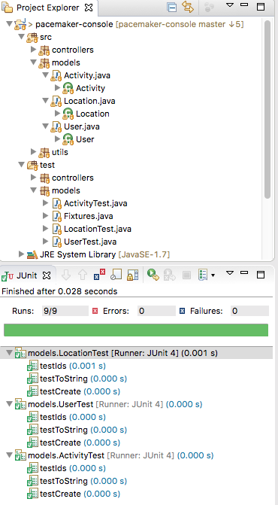
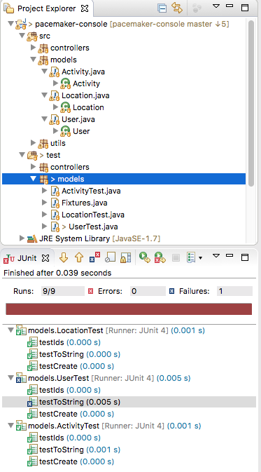

Slide 11
A note on the Optional Class
Guava and Java 8

Slide 12
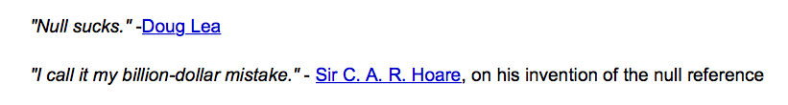
Careless use of null can cause a staggering variety of bugs.
Null is highly ambiguous, e.g., Map.get(key) can return null because
the value in the map is null,
or the value is not in the map.
i.e. Null can mean failure, can mean success, can mean almost anything. Using something other than null makes your meaning clear.

Slide 13
Why use the Optional Class?
“Optional is primarily used for two things:
to make it clearer what you would've meant by null,
and in method return values to make sure the caller takes care of the ‘absent’ case”.
http://stackoverflow.com/questions/11561789/guava-optional-how-to-use-the-correct

Slide 14
Where should we use the Optional Class?
“We certainly don't advocate replacing every nullable value with an Optional everywhere in your code -- we certainly don't do that within Guava itself!
A lot of this will have to be your decision – there's no universal rule, it's a relatively subjective judgement.”
Guava Contributor
http://stackoverflow.com/questions/11561789/guava-optional-how-to-use-the-correct
A brief discussion on use of the optional class: http://stackoverflow.com/questions/18681243/should-i-use-java8-guava-optional-for-every-method-that-may-return-null

Slide 15
Optional (Guava Component version)
Optional<Activity> activity = Optional.fromNullable(activitiesIndex.get(id));
if (activity.isPresent())
{
activity.get().route.add(new Location(latitude, longitude));
}
Optional is an immutable object used to contain a not-null object.
Optional object is used to represent null with an absent value.
This class has various utility methods to facilitate the code to handle:
values as available (present) or
values as not available (absent)
instead of checking null values.

Slide 16
Optional in the Guava Component
Optional<Activity> activity = Optional.fromNullable(activitiesIndex.get(id));
if (activity.isPresent())
{
activity.get().route.add(new Location(latitude, longitude));
}
activitiesindex.get(id) will return null if id not present.
Wrap this in a ‘Optional’ wrapper object - noting that the object it wraps may be null.
Use ‘isPresent’ to determine wrapped object is null or not.

Slide 17
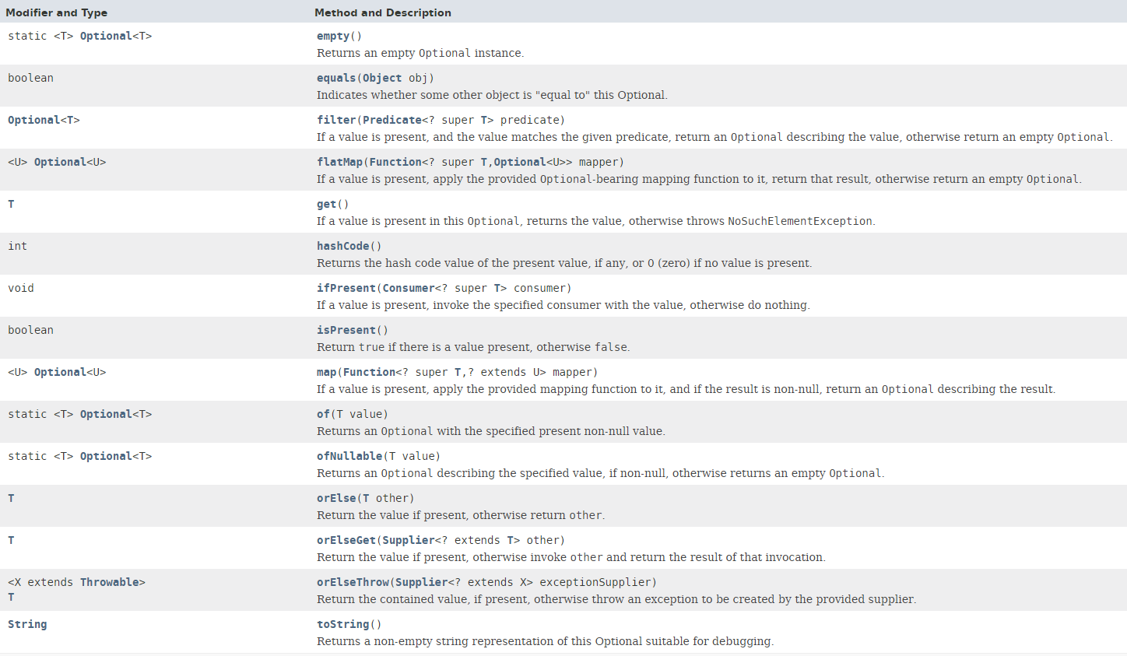
Optional in JDK 8
“A container object which may or may not contain a non-null value.”

Slide 18
Pacemaker Tests
Model
API
Serializer

Slide 19
PacemakerAPI (1)
public class PacemakerAPI
{
private Map<Long, User> userIndex = new HashMap<>();
private Map<String, User> emailIndex = new HashMap<>();
private Map<Long, Activity> activitiesIndex = new HashMap<>();
//...
public Collection<User> getUsers ()
{
return userIndex.values();
}
public void deleteUsers()
{
userIndex.clear();
emailIndex.clear();
}
public void deleteUser(Long id)
{
User user = userIndex.remove(id);
emailIndex.remove(user.email);
}
public Activity createActivity(Long id, String type,
String location, double distance)
{
Activity activity = null;
Optional<User> user = Optional.fromNullable(userIndex.get(id));
if (user.isPresent())
{
activity = new Activity (type, location, distance);
user.get().activities.put(activity.id, activity);
activitiesIndex.put(activity.id, activity);
}
return activity;
}
Implement the core features of the pacemaker service.
Not concerned with UI at this stage.

Slide 20
PacemakerAPI (2)
public class PacemakerAPI
{
private Map<Long, User> userIndex = new HashMap<>();
private Map<String, User> emailIndex = new HashMap<>();
private Map<Long, Activity> activitiesIndex = new HashMap<>();
//...
public Activity getActivity (Long id)
{
return activitiesIndex.get(id);
}
public void addLocation (Long id, float latitude, float longitude)
{
Optional<Activity> activity = Optional.fromNullable(activitiesIndex.get(id));
if (activity.isPresent())
{
activity.get().route.add(new Location(latitude, longitude));
}
}
}

Slide 21
PacemakerAPI
public class PacemakerAPI
{
private Map<Long, User> userIndex = new HashMap<>();
private Map<String, User> emailIndex = new HashMap<>();
private Map<Long, Activity> activitiesIndex = new HashMap<>();
//...
public Collection<User> getUsers ()
{
return userIndex.values();
}
public void deleteUsers()
{
userIndex.clear();
emailIndex.clear();
}
public void deleteUser(Long id)
{
User user = userIndex.remove(id);
emailIndex.remove(user.email);
}
public Activity createActivity(Long id, String type,
String location, double distance)
{
Activity activity = null;
Optional<User> user = Optional.fromNullable(userIndex.get(id));
if (user.isPresent())
{
activity = new Activity (type, location, distance);
user.get().activities.put(activity.id, activity);
activitiesIndex.put(activity.id, activity);
}
return activity;
}
public class PacemakerAPI
{
private Map<Long, User> userIndex = new HashMap<>();
private Map<String, User> emailIndex = new HashMap<>();
private Map<Long, Activity> activitiesIndex = new HashMap<>();
//...
public Activity getActivity (Long id)
{
return activitiesIndex.get(id);
}
public void addLocation (Long id, float latitude, float longitude)
{
Optional<Activity> activity = Optional.fromNullable(activitiesIndex.get(id));
if (activity.isPresent())
{
activity.get().route.add(new Location(latitude, longitude));
}
}
}

Slide 22
PacemakerAPITest (1)
public class PacemakerAPITest
{
private PacemakerAPI pacemaker;
@Before
public void setup()
{
pacemaker = new PacemakerAPI(null);
for (User user : users)
{
pacemaker.createUser(user.firstName, user.lastName, user.email, user.password);
}
}
@After
public void tearDown()
{
pacemaker = null;
}
@Test
public void testUser()
{
assertEquals (users.length, pacemaker.getUsers().size());
pacemaker.createUser("homer", "simpson", "homer@simpson.com", "secret");
assertEquals (users.length+1, pacemaker.getUsers().size());
assertEquals (users[0], pacemaker.getUserByEmail(users[0].email));
}
@Test
public void testUsers()
{
assertEquals (users.length, pacemaker.getUsers().size());
for (User user: users)
{
User eachUser = pacemaker.getUserByEmail(user.email);
assertEquals (user, eachUser);
assertNotSame(user, eachUser);
}
}

Slide 23
PacemakerAPITest (2)
@Test
public void testDeleteUsers()
{
assertEquals (users.length, pacemaker.getUsers().size());
User marge = pacemaker.getUserByEmail("marge@simpson.com");
pacemaker.deleteUser(marge.id);
assertEquals (users.length-1, pacemaker.getUsers().size());
}
@Test
public void testAddActivity()
{
User marge = pacemaker.getUserByEmail("marge@simpson.com");
Activity activity = pacemaker.createActivity(marge.id, activities[0].type,
activities[0].location, activities[0].distance);
Activity returnedActivity = pacemaker.getActivity(activity.id);
assertEquals(activities[0], returnedActivity);
assertNotSame(activities[0], returnedActivity);
}
@Test
public void testAddActivityWithSingleLocation()
{
User marge = pacemaker.getUserByEmail("marge@simpson.com");
Long activityId = pacemaker.createActivity(marge.id, activities[0].type, activities[0].location,
activities[0].distance).id;
pacemaker.addLocation(activityId, locations[0].latitude, locations[0].longitude);
Activity activity = pacemaker.getActivity(activityId);
assertEquals (1, activity.route.size());
assertEquals(0.0001, locations[0].latitude, activity.route.get(0).latitude);
assertEquals(0.0001, locations[0].longitude, activity.route.get(0).longitude);
}

Slide 24
PacemakerAPITest (3)
@Test
public void testAddActivityWithMultipleLocation()
{
User marge = pacemaker.getUserByEmail("marge@simpson.com");
Long activityId = pacemaker.createActivity(marge.id, activities[0].type,
activities[0].location,
activities[0].distance).id;
for (Location location : locations)
{
pacemaker.addLocation(activityId, location.latitude, location.longitude);
}
Activity activity = pacemaker.getActivity(activityId);
assertEquals (locations.length, activity.route.size());
int i = 0;
for (Location location : activity.route)
{
assertEquals(location, locations[i]);
i++;
}
}
}

Slide 25
Pacemaker Tests
Model
API
Serializer

Slide 26
pacemaker persistence
public interface Serializer
{
void push(Object o);
Object pop();
void write() throws Exception;
void read() throws Exception;
}
public class PacemakerAPI
{
private Map<Long, User> userIndex = new HashMap<>();
private Map<String, User> emailIndex = new HashMap<>();
private Map<Long, Activity> activitiesIndex = new HashMap<>();
private Serializer serializer;
public PacemakerAPI(Serializer serializer)
{
this.serializer = serializer;
}
@SuppressWarnings("unchecked")
public void load() throws Exception
{
serializer.read();
activitiesIndex = (Map<Long, Activity>) serializer.pop();
emailIndex = (Map<String, User>) serializer.pop();
userIndex = (Map<Long, User>) serializer.pop();
}
public void store() throws Exception
{
serializer.push(userIndex);
serializer.push(emailIndex);
serializer.push(activitiesIndex);
serializer.write();
}
}

Slide 27
XMLSerializer
public class XMLSerializer implements Serializer
{
private Stack stack = new Stack();
private File file;
public XMLSerializer(File file)
{
this.file = file;
}
public void push(Object o)
{
stack.push(o);
}
public Object pop()
{
return stack.pop();
}
@SuppressWarnings("unchecked")
public void read() throws Exception
{
ObjectInputStream is = null;
try
{
XStream xstream = new XStream(new DomDriver());
is = xstream.createObjectInputStream(new FileReader(file));
stack = (Stack) is.readObject();
}
finally
{
if (is != null)
{
is.close();
}
}
}
public void write() throws Exception
{
ObjectOutputStream os = null;
try
{
XStream xstream = new XStream(new DomDriver());
os = xstream.createObjectOutputStream(new FileWriter(file));
os.writeObject(stack);
}
finally
{
if (os != null)
{
os.close();
}
}
}
}

Slide 28
PersistenceTest - fixtures
public class Fixtures
{
public static User[] users =
{
new User ("marge", "simpson", "marge@simpson.com", "secret"),
new User ("lisa", "simpson", "lisa@simpson.com", "secret"),
new User ("bart", "simpson", "bart@simpson.com", "secret"),
new User ("maggie","simpson", "maggie@simpson.com", "secret")
};
public static Activity[] activities =
{
new Activity ("walk", "fridge", 0.001),
new Activity ("walk", "bar", 1.0),
new Activity ("run", "work", 2.2),
new Activity ("walk", "shop", 2.5),
new Activity ("cycle", "school", 4.5)
};
public static Location[] locations =
{
new Location(23.3f, 33.3f),
new Location(34.4f, 45.2f),
new Location(25.3f, 34.3f),
new Location(44.4f, 23.3f)
};
}
public class PersistenceTest
{
PacemakerAPI pacemaker;
void populate (PacemakerAPI pacemaker)
{
for (User user : users)
{
pacemaker.createUser(user.firstName, user.lastName, user.email, user.password);
}
User user1 = pacemaker.getUserByEmail(users[0].email);
Activity activity = pacemaker.createActivity(user1.id, activities[0].type, activities[0].location,
activities[0].distance);
pacemaker.createActivity(user1.id, activities[1].type, activities[1].location, activities[1].distance);
User user2 = pacemaker.getUserByEmail(users[1].email);
pacemaker.createActivity(user2.id, activities[2].type, activities[2].location, activities[2].distance);
pacemaker.createActivity(user2.id, activities[3].type, activities[3].location, activities[3].distance);
for (Location location : locations)
{
pacemaker.addLocation(activity.id, location.latitude, location.longitude);
}
}
void deleteFile(String fileName)
{
File datastore = new File ("testdatastore.xml");
if (datastore.exists())
{
datastore.delete();
}
}

Slide 29
Verify Fixture
@Test
public void testPopulate()
{
pacemaker = new PacemakerAPI(null);
assertEquals(0, pacemaker.getUsers().size());
populate (pacemaker);
assertEquals(users.length, pacemaker.getUsers().size());
assertEquals(2, pacemaker.getUserByEmail(users[0].email).activities.size());
assertEquals(2, pacemaker.getUserByEmail(users[1].email).activities.size());
Long activityID =
pacemaker.getUserByEmail(users[0].email).activities.keySet().iterator().next();
assertEquals(locations.length, pacemaker.getActivity(activityID).route.size());
}

Slide 30
Serializer Test (XML)
@Test
public void testXMLSerializer() throws Exception
{
String datastoreFile = "testdatastore.xml";
deleteFile (datastoreFile);
Serializer serializer = new XMLSerializer(new File (datastoreFile));
pacemaker = new PacemakerAPI(serializer);
populate(pacemaker);
pacemaker.store();
PacemakerAPI pacemaker2 = new PacemakerAPI(serializer);
pacemaker2.load();
assertEquals (pacemaker.getUsers().size(), pacemaker2.getUsers().size());
for (User user : pacemaker.getUsers())
{
assertTrue (pacemaker2.getUsers().contains(user));
}
deleteFile ("testdatastore.xml");
}

