Slide 1
Multiple Module Maven Projects
Eamonn de Leastar (edeleastar@wit.ie)
Dr. Siobhán Drohan (sdrohan@wit.ie)

Slide 2

Modular Approach

Slide 3
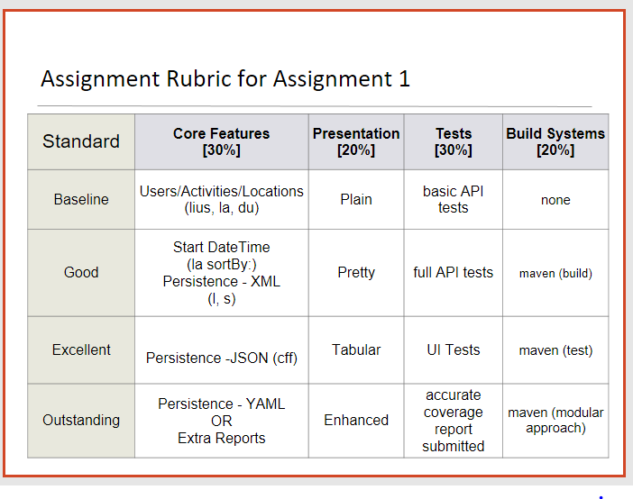


Slide 4
POM Relationships
A module (and their POMS) are potentially related in three ways:
    (1) Dependency
    (2) Inheritance
    (3) Aggregation
We have covered the Dependency relationship to date, so we will now look at Aggregation.

Slide 5
1. Dependency Relationship

Slide 6
1. Dependency
<dependencies>
<dependency>
<groupId>org.springframework</groupId>
<artifactId>spring-remoting</artifactId>
<version>2.0-rc2</version>
<type>jar</type>
<scope>compile</scope>
</dependency>
<dependency>
<groupId>cglib</groupId>
<artifactId>cglib</artifactId>
<version>2.1</version>
<type>jar</type>
<scope>runtime</scope>
</dependency>
<dependency>
<groupId>junit</groupId>
<artifactId>junit</artifactId>
<version>4.7</version>
<scope>test</scope>
</dependency>
<dependencies>
Module A requires module B, i.e. module B is to be on Module A’s classpath.
Module A’s POM will have an entry specifying a dependency on Module B.
Used when module is using another project’s API, developed in-house or by a third-party.

Slide 7
2. Inheritance Relationship

Slide 8
2. Inheritance
Applies to general project configuration, and not necessarily explicit dependency management.
Module A’s POM inherits module B’s POM:
    this automatically acquires all of Module B’s settings, configurations and dependencies.

Slide 9
2. Inheritance – Super POM
All maven POMs have an implicit “parent”
Called the Super POM is Maven's default POM (somewhat like the “cosmic” base class Object in java).
All POMs extend the Super POM unless explicitly set, meaning the configuration specified in the Super POM is inherited by the POMs you created for your projects.
Located in the maven.jar file, it is not editable or necessarily intended to be human readable
Can viewed by entering: mvn help:effective-pom

Slide 10
2. Inheritance - Hierarchies
You can define your own POM inheritance hierarchy.
mchat-api
mchat
mchat-client
mchat-server
Inherits (has knowledge of)

Slide 11
Parent
packaging - pom indicates a parent project – i.e. does not have code of its own
The Super POM is its parent, by default.
<groupId>msccomm.mchat</groupId>
<artifactId>mchat</artifactId>
<packaging>pom</packaging>
<version>1.0</version>
<name>mchat</name>
<url>http://vle.wit.ie</url>
Child
<parent>
<artifactId>mchat</artifactId>
<groupId>msccomm.mchat</groupId>
<version>1.0</version>
</parent>
<artifactId>mchat-server</artifactId>
<version>1.0</version>
<name>mchat-server</name>
mchat-server inherits from mchat

Slide 12
3. Aggregation Relationship

Slide 13
3. Aggregation
Recall the ‘single artifact per project’ principle.
Non-trivial projects should be broken into modules (sub-projects).
Facilitates reusability of code, manageability of projects.
Modules are maven projects (with their own POM), perhaps listed in a parent POM, and executed as a set.

Slide 14
3. Aggregation – high level example
app-api
myapp
app-model
app-db
Aggregates (has knowledge of)

Slide 15
POM (Project) relationships – Aggregation.
Typically the parent POM’s folder has a subfolder for each module.
Building from the parent folder will cause a build of each modules
<modelVersion>4.0.0</modelVersion>
<groupId>msccomm.mchat</groupId>
<artifactId>mchat</artifactId>
<packaging>pom</packaging>
<version>1.0</version>
<name>mchat</name>
<url>http://vle.wit.ie</url>
<modules>
<module>mchat-api</module>
<module>mchat-client</module>
<module>mchat-server</module>
</modules>
Names of folders housing the module projects

Slide 16
Example – Multi-Module Approach

Slide 17
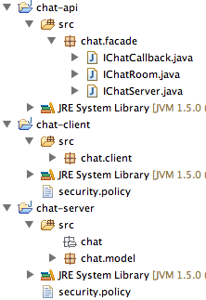
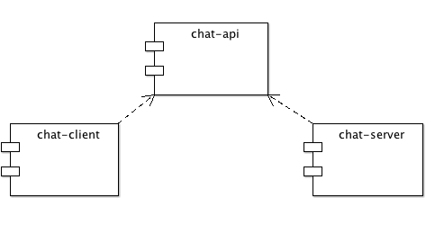
A "Chat" Project
Dependency Structure:

Slide 18
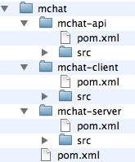
Dependencies in Maven
Define Parent POM for mchat “group” of projects.
Have mchat-api, mchat-client and mchat-server as children of this parent.
All stored hierarchy in subfolders

Slide 19
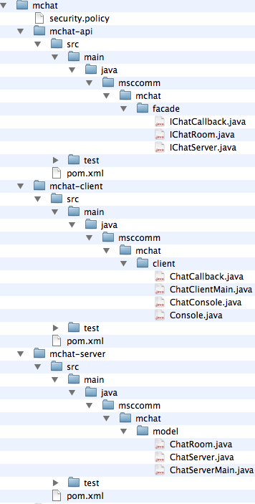
mchat group

Slide 20
mchat (parent)
<project xmlns="...”
<modelVersion>4.0.0</modelVersion>
<groupId>msccomm.mchat</groupId>
<artifactId>mchat</artifactId>
<packaging>pom</packaging>
<version>1.0</version>
<name>mchat</name>
<url>http://vle.wit.ie</url>
<dependencies>
</dependencies>
<modules>
<module>mchat-api</module>
<module>mchat-server</module>
<module>mchat-client</module>
</modules>
</project>
Defines
  groupID
  version
  base dependencies
  build options
  ... all of which will be inherited by child modules.
Specifically indicates modules that it aggregates (modules tag)

Slide 21
mchat-api
Standalone module, without any explicit dependences (apart form those inherited from parent).
Also inherits parent version, parent groupID and web site.
<project>
<parent>
<artifactId>mchat</artifactId>
<groupId>msccomm.mchat</groupId>
<version>1.0</version>
</parent>
<modelVersion>4.0.0</modelVersion>
<artifactId>mchat-api</artifactId>
<name>mchat-api</name>
</project>

Slide 22
mchat-client
<project>
<parent>
<artifactId>mchat</artifactId>
<groupId>msccomm.mchat</groupId>
<version>1.0</version>
</parent>
<modelVersion>4.0.0</modelVersion>
<artifactId>mchat-client</artifactId>
<name>mchat-client</name>
<version>1.0</version>
<dependencies>
<dependency>
<groupId>msccomm.mchat</groupId>
<artifactId>mchat-api</artifactId>
<version>1.0</version>
</dependency>
</dependencies>
</project>
Inherits same properties as mchat-api
Augments with explicit dependency on the mchat-api module

Slide 23
mchat-server
Similar to mchat-client, inherits key properties from parent.
Explicit dependency on mchat-api
<project>
<parent>
<artifactId>mchat</artifactId>
<groupId>msccomm.mchat</groupId>
<version>1.0</version>
</parent>
<modelVersion>4.0.0</modelVersion>
<artifactId>mchat-server</artifactId>
<name>mchat-server</name>
<dependencies>
<dependency>
<groupId>msccomm.mchat</groupId>
<artifactId>mchat-api</artifactId>
<version>1.0</version>
</dependency>
</dependencies>
</project>

Slide 24
Aggregation
Because mchat (the parent) explicitly aggregates the three modules, we can operate on the mchat parent for common operations.
    mvn clean
    mvn package
    mvn install
...will all perform these goals on each component.
<groupId>msccomm.mchat</groupId>
<artifactId>mchat</artifactId>
<packaging>pom</packaging>
...
<modules>
<module>mchat-api</module>
<module>mchat-server</module>
<module>mchat-client</module>
</modules>
...
</project>

Slide 25
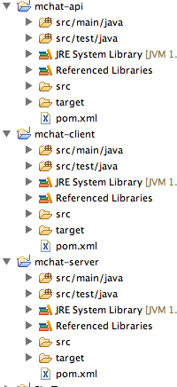
Eclipse View
The Eclipse projects generated by:
    mvn eclipse:eclipse
...will generate projects with the inter-module dependencies intact

Slide 26
More Reading
https://maven.apache.org/plugins/maven-assembly-plugin/examples/multimodule/module-source-inclusion-simple.html

