Slide 1
Exceptions
Introduction to the Java Programming Language
Dr. Siobhán Drohan (sdrohan@wit.ie)
Eamonn de Leastar (edeleastar@wit.ie)

Slide 2
Exceptions
Motivation / Definition
Catching and Throwing Exceptions
Java 7+ and Exceptions
Exception Hierarchy
Handling Mechanisms
Defining exceptions
Common exceptions and errors

Slide 3
Motivation
Exceptions provide the means to separate the details of what to do when something out of the ordinary happens from the main logic of a program.

Slide 4
Motivation
Exceptions provide the means to separate the details of what to do when something out of the ordinary happens from the main logic of a program.
readFile
{
open the file;
determine its size;
allocate that much memory;
read the file into memory;
close the file;
}

Slide 5
Motivation
Exceptions provide the means to separate the details of what to do when something out of the ordinary happens from the main logic of a program.
What happens if the file can't be opened?
What happens if the length of the file can't be determined?
What happens if enough memory can't be allocated?
What happens if the read fails?
What happens if the file can't be closed?
readFile
{
open the file;
determine its size;
allocate that much memory;
read the file into memory;
close the file;
}

Slide 6
Motivation Example (if-statements)
errorCodeType readFile {
initialize errorCode = 0;
open the file;
if (theFileIsOpen) {
determine the length of the file;
if (gotTheFileLength) {
allocate that much memory;
if (gotEnoughMemory) {
read the file into memory;
if (readFailed) {
errorCode = -1;
}
} else {
errorCode = -2;
}
} else {
errorCode = -3;
}
close the file;
if (theFileDidntClose && errorCode == 0) {
errorCode = -4;
} else {
errorCode = errorCode and -4;
}
} else {
errorCode = -5;
}
return errorCode;
}
readFile
{
open the file;
determine its size;
allocate that much memory;
read the file into memory;
close the file;
}

Slide 7
Motivation Example (exceptions)
readFile {
try {
open the file;
determine its size;
allocate that much memory;
read the file into memory;
close the file;
} catch (fileOpenFailed) {
doSomething;
} catch (sizeDeterminationFailed) {
doSomething;
} catch (memoryAllocationFailed) {
doSomething;
} catch (readFailed) {
doSomething;
} catch (fileCloseFailed) {
doSomething;
}
}
readFile
{
open the file;
determine its size;
allocate that much memory;
read the file into memory;
close the file;
}

Slide 8
What are Exceptions?
Exceptions are unexpected conditions in a program.
An Exception is an object that signals that some unusual condition has occurred while the program is executing.
Exceptions are intended to be detected and handled, so that the program can continue in a sensible way if at all possible.
Java has many predefined Exception objects, and we can also create our own.
Notes:
© Judith Bishop(2001), Java Gently, Third Edition, Addison-Wesley

Slide 9
When an exception occurs…
...the normal flow of execution is disrupted and transferred to code (catch), which can handle the exception condition.
The exception mechanism is a lot cleaner than having to check an error value after every method call that could potentially fail.
Notes:
© Judith Bishop(2001), Java Gently, Third Edition, Addison-Wesley

Slide 10
Exceptions
Motivation / Definition
Catching and Throwing Exceptions
Java 7+ and Exceptions
Exception Hierarchy
Handling Mechanisms
Defining exceptions
Common exceptions and errors

Slide 11
try and catch - syntax
Catching an exception means declaring that you can handle exceptions of a particular class from a particular block of code.
To catch exceptions - surround a block of code with a "try, catch" statement.

Slide 12
try and catch - syntax
Catching an exception means declaring that you can handle exceptions of a particular class from a particular block of code.
To catch exceptions - surround a block of code with a "try, catch" statement.
public void myMethod()
{
try{
//Code that throws exception e:
// The try clause is the piece of code which you want
// to try to execute. It contains statements in which an
// exception could be raised.
}
catch (Exception e){
//Code that handles exception e:
// The catch clauses are the handlers. for the various exceptions
// They contain code to handle the Exception and recover from
// it (if possible).
}
}

Slide 13
try and catch - example
The parameter e is of type Exception and we can use it to print out what exception occurred.
try{
//Code that throws exception e:
myMethod();
}
catch (Exception e){
//Code that handles exception e:
System.err.println(“Caught Exception: “ + e);
Notes:
© Judith Bishop(2001), Java Gently, Third Edition, Addison-Wesley

Slide 14
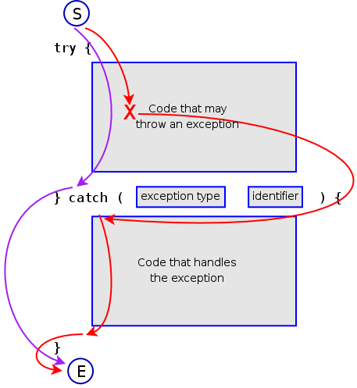
Flow of control in Exception Handing

Slide 15
Catching Multiple Exceptions
It is possible to catch multiple exceptions in a catch block
Order of exceptions is important as more generic exceptions should be handled at the end
public void myMethod()
{
try
{
//code that throws exception e1
//code that throws exception e2
}
catch(MyException e1)
{
//code that handles exception e1
}
catch(Exception e2)
{
//code that handles exception e2
}
}
Exception
MyException

Slide 16
finally block
Executes always at the end after the last catch block
Commonly used for cleaning up resources (closing files, streams, etc.)
public void myMethod()
{
try
{
//code that throws exception e1
//code that throws exception e2
}
catch (MyException e1)
{
//code that handles exception e1
}
catch (Exception e2)
{
//code that handles exception e2
}
finally
{
//clean up code, close resources
}
}

Slide 17
The Catch or Specify Requirement
Valid Java programming language code must honor the Catch or Specify Requirement.
This means that code that might throw certain exceptions must be enclosed by either of the following:
A try statement that catches the exception. The try must provide a handler for the exception, as described in Catching and Handling Exceptions.
A method that specifies that it can throw the exception. The method must provide a throws clause that lists the exception, as described in Specifying the Exceptions Thrown by a Method.
Code that fails to honor the Catch or Specify Requirement will not compile.
Not all exceptions are subject to the Catch or Specify Requirement.

Slide 18
Exceptions
Motivation / Definition
Catching and Throwing Exceptions
Java 7+ and Exceptions
Exception Hierarchy
Handling Mechanisms
Defining exceptions
Common exceptions and errors

Slide 19
RECAP - try-with-resources
Introduced in Java 7.
The try-with-resources statement is a try statement that declares one or more resources. A resource is an object that must be closed after the program is finished with it.
The try-with-resources statement ensures that each resource is closed at the end of the statement.

Slide 20
RECAP - try-with-resources
static String readFirstLineFromFile(String path) throws IOException {
BufferedReader br = new BufferedReader(new FileReader(path));
//try with a finally block, pre Java 7.
try {
return br.readLine();
}
finally {
if (br != null)
br.close();
}
}
static String readFirstLineFromFile(String path) throws IOException {
//try-with-resources, Java 7. br will be closed regardless of
//whether the try statement completes normally or abruptly
try (BufferedReader br = new BufferedReader(new FileReader(path))) {
return br.readLine();
}
}

Slide 21
try-with-resources
A try-with-resources statement can have catch and finally blocks just like an ordinary try statement.
In a try-with-resources statement, any catch or finally block is run after the resources declared have been closed.

Slide 22
Multiple Exception Handling
In Java 7 and later, you can catch more than one type of exception with one exception handler i.e.
A single catch block can handle more than one type of exception. This feature can reduce code duplication and lessen the temptation to catch an overly broad exception.

Slide 23
Multiple Exception Handling
In Java 7 and later, you can catch more than one type of exception with one exception handler i.e.
A single catch block can handle more than one type of exception. This feature can reduce code duplication and lessen the temptation to catch an overly broad exception.
In the catch clause, specify the types of exceptions that block can handle, and separate each exception type with a vertical bar (|).
catch (IOException|SQLException ex) {
logger.log(ex);
throw ex;
}

Slide 24
Exceptions
Motivation / Definition
Catching and Throwing Exceptions
Java 7+ and Exceptions
Exception Hierarchy
Handling Mechanisms
Defining exceptions
Common exceptions and errors

Slide 25
Exception Hierarchy
Checked
Throwable
Exception
Error
RuntimeException
Unchecked

Slide 26
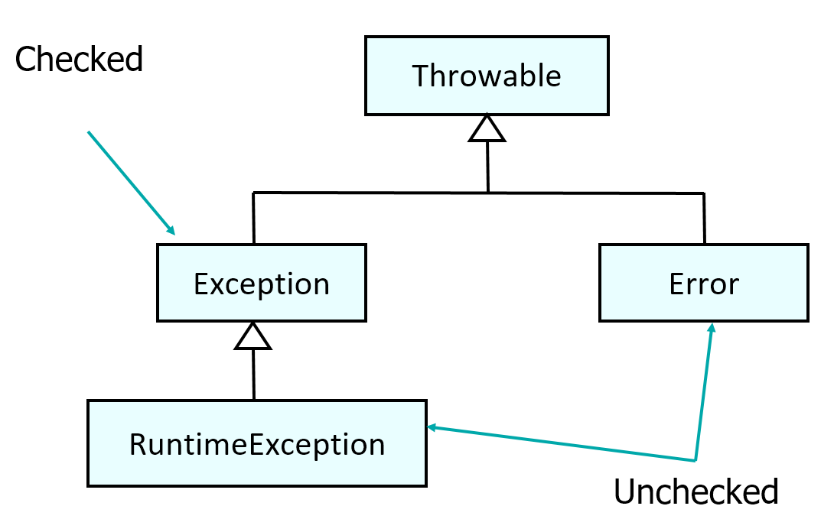
Exception Hierarchy
Throwable | Top of the exception hierarchy in Java, all exceptions are of this type.
Error (unchecked exception) | Represents serious problems in program, that usually cannot be covered from e.g hardware malfunction.
Exception (checked exception) | Superclass for all exceptions including user-defined exceptions. Users extend from this class exceptions that can be recovered from.
RuntimeException (unchecked exception) | Generally caused by illegal operations, bad API usage etc. These exceptions indicate serious bug that cannot be recovered from and should be eliminated from app.

Slide 27
Three Kinds of Exception in Java
Checked Exception: Exceptional conditions that a well-written application should anticipate and recover from:
e.g. attempt to open non-existent file.
Checked exceptions are subject to the Catch or Specify Requirement.

Slide 28
Three Kinds of Exception in Java
Errors: Exceptional conditions that are external to the application, and that the application usually cannot anticipate or recover from
e.g. hardware malfunction
Errors are not subject to the Catch or Specify Requirement

Slide 29
Three Kinds of Exception in Java
Runtime Exceptions: These are exceptional conditions that are internal to the application that usually happen at runtime. Typically can be avoided through good programming practices!
e.g. ArithmeticException(dividing by zero) NullPointerException (trying to access a null object)
Runtime exceptions are not subject to the Catch or Specify Requirement.

Slide 30
Exceptions
Motivation / Definition
Catching and Throwing Exceptions
Java 7+ and Exceptions
Exception Hierarchy
Handling Mechanisms
Defining exceptions
Common exceptions and errors

Slide 31
Handling Exceptions in Java
There are two different mechanisms for handling Java exceptions:
Where they occur: handling exceptions directly in the method where they are caught.
At another level: Propagating exceptions up the call stack to the calling method
The calling method then handles the exceptions
Which way you will handle exceptions depends on the overall design of the system.

Slide 32
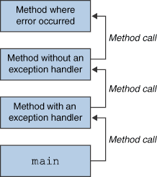
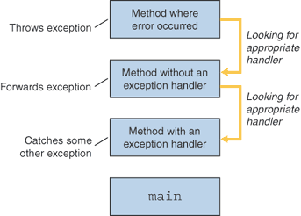
Throwing/Forwarding/Catching

Slide 33
Propagating Exceptions
Can be used instead of try-catch block
Let the calling method handle the exception
Need to declare that the method (in which code is defined) throws the exception
Keyword throws is used in method declaration
public void myMethod() throws Exception
{
//code that throws exception e
}

Slide 34
Handling Generic Exceptions
If you catch generic exception that will catch all the exceptions of that particular type.
For example, catching Throwable will handle checked and unchecked exceptions.
public void myMethod()
{
try
{
//code that can throw checked/unchecked exceptions
}
catch (Throwable e)
{
System.out.println(e.printStackTrace());
}
}

Slide 35
Exceptions
Motivation / Definition
Catching and Throwing Exceptions
Java 7+ and Exceptions
Exception Hierarchy
Handling Mechanisms
Defining exceptions
Common exceptions and errors

Slide 36
Creating new Exceptions
It is possible to create new exception types specific to the application
These must be subclasses of Exception class
For example, exception hierarchy for an insurance application could be:
Exception
InsuranceException
PolicyCreationException
LowPremiumException

Slide 37
Throwing Exceptions
To throw new exception:
Use keyword throw
Create a new instance of exception
public class PolicyFactory
{
public Policy createPolicy(Policyable aPolicyable) throws PolicyCreationException
{
if (aPolicyable.doesMatchInsuranceCriteria())
{
return aPolicyable.createPolicy();
}
else
{
throw new PolicyCreationException();
}
}

Slide 38
Exceptions
Motivation / Definition
Catching and Throwing Exceptions
Java 7+ and Exceptions
Exception Hierarchy
Handling Mechanisms
Defining exceptions
Common exceptions and errors

Slide 39
Some Common Java Exceptions
Unchecked, subclass of RuntimeException:
NullPointerException
Thrown if a message is sent to null object
ArrayIndexOutOfBoundsException
Thrown if an array is accessed by illegal index
Checked:
IOException
Generic class for exceptions produced by input/output operations
NoSuchMethodException
Thrown when a method cannot be found (Good example here)
ClassNotFoundException
Thrown when application tries to load class but definition cannot be found (good example here).

Slide 40
Some Common Java Errors
NoSuchMethodError
Application calls method that no longer exist in the class definition
Usually happens when a class definition removes a method and is recompiled, but other classes using the “removed” method are not recompiled.
NoClassDefFoundError
JVM tries to load class and class cannot be found
Usually happens if classpath is not set, or class somehow gets removed from the classpath
ClassFormatError
JVM tries to load class from file that is incorrect
Usually happens if class file is corrupted, or if it isn’t class file

Slide 41
Silent Fail Problem
public void process()
{
// do something
}
unchecked
What happens if an exception occurs in this code?
Who is monitoring the stack trace log file?
public void process() throws Exception
{
// do something
}
checked
public void process()
{
try
{
// do something
}
catch(Exception e)
{
e.printStackTrace();
}
}
checked

Slide 42
Checked Vs Unchecked?
Because Java does not require methods to catch or to specify unchecked exceptions programmers may be tempted to write code that throws only unchecked exceptions (or make all their exception subclasses inherit from RuntimeException).
This allows programmers to write code without bothering with compiler errors and without bothering to specify or to catch any exceptions.
Seems convenient to the programmer, as it sidesteps the intent of the catch or specify requirement.

Slide 43
Oracle Advice (Java Tutorial)
Generally speaking, do not throw a RuntimeException or create a subclass of RuntimeException simply because you don't want to be bothered with specifying the exceptions your methods can throw.
Bottom line guideline: If a client can reasonably be expected to recover from an exception, make it a checked exception. If a client cannot do anything to recover from the exception, make it an unchecked exception.
For alternative view see:
http://www.mindview.net/Etc/Discussions/CheckedExceptions

Slide 44
Exceptions
Motivation / Definition
Catching and Throwing Exceptions
Java 7+ and Exceptions
Exception Hierarchy
Handling Mechanisms
Defining exceptions
Common exceptions and errors

