Slide 1

DevOps
Dr. Siobhán Drohan (sdrohan@wit.ie)
Eamonn de Leastar (edeleastar@wit.ie)
Produced
by:
Department of Computing and Mathematics
http://www.wit.ie/

Slide 2
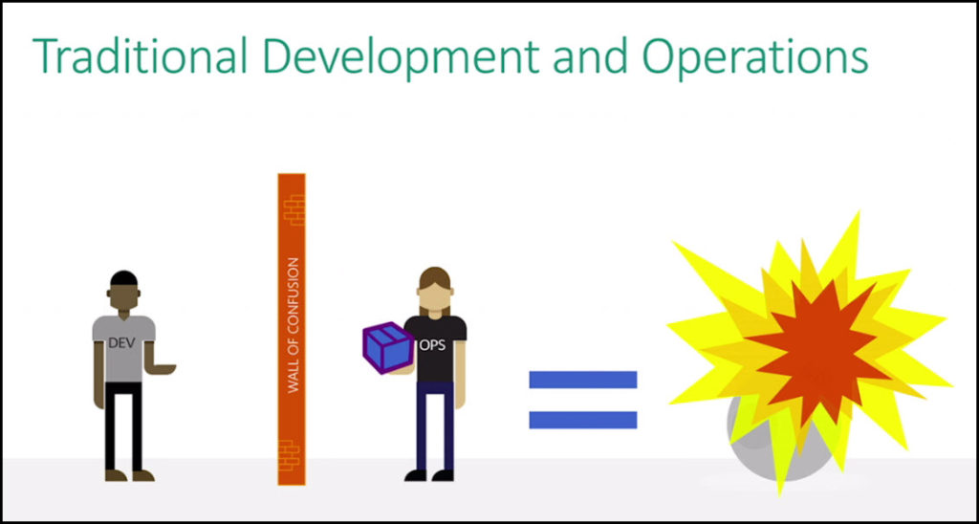
Dev team created a solution for production.
When it was finished they handed it over to the ops team.
Ops job is to implement the project in production by manually changing configuration files and other data in order to comply for deployment.

Slide 3
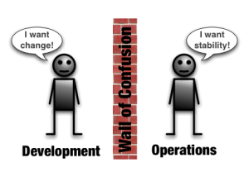
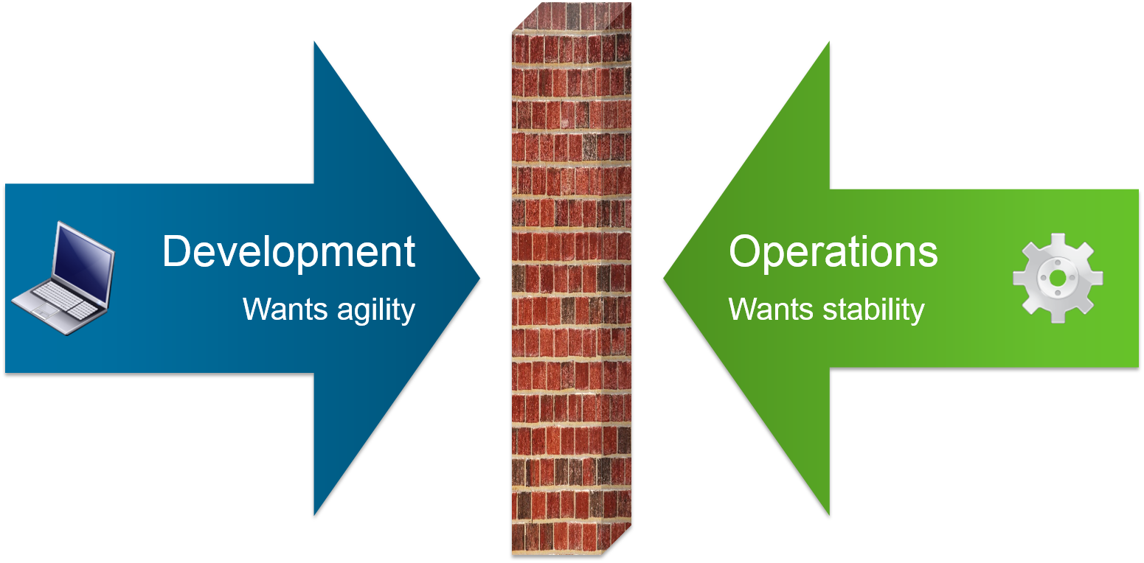
Notes:
https://www.zenoss.com/blog/wp-content/uploads/2012/01/DevOps-Wall-Of-Confusion.png
http://blogs.vmware.com/accelerate/files/2015/06/DevOps_graphic1.png

Slide 4
“The idea of shipping code
faster has been a priority
since the practice of
software development began”
https://dzone.com/whitepapers/devops-is-crippled-without-continuous-integration

Slide 5
“DevOps is about
more frequent,
higher quality releases.”
https://dzone.com/whitepapers/devops-is-crippled-without-continuous-integration

Slide 6
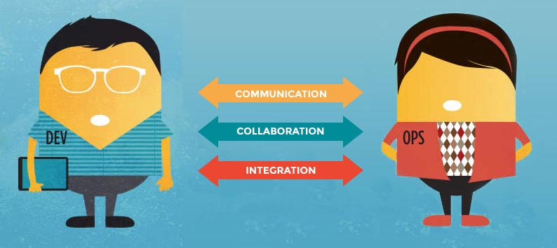
What is DevOps?
DevOps is a software development approach that stresses:
Communication
Collaboration
Integration
Trust
between software developers and operations i.e. the merging of two different disciplines → DevOps!
Notes:
https://dzone.com/articles/what-is-devops-2?edition=219172&utm_source=Daily%20Digest&utm_medium=email&utm_campaign=dd%202016-09-30
https://newrelic.com/assets/devops/dev-ops.jpg

Slide 7
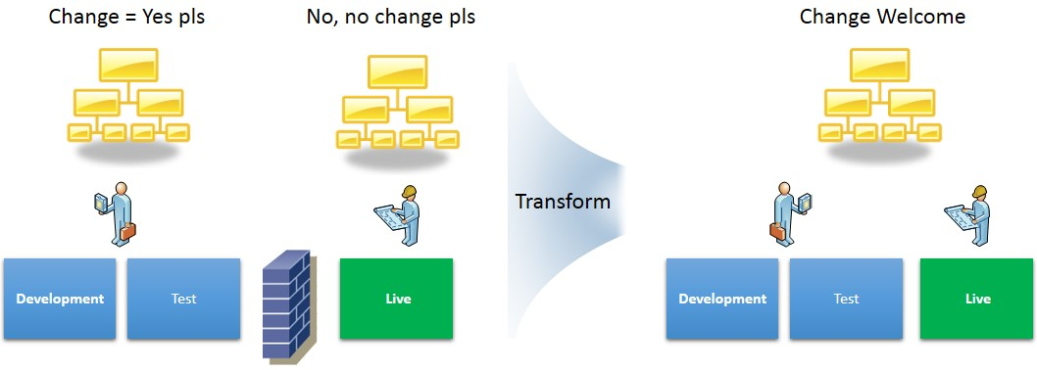
With DevOps, change is welcome
Notes:
https://www.capgemini.com/sites/default/files/en/2014/12/devops_pic_1_-_gmz_.jpg

Slide 8
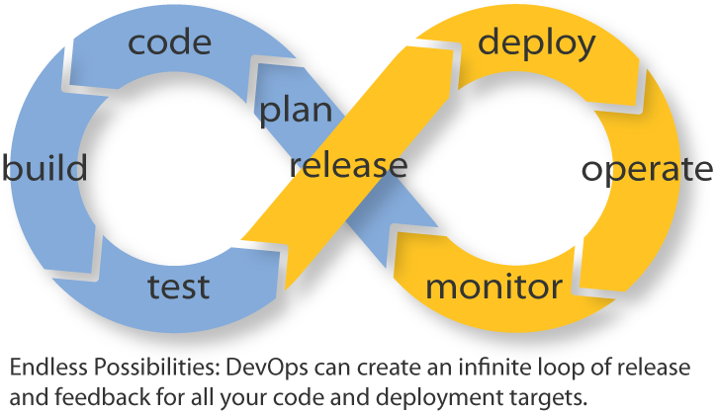
What is DevOps?
DevOps allows us to build, deploy, and change our software with accelerated delivery cycle times.
DevOps integration targets product delivery, quality testing, feature development, and maintenance releases in order to improve reliability and security and faster development and deployment cycles.
Notes:
https://dzone.com/articles/what-is-devops-2?edition=219172&utm_source=Daily%20Digest&utm_medium=email&utm_campaign=dd%202016-09-30
http://blog.appdynamics.com/wp-content/uploads/2013/06/DevOps-infinity-loop2.png

Slide 9
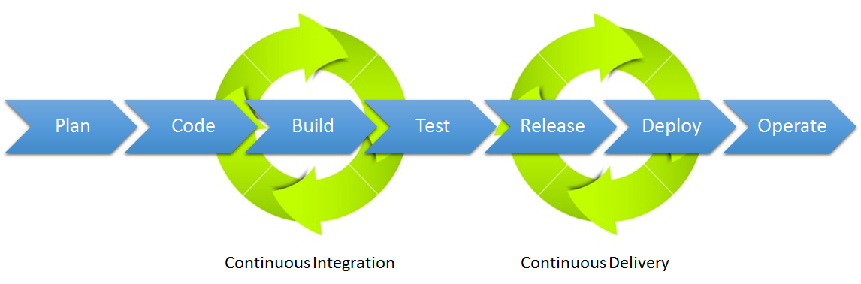
DevOps enables the merging of Continuous Integration and Continuous Delivery
Notes:
http://3.bp.blogspot.com/-MYEHcvf981A/U1KxlBPOuEI/AAAAAAAAmUg/rixSlNAt4KQ/s1600/CI-CD.png

Slide 10
Continuous Integration
The process of steadily adding new code commits to source code.
Originally, a daily build was the standard for continuous integration.
http://searchsoftwarequality.techtarget.com/definition/Continuous-Software-Development

Slide 11
Continuous Integration
The process of steadily adding new code commits to source code.
Originally, a daily build was the standard for continuous integration.
Today, the usual rule is for each team member to submit work as soon as it is finished and for a build to be conducted with each significant change.
Usually, a certain baseline of automated unit and integration testing is performed to ensure that new code does not break the build.
This way developers know as soon as they're done if their code will meet minimum standards and they can fix problems while the code is still fresh in their minds.
An important advantage of continuous integration is that it provides developers with immediate feedback and status updates for the software they are working on.
http://searchsoftwarequality.techtarget.com/definition/Continuous-Software-Development

Slide 12
Continuous Delivery
“Continuous Delivery is the ability to get changes of all types — including new features, configuration changes, bug fixes and experiments — into production, or into the hands of users, safely and quickly in a sustainable way.”
https://www.continuousdelivery.com

Slide 13
Continuous Delivery
“Continuous Delivery is the ability to get changes of all types — including new features, configuration changes, bug fixes and experiments — into production, or into the hands of users, safely and quickly in a sustainable way.”
https://www.continuousdelivery.com
Common goal of faster time to market for new services / releases.
Approach whereby teams ensure that every change to the system can be released, and that any version can be released at the push of a button.
http://automic.com/blog/whats-the-difference-between-devops-and-continuous-delivery

Slide 14
Why Continuous Delivery?
Low-risk releases | Make software deployments painless, low-risk events that can be performed at any time, on demand
https://www.continuousdelivery.com/

Slide 15
Why Continuous Delivery?
Low-risk releases | Make software deployments painless, low-risk events that can be performed at any time, on demand
Faster time to market | Integration and test/fix phase of the traditional phased software delivery lifecycle to consume weeks or even months. When teams work together to automate the build and deployment, environment provisioning, and regression testing processes, developers can incorporate integration and regression testing into their daily work and we completely remove these phases.
https://www.continuousdelivery.com/

Slide 16
Why Continuous Delivery?
Low-risk releases | Make software deployments painless, low-risk events that can be performed at any time, on demand
Faster time to market | Integration and test/fix phase of the traditional phased software delivery lifecycle to consume weeks or even months. When teams work together to automate the build and deployment, environment provisioning, and regression testing processes, developers can incorporate integration and regression testing into their daily work and we completely remove these phases.
Higher quality | When developers have automated tools that discover regressions within minutes, teams are freed to focus their effort on user research and higher level testing activities such as exploratory testing, usability testing, and performance and security testing.
https://www.continuousdelivery.com/

Slide 17
Why Continuous Delivery?
Low-risk releases | Make software deployments painless, low-risk events that can be performed at any time, on demand
Faster time to market | Integration and test/fix phase of the traditional phased software delivery lifecycle to consume weeks or even months. When teams work together to automate the build and deployment, environment provisioning, and regression testing processes, developers can incorporate integration and regression testing into their daily work and we completely remove these phases.
Higher quality | When developers have automated tools that discover regressions within minutes, teams are freed to focus their effort on user research and higher level testing activities such as exploratory testing, usability testing, and performance and security testing.
Lower costs | Software changes. By investing in build, test, deployment and environment automation, we substantially reduce the cost of making and delivering incremental changes to software by eliminating many of the fixed costs associated with the release process.
https://www.continuousdelivery.com/

Slide 18
Why Continuous Delivery?
Low-risk releases | Make software deployments painless, low-risk events that can be performed at any time, on demand
Faster time to market | Integration and test/fix phase of the traditional phased software delivery lifecycle to consume weeks or even months. When teams work together to automate the build and deployment, environment provisioning, and regression testing processes, developers can incorporate integration and regression testing into their daily work and we completely remove these phases.
Higher quality | When developers have automated tools that discover regressions within minutes, teams are freed to focus their effort on user research and higher level testing activities such as exploratory testing, usability testing, and performance and security testing.
Lower costs | Software changes. By investing in build, test, deployment and environment automation, we substantially reduce the cost of making and delivering incremental changes to software by eliminating many of the fixed costs associated with the release process.
Better products | Continuous delivery makes it economic to work in small batches.
https://www.continuousdelivery.com/

Slide 19
Why Continuous Delivery?
Low-risk releases | Make software deployments painless, low-risk events that can be performed at any time, on demand
Faster time to market | Integration and test/fix phase of the traditional phased software delivery lifecycle to consume weeks or even months. When teams work together to automate the build and deployment, environment provisioning, and regression testing processes, developers can incorporate integration and regression testing into their daily work and we completely remove these phases.
Higher quality | When developers have automated tools that discover regressions within minutes, teams are freed to focus their effort on user research and higher level testing activities such as exploratory testing, usability testing, and performance and security testing.
Lower costs | Software changes. By investing in build, test, deployment and environment automation, we substantially reduce the cost of making and delivering incremental changes to software by eliminating many of the fixed costs associated with the release process.
Better products | Continuous delivery makes it economic to work in small batches.
Happier teams | Continuous delivery makes releases less painful and reduces team burnout. By removing the low-value painful activities associated with software delivery, we can focus on what we care about most—continuously delighting our users.
https://www.continuousdelivery.com/

Slide 20
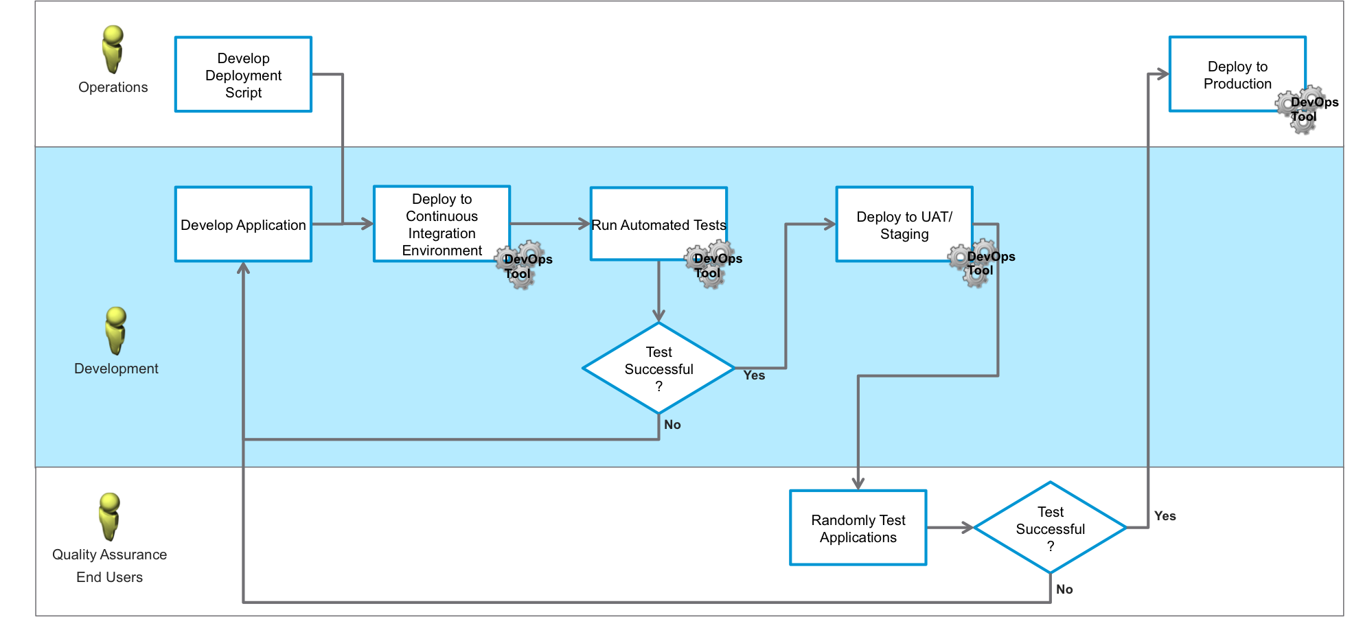
Sample DevOps LifeCycle
Notes:
http://blogs.vmware.com/cloudops/files/2014/11/devops-flow.png

Slide 21
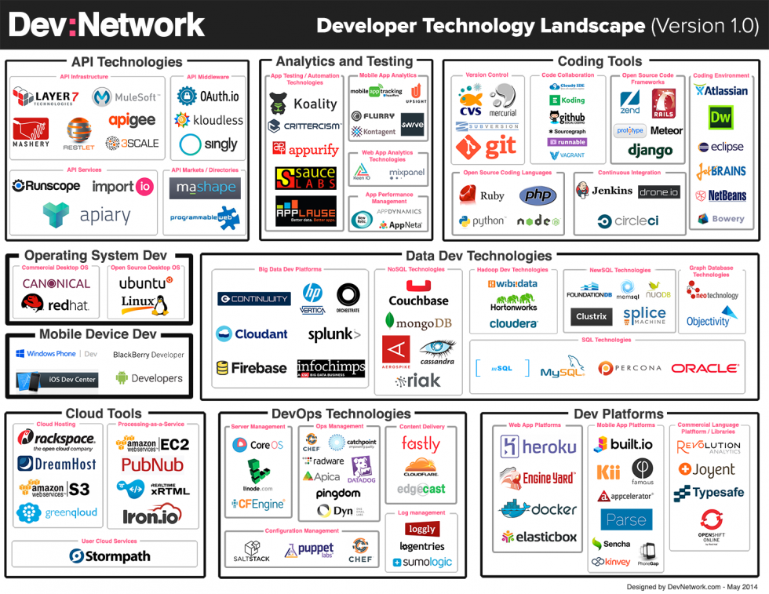

Slide 22
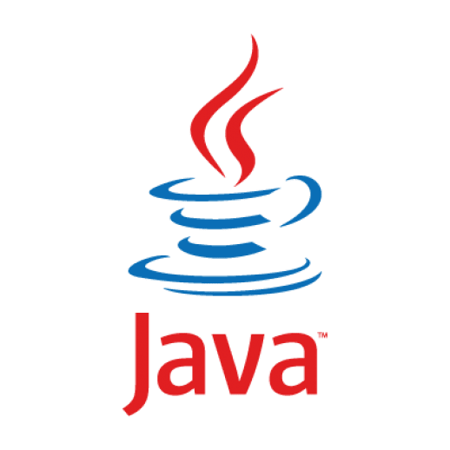
Developer Technology Landscape 2014-2016

Slide 23
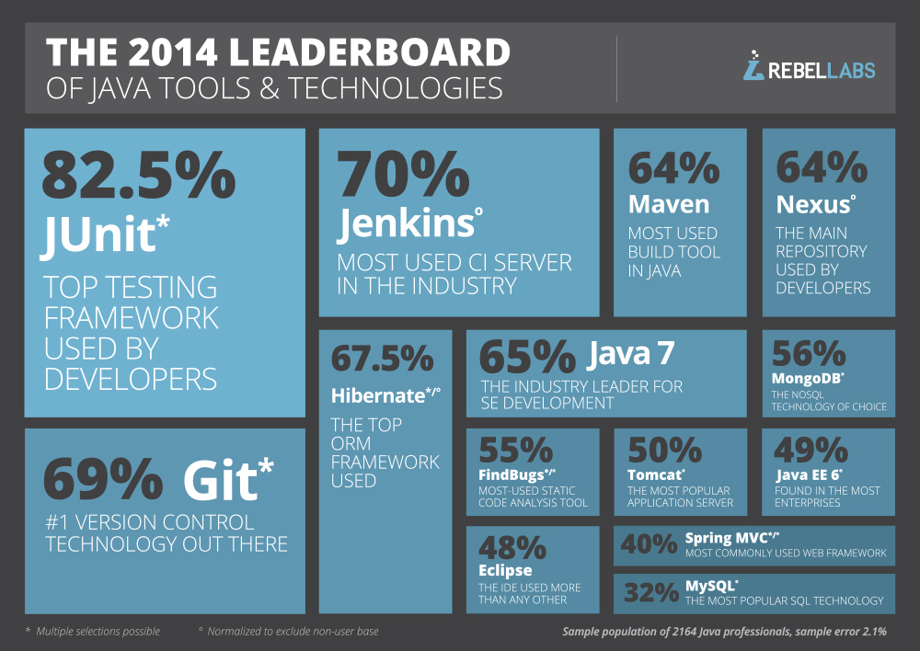
https://zeroturnaround.com/rebellabs/java-tools-and-technologies-landscape-for-2014/

Slide 24
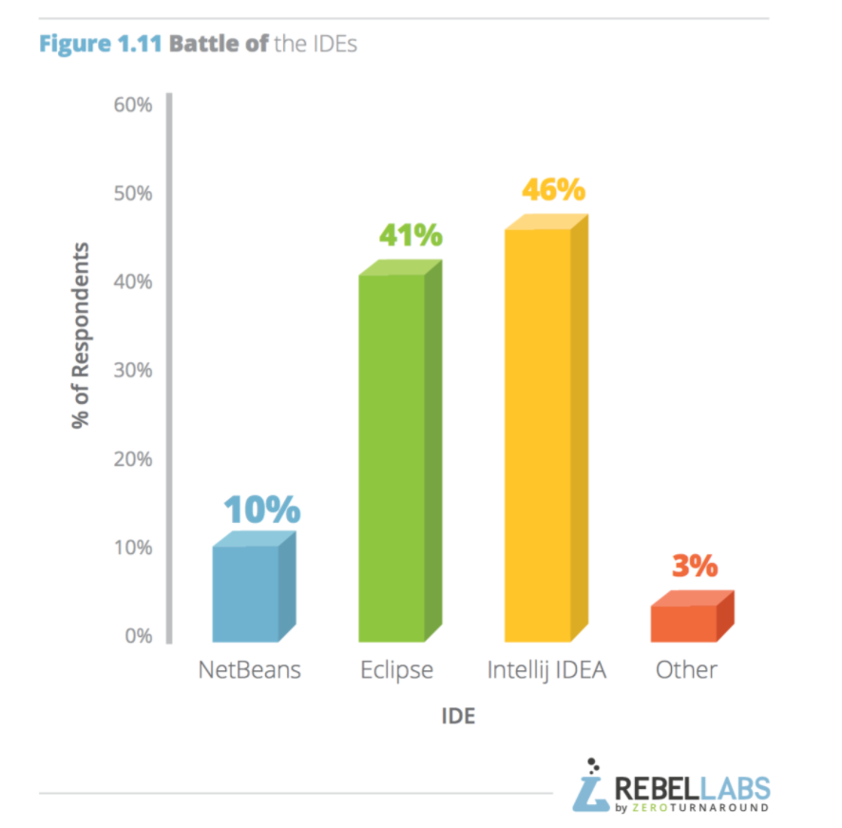
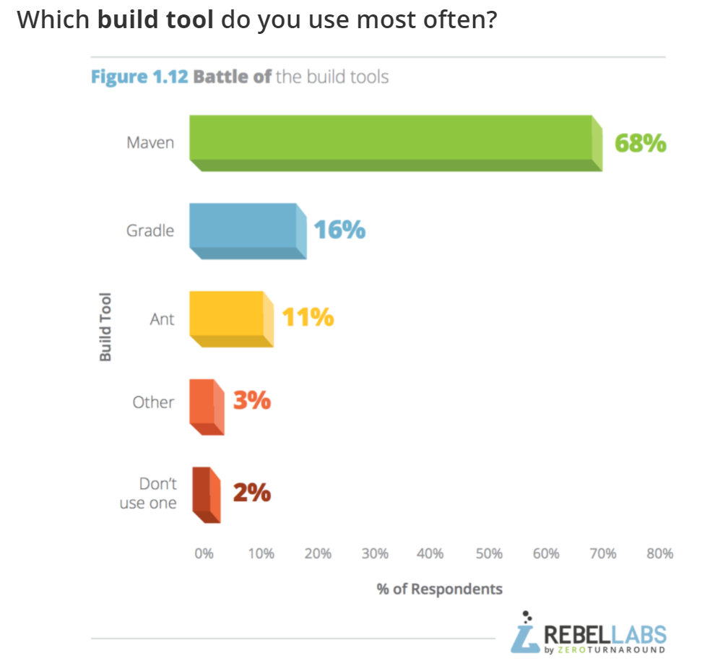
2016 Stats:
https://zeroturnaround.com/rebellabs/java-tools-and-technologies-landscape-2016/

Slide 25
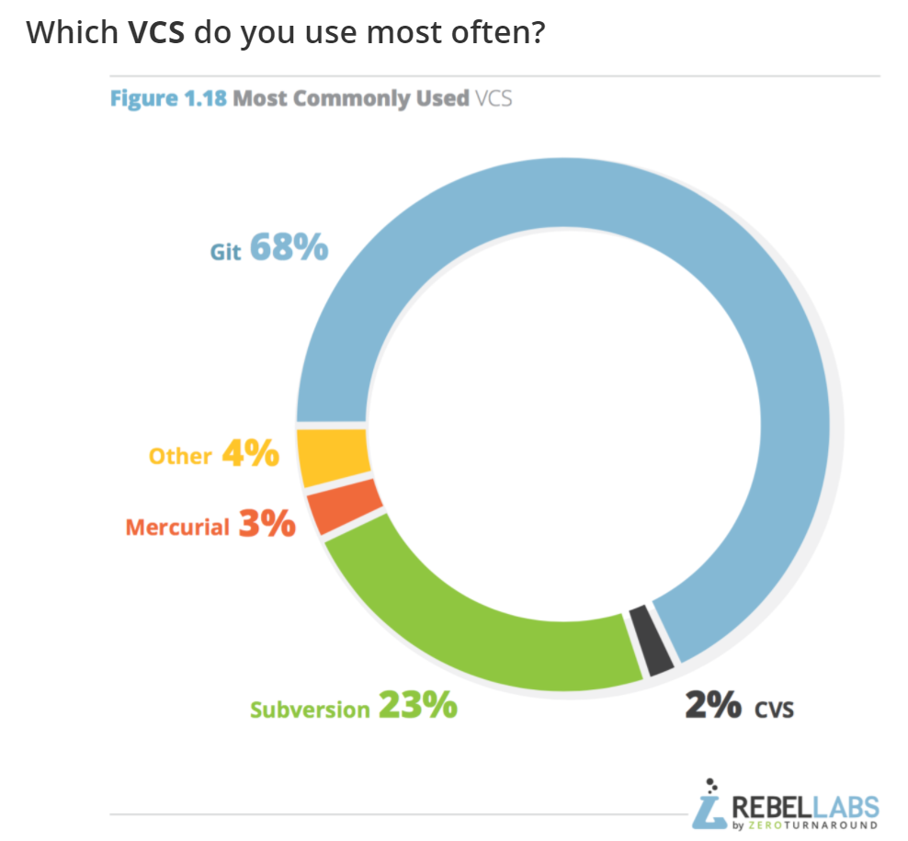
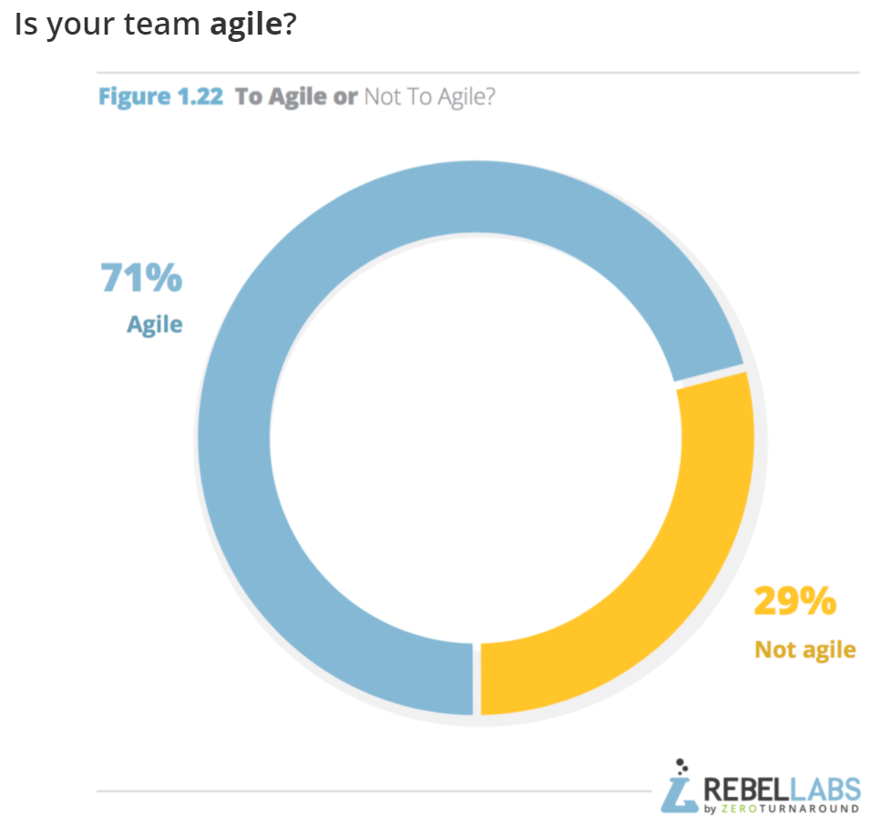
2016 Stats:
https://zeroturnaround.com/rebellabs/java-tools-and-technologies-landscape-2016/

