Slide 1

Introduction to Maven
Dr. Siobhán Drohan (sdrohan@wit.ie)
Eamonn de Leastar (edeleastar@wit.ie)
Produced
by:
Department of Computing and Mathematics
http://www.wit.ie/

Slide 2

Definition and Objectives

Slide 3
What is Maven?
a Yiddish word meaning accumulator of knowledge!
a tool for building and managing any Java-based project (i.e. a software project management and comprehension tool).
http://maven.apache.org/what-is-maven.html

Slide 4
Maven’s Objectives
Maven’s goal is to allow a developer to understand the complete state of a development effort in the shortest period of time. It encompasses:
Making the build process easy
Providing a uniform build system
Providing quality project information
Providing guidelines for best practices development
Allowing transparent migration to new features
http://maven.apache.org/what-is-maven.html

Slide 5
Objective 1: Making the build process easy
“While using Maven doesn’t eliminate the need to know about the underlying mechanisms, Maven does provide a lot of shielding from the details.”
http://maven.apache.org/what-is-maven.html

Slide 6
Objective 2: Providing a uniform build system
Maven builds a project using its project object model (pom.xml) and a set of plugins shared by all projects using Maven: → providing a uniform build system.
If you know how one Maven project builds you automatically know how all Maven projects build: → saves immense time when involved in many projects.
http://maven.apache.org/what-is-maven.html

Slide 7
Objective 3: Providing quality project information
Maven provides plenty of useful project information, some from pom.xml, some generated from your project’s sources e.g.:
Build Settings e.g. versions of JDK/JUnit, plugins, etc.
List of Dependencies
Unit test reports including code coverage
etc.
http://maven.apache.org/what-is-maven.html

Slide 8
Objective 4: Providing guidelines for best practices development
Maven aims to gather current principles for best practices development, and make it easy to guide a project in that direction e.g.
specification, execution, and reporting of unit tests are part of the normal build cycle using Maven. Current unit testing best practices were used as guidelines:
Keeping your test source code in a separate, but parallel source tree
Using test case naming conventions to locate and execute tests
Have test cases setup their environment and don’t rely on customizing the build for test preparation.
Maven also lays out your project’s directory structure → once you learn the layout you can easily navigate any other Maven project.
http://maven.apache.org/what-is-maven.html

Slide 9
Objective 5: Allowing transparent migration to new features
Maven installation is easy to update so you can take advantage of any changes made to Maven itself.
http://maven.apache.org/what-is-maven.html

Slide 10
Some More Objectives…
Provides a standard development infrastructure across projects.
Make the development process transparent.
Decrease training for new developers.
Bring together tools in a uniform way.
Prevent inconsistent setups.
Divert energy to application development activities.
Project setups are simple and reusable; new projects can be set up in a very short time.

Slide 11
Project Object Model (pom.xml)

Slide 12
Project Object Model (pom.xml)
XML representation of a Maven project; a one-stop-shop for all things concerning the project.
It is, effectively:
the declarative manifestation of the "who", "what", and "where",
while the build lifecycle is the "when" and "how".
pom.xml is found in the base directory of project.
https://maven.apache.org/pom.html#What_is_the_POM

Slide 13
Project Object Model (pom.xml)
It tells Maven how to execute a project.
Contains metadata about the project
Location of directories, Developers/Contributors Extra plugins required Special plugin configuration Jars required (3rd party and in-house) Repositories to search for plugins/jars, etc.
A project’s POM inherits from the Super POM.
All standard project information (e.g. directory structure) is held in the Super POM (principle).

Slide 14
Skeleton/Minimal pom.xml
<project>
<modelVersion>4.0.0</modelVersion>
<groupId>com.mycompany.app</groupId>
<artifactId>my-app</artifactId>
<packaging>jar</packaging>
<version>1.0</version>
<dependencies>
<dependency>
<groupId>com.thoughtworks.xstream</groupId>
<artifactId>xstream</artifactId>
<version>1.4.10</version>
</dependency>
</dependencies>
</project>
Uniquely identify
project in the
repo

Slide 15
Coherent organization of dependencies
Three related concepts: Artifact; Dependencies; Repositories
<project>
………
<dependencies>
<dependency>
<groupId>com.thoughtworks.xstream</groupId>
<artifactId>xstream</artifactId>
<version>1.4.10</version>
</dependency>
</dependencies>
</project>
This project has a dependency
on version 1.4.10 of the artifact
with id xstream, produced by the
com.thoughtworks.xstream group.

Slide 16
Coherent organization of dependencies
All artifacts/dependencies are stored in repositories
Local and remote repositories
The local repository is searched first, then remote ones.

Slide 17
Coherent organization of dependencies
All artifacts/dependencies are stored in repositories
Local and remote repositories
The local repository is searched first, then remote ones.
Dependencies are automatically downloaded (from remote repositories) and installed (in local repository) for future use.
Maven knows about some remote repositories, e.g.
http://www.ibiblio.org/archive/2013/02/ibiblio-tagged-in-maven/
Other remote repositories can be listed in the project POM or in Maven’s configuration file (setting.xml)

Slide 18
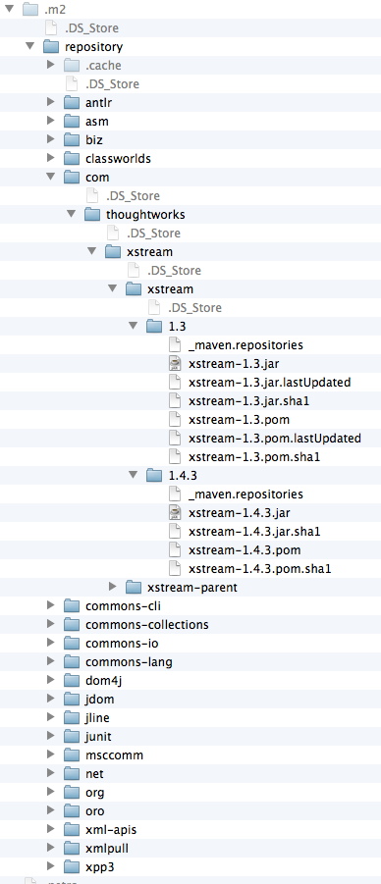
Local repositories
After installing and running Maven for the first time a local repository is automatically created and populated with some standard artifacts.
Default Local repository location: Home/.m2/repository
Plugins are also stored in repositories.
In theory a repository is an abstract storage mechanism, but in practice it is a directory structure in your file system

Slide 19
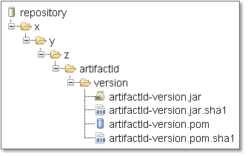
Repository structure
Maven uses artifact’s id, group id. and version to navigate to the correct folder.
If the groupId is a fully qualified domain name such as x.y.z then it is fully expanded.

Slide 20
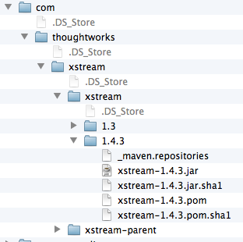
Repository structure
Maven uses artifact’s id, group id. and version to navigate to the correct folder.
If the groupId is a fully qualified domain name such as x.y.z then it is fully expanded.
<project>
………
<dependencies>
<dependency>
<groupId>com.thoughtworks.xstream</groupId>
<artifactId>xstream</artifactId>
<version>1.4.3</version>
</dependency>
</dependencies>
</project>

Slide 21
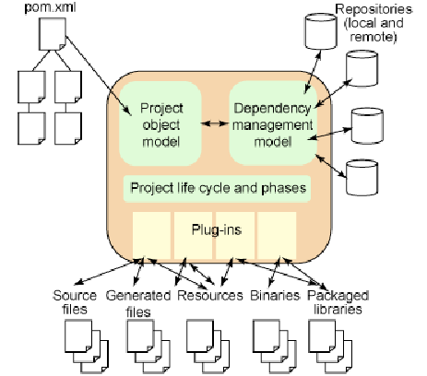
The full picture

Slide 22
Plugins and MOJOs

Slide 23
Build Lifecycle
Maven simplifies and standardizes the project build process. It handles:
Compilation
Distribution
Documentation
Team collaboration and
Other tasks seamlessly.
http://www.tutorialspoint.com/maven/

Slide 24
Maven Plugins
Maven encapsulates build logic into modules called plugins:
Build Plugins:
executed during the build
configured in the <build/> element of the POM (if required).
Reporting Plugins:
executed during the site generation
configured in the <reporting/> element of the POM (if required).
http://maven.apache.org/plugins/index.html

Slide 25
Plugins and MOJOs
A plugin’s components, called mojos, perform build tasks.
MOJO - Maven plain Old Java Objects
Maven acts as a framework which coordinates the execution of plugins in a well defined way.
Some plugins are standard, others are downloaded on demand.

Slide 26

Plugins and MOJOs
A lifecycle phase invokes the relevant plugins (the mojos) to do the work.
Maven
validate
mojo
compile
mojo
test
mojo
plugins
package
user
verify
mojo
install
e.g. mvn install
mojo
deploy
bindings
Build Lifecycle Phases
Notes:
- MOJO = Maven POJO = goals. For example when you call « mvn [plugin prefix]:[goal name] » it is mapped to a mojo at execution time.
- There are more phases than those represented:
<phases>
<phase>validate</phase>
<phase>initialize</phase>
<phase>generate-sources</phase>
<phase>process-sources</phase>
<phase>generate-resources</phase>
<phase>process-resources</phase>
<phase>compile</phase>
<phase>process-classes</phase>
<phase>generate-test-sources</phase>
<phase>process-test-sources</phase>
<phase>generate-test-resources</phase>
<phase>process-test-resources</phase>
<phase>test-compile</phase>
<phase>test</phase>
<phase>package</phase>
<phase>integration-test</phase>
<phase>verify</phase>
<phase>install</phase>
<phase>deploy</phase>
</phases>

Slide 27
Build Lifecycle Phases
validate | validate the project is correct and all necessary information is available.
compile | compile the source code of the project.
test | test the compiled source code using a suitable unit testing framework. These tests should not require the code be packaged or deployed.
package | take the compiled code and package it in its distributable format, such as a JAR.
verify | run any checks on results of integration tests to ensure quality criteria are met.
install | install the package into the local repository, for use as a dependency in other projects locally.
deploy | done in the build environment, copies the final package to the remote repository for sharing with other developers and projects.
Full lifecycle reference: https://maven.apache.org/guides/introduction/introduction-to-the-lifecycle.html#Lifecycle_Reference

Slide 28
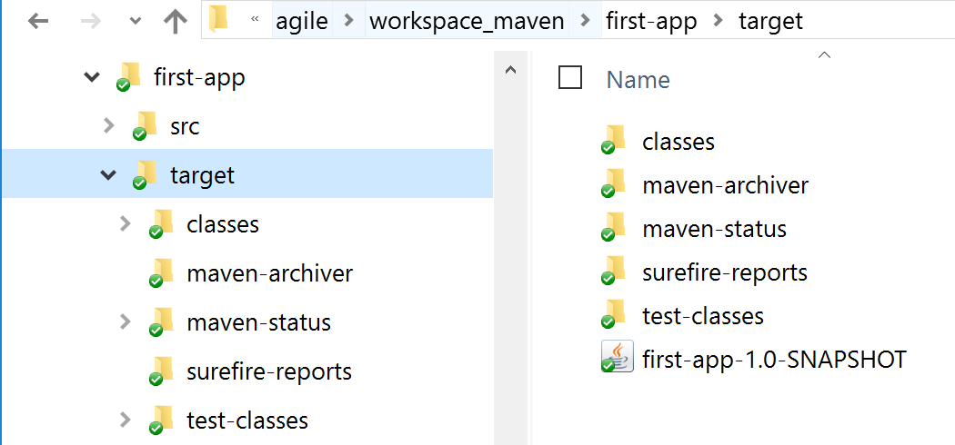
Declarative Execution
validate
compile
test
package
verify
install
deploy
When user invokes a lifecycle phase, all its predecessors are also executed, if necessary, e.g. mvn package (invokes validate, compile & test also).

Slide 29
Archetypes

Slide 30
What are Archetypes?
Archetype is a Maven project templating toolkit:
→ provides sample maven projects to get users up and running as quickly as possible.
Using archetypes provides a great way to enable developers quickly in a way consistent with best practices.
https://maven.apache.org/archetype/index.html

Slide 31
Some Archetype Options
maven-archetype-webapp | Web application (WAR) project template
maven-archetype-j2ee-simple | J2EE project (EAR) with directories and subprojects for the EJBs, servlets, etc.
maven-archetype-quickstart (default) | simple Java project (JAR)
We will experiment with this archetype in the
next slide deck.

Slide 32
Archetypes
To create a new project folder structure with the archetype plugin, invoke the generate goal
Command format: mvn plugin-name:goal
Actual command: mvn archetype:generate
mvn archetype:generate
-DgroupId=[your project's group id]
-DartifactId=[your project's artifact id]
-DarchetypeArtifactId=[artifact type]

Slide 33
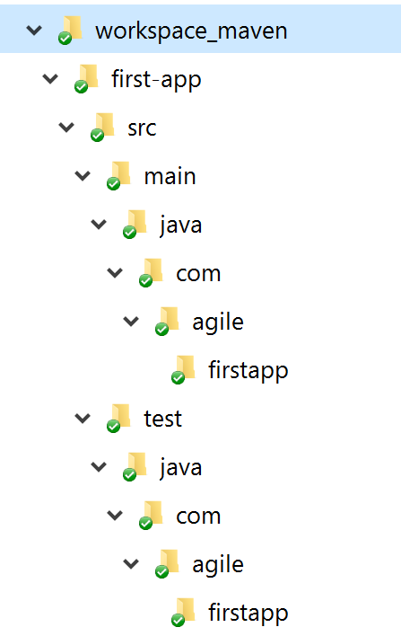
Archetype (Quickstart)
Folder structure for ‘quickstart’ archetype.
The base directory name is taken from artifactid.
A skeleton POM is included in base directory.
mvn archetype:generate
-DgroupId=com.agile.firstapp
-DartifactId=first-app
-DarchetypeArtifactId=maven-archetype-quickstart

Slide 34
Archetype (Quickstart)
package com.agile.firstapp;
/**
* Hello world!
*
*/
public class App
{
public static void main( String[] args )
{
System.out.println( "Hello World!" );
}
}
mvn archetype:generate
-DgroupId=com.agile.firstapp
-DartifactId=first-app
-DarchetypeArtifactId=maven-archetype-quickstart

Slide 35
Site Lifecycle

Slide 36
Site Lifecycle
pre-site | execute processes needed prior to the actual project site generation
site | generate the project's site documentation
post-site | execute processes needed to finalize the site generation, and to prepare for site deployment
site-deploy | deploy the generated site documentation to the specified web server
https://maven.apache.org/guides/introduction/introduction-to-the-lifecycle.html#Lifecycle_Reference

Slide 37
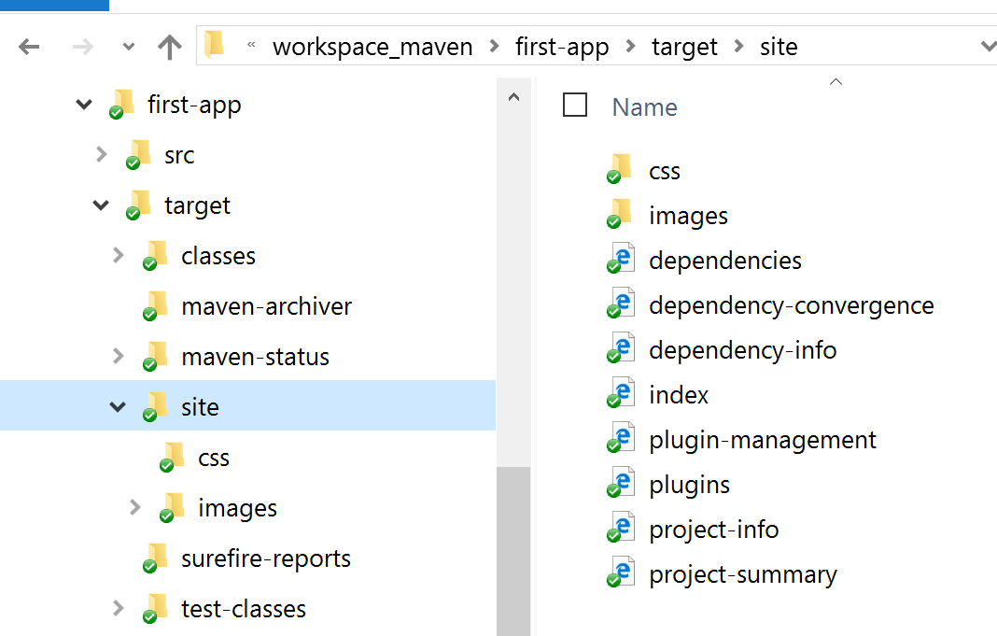
mvn site
mvn site
generate the project's site documentation

Slide 38
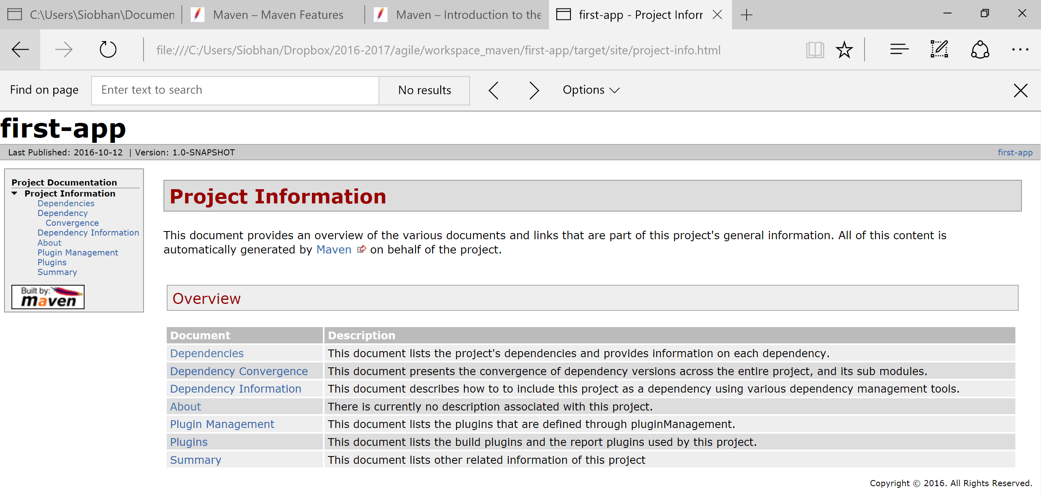
mvn site
generate the project's site documentation

Slide 39
Repository

Slide 40
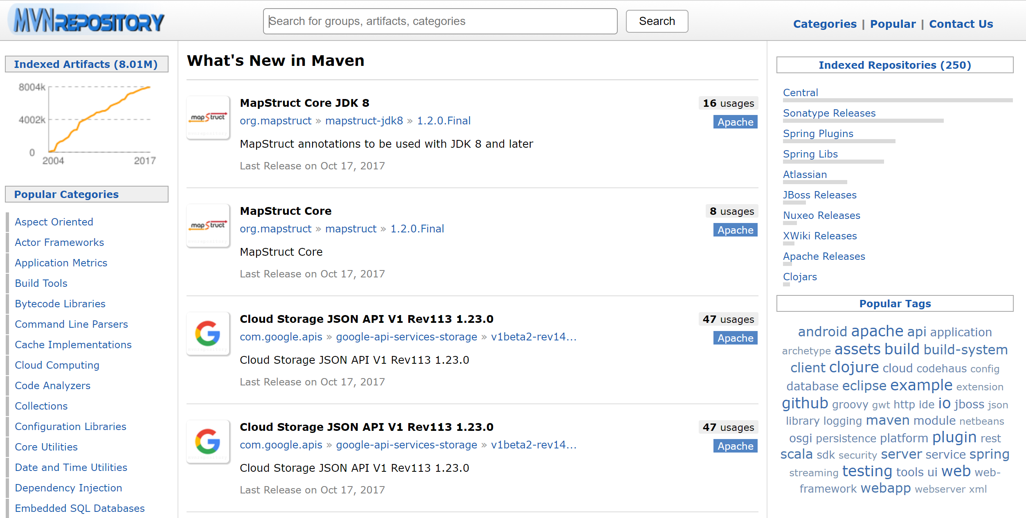
A repo of our dependencies!
https://mvnrepository.com/

Slide 41
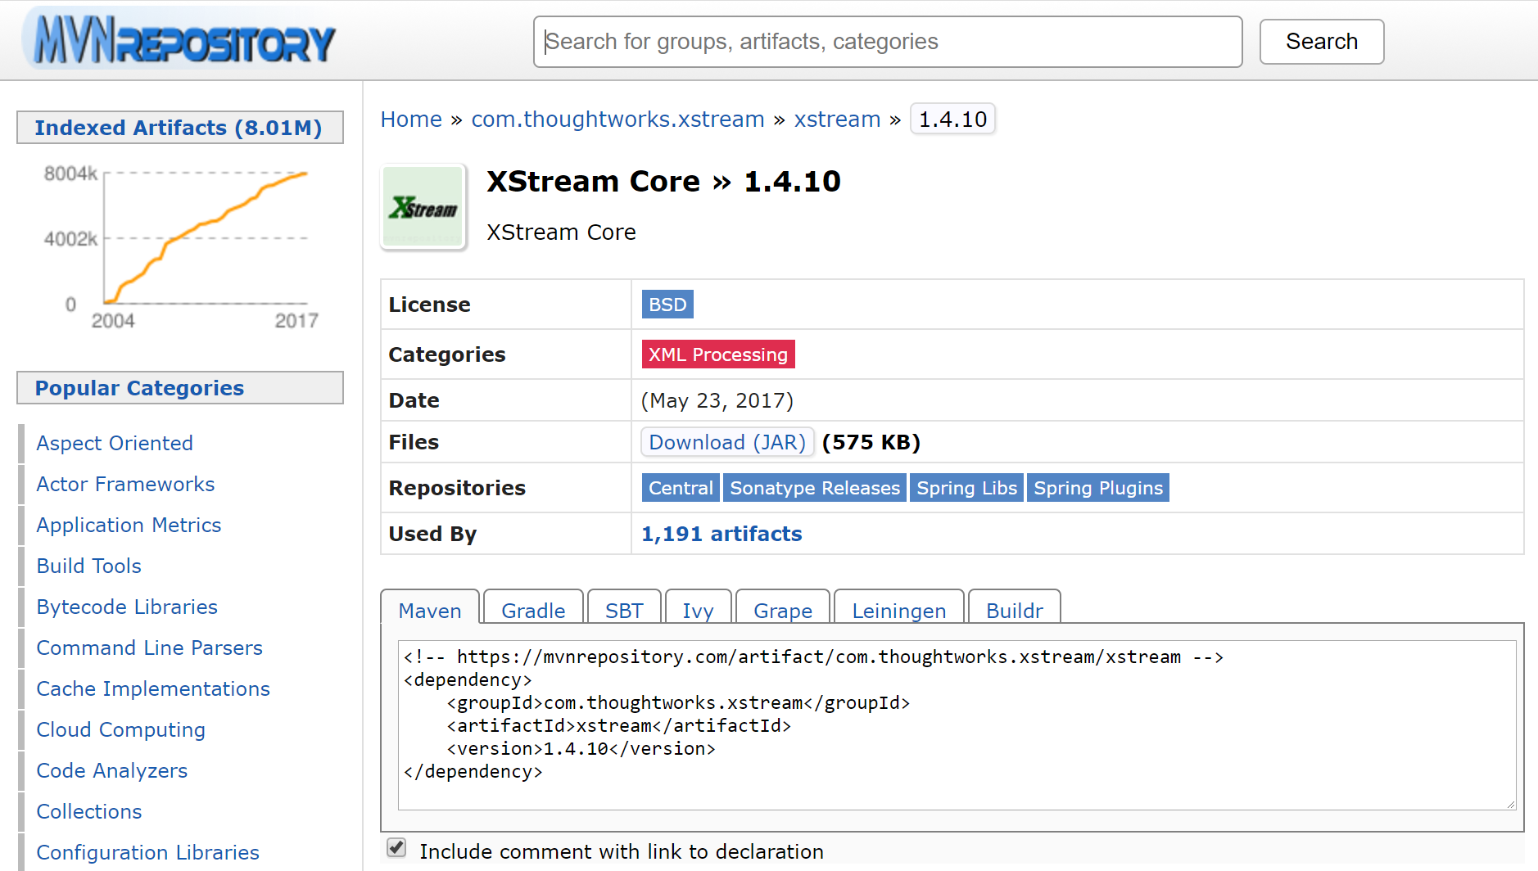
XStream 1.4.10 (XML dependency code too)

