Slide 1

Maven Example & Labs
Dr. Siobhán Drohan (sdrohan@wit.ie)
Eamonn de Leastar (edeleastar@wit.ie)
Produced
by:
Department of Computing and Mathematics
http://www.wit.ie/

Slide 2

Installing the tool

Slide 3
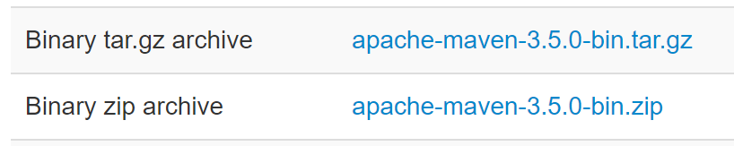
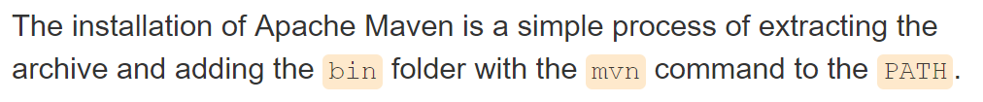
Installing Maven
Maven is a Java tool, so you must have Java installed in order to proceed.
Download Maven (Binary archive): http://maven.apache.org/download.html
Install Maven: http://maven.apache.org/install.html
http://maven.apache.org/guides/getting-started/maven-in-five-minutes.html

Slide 4
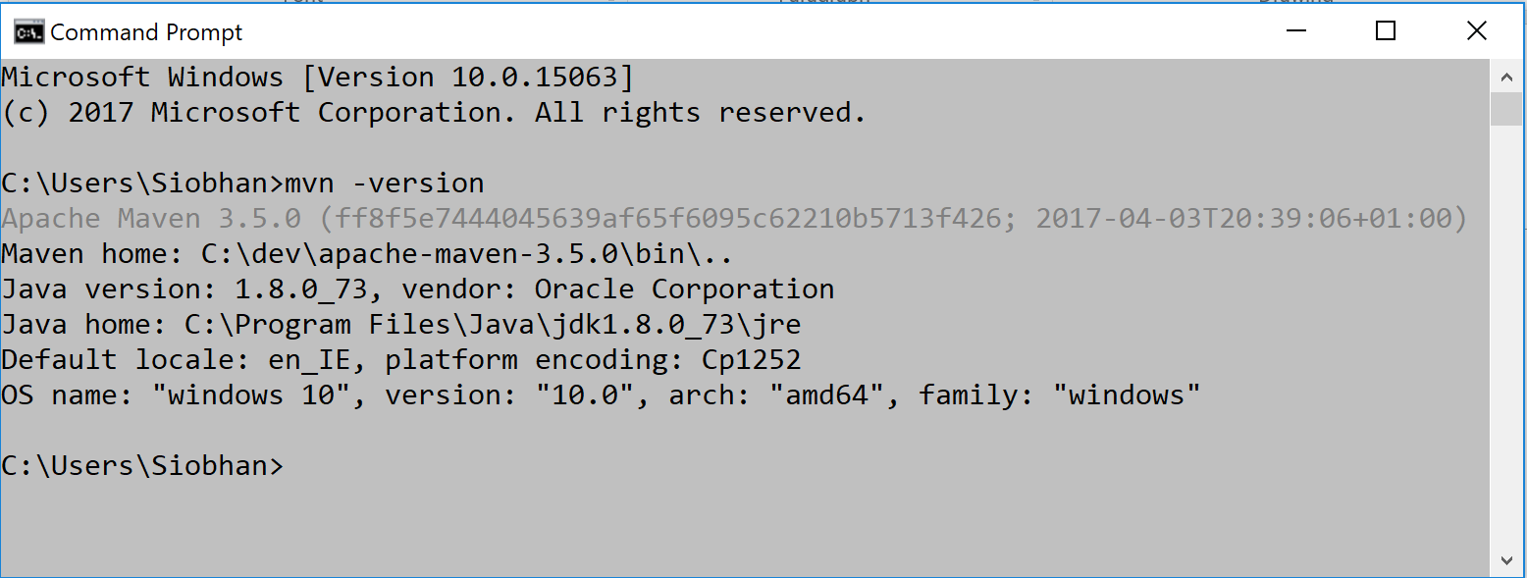
Verifying the Install
mvn -version
http://maven.apache.org/guides/getting-started/maven-in-five-minutes.html

Slide 5
Creating a Java Archetype Project

Slide 6
Creating a Java Project (using Archetypes)
mvn archetype:generate
-DgroupId=com.mycompany.app
-DartifactId=my-app
-DarchetypeArtifactId=maven-archetype-quickstart
-DinteractiveMode=false
http://maven.apache.org/guides/getting-started/maven-in-five-minutes.html

Slide 7
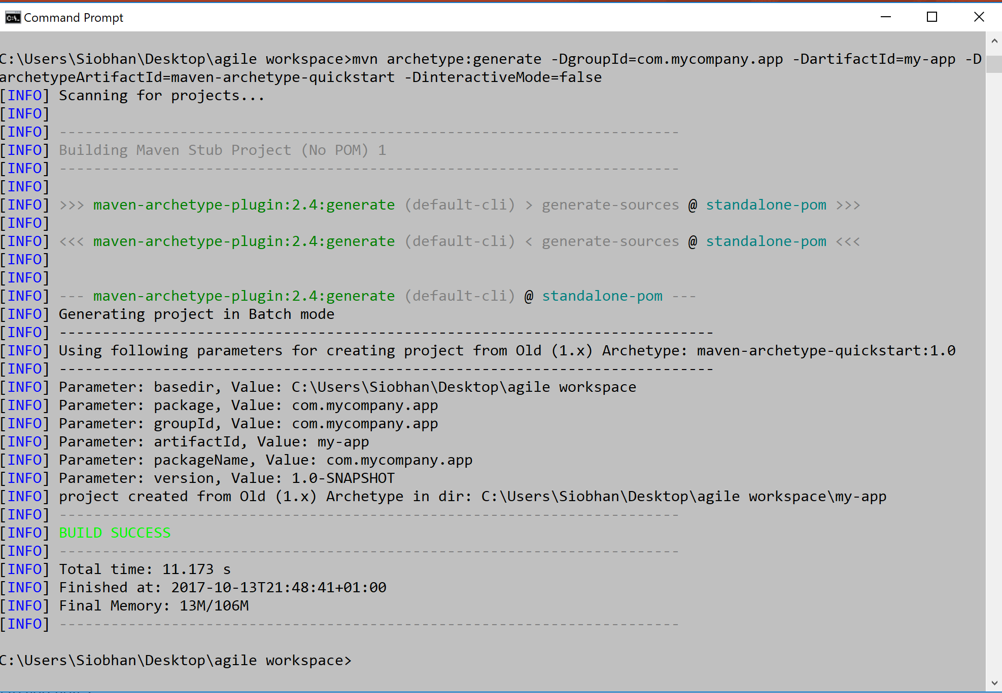

Slide 8
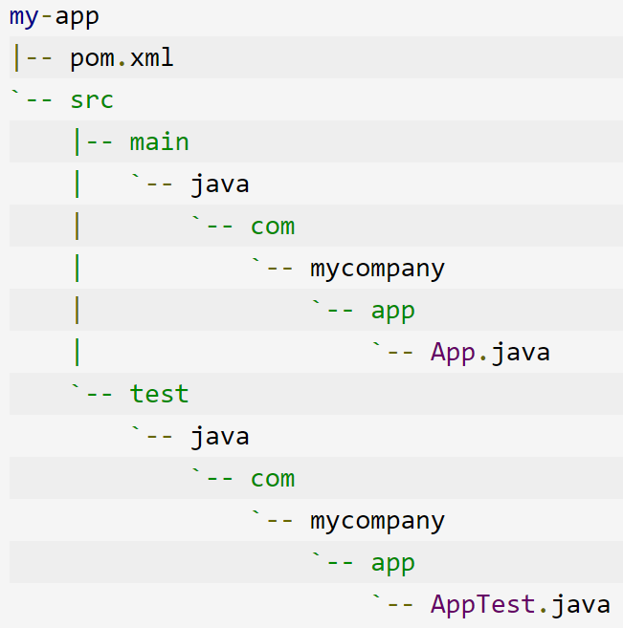
Creating a Java Project (using Archetypes)
Folder structure for ‘quickstart’ archetype, which is the Java sample project.
mvn archetype:generate
-DgroupId=com.mycompany.app
-DartifactId=my-app
-DarchetypeArtifactId=maven-archetype-quickstart
-DinteractiveMode=false
http://maven.apache.org/guides/getting-started/maven-in-five-minutes.html

Slide 9
Creating a Java Project (using Archetypes)
The base directory name is taken from artifactid.
mvn archetype:generate
-DgroupId=com.mycompany.app
-DartifactId=my-app
-DarchetypeArtifactId=maven-archetype-quickstart
-DinteractiveMode=false
http://maven.apache.org/guides/getting-started/maven-in-five-minutes.html

Slide 10
Creating a Java Project (using Archetypes)
package com.mycompany.app;
public class App
{
public static void main( String[] args )
{
System.out.println( "Hello World!" );
}
}
mvn archetype:generate
-DgroupId=com.mycompany.app
-DartifactId=my-app
-DarchetypeArtifactId=maven-archetype-quickstart
-DinteractiveMode=false
http://maven.apache.org/guides/getting-started/maven-in-five-minutes.html

Slide 11
Creating a Java Project (using Archetypes)
DinteractiveMode:
If set to true, maven will ask confirmation on each step of the project generation.
mvn archetype:generate
-DgroupId=com.mycompany.app
-DartifactId=my-app
-DarchetypeArtifactId=maven-archetype-quickstart
-DinteractiveMode=false
http://maven.apache.org/guides/getting-started/maven-in-five-minutes.html

Slide 12
Creating a Java Project (using Archetypes)
A minimal POM is included in base directory.
mvn archetype:generate
-DgroupId=com.mycompany.app
-DartifactId=my-app
-DarchetypeArtifactId=maven-archetype-quickstart
-DinteractiveMode=false
http://maven.apache.org/guides/getting-started/maven-in-five-minutes.html

Slide 13
pom.xml

Slide 14
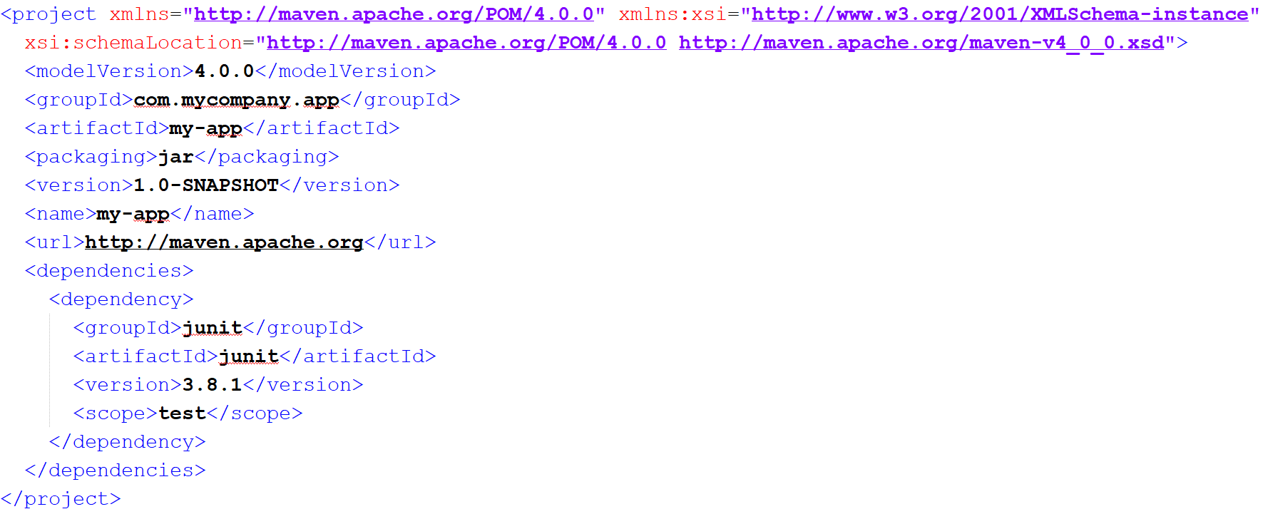
pom.xml
http://maven.apache.org/guides/getting-started/maven-in-five-minutes.html

Slide 15
pom.xml
mvn archetype:generate
-DgroupId=com.mycompany.app
-DartifactId=my-app
-DarchetypeArtifactId=maven-archetype-quickstart
-DinteractiveMode=false
http://maven.apache.org/guides/getting-started/maven-in-five-minutes.html

Slide 16
pom.xml
mvn archetype:generate
-DgroupId=com.mycompany.app
-DartifactId=my-app
-DarchetypeArtifactId=maven-archetype-quickstart
-DinteractiveMode=false
http://maven.apache.org/guides/getting-started/maven-in-five-minutes.html

Slide 17
pom.xml
SNAPSHOT indicates that the version is still in development (i.e. not released).
Unlike regular versions, Maven checks for a new SNAPSHOT version in the repository for every build.
mvn archetype:generate
-DgroupId=com.mycompany.app
-DartifactId=my-app
-DarchetypeArtifactId=maven-archetype-quickstart
-DinteractiveMode=false
http://maven.apache.org/guides/getting-started/maven-in-five-minutes.html

Slide 18
pom.xml
One dependency, JUnit 3.8.1 has been included with the sample project.
mvn archetype:generate
-DgroupId=com.mycompany.app
-DartifactId=my-app
-DarchetypeArtifactId=maven-archetype-quickstart
-DinteractiveMode=false
http://maven.apache.org/guides/getting-started/maven-in-five-minutes.html

Slide 19
Building the Project

Slide 20
RECAP – Build LifeCycle
When user invokes a lifecycle phase, all its predecessors are also executed, if necessary, e.g.
mvn package
(invokes validate, compile & test also).
validate
compile
test
package
verify
install
deploy

Slide 21
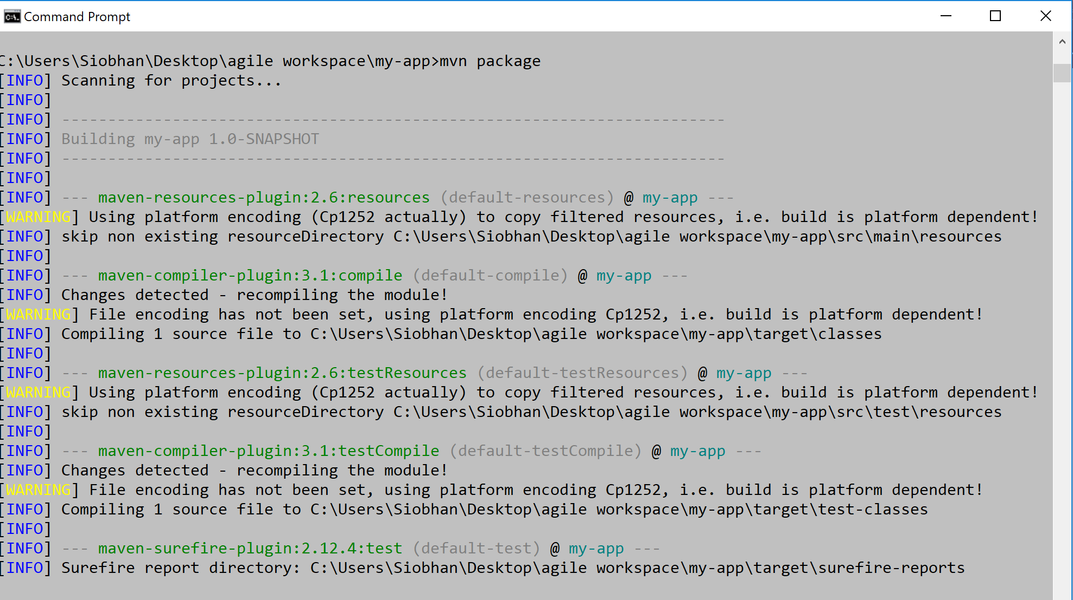
Build the Project (1 of 2)
mvn package
http://maven.apache.org/guides/getting-started/maven-in-five-minutes.html

Slide 22
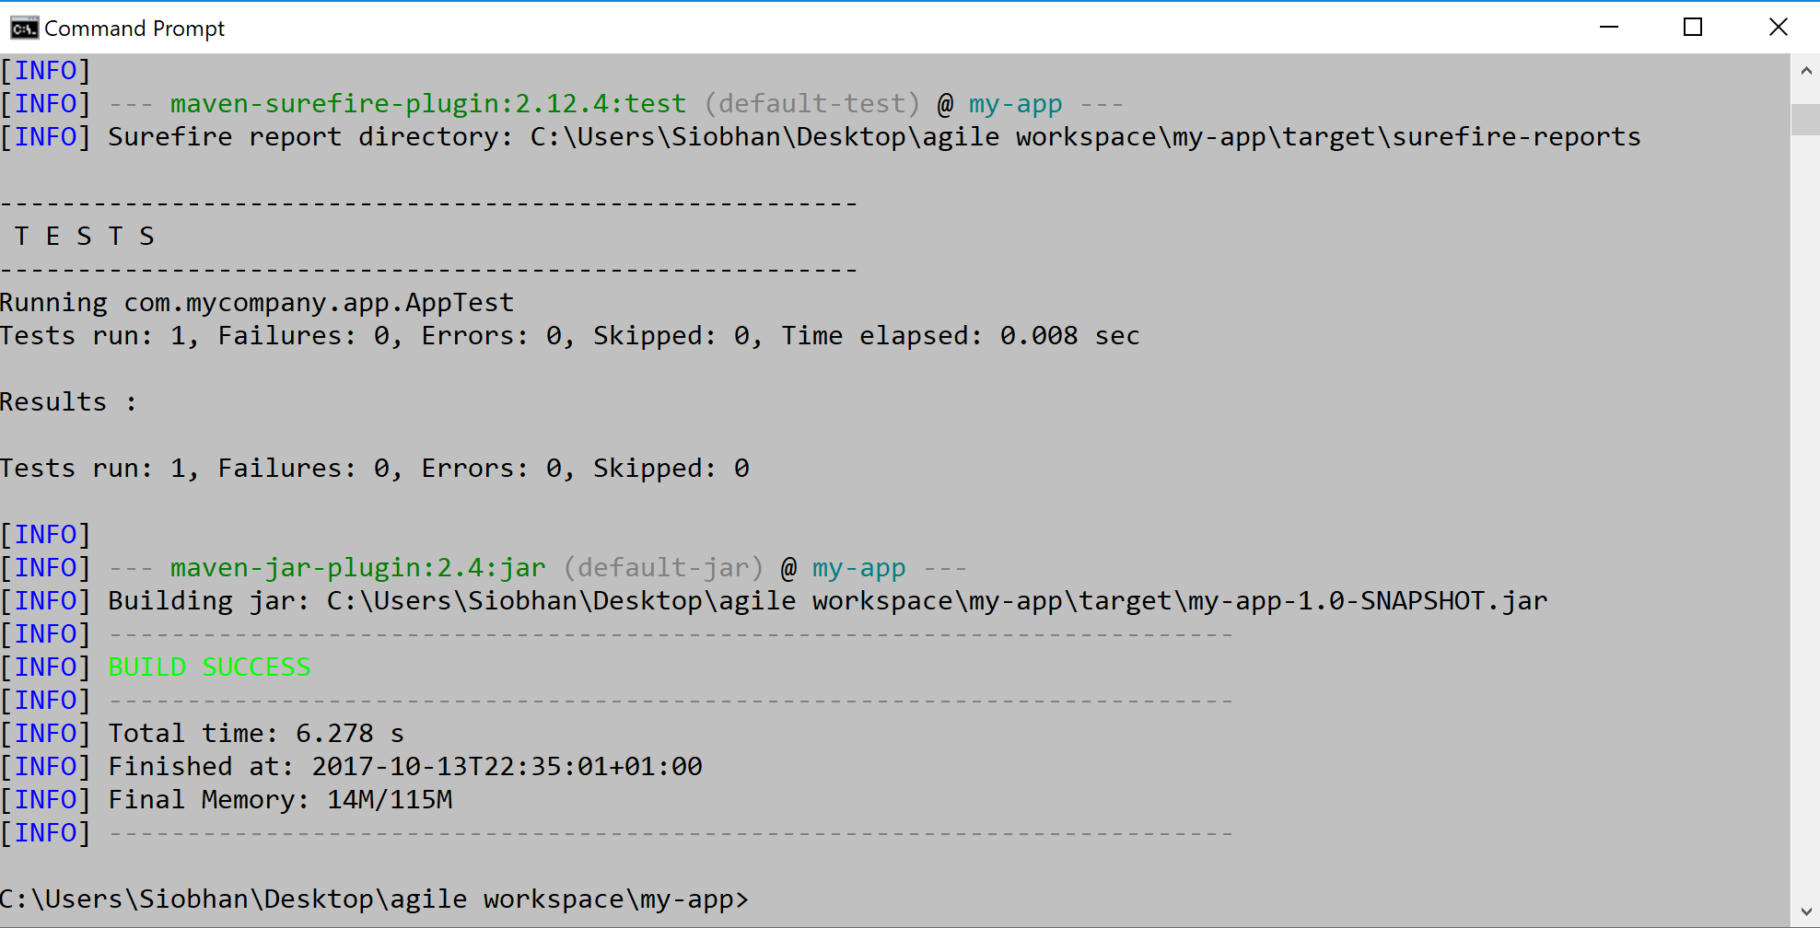
Build the Project (2 of 2)
mvn package
http://maven.apache.org/guides/getting-started/maven-in-five-minutes.html

Slide 23
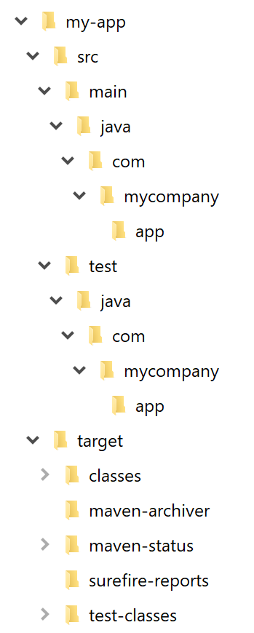
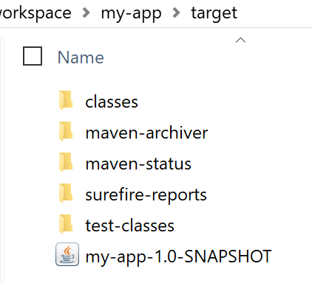
Build the Project – target directory
Jar
package
http://maven.apache.org/guides/getting-started/maven-in-five-minutes.html

Slide 24
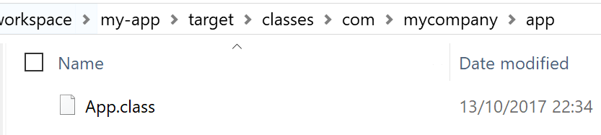
Build the Project – target directory
Compiled
Java
Classes
http://maven.apache.org/guides/getting-started/maven-in-five-minutes.html

Slide 25
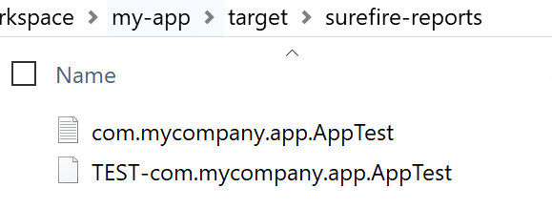
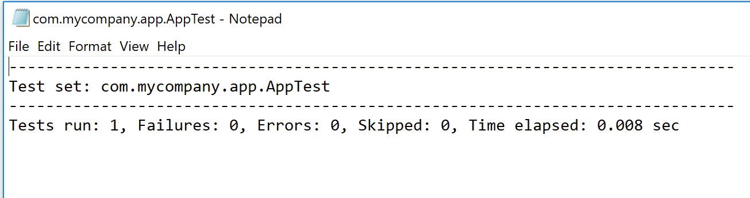
Build the Project – target directory
Results of JUnit Tests (they were
also printed to the console)
http://maven.apache.org/guides/getting-started/maven-in-five-minutes.html

Slide 26
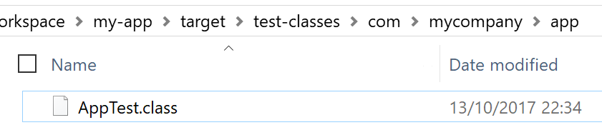
Build the Project – target directory
Compiled
JUnit
Classes
http://maven.apache.org/guides/getting-started/maven-in-five-minutes.html

Slide 27
Running the Project

Slide 28
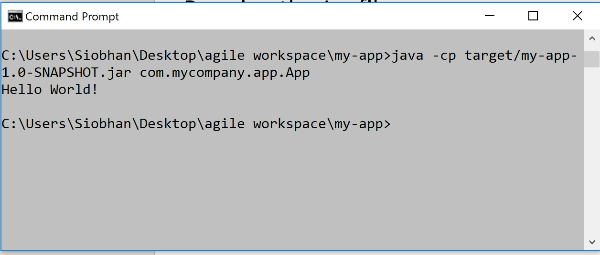
Running the Jar file
java -cp target/my-app-1.0-SNAPSHOT.jar com.mycompany.app.App
http://maven.apache.org/guides/getting-started/maven-in-five-minutes.html

Slide 29
Generating the Site

Slide 30
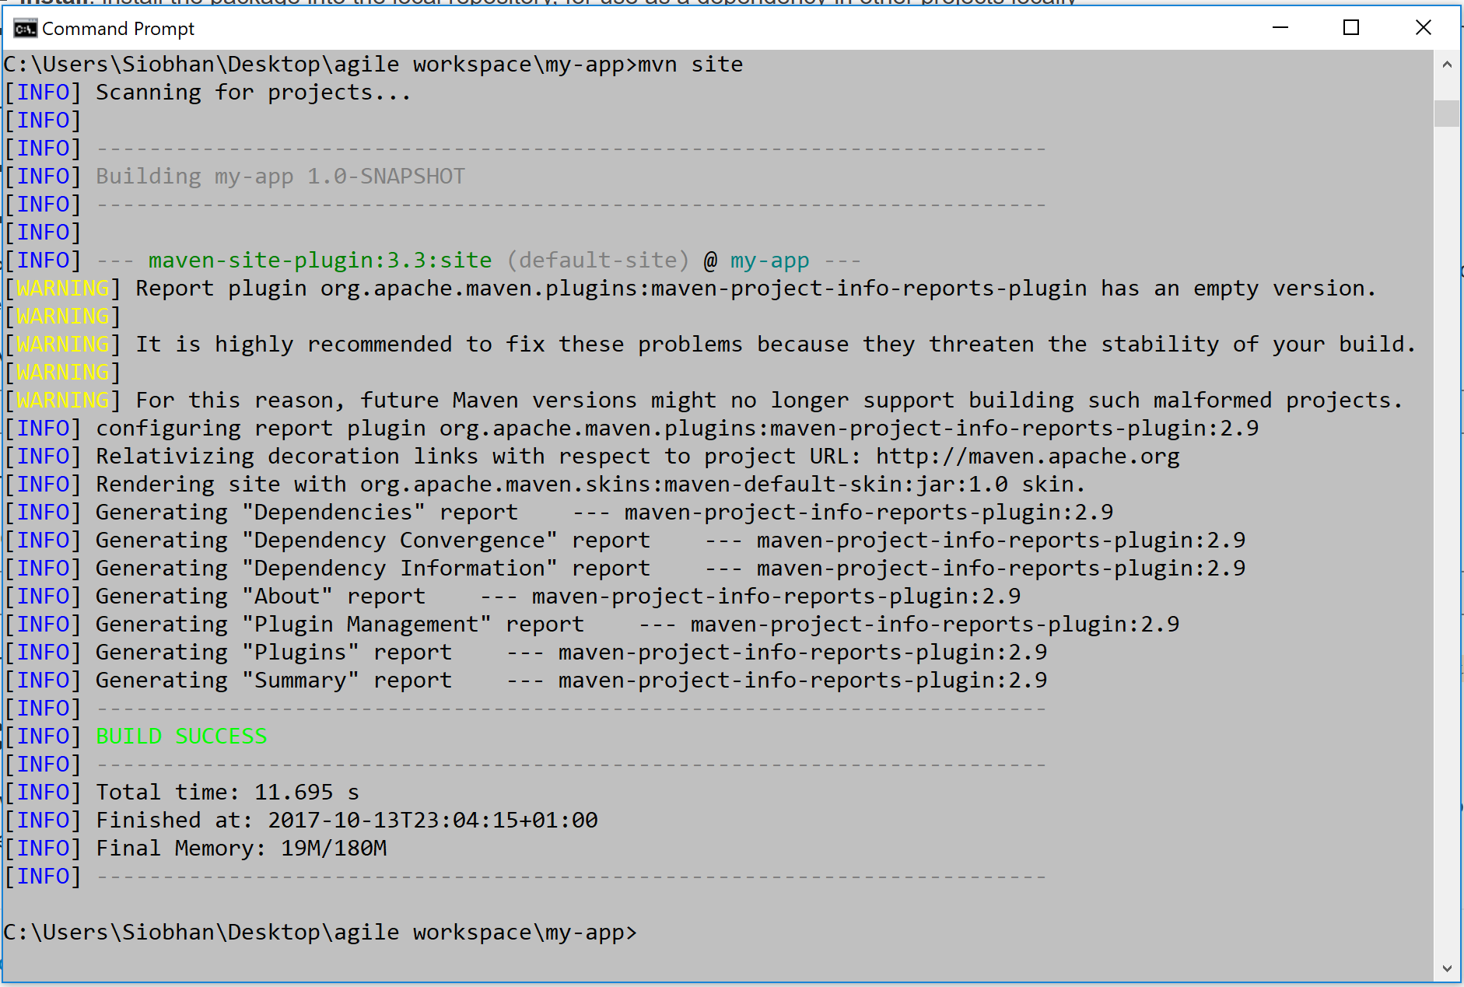
Generating a Site for the App
mvn site
generates a site based upon information on the project's pom.
http://maven.apache.org/guides/getting-started/maven-in-five-minutes.html

Slide 31
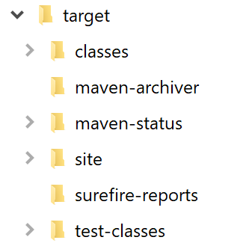
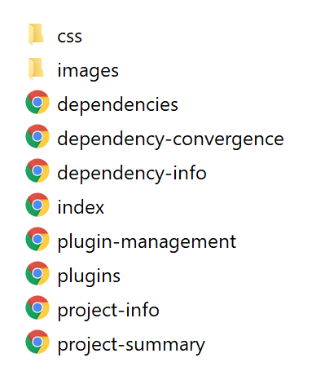
Generating a Site for the App
mvn site
http://maven.apache.org/guides/getting-started/maven-in-five-minutes.html

Slide 32
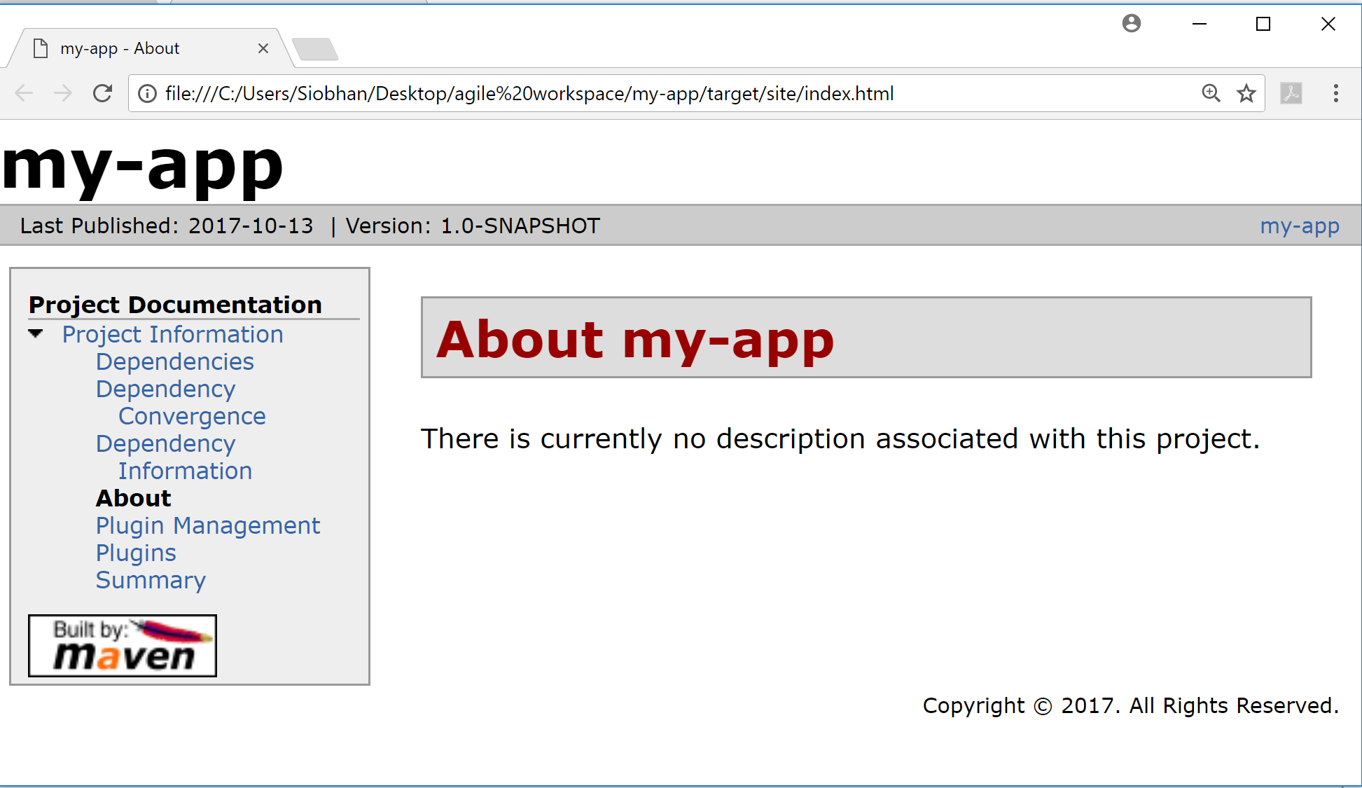
Generating a Site for the App
mvn site
http://maven.apache.org/guides/getting-started/maven-in-five-minutes.html

Slide 33
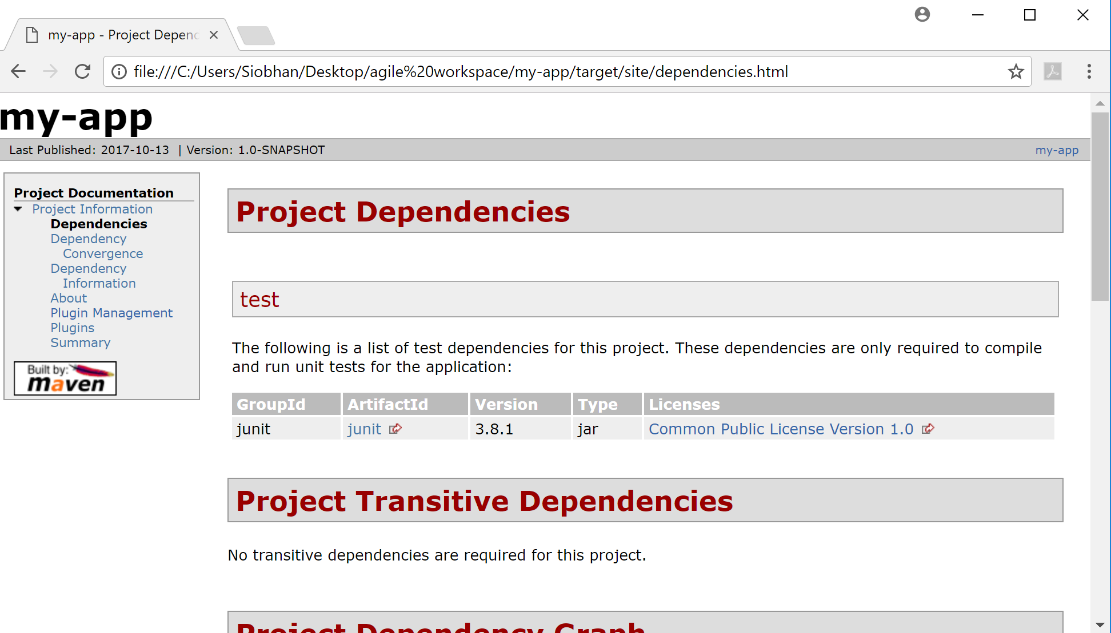
Generating a Site for the App
mvn site
http://maven.apache.org/guides/getting-started/maven-in-five-minutes.html

Slide 34
Importing into Eclipse

Slide 35
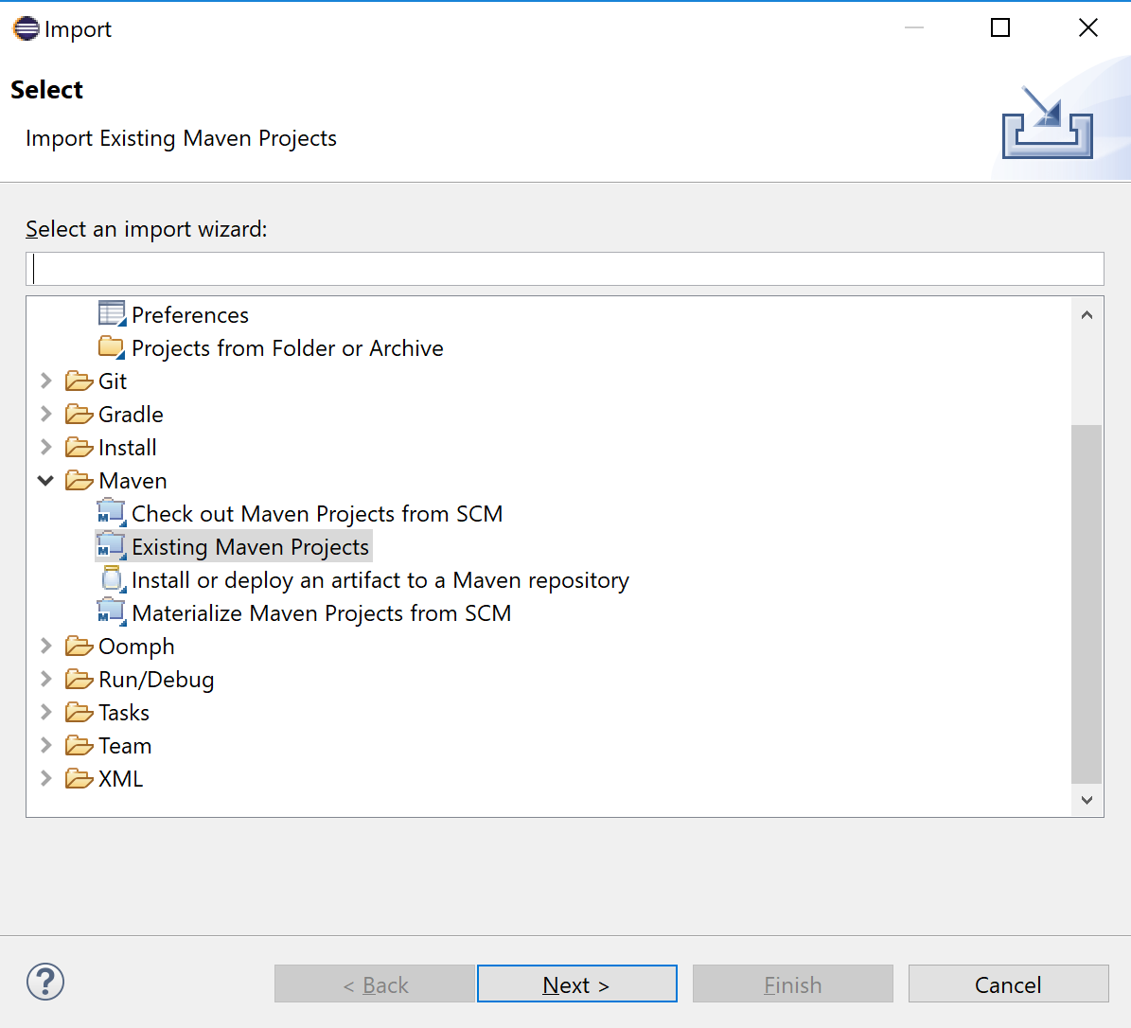
Import into Eclipse
Menu Items:
→ File
→ Import…

Slide 36
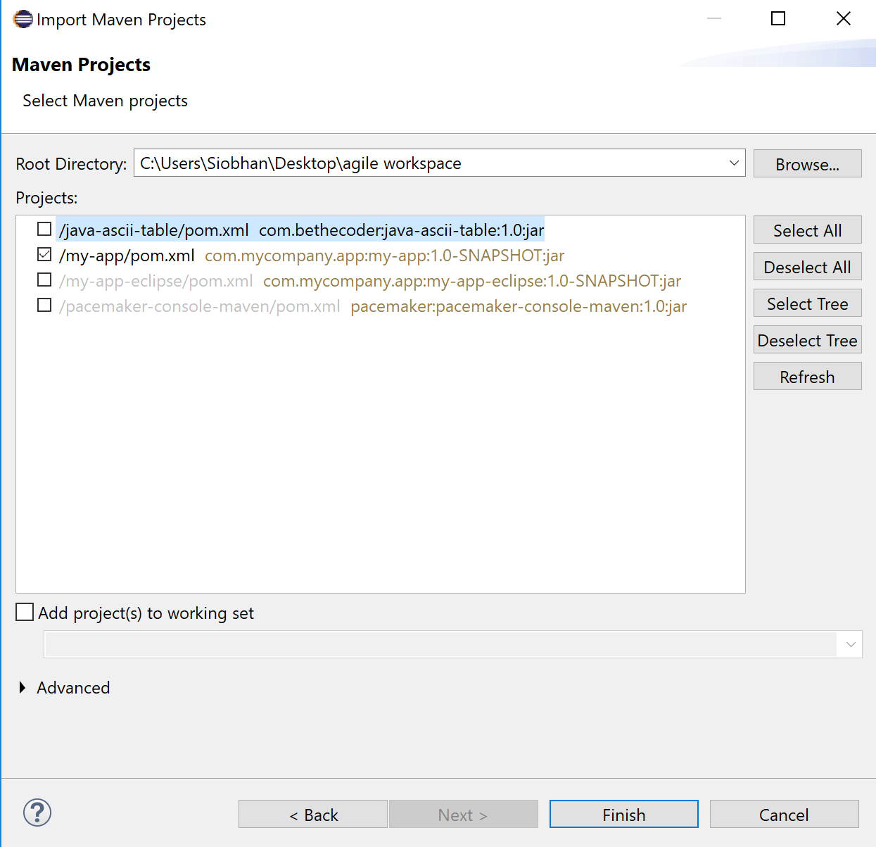
Import into Eclipse

Slide 37
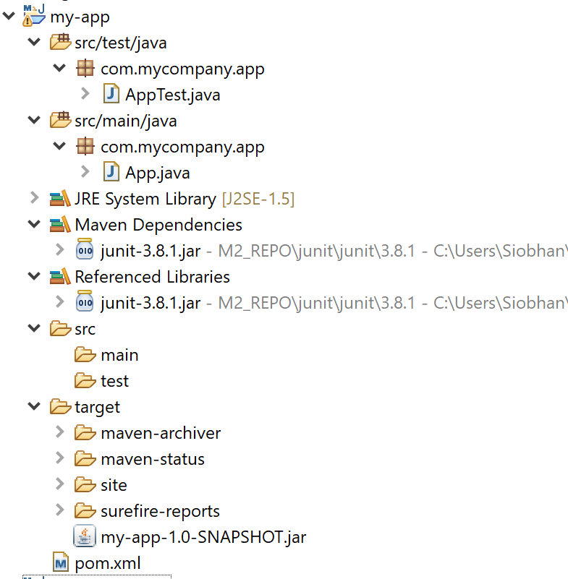
Eclipse Project Structure

Slide 38
Deprecated command…you might need this approach if you are working with an older version of Eclipse!
mvn eclipse:eclipse
Generates the ‘.project’ and ‘.classpath’ Eclipse uses to specify project name, structure and dependencies.
The project can then be ‘imported’ into eclipse.
Note: you also use this command to refresh the project in Eclipse.

Slide 39
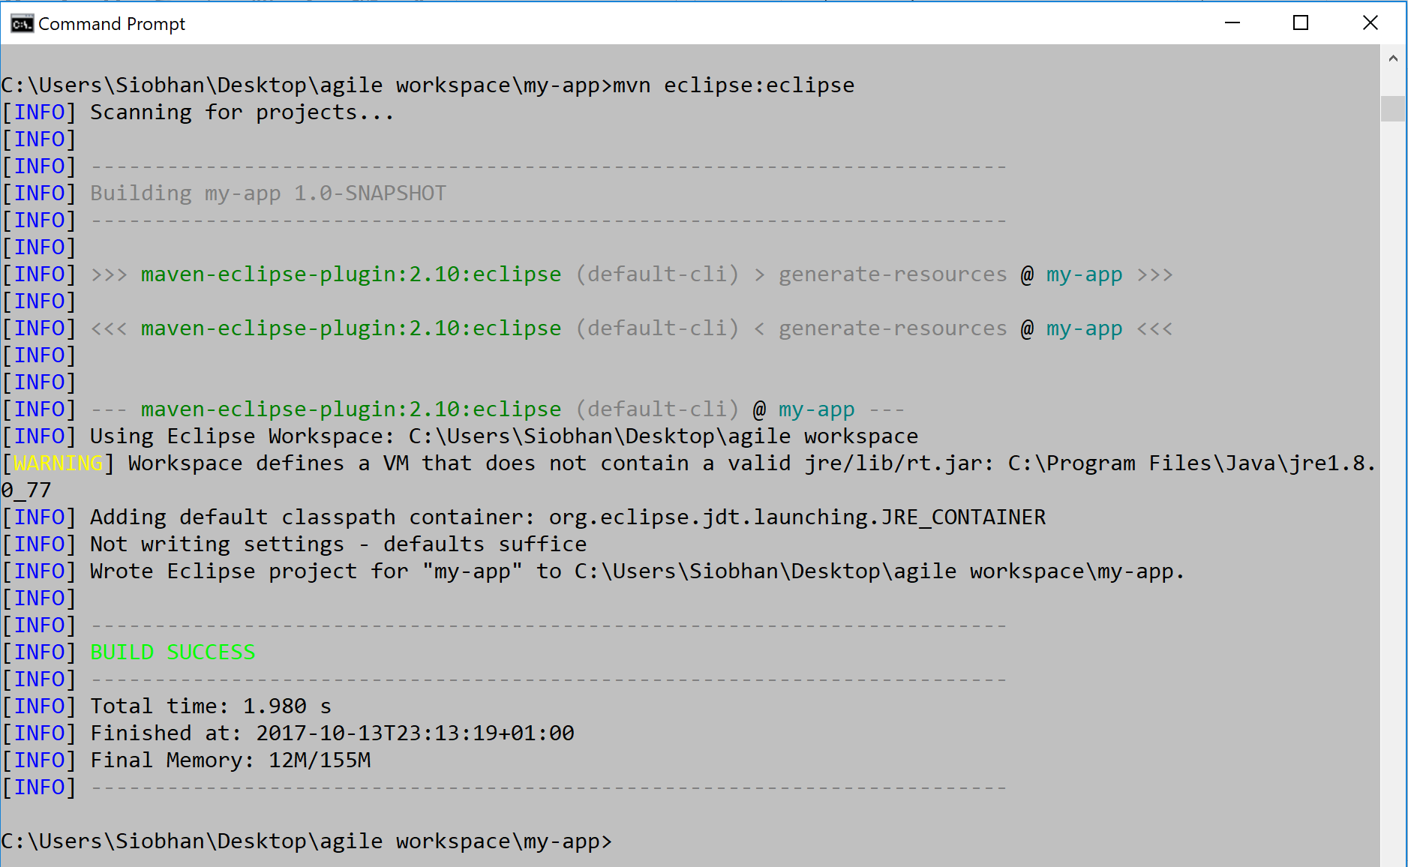
Format / Refresh as Eclipse Project
mvn eclipse:eclipse

Slide 40
Labs this week

Slide 41
Maven Labs
Verify your Maven Installation is ok (installed in a previous lab)
Build the my-app Java Project we just looked at.
Pacemaker-console:
Create an empty Maven Java Project called pacemaker-console-maven.
Copy the existing pacemaker files into the pacemaker-console-maven project.
Edit pom.xml to incorporate required dependencies (both remote and local).
Build, package and run pacemaker-console-maven.
Write a script to simply running pacemaker-console-maven.
Include JUnit5 capabilities.

Slide 42



Slide 43

A good video on Eclipse Oxygen and Code Coverage
https://www.youtube.com/watch?v=p_mVa9iNmzk

