Slide 1
Mobile Application Development
David Drohan (ddrohan@wit.ie)

Slide 2

Firebase Overview

Slide 3
Firebase Overview
Firebase history
The all new Firebase
Real-time database
Firestore
Authentication
Storage
Remote config
Hosting
Crash reporting
Test lab
Firebase cloud messaging
Dynamic links
App indexing
Analytics
Donation Highlights & Demos along the way…

Slide 4
Firebase Overview
Firebase history
The all new Firebase
Real-time database
Firestore
Authentication
Storage
Remote config
Hosting
Crash reporting
Test lab
Firebase cloud messaging
Dynamic links
App indexing
Analytics
Donation Highlights & Demos along the way…

Slide 5
History of firebase
Originally firebase was an online chat message integration service.
Later the real time architecture was separated to create firebase database in 2012.
Firebase surfaced as a popular choice when Parse.com went down.
Google acquired firebase in 2014 and added a whole lot of features in Google IO-2016.
Firebase is now a complete BaaS solution.

Slide 6

Part 4
Introduction to Firebase

Slide 7
What Is It?
Cloud database ?
Another name for Google app engine?
Cross platform solution ?
Another name for GCM ?
Analytics ?
Virtual private server ?
@^#%$&)!<*>^%($....
Notes:
We have heard a lot of fuss about firebase now. What is it actually

Slide 8
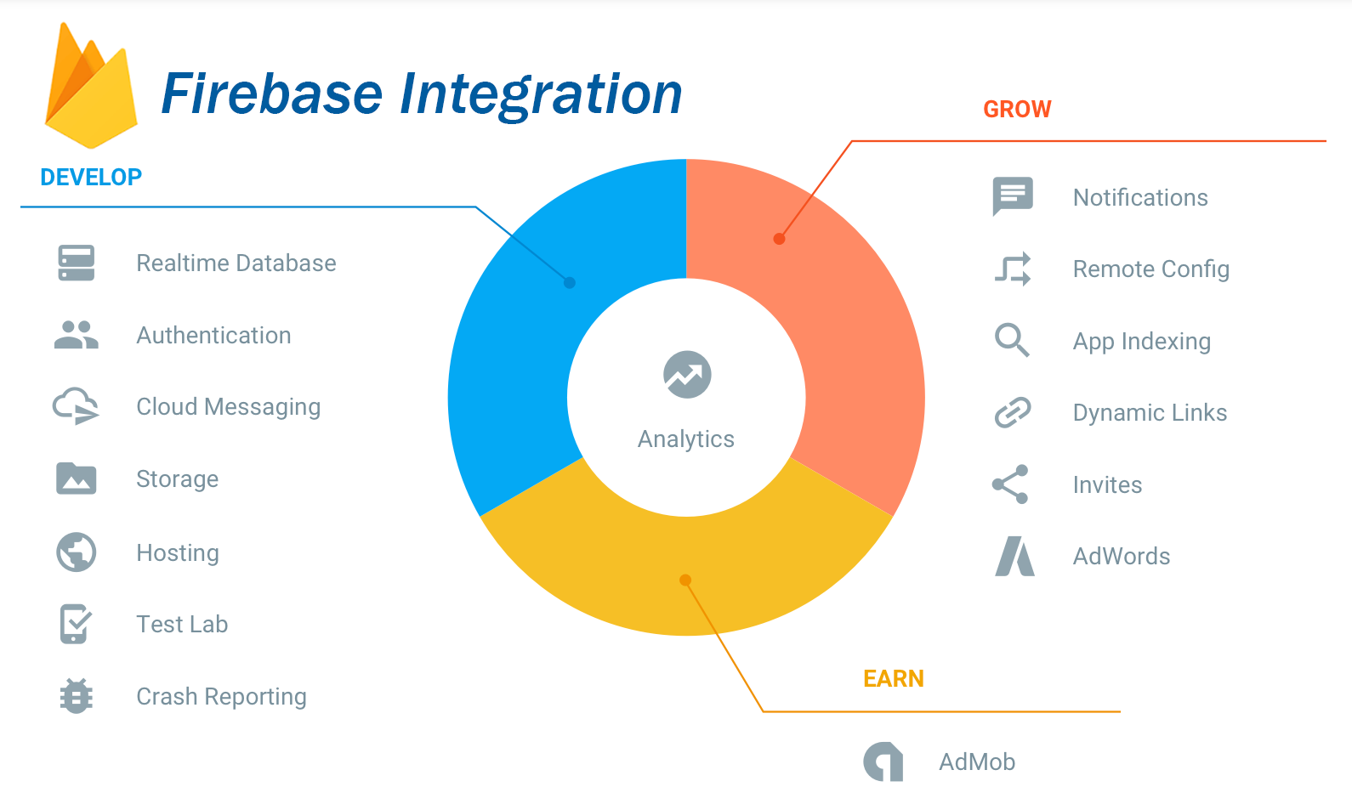
What It is, is …
A complete BaaS solution that includes
Real time JSON database
Authentication
Cloud storage
Cloud messaging
Crash reporting and analytics
And a lot more

Slide 9
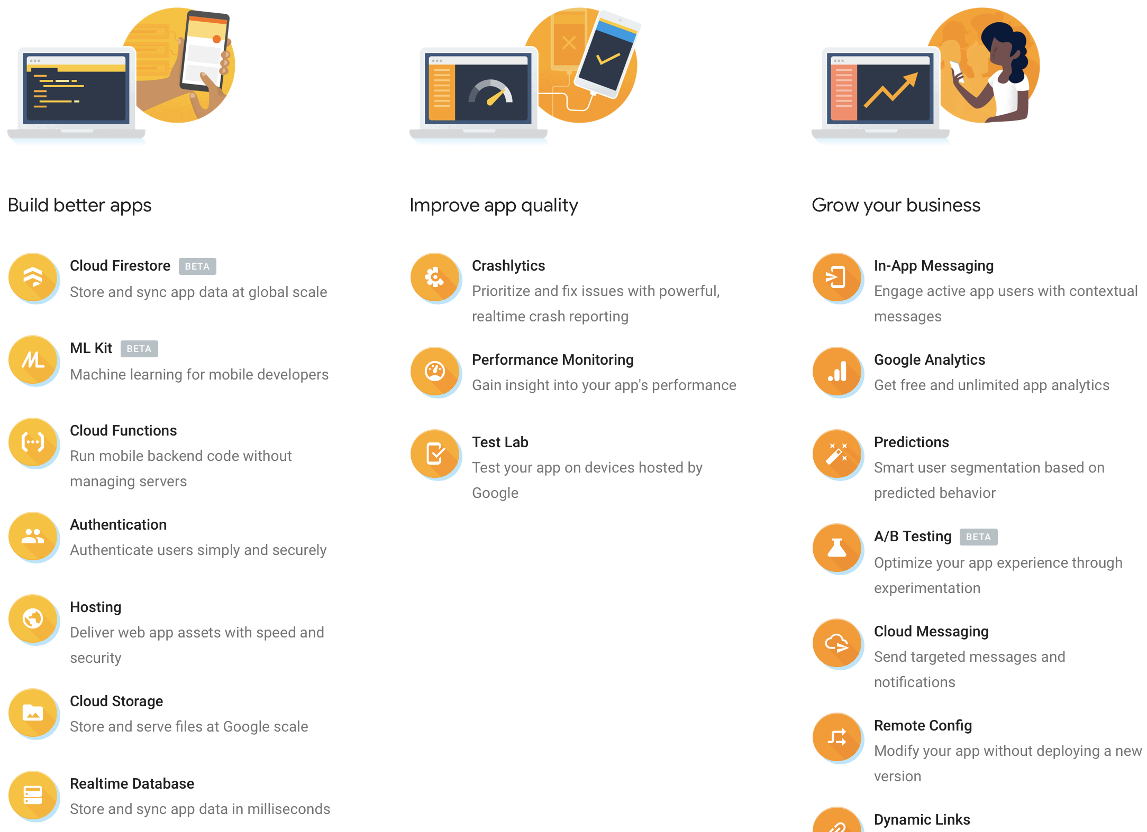
Firebase Products

Slide 10
Why use Firebase?

Slide 11

So… You have an Idea For An App…
What people think…
Create an android app? what’s the big deal??

Slide 12


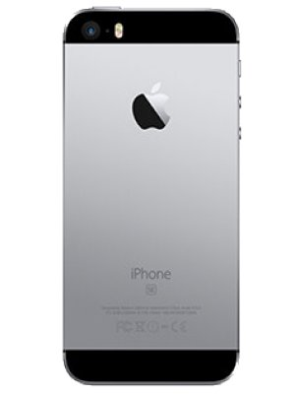
Idea For An App
In Reality
Web app
backend
Android
iOS

Slide 13
In Reality
That’s a lot to learn
A lot of code
A lot of concerns
A lot of resources
A lot of maintenance
And the most dangerous of all – a lot of unknowns
Notes:
And this is just the beginning phase, when you start development, you will start thinking about…<next slide>

Slide 14
And What About…
Scalability
Infrastructure
Reporting
Analytics
Security
Monetization
Testing
Pricing
Authentication

Slide 15
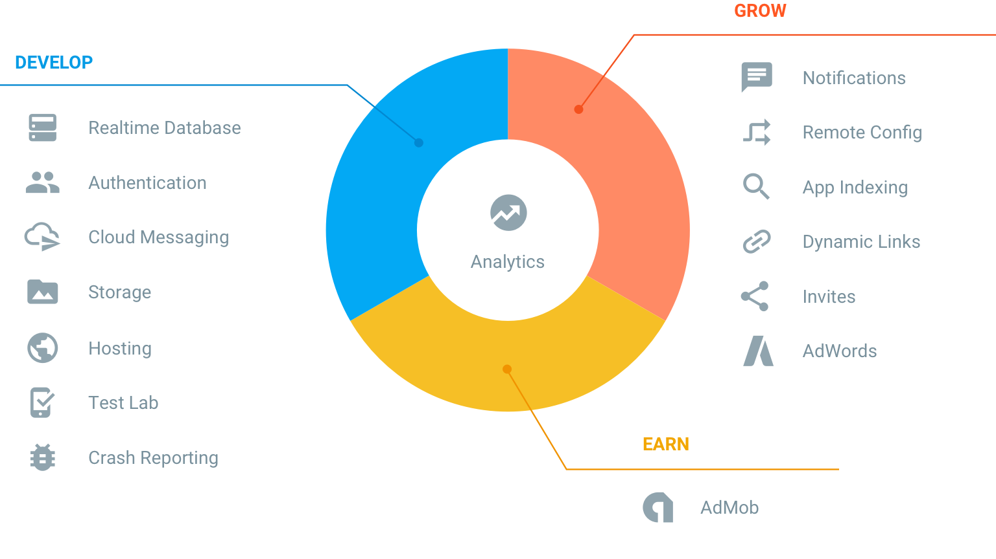
Enter The New Firebase

Slide 16

References
https://console.firebase.google.com/
https://firebase.google.com/

Slide 17


