Slide 1
Mobile Application Development
David Drohan (ddrohan@wit.ie)

Slide 2
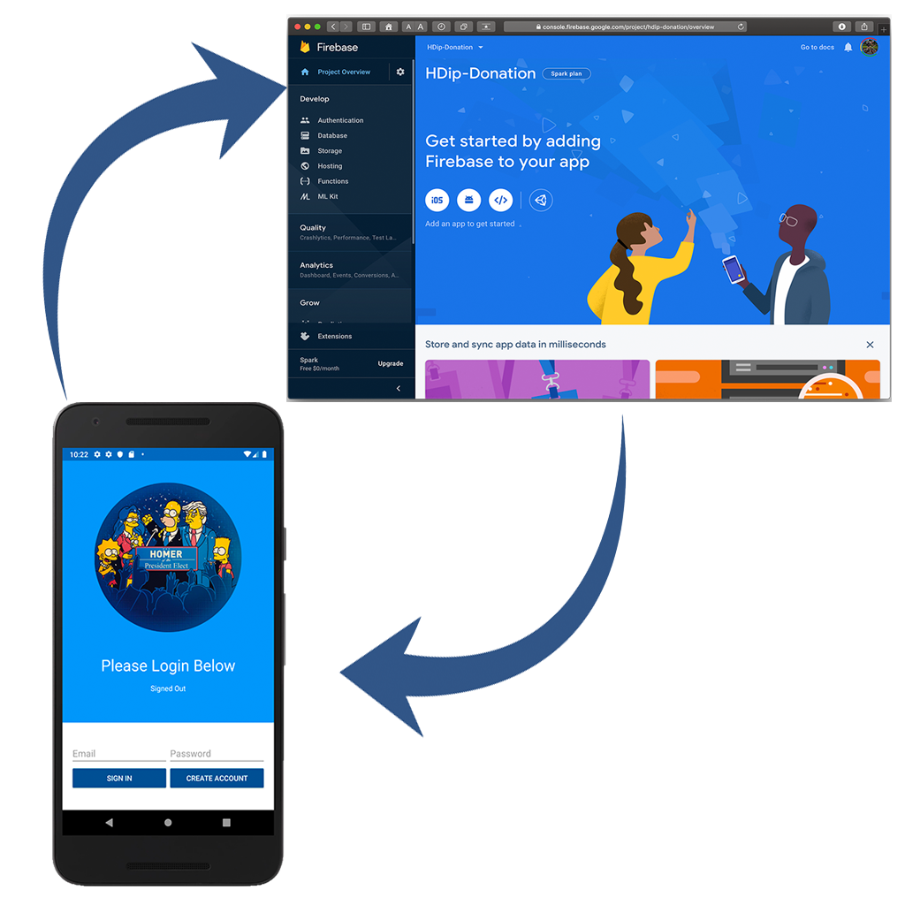
Donation-V4 Walkthrough

Slide 3
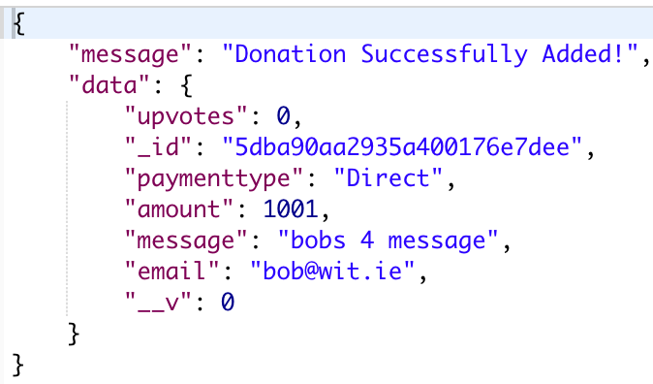
Aside – Multi User Donation Service
http://donationweb-hdip-mu-server.herokuapp.com api endpoints
{ method: 'GET', path: ‘/donations/', config: Donations.getAll },
{ method: 'GET', path: ‘/donations/:email', config: Donations.findAll }, { method: 'GET', path: '/donations/:email/{id}', config: Donations.findOne }, { method: 'POST', path: '/donations/:email', config: Donations.addDonation }, { method: 'PUT', path: '/donations/:email/{id}', config: Donations.editDonation }, { method: 'DELETE', path: /donations/:email/{id}', config: Donations.deleteDonation }
Use DonationService for
Adding / Updating / Deleting a Donation
Listing All Donations
Finding a single Donation
FOR A SINGLE USER

Slide 4
Steps to integrate Firebase Auth into your App
Create your Firebase Project
Setup your Sign-In Method
Setup Firebase in your App
Introduce Authentication Flow – Create Account & Sign In / Sign Out
Utilize your Authenticated User in your App

Slide 5
Steps to integrate Firebase Auth into your App
Create your Firebase Project
Setup your Sign-In Method
Setup Firebase in your App
Introduce Authentication Flow – Create Account & Sign In / Sign Out
Utilize your Authenticated User in your App

Slide 6
https://github.com/firebase/quickstart-android

Slide 7
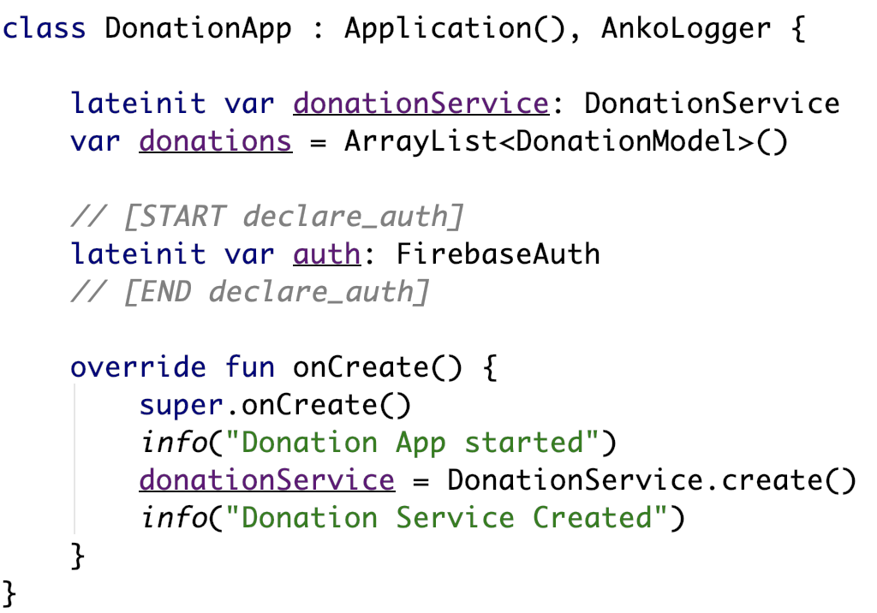
Introduce Authentication Flow – Create Account
Our FirebaseAuth instance

Slide 8
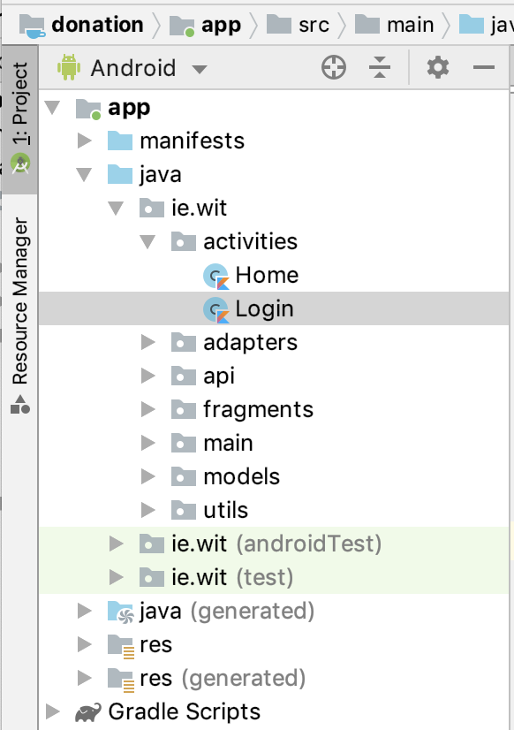
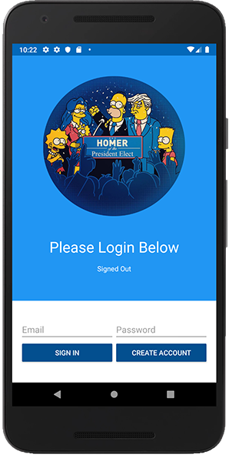
Introduce Authentication Flow – Create Account
Our Login Activity

Slide 9
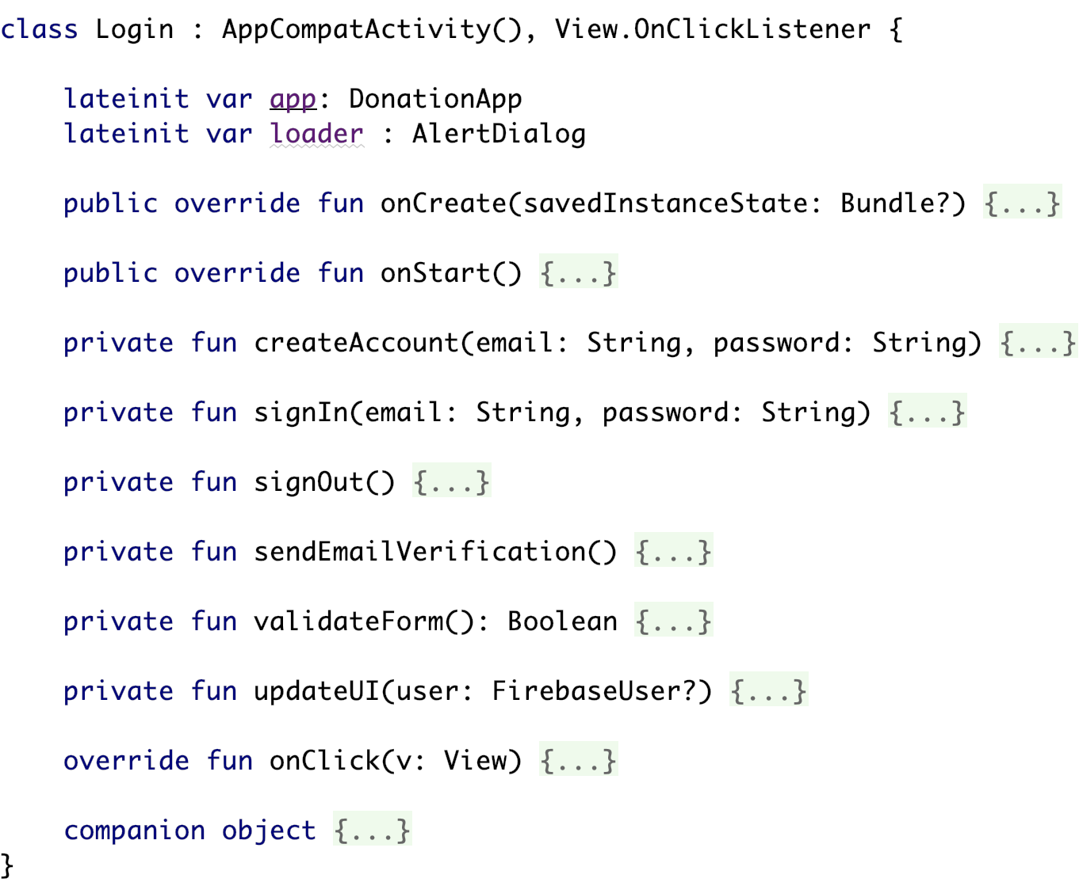
Introduce Authentication Flow – Create Account
Our Login Activity

Slide 10
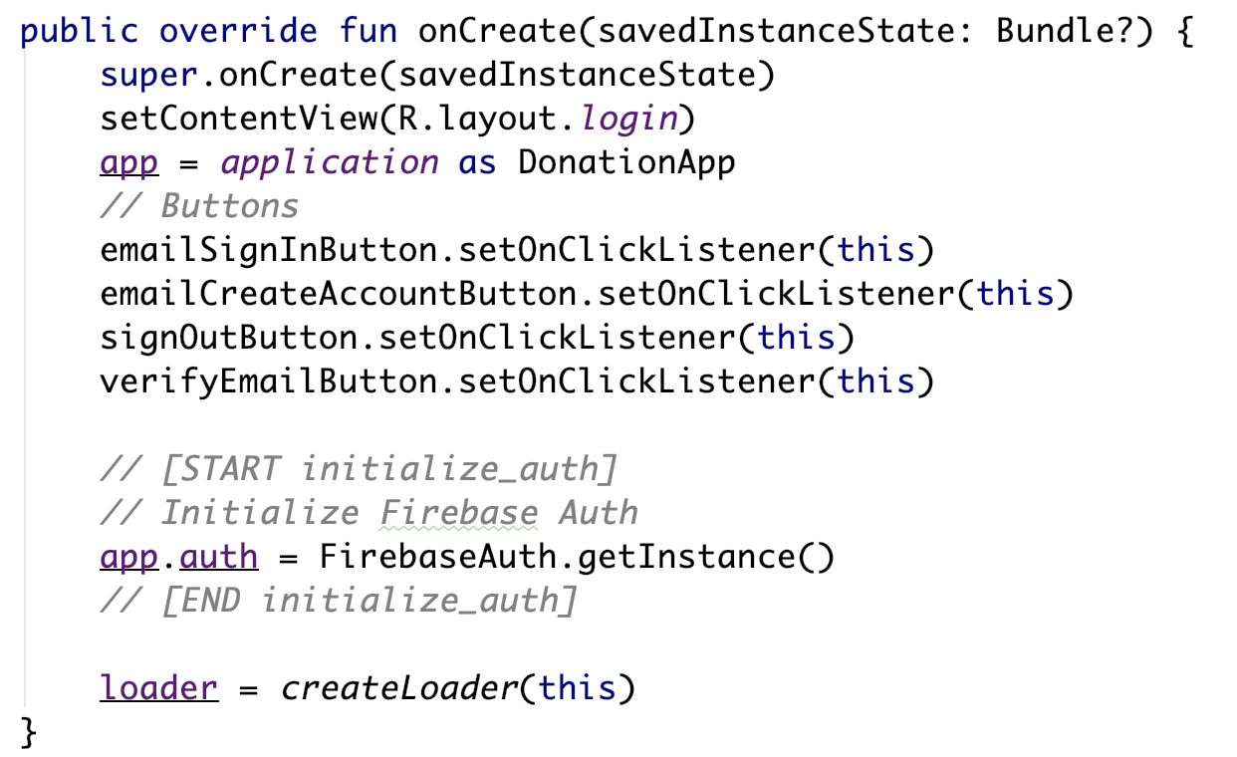
Introduce Authentication Flow – Create Account

Slide 11
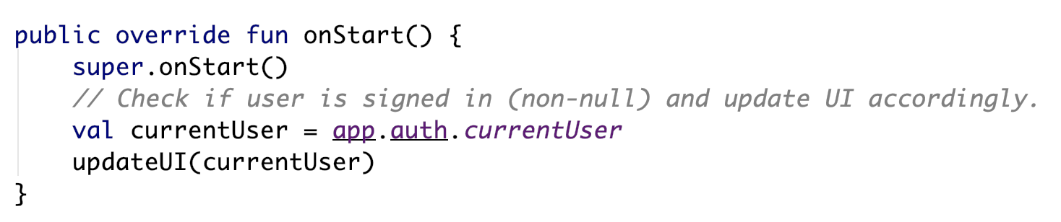
Introduce Authentication Flow – Create Account

Slide 12
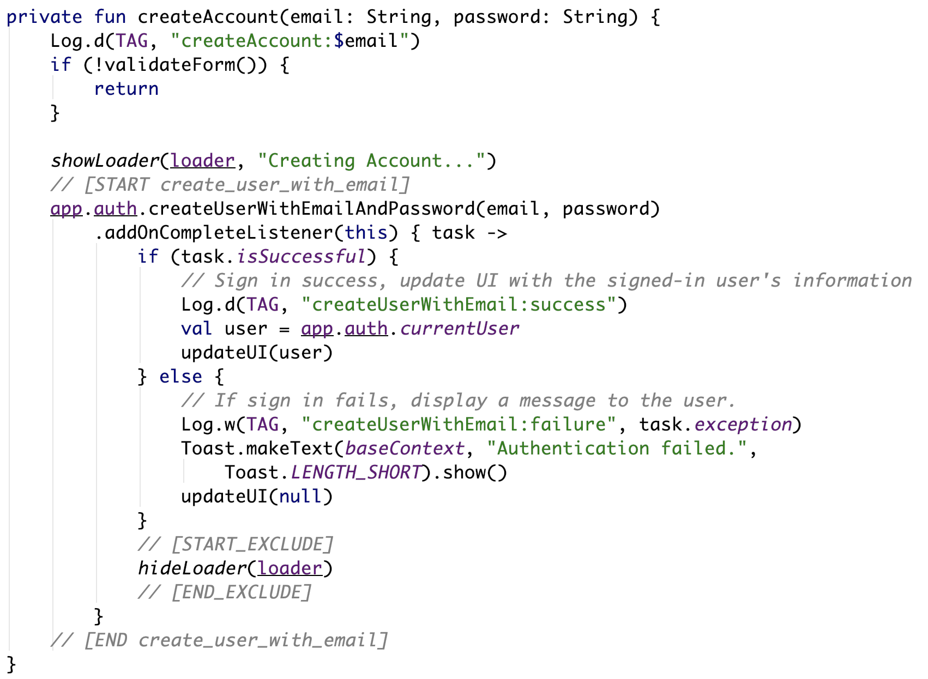
Introduce Authentication Flow – Create Account

Slide 13
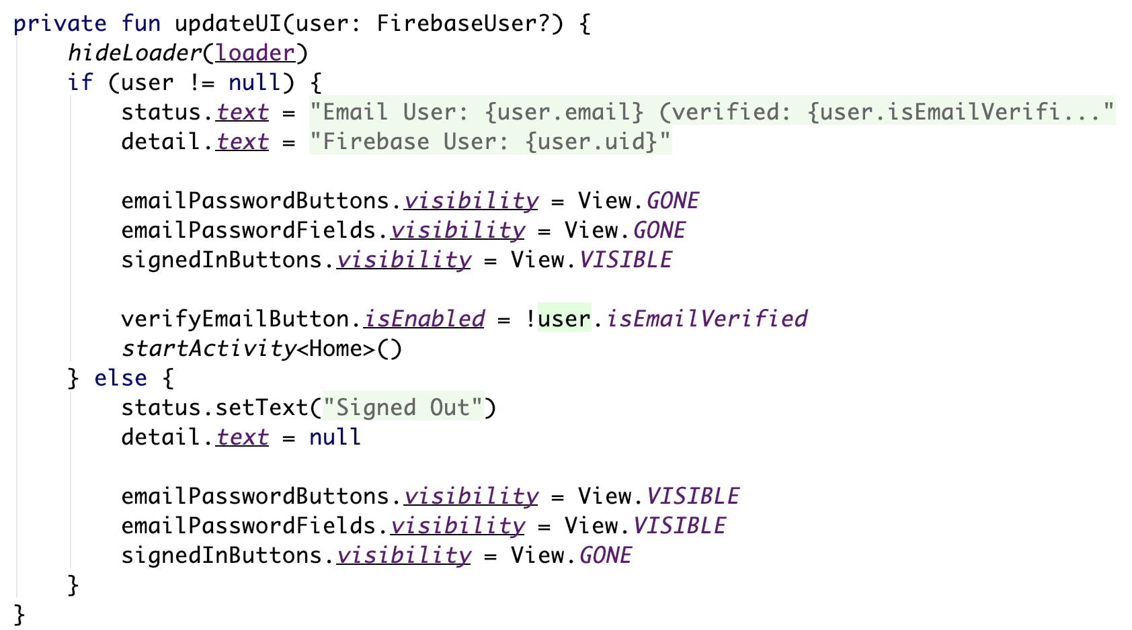
Introduce Authentication Flow – Create Account

Slide 14
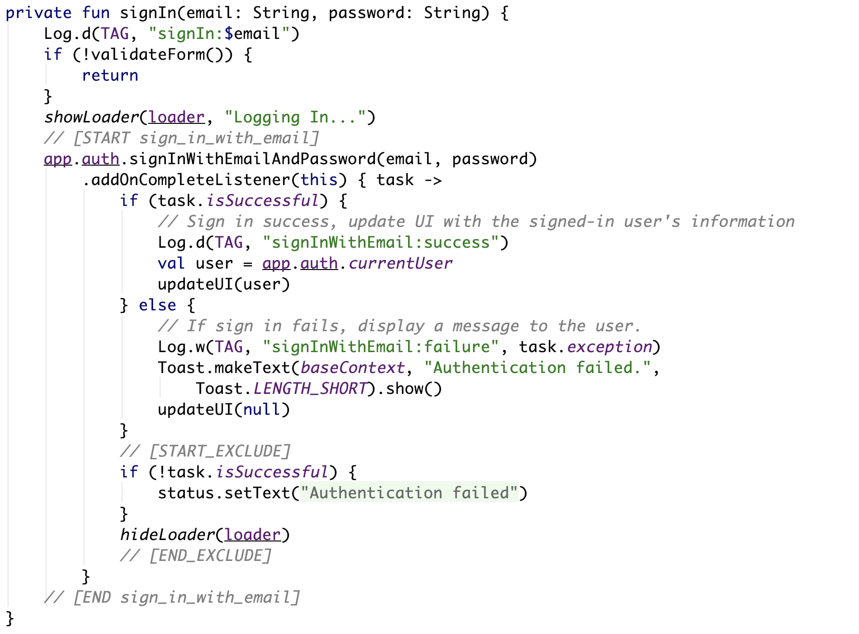
Introduce Authentication Flow – Sign In User

Slide 15
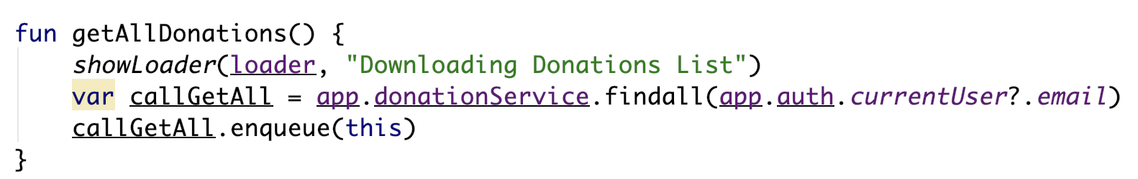
Utilize your Authenticated User in your App
Setting the email in ‘Home’
Getting All Donations in ‘Donate’

Slide 16
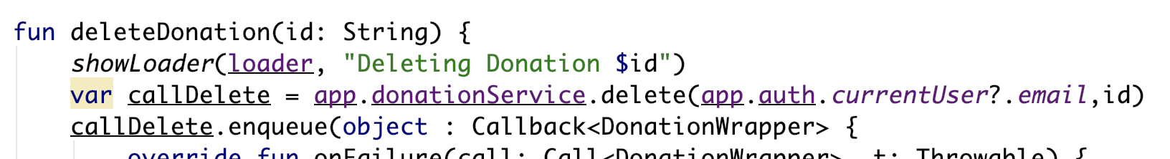
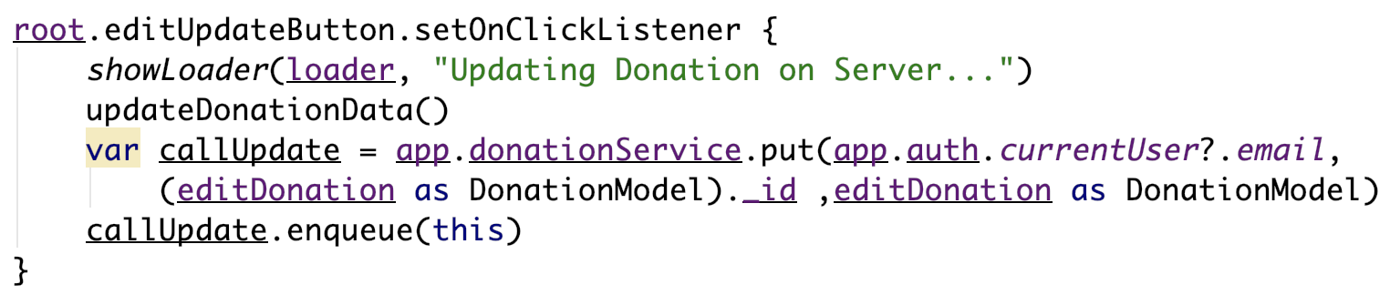
Utilize your Authenticated User in your App
Deleting a Donation
Updating a Donation

Slide 17
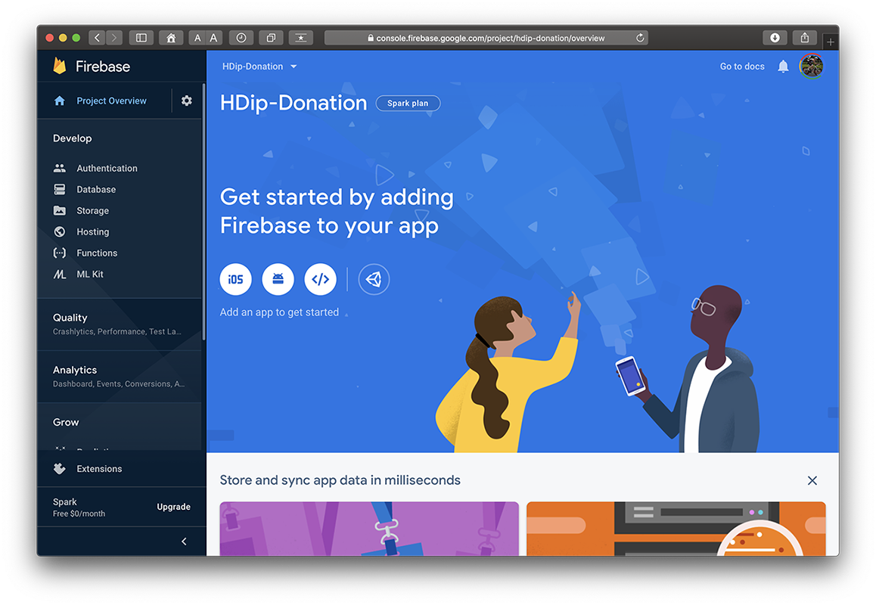
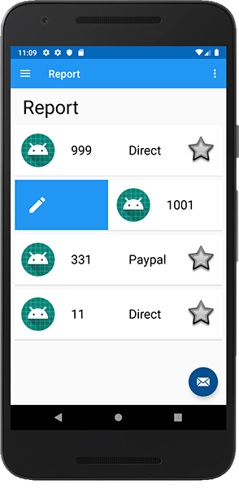
Donation Service + Mobile App

Slide 18

References
https://console.firebase.google.com/
https://firebase.google.com/
https://github.com/firebase/quickstart-android

Slide 19


