Slide 1
Mobile Application Development
David Drohan (ddrohan@wit.ie)
Dr. Siobhan Drohan (sdrohan@wit.ie)

Slide 2
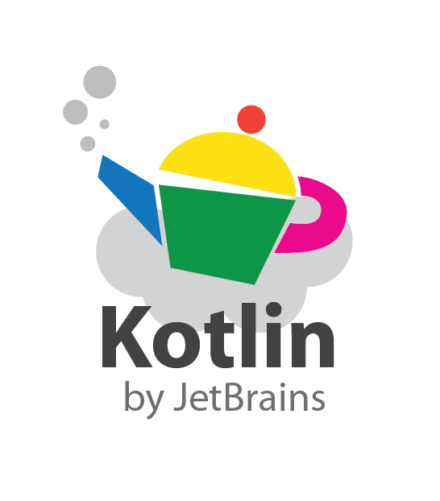
Introducing Kotlin
Overview – Part 1

Slide 3
Agenda
What is Kotlin?
Context - Java Vs JVM
Kotlin History
Milestones
General Overview & Features
Kotlin & IntelliJ IDEA
Conclusion

Slide 4
Agenda
What is Kotlin?
Context - Java Vs JVM
Kotlin History
Milestones
General Overview & Features
Kotlin & IntelliJ IDEA
Conclusion

Slide 5
So What is Kotlin?
A (fairly) new statically-typed language from JetBrains (creators of IntelliJ IDEA which it works seamlessly with)
Tries to fix many of Java’s shortcomings
Compiles to JVM bytecode, JavaScript and Kotlin native
Created with focus on Java interoperability – Kotlin and Java classes can be used together in a project
Gaining more traction and is being increasingly adopted, especially in the last few years (see later slides)
Has very good support from JetBrains, an established company, who use Kotlin to develop their own products

Slide 6
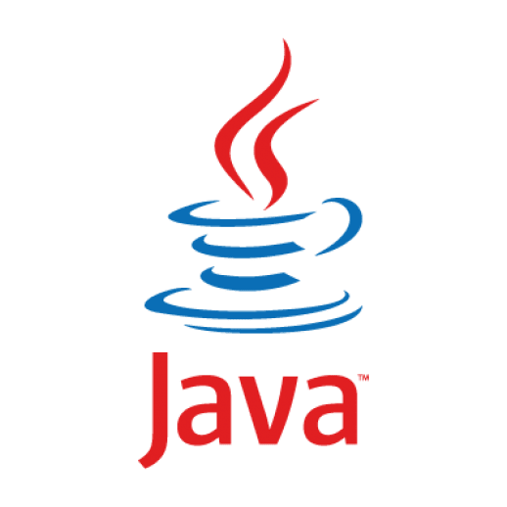
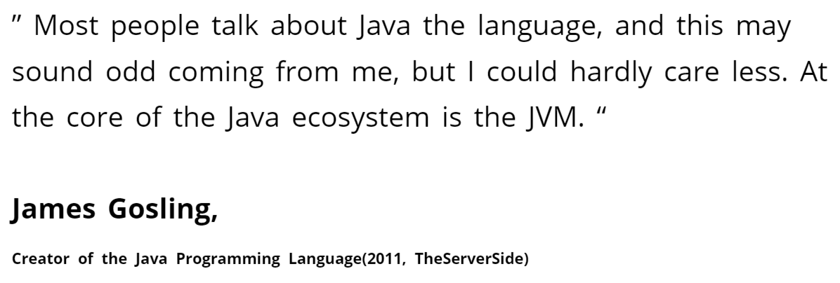

Context - JAVA Vs JVM

Slide 7
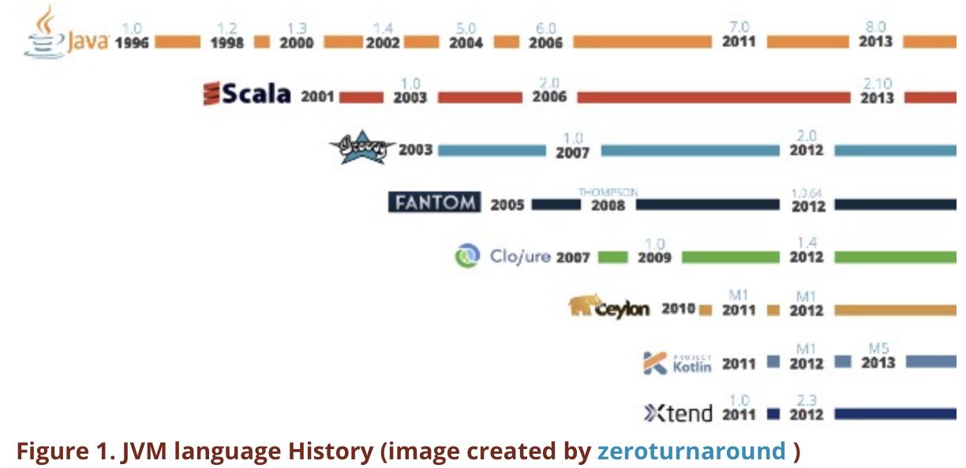
Context - JVM Language History

Slide 8
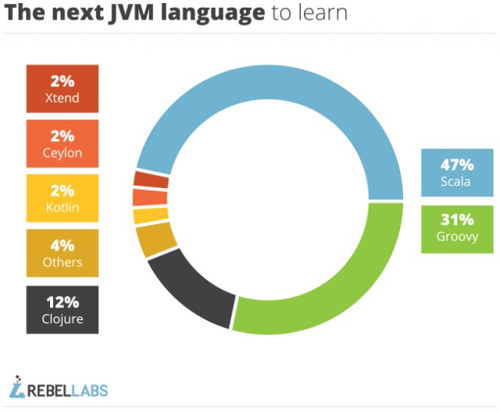

https://zeroturnaround.com/rebellabs/a-month-of-jvm-languages-groovy-ceylon-kotlin-and-scala/

Slide 9
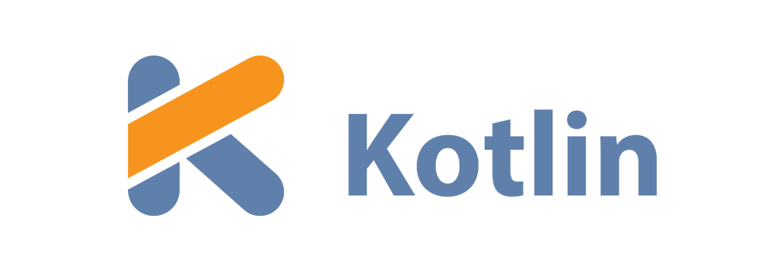
History of
In July 2011 JetBrains Start Project Kotlin, a new language for the JVM, which had been under development for a year.
JetBrains hopes that the new language will drive IntelliJ IDEA sales.
Kotlin v1.0 released on February 15, 2016.
In May 2017 Google make an announcement that changes the Kotlin roadmap completely (see later)

Slide 10
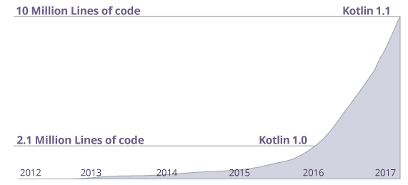
Many companies like Netflix, Uber, Trello, Pinterest, Corda etc. are using Kotlin (along with other programming languages) to create applications.
https://www.programiz.com/kotlin-programming

Slide 11
April 21st 2017

Slide 12
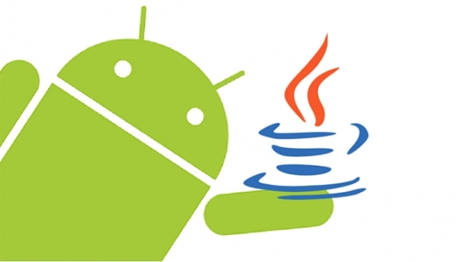
“Java is the primary and official language for Android development, but that doesn’t mean it is the best or the only choice.” “To give Java credit, it is a robust language that has been around for a while, but it comes with a specific set of challenges that can be a deterrent for developers.” “A new breed of modern JVM languages is slowly gaining traction within the Android community, and Kotlin is leading the pack.”
Dzone Article (Why You Should Consider Kotlin For Android Development)
Source: Dzone, April 21st 2017
Notes:
All the Boilerplate Java code is an issue for developers in Android Development

Slide 13
May 17th 2017

Slide 14
Google I/O 2017 - Google announces that Kotlin would receive first-class support for Android development

Slide 15
JetBrains Posted (same day) ….
“For Android developers, Kotlin support is a chance to use a modern and powerful language, helping solve common headaches such as runtime exceptions and source code verbosity.
Kotlin is easy to get started with and can be gradually introduced into existing projects, which means that your existing skills and technology investments are preserved.”
“Starting now, Android Studio 3.0 ships with Kotlin out of the box, meaning Android developers no longer need to install any extras or worry about compatibility. It also means that moving forward, you can rest assured that both JetBrains and Google will be supporting Android development in Kotlin.”
https://blog.jetbrains.com/kotlin/2017/05/kotlin-on-android-now-official/
Notes:
Kotlin is interoperable with Java – you don’t have to ‘bin’ all your Java code to make the changeover

Slide 16
Agenda Recap
What is Kotlin?
Context - Java Vs JVM
Kotlin History
Milestones
General Overview & Features
Kotlin & IntelliJ IDEA
Conclusion

Slide 17



