Slide 1
Mobile Application Development
David Drohan (ddrohan@wit.ie)

Slide 2
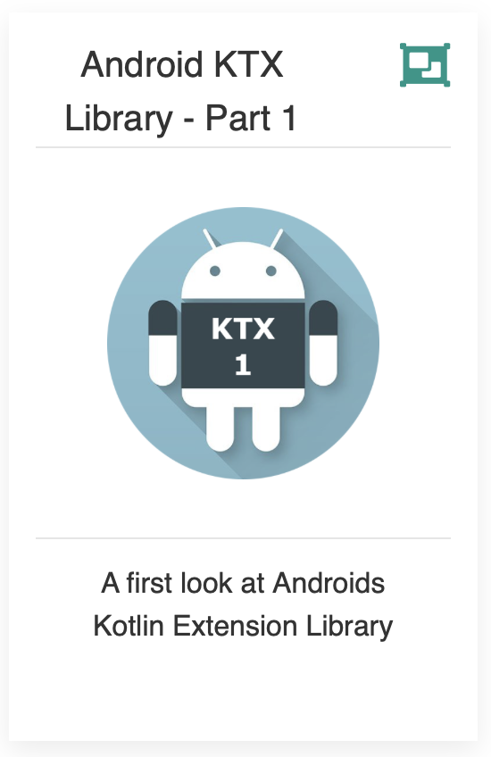
Introducing Android KTX Library

Slide 3
Agenda
Background
Extension Functions
The KTX Library Packages (Core, Fragment, Palette, SQLite, Collections)
KTX in our Case Study (Donation)

Slide 4
Agenda
Background
Extension Functions
The KTX Library Packages (Core, Fragment, Palette, SQLite, Collections)
KTX in our Case Study (Donation)

Slide 5
What is it?
Android KTX is one of the new additions to the Android Jetpack family.
It’s a collection of Kotlin extension functions that enhances and give a Kotlin-ish touch to existing Android APIs.
KTX takes advantage of many of the new features in the Kotlin language to make all the old Java Android APIs feel like brand new.
Notes:
So things like Extension functions, Extension properties, Lambdas, Named parameters, Parameter default values and Coroutines
Android KTX is an effort by the Google Android team to make those Android APIs more pleasant and easy to use for Kotlin developers - without adding any new features to the existing Android APIs.

Slide 6
Why is it Useful?
It simplifies the developers interaction with Android APIs by using those new features of the Kotlin language (extension functions, lambdas, and named and default parameters)
For example… did you know that the class TextUtils has the methods isDigitsOnly and getTrimmedLength
It helps you discover many features of the Android APIs like these that you did not previously know existed because they were buried under tons of utility classes or static methods.
Notes:
So Just by writing a dot after any object, you can now have a concise list of all the operations that you can apply to it, without having to memorize the methods in utility classes or make constant searches on Stack Overflow.

Slide 7
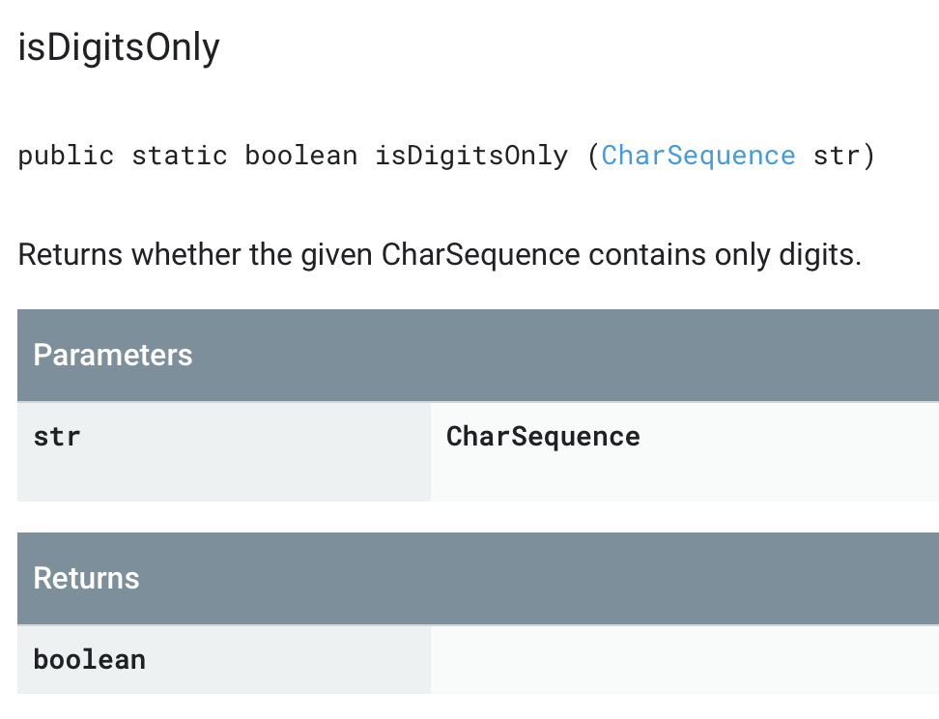
Java
Notes:
So Just by writing a dot after any object, you can now have a concise list of all the operations that you can apply to it, without having to memorize the methods in utility classes or make constant searches on Stack Overflow.

Slide 8
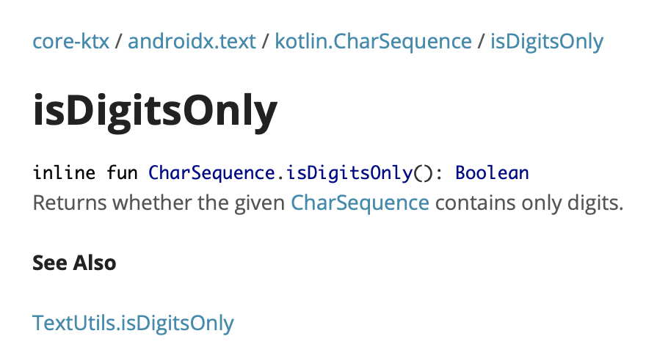
KTX
Notes:
So Just by writing a dot after any object, you can now have a concise list of all the operations that you can apply to it, without having to memorize the methods in utility classes or make constant searches on Stack Overflow.

Slide 9
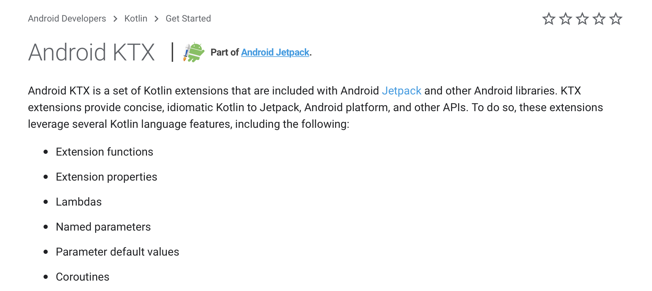
Official Docs (https://developer.android.com/kotlin/ktx)
Notes:
DSL – Domain Specific Language

Slide 10
Official Docs (https://developer.android.com/kotlin/ktx)
Notes:
DSL – Domain Specific Language

Slide 11
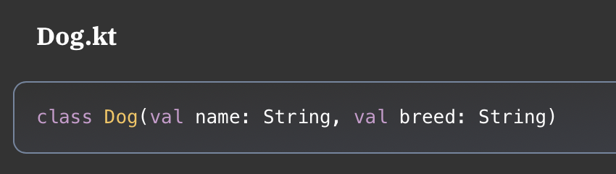
Extension Functions
To understand how KTX works, you need to understand Kotlin Extension Functions. They allow you to add a function to an existing class without modifying the class.
For example, say you had a Dog class:

Slide 12
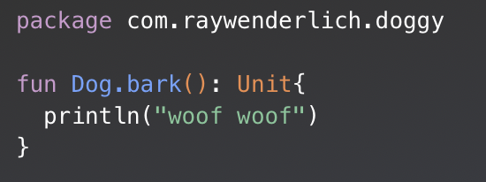
Extension Functions
In another Kotlin file you could add a function to Dog without modifying the original file:
To create the extension function, after fun type the class, then a dot, then the name of the extension function.

Slide 13
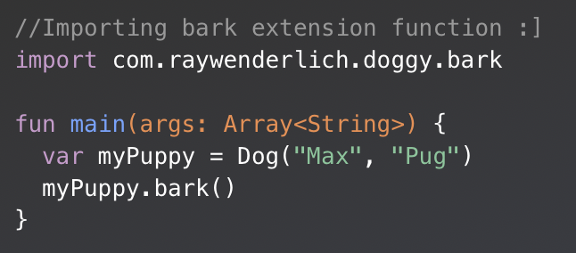
Extension Functions
You could test your extension function in another file as follows:
To use the extension function, you only import bark, and then every Dog object will be able to use the bark() function.
Notes:
Note: If you don’t import the extension function, you won’t be able to use it, because it won’t be visible in your code., and you’ll get a compiler error

Slide 14
Android KTX Packages
The KTX toolset is broken up into a number of different packages, so that you can import only the ones you need into your app project:
Core KTX: for use with framework APIs such as Toasts, Spans, and Menus
Fragment KTX: simplifies Fragment transactions
Palette KTX: for working with color palette APIs
SQLite KTX: simplifies SQLite database transactions
Collections KTX: for use with collection APIs
Navigation KTX: for use with Jetpack Navigation

Slide 15
Android KTX Packages
The KTX toolset is broken up into a number of different packages, so that you can import only the ones you need into your app project:
Core KTX: for use with framework APIs such as Toasts, Spans, and Menus
Fragment KTX: simplifies Fragment transactions
Palette KTX: for working with color palette APIs
SQLite KTX: simplifies SQLite database transactions
Collections KTX: for use with collection APIs
Navigation KTX: for use with Jetpack Navigation

Slide 16

Core KTX
helpers for util, os, view, net & more…

Slide 17
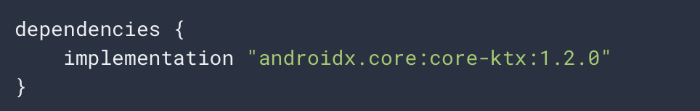
Core KTX
The Core KTX module provides extensions for common libraries that are part of the Android framework.
These libraries do not have Java-based dependencies that you need to add to build.gradle.
To include this module, add the following to your app's build.gradle file:

Slide 18
Core KTX packages/libraries
androidx.core.animation
androidx.core.content
androidx.core.graphics
androidx.core.graphics.drawable
androidx.core.net
androidx.core.os
androidx.core.preference
androidx.core.text
androidx.core.transition
androidx.core.util
androidx.core.view
androidx.core.widget

Slide 19
Core KTX packages/libraries
androidx.core.animation
androidx.core.content
androidx.core.graphics
androidx.core.graphics.drawable
androidx.core.net
androidx.core.os
androidx.core.preference
androidx.core.text
androidx.core.transition
androidx.core.util
androidx.core.view
androidx.core.widget

Slide 20
Core KTX – bundleOf (androidx.core.os)
bundleOf is a Core KTX helper function that lets you create a Bundle object from anywhere.
Instead of
var bundle = bundleOf("ARG_1" to "Bob", "ARG_2" to false)
var bundle = bundle() bundle.putString("ARG_1”, "Bob” bundle.putBoolean("ARG_2”, false)
Notes:
Using bundleOf(), you avoid needing to first create a Bundle object and then making multiple put calls to add data into the Bundle. Instead, with Core KTX you pass one or many key/value arguments as Kotlin Pair objects using the to infix function into bundleOf() all at once.
So Core KTX has made your code more concise and readable

Slide 21
Core KTX – drawToBitmap (androidx.core.view)
This helper function converts a View to a Bitmap object
Instead of
private fun viewToBitmap(view: View) = view.drawToBitmap()
private fun viewToBitmap(view: View): Bitmap { // 1 Create a new bitmap with the view info val bitmap = Bitmap.createBitmap(view.width, view.height, Bitmap.Config.ARGB_8888) // 2 Draw the view pixes into the bitmap val canvas = Canvas(bitmap) view.draw(canvas) return bitmap }
Notes:
Using Core KTX, you got rid of all the boilerplate Bitmap creation code and focused on the main goal.

Slide 22
Agenda
Background
Extension Functions
The KTX Library Packages (Core, Fragment, Palette, SQLite, Collections)
KTX in our Case Study (Donation)

Slide 23
References
Sources: https://www.raywenderlich.com/5576-android-ktx-tutorial-getting-started
https://blog.mindorks.com/android-ktx-android-development-with-kotlin
https://developer.android.com/kotlin/ktx
https://codinginfinite.com/android-ktx-example-android-ktx-core-ktx/

Slide 24


