Slide 1
Mobile Application Development
David Drohan (ddrohan@wit.ie)

Slide 2
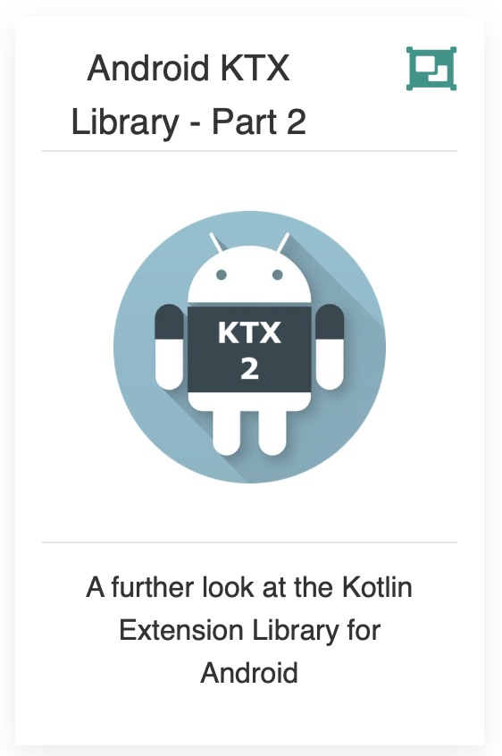
Introducing Android KTX Library

Slide 3
Agenda
Background
Extension Functions
The KTX Library Packages (Core, Fragment, Palette, SQLite, Collections)
KTX in our Case Study (Donation)

Slide 4
Agenda
Background
Extension Functions
The KTX Library Packages (Core, Fragment, Palette, SQLite, Collections)
KTX in our Case Study (Donation)

Slide 5
Recap
new addition to the Android Jetpack family
collection of Kotlin extension functions that enhances existing Android APIs
takes advantage of many of the new features in Kotlin
Notes:
So things like Extension functions, Extension properties, Lambdas, Named parameters, Parameter default values and Coroutines

Slide 6
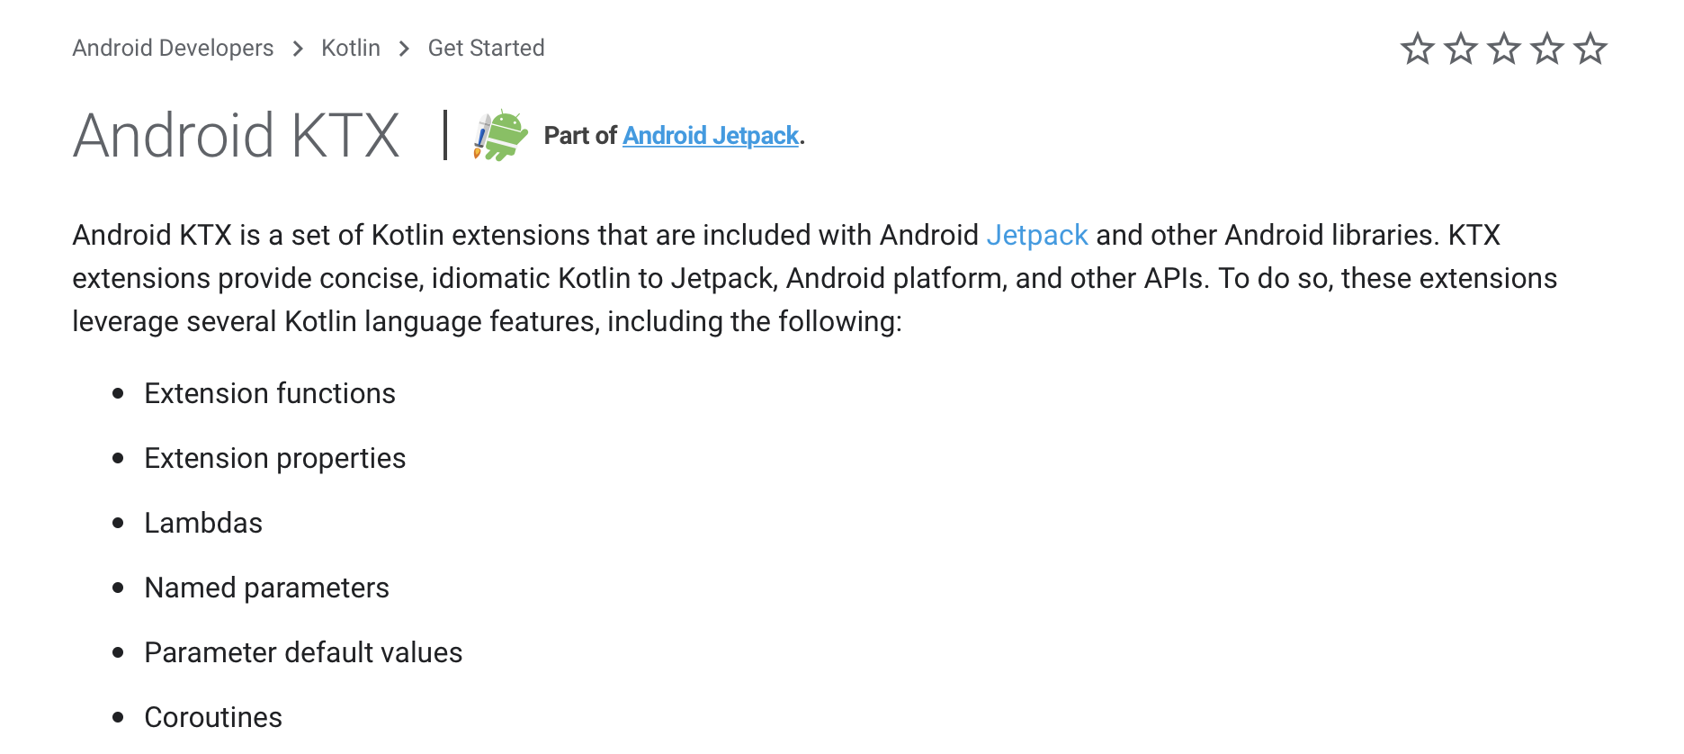
Official Docs (https://developer.android.com/kotlin/ktx)

Slide 7
Android KTX Packages
The KTX toolset is broken up into a number of different packages, so that you can import only the ones you need into your app project:
Core KTX: for use with framework APIs such as Toasts, Spans, and Menus
Fragment KTX: simplifies Fragment transactions
Palette KTX: for working with color palette APIs
SQLite KTX: simplifies SQLite database transactions
Collections KTX: for use with collection APIs
Navigation KTX: for use with Jetpack Navigation

Slide 8
Android KTX Packages
The KTX toolset is broken up into a number of different packages, so that you can import only the ones you need into your app project:
Core KTX: for use with framework APIs such as Toasts, Spans, and Menus
Fragment KTX: simplifies Fragment transactions
Palette KTX: for working with color palette APIs
SQLite KTX: simplifies SQLite database transactions
Collections KTX: for use with collection APIs
Navigation KTX: for use with Jetpack Navigation

Slide 9

Fragment KTX
simplify the fragment api

Slide 10
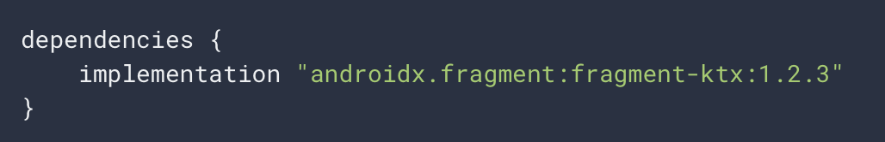
Fragment KTX
The Fragment KTX module provides a number of extensions to simplify the fragment API.
To include this module, add the following to your app's build.gradle file:

Slide 11
Fragment KTX – findFragment
Find a Fragment associated with a View.
This method will locate the Fragment associated with this view. This is automatically populated for the View returned by Fragment.onCreateView and its children.
var myFragment = view.findFragment()

Slide 12
Fragment KTX – commit
A helper function to simplify the fragment transaction process
Instead of
supportFragmentManager.commit {
addToBackStack("...")
replace(R.id.fragment_container, myFragment, MY_TAG)
}
supportFragmentManager
.beginTransaction()
.addToBackStack("...")
.replace(R.id.fragment_container, myFragment, MY_TAG)
.commit()

Slide 13
SQLite KTX
simplify database transactions

Slide 14
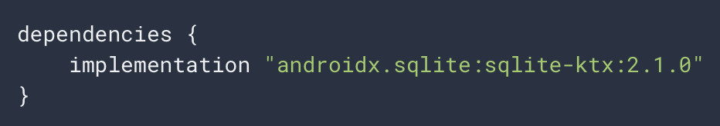
SQLite KTX
provides a number of extensions to simplify the fragment API.
wraps SQL-related code in transactions, eliminating a lot of boilerplate code.

Slide 15
Fragment KTX – transaction
A helper function to simplify the database transaction process
Instead of
db.transaction { // insert data }
db.beginTransaction()
try {
// insert data
db.setTransactionSuccessful()
}
finally {
db.endTransaction()
}

Slide 16
Collections KTX
helper functions for the collections api

Slide 17
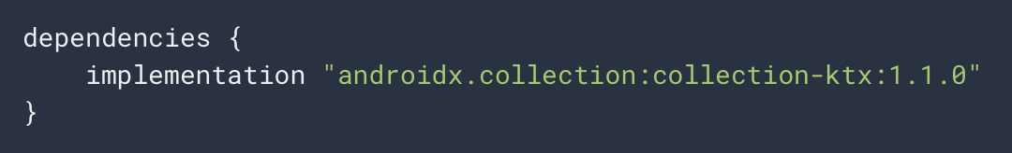
Collections KTX
provides utility functions for working with Android's memory-efficient collection libraries, including ArrayMap, LongParseArray, LruCache, and others.
Notes:
Last Recently Used Cache / SparseArray mapping longs to Objects

Slide 18
Collections KTX – + (concatenation)
takes advantage of Kotlin’s operator overloading to simplify collection concatenation
Instead of
// Combine 2 ArraySets into 1.
val combined = arraySetOf(1, 2, 3) + arraySetOf(4, 5, 6)
// Combine with numbers to create a new sets.
val newArraySet = combined + 7 + 8

Slide 19
Collections KTX – + (concatenation)
// Combine 2 ArraySets into 1.
var set1 = arraySetOf(1, 2, 3)
var set2 = arraySetOf(4, 5, 6)
var combined = arraySetOf<Int>() combined.addAll(set1)
combined.addAll(set2)
// Combine with numbers to create a new sets.
val newArraySet = combined
newArraySet.add(7)
newArraySet.add(8)

Slide 20
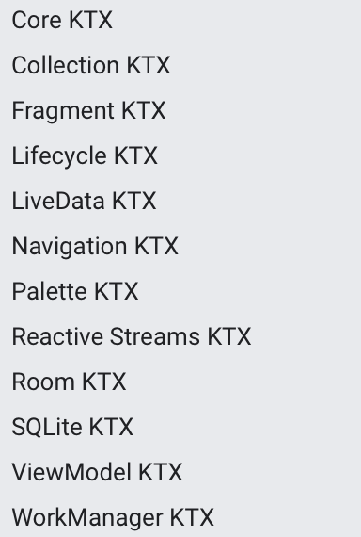
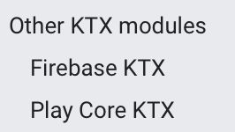
Android KTX Modules

Slide 21
Android KTX Modules

Slide 22
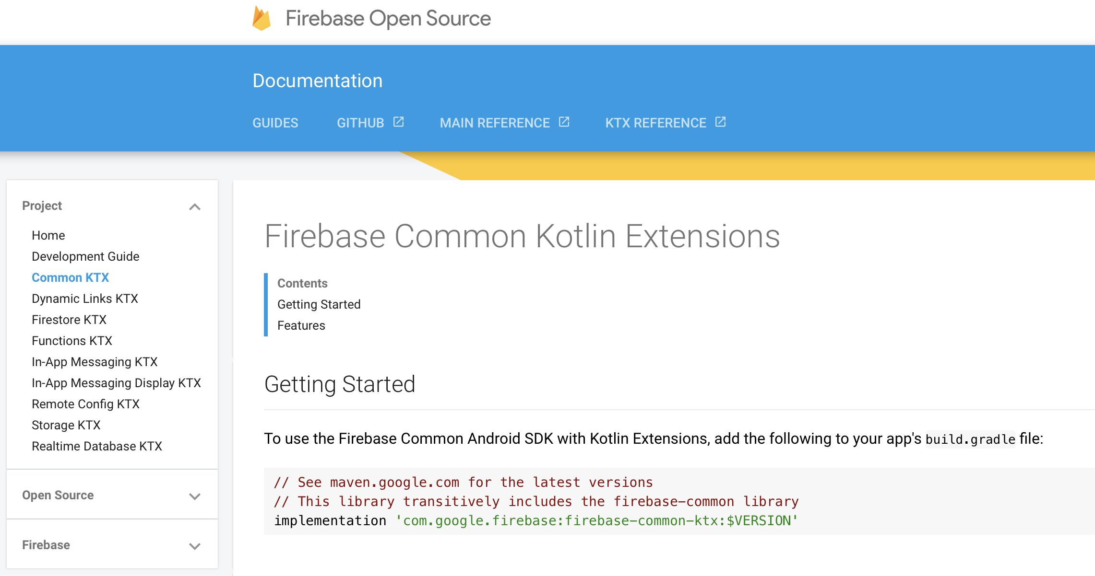

Slide 23
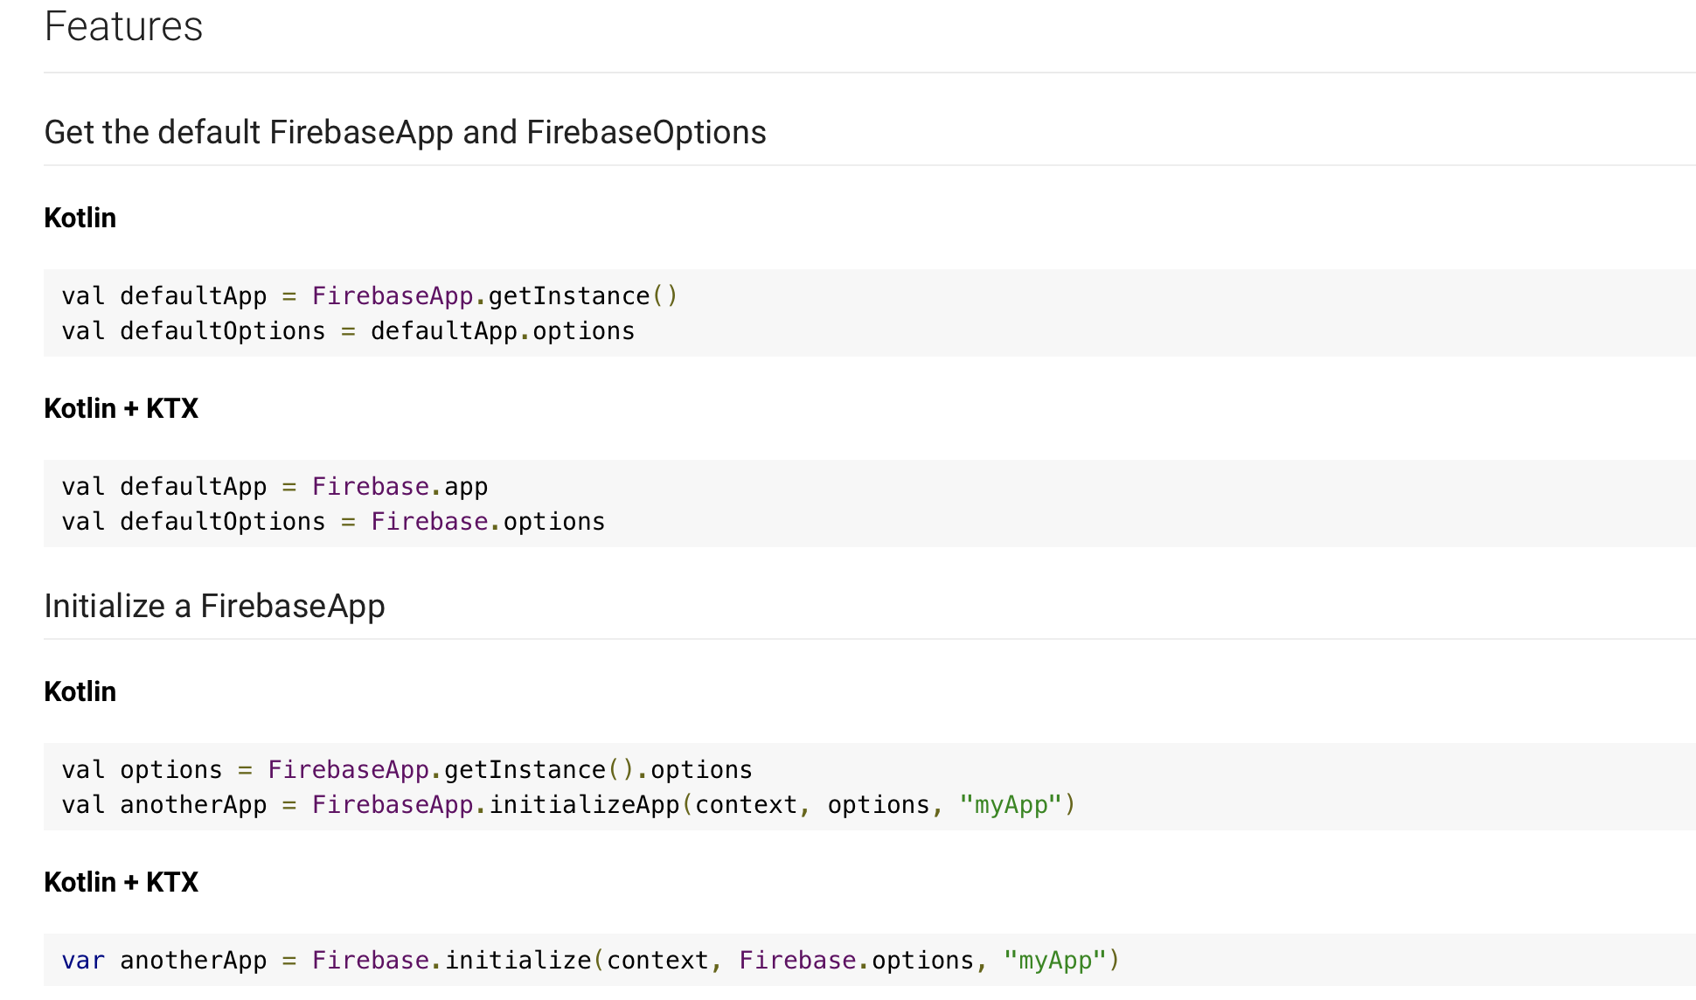

Slide 24
Agenda
Background
Extension Functions
The KTX Library Packages (Core, Fragment, Palette, SQLite, Collections)
KTX in our Case Study (Donation)

Slide 25
References
Sources: https://www.raywenderlich.com/5576-android-ktx-tutorial-getting-started
https://blog.mindorks.com/android-ktx-android-development-with-kotlin
https://developer.android.com/kotlin/ktx
https://codinginfinite.com/android-ktx-example-android-ktx-core-ktx/
https://ansgarlin.github.io/zh-tw/kotlin/kotlin_vs_ktx.html

Slide 26


