Slide 1
Mobile Application Development
David Drohan (ddrohan@wit.ie)

Slide 2
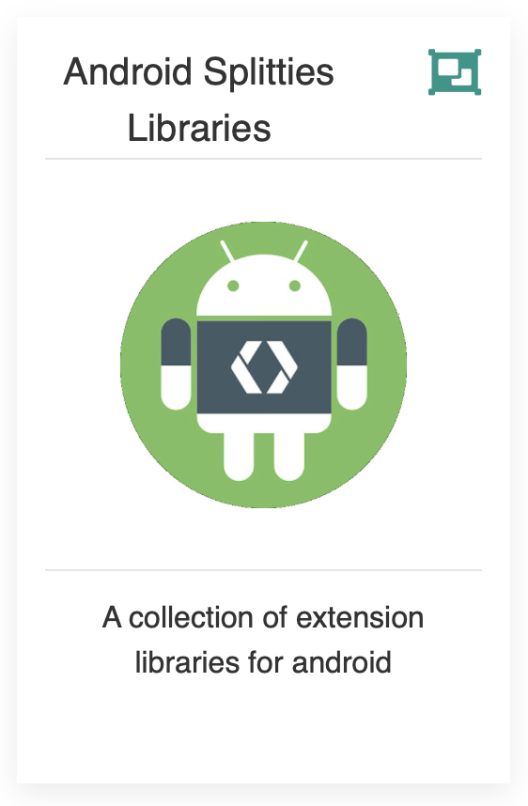
Introducing Android Splitties

Slide 3
Agenda
Background
Extension Functions
The Android Splitties Packages
KTX in our Case Study (Donation)

Slide 4
Agenda
Background
Extension Functions
The Android Splitties Packages
KTX in our Case Study (Donation)

Slide 5
What is it?
Splitties a collection of small Kotlin multiplatform libraries (with Android as first target)
intended to reduce the amount of code you have to write, so you can focus more on what you want to build for your users
named as such because it is split in small modules, distributed as independent libraries - add only the ones you need - helping reduce the size of the final binary download
Notes:
Very similar to Anko

Slide 6
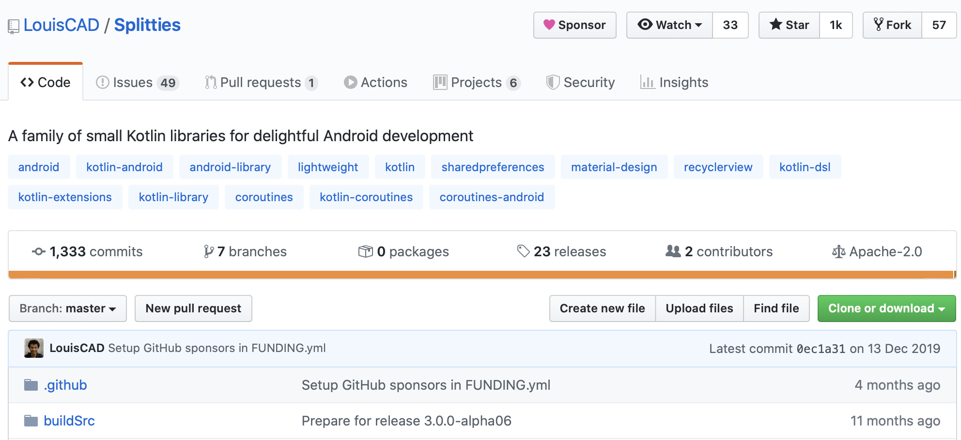
Official Docs (https://github.com/LouisCAD/Splitties)
Notes:
DSL – Domain Specific Language

Slide 7
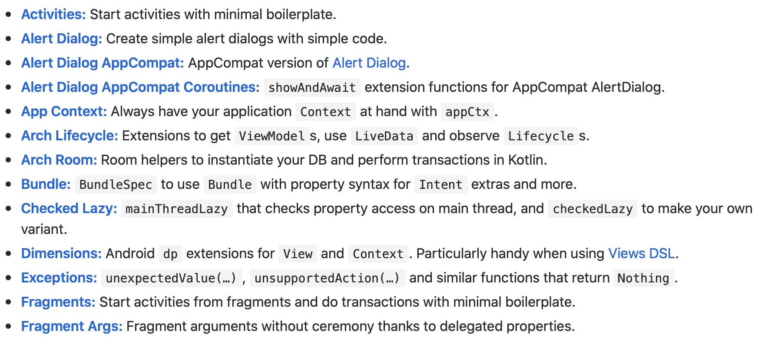
Official Docs (https://developer.android.com/kotlin/ktx)
Notes:
DSL – Domain Specific Language

Slide 8
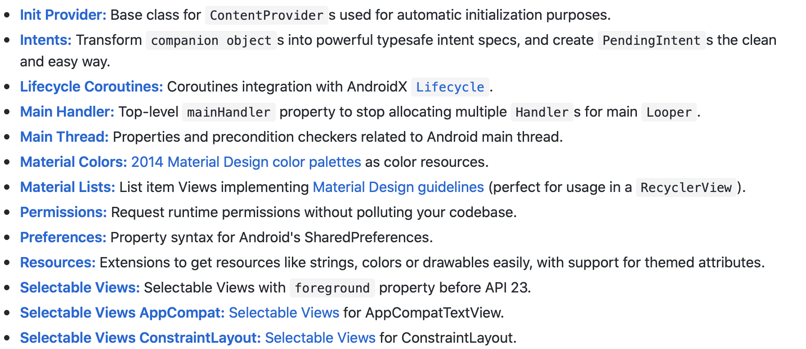
Official Docs (https://developer.android.com/kotlin/ktx)
Notes:
DSL – Domain Specific Language

Slide 9
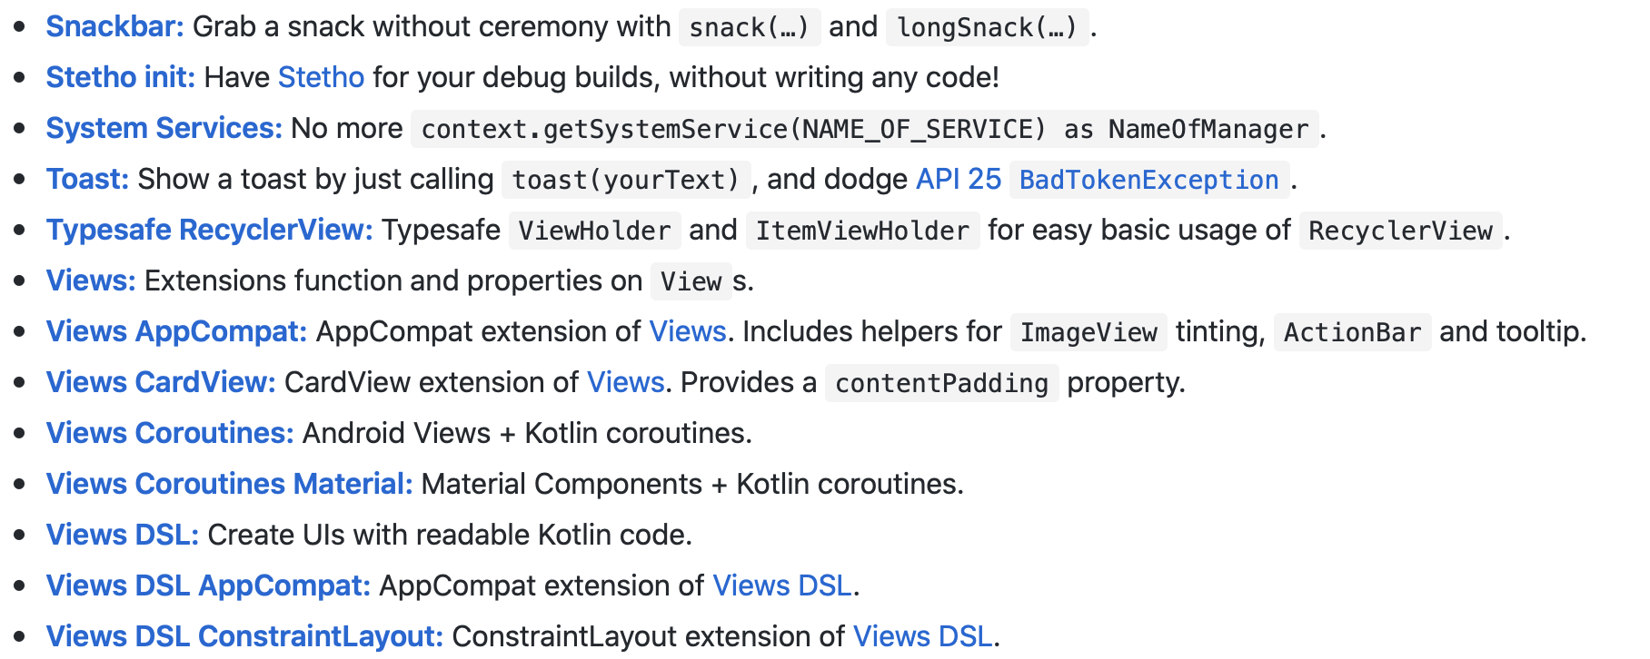
Official Docs (https://developer.android.com/kotlin/ktx)
Notes:
DSL – Domain Specific Language

Slide 10
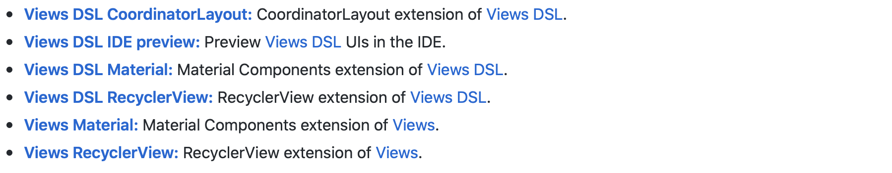
Official Docs (https://developer.android.com/kotlin/ktx)
Notes:
DSL – Domain Specific Language

Slide 11

Android Splitties
some examples…

Slide 12
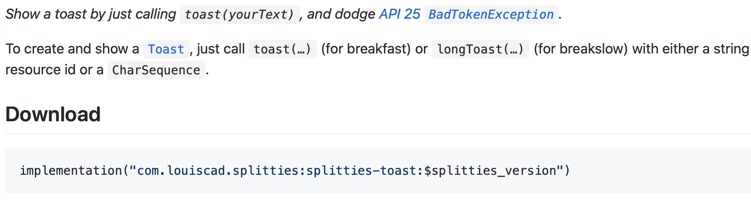
Toasts
Notes:
type arguments can’t be erased, or reified.

Slide 13
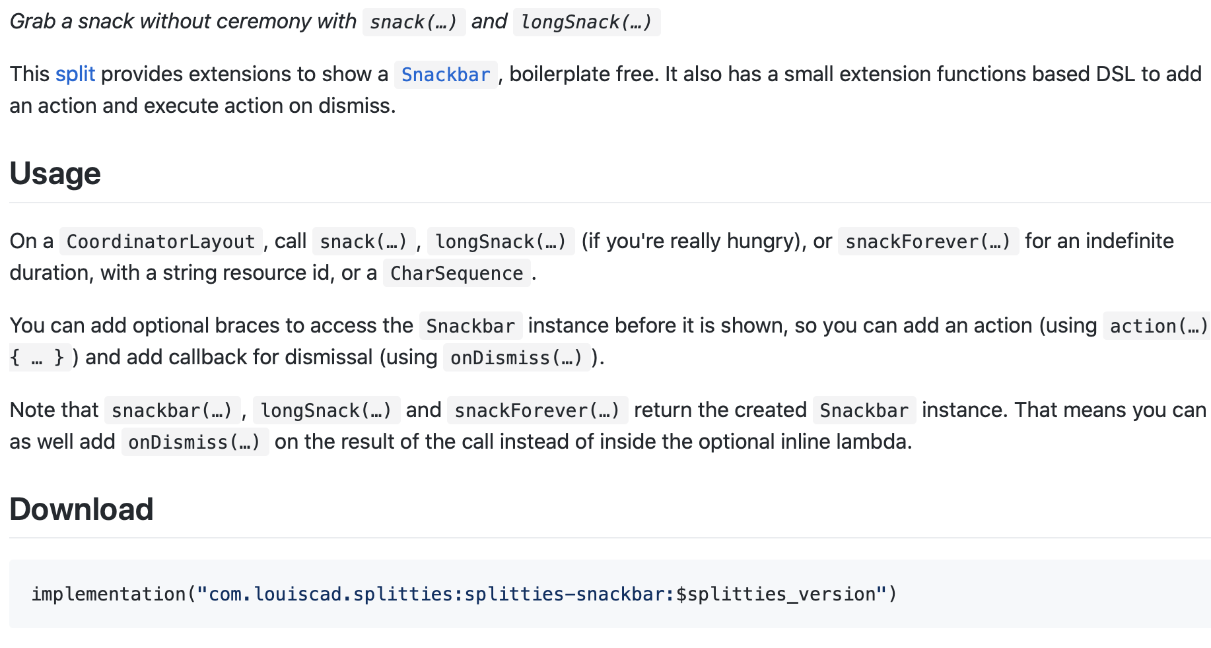
Snackbars
Notes:
type arguments can’t be erased, or reified.

Slide 14

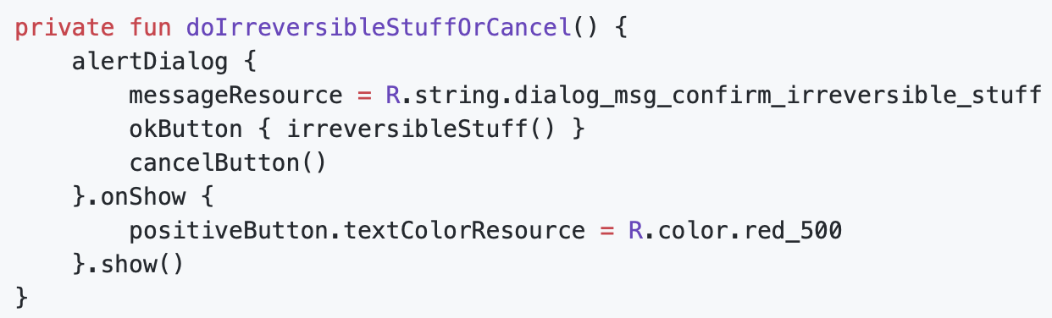
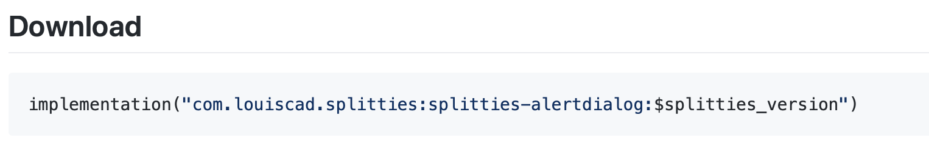
Alert Dialogs
Notes:
type arguments can’t be erased, or reified.

Slide 15
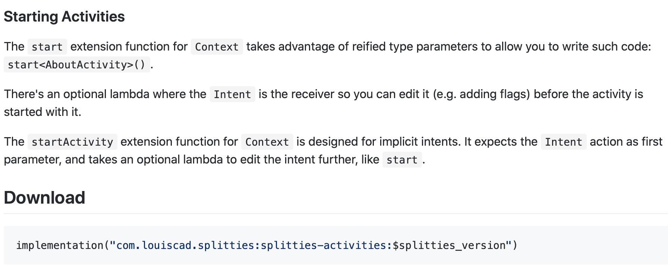
Activities
Notes:
type arguments can’t be erased, or reified.

Slide 16
Agenda
We’ll have a look at some examples in practice in Donation in the next section

Slide 17
References
Sources: https://github.com/LouisCAD/Splitties

Slide 18


