Slide 1
Mobile Application Development
David Drohan (ddrohan@wit.ie)

Slide 2
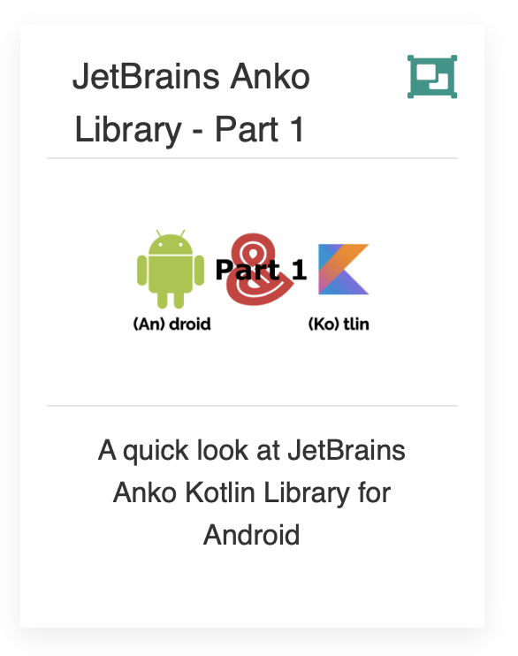
Introducing JetBrains Anko Library

Slide 3
Agenda
Background
Extension Functions
The Anko Library Components (Commons, Layouts, SQLite, Coroutines)
Anko in our Case Study (Donation)

Slide 4
Agenda
Background
Extension Functions
The Anko Library Components (Commons, Layouts, SQLite, Coroutines)
Anko in our Case Study (Donation)

Slide 5
Background
Anko is a library for Android developers that want to achieve more while writing less.
It simplifies common tasks that are tedious and generate a lot of boilerplate, making your code a lot easier to read and keeps it concise and clean
The folks at JetBrains, (creators of Kotlin & IntelliJ) have created and continue to maintain Anko

Slide 6
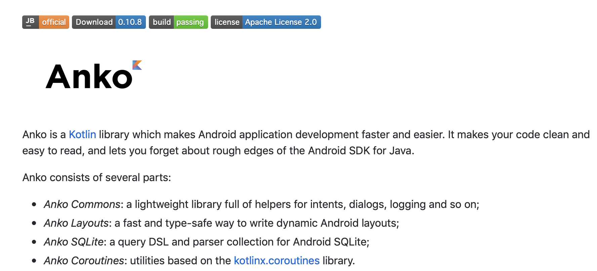
Background (https://github.com/Kotlin/anko)
Notes:
DSL – Domain Specific Language

Slide 7
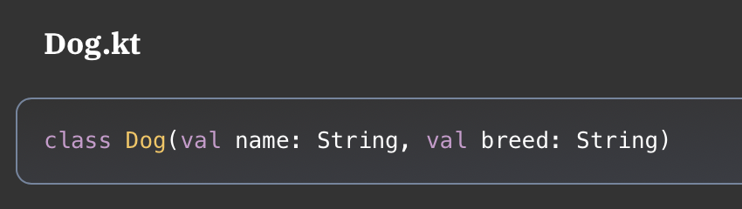
Extension Functions
To understand how Anko works, you need to understand Kotlin Extension Functions. They allow you to add a function to an existing class without modifying the class.
For example, say you had a Dog class:

Slide 8
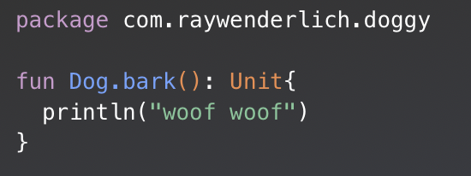
Extension Functions
In another Kotlin file you could add a function to Dog without modifying the original file:
To create the extension function, after fun type the class, then a dot, then the name of the extension function.

Slide 9
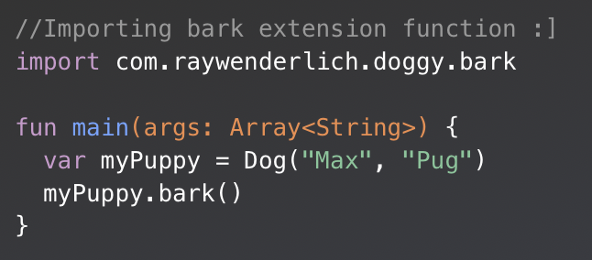
Extension Functions
You could test your extension function in another file as follows:
To use the extension function, you only import bark, and then every Dog object will be able to use the bark() function.
Notes:
Note: If you don’t import the extension function, you won’t be able to use it, because it won’t be visible in your code., and you’ll get a compiler error

Slide 10

Anko Commons
helpers for intents, dialogs, logging;

Slide 11
Anko Commons
Anko Commons is a "toolbox" for Kotlin Android developers
The library contains a lot of helpers for the Android SDK, including, but not limited to:
Intents
Dialogs and toasts
Logging
Resources and dimensions

Slide 12
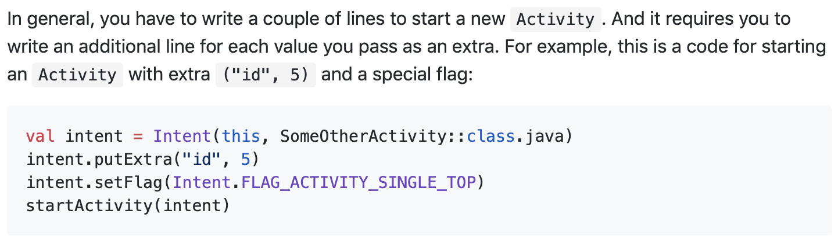
Anko Commons - Intents

Slide 13
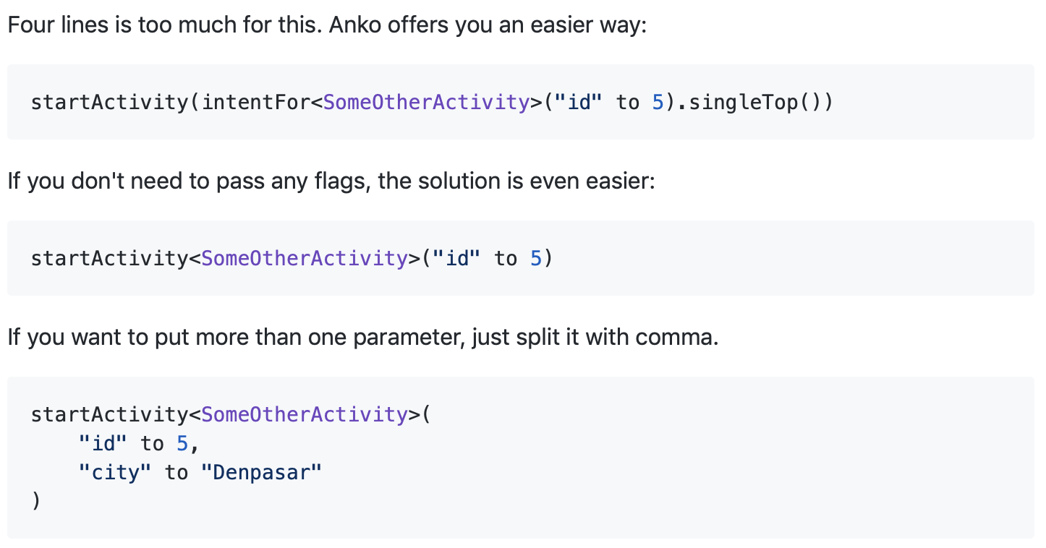
Anko Commons - Intents

Slide 14
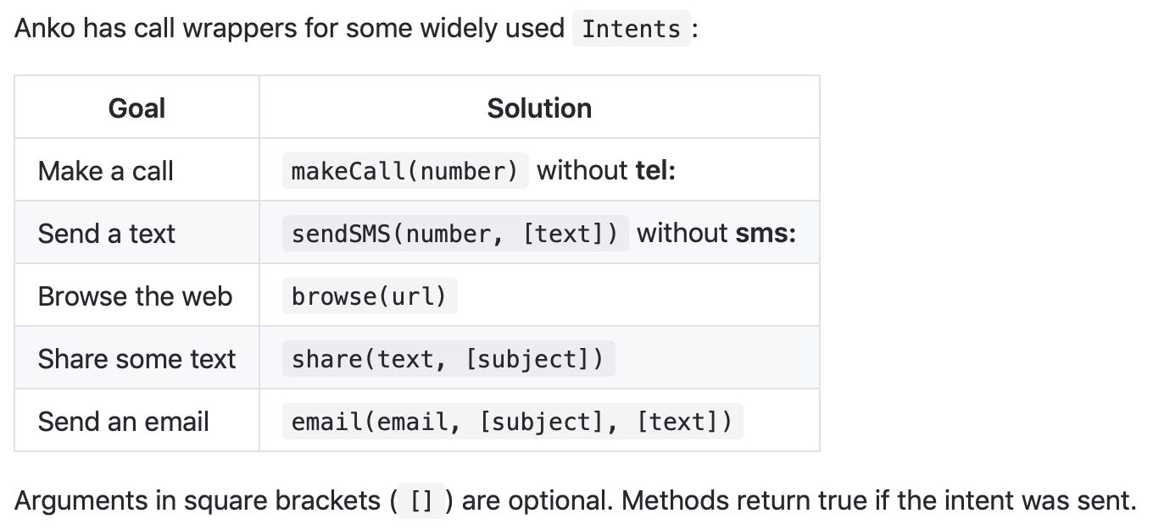
Anko Commons – Useful Intent Callers

Slide 15
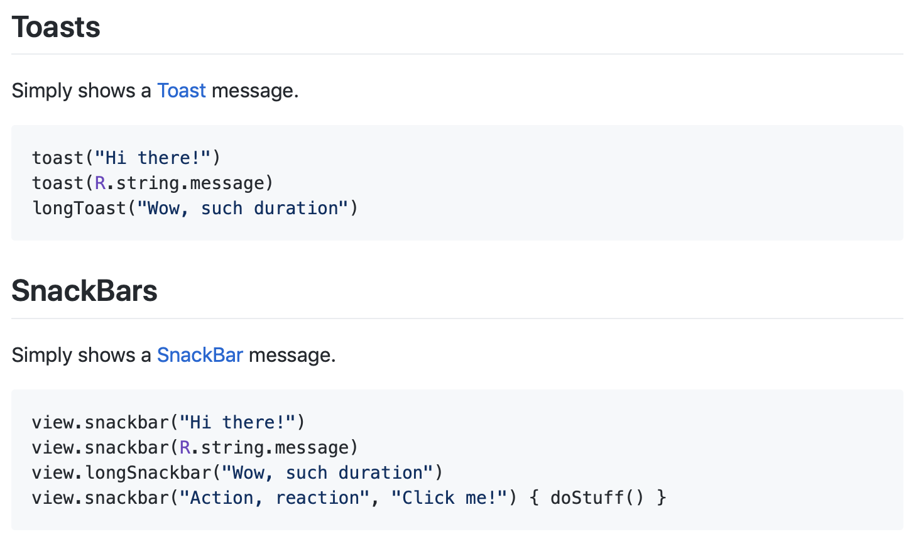
Anko Commons – Dialogs & Toasts

Slide 16
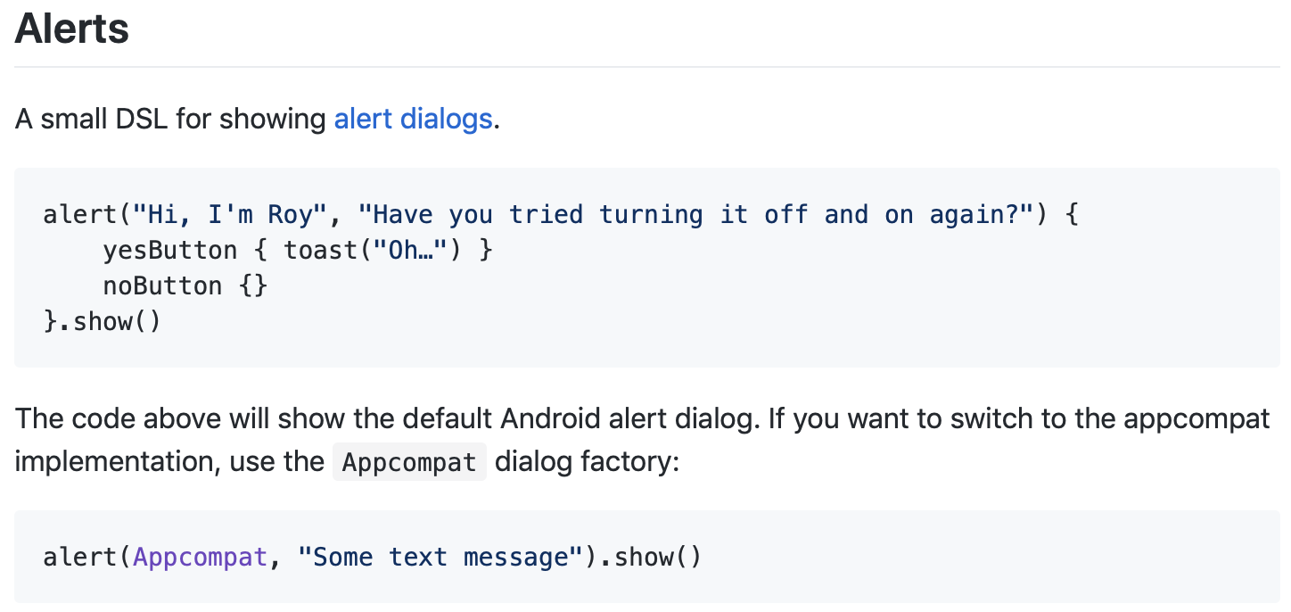
Anko Commons – Dialogs & Toasts
Notes:
˘Android and Appcompat dialog factories are included by default, but you can create your custom factories by implementing the AlertBuilderFactory interface.

Slide 17
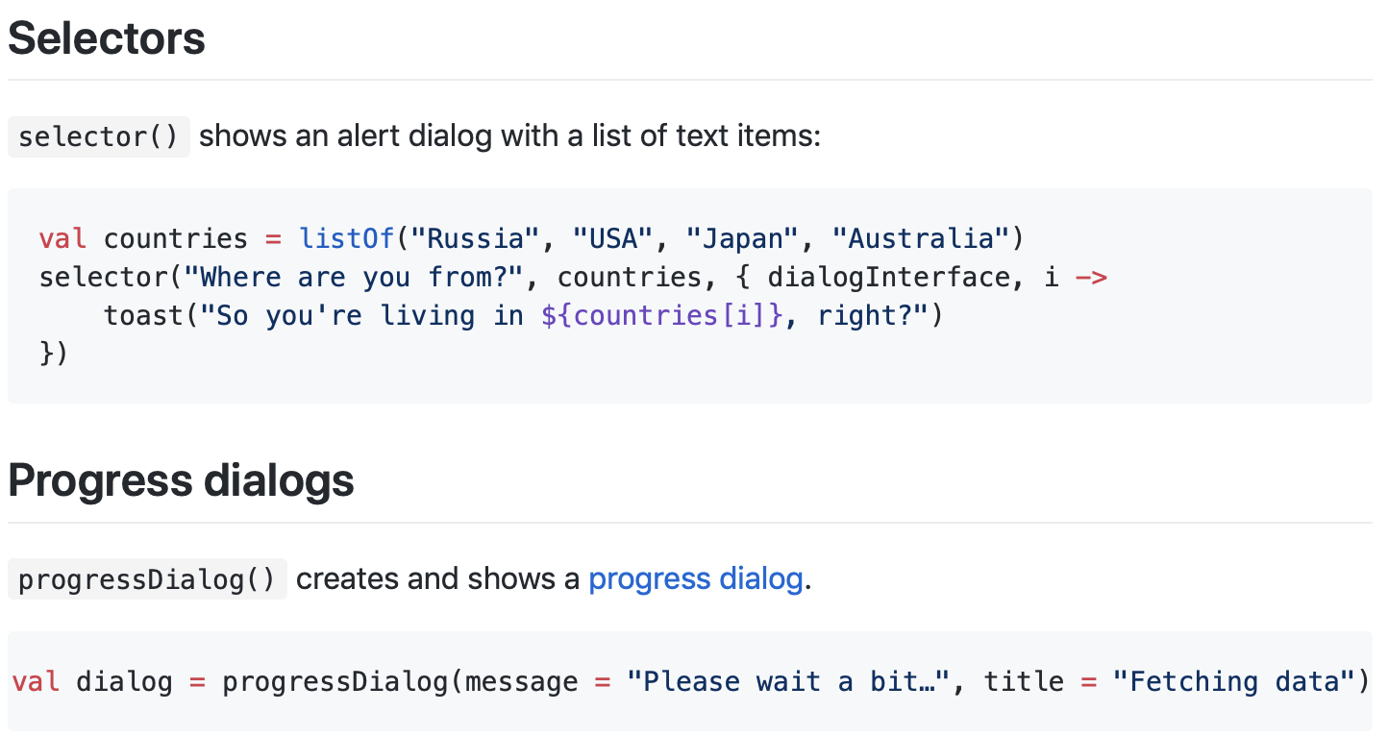
Anko Commons – Dialogs & Toasts

Slide 18
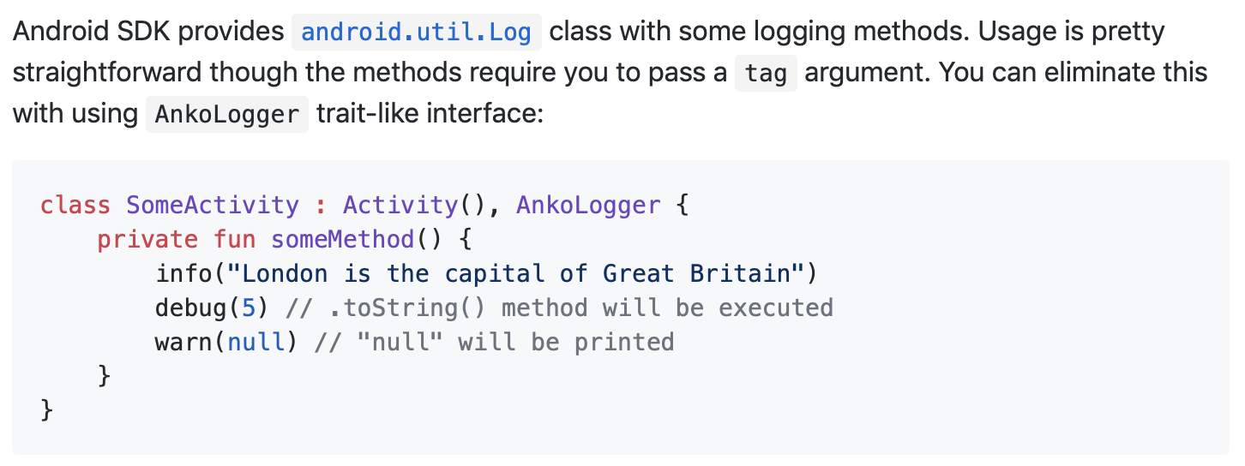
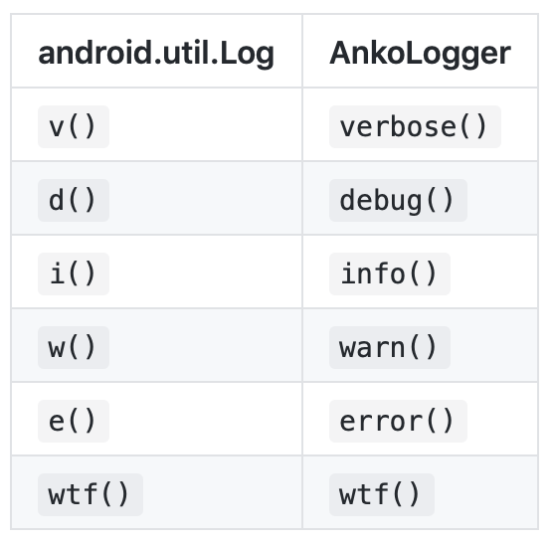
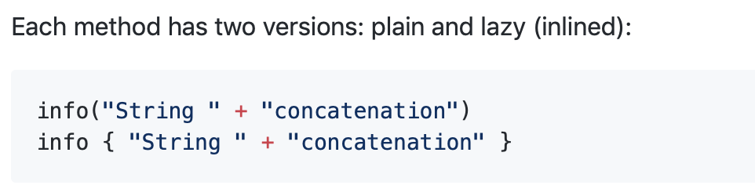
Anko Commons – Logging with AnkoLogger

Slide 19
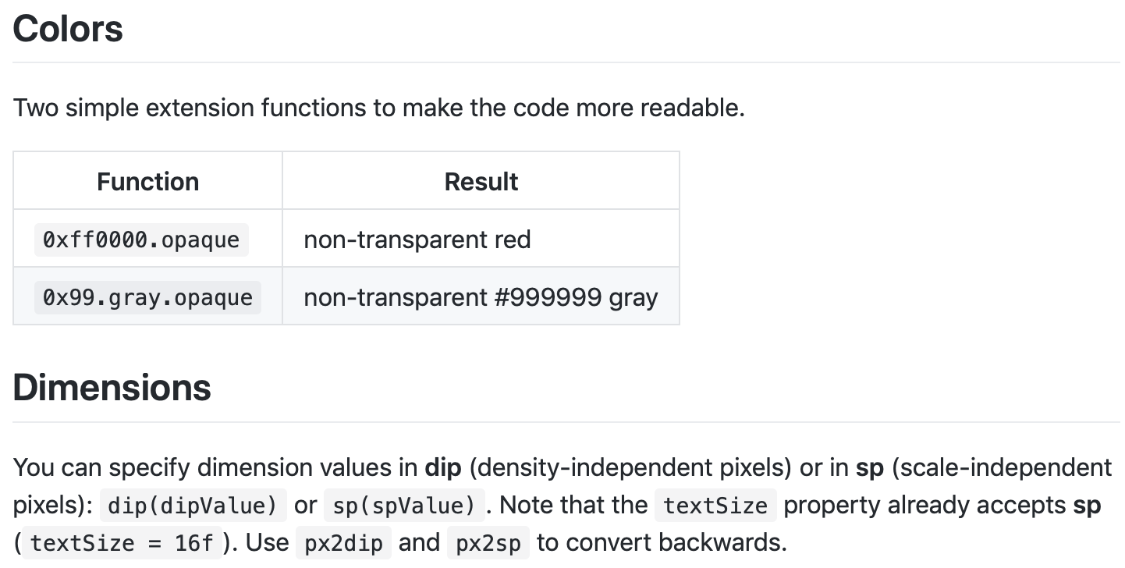
Anko Commons – Resources & Dimensions

Slide 20

References
Sources: https://github.com/Kotlin/anko
https://adorahack.com/introduction-to-anko

Slide 21


