Slide 1
Mobile Application Development
David Drohan (ddrohan@wit.ie)

Slide 2
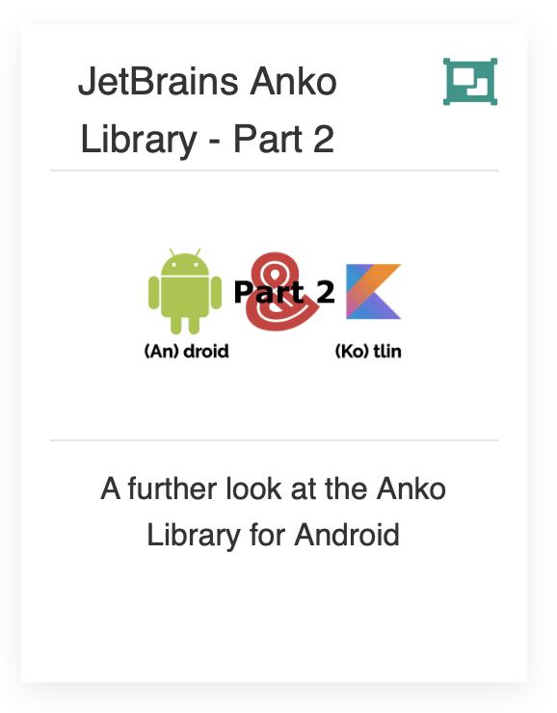
Introducing JetBrains Anko Library

Slide 3
Agenda
Background
Extension Functions
The Anko Library Components
Anko Commons
Anko Layouts
Anko SQLite
Anko Coroutines
Anko in our Case Study (Donation)

Slide 4
Agenda
Background
Extension Functions
The Anko Library Components
Anko Commons
Anko Layouts
Anko SQLite
Anko Coroutines
Anko in our Case Study (Donation)

Slide 5
Background Recap
Anko is a library for Android developers that want to achieve more while writing less.
It simplifies common tasks that are tedious and generate a lot of boilerplate, making your code a lot easier to read and keeps it concise and clean
Created and maintained by JetBrains

Slide 6

Anko Layouts
create type-safe Android layouts

Slide 7
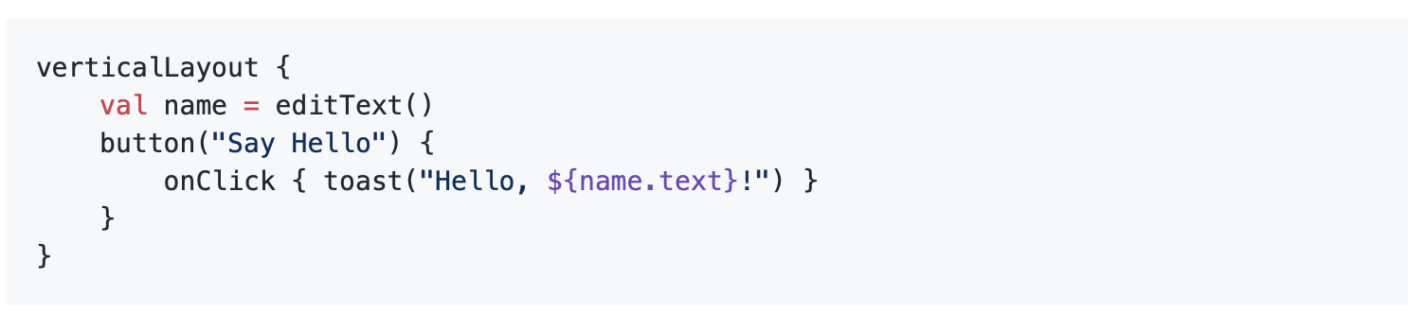

Anko Layouts – What is it?
Anko Layouts is a DSL for writing dynamic Android layouts. Here is a simple UI written with Anko DSL:
Notes:
DSL – Domain Specific Language Note that this is the complete layout code. No XML is required!

Slide 8
Anko Layouts – What is it?
The code previous creates a button inside a LinearLayout and attaches an OnClickListener to that button.
Moreover, onClick accepts a suspend lambda, so you can write your asynchronous code right inside the listener.
There is also a plugin for Android Studio that supports previewing Anko DSL layouts.
Notes:
Note that this is the complete layout code. No XML is required!

Slide 9
Anko Layouts – Why? (and why a DSL?)
By default, UI in Android is written using XML. That is inconvenient in the following ways:
It is not type-safe;
It is not null-safe;
It forces you to write almost the same code for every layout you make;
XML is parsed on the device wasting CPU time and battery;
Most of all, it allows no code reuse.
While you can create UI programmatically, it's hardly ever done because it’s messy and hard to maintain. Here's a plain Kotlin version (Java’s is even longer):

Slide 10
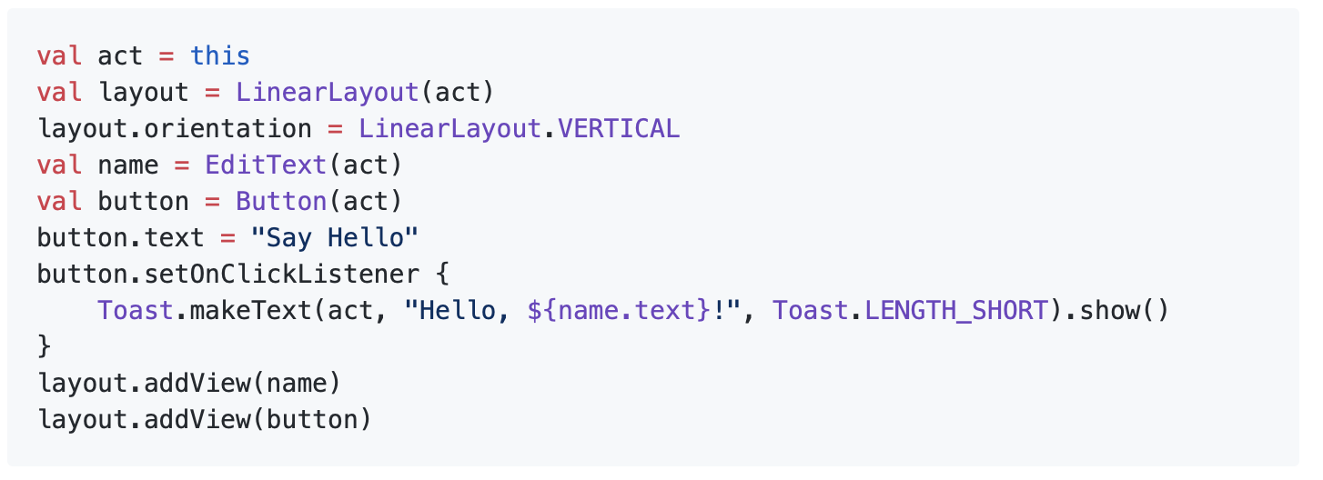
Anko Layouts – Why? (and why a DSL?)

Slide 11
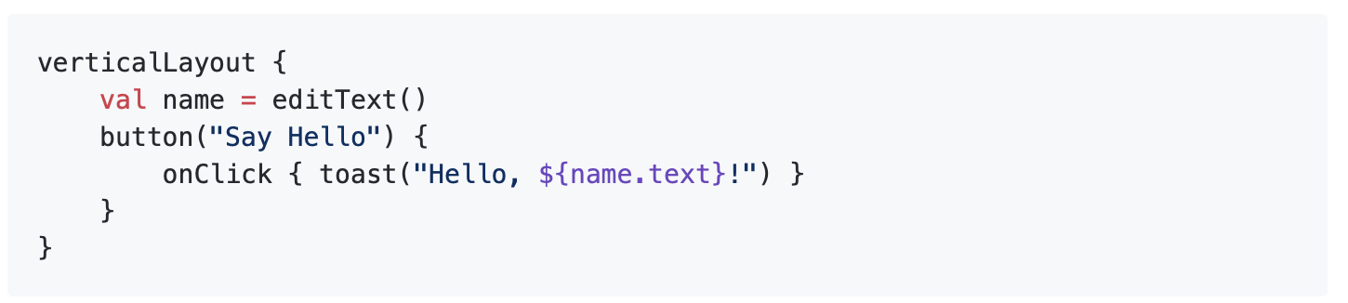
Anko Layouts – Why? (and why a DSL?)
A DSL makes the same logic easy to read, easy to write and there is no runtime overhead. Here it is again:
As previously mentioned, onClick() supports coroutines (accepts suspending lambda) so you can write your asynchronous code without an explicit async(UI) call.

Slide 12
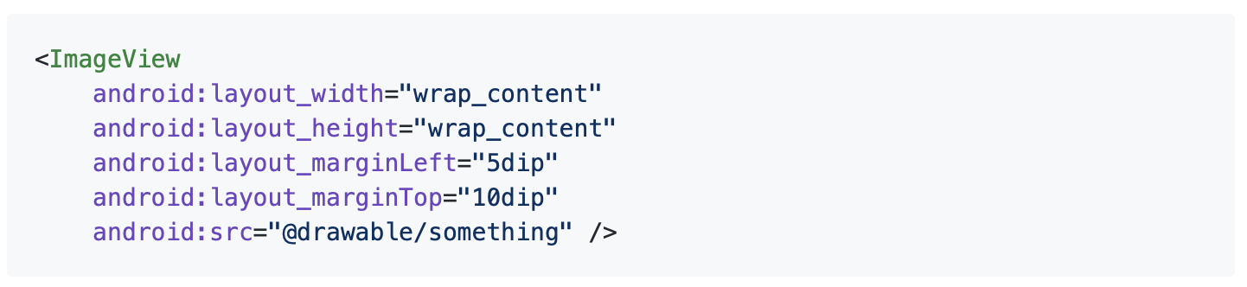
Anko Layouts – LayoutParams
The positioning of widgets inside parent containers can be tweaked using LayoutParams. In XML it looks like this:
In Anko, you specify LayoutParams right after a View description using lparams()

Slide 13
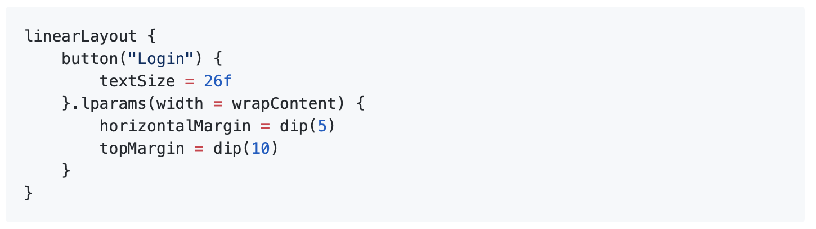
Anko Layouts – LayoutParams
If you specify lparams(), but omit width and/or height, their default values are both wrapContent.
Notes:
But you always can pass them explicitly: use named arguments.
Now there’s a lot more to Anko Layouts but it’s defo worth being aware of this library component.

Slide 14
Anko SQLite
helpers for working with Android SQLite;

Slide 15
Anko SQLite
If you’ve ever tried to parse SQLite query results using Android cursors, you would have had to write lots of boilerplate code just to parse query result rows, and enclose it in countless try..finally blocks to properly close all opened resources.
You would use SQLiteOpenHelper, and call getReadableDatabase() or getWritableDatabase()
Anko provides lots of extension functions to simplify working with SQLite databases.
Notes:
All this is pretty tough. That is why Android developers are not really keen on default SQLite API and prefer to use fairly expensive wrappers such as ORMs instead.

Slide 16
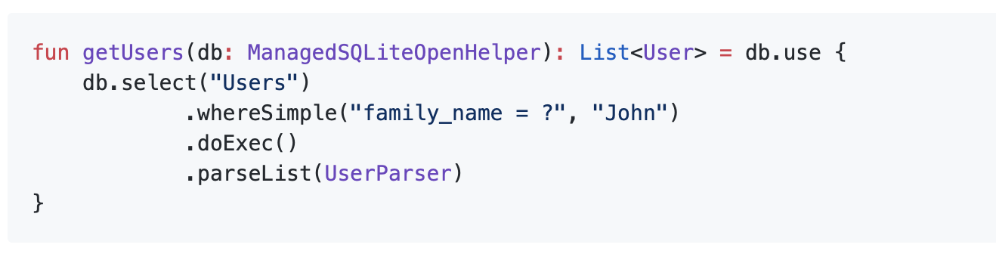
Anko SQLite
Anko provides a special class ManagedSQLiteOpenHelper that seamlessly replaces the default one
Instead of enclosing your code in lots of try blocks, you can just write databasereference.use { }

Slide 17
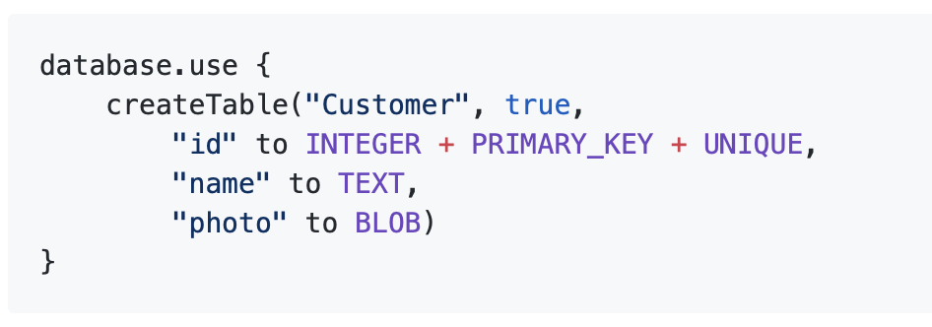
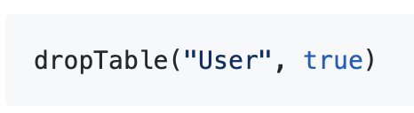
Anko SQLite – Creating and dropping tables
With Anko you can easily create new tables and drop existing ones. The syntax is straightforward.
and

Slide 18
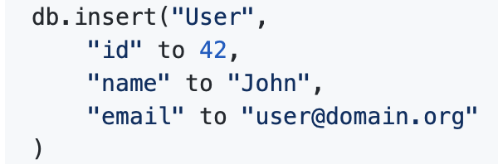
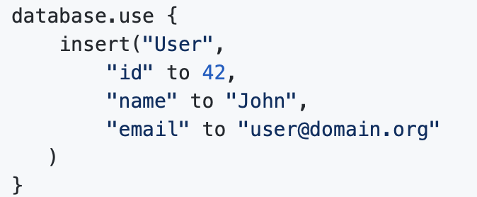
Anko SQLite – Inserting Data
Usually, you need a ContentValues instance to insert a row into the table, Anko has a simple insert function
or
Notes:
passing values directly as arguments for the insert() function:

Slide 19
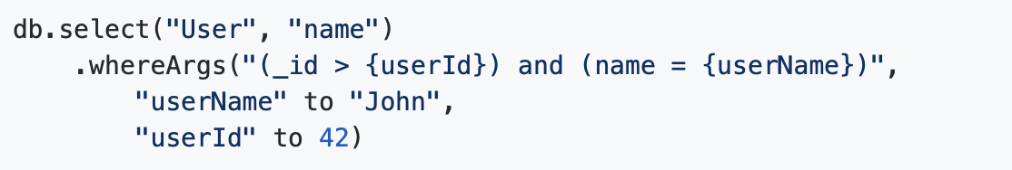
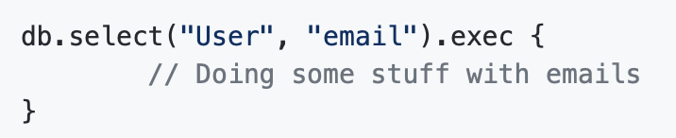
Anko SQLite – Querying Data
Anko provides a convenient query builder. It may be created with db.select(tableName, vararg columns)
and
Notes:
Here, {userId} part will be replaced with 42 and {userName} — with 'John’

Slide 20
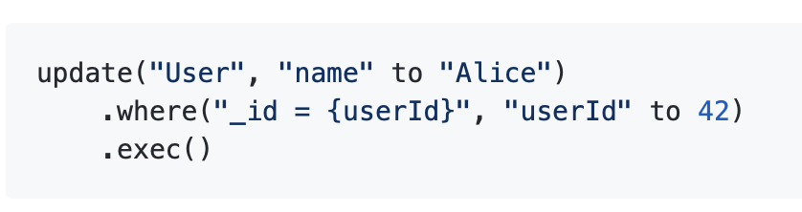
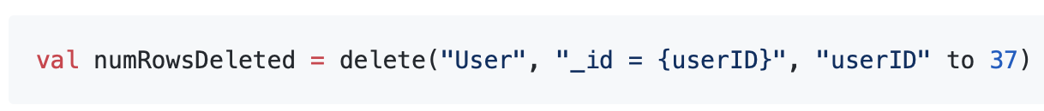
Anko SQLite – Updating/Deleting Data
and
Notes:
Again, a lot more to this, so check out the online resources for more examples

Slide 21
Anko Coroutines
utilities for using Kotlin coroutins.

Slide 22
Anko Coroutines
Anko Coroutines is based on the kotlinx.coroutines library and provides:
bg() function that executes your code in a common pool.
asReference() function which creates a weak reference wrapper. By default, a coroutine holds references to captured objects until it is finished or canceled. If your asynchronous framework does not support cancellation, the values you use inside the asynchronous block can be leaked. asReference() protects you from this.
doAsync() let us run codes asynchronously or in the background.
Notes:
It’s work noting the bg function is deprecated, as well as Anko's doAsync function

Slide 23
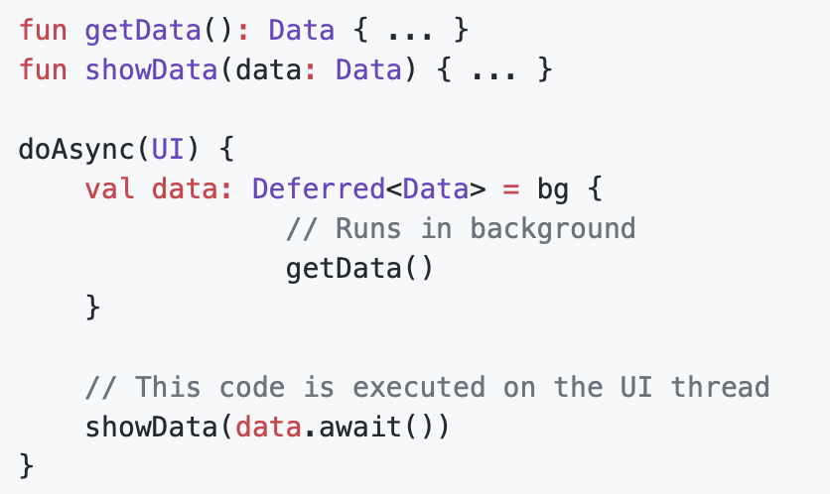
Anko Coroutines

Slide 24
Summary
Anko is a Kotlin library which makes Android application development faster and easier
It consists of several parts:
Anko Commons: a lightweight library full of helpers for intents, dialogs, logging and so on;
Anko Layouts: a fast and type-safe way to write dynamic Android layouts;
Anko SQLite: a query DSL and parser collection for Android SQLite;
Anko Coroutines: utilities based on the kotlinx.coroutines library.
Notes:
Concurrency means executing multiple tasks at the same time but not necessarily simultaneously
Parallelism means performing two or more tasks simultaneously

Slide 25

References
Sources: https://github.com/Kotlin/anko
https://adorahack.com/introduction-to-anko

Slide 26


