Slide 1
Mobile Application Development
David Drohan (ddrohan@wit.ie)

Slide 2
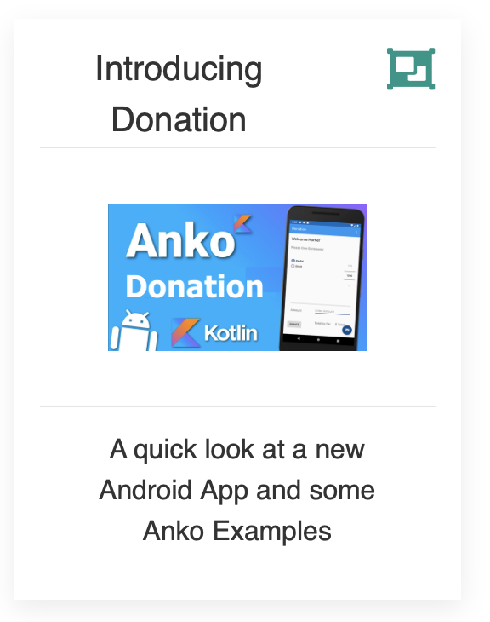
Anko in Donation

Slide 3
Agenda
Background
Extension Functions
The Anko Library Components
Anko Commons
Anko Layouts
Anko SQLite
Anko Coroutines
Anko in our Case Study (Donation)

Slide 4
Agenda
Background
Extension Functions
The Anko Library Components
Anko Commons
Anko Layouts
Anko SQLite
Anko Coroutines
Anko in our Case Study (Donation)

Slide 5

Donation
Let’s get Homer Elected!

Slide 6
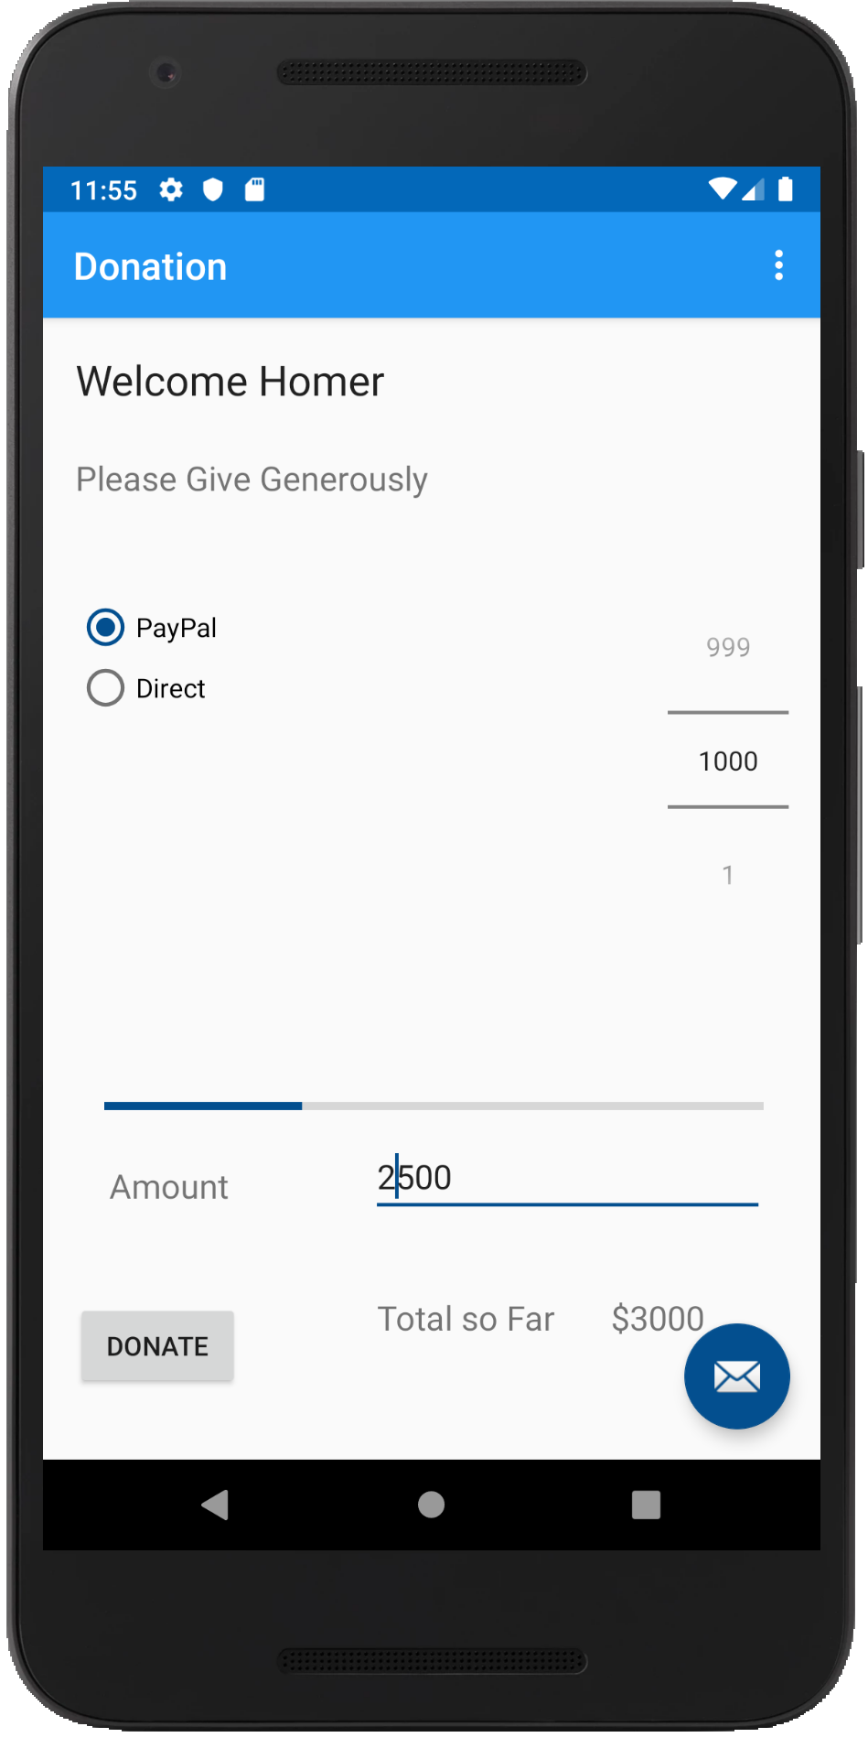
Introduction – What is Donation?
An Android App to keep track of donations made to ‘Homers Presidential Campaign ’.
App Features
Accept donation via number picker or typed amount
Keep a running total of donations
Display report on donation amounts and types
Display running total on progress bar

Slide 7
Donate Screen
This is the main (launch) screen
Single Activity
Welcome message
Multiple Widgets
NumberPicker
RadioButtons
Button
ProgressBar
EditText etc.

Slide 8
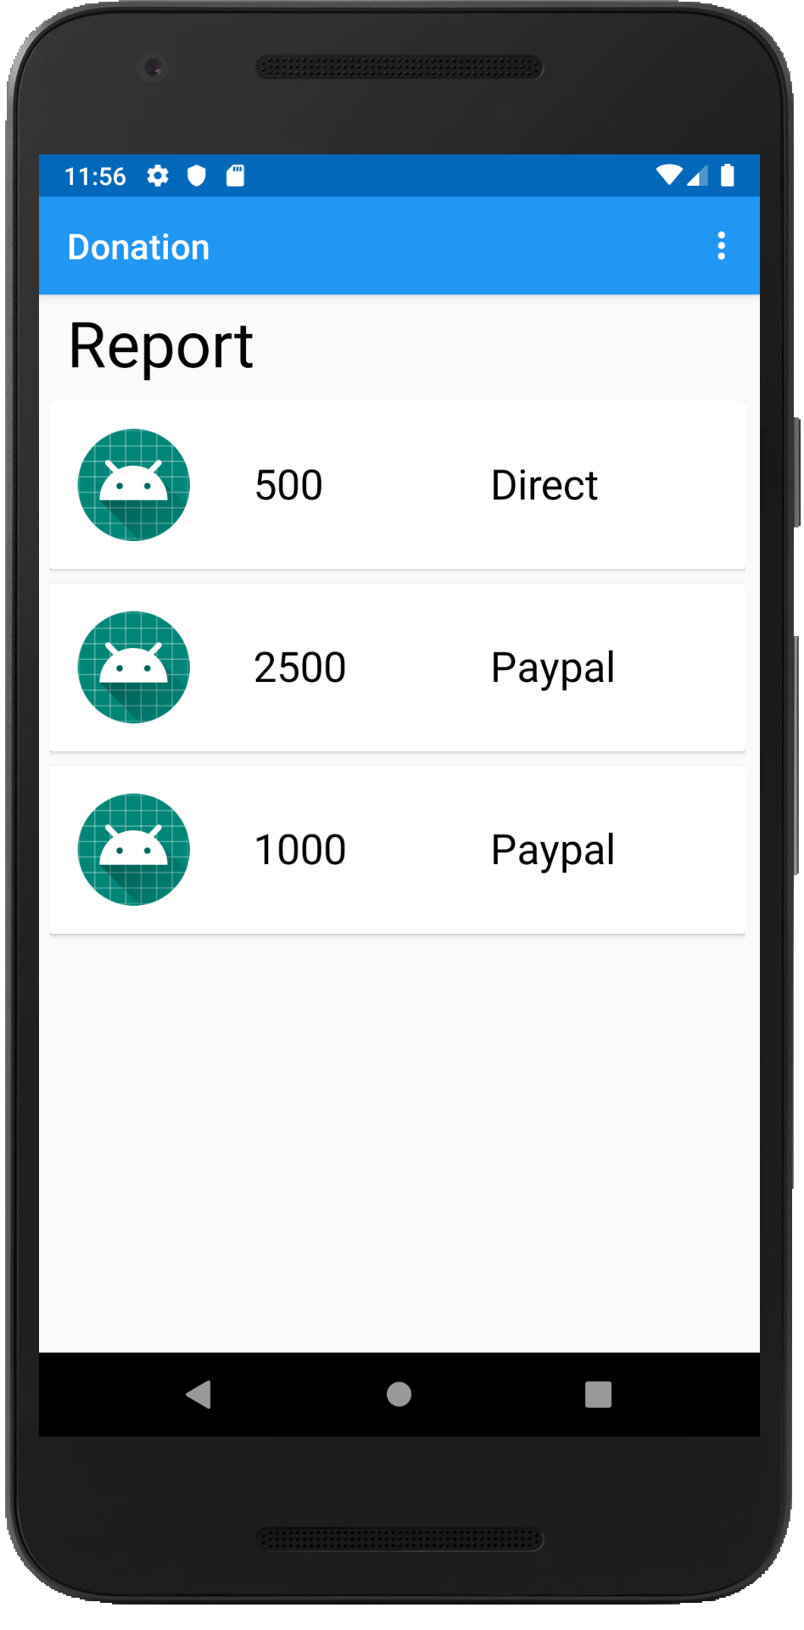
Report Screen
Single Activity:
1 TextView
1 RecyclerView
amount donated
payment type
placeholder for photo

Slide 9
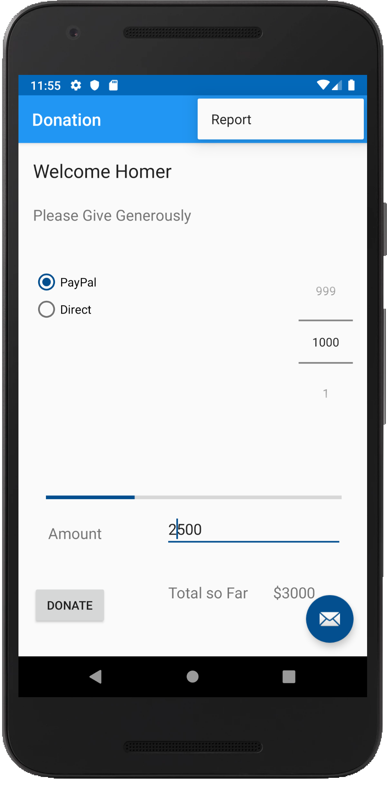
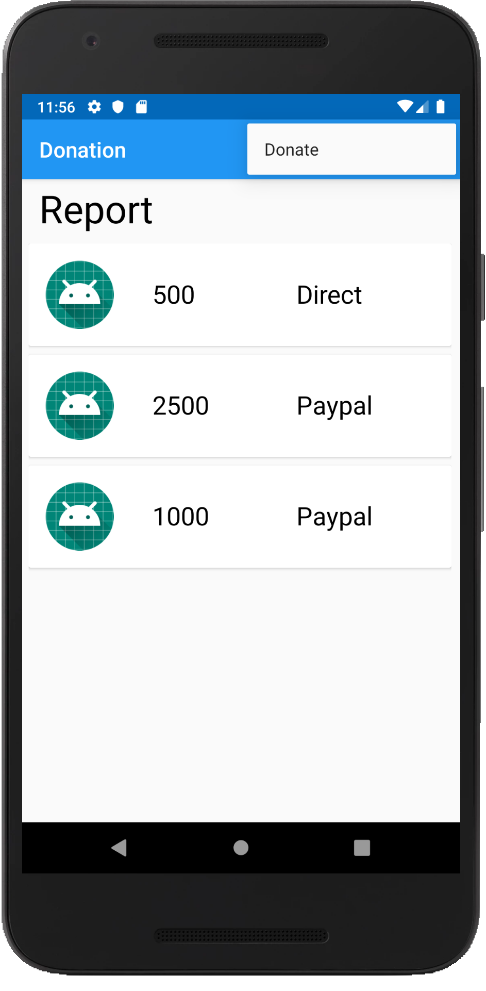
Action Bar / Menus
App has an action bar with:
Menu options to navigate between activities.
Overflow option can display other Menu Options

Slide 10
DonationAnko
intents, dialogs, logging;

Slide 11
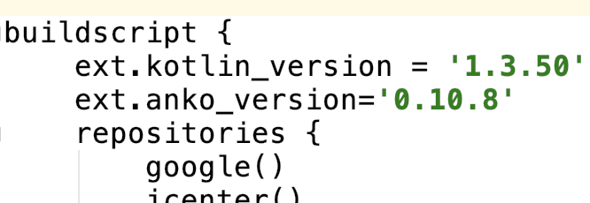
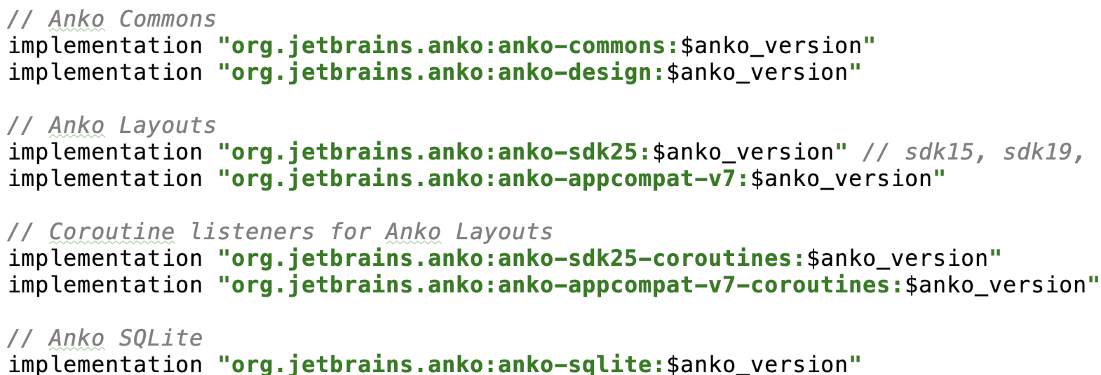
Anko Dependencies

Slide 12
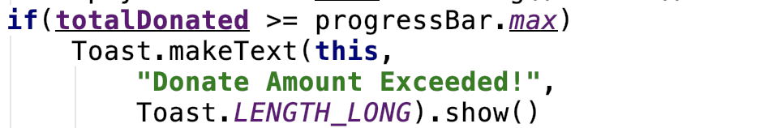
Anko Usage - Toast
Before Anko
After

Slide 13
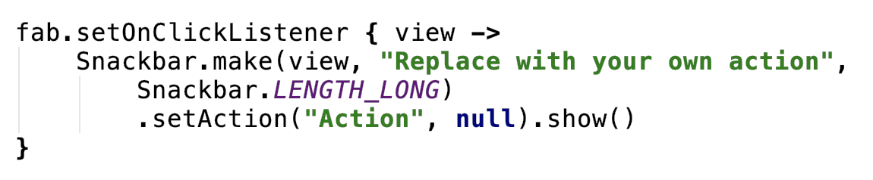
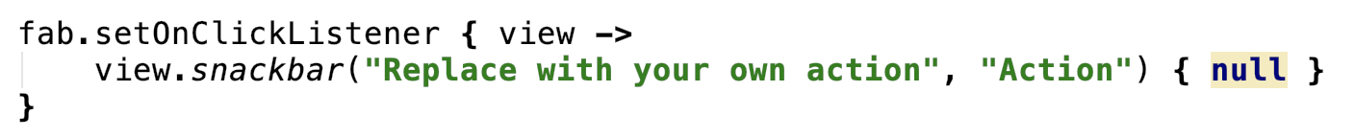
Anko Usage - Snackbar
Before Anko
After

Slide 14
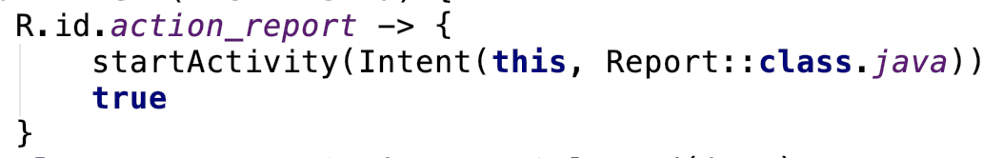
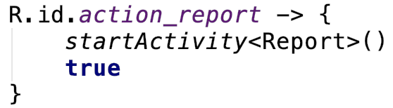
Anko Usage - Intents
Before Anko
After

Slide 15
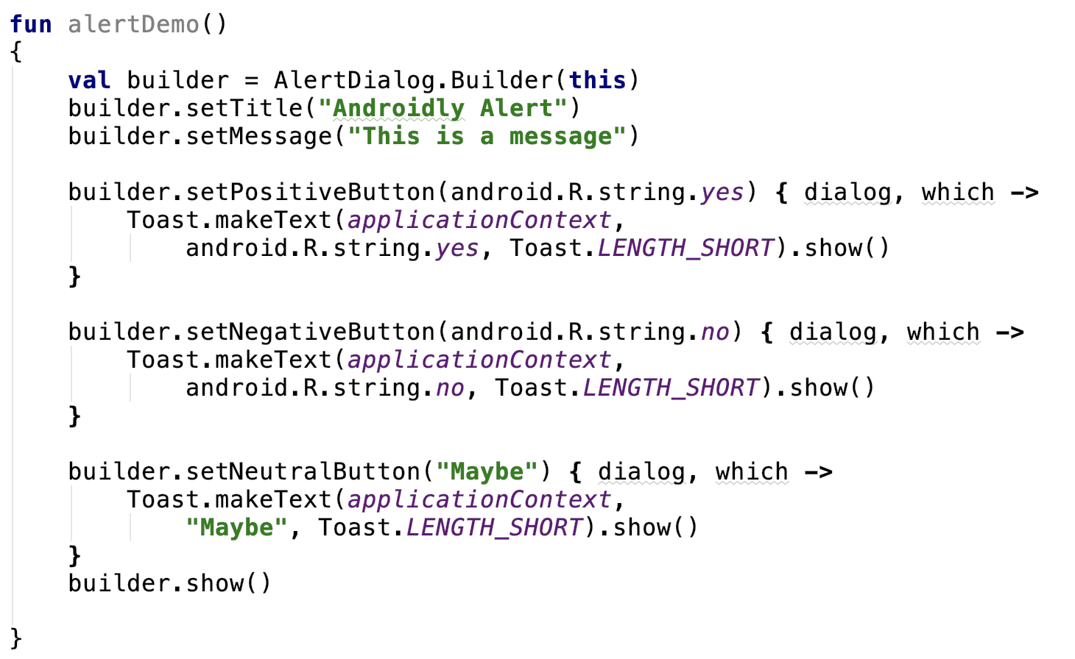
Anko Usage – Alerts (Before)

Slide 16
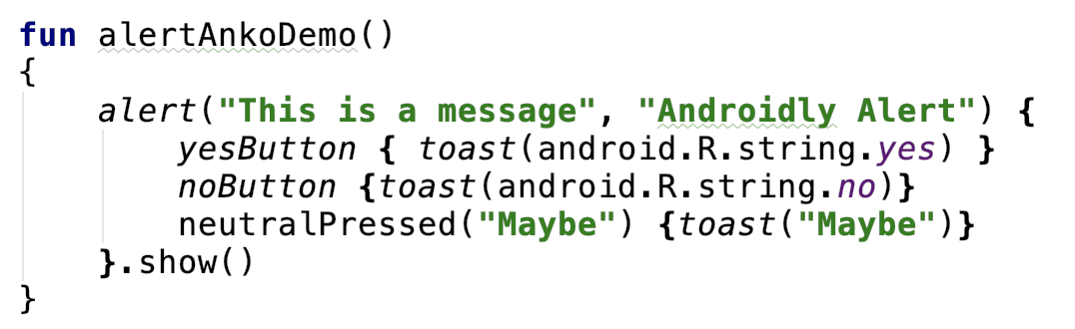
Anko Usage – Alerts (After)

Slide 17

References
Sources: https://github.com/Kotlin/anko
https://adorahack.com/introduction-to-anko

Slide 18


