Slide 1
Mobile Application Development
David Drohan (ddrohan@wit.ie)

Slide 2
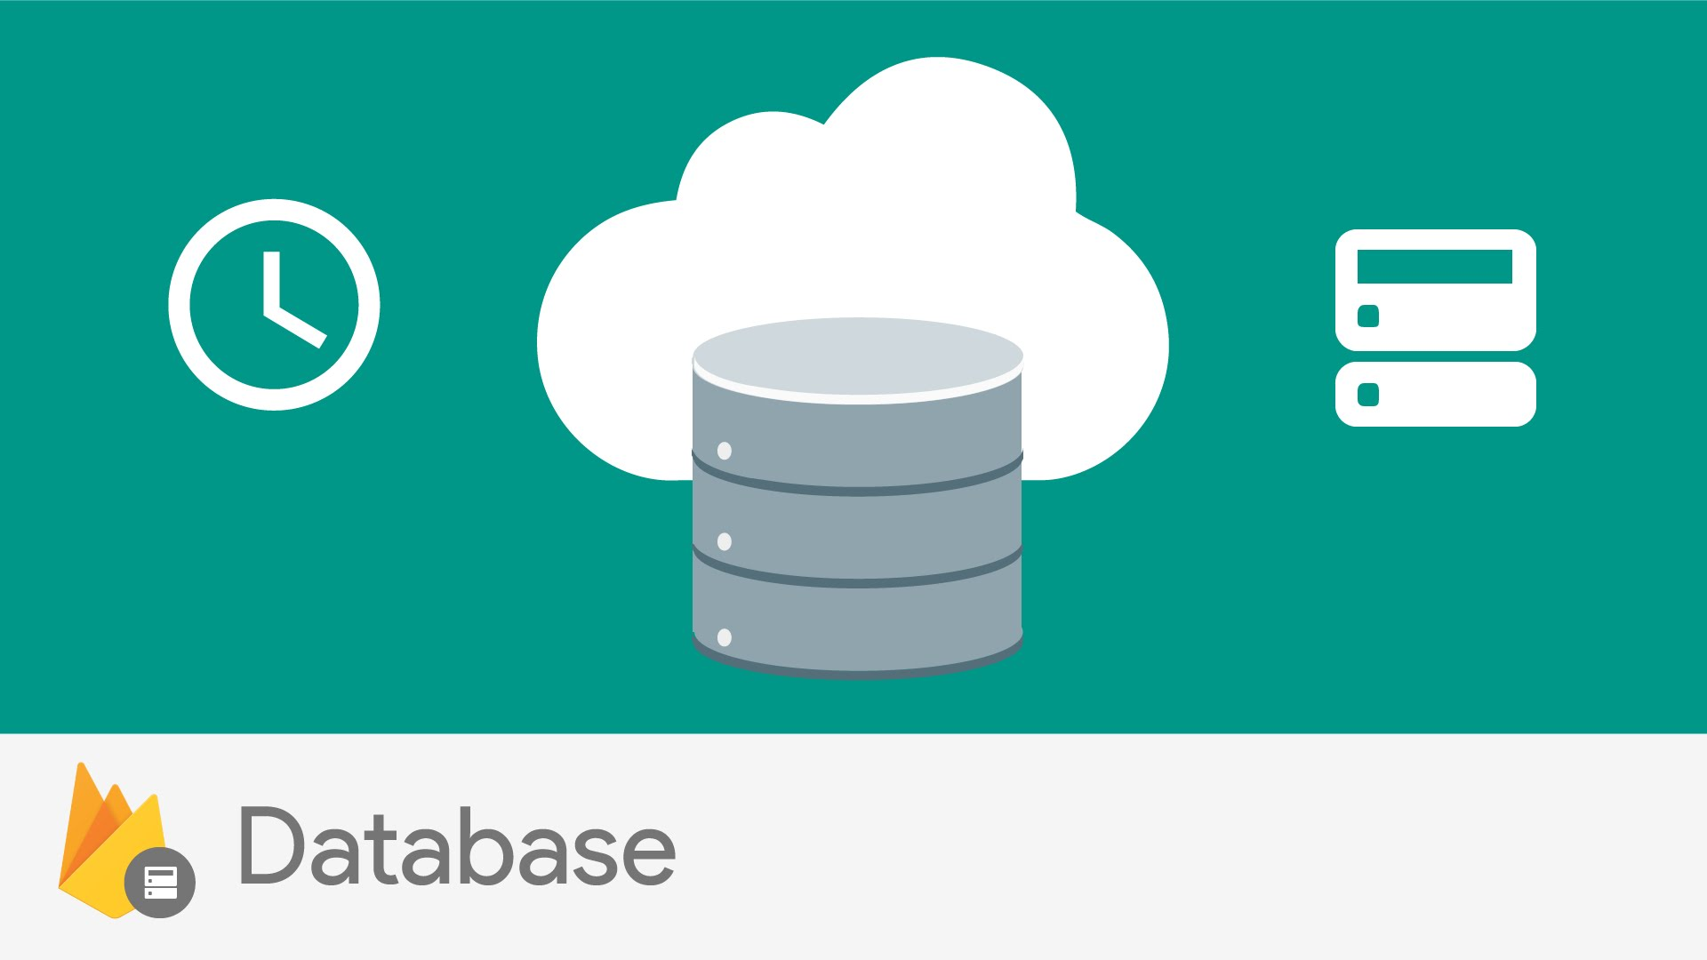

Firebase Realtime Database
Goodbye RDBMS…

Slide 3
Overview – What is it?
The Firebase Realtime Database is a cloud-hosted database
Data is stored as JSON (NOSQL db) and synchronized in real-time to every connected client
When you build cross-platform apps with their iOS, Android, and JavaScript SDKs, all of your clients share one Realtime Database instance and automatically receive updates with the newest data
Data even remains available when your app goes offline
Notes:
Show google integration in app
Show template in console

Slide 4
Overview – Key Capabilities
Realtime
Instead of typical HTTP requests, the Firebase Realtime Database uses data synchronization—every time data changes, any connected device receives that update within milliseconds. Provide collaborative and immersive experiences without thinking about networking code
Offline
Firebase apps remain responsive even when offline because the Firebase Realtime Database SDK persists your data to disk. Once connectivity is reestablished, the client device receives any changes it missed, synchronizing it with the current server state
Notes:
Show google integration in app
Show template in console

Slide 5
Overview – Key Capabilities
Accessible from Client Devices
The Firebase Realtime Database can be accessed directly from a mobile device or web browser; there’s no need for an application server. Security and data validation are available through the Firebase Realtime Database Security Rules, expression-based rules that are executed when data is read or written.
Scale across multiple Databases (Blaze Pricing Plan)
Support your app's data needs at scale by splitting your data across multiple database instances in the same Project. Streamline authentication with Firebase Auth on your project and authenticate users across your database instances. Control access to the data in each database with custom Rules for each database instance.
Notes:
Show google integration in app
Show template in console

Slide 6
Overview – How it Works
The Firebase Realtime Database lets you build rich, collaborative applications by allowing secure access to the database directly from client-side code
Data is persisted locally, and even while offline, real-time events continue to fire, giving the end user a responsive experience
When the device regains connection, the Realtime Database synchronizes the local data changes with the remote updates that occurred while the client was offline, merging any conflicts automatically
Notes:
Show google integration in app
Show template in console

Slide 7
Implementation Pathway (Generally)
Integrate the Firebase Realtime Database SDKs
Quickly include clients via Gradle
Create Realtime Database References
Reference your JSON data, to set data or subscribe to data changes
Set Data and Listen for Changes
Use these references to write data or subscribe to changes
Enable Offline Persistence
Allow data to be written locally so it can be available while offline
Secure your data
Use Firebase Realtime Database Security Rules to secure your data.

Slide 8
In a Nutshell
Unlike RDBMS, data is stored as JSON. It is a no-SQL JSON database
What makes it real time it its ability to notify listeners of any change in data
Whenever any change is made in the JSON database structure, the firebase SDK notifies all connected devices
You can forget about REST API calls, connectivity checks, 3rd party libraries and polling

Slide 9
The Core Magic Of Firebase

Slide 10

References
https://console.firebase.google.com/
https://firebase.google.com/
https://github.com/firebase/quickstart-android

Slide 11


