Slide 1
Mobile Application Development
David Drohan (ddrohan@wit.ie)

Slide 2
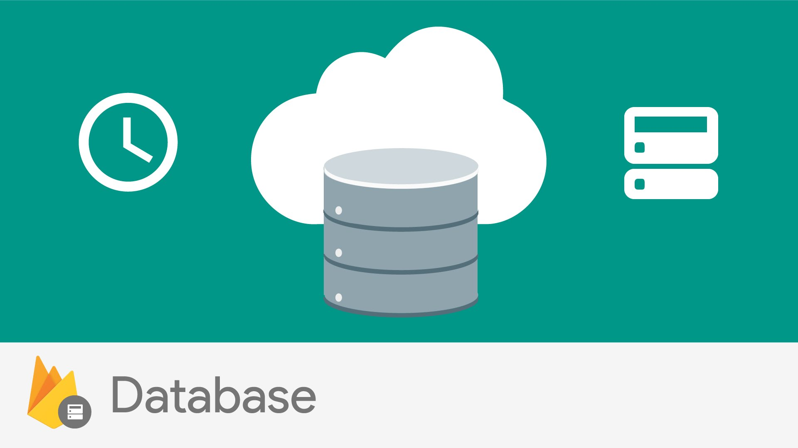

Firebase Realtime Database
Goodbye RDBMS…

Slide 3
Overview – What is it?
The Firebase Realtime Database is a cloud-hosted database
Data is stored as JSON (NOSQL db) and synchronized in real-time to every connected client
When you build cross-platform apps with their iOS, Android, and JavaScript SDKs, all of your clients share one Realtime Database instance and automatically receive updates with the newest data
Data even remains available when your app goes offline
Notes:
Show google integration in app
Show template in console

Slide 4
Overview – Key Capabilities
Realtime
Instead of typical HTTP requests, the Firebase Realtime Database uses data synchronization—every time data changes, any connected device receives that update within milliseconds. Provide collaborative and immersive experiences without thinking about networking code
Offline
Firebase apps remain responsive even when offline because the Firebase Realtime Database SDK persists your data to disk. Once connectivity is reestablished, the client device receives any changes it missed, synchronizing it with the current server state
Notes:
Show google integration in app
Show template in console

Slide 5
Overview – Key Capabilities
Accessible from Client Devices
The Firebase Realtime Database can be accessed directly from a mobile device or web browser; there’s no need for an application server. Security and data validation are available through the Firebase Realtime Database Security Rules, expression-based rules that are executed when data is read or written.
Scale across multiple Databases (Blaze Pricing Plan)
Support your app's data needs at scale by splitting your data across multiple database instances in the same Project. Streamline authentication with Firebase Auth on your project and authenticate users across your database instances. Control access to the data in each database with custom Rules for each database instance.
Notes:
Show google integration in app
Show template in console

Slide 6
Overview – How it Works
The Firebase Realtime Database lets you build rich, collaborative applications by allowing secure access to the database directly from client-side code
Data is persisted locally, and even while offline, real-time events continue to fire, giving the end user a responsive experience
When the device regains connection, the Realtime Database synchronizes the local data changes with the remote updates that occurred while the client was offline, merging any conflicts automatically
Notes:
Show google integration in app
Show template in console

Slide 7
In a Nutshell
Unlike RDBMS, data is stored as JSON. It is a no-SQL JSON database
What makes it real time it its ability to notify listeners of any change in data
Whenever any change is made in the JSON database structure, the firebase SDK notifies all connected devices
You can forget about REST API calls, connectivity checks, 3rd party libraries and polling

Slide 8
Firebase Database

Slide 9
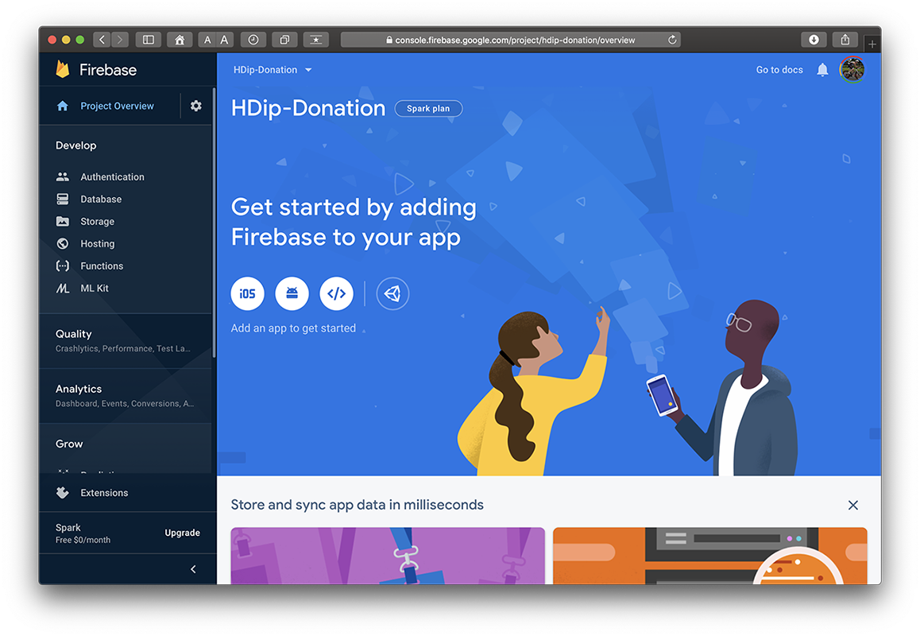
1. Create your Firebase Project

Slide 10
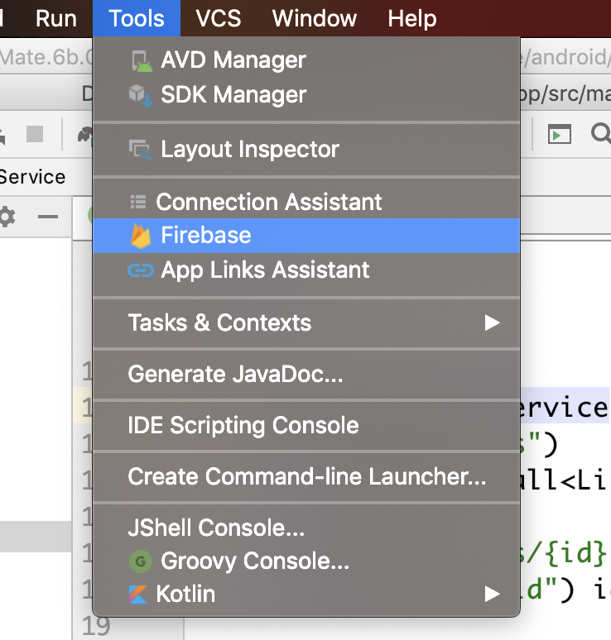
3. Setup Firebase in your App

Slide 11
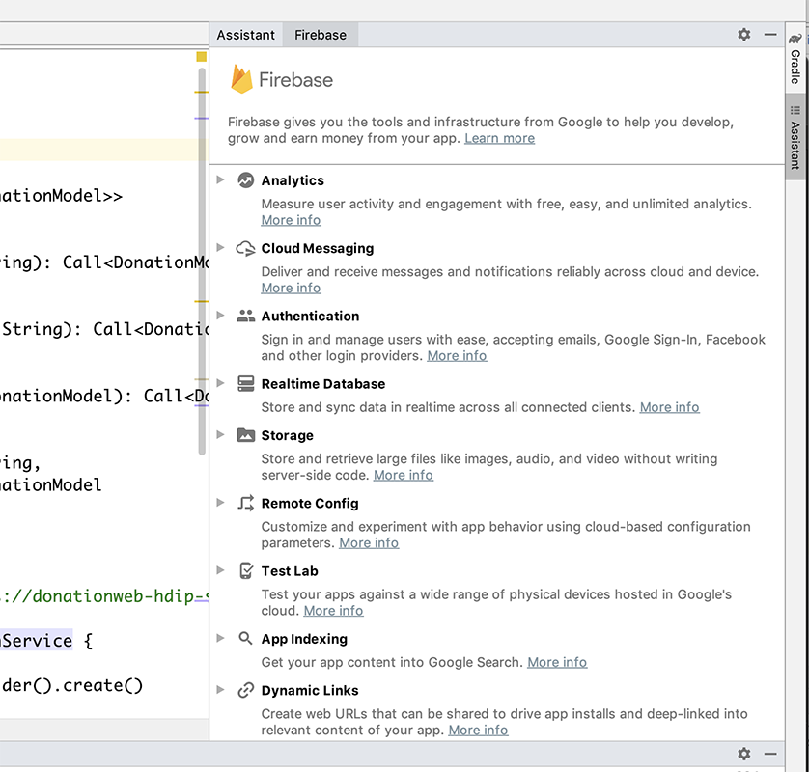
3. Setup Firebase in your App

Slide 12
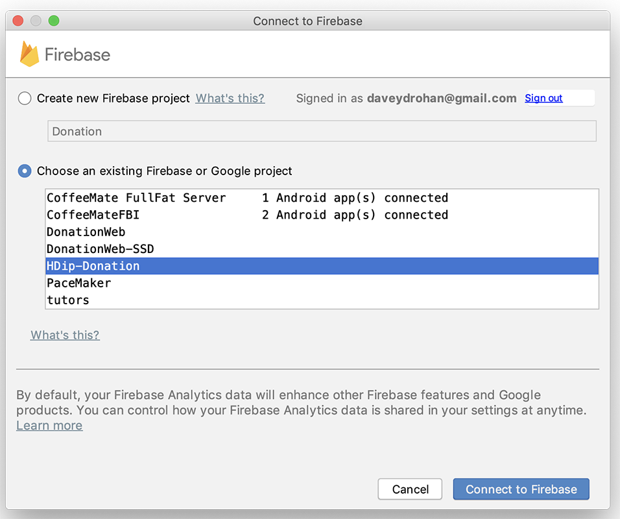
3. Setup Firebase in your App

Slide 13
4. Introduce Authentication Flow
https://github.com/firebase/quickstart-android

Slide 14
The Core Magic Of Firebase *

Slide 15
Saving Data In Firebase
Get database reference (your base node)
DatabaseReference mDBRef = FirebaseDatabase.getInstance().getReference();
Point it to the right JSON node
mDBRef = mDBRef.child(“mydb”).child(“table1”);
Set the value at the pointed node
mDBRef.child(‘row1’).setValue(myPOJO);
Or push the value to create a unique key and set the value
mDBRef.push().setValue(myPOJO);
Create a Key
Firebase takes care of the Key

Slide 16
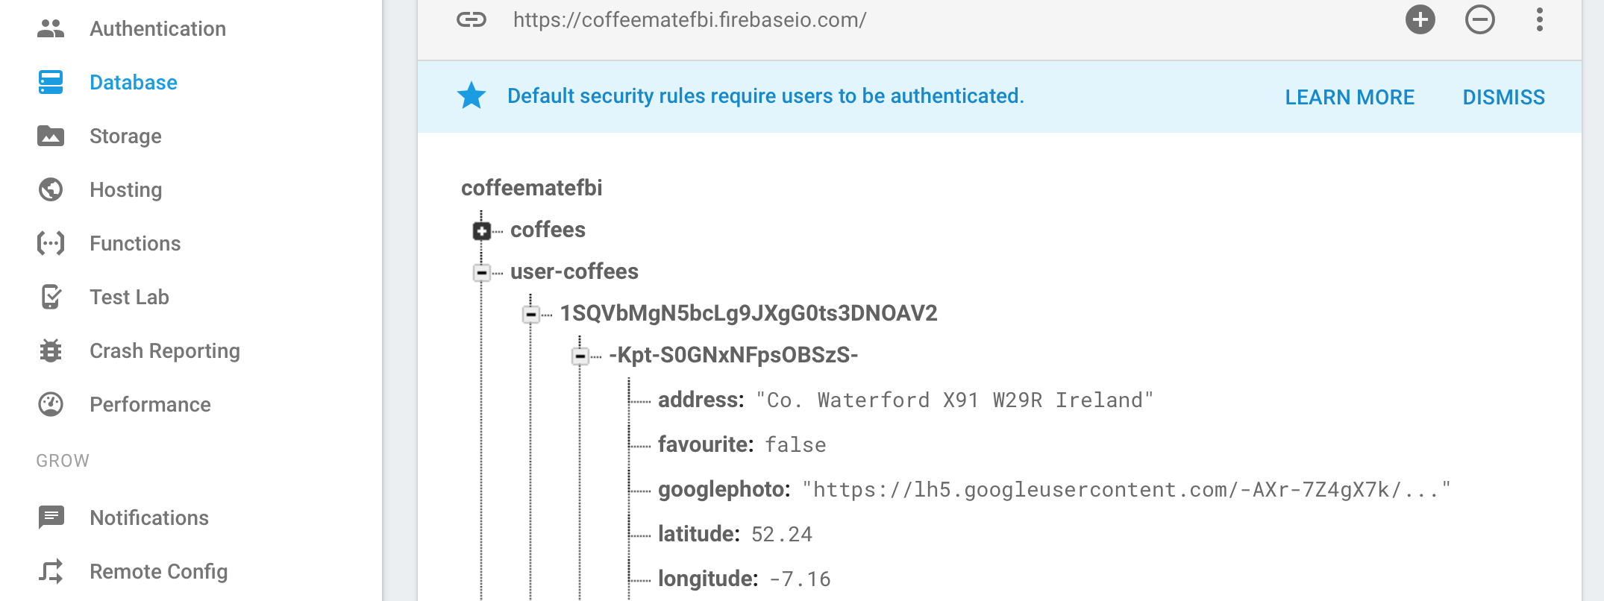
View Your Saved Data
Log on to https://firebase.google.com.
Go to console and select your project.
Hit database and select data tab

Slide 17
Retrieving Data
Data is retrieved via callbacks listeners.
There are mainly 2 types of listeners
ValueEventListener – get entire child structure.
ChildEventListener – get only the child that got changed / added or deleted.
Attach these listeners to Database reference we saw earlier.
Both of these listeners are called once, so app can get the data and prepare UI

Slide 18
Attaching Data Listeners
ValueEventListeners can be added in 2 ways:
addListenerForSingleValueEvent (valEvListener); //next slide
Get the entire data snapshot only once
addValueEventListener(valEvListener);
Get entire data snapshot whenever there is a change in any of the child nodes
ChildEventListener can be added in only one way:
addChildEventListener(childEvListener)
Get updates as child nodes
Notes:
Show listeners here on web.
Show sample code

Slide 19
Retrieving Data As POJO
public ChildEventListener childEvListener = new ChildEventListener() { public void onChildAdded(DataSnapshot dataSnapshot, String s) { MyPOJO m = dataSnapshot.getValue(MyPOJO.class);
} public void onChildChanged(DataSnapshot dataSnapshot, String s) {} public void onChildRemoved(DataSnapshot dataSnapshot) {} public void onChildMoved(DataSnapshot dataSnapshot, String s) {} public void onCancelled(DatabaseError databaseError) {} };

Slide 20
Retrieving Data As POJO
public ValueEventListener valEvListener = new ValueEventListener() { @Override public void onDataChange(DataSnapshot dataSnapshot) { MyPOJO m = dataSnapshot.getValue(MyPOJO.class); } @Override public void onCancelled(DatabaseError databaseError) {} };

Slide 21
Filtering Data
Set DatabaseReference to the right parent node.
Db = base.child(‘Institute’).child(‘year’);
To get all students with major = ‘Computing’.
Set orderByChild(‘major’).
Set equalTo(‘Computing’);
Add listeners
Db.orderByChild(‘major’).equalTo(‘Computing’)
.addChildEventListener(childEvListener);
Notes:
The contact number problem faced

Slide 22
Pagination
Create a Query object or keep using DatabaseReference. Query is super class of DatabaseReference class.
Set orderBy some child key (and filter if needed)
Set limits (startAt, limit etc.)
Attach data listeners
And done. Appropriate callback will be called when operation is complete.
Notes:
StackOverflow Documentation

Slide 23
Pagination Code
// class level
final int limit = 50;
int start = 0;
// event level
Query userListQuery = userDBRef.orderByChild("email")
.limitToFirst(limit).startAt(start);
userListQuery.addValueEventListener(new ValueEventListener() {
@Override
public void onDataChange(DataSnapshot d) {
// Do something
start += (limit+1);
Notes:
StackOverflow Documentation
http://stackoverflow.com/documentation/android/5511/firebase-realtime-database#t=201611300156362003703

Slide 24
Firebase Realtime Database
Quick DEMO…

Slide 25
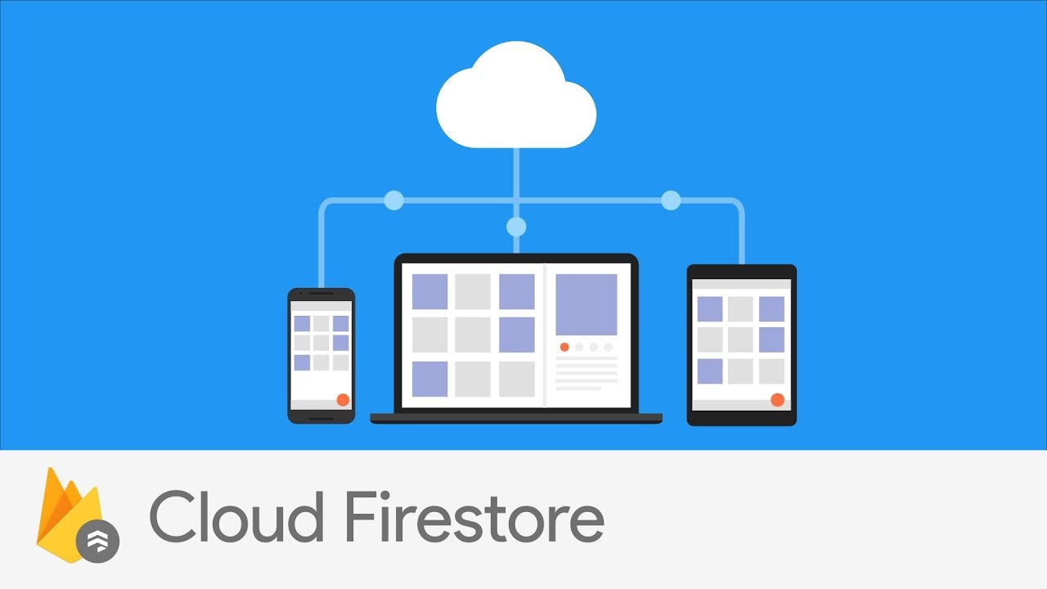
Firebase Realtime Database
Goodbye RDBMS…

Slide 26
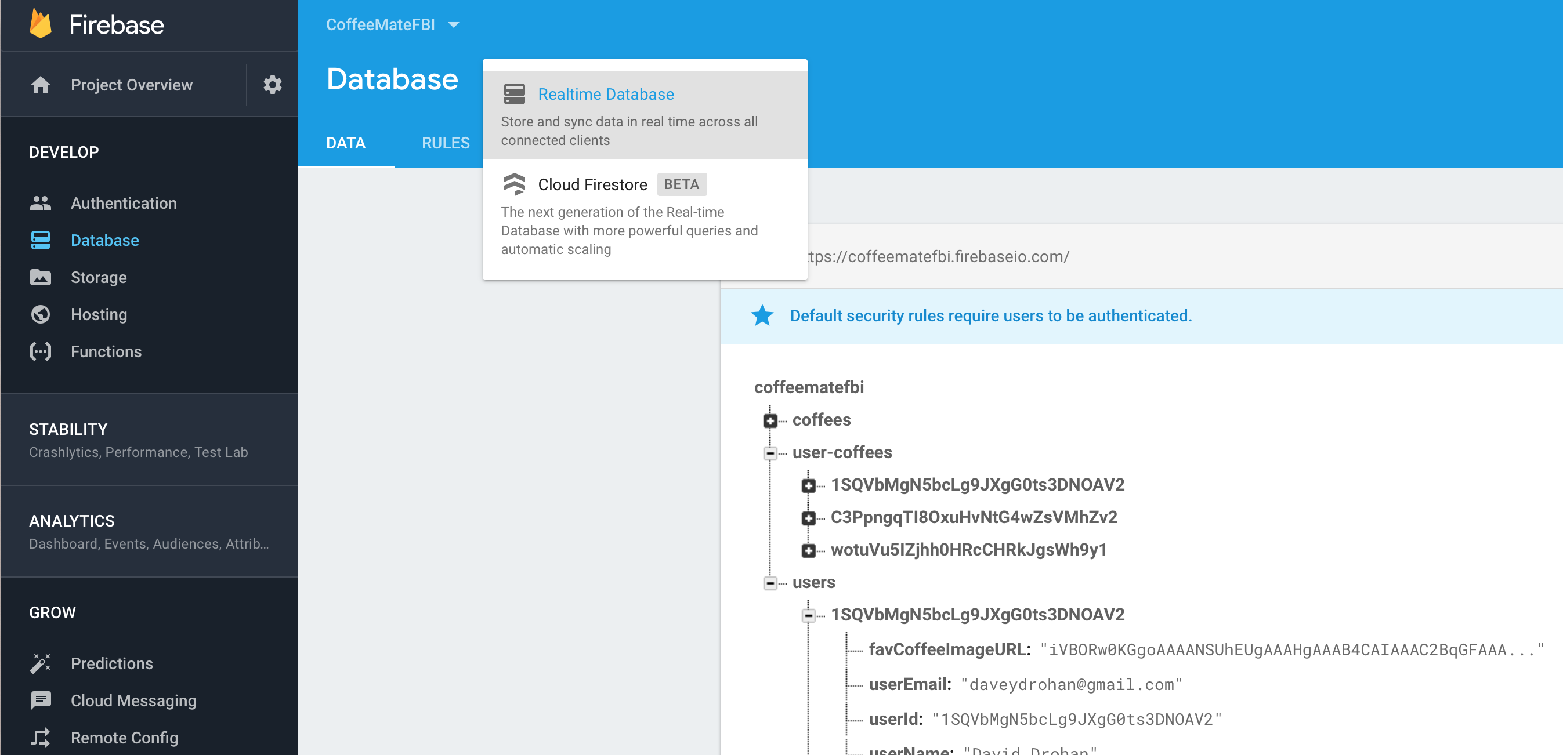
Firebase Console – Cloud Firestore

Slide 27
What is it?
Cloud Firestore is a NoSQL document database that lets you easily store, sync, and query data for your mobile and web apps — at a global scale.
Though this may sound like something similar to the Realtime Database, Firestore brings many new things to the platform that makes it into something completely different from Realtime Database.

Slide 28
Improved Querying and Data Structure
Where Realtime Database stores data in the form of a giant JSON tree, Cloud Firestore takes a much more structured approach.
Firestore keeps its data inside objects called documents. These documents consist of key-value pairs and can contain any kind of data, from strings to binary data to even objects that resemble JSON trees (Firestore calls it maps).
(Sounds a bit like mongodb to me ☺)

Slide 29
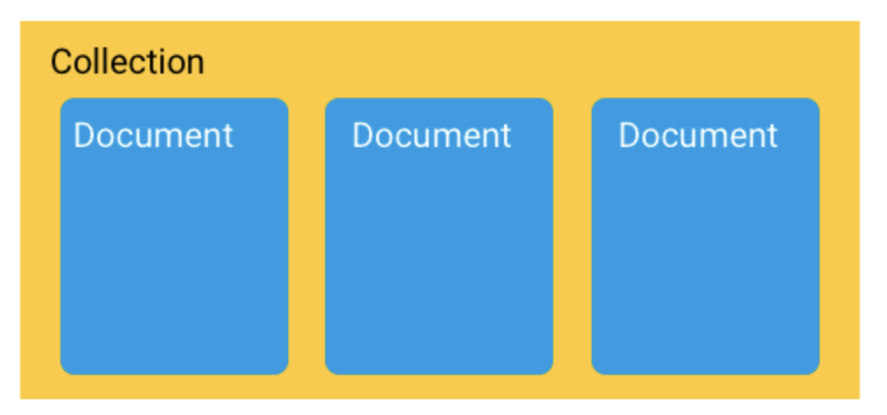
Improved Querying and Data Structure
The documents, in turn, are grouped into collections.
Firestore database can consist of multiple collections that can contain documents pointing towards sub-collections.
These sub-collections can again contain documents that point to other sub-collections, and so on.

Slide 30
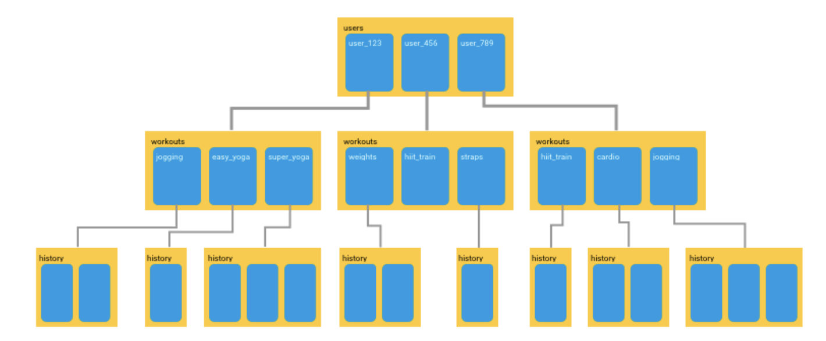
Improved Querying and Data Structure
You can build hierarchies to store related data and easily retrieve any data that you need using queries. All queries can scale with the size of your result set, so your app is ready to scale from day one.

Slide 31
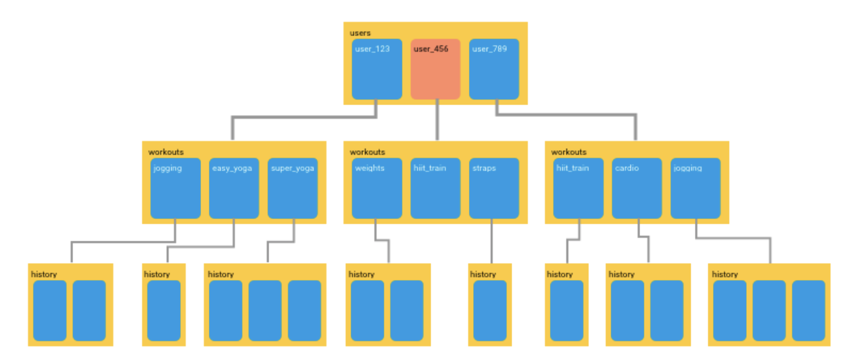
Improved Querying and Data Structure
Firestore’s queries are shallow. By this, I mean to say that in Firestore, you can simply fetch any document that you want without having to fetch all of the data that is contained in any of its linked sub-collections.

Slide 32
Better Scalability
Though Firebase’s Realtime Database is capable of scaling, things will start to get crazy when your app becomes really popular or if your database becomes really massive.
Cloud Firestore is based on Googles Cloud infrastructure. This allows it to scale much more easily and to a greater capacity than the Realtime Database.

Slide 33
Multi-Region Database
In Firestore, your data is automatically copied to various regions. So if one data center goes offline due to some unforeseen reason, you can be sure that your app’s data is still safe somewhere else.
Firestore’s multi-region database also provides strong consistency. Any changes to your data will be mirrored across every copy of your database.

Slide 34
Different Pricing Model
The Realtime Database charges its users based on the amount of data that you have stored in the database.
Cloud Firestore also charges you for the same, but the cost is significantly lower than that of Realtime Database and instead of basing the cost on the amount of data stored, Firestore’s pricing is driven by the number of reads/writes that you perform.

Slide 35
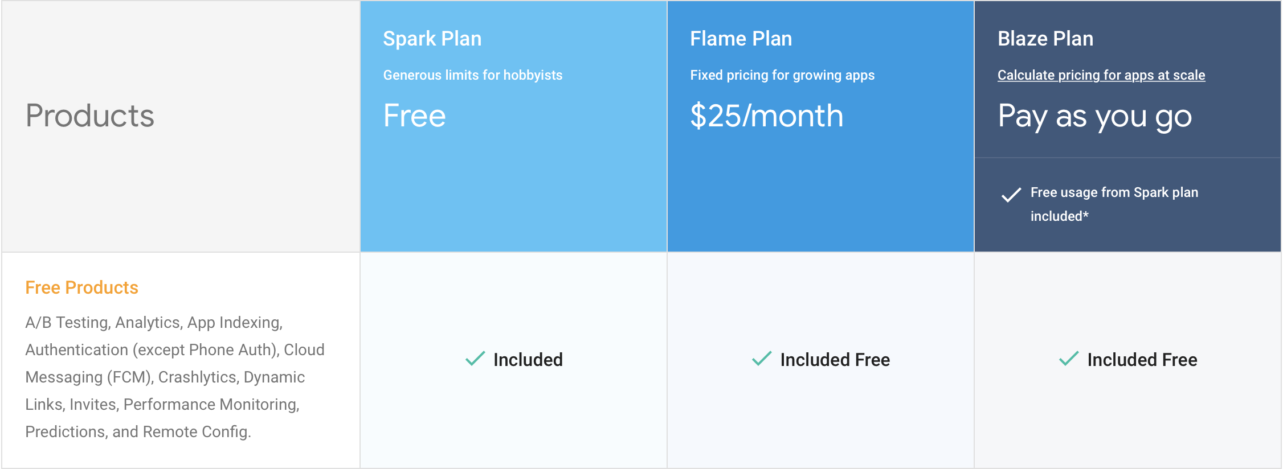
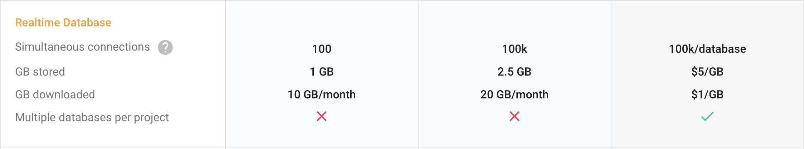
Pricing
https://firebase.google.com/pricing/

Slide 36
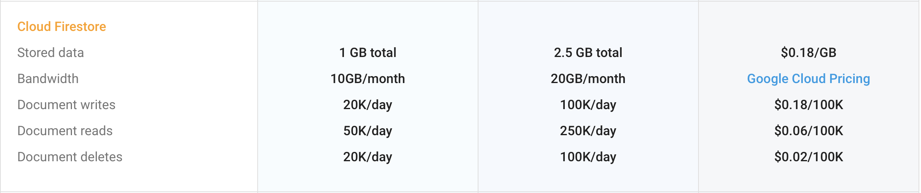
Pricing
https://firebase.google.com/pricing/

Slide 37
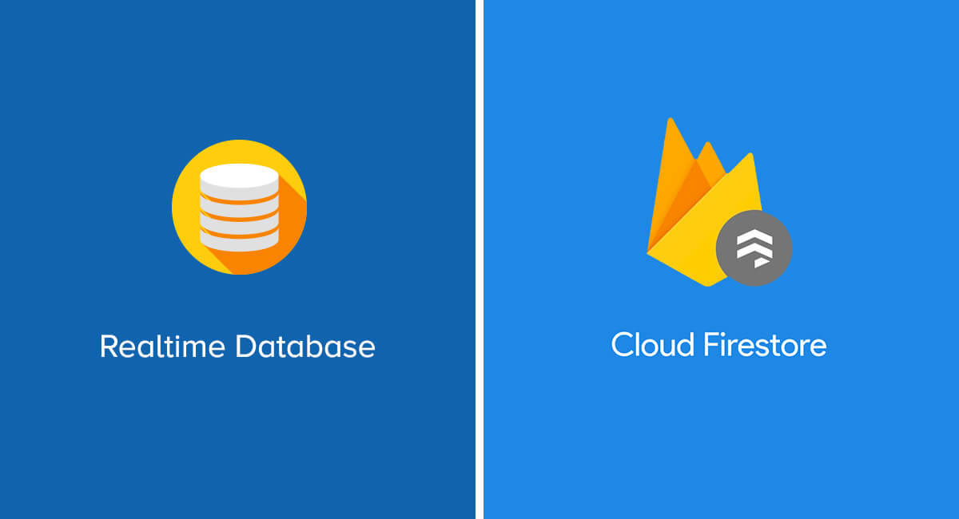
Firebase Realtime Database
Goodbye RDBMS…

Slide 38

References
https://console.firebase.google.com/
https://firebase.google.com/
https://github.com/firebase/quickstart-android

Slide 39


