Slide 1
Mobile Application Development
David Drohan (ddrohan@wit.ie)

Slide 2
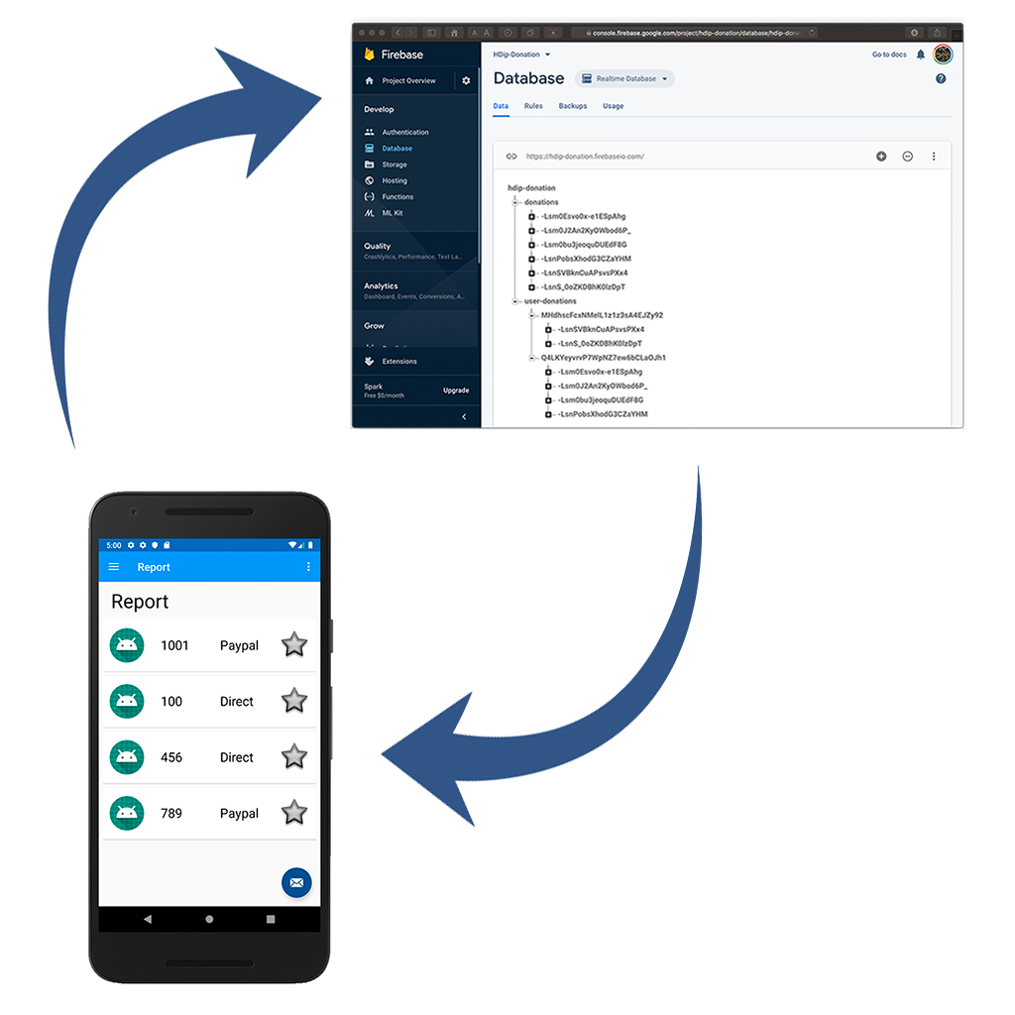
Donation-V5 Walkthrough

Slide 3
Steps to integrate Firebase Database into your App
Create your Firebase Project
Setup your Database & Rules
Setup Firebase Database in your App
Introduce Access Flow – CRUD operations on Donations

Slide 4
Steps to integrate Firebase Database into your App
Create your Firebase Project
Setup your Database & Rules
Setup Firebase Database in your App
Introduce Access Flow – CRUD operations on Donations

Slide 5
https://github.com/firebase/quickstart-android

Slide 6
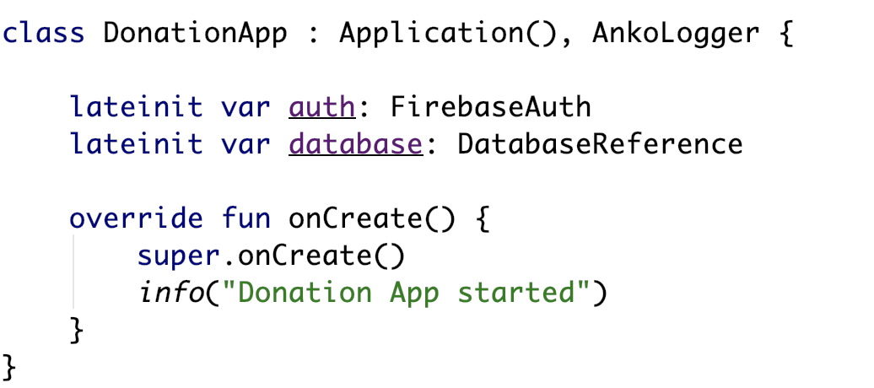
Introduce Access Flow – DonationApp
Our DatabaseReference instance

Slide 7
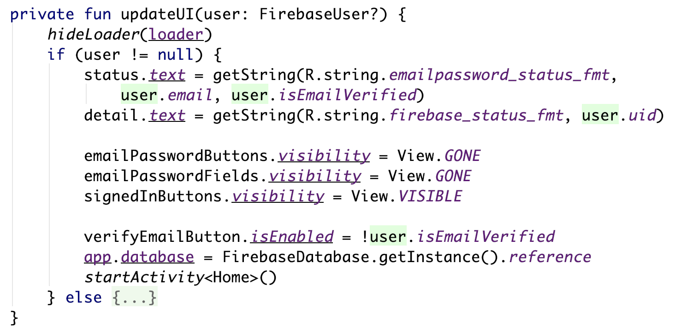
Introduce Access Flow – Login
Our DatabaseReference instance

Slide 8
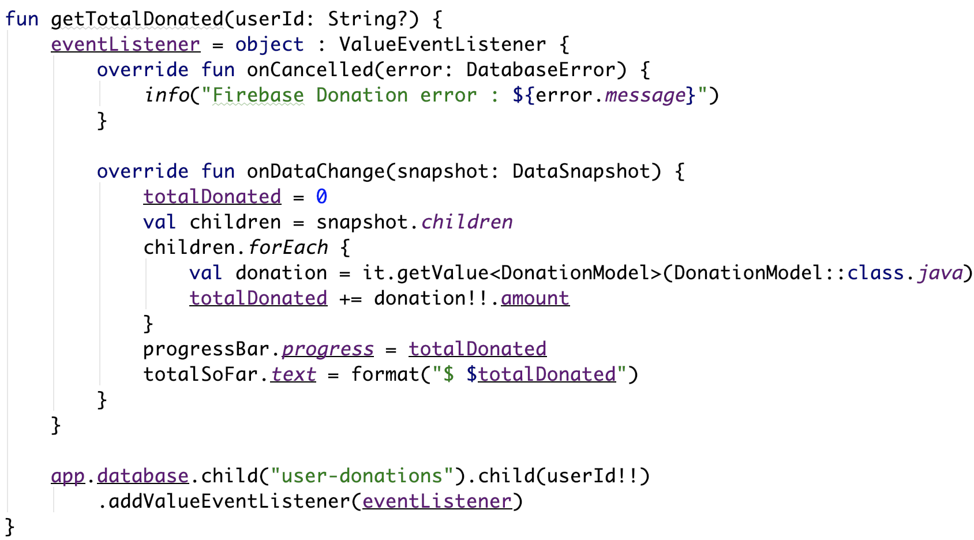
Introduce Access Flow – Donate

Slide 9
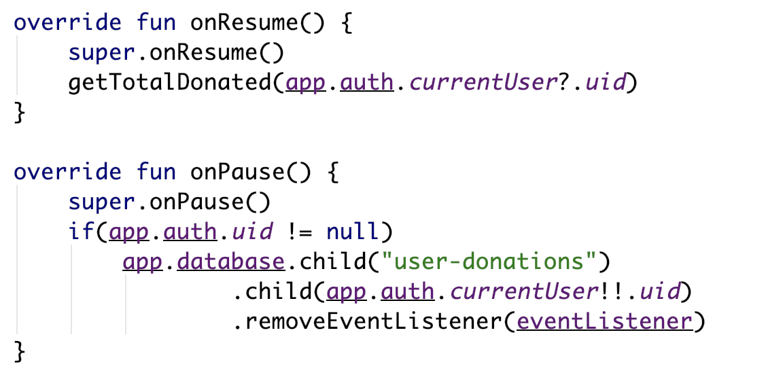
Introduce Access Flow – Donate

Slide 10
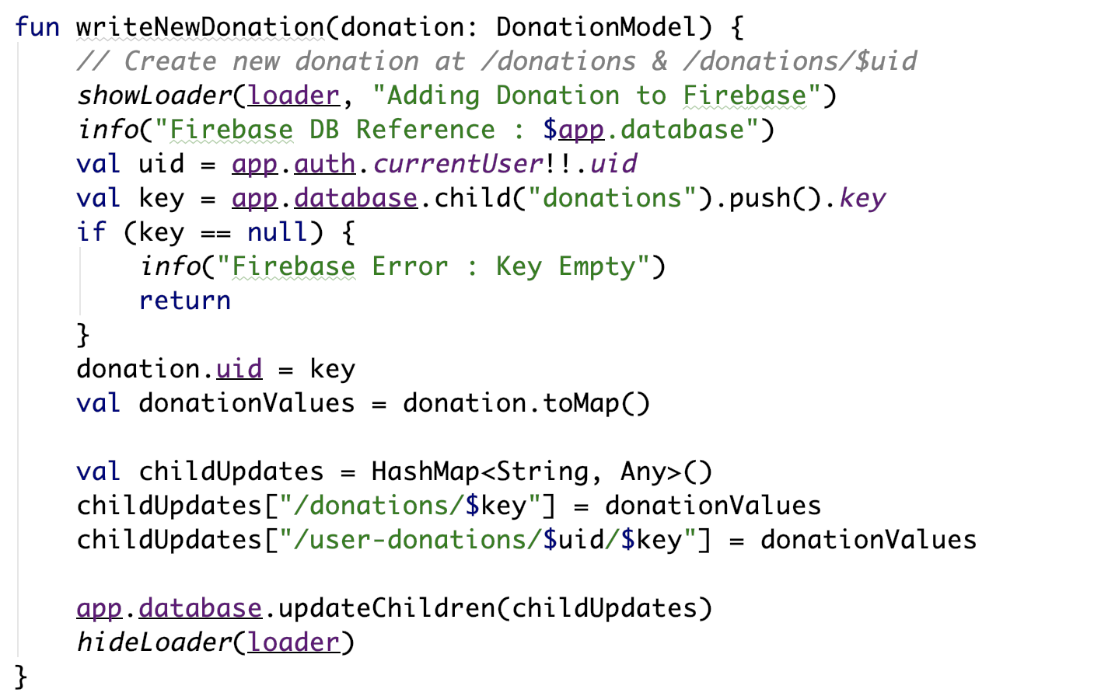
Introduce Access Flow – Donate

Slide 11
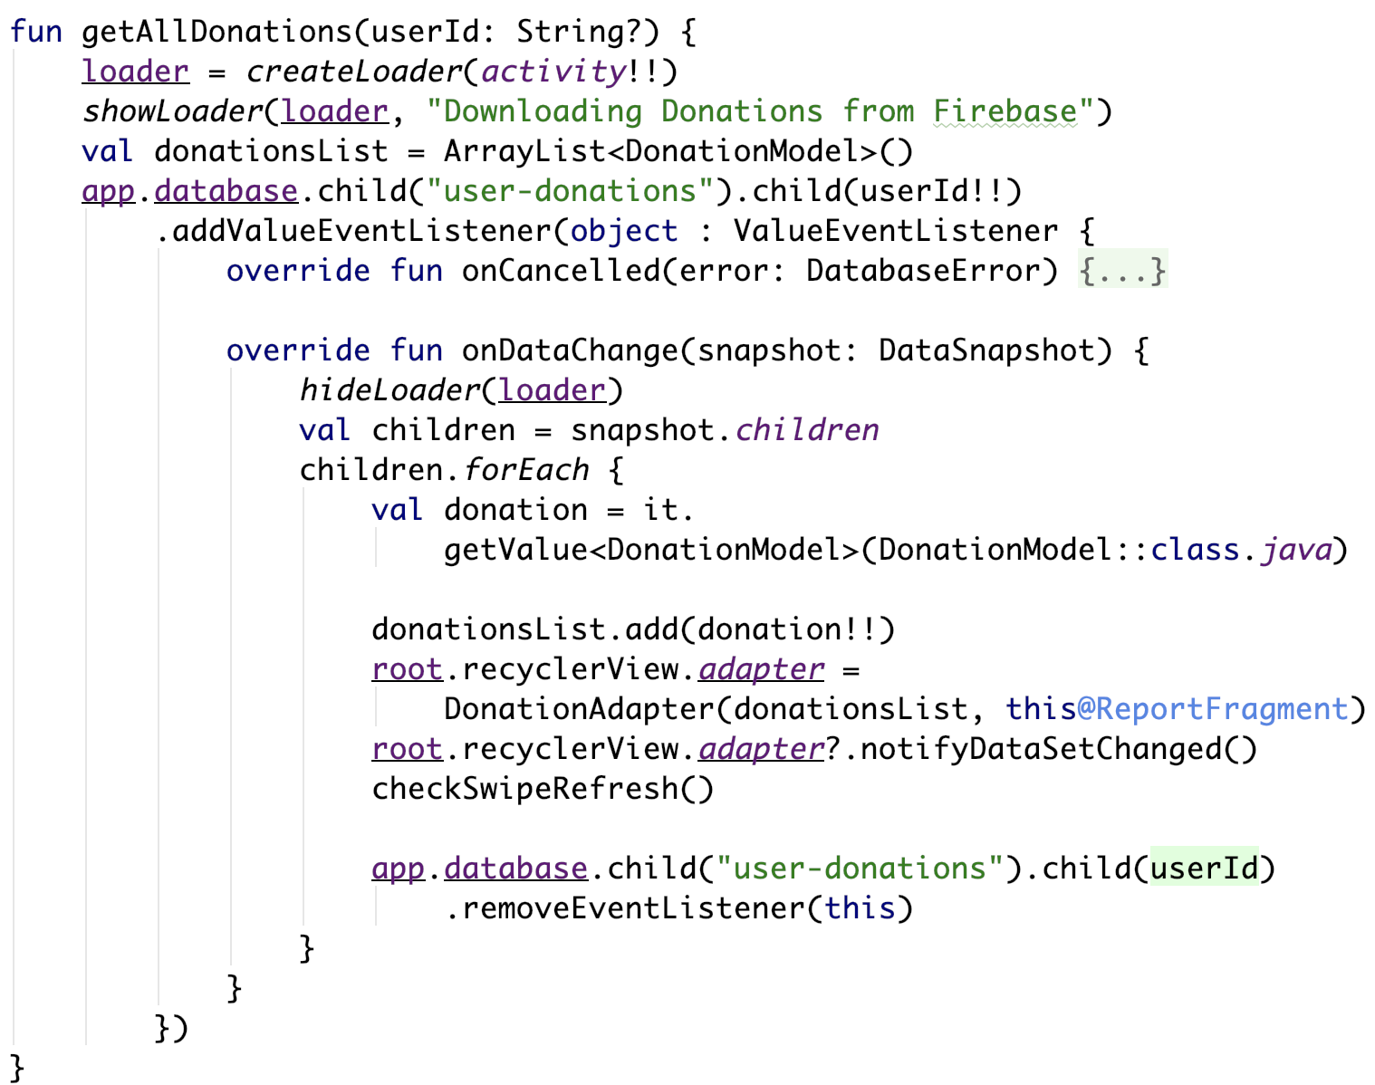
Introduce Access Flow – Report

Slide 12
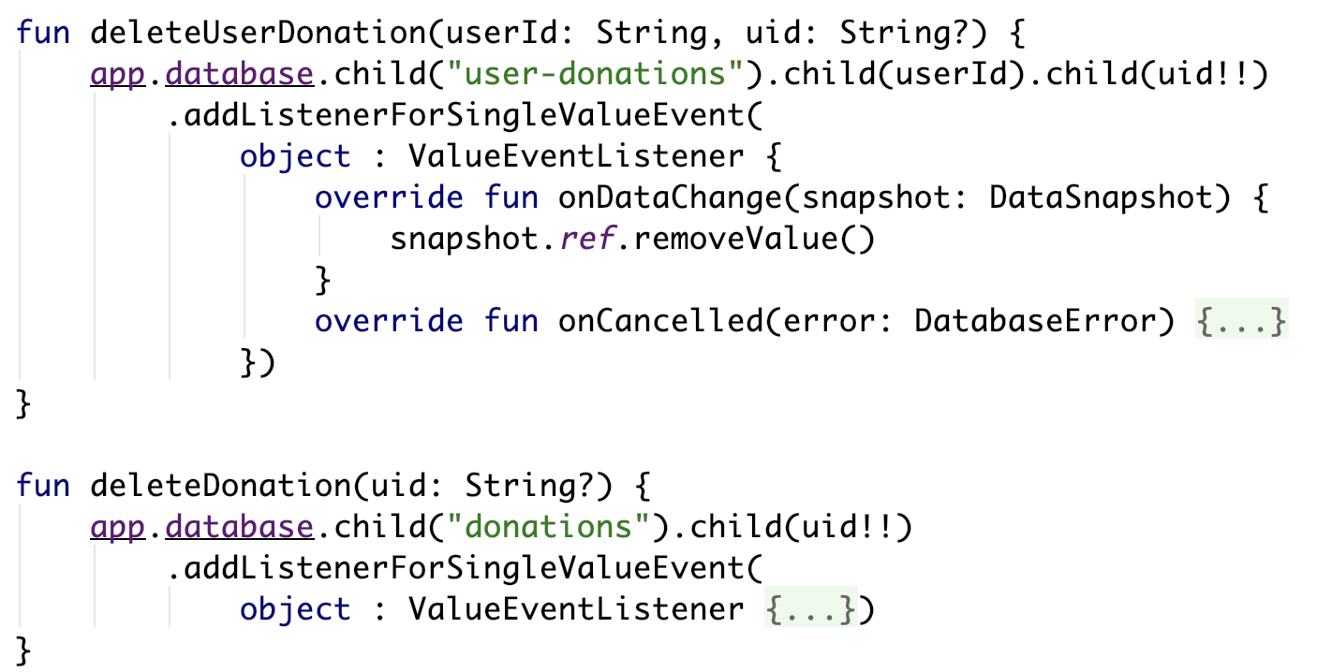
Introduce Access Flow – Report

Slide 13
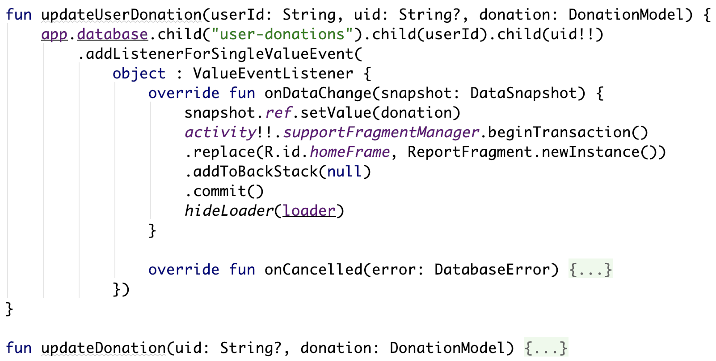
Introduce Access Flow – Edit

Slide 14
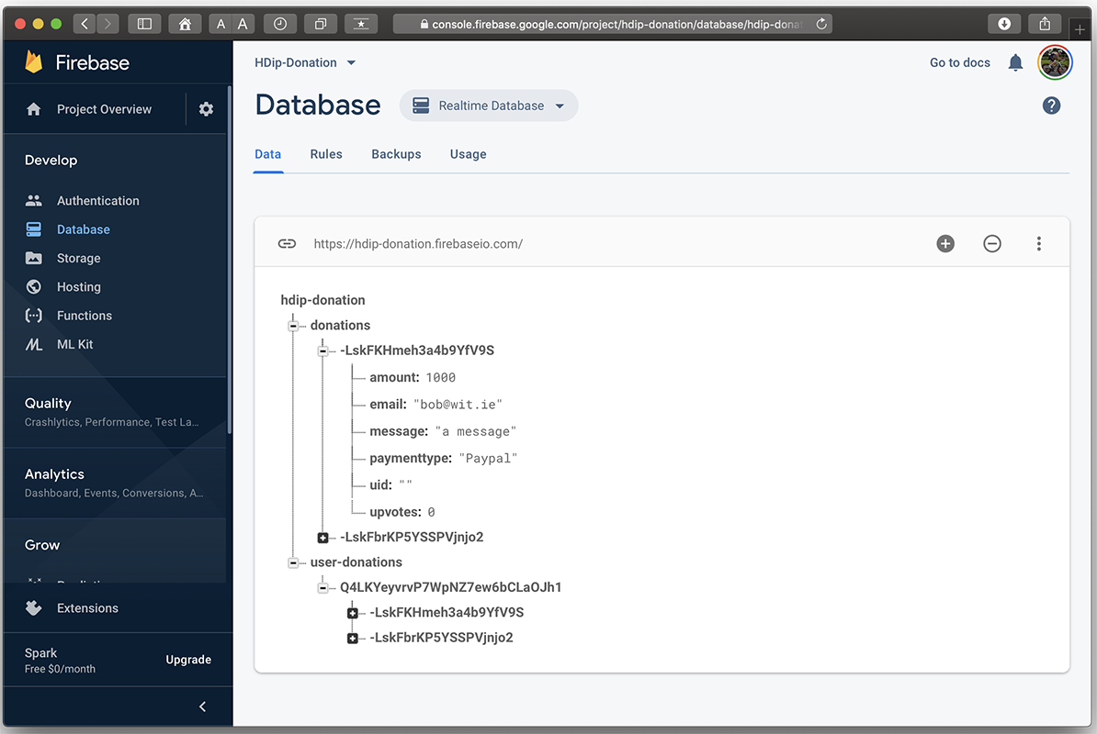
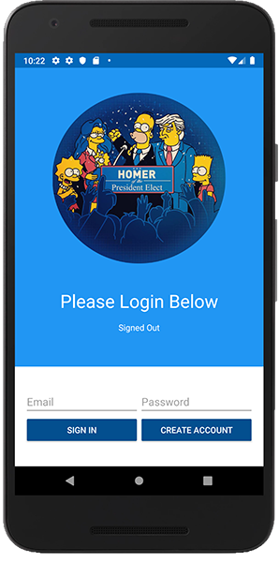
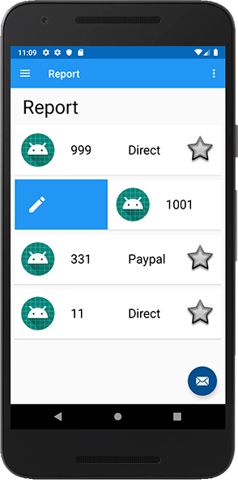
Firebase + Mobile App

Slide 15

References
https://console.firebase.google.com/
https://firebase.google.com/
https://firebase.google.com/docs/database/android/lists-of-data
https://github.com/firebase/quickstart-android

Slide 16


