Slide 1
Mobile Application Development
David Drohan (ddrohan@wit.ie)

Slide 2
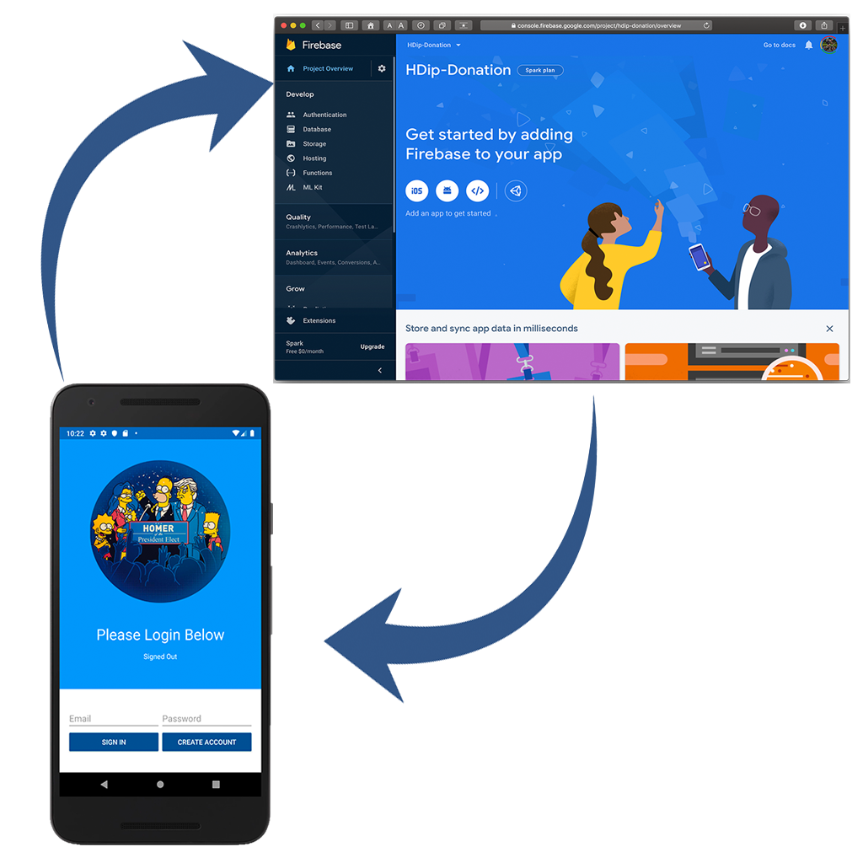
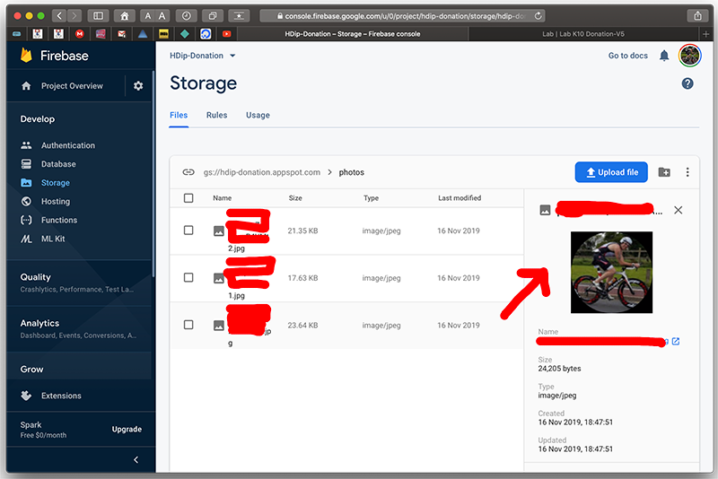
Donation-V6 Walkthrough

Slide 3
https://github.com/firebase/quickstart-android

Slide 4
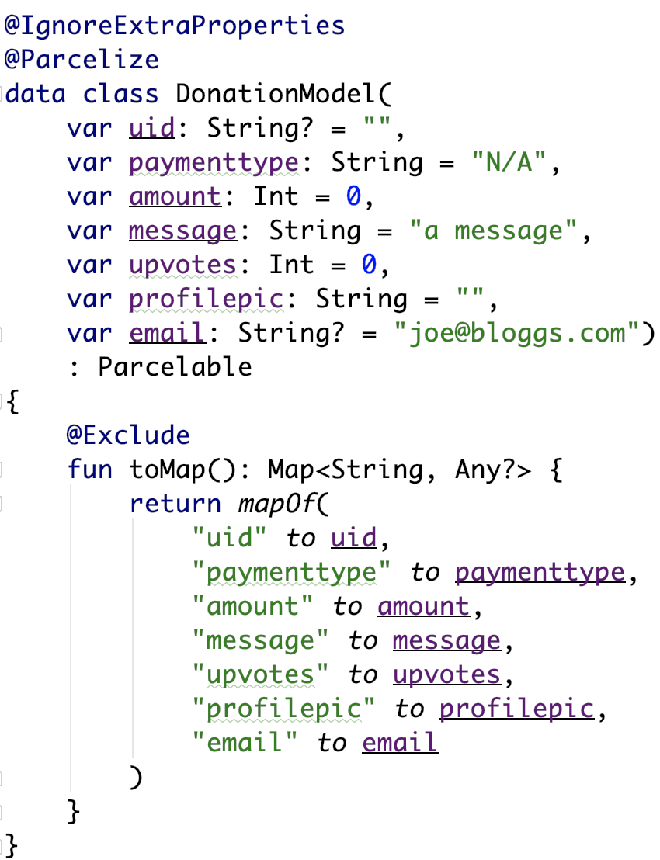
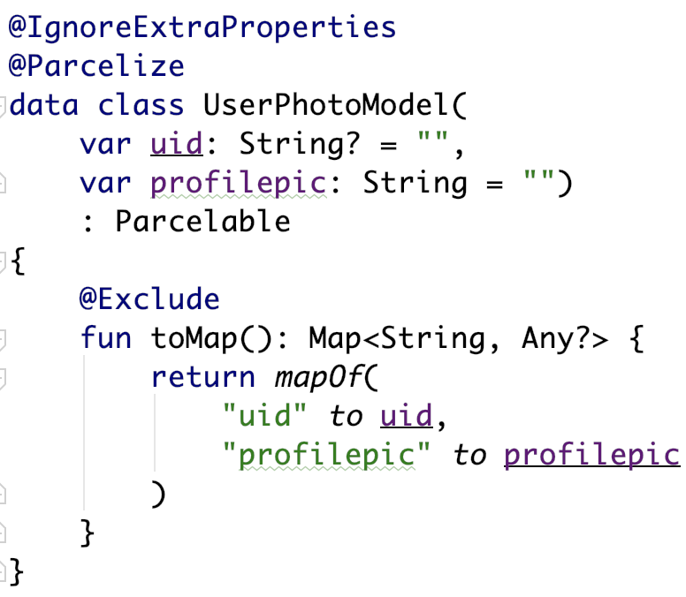
Refactor Models
New UserPhotoModel class

Slide 5
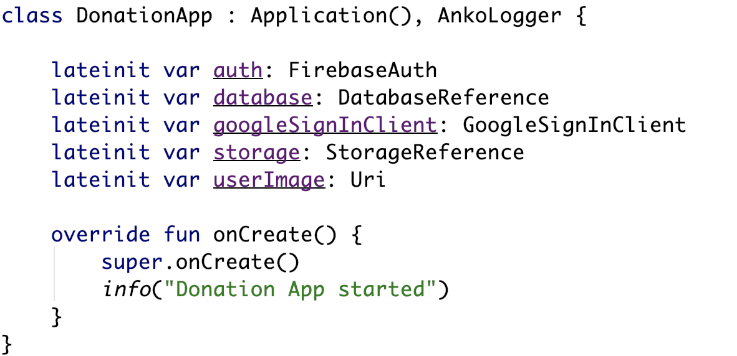
Introduce Storage Reference
Our Storage instance
Current Users Image ref

Slide 6
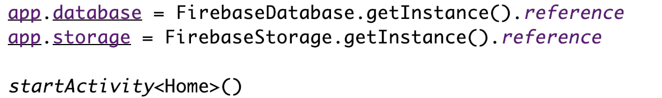
Introduce Storage Reference (UpdateUI( ) in Login)
Our Storage instance

Slide 7


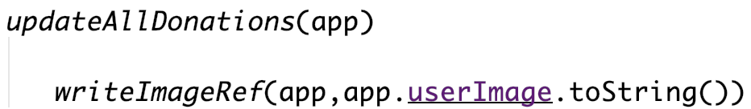
Introduce Photo Validation Process
Updates storage
Updates database

Slide 8
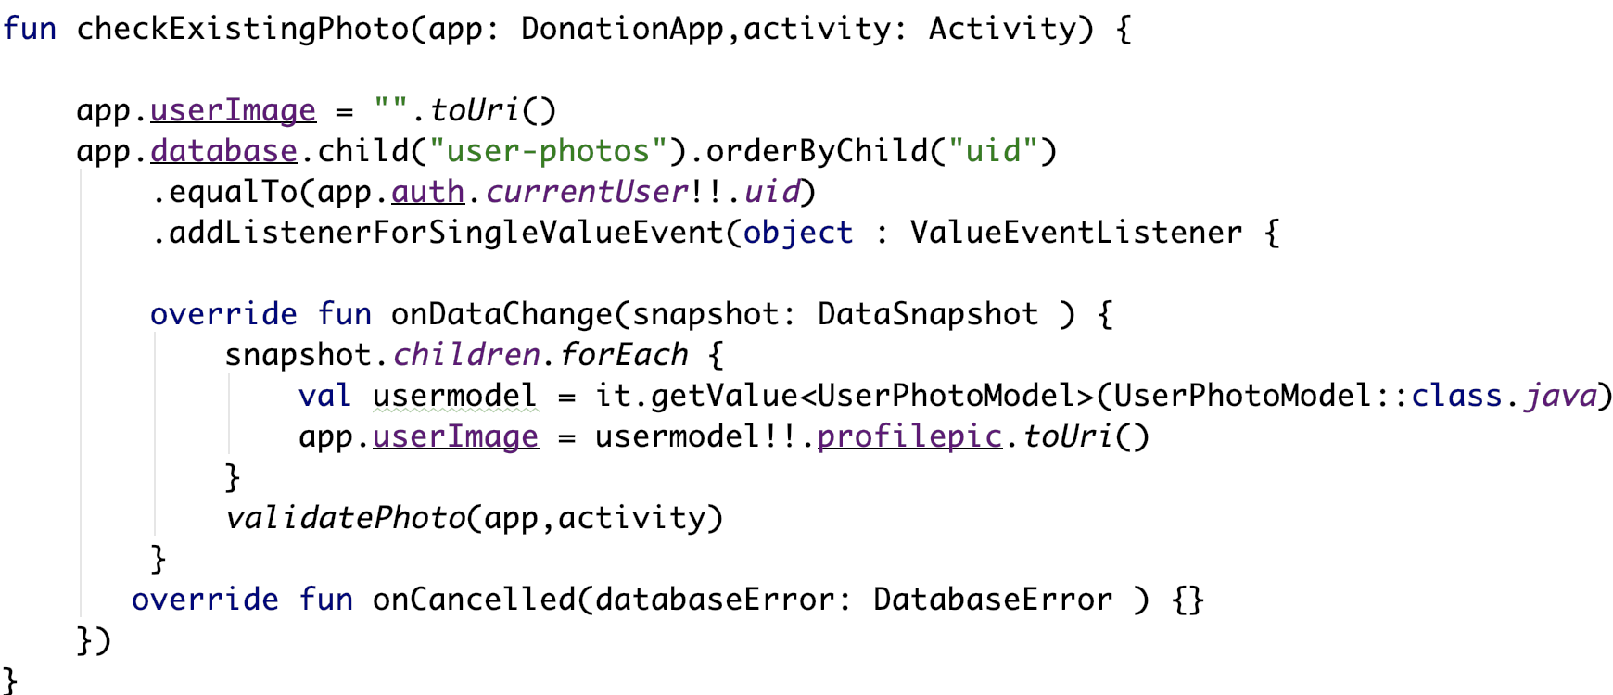
Introduce Photo Validation Process

Slide 9
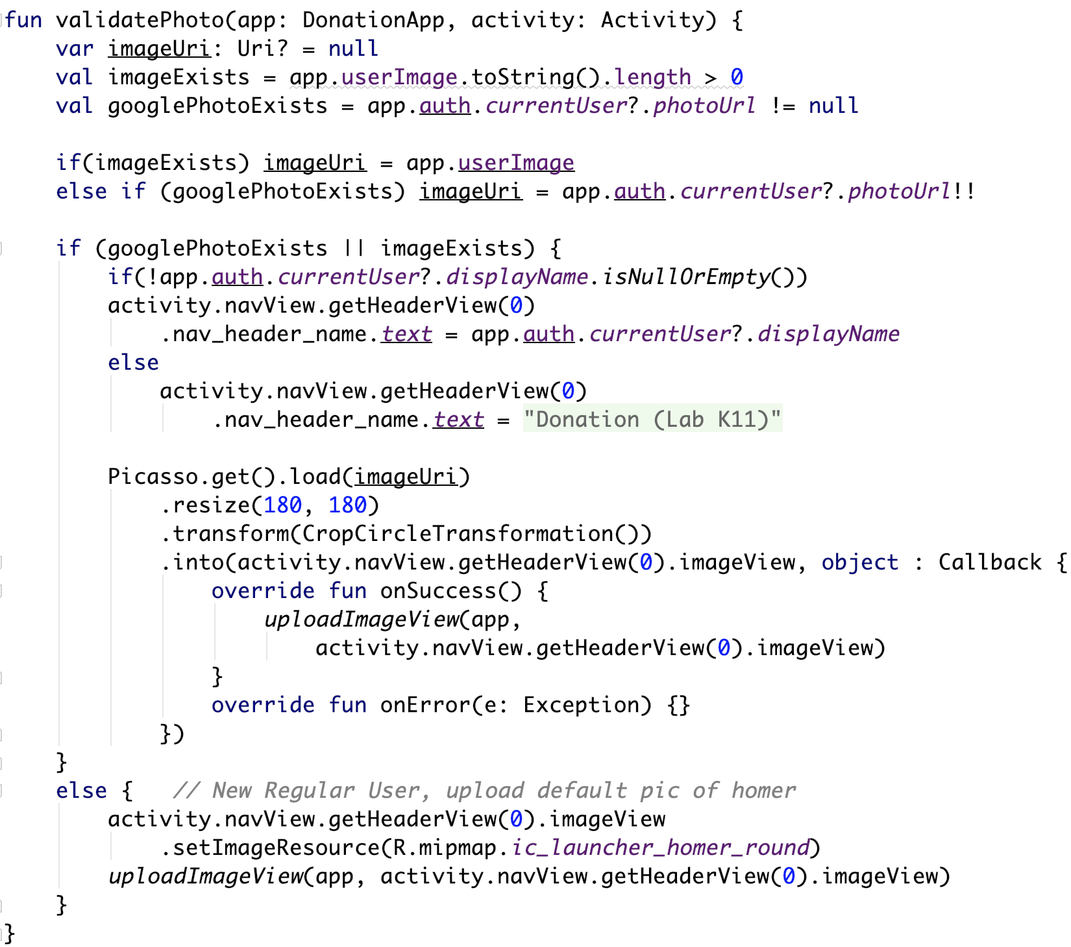
Introduce Photo Validation Process

Slide 10
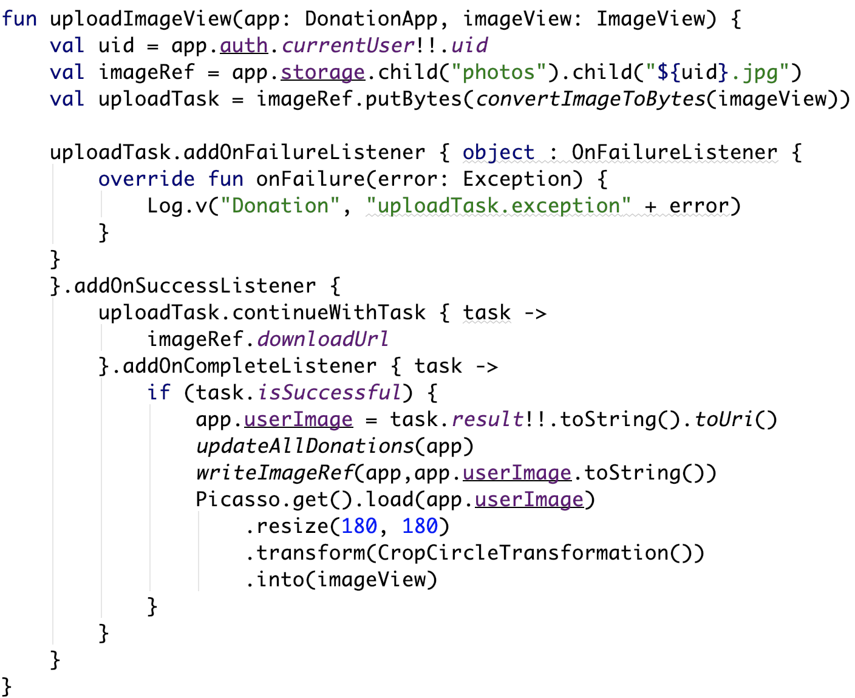
Introduce Photo Validation Process

Slide 11
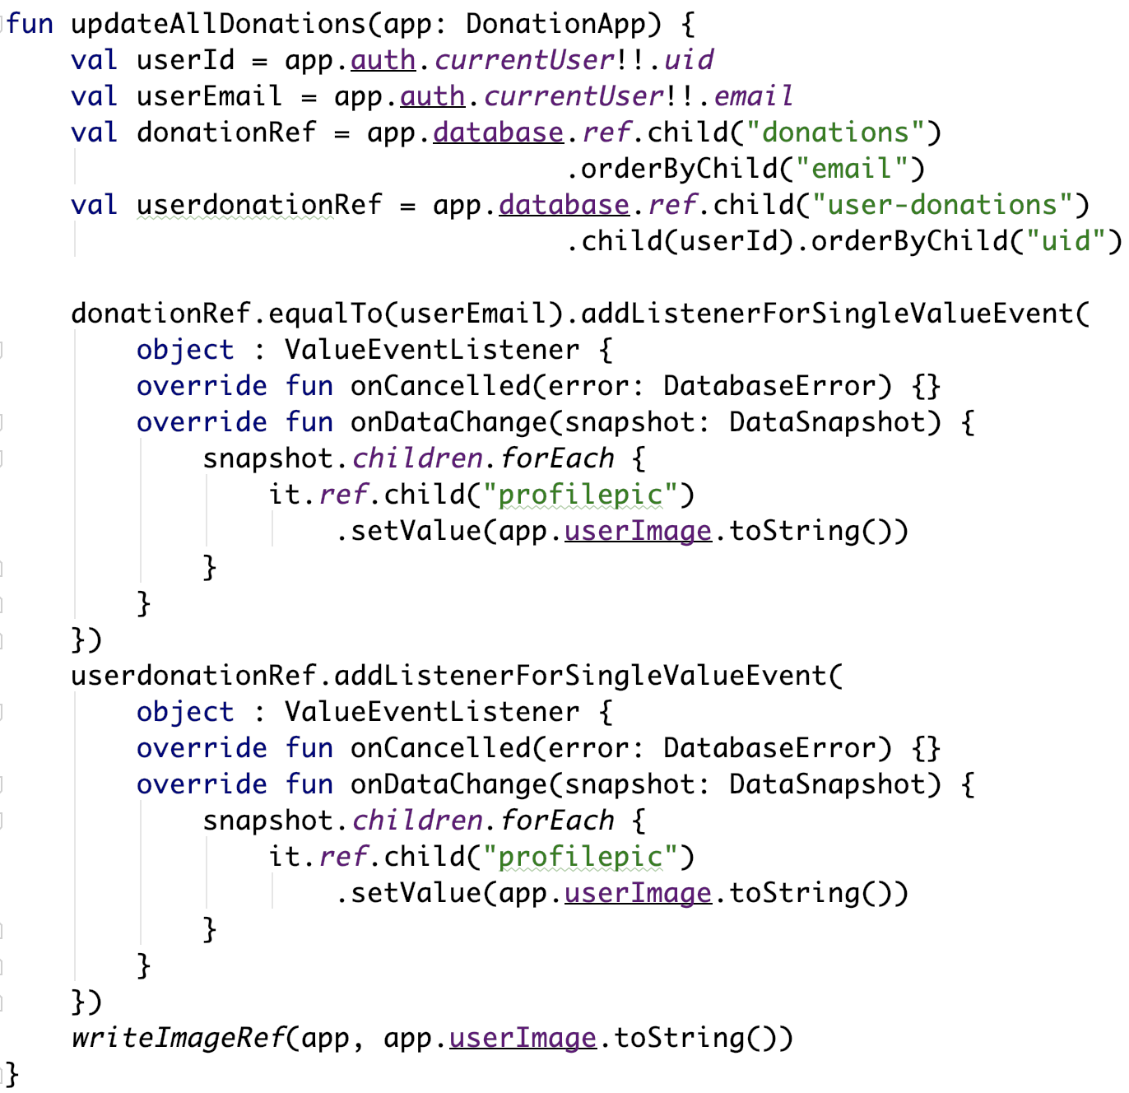
Introduce Photo Validation Process

Slide 12
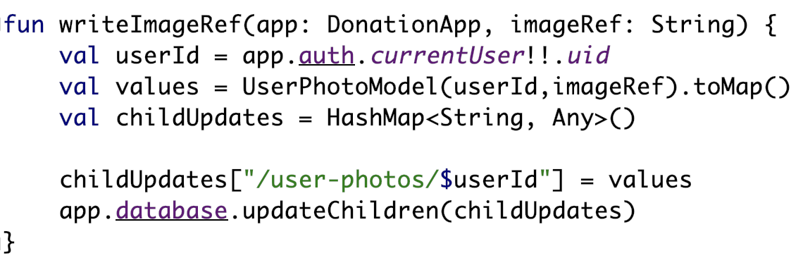
Introduce Photo Validation Process

Slide 13
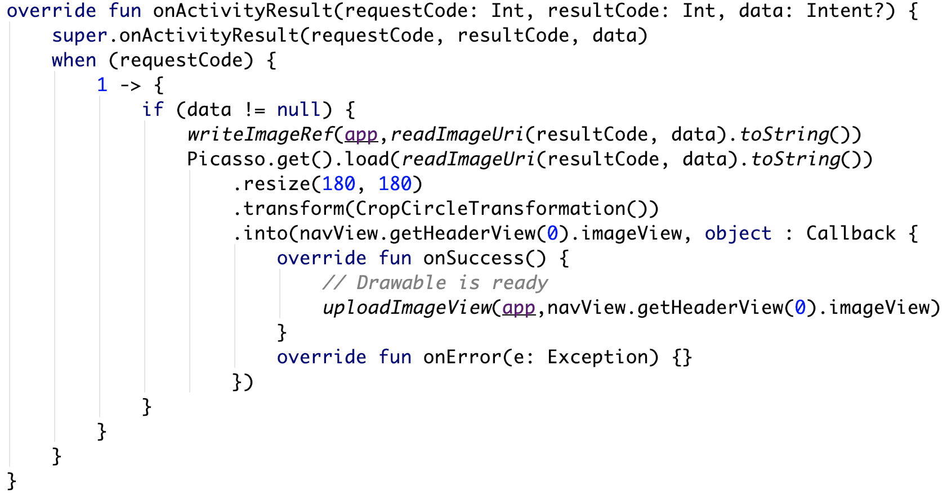
Respond to ImageView Click in Nav Drawer

Slide 14
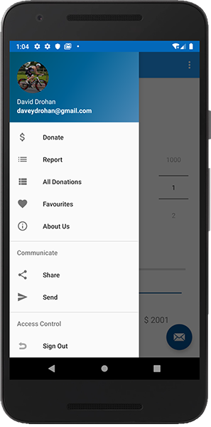
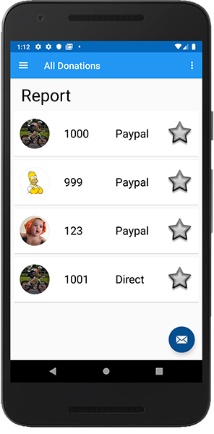
Cloud Storage + Mobile App

Slide 15

References
https://console.firebase.google.com/
https://firebase.google.com/
https://github.com/firebase/quickstart-android

Slide 16


