Slide 1
Mobile Application Development
David Drohan (ddrohan@wit.ie)

Slide 2
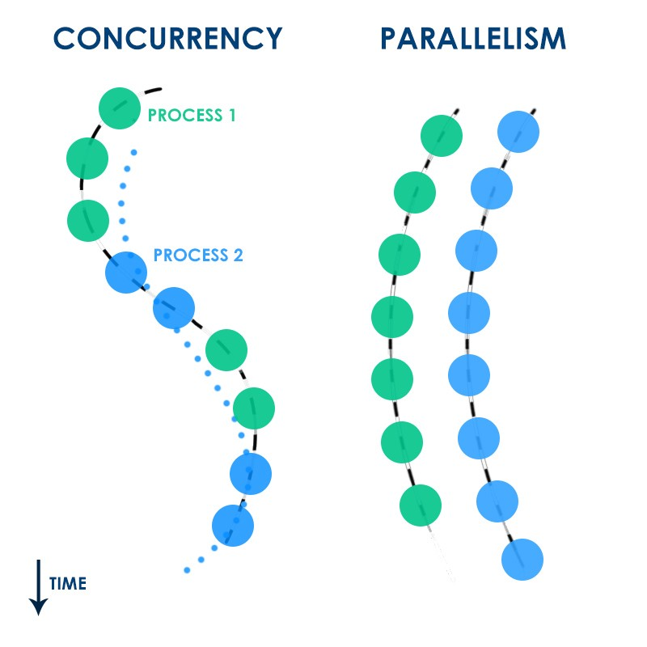
Introducing Concurrency

Slide 3
Agenda
Background (What, Why & How)
Concurrency & Parallelism
Models for Concurrent Programming
Processes & Threads
Synchronous and Asynchronous Programming

Slide 4
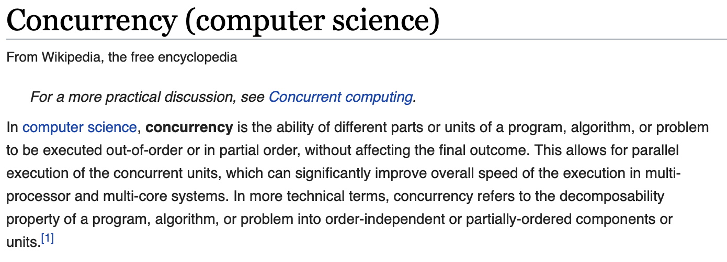
Background - What
multiple computations are happening at the same time, but not necessarily in parallel
Notes:
We’ll return to parallelism later on

Slide 5
Background - Why
Concurrency is everywhere in modern programming, whether we like it or not:
Multiple computers on a network
Multiple applications running on one computer
Multiple processors in a computer (multi-core processors)
In fact, concurrency is essential in modern programming:
Web Sites / Web Apps handling multiple simultaneous users
Mobile apps need to do some of their processing “in the cloud”
GUIs/IDEs almost always require background work that does not interrupt the user. E.g, AS compiles your code while you’re still editing it

Slide 6
Background - Why
Being able to program with concurrency is important now and will still be important in the future
Processor clock speeds are no longer increasing, instead, we’re getting more cores with each new generation of chips. (quad-core etc.)
So in the future, in order to get a computation to run faster, we’ll have to split up a computation into concurrent pieces.

Slide 7
Background – How (Models for Concurrent Programming)
There are two common models for concurrent programming:
shared memory and
message passing
In the shared memory model of concurrency, concurrent modules interact by reading and writing shared objects in memory.
In the message-passing model, concurrent modules interact by sending messages to each other through a communication channel. Modules send off messages, and incoming messages to each module are queued up for handling.

Slide 8
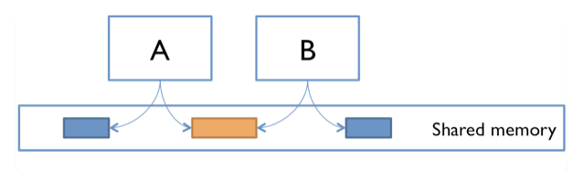
Background – How (Shared Memory Model Examples)
A and B might be two processors (or processor cores) in the same computer, sharing the same physical memory.
A and B might be two programs running on the same computer, sharing a common filesystem with files they can read and write.
A and B might be two threads in the same program (we’ll explain what a thread is soon), sharing the same objects.

Slide 9

Background – How (Message Passing Model Examples)
A and B might be two computers in a network, communicating by network connections.
A and B might be a web browser and a web server – A opens a connection to B, asks for a web page, and B sends the web page data back to A.
A and B might be an instant messaging client and server.

Slide 10
Processes & Threads
The message-passing and shared-memory models are about how concurrent modules communicate. The concurrent modules themselves come in two different kinds:
processes and
Threads
Both processes and threads are independent sequences of execution.
The typical difference is that threads (of the same process) run in a shared memory space, while processes run in separate memory spaces.

Slide 11
Processes & Threads
Threads are a sequence of execution of code which can be executed independently of one another. It is the smallest unit of tasks that can be executed by an OS. A program can be single threaded or multi-threaded.
A process is an instance of a running program. A program can have multiple processes. A process usually starts with a single thread i.e. a primary thread but later down the line of execution it can create multiple threads.

Slide 12
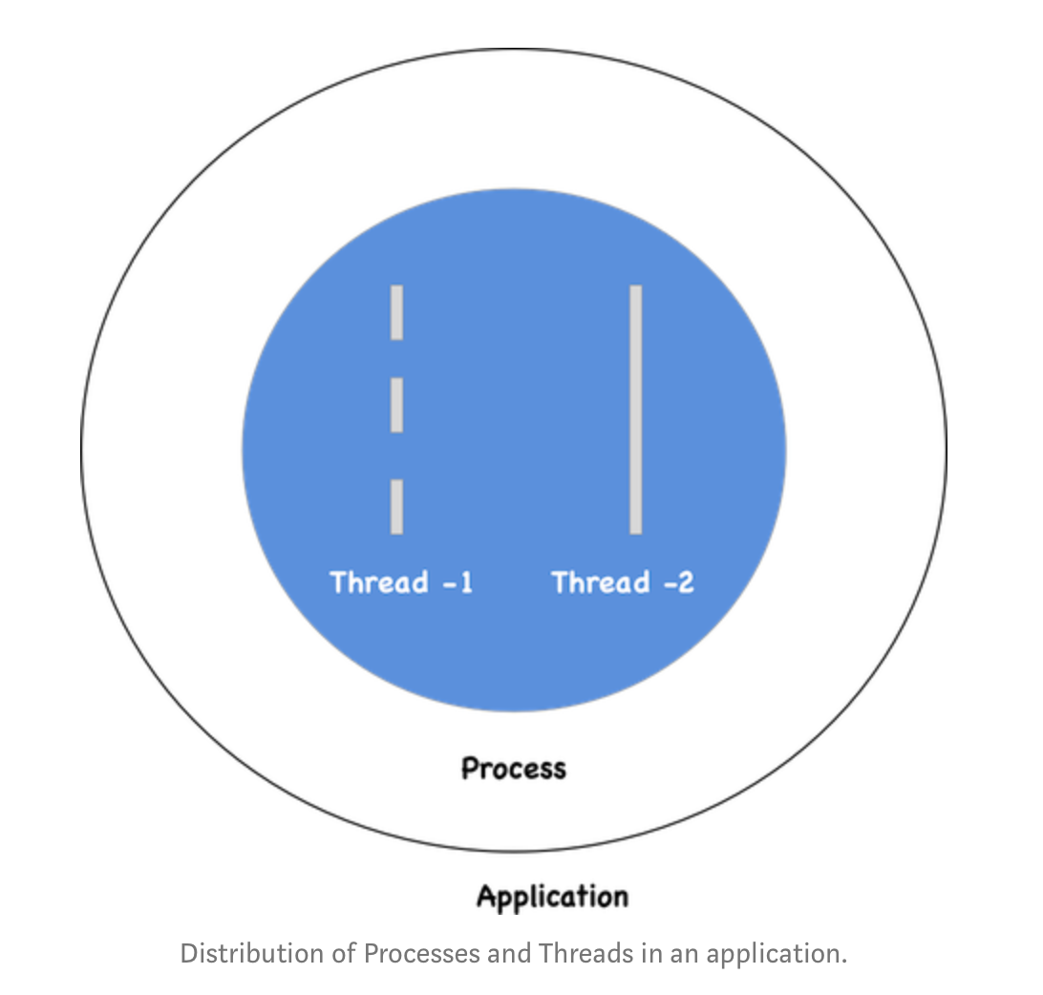
Processes & Threads

Slide 13
Synchronous and Asynchronous Programming
In a synchronous programming model, tasks are executed one after another. Each task waits for any previous task to complete and then gets executed.
In an asynchronous programming model, when one task gets executed, you could switch to a different task without waiting for the previous to get completed.

Slide 14
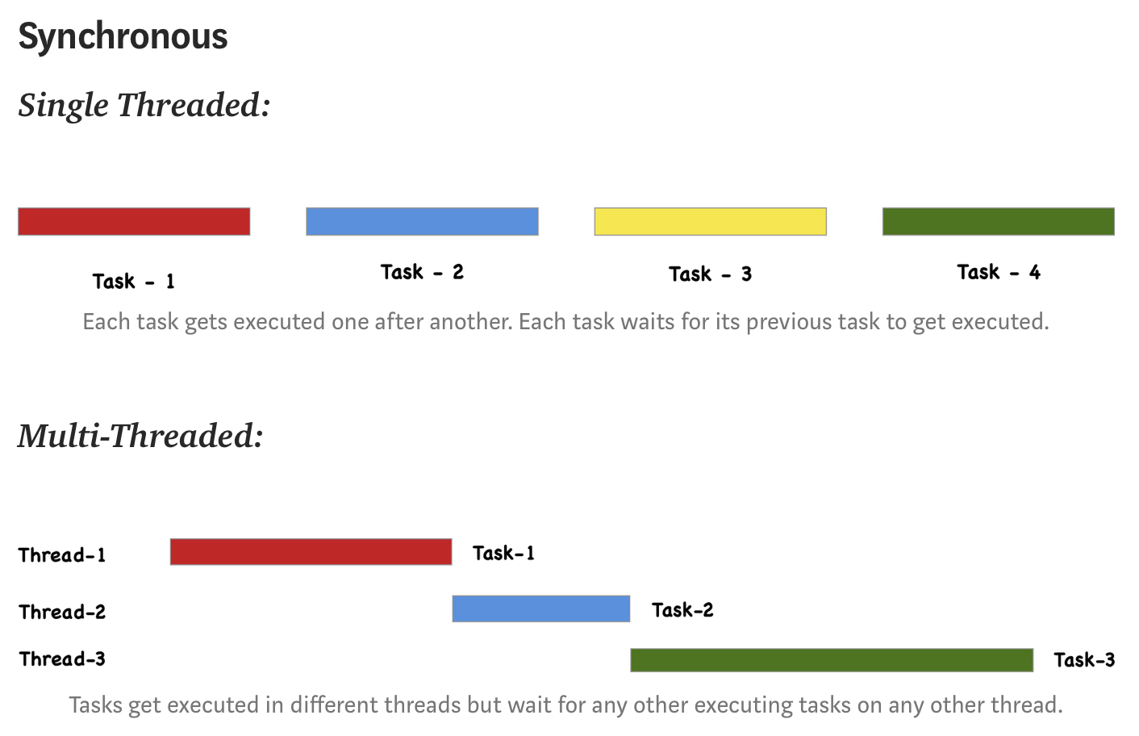
Synchronous and Asynchronous Programming

Slide 15
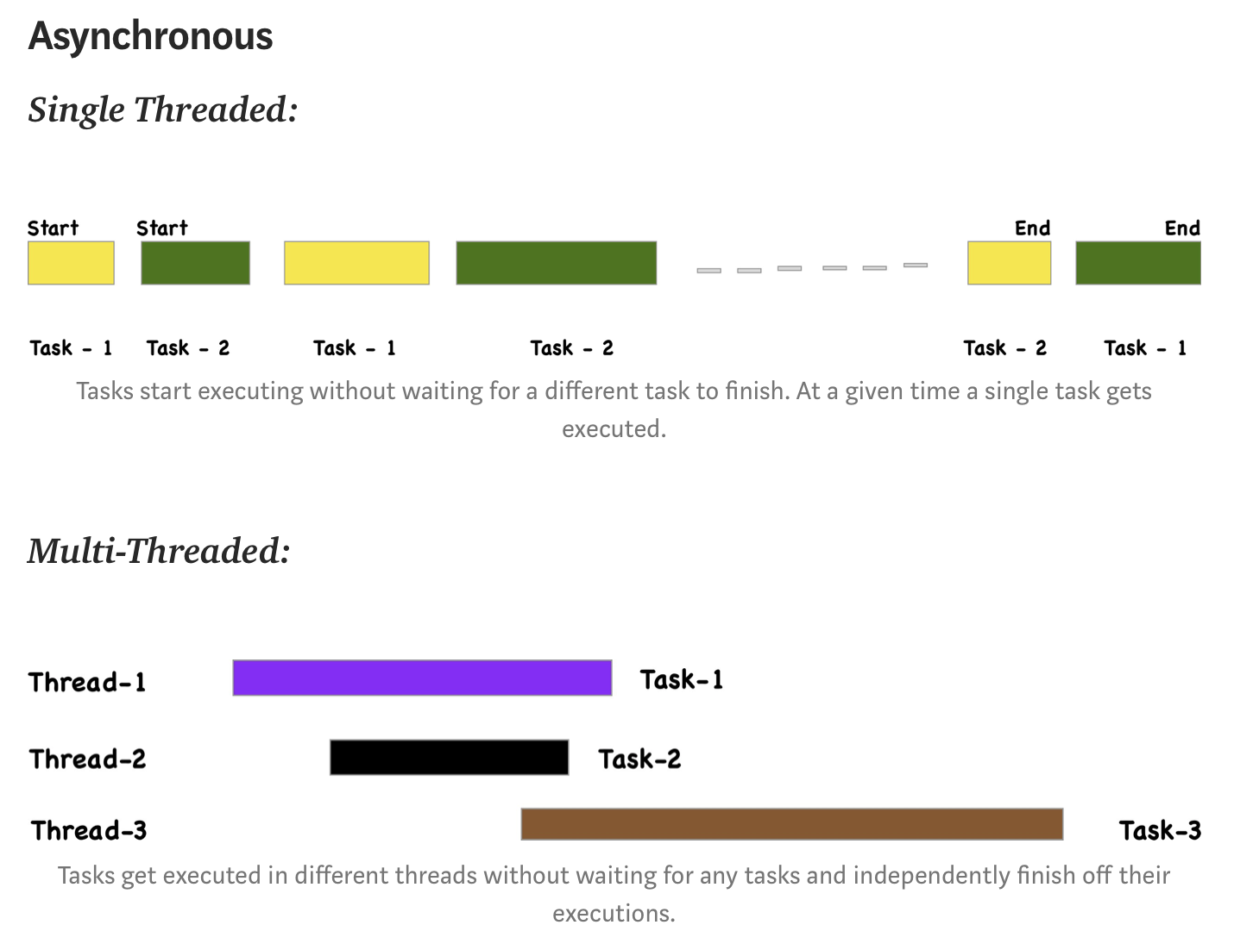
Synchronous and Asynchronous Programming

Slide 16
Synchronous and Asynchronous Programming
What is the role of synchronous and asynchronous programming in concurrency and parallelism?
Asynchronous programming model helps us to achieve concurrency.
Asynchronous programming model in a multi-threaded environment is a way to achieve parallelism.

Slide 17
In a Nutshell…
Concurrency and Parallelism
Way tasks are executed
Single Threaded and Multi-Threaded
The environment of task execution
Synchronous and Asynchronous
Programming model
Notes:
Concurrency means executing multiple tasks at the same time but not necessarily simultaneously
Parallelism means performing two or more tasks simultaneously

Slide 18
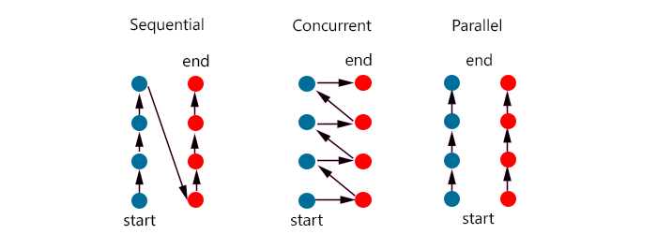
In a Nutshell…
Notes:
Concurrency means executing multiple tasks at the same time but not necessarily simultaneously
Parallelism means performing two or more tasks simultaneously

Slide 19

References
Sources: https://web.mit.edu/6.005/www/fa14/classes/17-concurrency/
https://medium.com/swift-india/concurrency-parallelism-threads-processes-async-and-sync-related-39fd951bc61d

Slide 20


