Slide 1
Mobile Application Development
David Drohan (ddrohan@wit.ie)

Slide 2
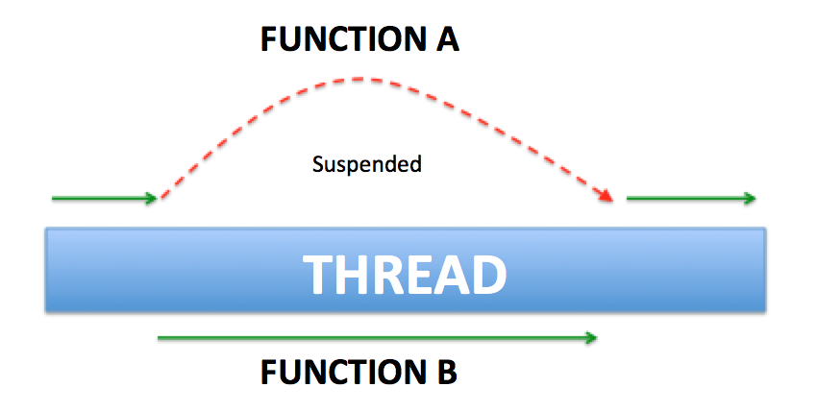
Introducing Coroutines

Slide 3
Agenda
Context
Background (What, Why & How)

Slide 4
Context
If you’re coming from Java, you probably associate asynchronous code with threads :
you’ve dealt with shared mutable state
you’ve spent countless hours chasing down deadlocks and race conditions
you’ve taken care when modifying shared state using locking primitives like synchronized.
At this point you’ve realized that concurrency is hard. When you take a single threaded piece of code and make it concurrent, you inherently introduce a tremendous amount of complexity.

Slide 5
Context
The main purpose of coroutines is to take care of the complexities in working with asynchronous programming & concurrency

Slide 6
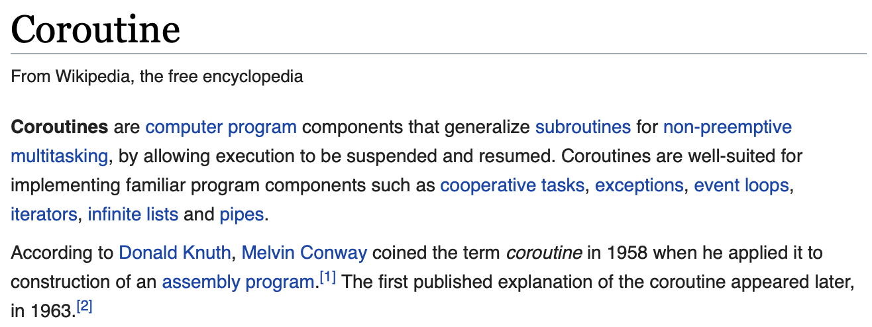
Background - What
Coroutines provide a way to write asynchronous code sequentially making multithreaded programming more debuggable and maintainable.
Notes:
We’ll return to parallelism later on

Slide 7
Background - Why
The problem coroutines try to tackle is how to prevent our applications from blocking.
Asynchronous or non-blocking programming is the new reality both on the client side to provide a fluid experience and on the server side for a more scalable architecture.
There are several approaches to this problem including Threads, Callbacks, Futures/Promises and Reactive extensions (Rx).
Notes:
And is very relevant for us in the Android World and not blocking the main Ui Thread – don’t forget Callback Hell !!

Slide 8
Background - Why
If you’ve worked with Rx, then you know it takes a lot of effort to get to know it enough, to be able to use it safely
On the other hand, AsyncTasks and Threads can easily introduce leaks and memory overhead
Finally, relying on all these APIs, which use callbacks, can introduce a ton of code. Not only that, but the code can become unreadable, as you introduce more callbacks.
Notes:
Leading to callback hell

Slide 9
Background - How (high level overview)
Based on the concept of suspending functions coroutines approached the problem in a different way.
Main advantage over competitive approaches is that the structure of the code is still sequential and easier to write.
Kotlin provides coroutine support at the language level but the functionality is delegated to libraries.
Only one keyword is added to the core language, the suspend keyword.
Notes:
You write code sequentially, like you usually do, and then leave to the coroutines the hard work.

Slide 10
Background - How (high level overview)
Similar to threads, they take a block of code and have a lifecycle - it can be created, started, suspended, resumed and terminated (cancelled).
Coroutines are non-blocking and you can have many of them running on a single thread.
In the world of a coroutine, suspending and resuming work replaces the need for callbacks.

Slide 11
Background - How (high level overview)
How in Kotlin?
Notes:
We will look at in the next section ☺

Slide 12

References
Sources: https://antonis.me/2018/12/12/an-introduction-to-kotlin-coroutines/ https://proandroiddev.com/kotlin-coroutines-channels-csp-android-db441400965f
https://superkotlin.com/coroutines/
https://www.codementor.io/jimmy_chuks/introduction-to-coroutines-xr674rfpo

Slide 13


