Slide 1
Mobile Application Development
David Drohan (ddrohan@wit.ie)

Slide 2
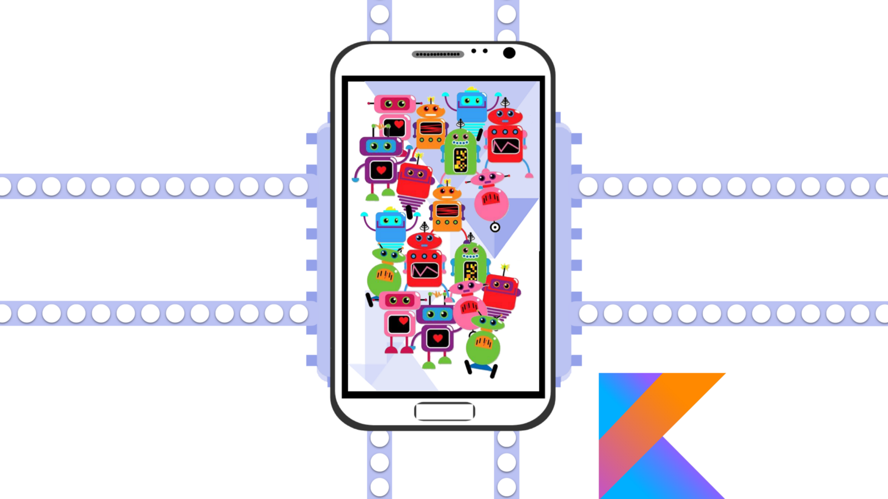
Coroutines in Kotlin

Slide 3
Agenda
Background
Introduction
The Terminology
Sample Code
Case Study

Slide 4
Agenda
Background
Introduction
The Terminology
Sample Code
Case Study

Slide 5

Background

Slide 6
Background
Asynchronous programming is very important for modern applications. Using it increases the amount of work your app can perform in parallel
This in turn allows you to run heavy-duty tasks away from the UI thread, in the background
By doing so, you avoid UI freezes, and provide a fluid experience for your users (good UX)

Slide 7
Background
Android provides several asynchronous programming mechanisms, but it’s difficult to find the most appropriate one to use
Some mechanisms have a huge learning curve. Others require a ton of boilerplate code to implement, and aren’t that concise
This all affects the scalability of your app, and increases the cognitive load for new developers
It’s best if the APIs you rely on are easy to use and scale when needed

Slide 8
Background
Because all platforms on the JVM had the same problem, the team from JetBrains has come up with a new API.
The idea behind it is to help you solve all these problems, without a steep learning curve.
Here, hopefully, ☺ you’ll learn about that API – Kotlin Coroutines
Notes:
It was experimental for a while but now it’s out of beta and available in Kotlin 1.3+ (I think?)

Slide 9
Recap
Coroutines help you to write asynchronous code in a more natural, synchronous way
That is, in a sequential style of programming, which is more humanly-understandable and readable
They offer a number of benefits, which we’ll cover later
Notes:
So now lets have a look at how Kotlin deals with Coroutines

Slide 10
Coroutines in Kotlin

Slide 11
Introduction
In Android, coroutines are used mainly to solve two frequently faced problems, namely
Long-running tasks that could block the main thread
Disk operations from the main thread.
Notes:
So we’ll focus on the blocking the main thread (the UI thread) for the moment

Slide 12
Introduction
The documentation says Kotlin Coroutines are like lightweight threads. They are lightweight because creating coroutines doesn’t allocate new threads.
Instead, they use predefined thread pools, and smart scheduling (the process of determining which piece of work you will execute next)
Additionally, coroutines can be suspended and resumed mid-execution
Creating a large number of Kotlin Coroutines won’t bring unnecessary memory overhead to your program
Notes:
This means you can have a long-running task, which you can execute yourself little-by-little. You can pause it any number of times, and resume it when you’re ready to go again.
You just suspend some of them until the thread pool frees up.
So what does suspended at certain points mean and how is it different from blocking the thread?

Slide 13
Introduction – Suspending Vs Blocking
Suspension and blocking sound similar, but they’re actually very different.
A blocking call to a function means that a call to any other function, from the same thread, will halt the parent’s execution.
So if you make a blocking call on the main thread’s execution, you effectively freeze the UI. Until that blocking calls finishes, the user will see a static screen, which is not a good thing to say the least!
You can visualize it like this:

Slide 14
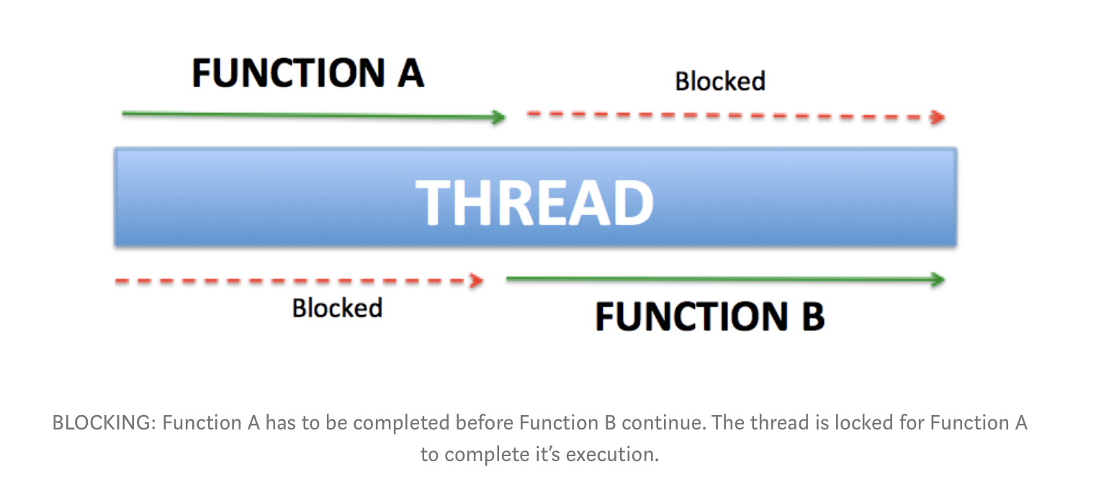
Introduction – Suspending Vs Blocking

Slide 15
Introduction – Suspending Vs Blocking
On the other hand, suspending doesn’t necessarily block your parent function’s execution.
If you call a suspending function in some thread, you can easily push that function to a different thread. If it’s a heavy operation, it won’t block the main thread.
If you require a result from the function, you can bridge back to the main thread, without a lot of code. That way you can fetch data in a coroutine, from the main thread.
You can visualize that like this:
Notes:
All you have to do is launch your coroutine in a worker thread. This way you’ll effectively call something from the main thread, switch to the background, and switch back once the data is ready.
If the suspending function has to suspend, it will simply pause its execution. This way you free up its thread for other work. Once it’s done suspending, it will resume again to finish its work.

Slide 16
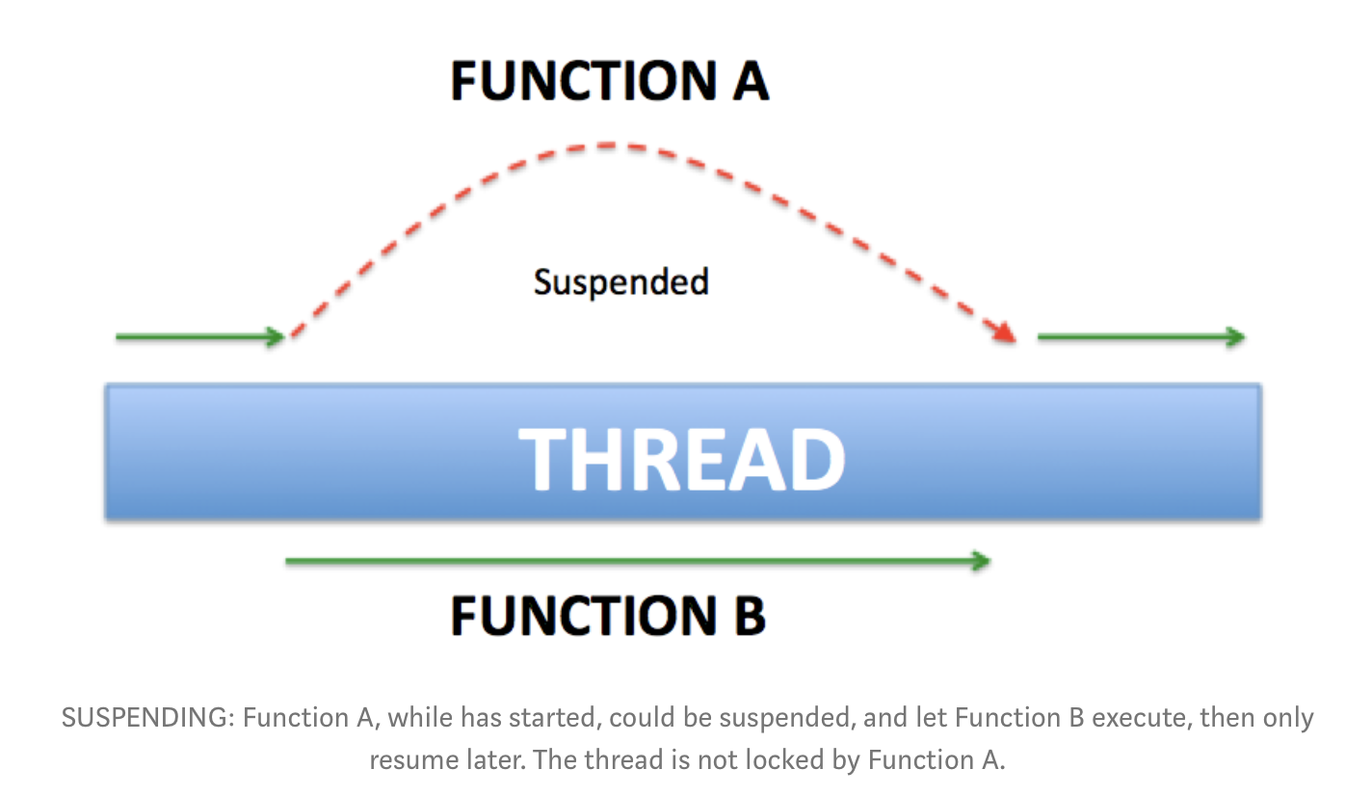
Introduction – Suspending Vs Blocking
Notes:
And all this has huge implications for the UX in the Android World, anything that could block the main UI Thread we can stick in a couroutine and get back results whenever they’re ready
So now that we have an idea of the purpose of coroutines in Kotlin and Android, let’s have a look at some of the terminology

Slide 17
The Terminology

Slide 18
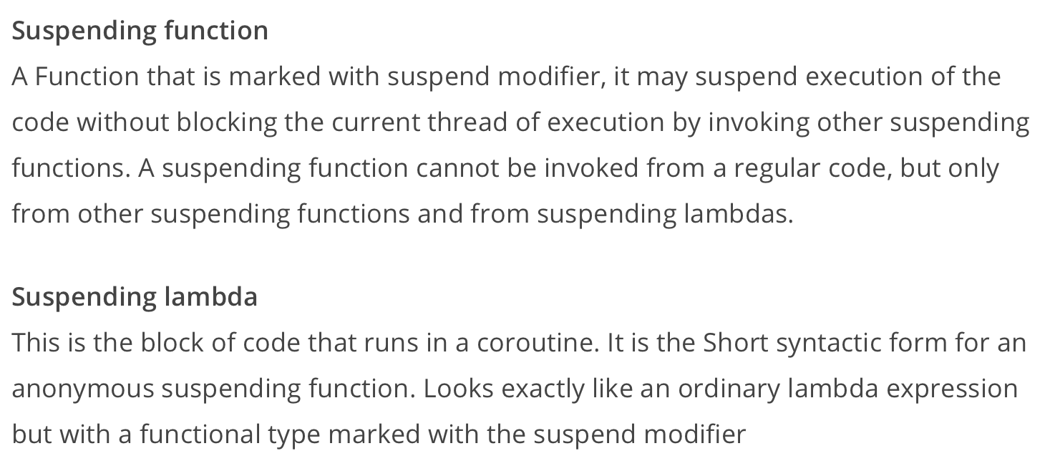
Coroutine Terminology

Slide 19
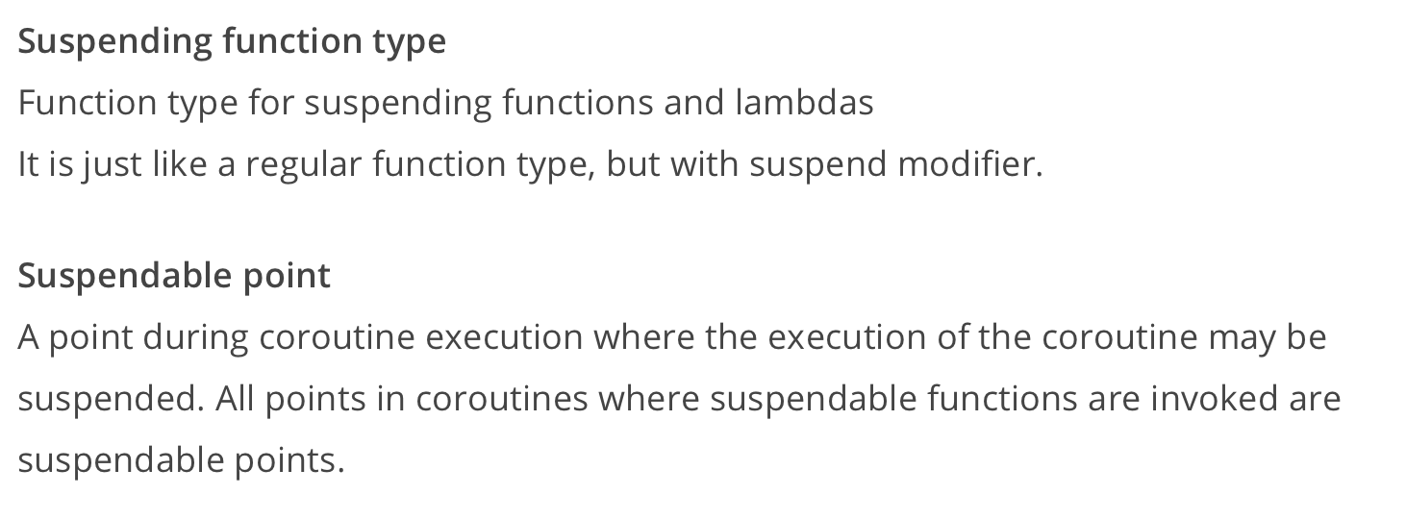
Coroutine Terminology

Slide 20
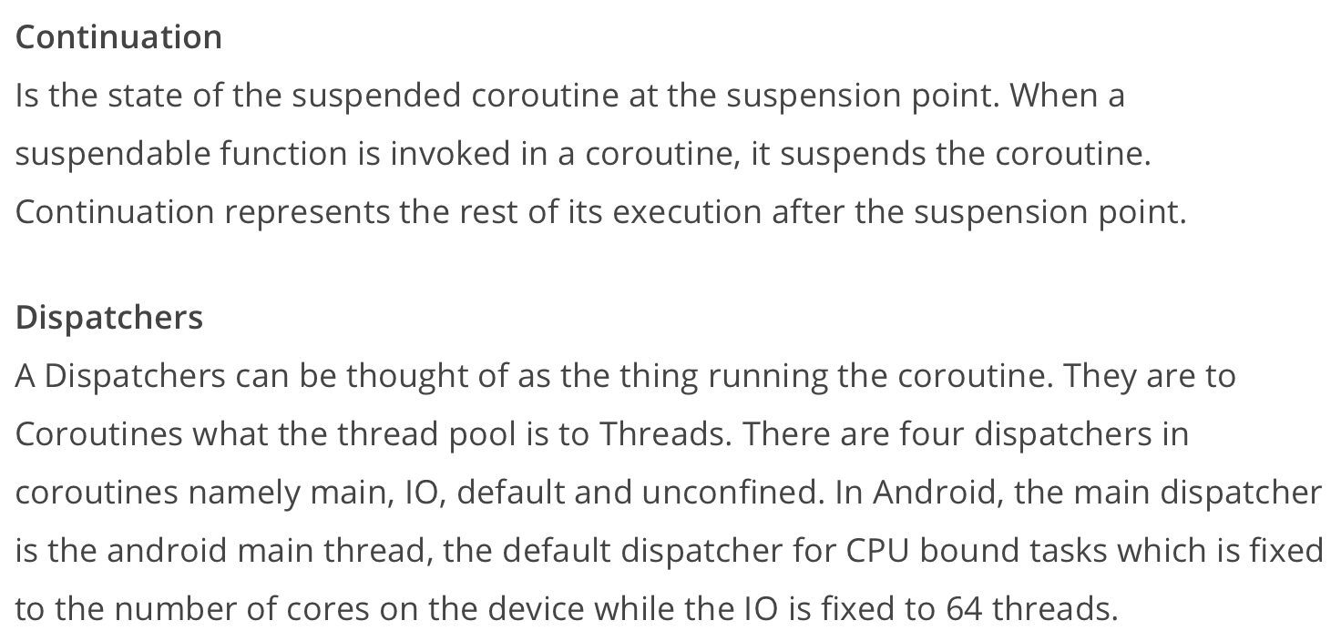
Coroutine Terminology

Slide 21
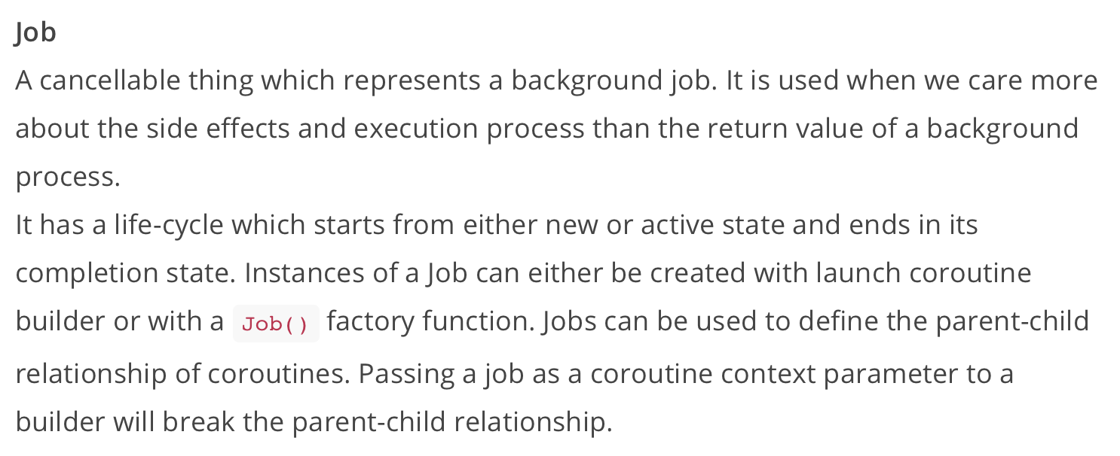
Coroutine Terminology

Slide 22
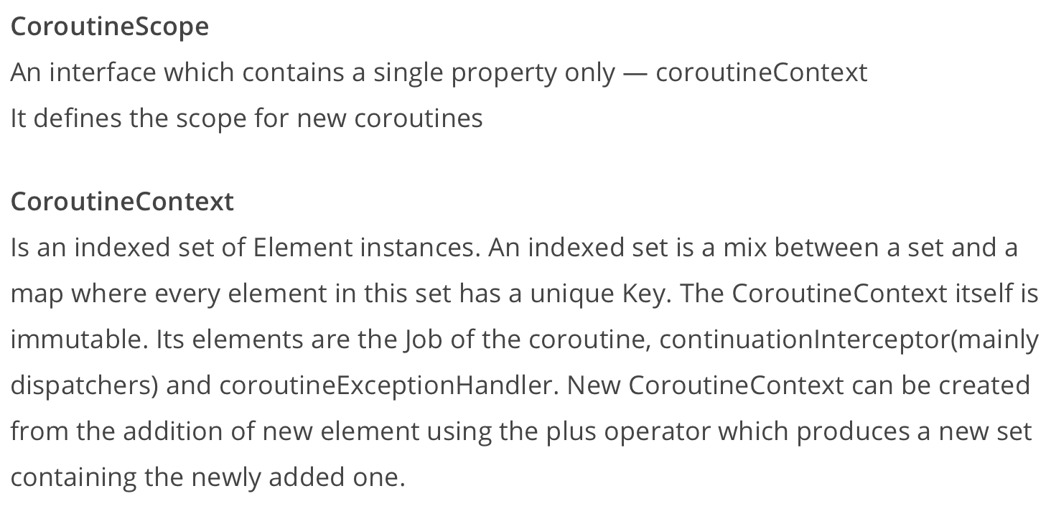
Coroutine Terminology

Slide 23
Coroutine Terminology
CoroutineBuilders: These take a suspending lambda as an argument to create a coroutine. There are a bunch of coroutine builders provided by Kotlin Coroutines, including async(), launch(), runBlocking.

Slide 24
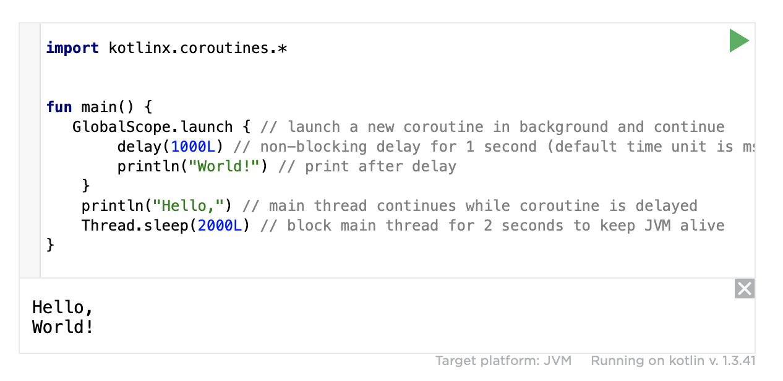
Coroutine Example
Notes:
And we’ll look at a lot more code examples in the final section.

Slide 25
References
Sources: https://antonis.me/2018/12/12/an-introduction-to-kotlin-coroutines/ https://proandroiddev.com/kotlin-coroutines-channels-csp-android-db441400965f
https://superkotlin.com/coroutines/
https://www.codementor.io/jimmy_chuks/introduction-to-coroutines-xr674rfpo
https://www.raywenderlich.com/1423941-kotlin-coroutines-tutorial-for-android-getting-started
https://android.jlelse.eu/kotlin-coroutines-threads-concurrency-and-parallelism-101-78a56e09d373

Slide 26


