Slide 1
Mobile Application Development
David Drohan (ddrohan@wit.ie)

Slide 2
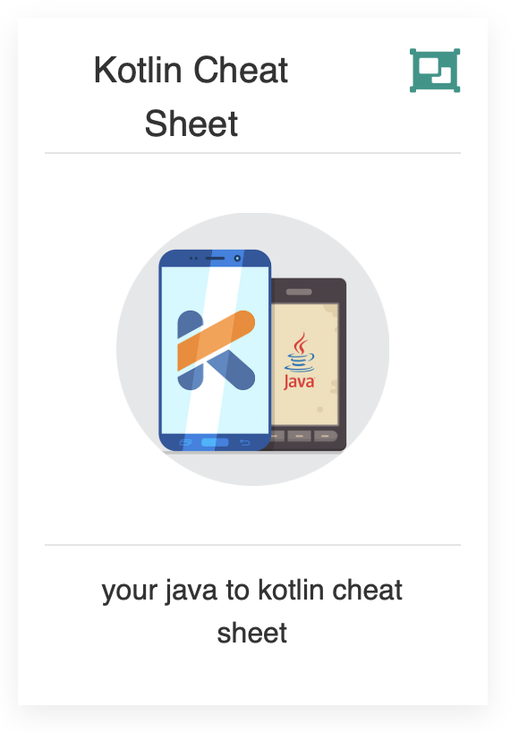
From Java to Kotlin
Your Java to Kotlin Cheat Sheet

Slide 3
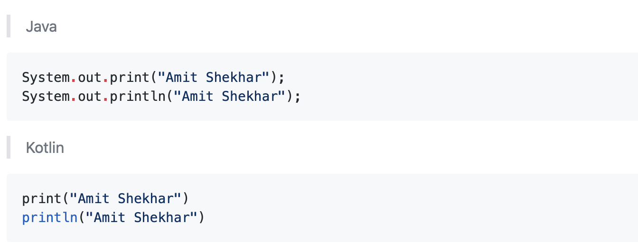
Print to Console

Slide 4
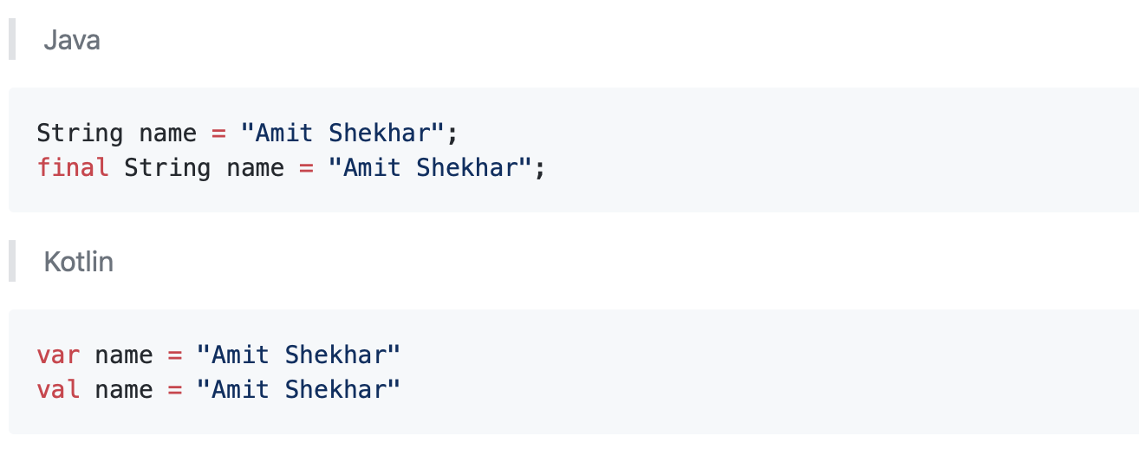
Constants and Variables

Slide 5
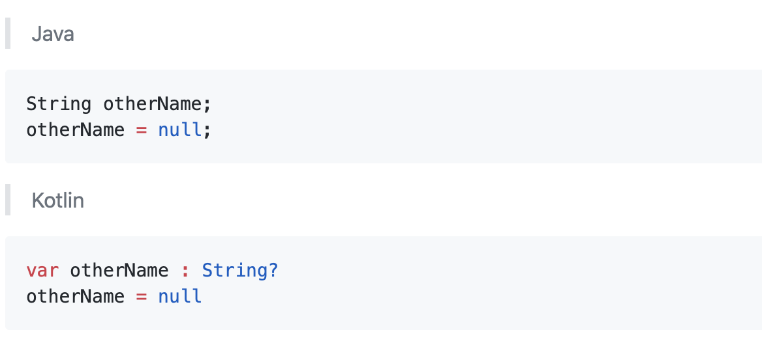
Assigning the null value

Slide 6
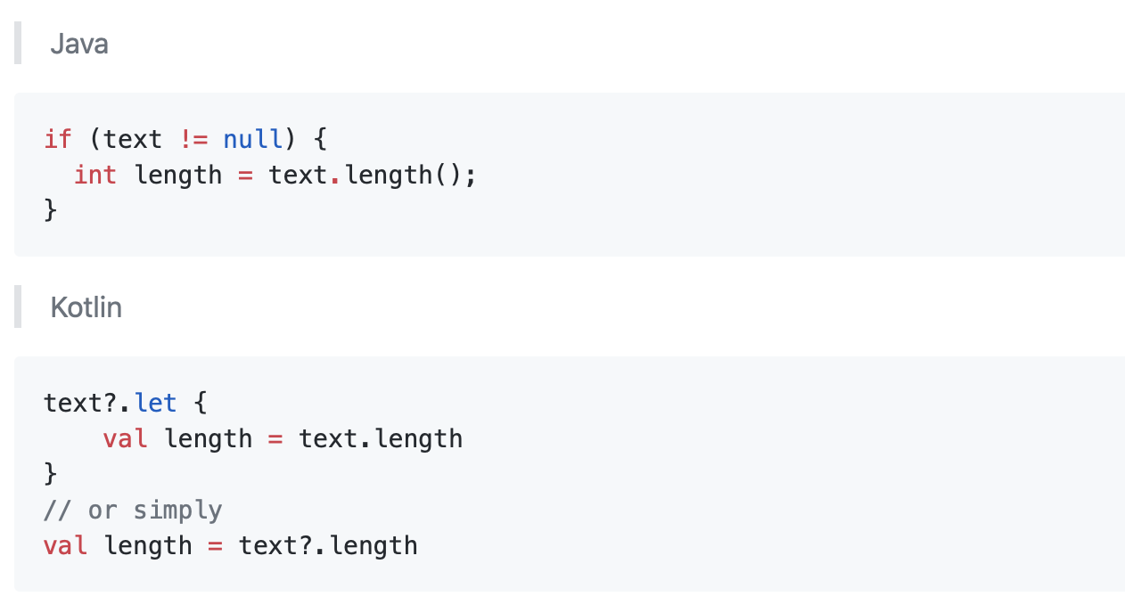
Verify if value is null
Notes:
let takes the object it is invoked upon as the parameter and returns the result of the lambda expression.
Kotlin let is a scoping function wherein the variables declared inside the expression cannot be used outside.

Slide 7
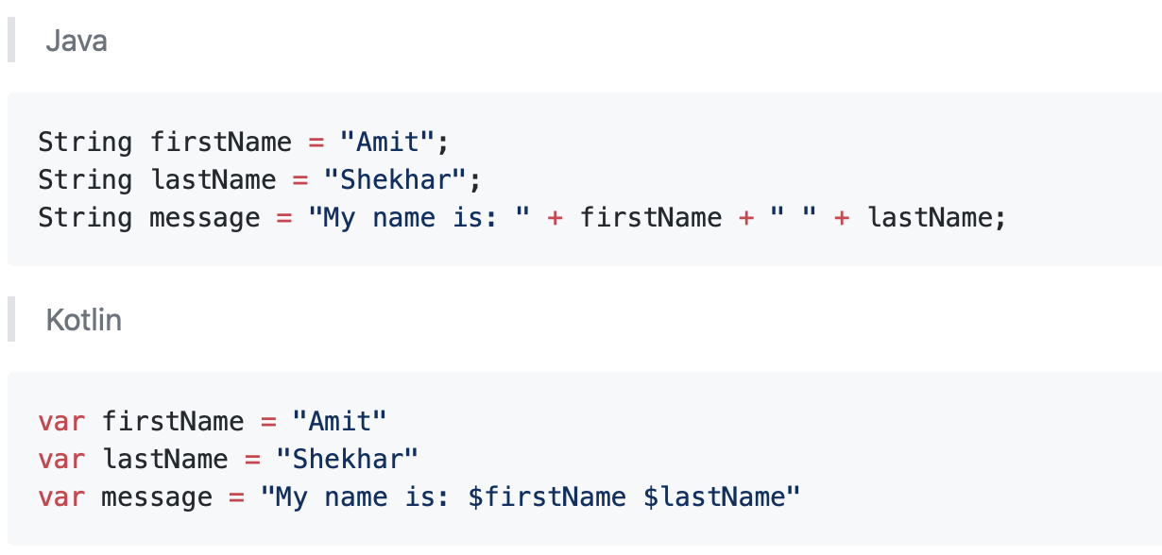
Concatenation of strings

Slide 8
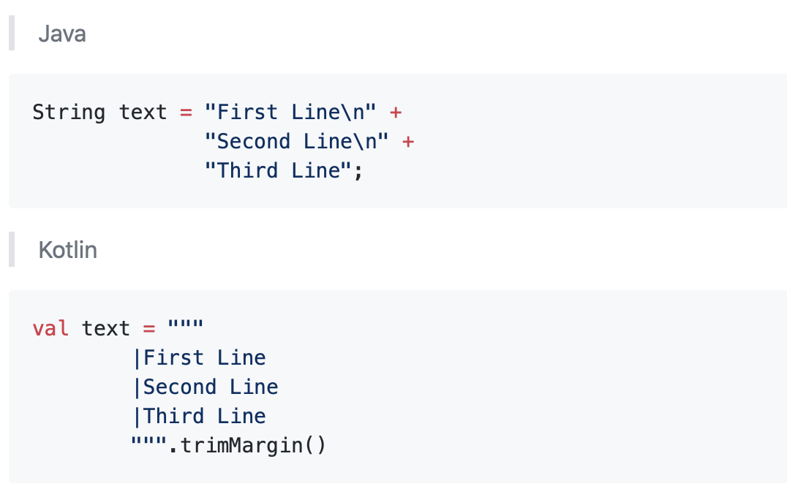
New line in string

Slide 9
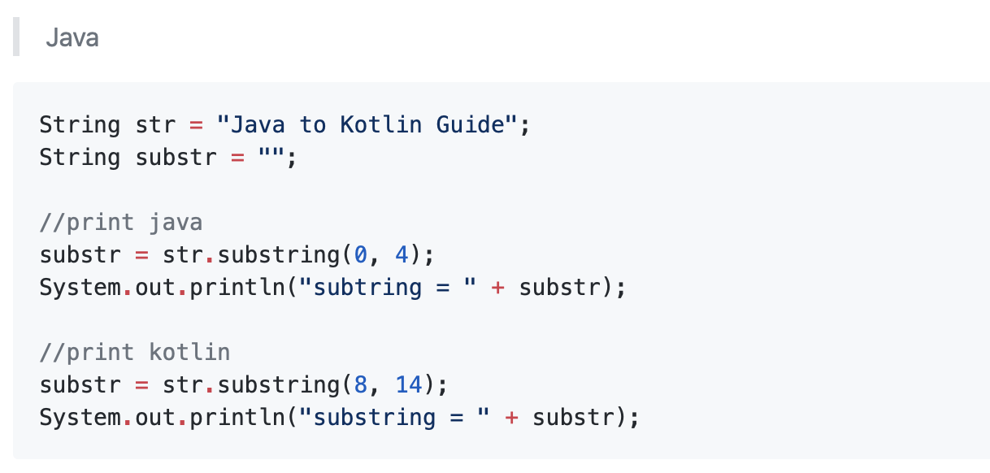
Substring

Slide 10
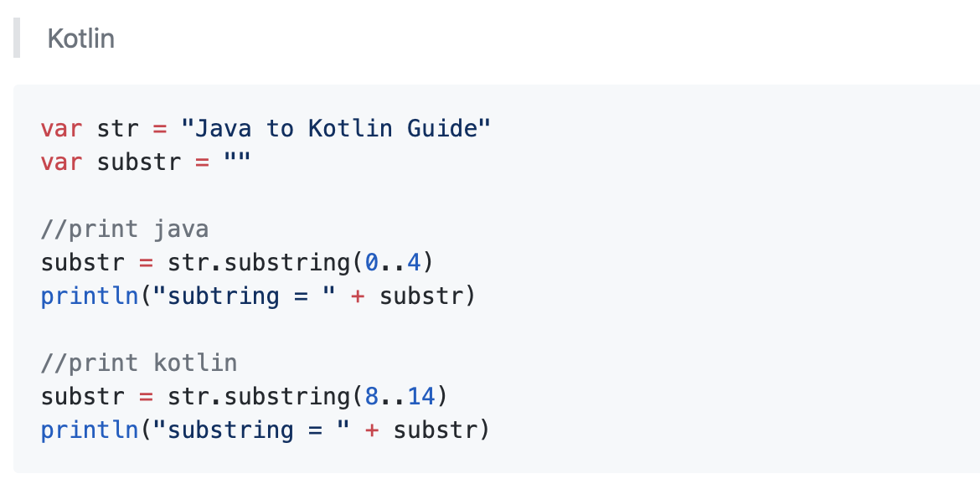
Substring

Slide 11
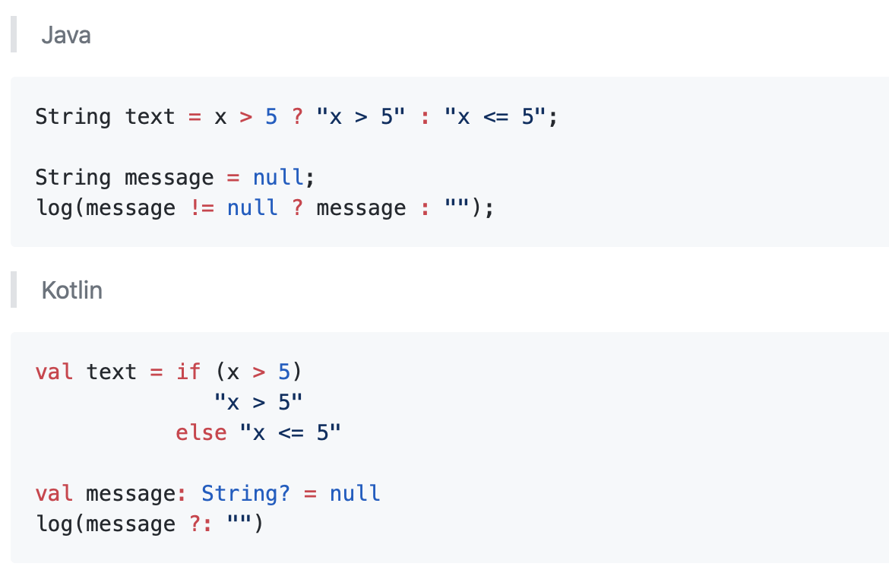
Ternary Operations
Notes:
Elvis operator ?: evaluates left side, if it’s null you get the right side

Slide 12
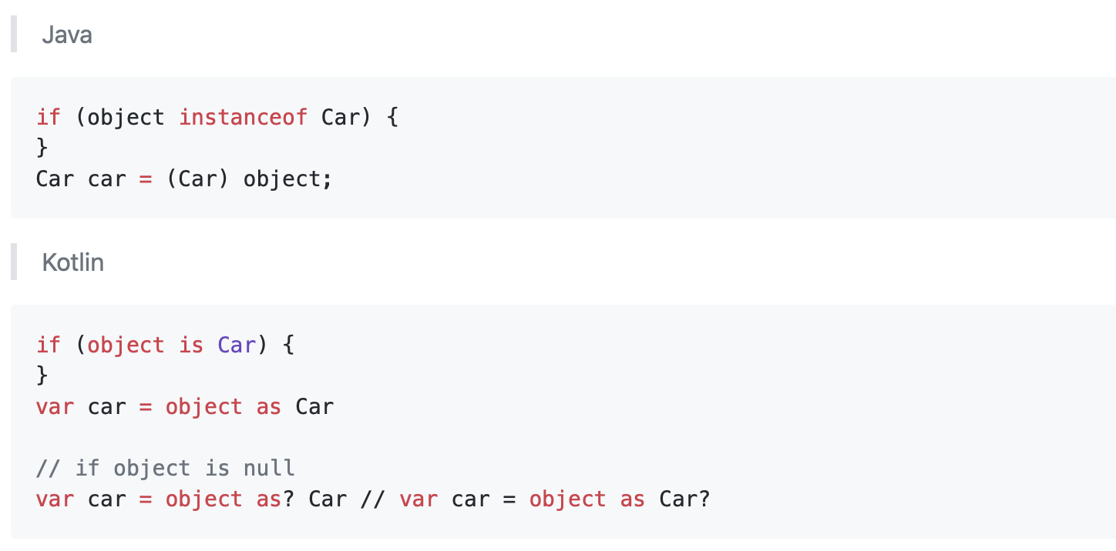
Check the type and casting
Notes:
The “as?” allows the cast to return null when the left-hand side is null

Slide 13
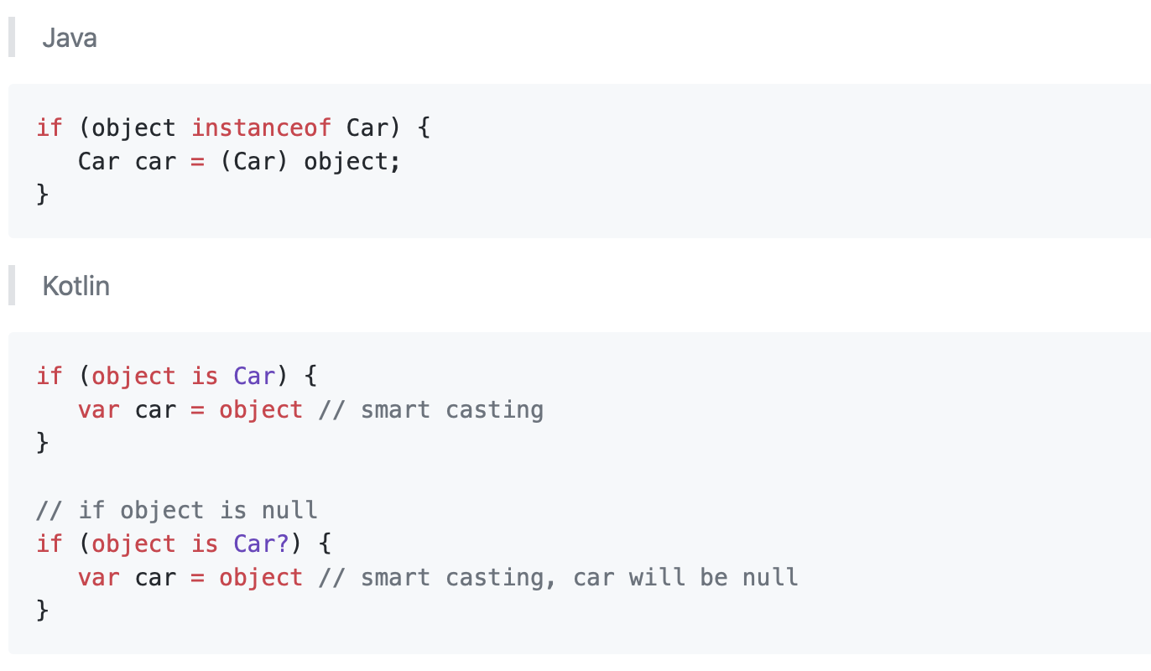
Check the type and casting (implicit)

Slide 14
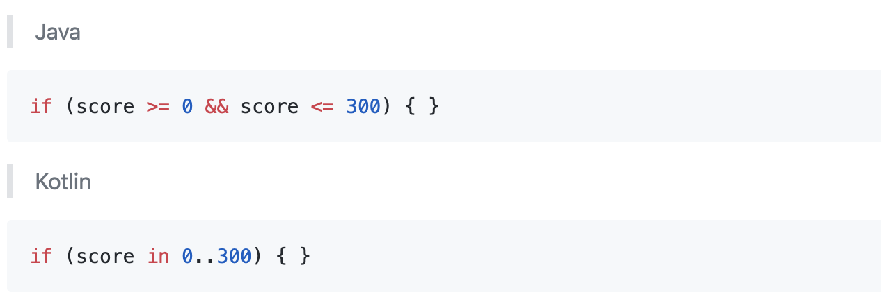
Multiple conditions ( if )

Slide 15
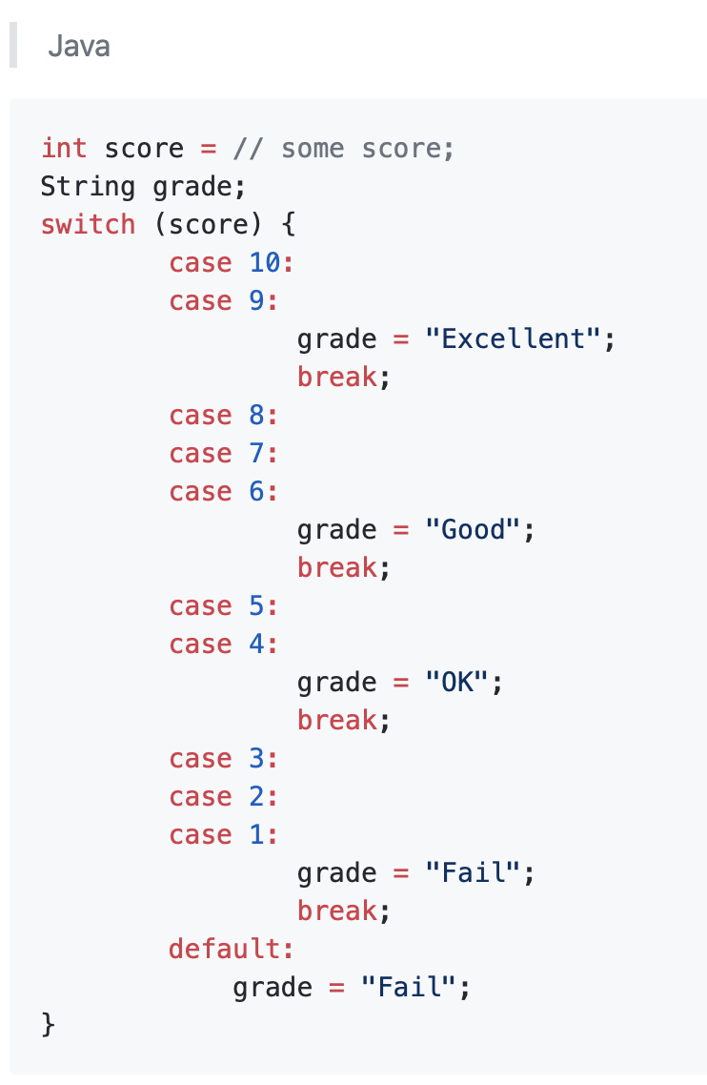
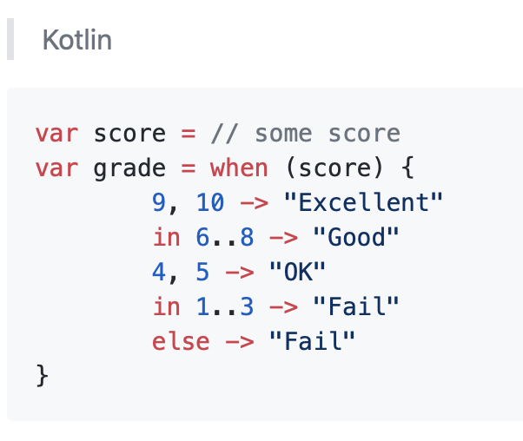
Multiple conditions ( switch case )

Slide 16
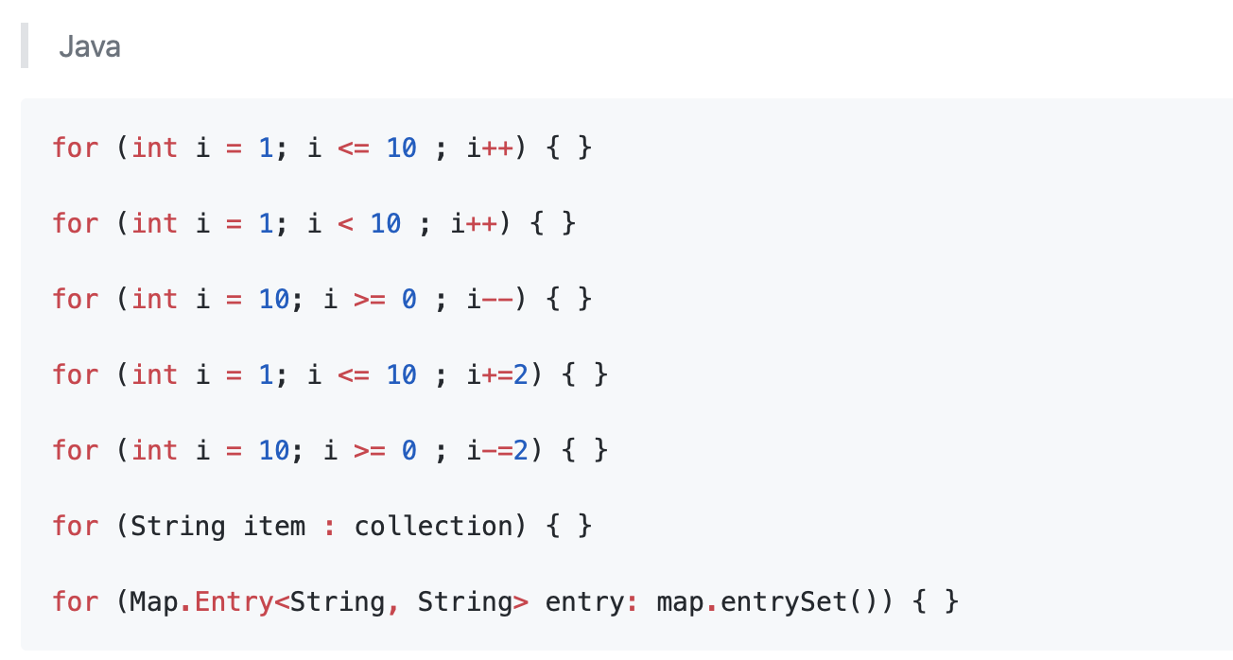
For-loops

Slide 17
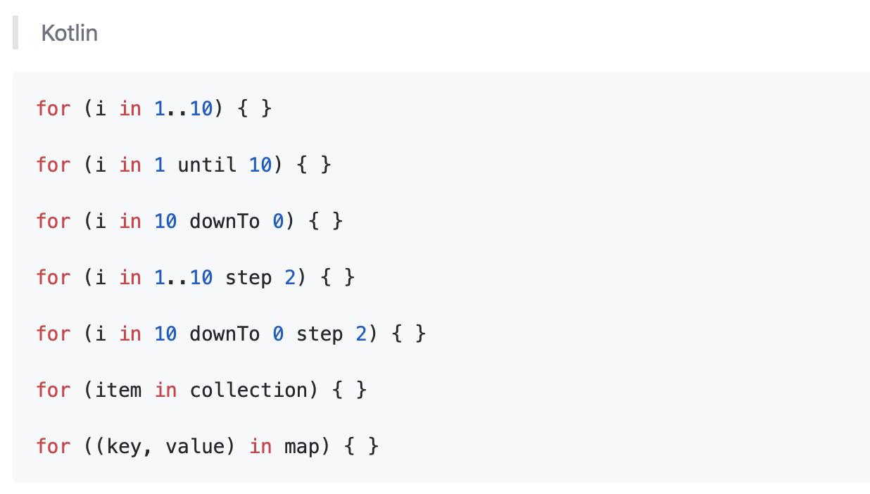
For-loops

Slide 18
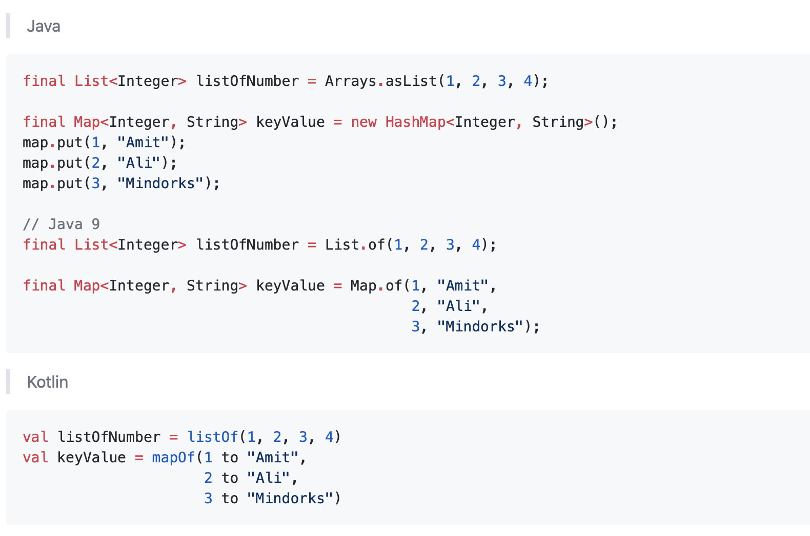
Collections

Slide 19
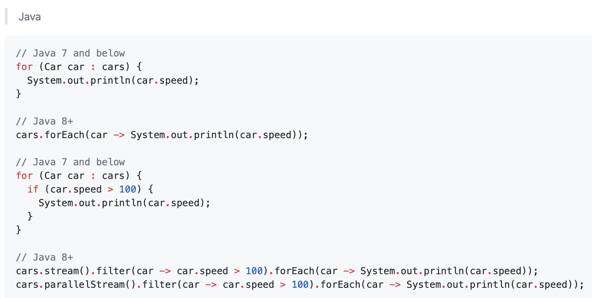
for each

Slide 20
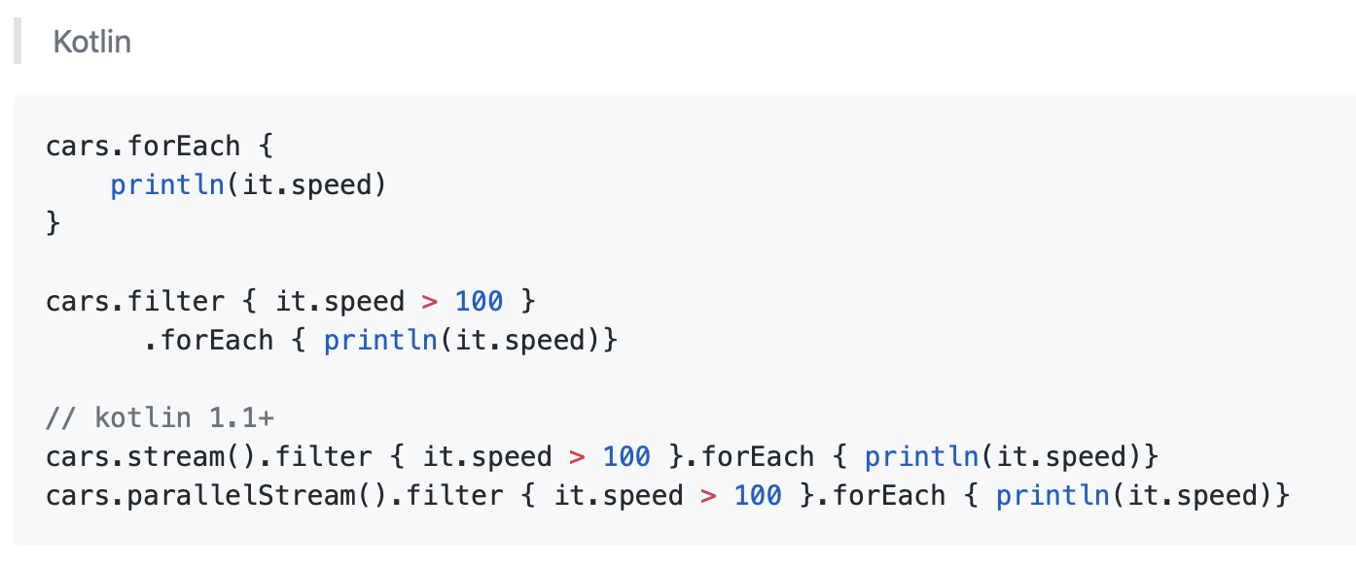
for each

Slide 21
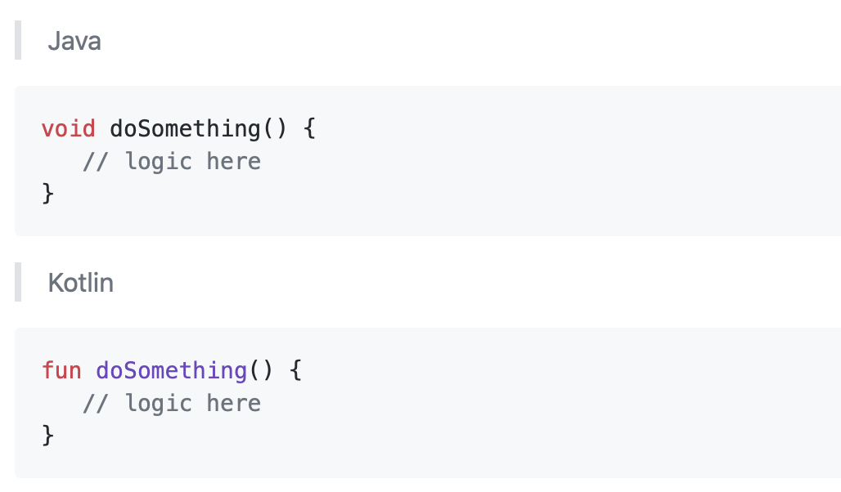
Defining methods

Slide 22
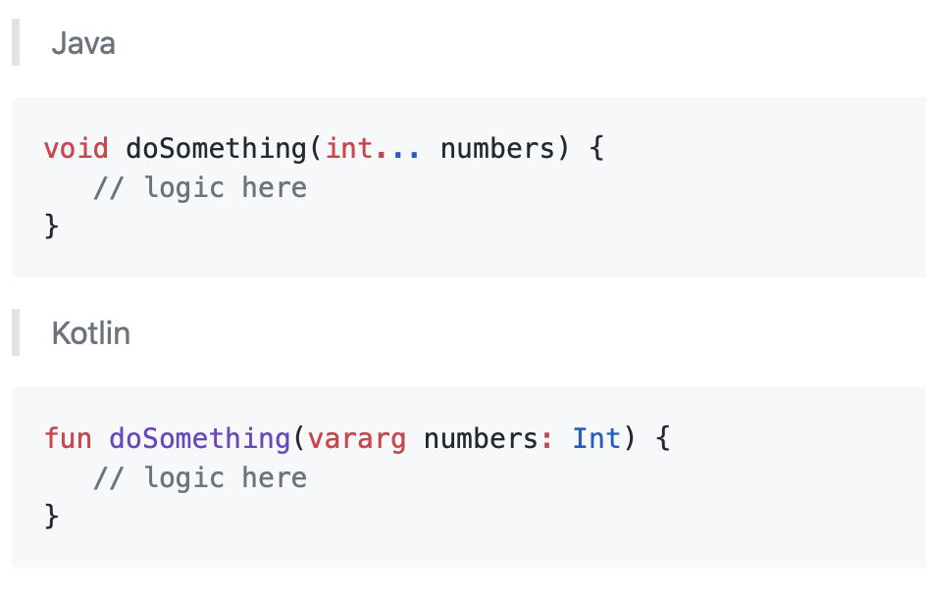
Variable number of arguments

Slide 23
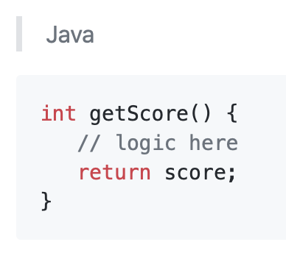
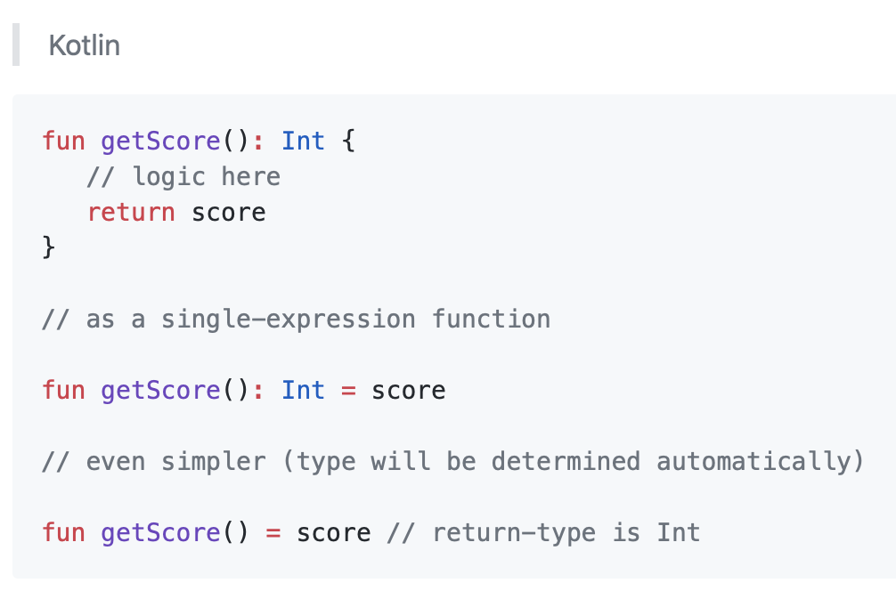
Defining methods with return

Slide 24
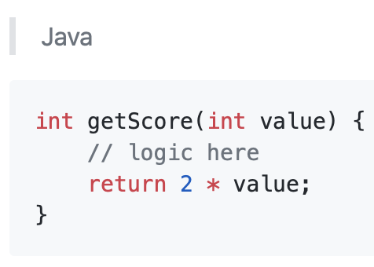
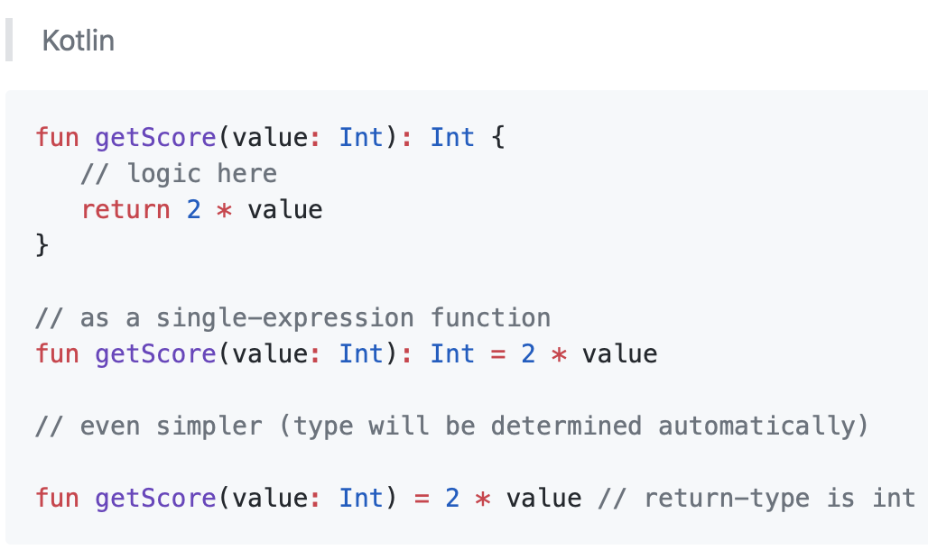
Returning result of an operation

Slide 25
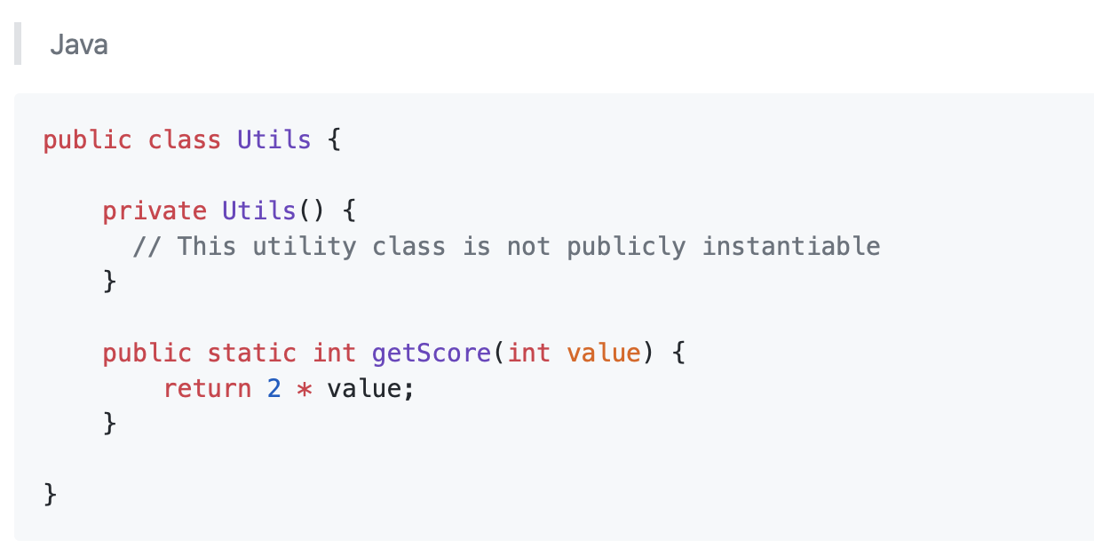
Constructors (and static methods)

Slide 26
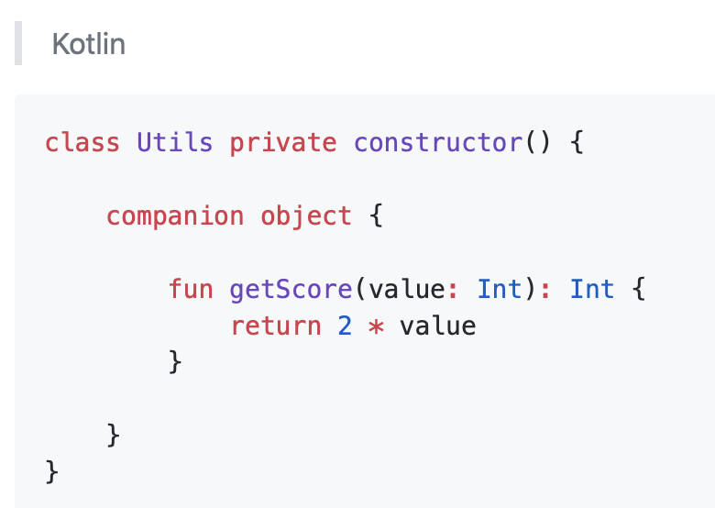
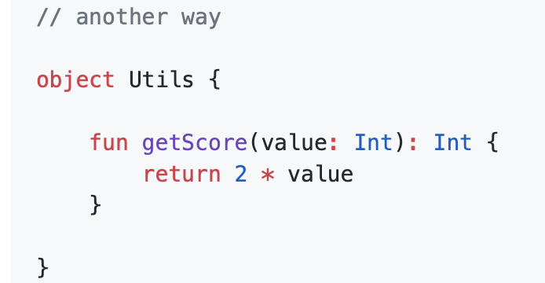
Constructors (and static methods)
Notes:
If you need a function or a property to be tied to a class rather than to instances of it, you can declare it inside a companion object:
If you need a singleton - a class that only has got one instance - you can declare the class in the usual way, but use the object keyword instead of class:

Slide 27
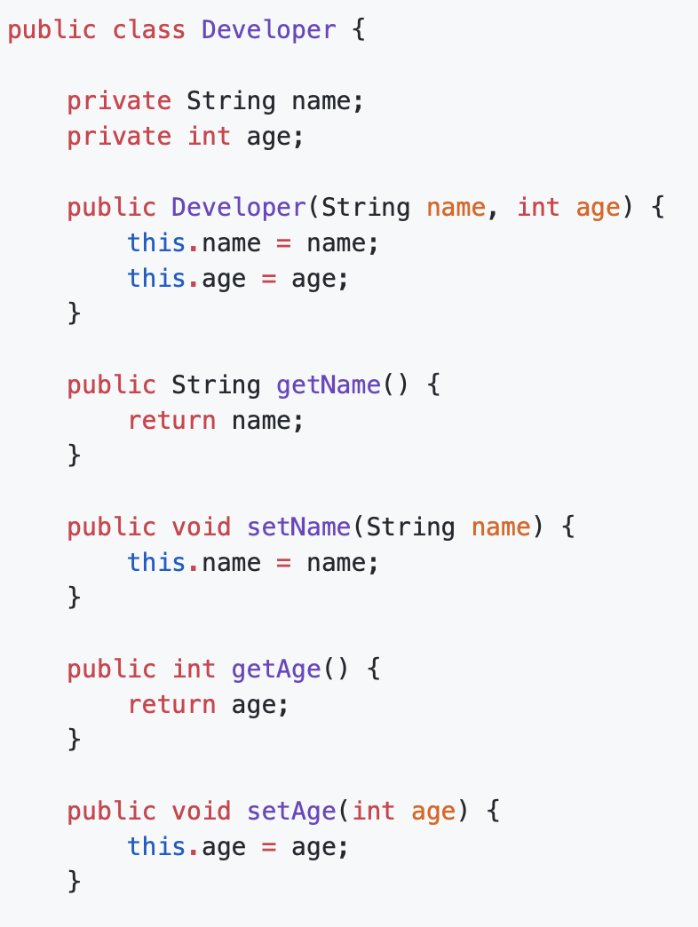
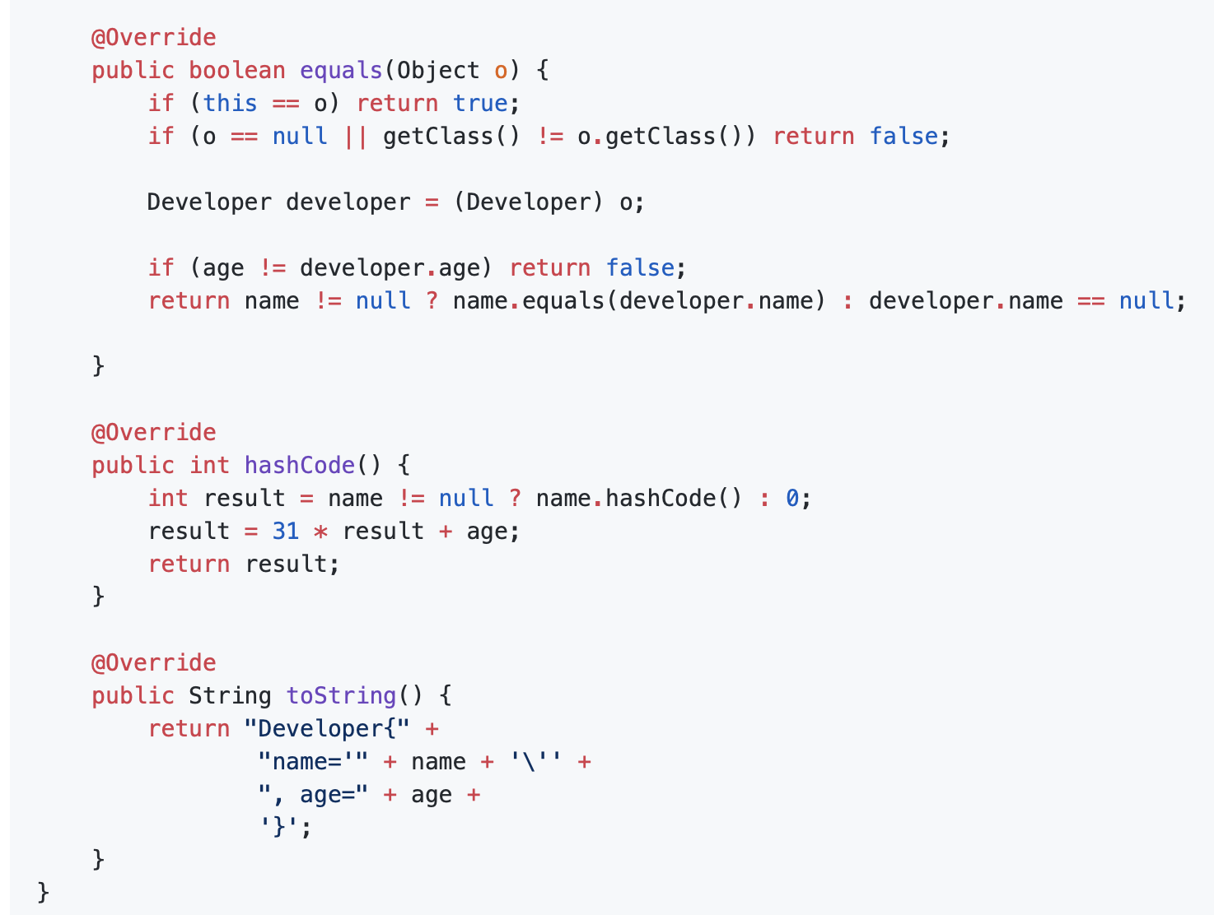
Constructors (and getters + setters etc.)

Slide 28
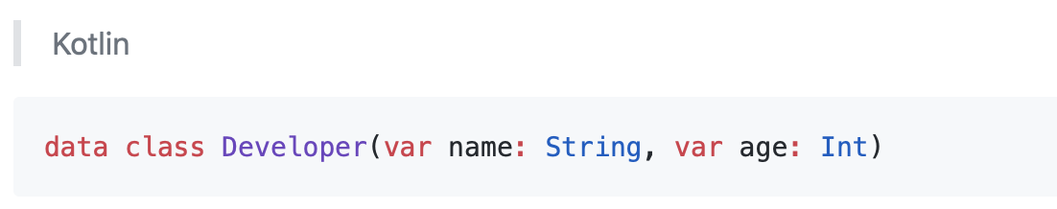
Constructors (and getters + setters etc.)

Slide 29
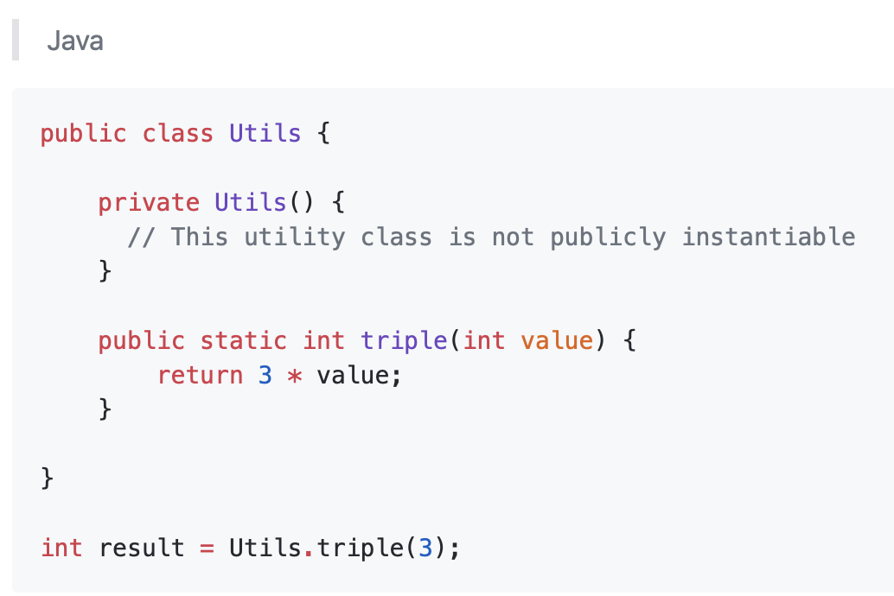
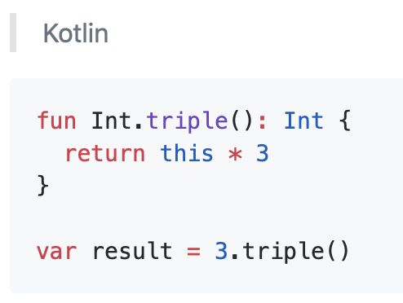
Class Methods
Notes:
Kotlin Extension Function

Slide 30
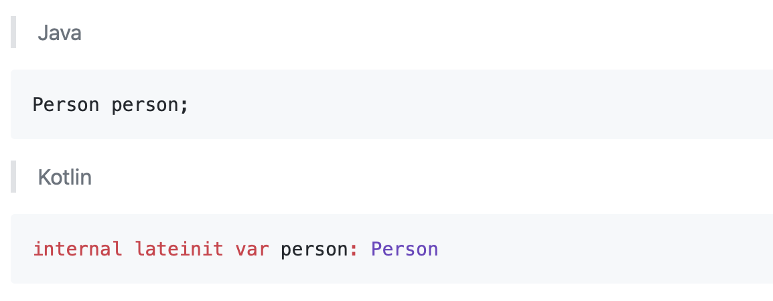
Defining uninitialized objects
Notes:
Kotlin Extension Function

Slide 31
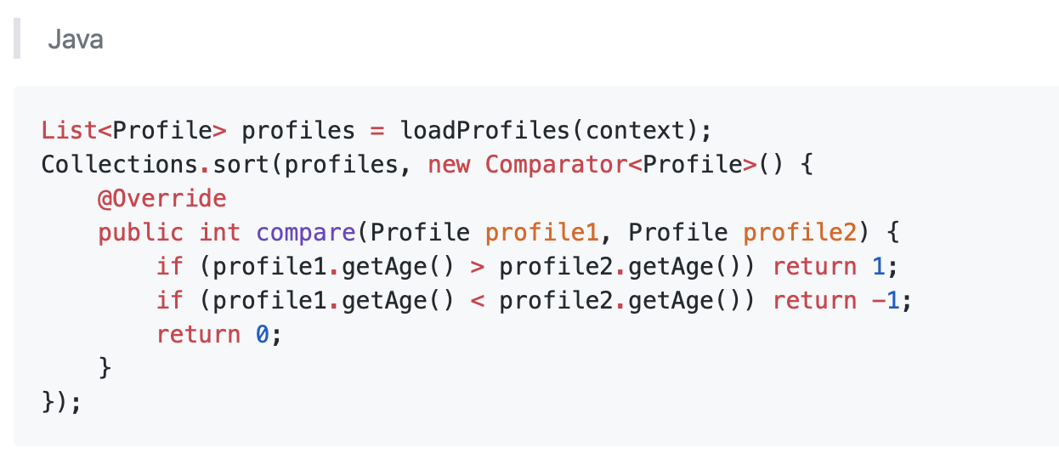
Sorting Lists
Notes:
Kotlin Extension Function

Slide 32
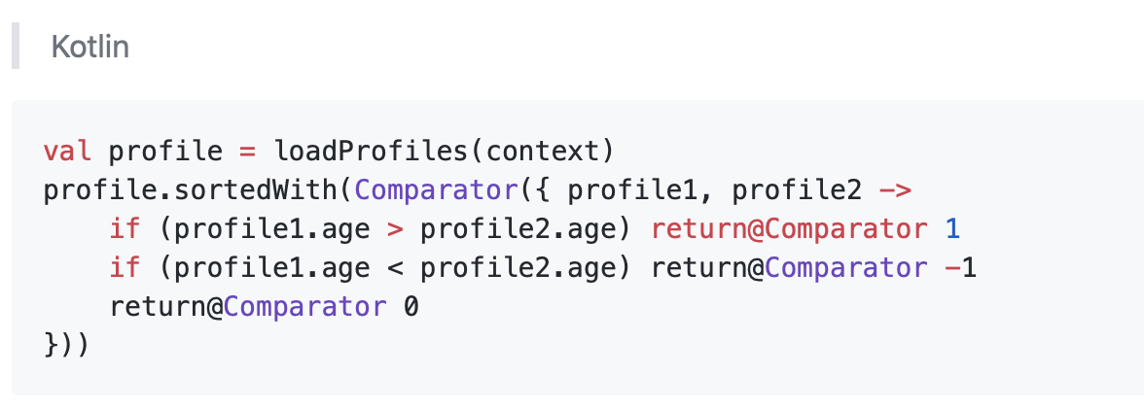
Sorting Lists
Notes:
Kotlin Extension Function

Slide 33
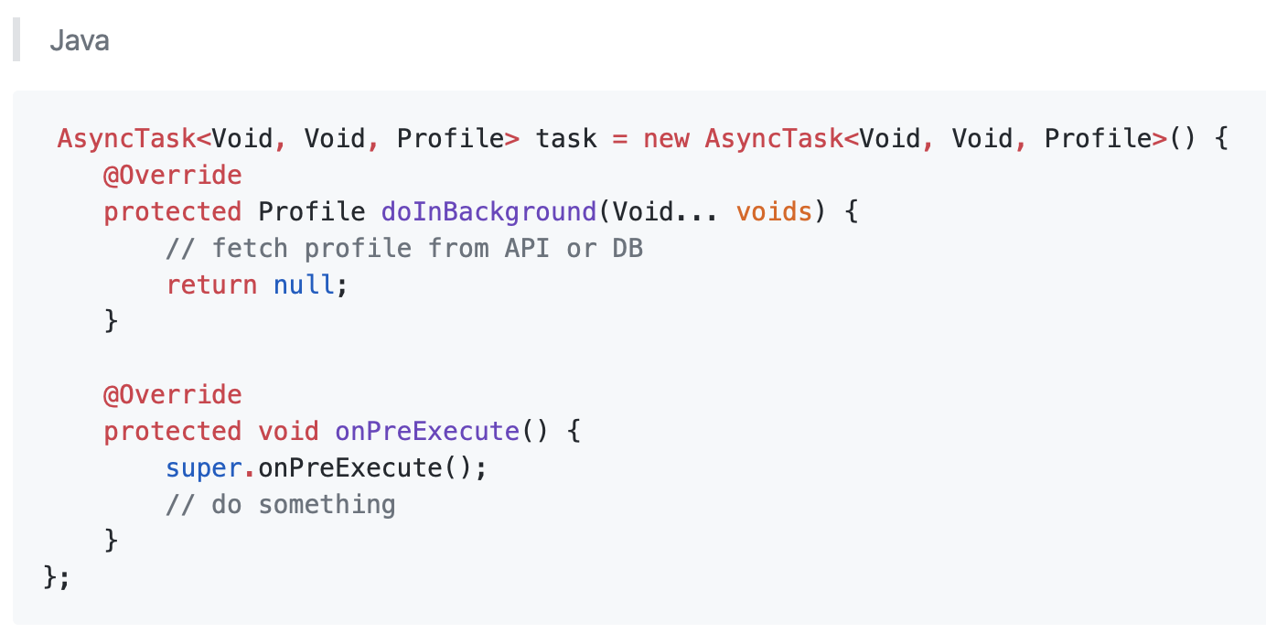
Anonymous Class
Notes:
Kotlin Extension Function

Slide 34
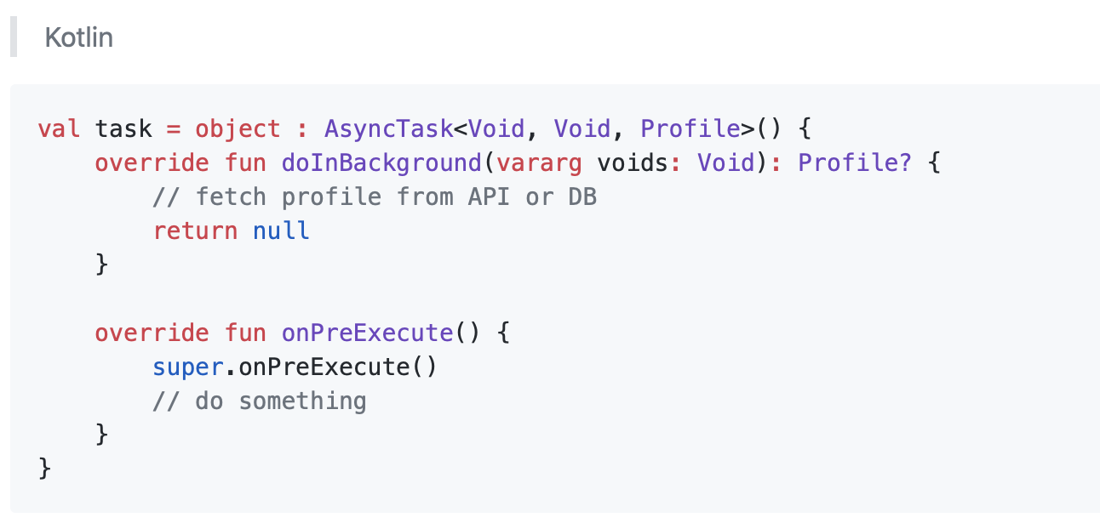
Anonymous Class
Notes:
Kotlin Extension Function

Slide 35
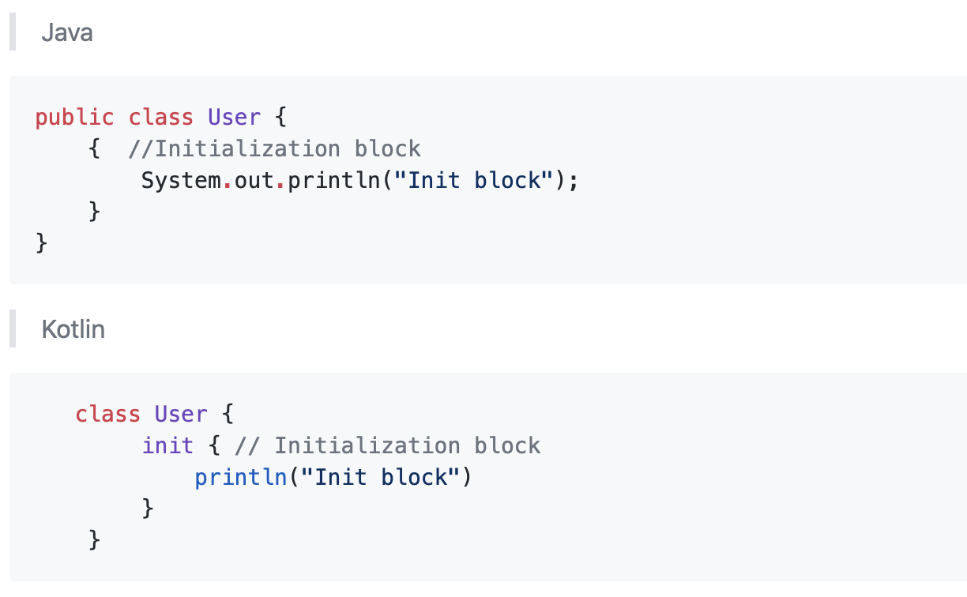
Initialization block
Notes:
Kotlin Extension Function

Slide 36

References
https://github.com/MindorksOpenSource/from-java-to-kotlin

Slide 37



