Slide 1
Mobile Application Development
David Drohan (ddrohan@wit.ie)

Slide 2
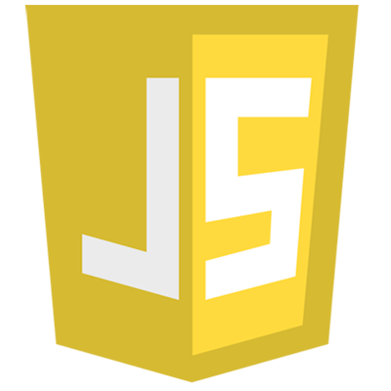

JS 2 K - Part 1
JavaScript to Kotlin

Slide 3
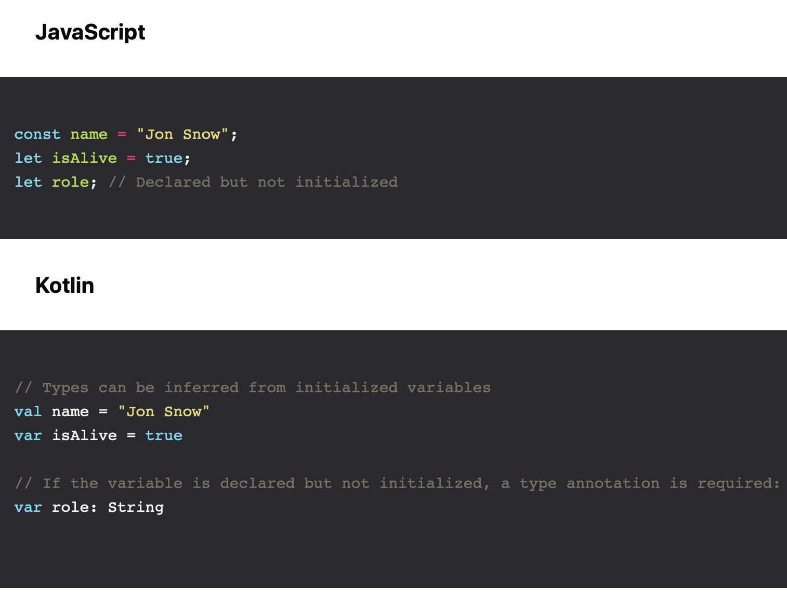
Variables and Constants
Notes:
Kotlin variables are declared with the var keyword. To prevent reassignment, you can use val — both works much like JavaScript’s let and const.

Slide 4
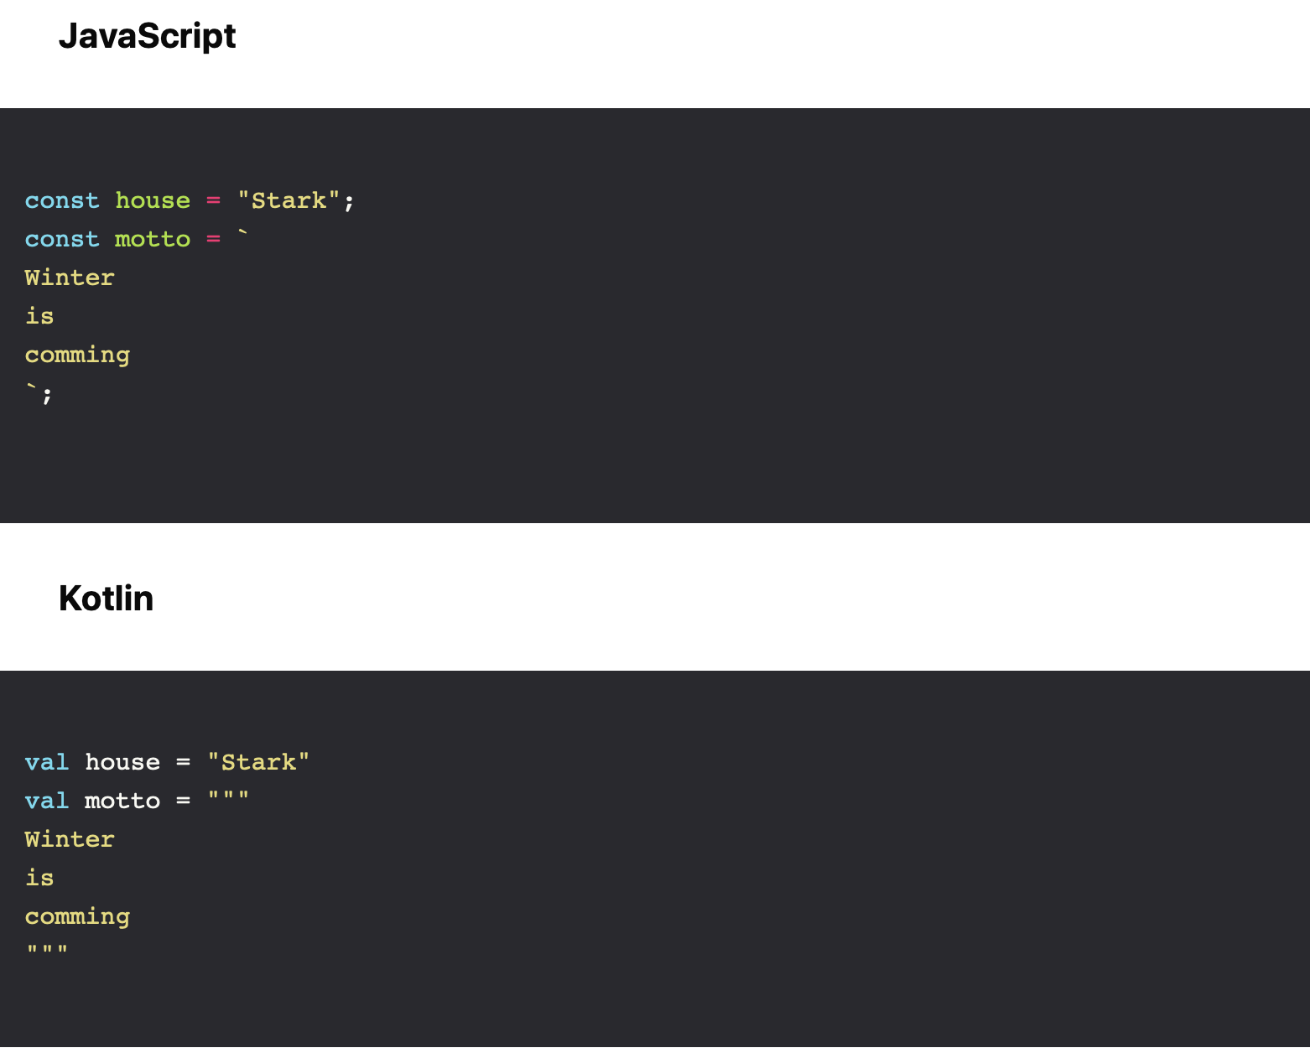
Strings

Slide 5
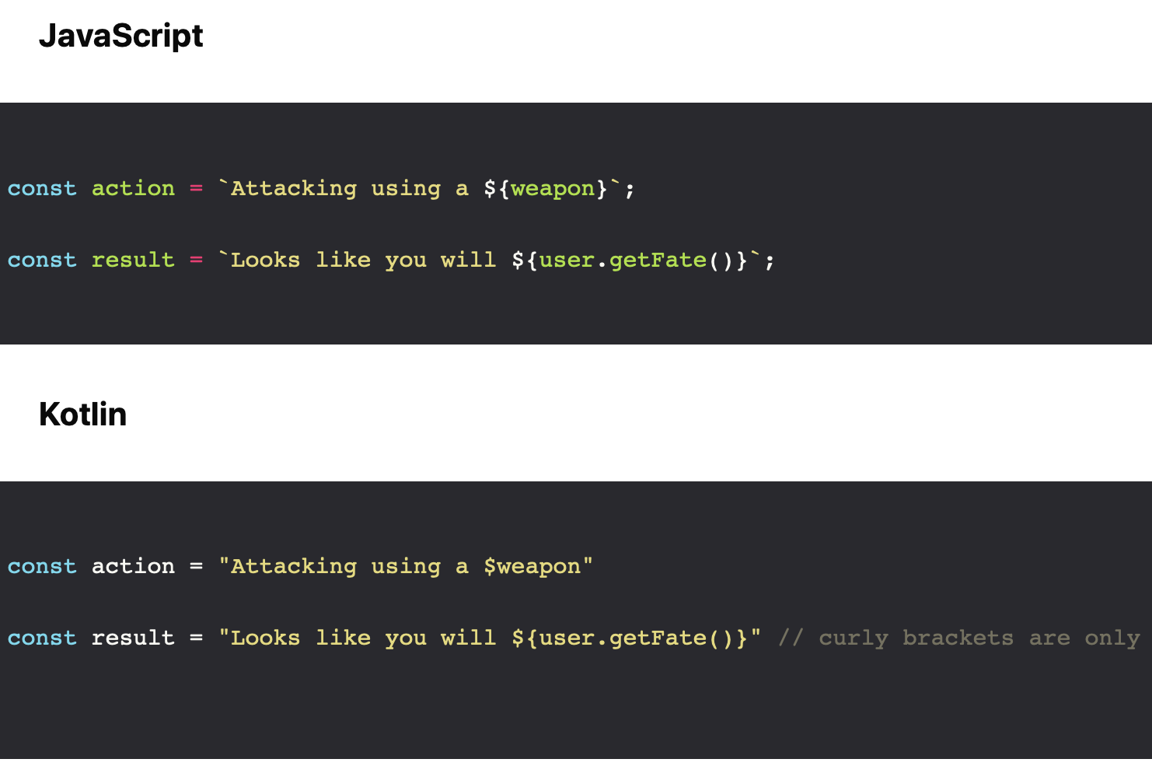
String Interpolation

Slide 6
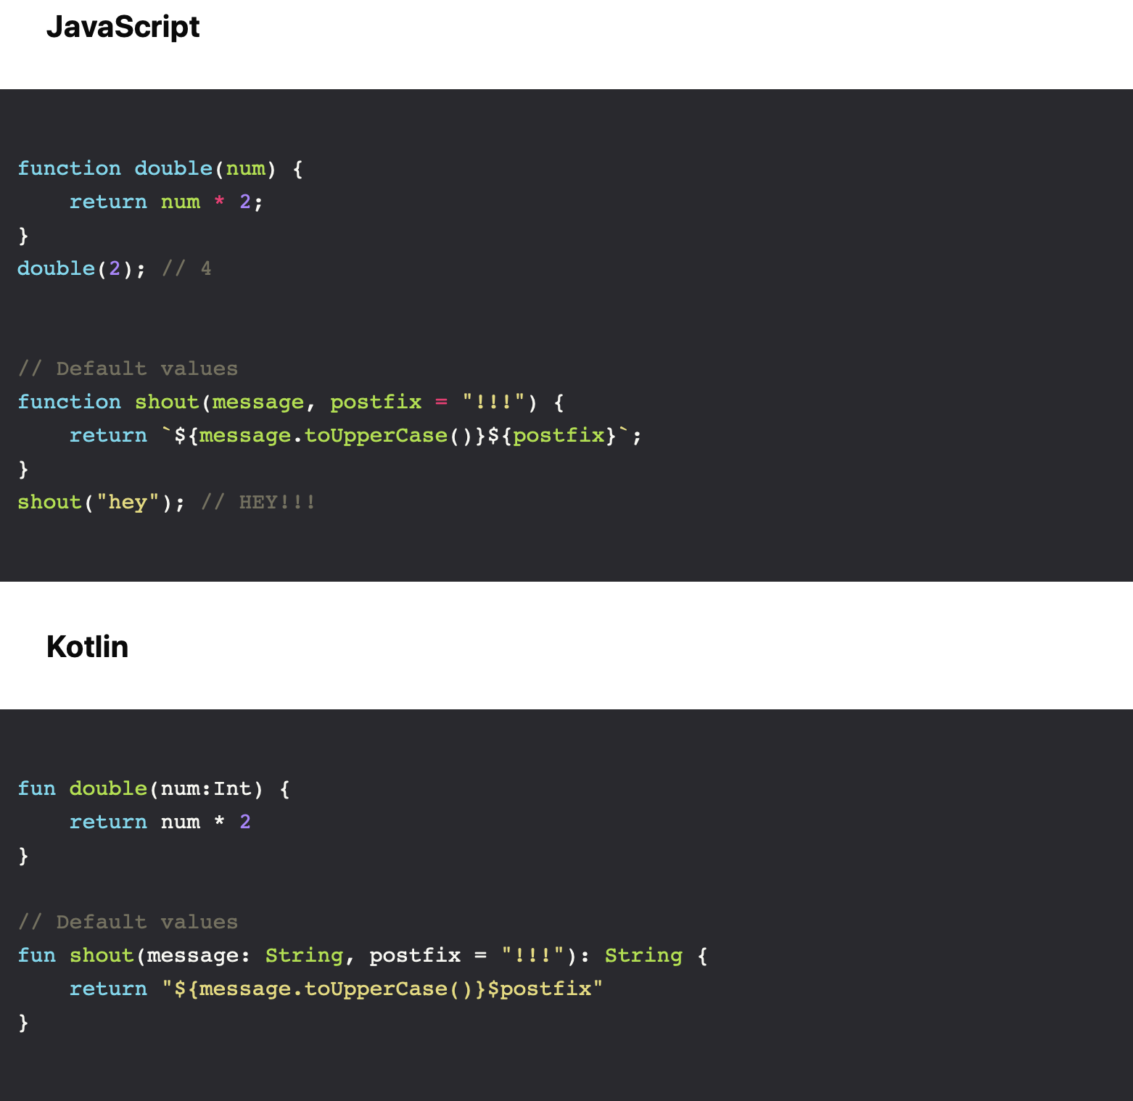
Functions : Named Functions

Slide 7
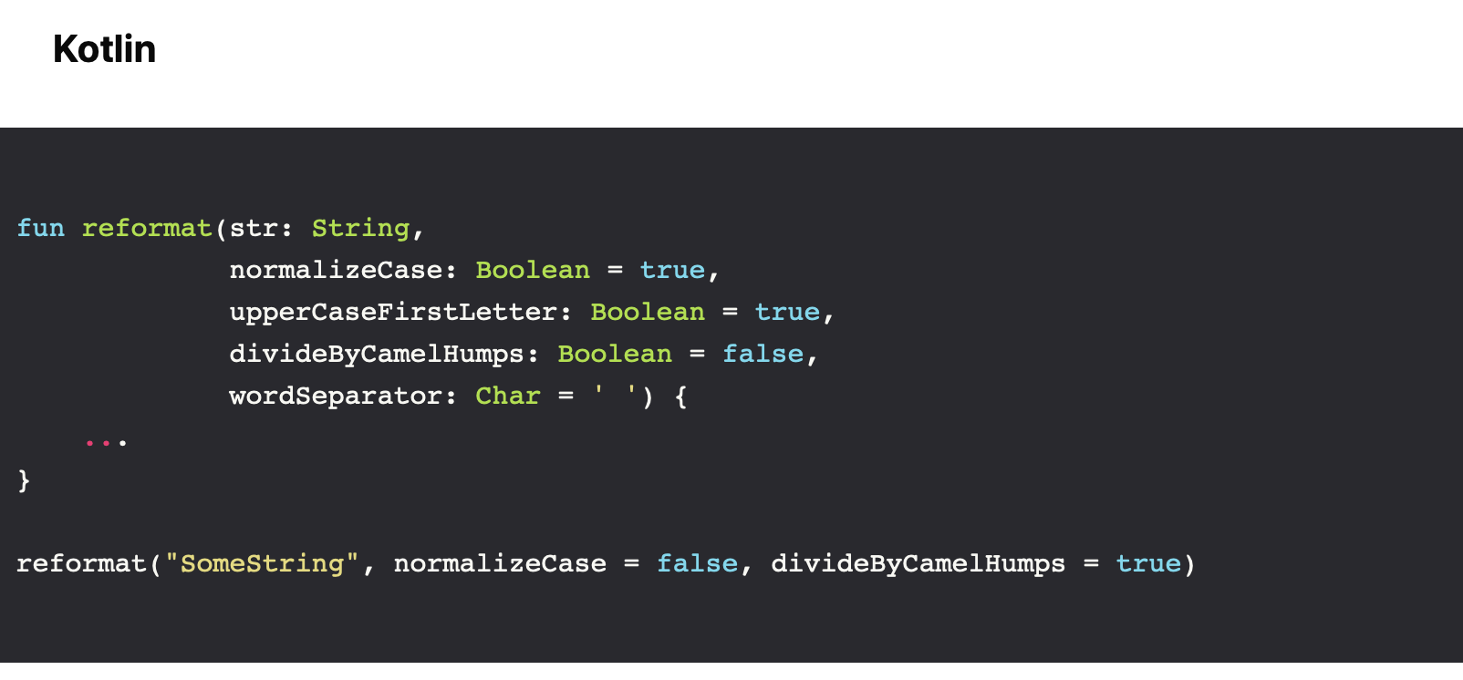
Functions : Named Parameters
Notes:
In Kotlin, function parameters can be named when calling functions. This is very convenient when a function has a high number of parameters or default ones.

Slide 8
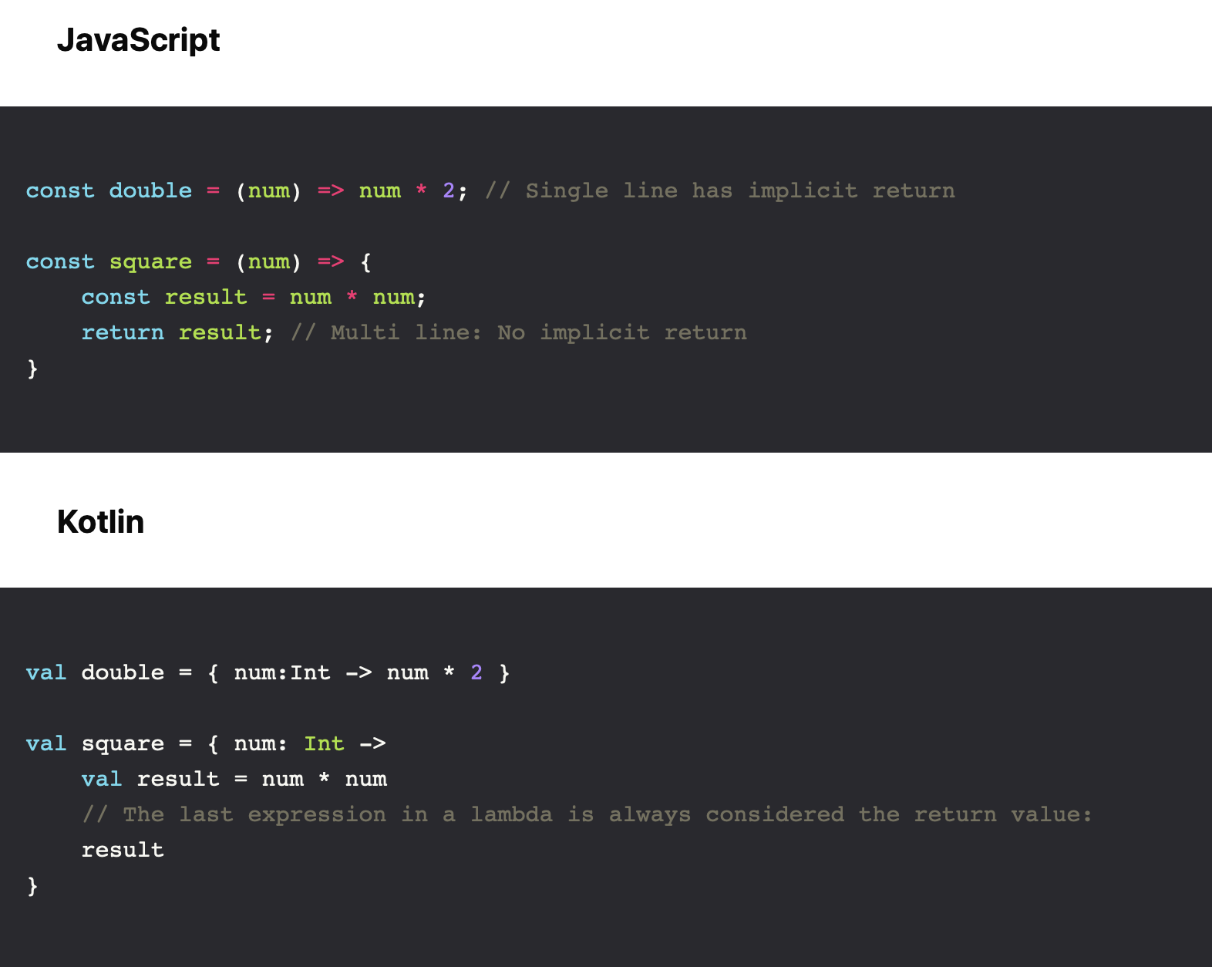
Function Expressions
“arrow functions” Vs lambdas

Slide 9
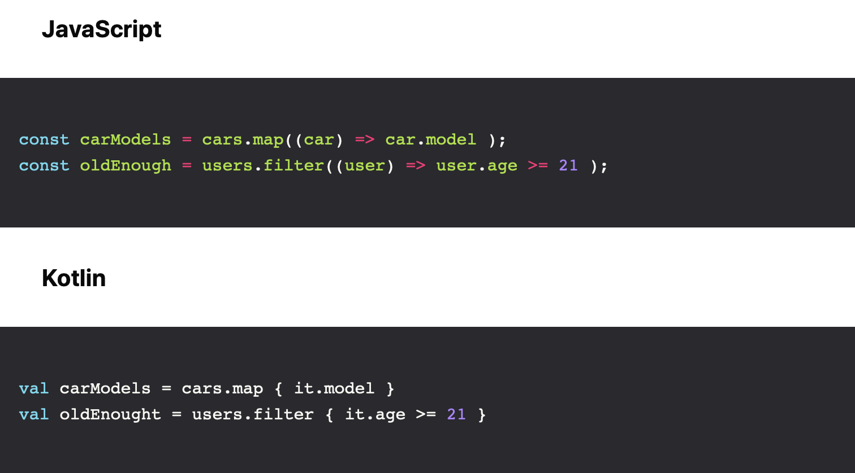
Function Expressions
“arrow functions” Vs lambdas
Notes:
It’s very common that a lambda expression has only one parameter. As a convenience, Kotlin gives special treatment to those and automatically declares the single parameter under the name it:

Slide 10
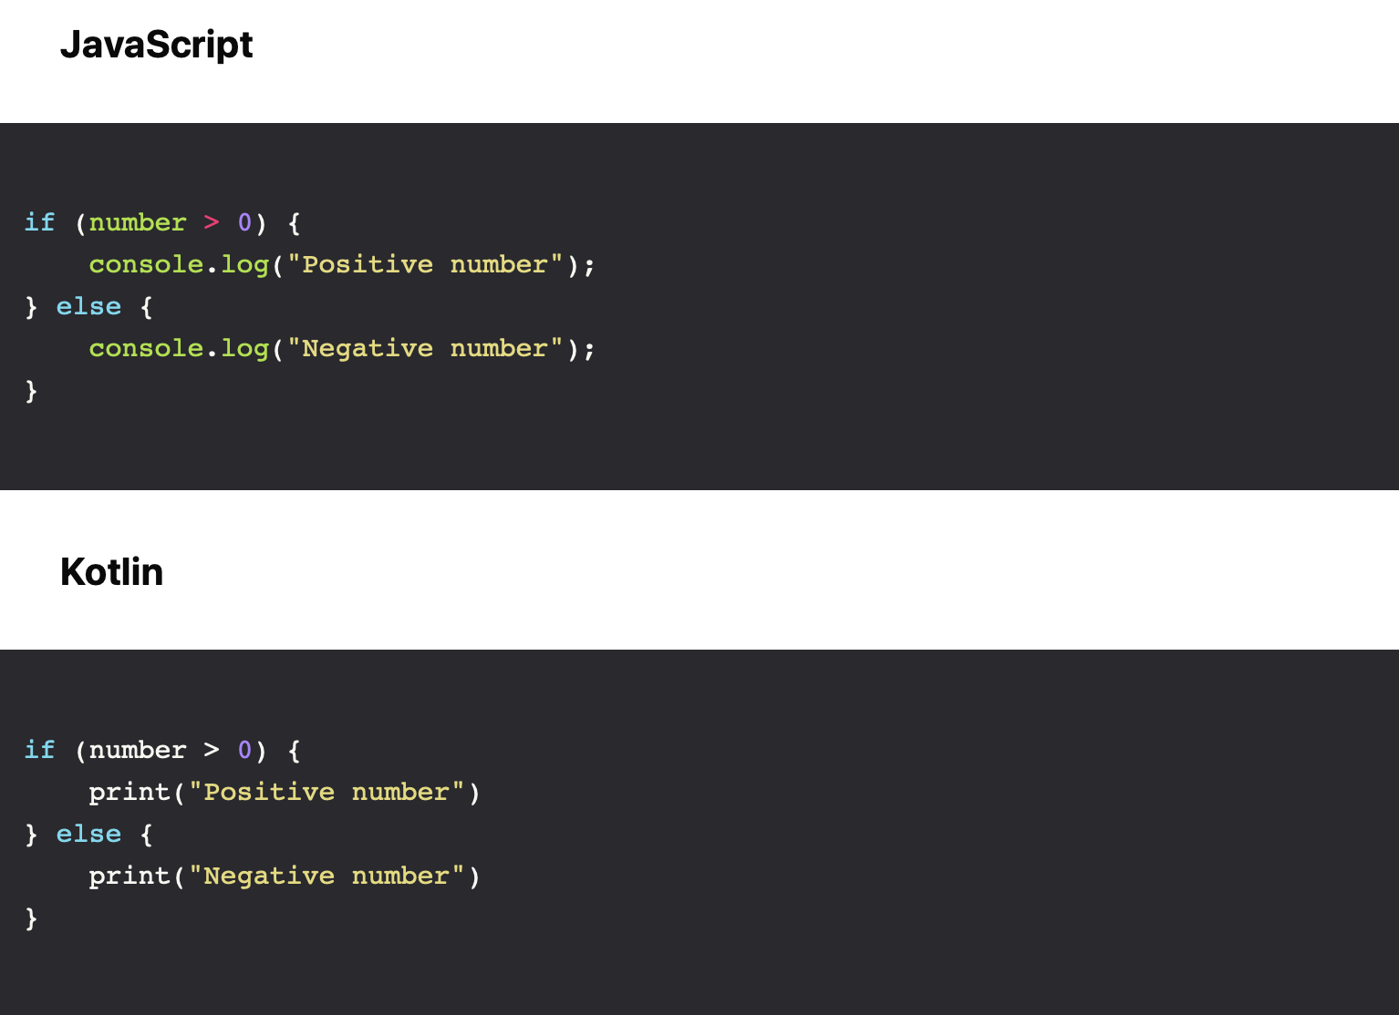
Flow Control
if / else

Slide 11
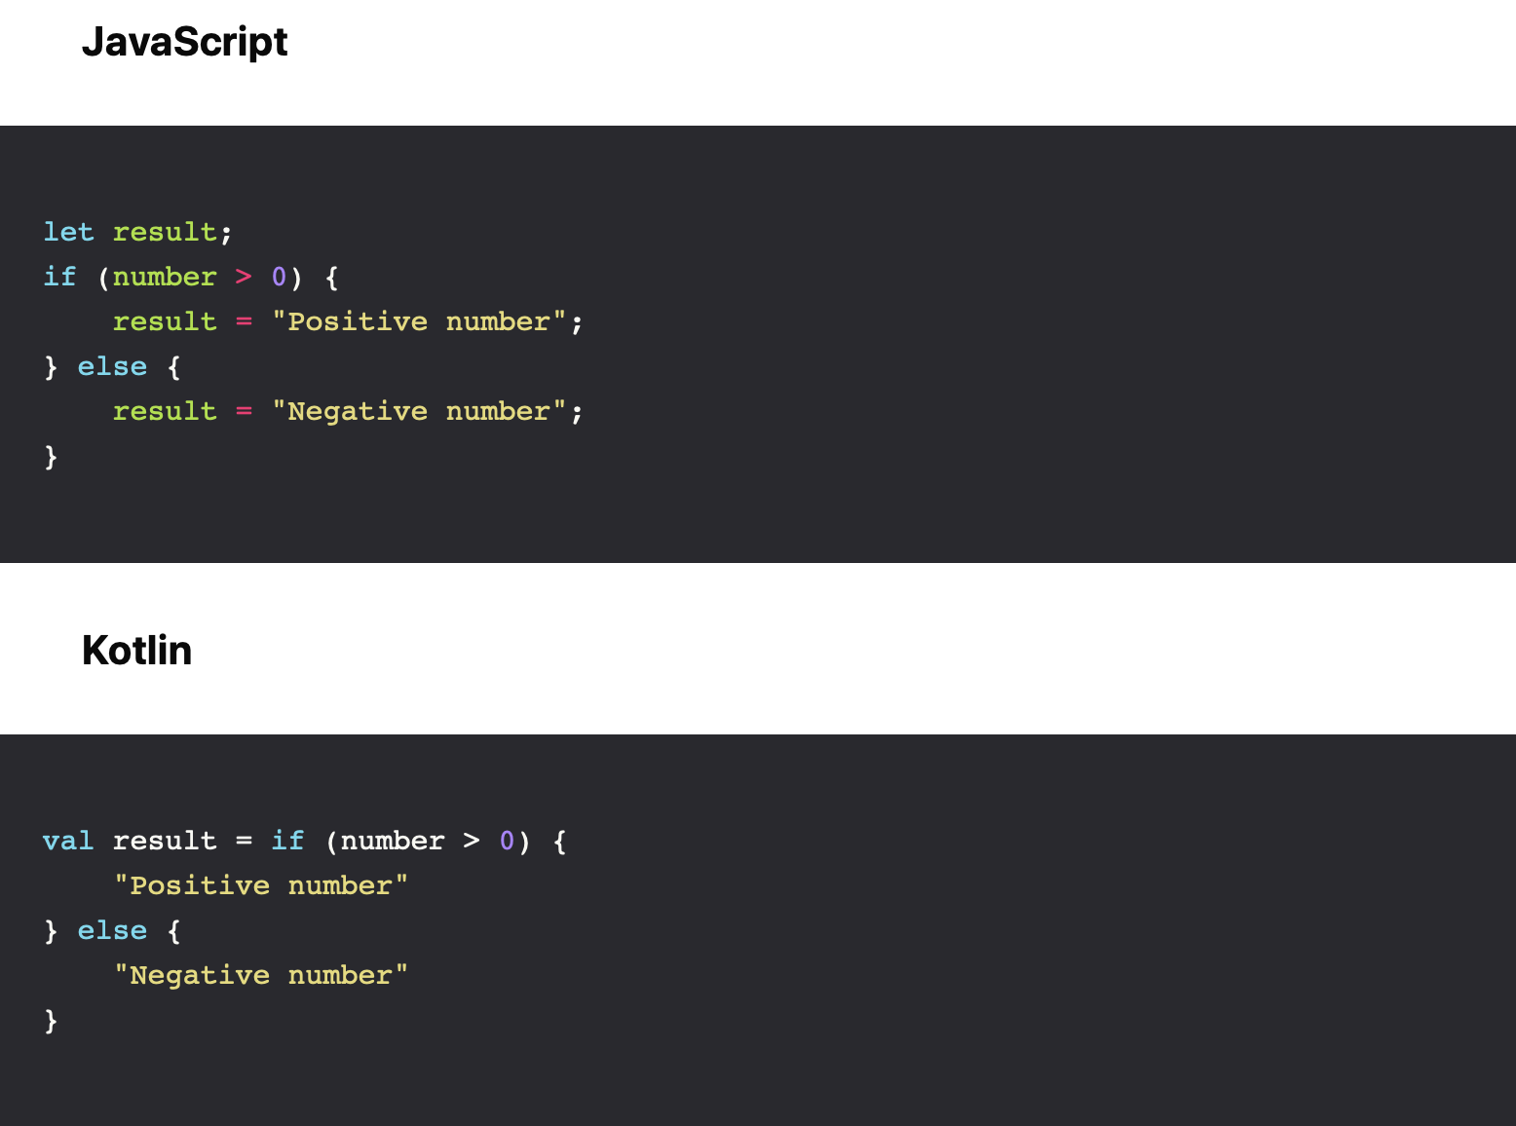
Flow Control
if / else
Notes:
Unlike JavaScript (and many other programming languages), if is an expression in Kotlin - it returns a value:

Slide 12
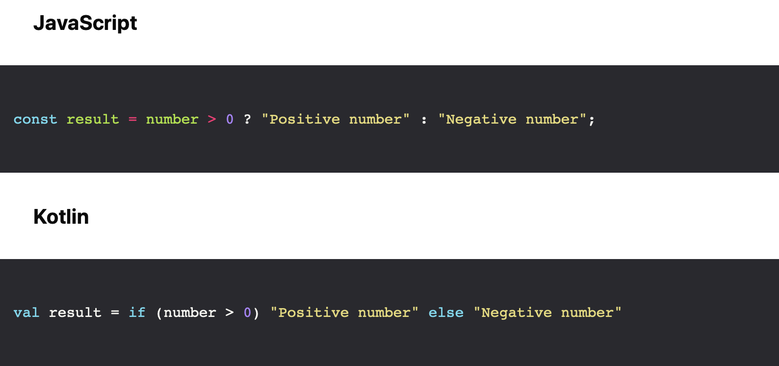
Flow Control
if / else
Notes:
In Kotlin, you can leave the curly braces out if you’re writing in one line — therefore there is no ternary operator:

Slide 13
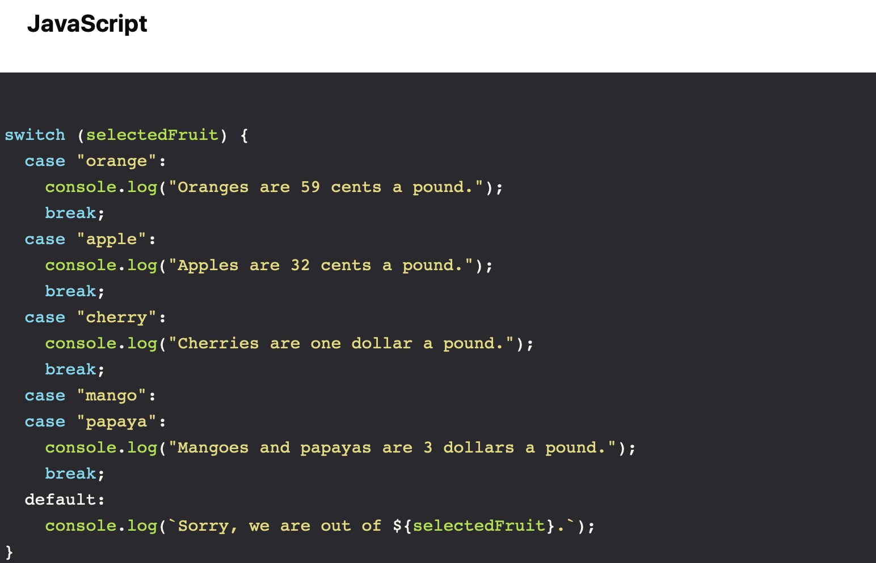
Flow Control
switch/when
Notes:
Kotlin has a when construct that can be thought of as a replacement for JavaScript switch Statement:

Slide 14
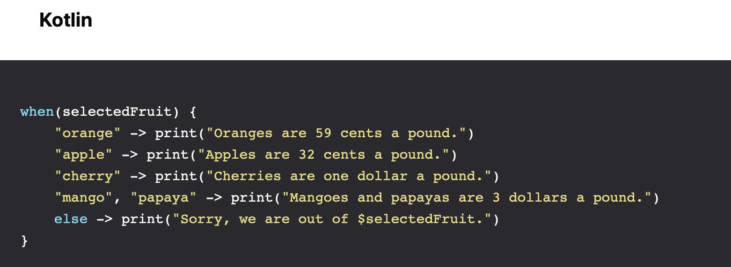
Flow Control
switch/when
Notes:
And When can also be used as an expression

Slide 15
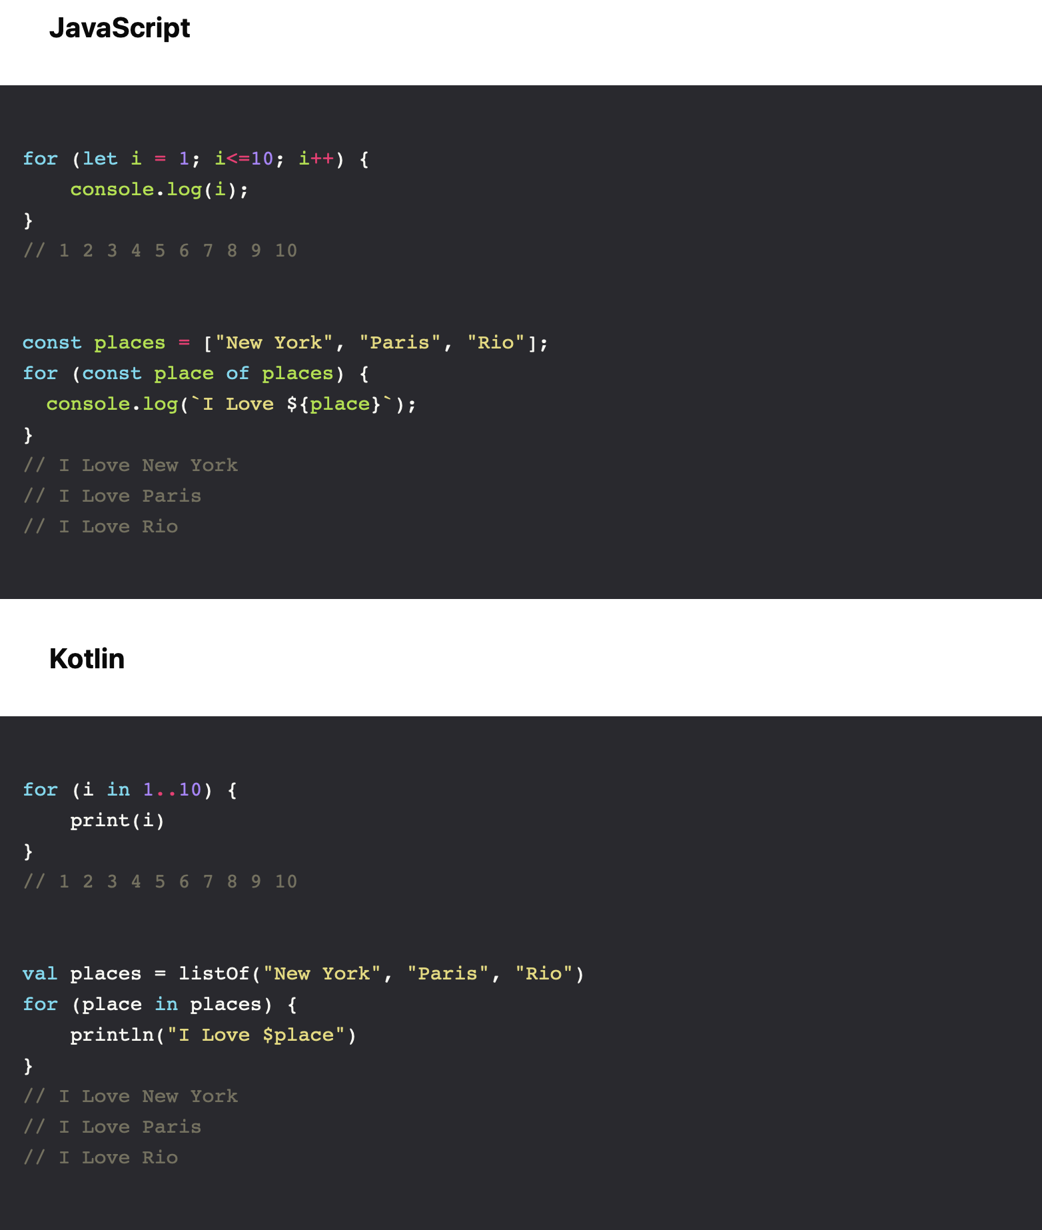
Flow Control
Loops
Notes:
Kotlin does provide a for loop, but it only works with iterators (like Lists and Maps). Fortunately Kotlin also provides ranges, iterators which can be created using the .. operator:

Slide 16

References
Sources: https://dev.to/cassiozen/kotlin-for-js-devs-part-1-5bld

Slide 17


