Slide 1
Mobile Application Development
David Drohan (ddrohan@wit.ie)
Dr.

Slide 2


JS 2 K - Part 2
JavaScript to Kotlin

Slide 3
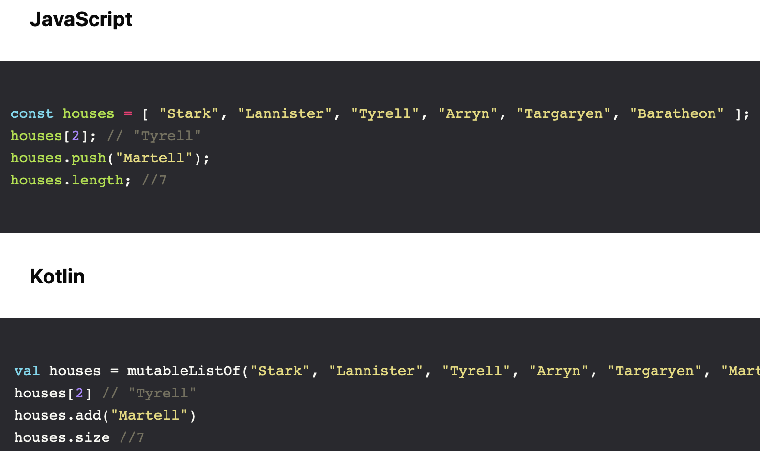
Collections

Slide 4
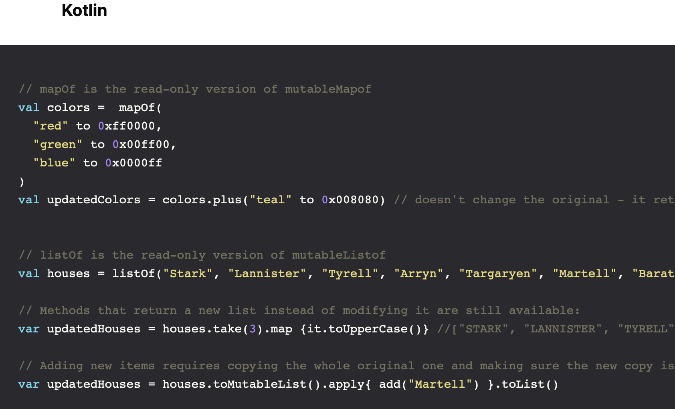
Collections
Notes:
Kotlin also provides provides read-only versions of its collections:

Slide 5
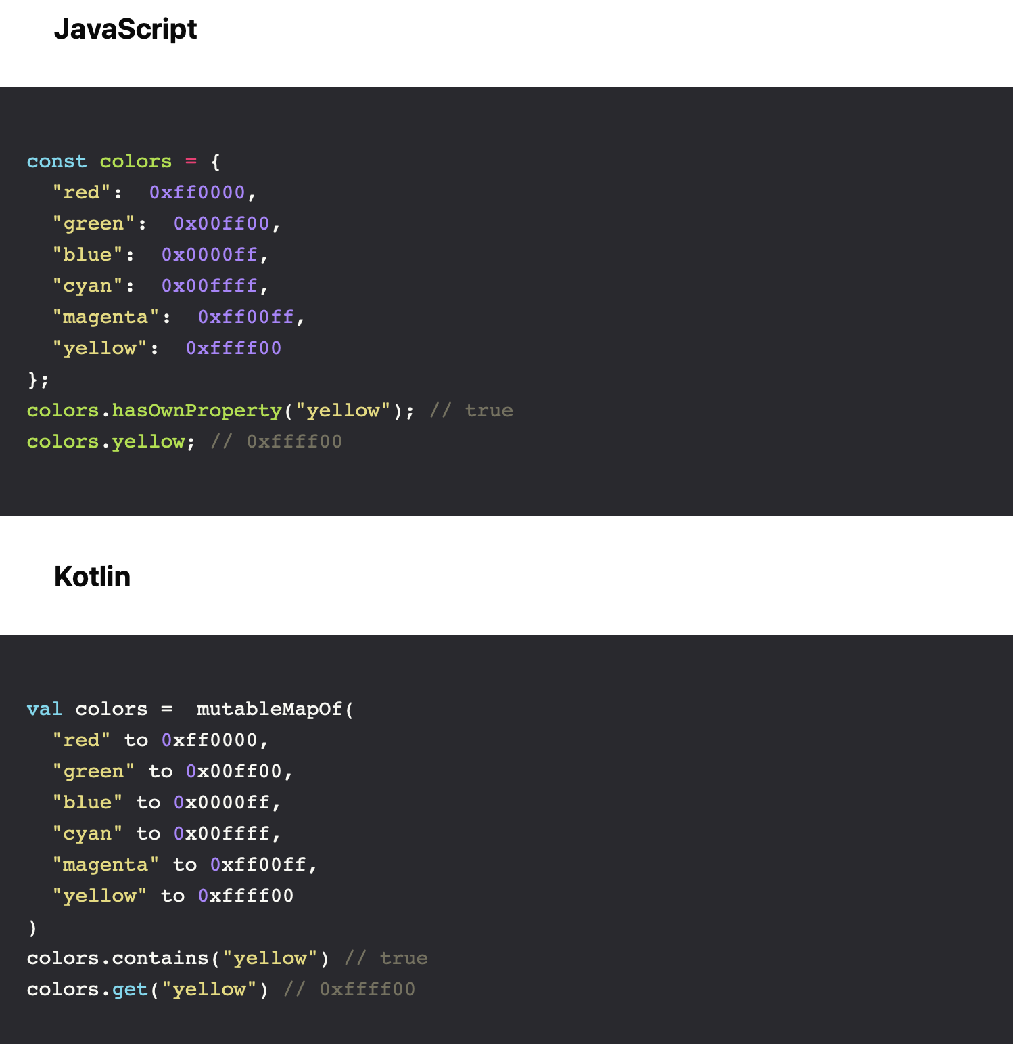
Objects (key-value maps)
Notes:
Objects in JavaScript serves many purposes: It’s mainly a hashmap, but it’s also the base construct from which everything (except primitives) are descended + lots of utility functions

Slide 6
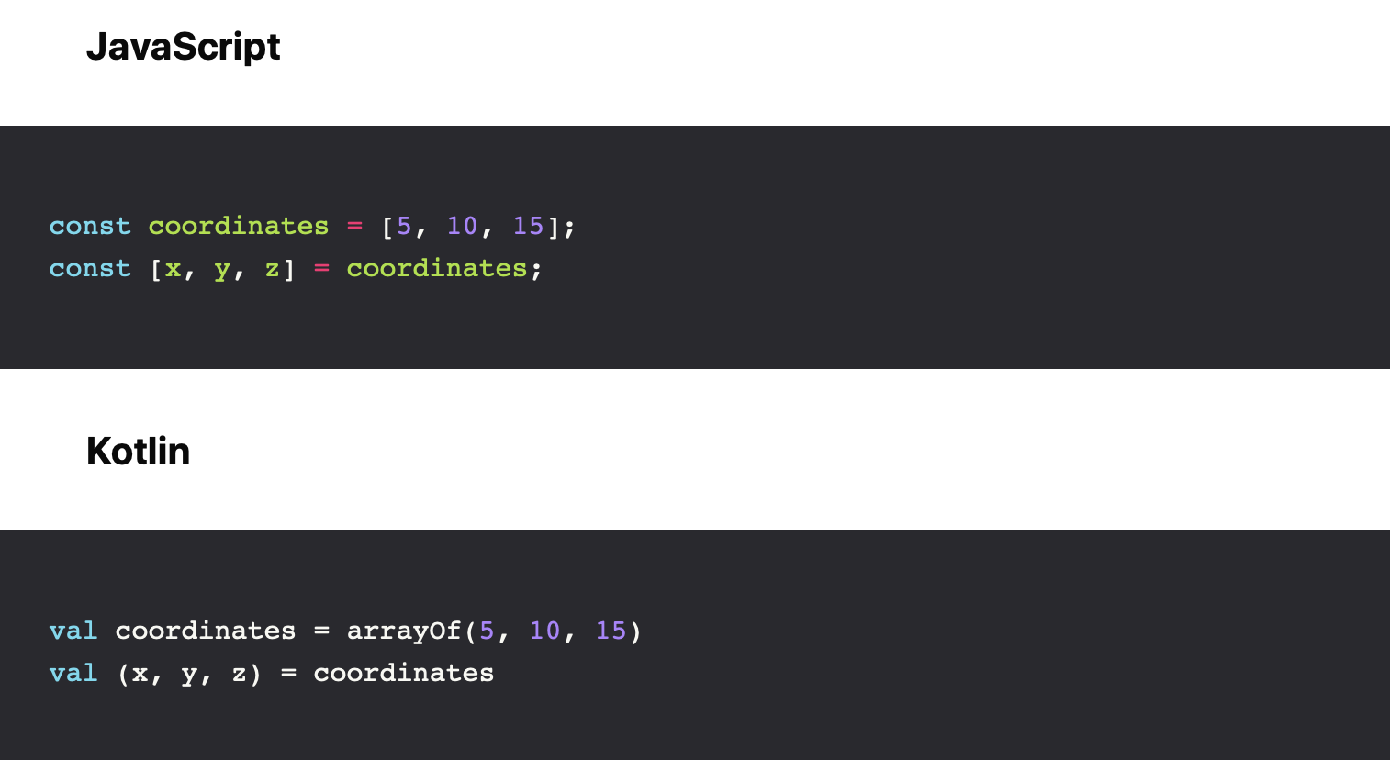
Destructuring Assignment
Notes:
Destructuring declaration syntax can be very handy and save you a few lines of code: when you assign a collection to a value, Kotlin breaks its up and matches the sides against each other, assigning the values on the right to the variables on the left.

Slide 7
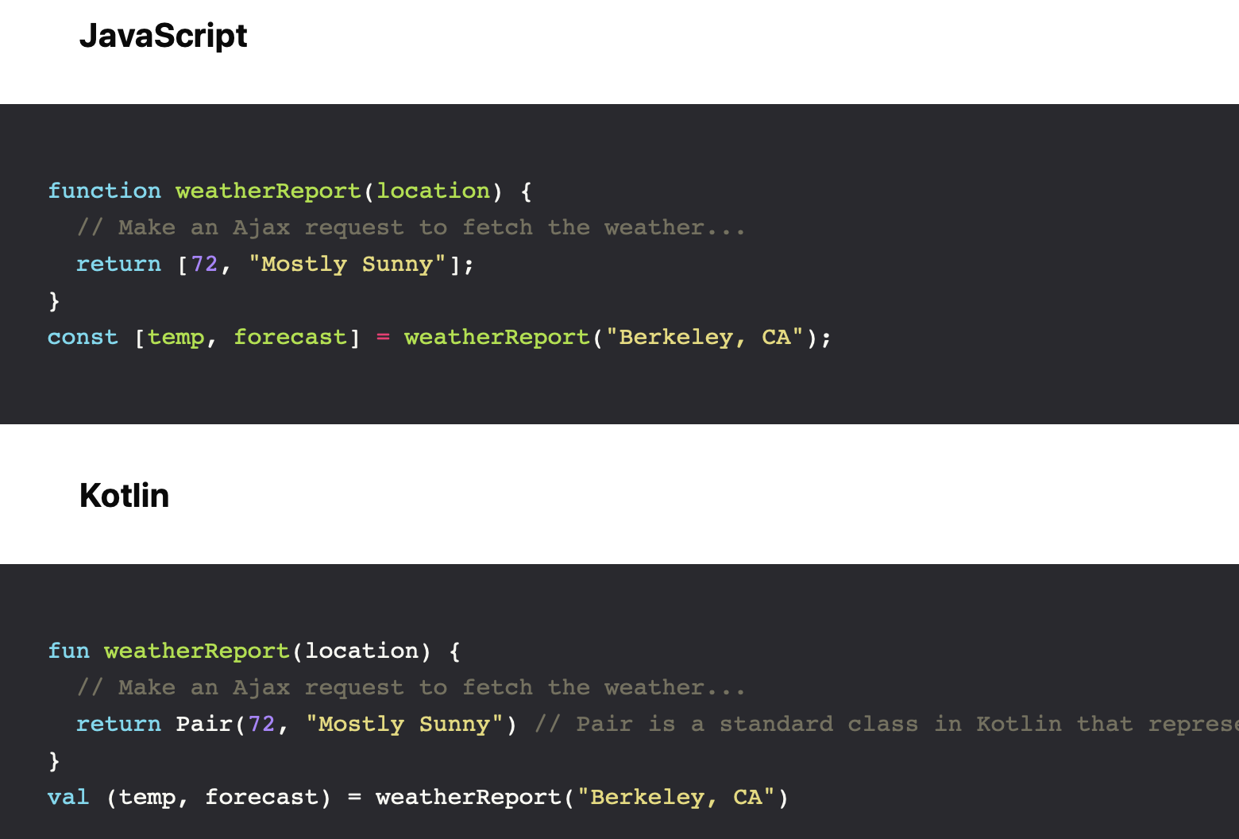
Destructuring Assignment
Notes:
While the previous example can look silly, this is especially convenient for dealing with functions that return multiple values:

Slide 8
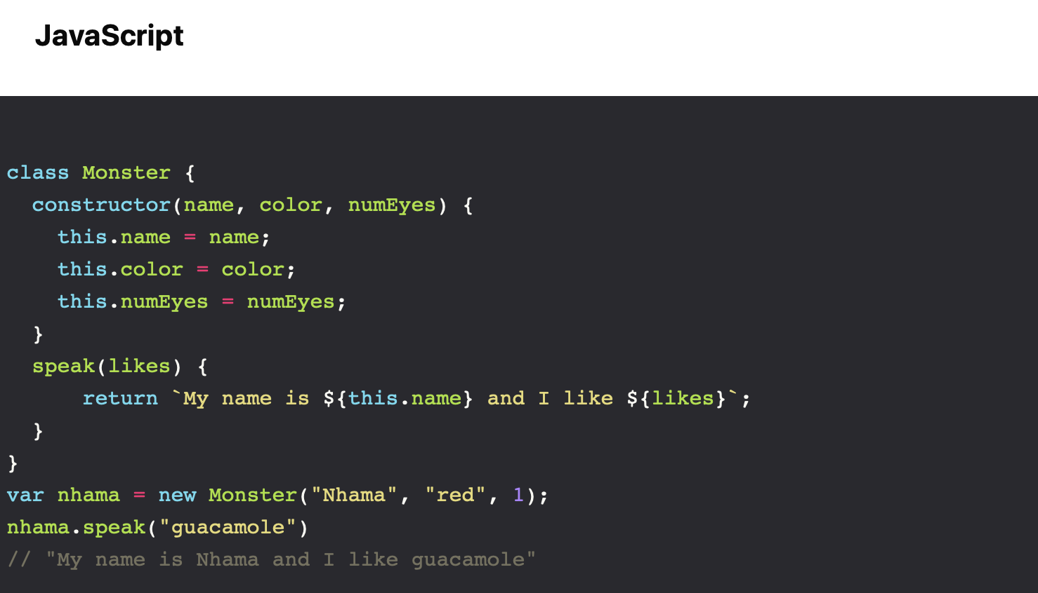
Classes
Notes:
Much like in JavaScript, classes in Kotlin are declared using the keyword class:

Slide 9
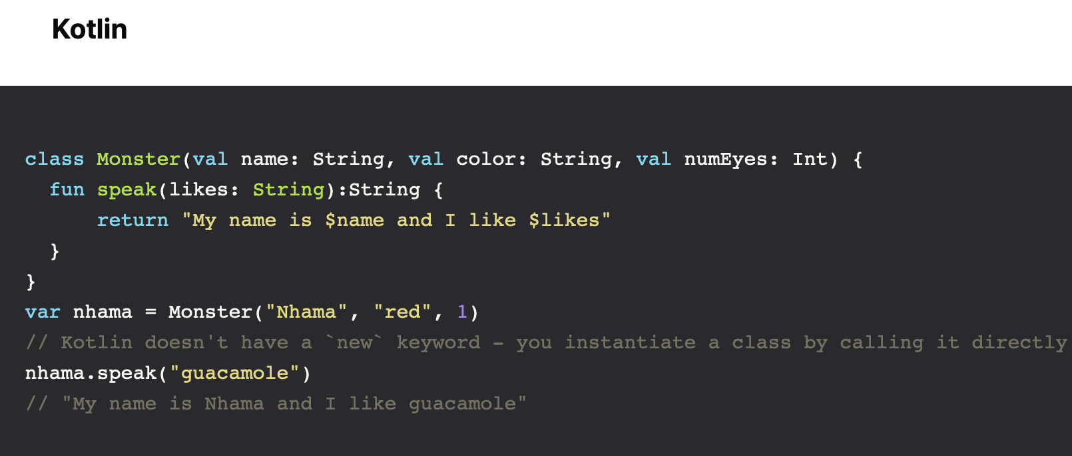
Classes
Notes:
We don’t need to explicitly use the constructor keyword when there’s only a single constructor

Slide 10
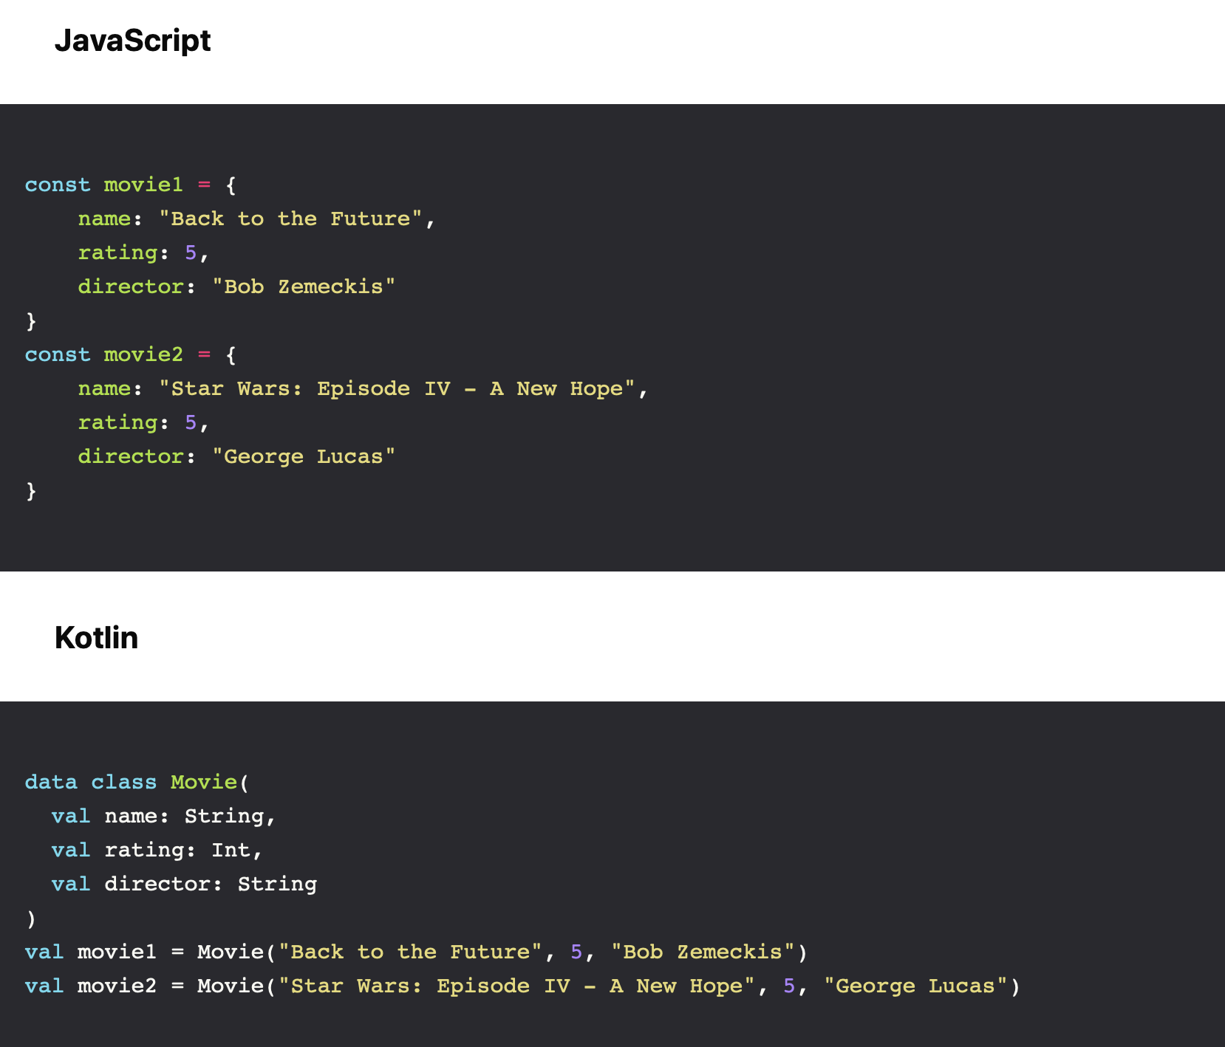
Data Containers
Notes:
In JavaScript, it is common place to create plain Objects to group named values together. In Kotlin, you will want to create a Data Class —

Slide 11

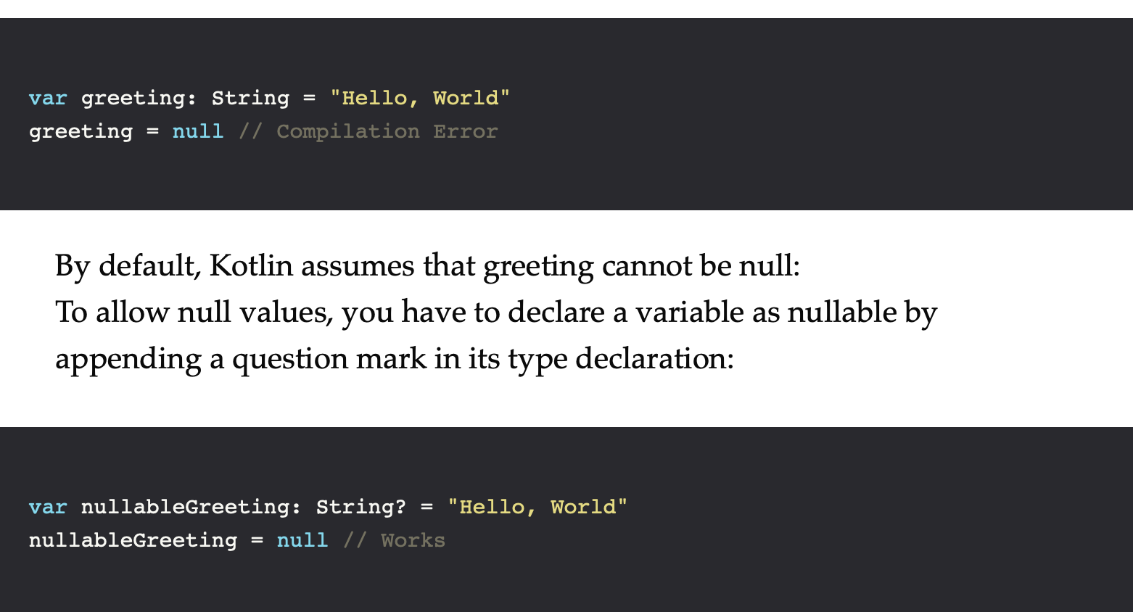
Nullability
Notes:
Javascript has two “non-values” — undefined and null. The former is used by the language to inform the absence of a value and the latter can be used by the developer to explicitly set something to a non-existent value — but more often than not they cause more trouble than they solve. How many times have you dealt with “Uncaught TypeError: Cannot read property x of undefined” or “TypeError: ‘null’ is not an object”?
Kotlin’s approach deserves special merits for being pragmatic, simple & elegant.

Slide 12
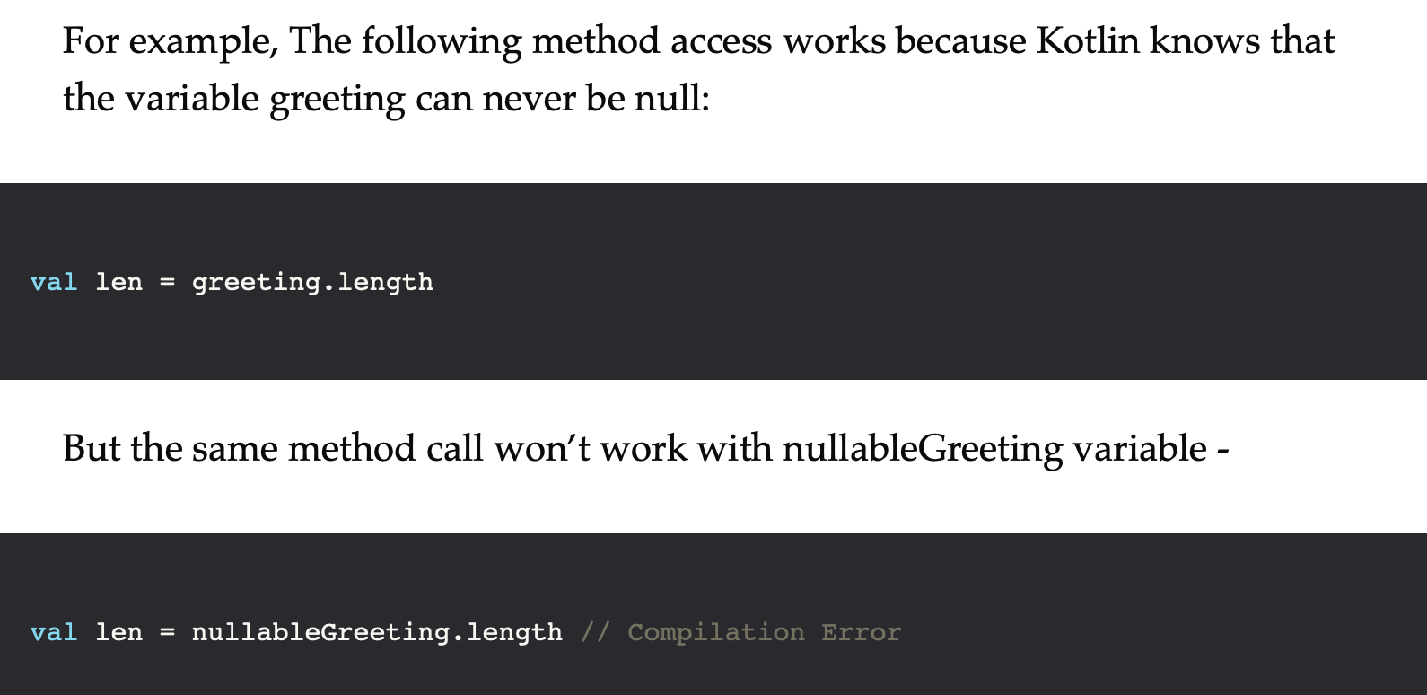
Nullability
Notes:
And If you handle the possibility of the null value, for eg, stick it inside an if statement to check for null, the Kotlin compiler will accept it no problem

Slide 13
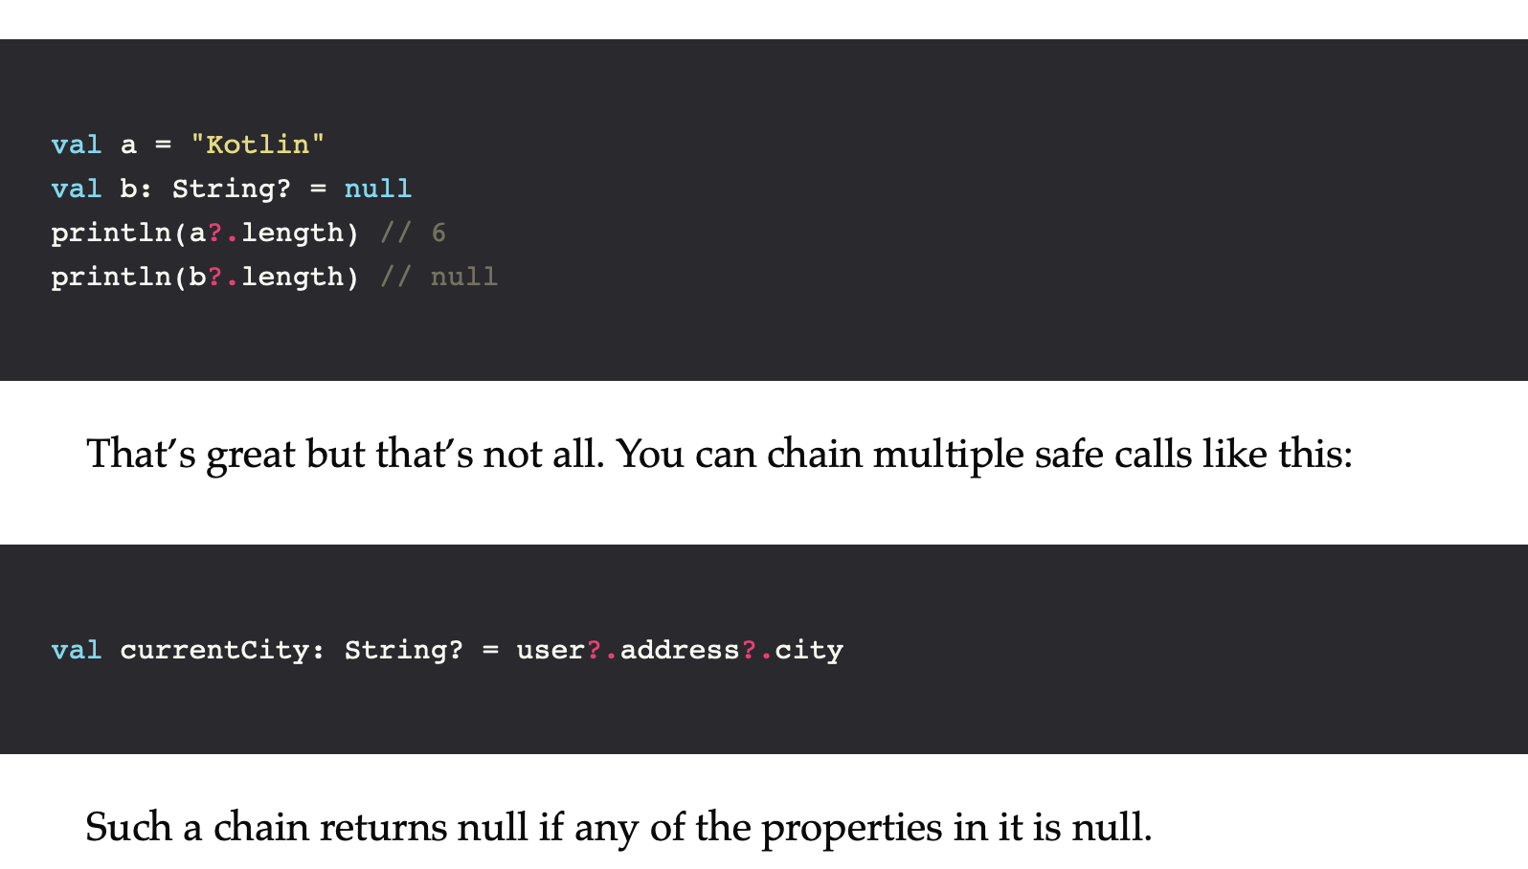
Safe Call Operator
Notes:
Of course, Null Comparisons are a little too verbose so Kotlin provides a Safe call operator, ?. that combines a null-check and a method call in a single expression.

Slide 14
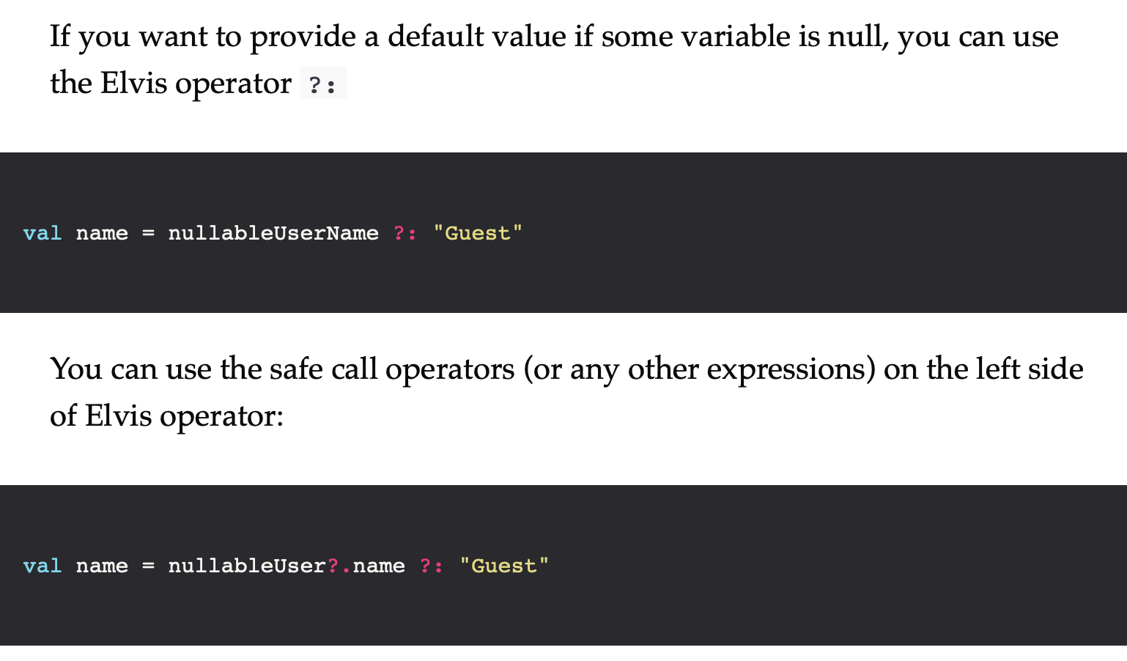
Elvis Operator

Slide 15
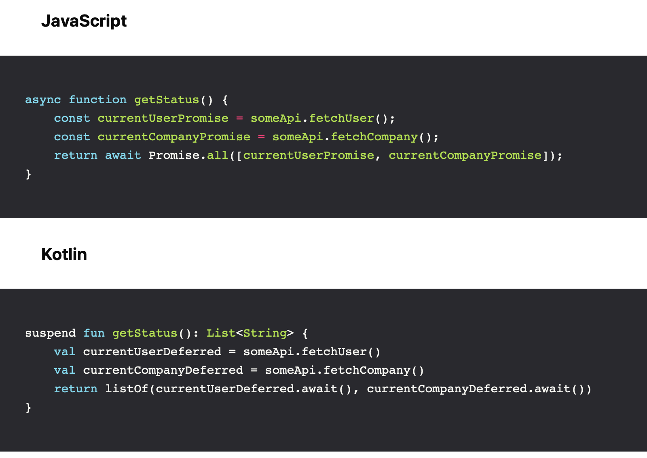
Asynchronous Programming
Notes:
JavaScript is a Single-threaded language that uses an Event Loop to allow asynchronous behaviour (NODE) so we have the notion of callbacks and more recently promises and async/await pattern Kotlin is a multi-threaded language — you can spawn multiple threads and execute code concurrently and has a built-in co-routine mechanism with support for Deferred (analogous to promises) and async/await patterns:
In both cases it allows you to write async code that looks like synchronous code.

Slide 16

References
Sources: https://dev.to/cassiozen/kotlin-for-js-devs-part-1-5bld https://dev.to/cassiozen/kotlin-for-js-devs-part-2-fam

Slide 17


