Slide 1
Mobile Application Development
David Drohan (ddrohan@wit.ie)

Slide 2
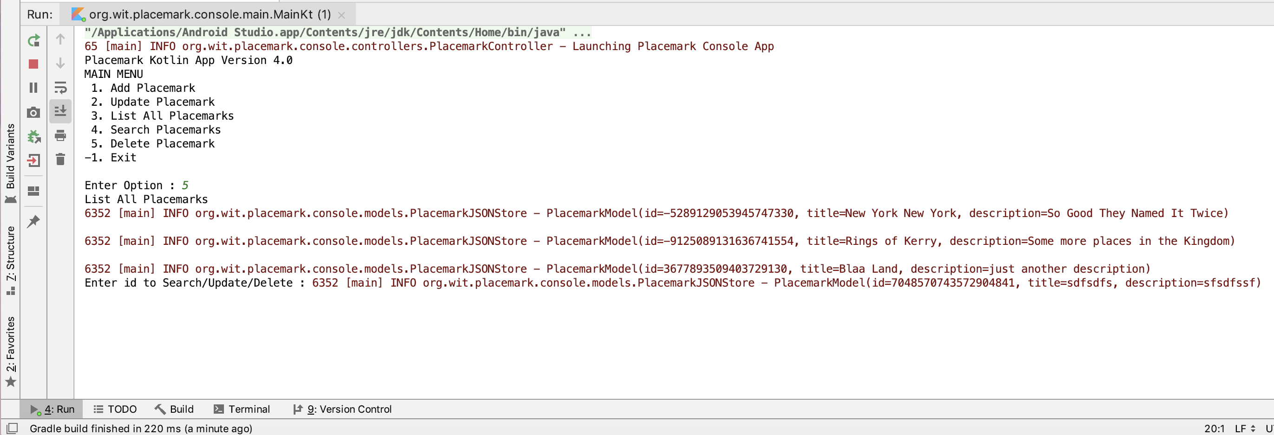
Placemark-Console Version 4.0

Slide 3

Features Covered (from Part 1)
Basic Types
Local Variables (val & var)
Functions
Control Flow (if, when, for, while)
Strings & String Templates
Ranges (and the in operator)
Type Checks & Casts
Null Safety
Comments

Slide 4
Features Covered (from Part 2)
Writing Classes (properties and fields)
Data Classes (just for data)
Collections: Arrays and Collections
Collections: in operator and lambdas
Arguments (default and named)

Slide 5
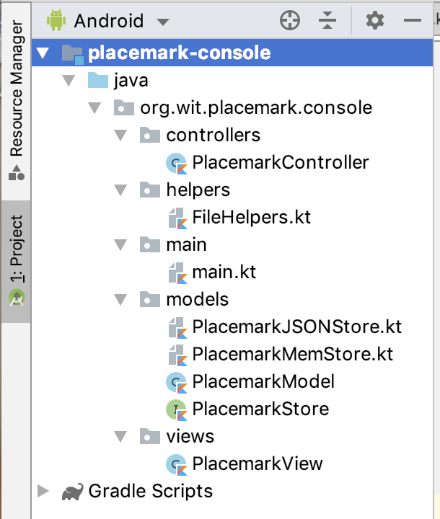
Project Structure
Again, more complex
Multiple packages

Slide 6
Project Structure
Again, more complex
Multiple packages
Helper File & JSON Support

Slide 7
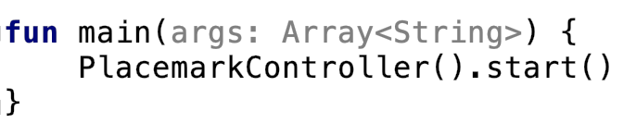
main.kt
Codebase in main file substantially Reduced
fun main
Single line of code

Slide 8
Classes & Interfaces
Placemark-Console Version 4.0

Slide 9
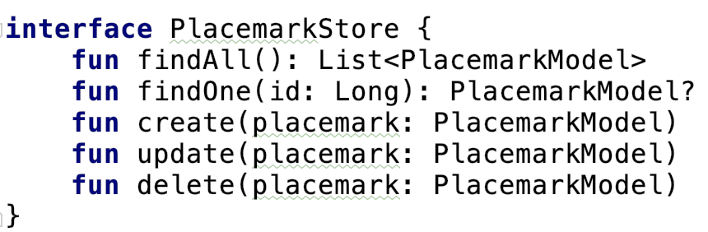
Interface PlacemarkStore
Additional delete function to allow for full CRUD support in implemented classes

Slide 10
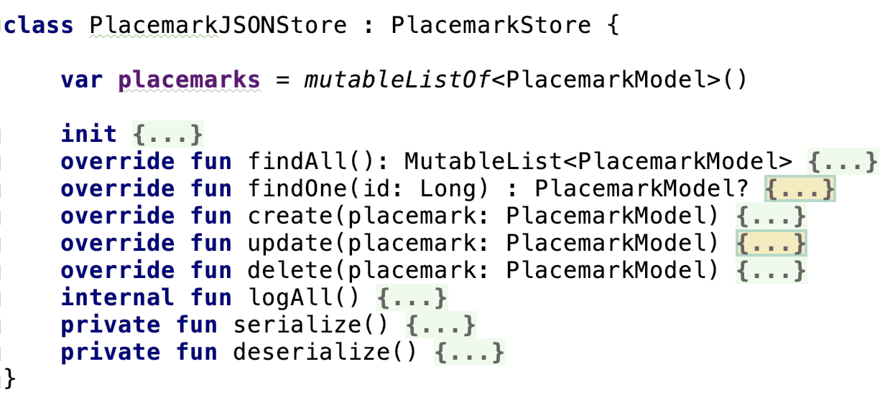
Class PlacemarkJSONStore
Implements PlacemarkStore – allows for Placemark objects to be stored in JSON file using serialize() and deserialize()

Slide 11
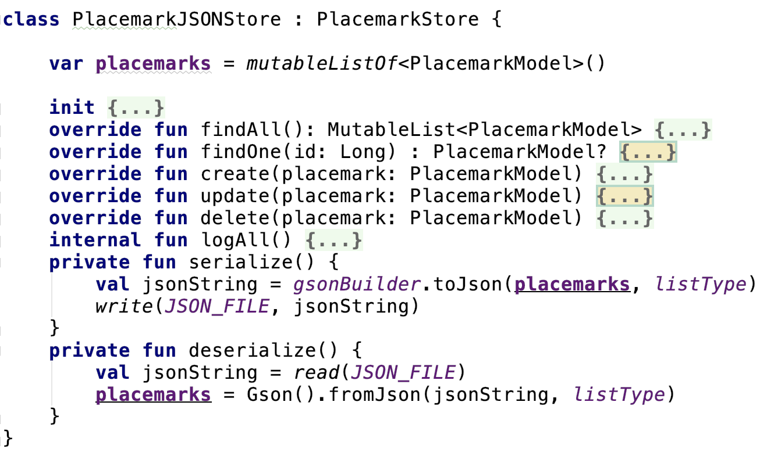
Class PlacemarkJSONStore

Slide 12
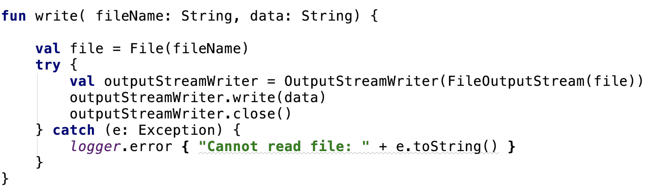
FileHelpers.kt
Main purpose to write out a stream of data to a file
Data stored in JSON format

Slide 13
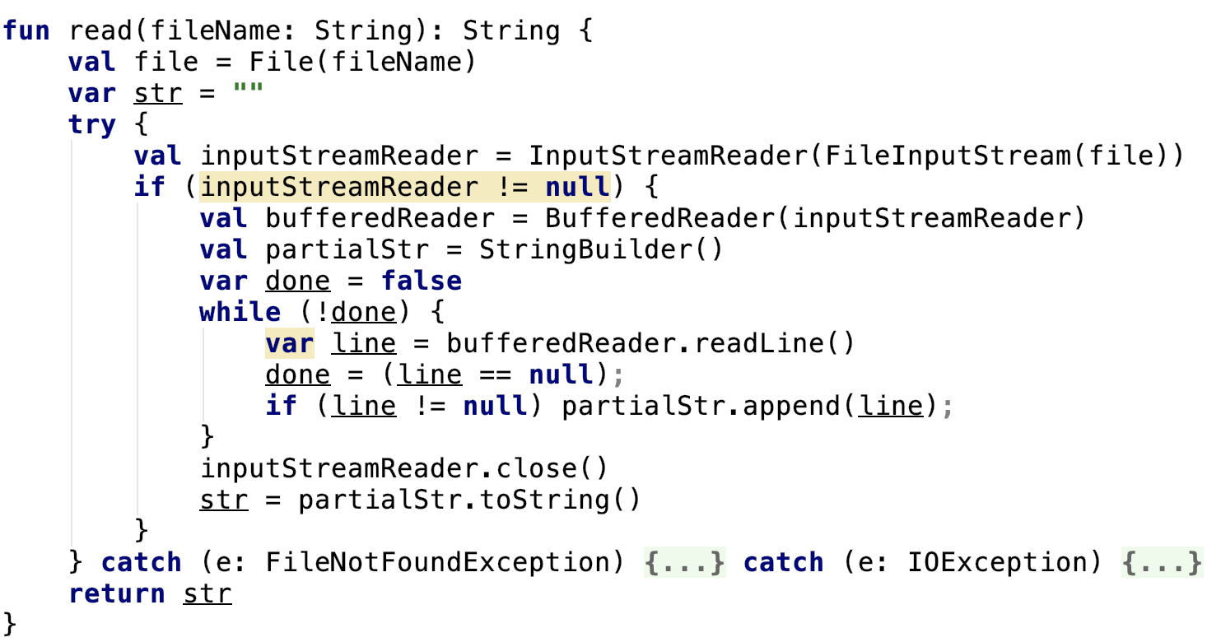
FileHelpers.kt
Main purpose to read in a stream of data from a file (more later)

Slide 14
The Serialization Mechanism
Placemark-Console Version 4.0

Slide 15
The Serialization Mechanism
App is launched and a PlacemarkController object is created and started via .start()
The PlacemarkController creates a PlacemarkJSONStore object which in turn creates it’s own internal list of Placemark objects for the app

Slide 16
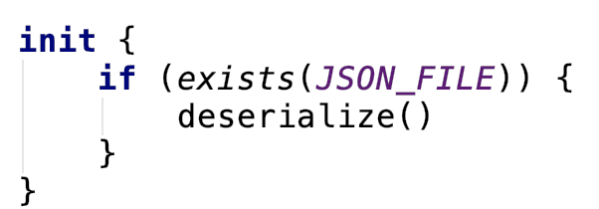
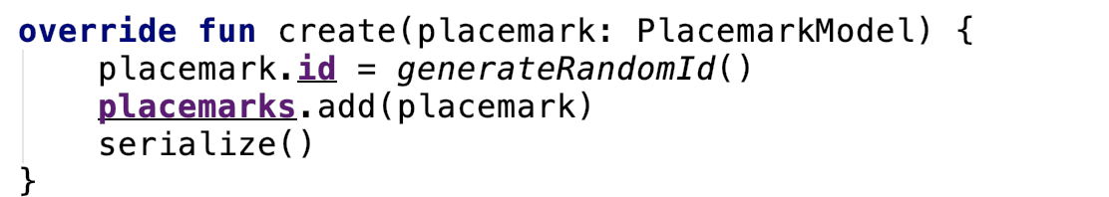
The Serialization Mechanism
If a file already exists, placemarks is populated with the data from the file via deserialize()
Otherwise the data is written to file every time a new Placemark is created, updated or deleted with serialize()

Slide 17
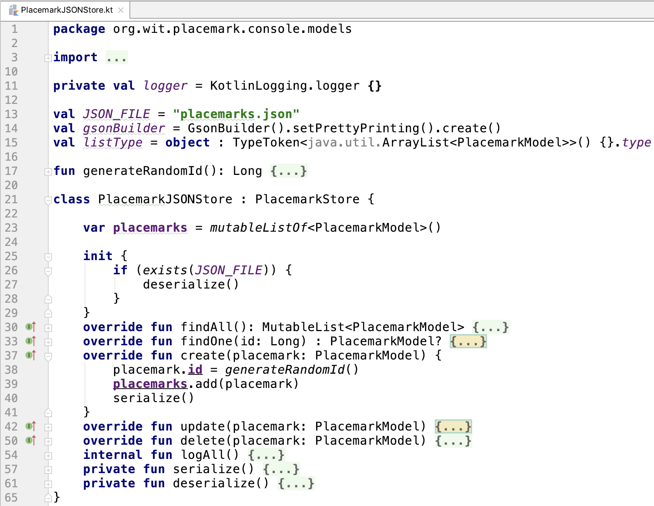
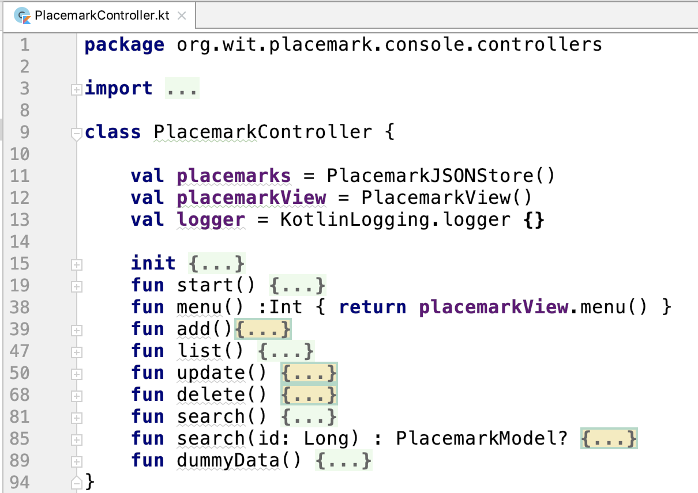
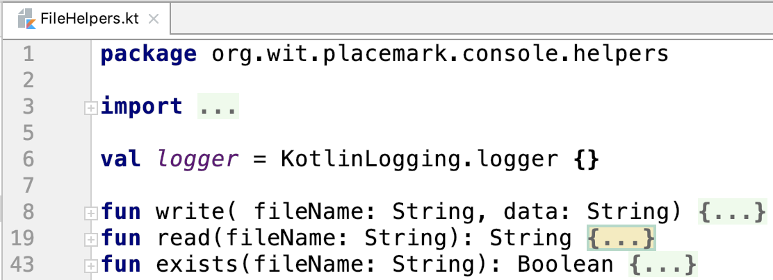
The Serialization Mechanism
1
2
3
4

Slide 18
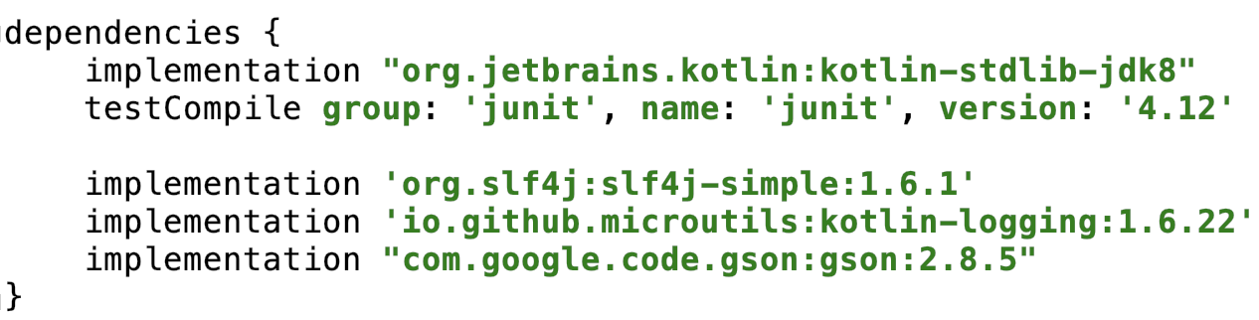
The Serialization Mechanism – Using Gson
Add necessary library to our dependencies

Slide 19
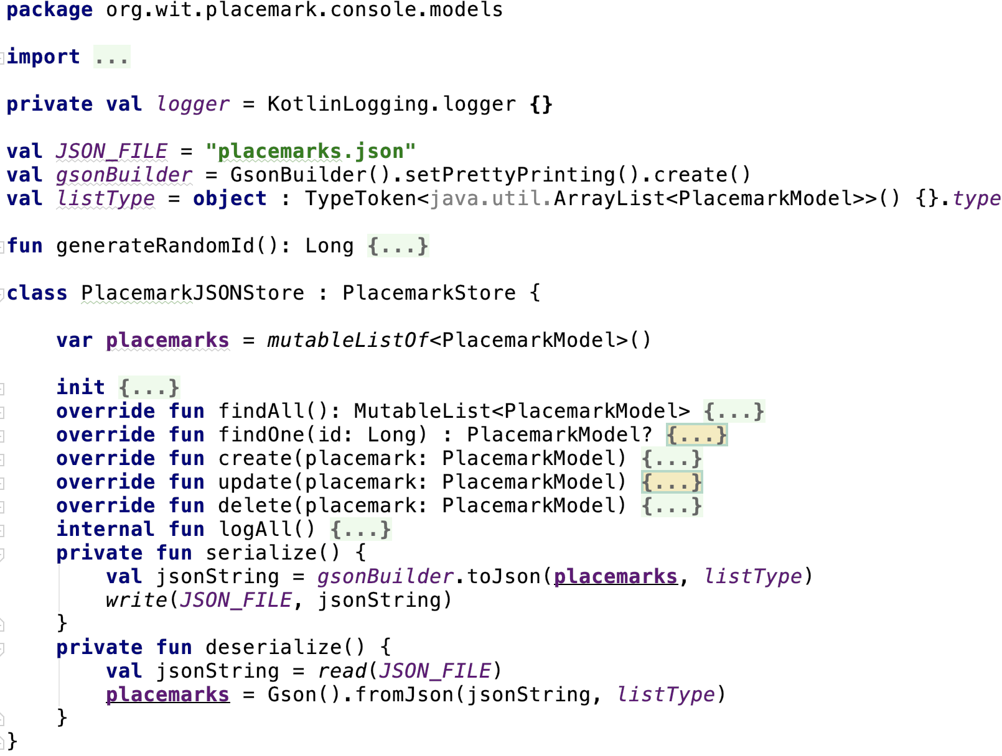
The Serialization Mechanism – Using Gson
Create a GsonBuilder
Define Object Type for Builder
Convert list of placemarks to JSON
Convert JSON to list of placemarks

Slide 20
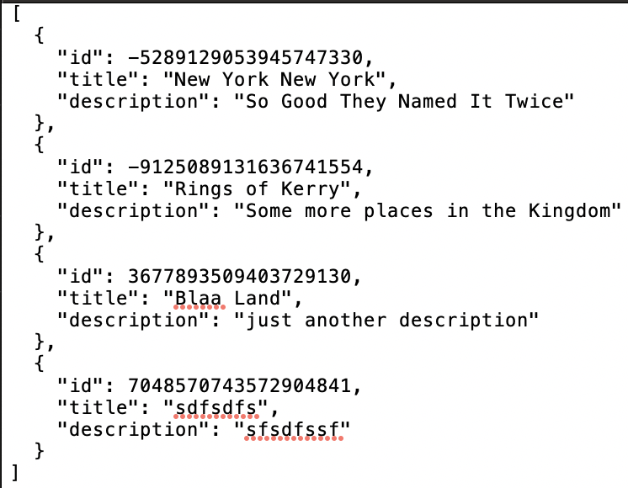
The Serialization Mechanism – Using Gson
placemarks.json

Slide 21
References
Sources: http://kotlinlang.org/docs/reference/basic-syntax.html
http://petersommerhoff.com/dev/kotlin/kotlin-for-java-devs/
https://www.programiz.com/kotlin-programming
https://medium.com/@napperley/kotlin-tutorial-5-basic-collections-3f114996692b

Slide 22


