Slide 1
Mobile Application Development
David Drohan (ddrohan@wit.ie)

Slide 2
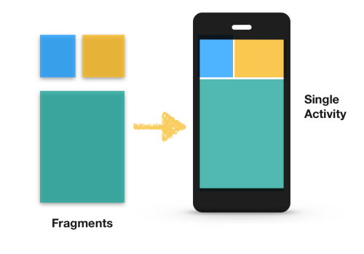
Introduction to Fragments

Slide 3
Agenda
Recap on Activities
Introduction to Fragments
The Fragment Lifecycle
Managing Fragments
Conclusion

Slide 4
Activities Recap
An activity is a single, focused thing that the user can do.
Almost all activities interact with the user, so the Activity class takes care of creating a window for you in which you can place your UI with setContentView(View).
While activities are often presented to the user as full-screen windows, they can also be used in other ways (as floating windows, in Multi-Window mode or embedded into other windows.
There are two methods almost all subclasses of Activity will implement:

Slide 5
Activities Recap
onCreate(Bundle)is where you initialize your activity, calling setContentView(int) with a layout resource defining your UI
onPause() is where you deal with the user pausing active interaction with the activity. Any changes made by the user should at this point be committed (usually to the ContentProvider holding the data). In this state the activity is still visible on screen.

Slide 6
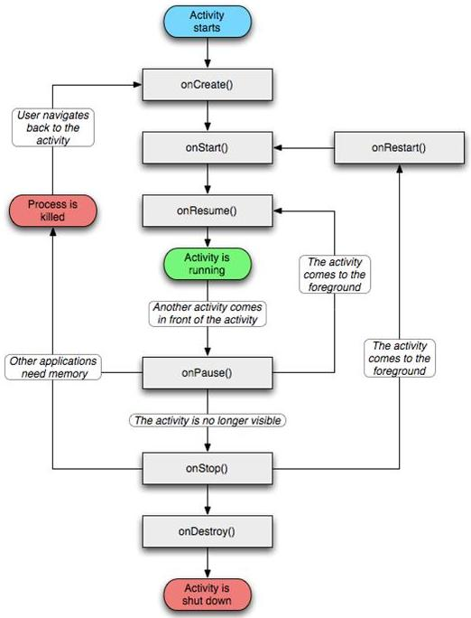
The Activity Life Cycle
At the very minimum ,you need (and is supplied) onCreate()
onStop() and onDestroy() are optional and may never be called
If you need persistence, the save needs to happen in onPause()

Slide 7

Introduction to Fragments
Reusable UI Components

Slide 8
Introduction to Fragments
Fragments represents a behaviour or a portion of a user interface in an Activity (specifically a FragmentActivity)
Introduced in Android 3.0 (API level 11), primarily supports more dynamic and flexible UI designs on larger screens
You can combine multiple fragments in a single activity to build a multi-pane UI and reuse a fragment in multiple activities
Each Fragment has its own lifecycle, receives its own input events, and you can add or remove it while the activity is running

Slide 9
Designing Fragments
You should design each fragment as a modular and reusable activity component.
When designing your application to support both tablets and handsets, you can reuse your fragments in different layout configurations to optimize the user experience based on the available screen space.
For example, on a handset, it might be necessary for separate fragments to provide a single-pane UI when more than one cannot fit within the same activity. (Next)

Slide 10
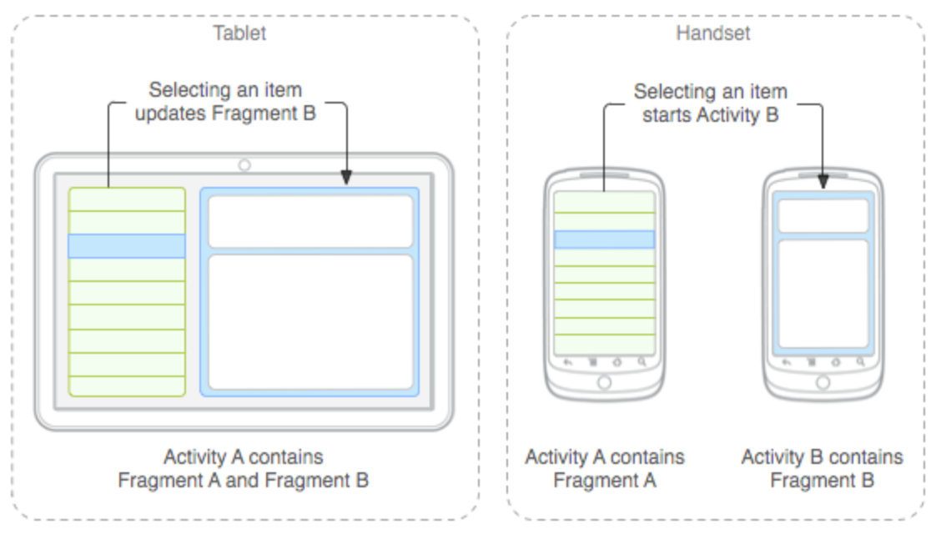
Designing Fragments
An example of how two UI modules defined by fragments can be combined into one activity for a tablet design, but separated for a handset design.

Slide 11
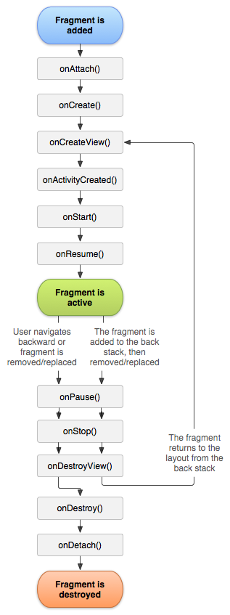
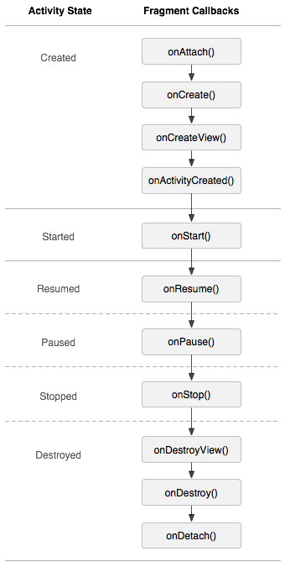
The Fragment Life Cycle
To create a fragment, you must subclass Fragment (or an existing subclass of it).
Has code that looks a lot like an Activity. Contains callback methods similar to an activity, such as onCreate(), onStart(), onPause(), and onStop().
Usually, you should implement at least onCreate(), onCreateView() and onPause()

Slide 12
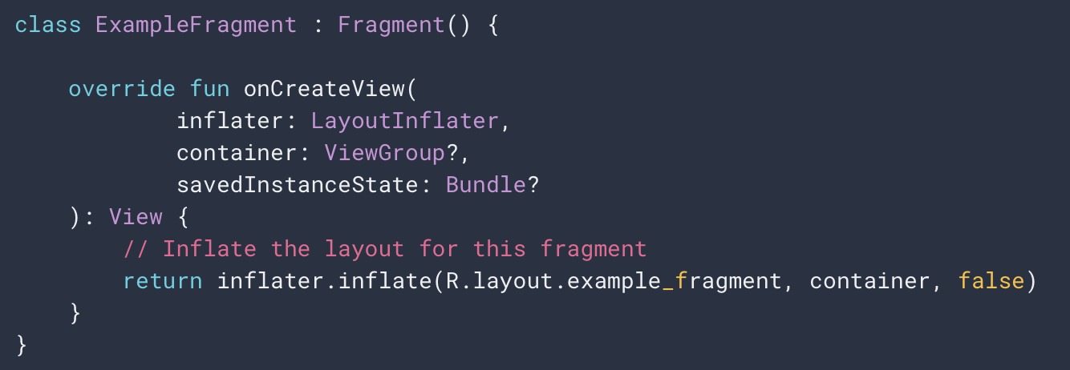
Example Fragment

Slide 13
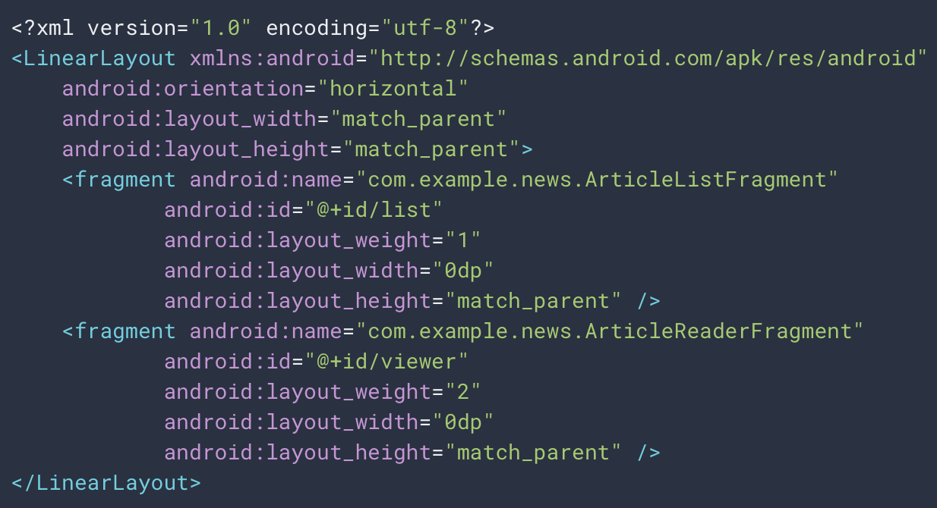
Example Usage (in Activity Layout)
Notes:
When the system creates this activity layout, it instantiates each fragment specified in the layout and calls the onCreateView() method for each one, to retrieve each fragment's layout. The system inserts the View returned by the fragment directly in place of the <fragment> element.

Slide 14
Fragment Managers & Transactions
A great feature about using fragments in your activity is the ability to add, remove, replace, and perform other actions with them, in response to user interaction.
Each set of changes that you commit to the activity is called a transaction and you can perform one by using APIs in FragmentTransaction.
You can also save each transaction to a back stack managed by the activity, allowing the user to navigate backward through the fragment changes (similar to navigating backward through activities).

Slide 15
Managing Fragments
To manage the fragments in your activity, you need to use FragmentManager. To get it, call getSupportFragmentManager() from your activity
You acquire an instance of FragmentTransaction from the FragmentManager like this:
Each transaction is a set of changes that you want to perform at the same time. You can perform transaction methods such as add(), remove(), and replace()
Then, to apply the transaction to the activity, you must call commit()
methods/references can be ‘chained’

Slide 16
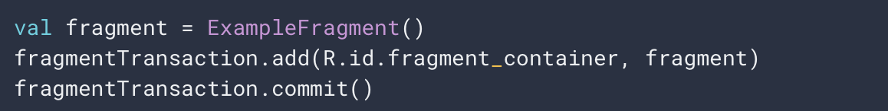
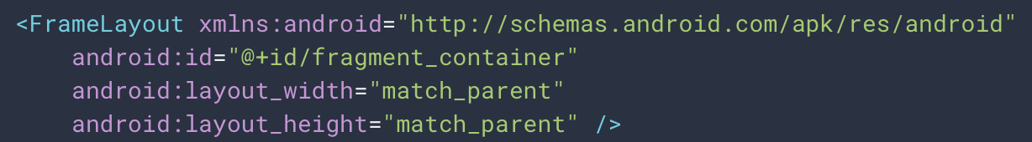
Managing Fragments
Here we add a fragment using the add() method, specifying the fragment to add and the view in which to insert it
And render it like so

Slide 17
Managing Fragments
Before you call commit(), however, you might want to call addToBackStack(), in order to add the transaction to a back stack of fragment transactions
This back stack is managed by the activity and allows the user to return to the previous fragment state, by pressing the Back button
For example, here's how you can replace one fragment with another, and preserve the previous state in the back stack

Slide 18
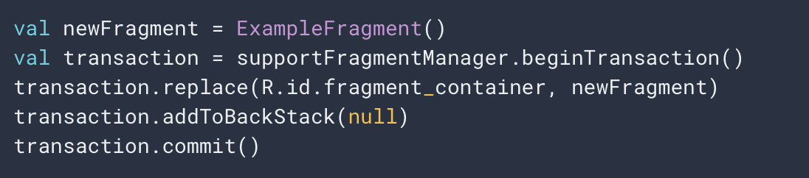
Managing Fragments
In this example, newFragment replaces whatever fragment (if any) is currently in the layout container identified by the R.id.fragment_container ID. By calling addToBackStack(), the replace transaction is saved to the back stack so the user can reverse the transaction and bring back the previous fragment by pressing the Back button.
FragmentActivity then automatically retrieves fragments from the back stack via onBackPressed()

Slide 19
Communicating with the Activity
Although a Fragment is implemented as an object that's independent from a FragmentActivity and can be used inside multiple activities, a given instance of a fragment is directly tied to the activity that hosts it
Specifically, the fragment can access the FragmentActivity instance with getActivity() and easily perform tasks such as find a view in the activity layout

Slide 20
Communicating with the Activity
Likewise, your activity can call methods in the fragment by acquiring a reference to the Fragment from FragmentManager, using findFragmentById() or findFragmentByTag()

Slide 21
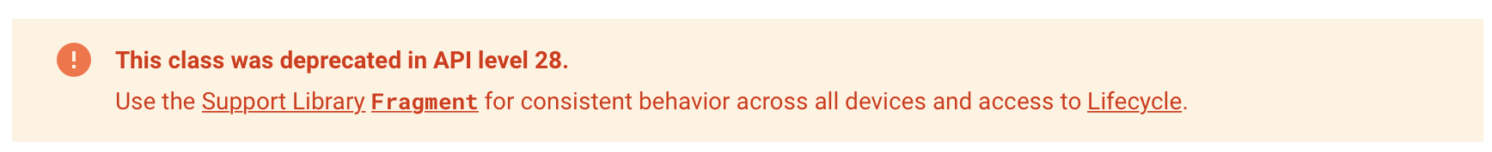
Fragments & Android Pie (API 28)
android.app.Fragment
getFragmentManager().beginTransaction()

Slide 22
Fragments Conclusion
It’s worth noting you don’t have to use fragments - however, if you use them well, they can provide:
Modularity: Dividing complex activity code across fragments for better organization and maintenance.
Reusability: Placing behavior or UI parts into fragments that multiple activities can share.
Adaptability: Representing sections of a UI as different fragments and utilizing different layouts depending on screen orientation and size.

Slide 23
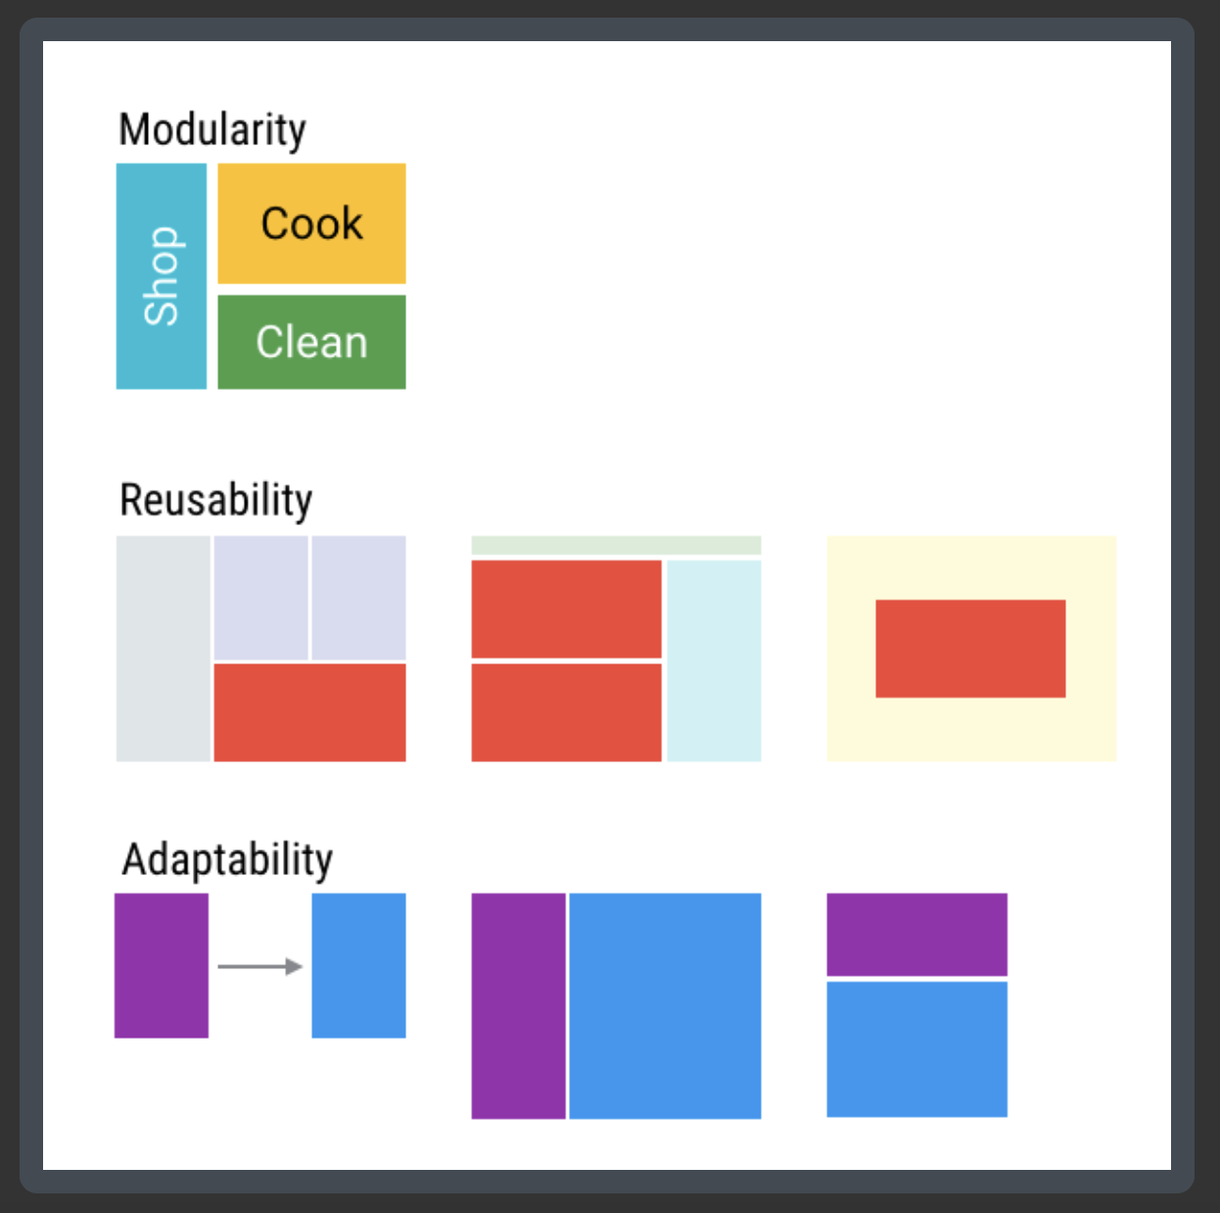
Fragments Conclusion

Slide 24

References
Sources: https://www.raywenderlich.com/1364094-android-fragments-tutorial-an-introduction-with-kotlin
https://developer.android.com/guide/components/fragments

Slide 25


