Slide 1
Mobile Application Development
David Drohan (ddrohan@wit.ie)

Slide 2
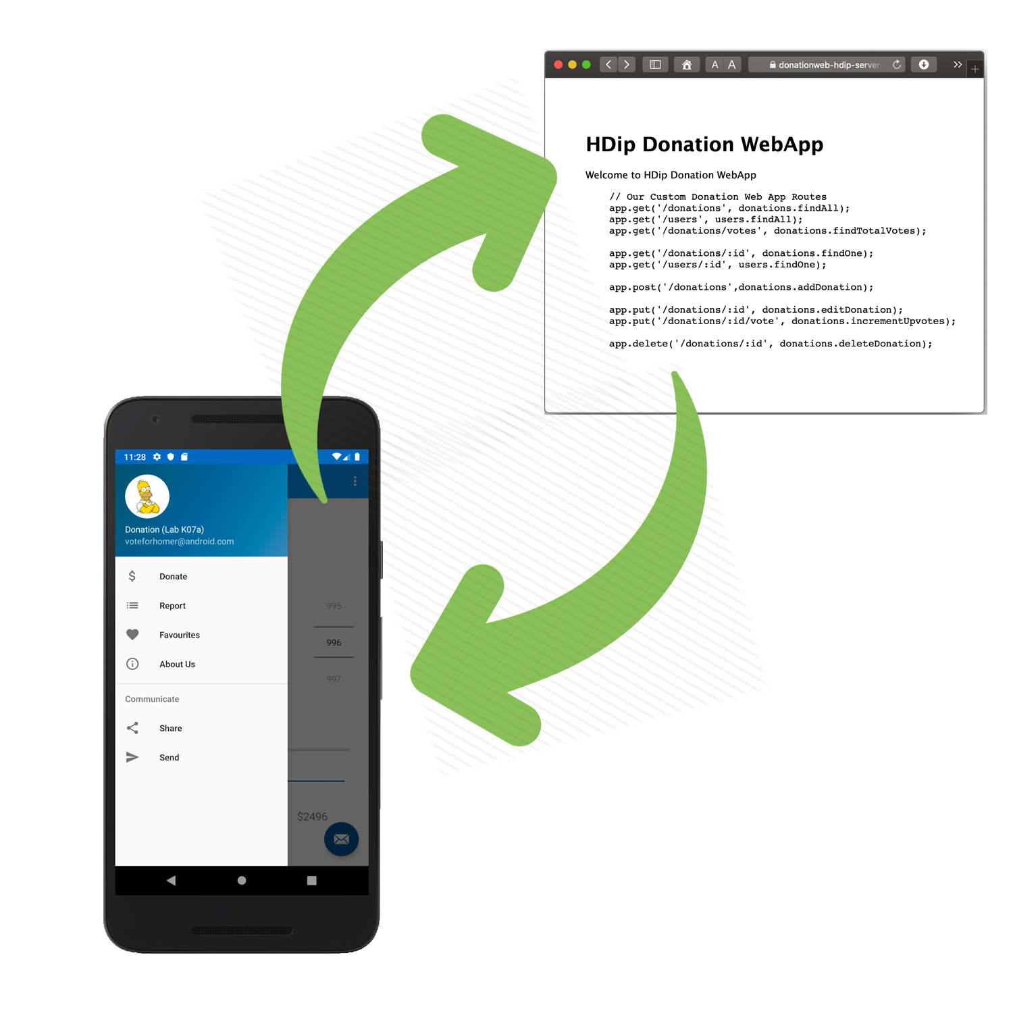
Donation-V3 Walkthrough

Slide 3
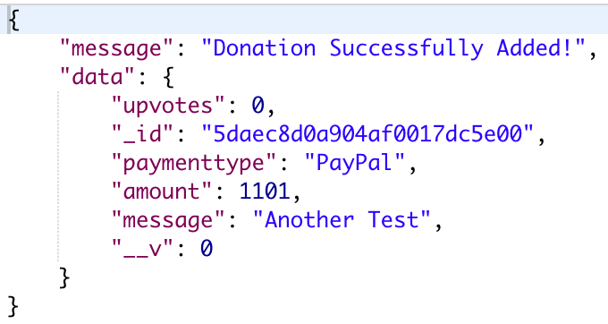
Aside - Donation Service
http://donationweb-hdip-server.herokuapp.com api endpoints
{ method: 'GET', path: ‘/donations', config: Donations.findAll }, { method: 'GET', path: '/donations/{id}', config: Donations.findOne }, { method: 'POST', path: '/donations', config: Donations.addDonation }, { method: 'PUT', path: '/donations/{id}', config: Donations.editDonation }, { method: 'DELETE', path: /donations/{id}', config: Donations.deleteDonation }
Use DonationService for
Adding / Updating / Deleting a Donation
Listing All Donations
Finding a single Donation

Slide 4
Steps to integrate Retrofit into your App
Set up your Project Dependencies & Permissions
Create Interface for API and declare methods for each REST Call, specifying method type using Annotations - @GET, @POST, @PUT, etc. For parameters use - @Path, @Query, @Body
Use Retrofit to build the service client
Make the REST Calls as necessary using the relevant Callback mechanism

Slide 5
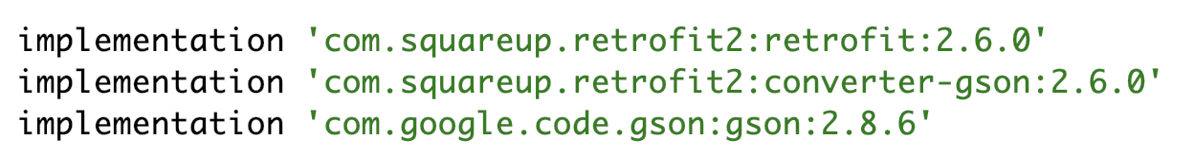
1. Project Dependencies & Permissions
Add the required dependencies to your build.gradle
And the necessary permissions to your manifest – BEFORE/OUTSIDE the application tag

Slide 6
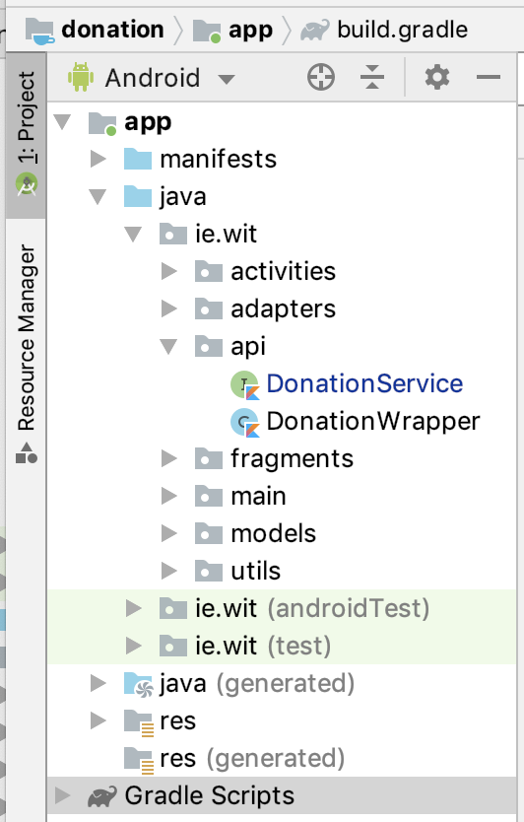
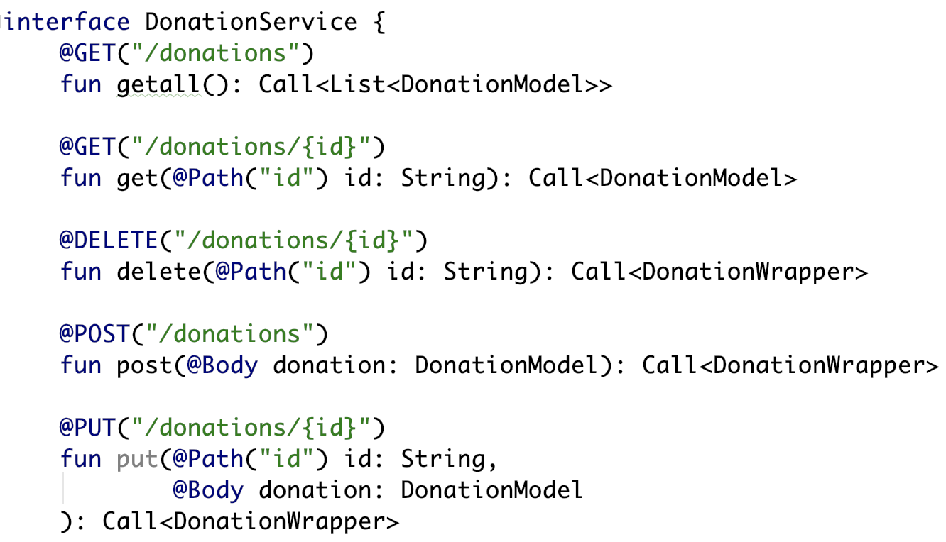
2. Create interface (and Wrapper) for API

Slide 7
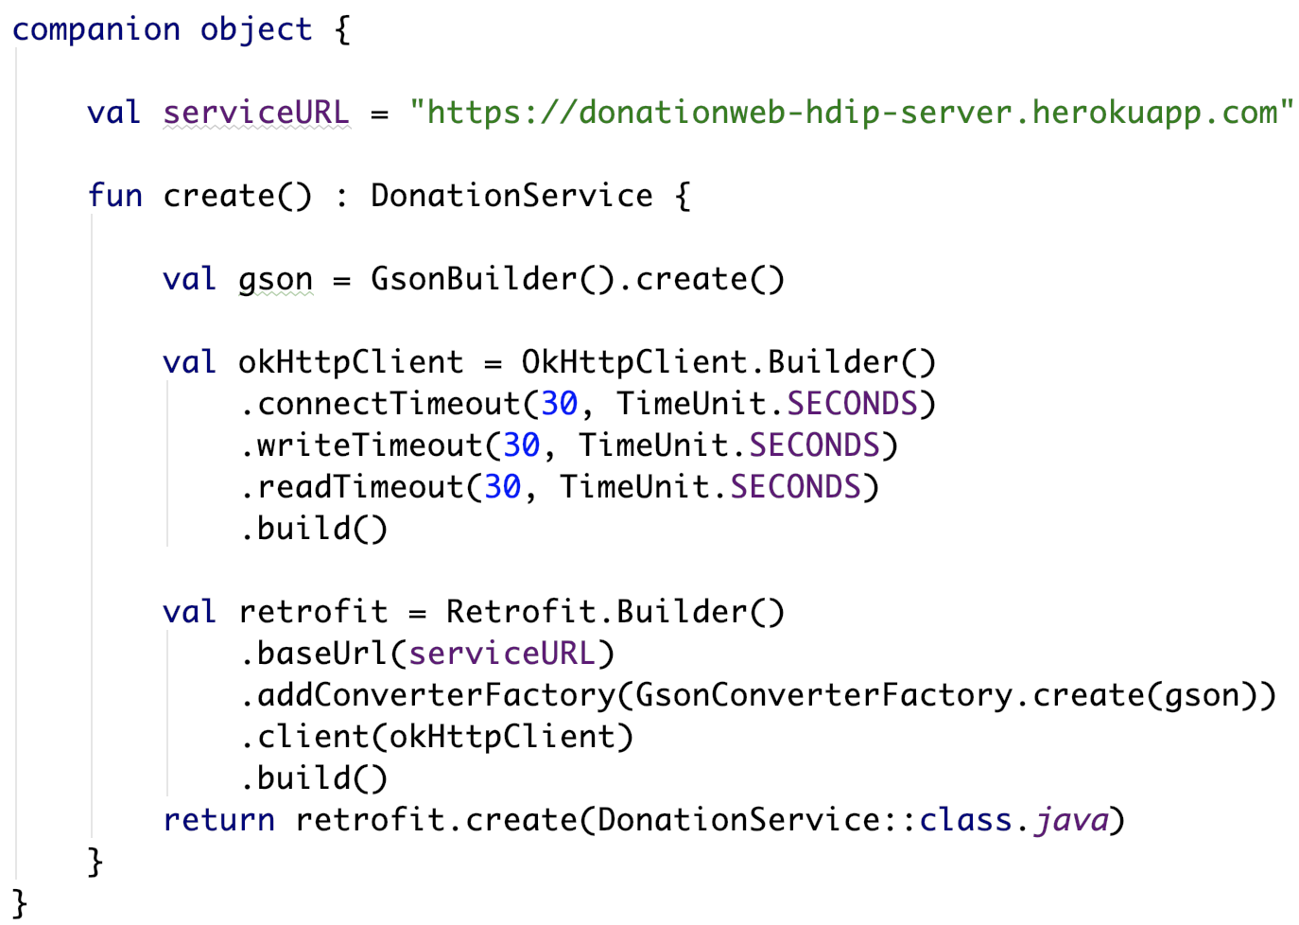
2. Create interface (and Wrapper) for API
Gson for converting our JSON
OkHttpClient for timeouts (optional)
Retrofit.Builder to create an instance of our interface

Slide 8
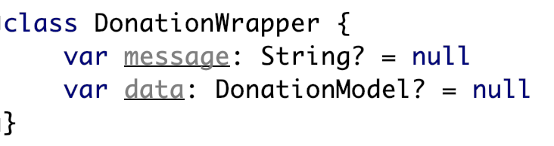
2. Create interface (and Wrapper) for API

Slide 9
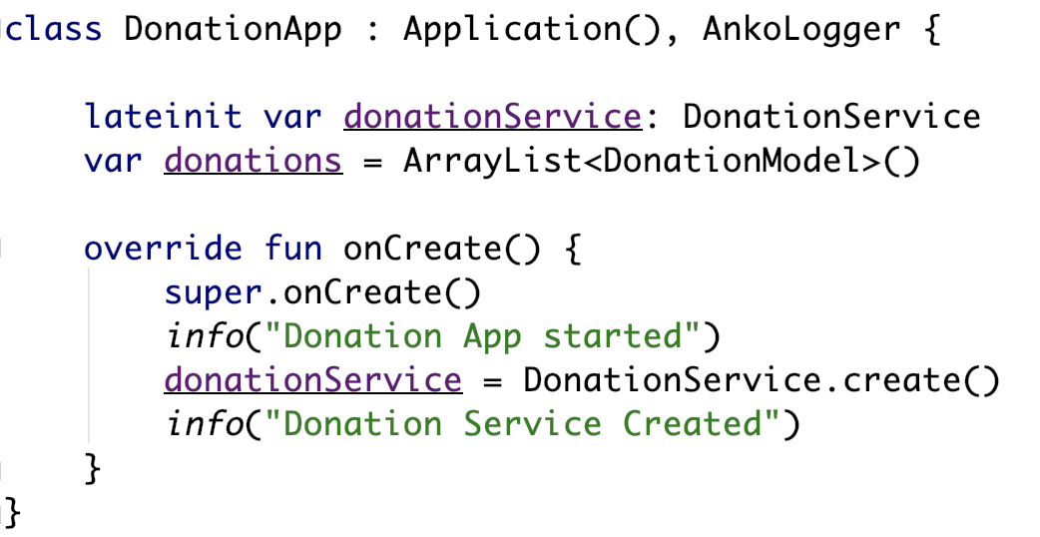
3. Create Service Client - DonationApp
Our DonationService instance

Slide 10
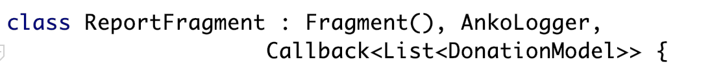
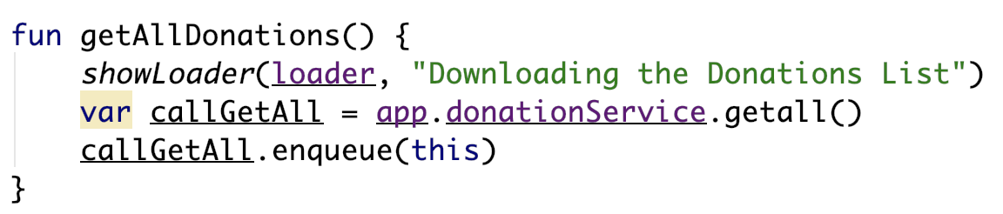
4. Calling the API - ReportFragment
Note the Callback interface
Implement the necessary interface
and Callback objects
Called inside onResume()
enqueue() allows for asynchronous callback to our service

Slide 11
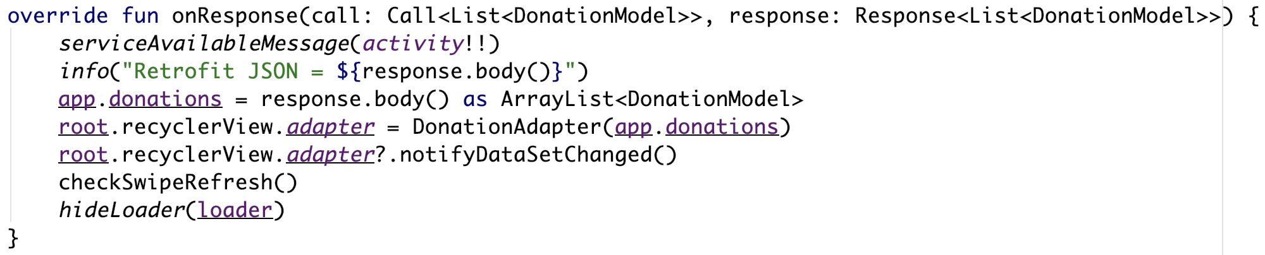
4. ReportFragment – onResponse()
Triggered on a successful call to the API
Takes 2 parameters
The Call object
The expected Response object
Converted JSON result stored in response.body()

Slide 12
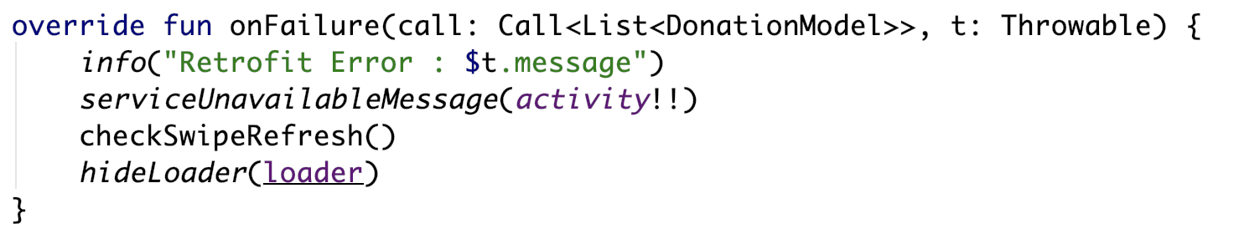
4. ReportFragment – onFailure()
Triggered on an unsuccessful call to the API
Takes 2 parameters
The Call object
A Throwable object containing error info
Probably should inform user of what’s happened

Slide 13
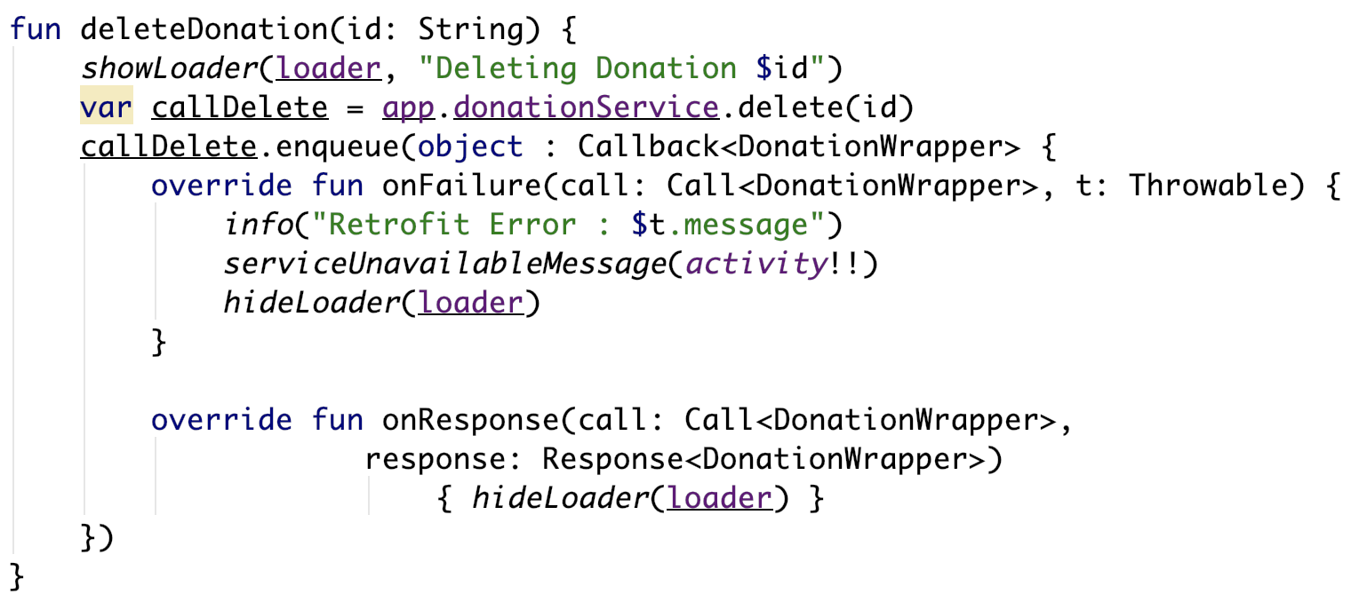
Anonymous Callbacks
Anonymous Callbacks allows for multiple calls in same class

Slide 14
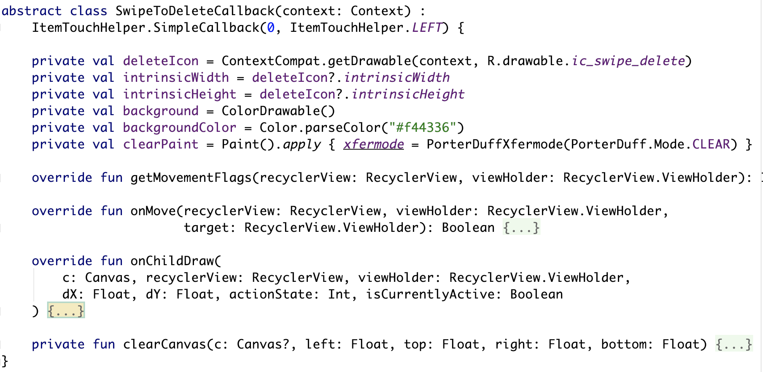
Helper Classes - SwipeToDeleteCallback
Notes:
Responsible for 1 – setting the icon & drawing the icon 2 – setting the background colour and 3 – drawing the background colour as you swipe

Slide 15
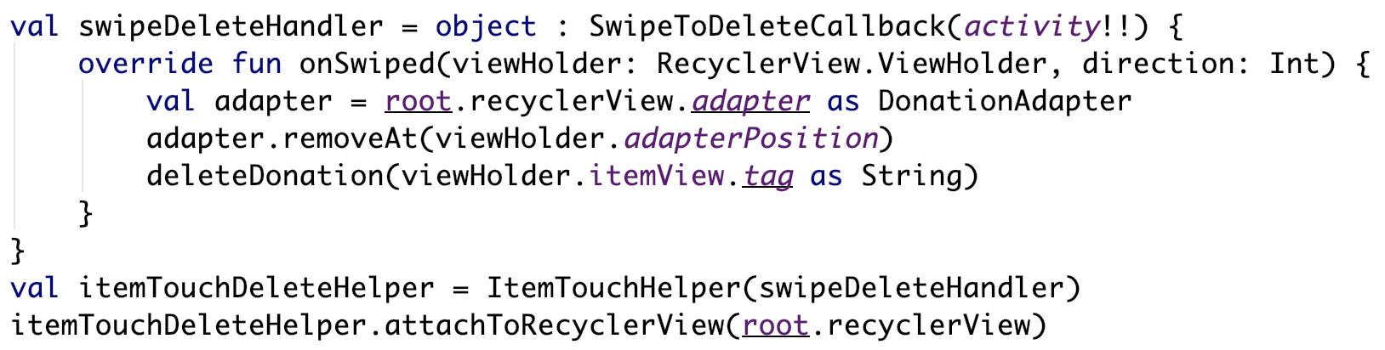
SwipeToDeleteCallback Usage
Notes:
Responsible for 1 – setting the icon & drawing the icon 2 – setting the background colour and 3 – drawing the background colour as you swipe

Slide 16
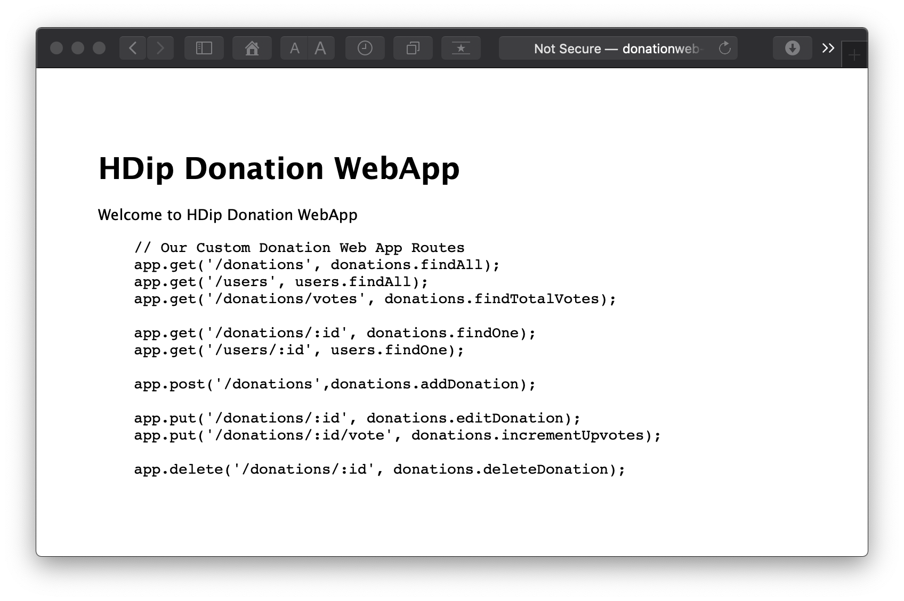
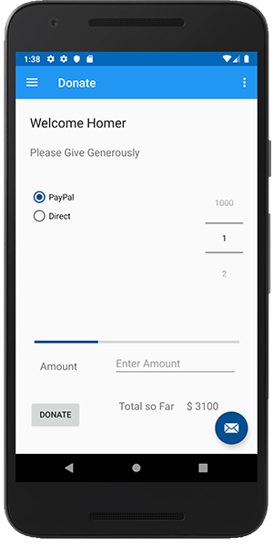
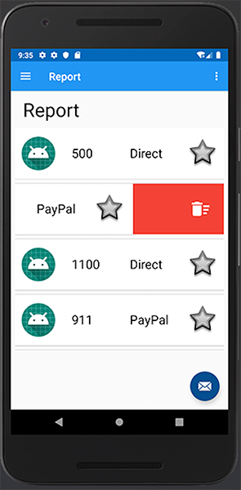
Donation Service + Mobile App

Slide 17


