Slide 1
User Experience (UX)
Annetta Stack, WIT.

Slide 2
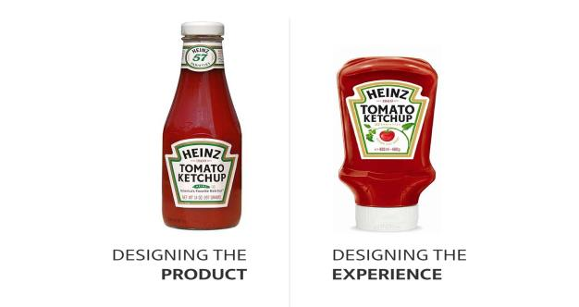
Introduction
every product or service that is used by someone creates a user experience: books, ketchup bottles, armchairs, earphones, domestic appliances etc.
UX is the process of enhancing a users satisfaction with a product or service by improving the usability, accessibility & pleasure provided in the interaction
when a product or service is being developed a lot of attention goes to defining what it does – UX focuses on how it works - in designing a system you are trying to solve a problem which your user’s may have

Slide 3
Does UX Matter?
UX is extremely important – if your users experience success:
it encourages repeat usage as they are more likely to come back again
users are more likely to recommend your product to others
ultimately your product achieves it’s goals
UX is therefore a balance between:
the goals of your site/app [purpose or what it is you wish to achieve]
user needs & behaviours
usability/functionality of site/app

Slide 4
UX expressed as…..
What is a Good UX
usable (used by particular individuals for a particular goal)
helpful
easy to learn
accessible
attractive
fun, satisfying
credible
valuable
useful
desireable
What is a Bad UX
stressful
confusing
distracting
ugly
inefficient
inconsiderate
frustrating

Slide 5
UX versus UI
UI (User Interface) components:
layout (relationship of space to copy – copy pertaining to text & images)
colour
typography
UX (User Experience) components:
user research (defining your target audience)
user stories (personas, scenarios)
information architecture/ content strategy
content inventory, grouping & labelling, context diagram, flow chart
prototype
(interaction design & the UI elements - flow of the product) paper prototypes, wireframes, mock-ups)
test

Slide 6
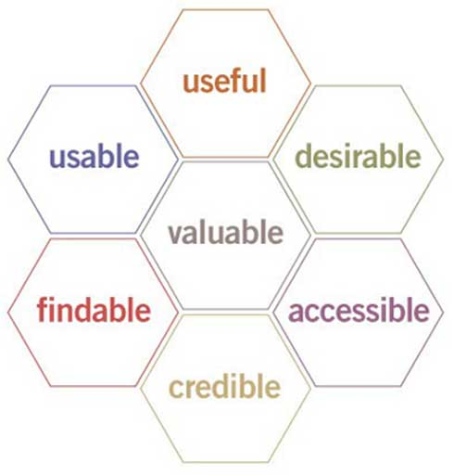
UX as a Discipline
UX as a discipline originated from usability studies (which describes how easy it is to use a product)
Honeycomb User Experience (Morville, 1994)
Notes:
Useable: simple & easy to understand
Useful: fit for purpose, achieves the user’s goal, fulfills a need
Desirable: visual aesthetics of the product or service
Findable: information needs to be easy to find, easy to navigate to find what you want (we scan not read)
Credible: trustworthy
Accessible: inclusivity

Slide 7
Nielsen’s 10 Heuristics
visibility of system status: the system must always keep the users informed about what is going on through appropriate feedback within reasonable time
match between the system & real world: use concepts, images, phrases that are familiar to users rather than system oriented terms. Follow real world conventions.
user control & freedom: we often choose the incorrect functions through trial & error tactics [but also human error in general] & will need clear & obvious ‘escape’ routes such as ‘redo’ or ‘undo’ or safety nets such as ‘do you wish to delete the item…..’
consistency & standards: follow conventions, don’t make user’s have to second guess what functions actually do – be specific [click here!]
error prevention: even better than good error messages is a careful design which prevents a problem from occurring in the first place

Slide 8
Nielsen’s 10 Heuristics
recognition rather than recall: make options, actions & objects visible – the user should not have to remember information from one part of a dialogue to another
flexibility & efficiency of use: allow user’s to tailor frequent actions. Where the system can cater for both novice & expert user [menu system versus shortcut key system]
aesthetic & minimalist design: every extra unit of dialogue competes with the relevant units of information & diminishes the overall effect. Be succinct, use clear signposts, clear naming conventions – in essence clear language
help user’s recognise, diagnose & recover from errors: error messages must be expressed in clear language (no codes), precisely indicate the problem & constructively suggest a solution
help & documentation: even though it is better if the system can be used without documentation, it may be necessary to provide help & documentation. Any such information should be easy to search, focus on user’s task, list concrete steps to be carried out & not be too large

Slide 9
UX Accessibility
the web has become an essential part of our daily lives & everyone needs access to this technology
web accessibility focuses upon ensuring equivalent access for everyone
web accessibility addresses all impairments which may be permanent or temporary & include learning and cognition, physical speech, auditory & visual ability
impairments may affect a user’s ability to perceive, understand or physically manipulate an object
& can occur for many reasons including medical conditions, injury, the environment or simply old age

Slide 10
Barriers to Accessibility
users may have difficulty perceiving visual things as in the case of blind people or partially sighted people
else they may have forgotten their glasses or may be working in a very dark or bright environment
users may have difficulty perceiving sounds if they are deaf or hard of hearing
or working in a noisy environment
users may have difficulty understanding things if they have a learning impairment
else they may have a low level of literacy in the language being spoken
else they may be stressed
users may have difficulty manipulating things if they have a physical disability
else they may be injured or it may simply be old age

Slide 11
Barriers to Accessibility
users may also be impaired by the technology itself:
services delivered through the web require users to have their own technology in the form of smart device, computer, printer etc
issue of broadband
physical size of hand held devices
accessibility barriers occur when the design of a technology fails to allow for a variation in a user’s ability: this can be as simple as failing to shield a cash dispenser display from sunlight or it could be something more fundamental to the design such as poor choice of colour or size of navigational aids

Slide 12
Accessibility Goals
web accessibility benefits all users:
if all users are able to perceive & understand the controls [navigation], instructions & outputs [prompts/menus else money, tickets]
if all users are able to reach & manipulate the controls, instructions & outputs
if the GUI/UI is consistent across functions, devices & repeated use
for users who cannot use a particular service, an equivalent alternative service is available

Slide 13
UX Summary
visibility considerations
cognitive & learning considerations
language considerations
hearing/ auditory considerations
dexterity considerations
technology considerations

