Slide 1
Web Development
Eamonn de Leastar (edeleastar@wit.ie)

Slide 2
Agenda
Planning
Modelling
Execution
3

Slide 3
Web Design: Definition
Wikipedia: “a process of conceptualization, planning, modeling, and execution of electronic media delivery via Internet in the form of Markup language suitable for interpretation by Web browser and display as Graphical user interface”.
Processes:
Planning Stage - flowcharts (the outline) are created which illustrate the navigational structure of your website.
Modeling Stage - static wireframes are created (the rough draft) which illustrate the skeletal layout for each section of your website. After the wire frames are created, graphics, colors and text are used to create the design of your web pages based on the layout of the wire frames.
Execution Stage - your design is converted into a format supported by web browsers, text and content are added, and finally, your website is published live to the Internet (final draft).
5

Slide 4
Stage 1: Conceptualization and Planning
A. Define your Target Audience
B. Define the Purpose of the site
C. Consider the types of content
D. Define a Strategy / Style to best suit the purpose of the site
E. Sitemap
7

Slide 5
A. Define your Target Audience
Their need
Their interests
Their technological skills
What hardware/software they use
8

Slide 6
B. Define the Purpose of the site
Personal
Profit-earning business
Non-profit organisation
Educational
Entertainment
Social
9

Slide 7
C. Consider the types of content:
Text
Graphics
Video
Sound
Forms
Animation
10

Slide 8
D. Define a Style to best suit the purpose of the site:
Professional
Scholarly
Casual
Child friendly
Teen oriented
Artistic
11

Slide 9
E.Sitemap (1)
Tools:
Pen and Paper or
Diagramming Software
At the top of the sitemap list the name of the website. Then list each primary section of the website:
These sections are the main navigation for your website. Try to limit the number of these section so that your visitors are not overwhelmed.Add all of the secondary pages (subsections) that will be listed on each of the primary pages.
The secondary navigation needs to be more descriptive than the primary navigation.
The deeper your websites’ navigational hierarchy goes, the more descriptive each label should be.
12

Slide 10
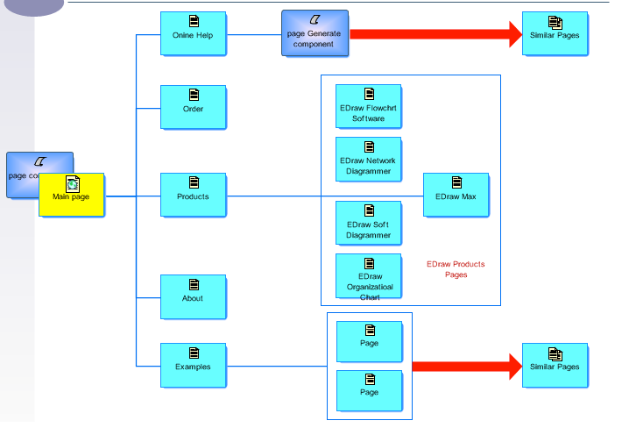
E.Sitemap (2)
13

Slide 11
E.Sitemap (3)
Do:
Less is more; keep the number of primary sections to a minimum.
Whether you use a pen and paper or flowchart software, keep things as clean and organized as possible. Although you (and anyone working with you) are the only ones that will be using the flowchart, it still needs to make sense.
Your primary sections should use broader terms, while secondary and tertiary terms should be more descriptive.
14

Slide 12
E.Sitemap (4)
Dont
Don’t use very descriptive terms in your primary navigation unless your entire website focuses on one narrow topic.
Don’t try and lump multiple topics on the same page. Create a general section for these topics and from that section create subsections. This will make the subsection (descriptive) web pages more likely to have better rankings in the search engines.
15

Slide 13
Web Design Stages
Planning
Modeling
Execution
16

Slide 14
2. Modeling
In the modeling stage, static “wireframe” mockups are created.
Simple drawings that show the placement of elements on a web page.
Allow web designers and clients to focus on the layout of the site without the distraction of colour, type and other design elements.
Each mockup illustrates a bare-bones skeleton of the layout for each of the web pages that will be included in your website.
This stage is important because it gives us an idea of where different elements will be placed in our design.
17

Slide 15
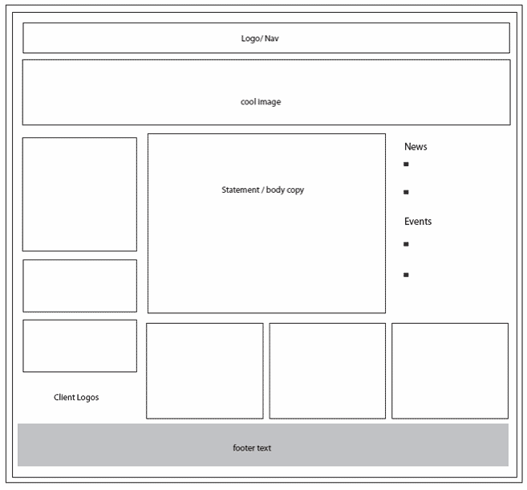
Wireframe Example
No colors or graphics included
If some of your pages will be using the same layout, then it is not necessary to mock all of those pages up - just be sure to mockup any unique layout that your website will have
18

Slide 16
Modeling : Do’s
Mockup all unique pages
Include important elements (logo, navigation, content placement, images/video placement)
Start from the top and work your way down
Reference your flowchart created in stage 1 to make you don’t forget to mockup any pages
Focus on clean, user friendly layouts
Label your elements so you don’t forget what they are when you reference them in stage 3, execution
Use other web sites as inspiration
For images - search for “Creative Commons” licensed images
19

Slide 17
Modeling: Don’t’s
Don’t include graphics or colors (that’s for the next stage)
Don’t make your mockups too “busy”; focus on clean, well organized, user friendly layouts
Don’t skip this stage; it is just as important as the first and the last
If you take elements from other websites, make sure you don’t plagiarize; there is a difference between being inspired by another website to create certain elements of your design and merely replicating their layout and colors
20

Slide 18
Web Design Stages
Planning
Modeling
Execution
21

Slide 19
Execution
The planning from stages 1 and 2 are combined to assist in creating a live, interactive website.
By the time you reach the third stage, you should have a clear idea of:
how your visitors will get from one place to another (stage 1, flowchart)
how your web pages will be laid out (stage 2, wireframe mockups)
If you don’t have a clear idea of these two things, go back to the first and second stages and continue to develop them. You will find that the third stage is easiest when you have constructed a clear, concise battle plan for designing your website
22

Slide 20
Execution Do’s & Don’t’s
Do
Experiment and Innovate
Use you text book & sitepoint web site as a reference manual for html & CSS
Make intelligent use of Sublime
Publish the site regularly to verify its operation
Use w3c site for regular html and css validation
Spend 2 hours of supervised labs on project + 1-2 other hours per week.
Dont
PANIC!
The project should be fun and interesting and a way of deepening your knowledge of HTML, CSS and Sublime.
23

