Slide 1
CSS Layout Part 2
Web Development

Slide 2
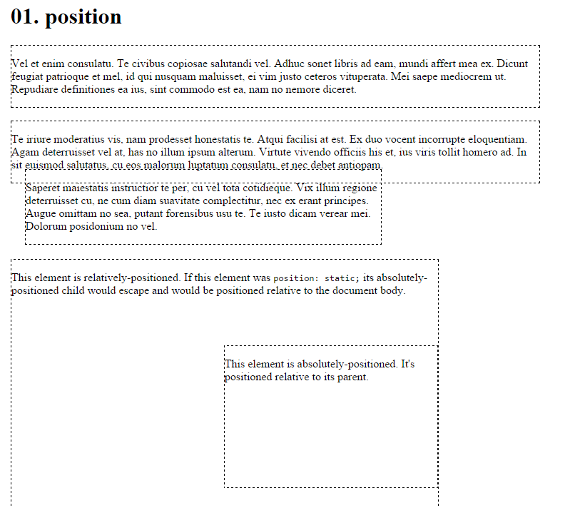
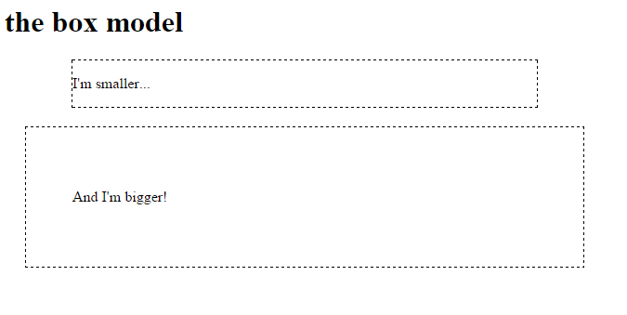
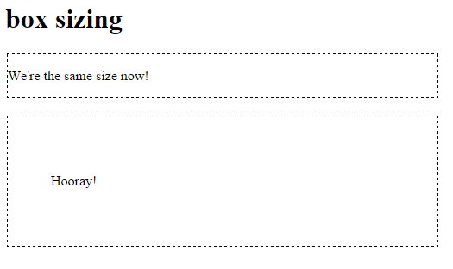
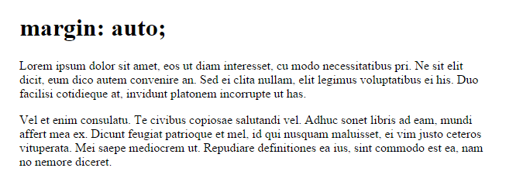
Lab 07: Learn CSS Layout Part 2

Slide 3
CSS Layout Part 2
The clearfix hack
Float layout example
Percent width
Mobile Site Design
Media queries Inline-block
Viewport Meta Tag
Inline-block layout
Column
Flexbox
Further Reading

Slide 4
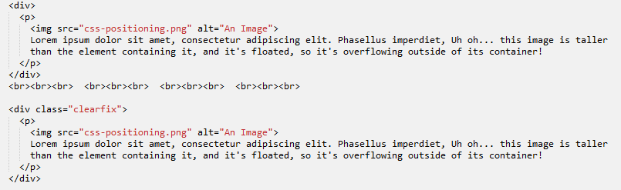
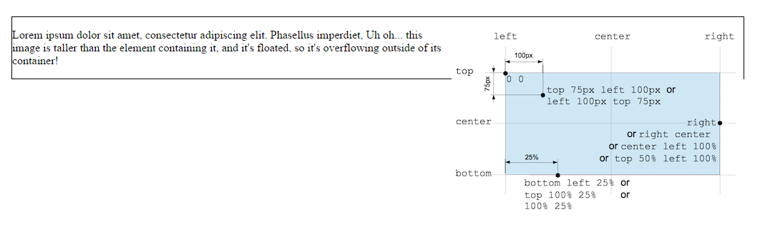

Clearfix hack
Bad things can sometimes happen when using floats:
In this case an image overflows the container, we used float right for the image within the <p>, however because it is taller than the text it overflows.

Slide 5
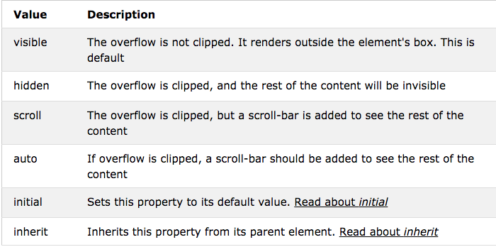
overflow Property
The overflow property specifies what happens if content overflows an element's box.
This property specifies whether to clip content or to add scrollbars when an element's content is too big to fit in a specified area.

Slide 6
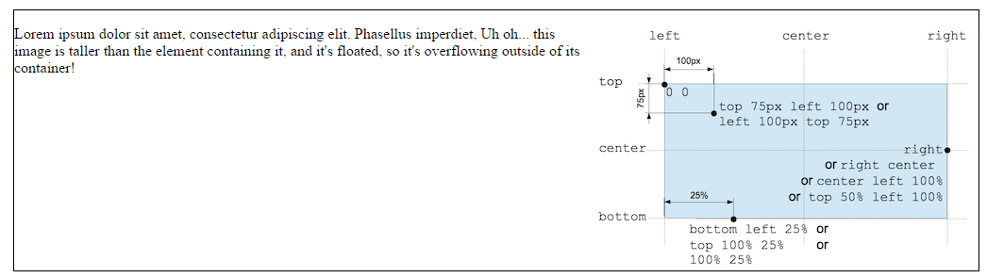

Clearfix hack

Slide 7
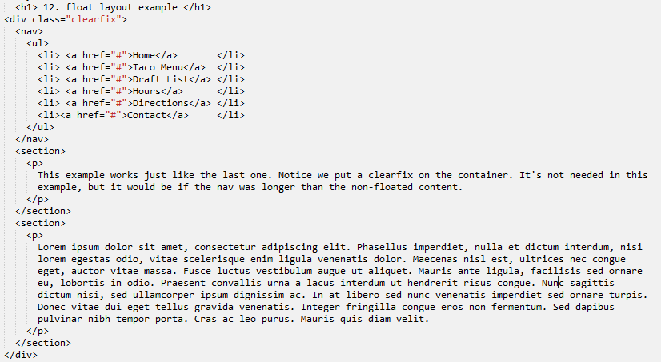
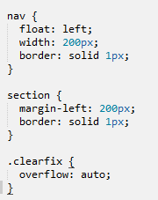
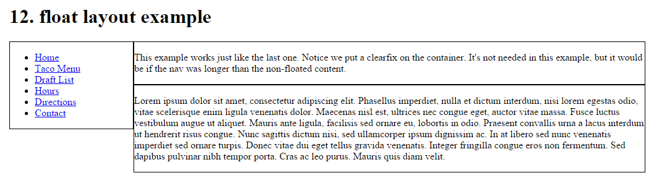
Float layout example
It is common to do entire layouts using float. Here is the same layout we did with position last week, but using float instead.

Slide 8
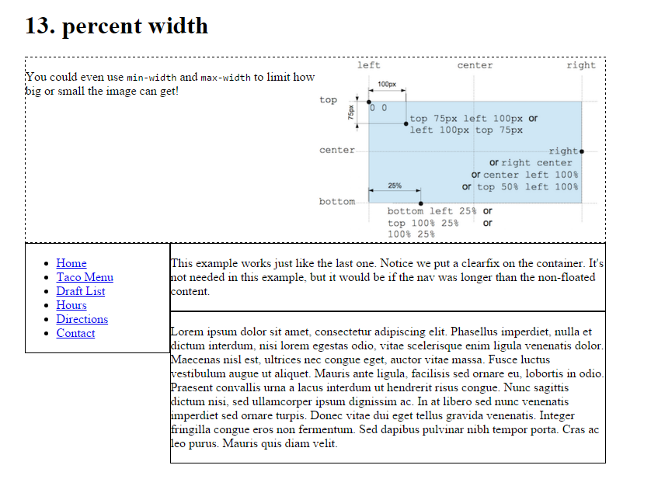
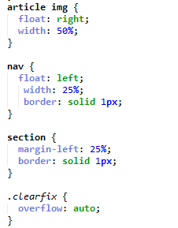
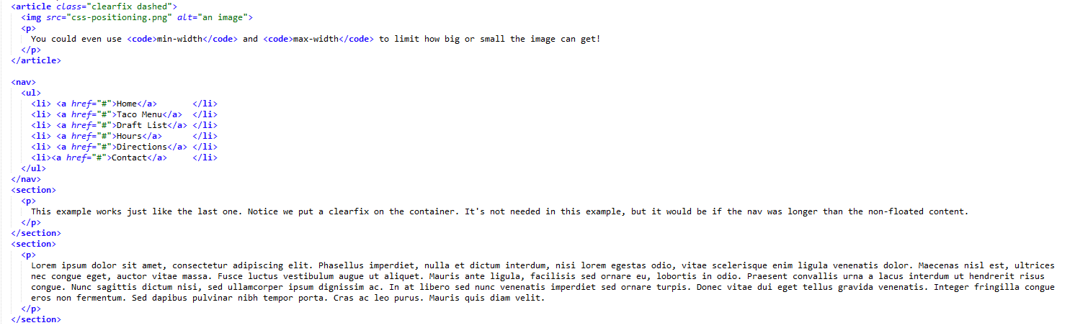
percent width
Percent relative to the containing block.

Slide 9
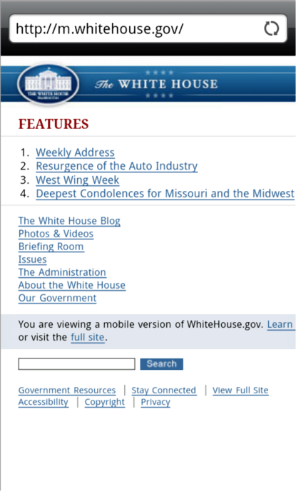
Mobile Web Design Best Practices
Three Approaches to Mobile Web:
Create a separate website hosted within your current domain targeted for mobile users e.g. m.itworld.com
Use CSS to configure your current website for display on both mobile and desktop devices.
Develop a mobile app which resides on the device

Slide 10
Mobile Web Limitations
Small Screen Size
Low bandwidth
Poor connectivity
No hover states
Slow error prone typing
Less context
Inaccurate clicks
Slow hardware
Awkward controls
Limited processor and memory
http://www.whitehouse.gov
http://m.whitehouse.gov

Slide 11
Approaches to mobile web
Make web sites that work well on a variety of screens (presentation)
Adjust your content for mobile users (content)
Give your users a smooth experience even on a slow connection (performance)

Slide 12
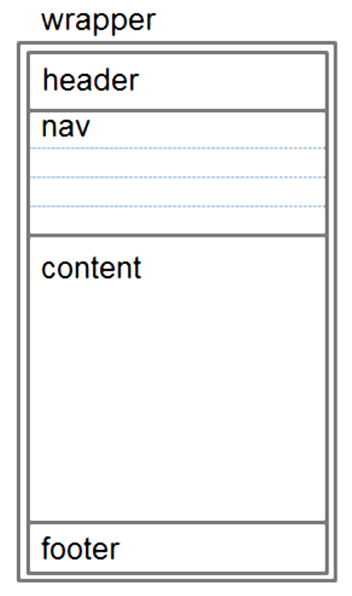
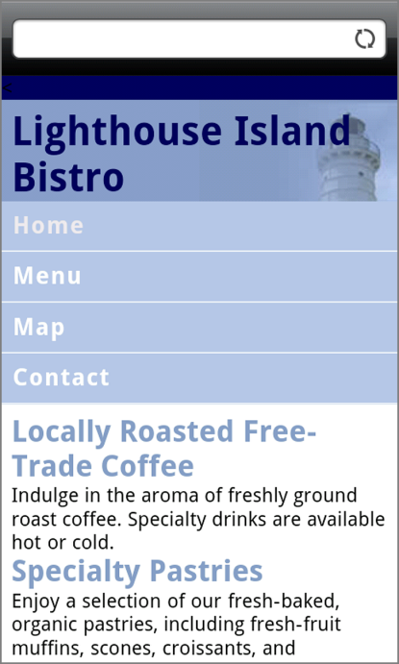
Design Techniques for Mobile Web
Single column design
Avoid floats, tables, frames
Descriptive page title
Descriptive heading tags
Optimize images
Descriptive alt text for images
Eliminate unneeded images
Navigation in lists
Em or percentage font size units
Common font typefaces
Good contrast between text and background colors
Provide “Skip to Content” hyperlink
Provide “Back to Top” hyperlink

Slide 13
Design Techniques for Mobile Web
Set most padding and margin to 0.
Background images may have to be adjusted so they have no-repeat and are positioned in the right top of the screen.
Logos may also need modifying.

Slide 14
Media queries
Responsive design is the strategy of making a site that “responds” to the browser and device that it is being shown on so it is awesome no matter what.
CSS3 media queries are the most powerful tool for doing this. Allow you to gather data about the site visitor and use it to conditionally apply CSS styles.
A simple technique would be to consider the min-width media feature, which allows us to apply specific CSS styles if the browser window drops below a particular width that we can specify. Target these widths:
320px, 480px, 600px, 768px, 900px, 1200px
These are sometimes called ’breakpoints’

Slide 15
Media Queries
Determines the capability of the mobile device, such as screen resolution
Directs the browser to styles configured specifically for those capabilities
Example:
<link href="lighthousemobile.css" rel="stylesheet" media="only screen and (max-device-width: 480px)">

Slide 16
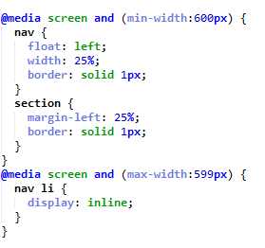
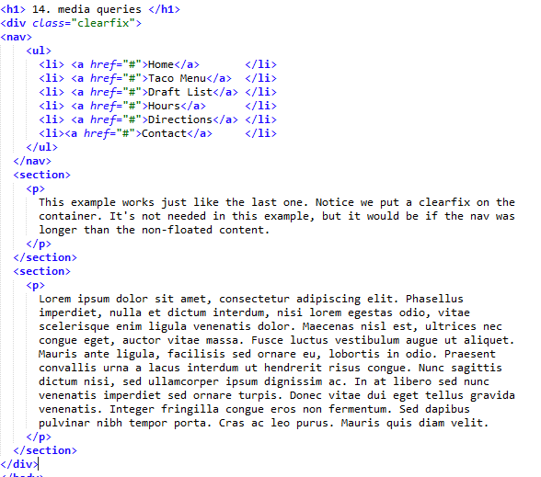
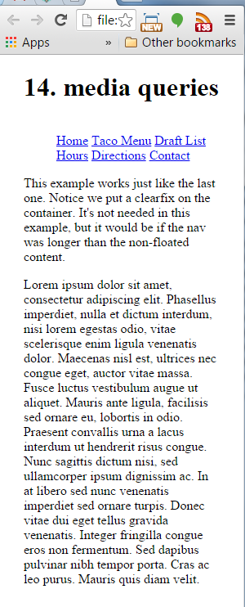
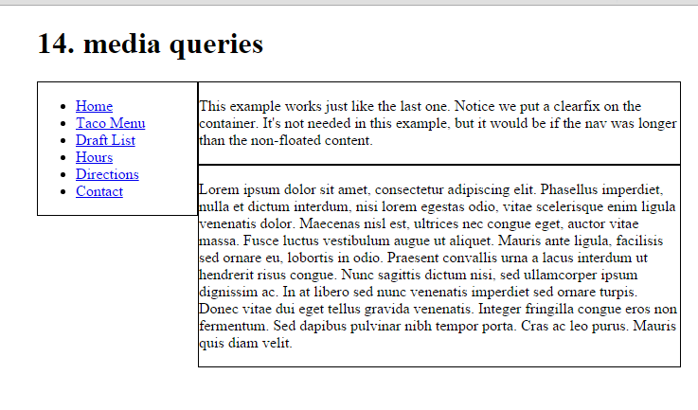
media queries

Slide 17
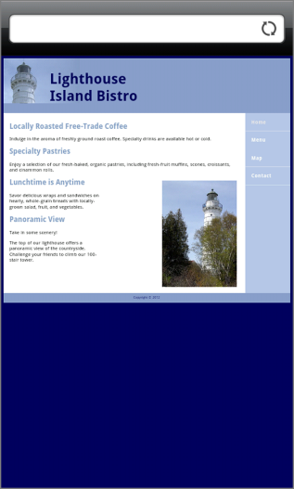
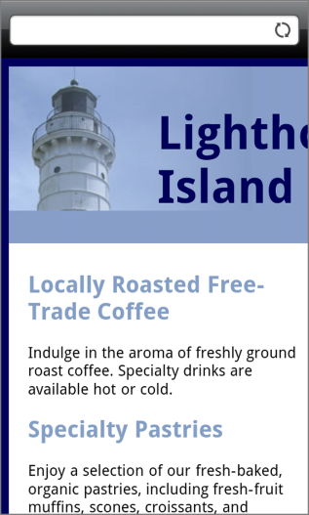
Viewport Meta Tag
Default action for most mobile devices is to zoom out and scale the web page
Viewport Meta Tag
Configures width and initial scale of browser viewport
<meta name="viewport" content= "width=device-width, initial-scale=1.0">
http://www.quirksmode.org/mobile/viewports.html

Slide 18
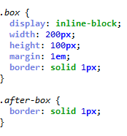
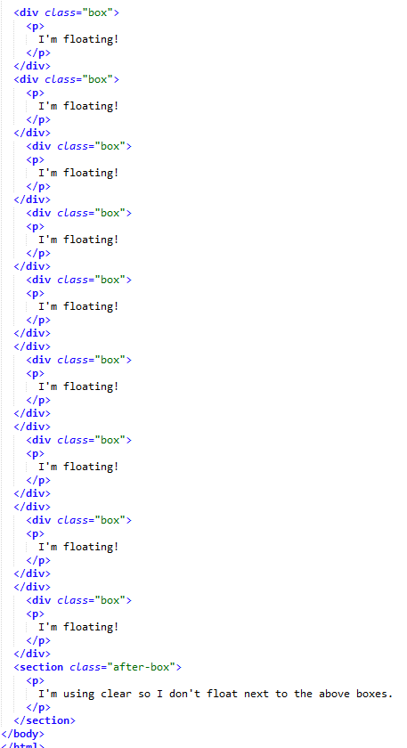
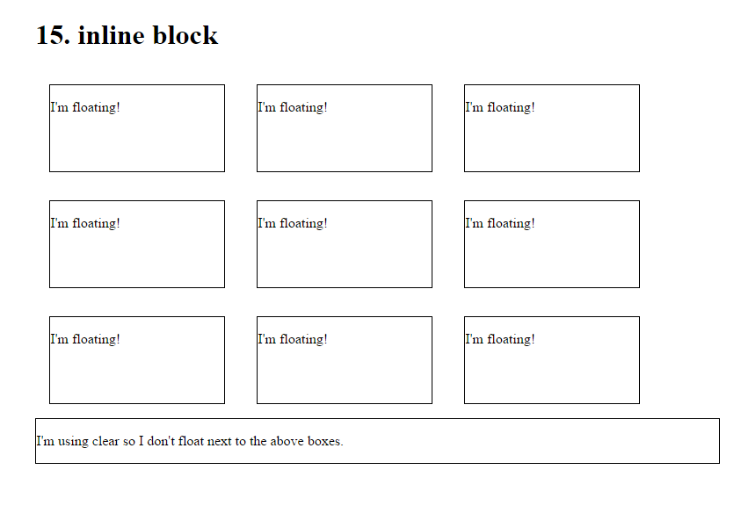
inline-block
Grid of boxes that fills the browser width and wraps nicely. You can set a width and height.

Slide 19
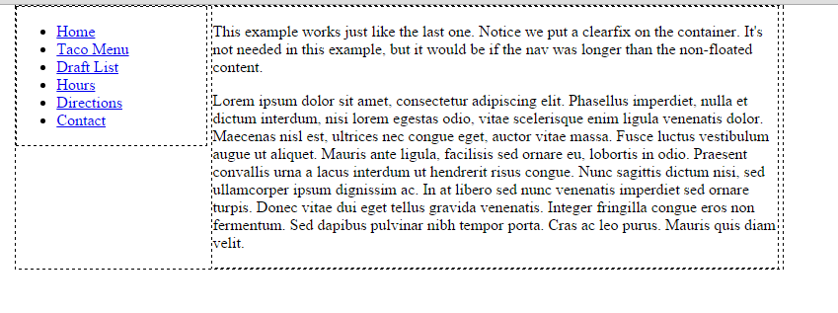
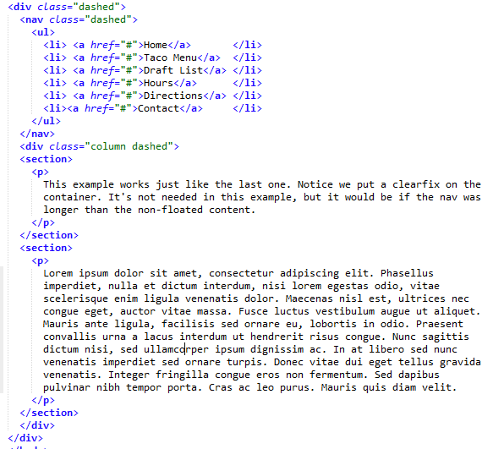
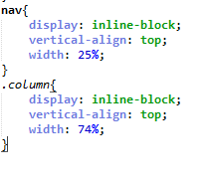
inline-block layout
You can use inline-block for layouts. Remember to set the width and vertical-align to top.

Slide 20
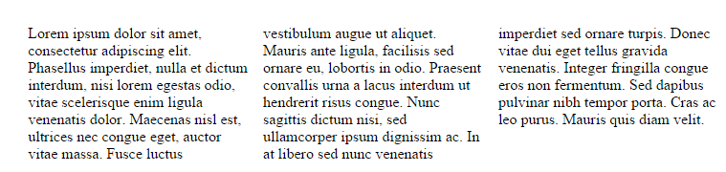
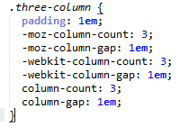
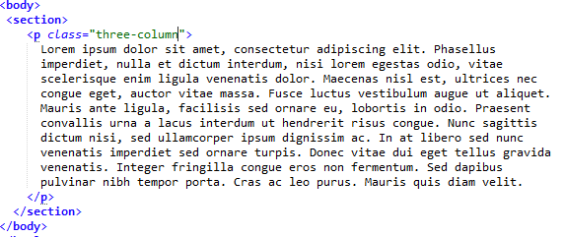
column
css columns are very new, so you need to use the prefixes and it won’t work in IE9 or Opera Mini

Slide 21
flexbox
The new flexbox layout mode is poised to redefine how we do layouts in CSS.
The following examples only work with some browsers that use the latest version of the standard.
https://css-tricks.com/snippets/css/a-guide-to-flexbox/

Slide 22
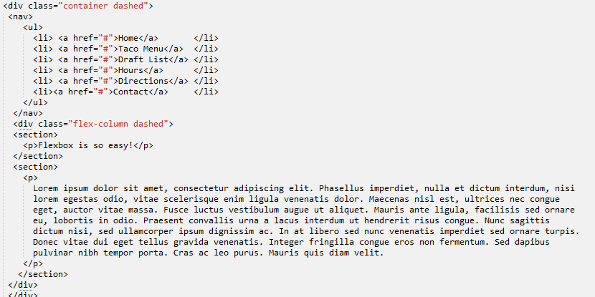
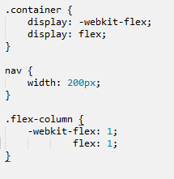
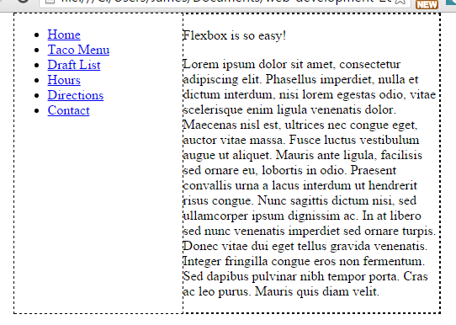
flexbox
simple layout.

Slide 23
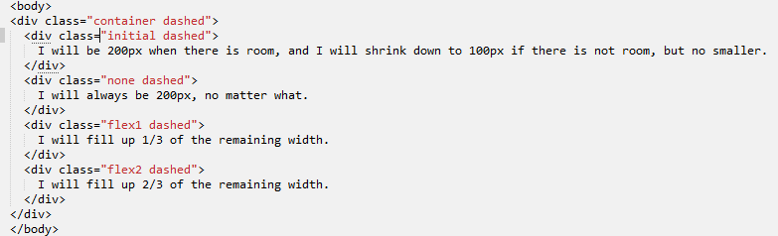
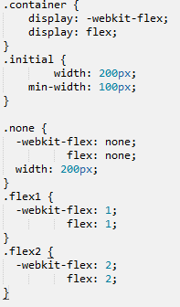
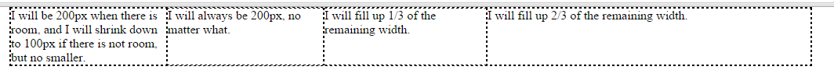
flexbox
more complex layout, one flex container with several div’s each with its own properties set for sizing.

Slide 24
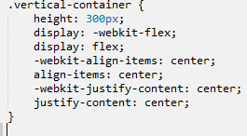
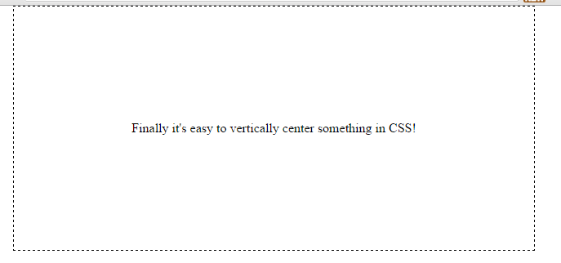
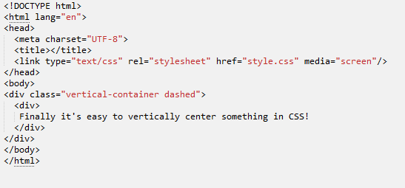
flexbox
Centering using Flexbox makes the process a lot easier and exact than alternative methods.

Slide 25
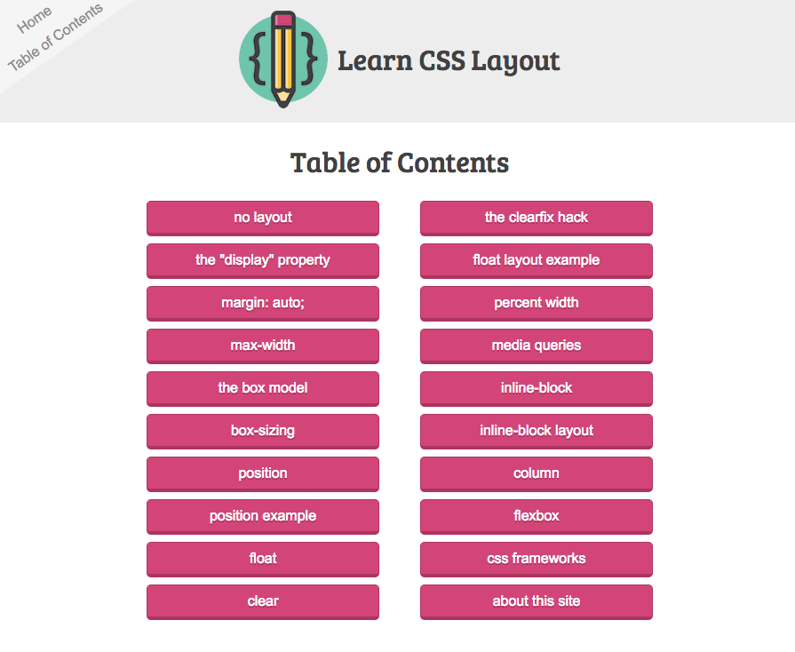
http://learnlayout.com

Slide 26
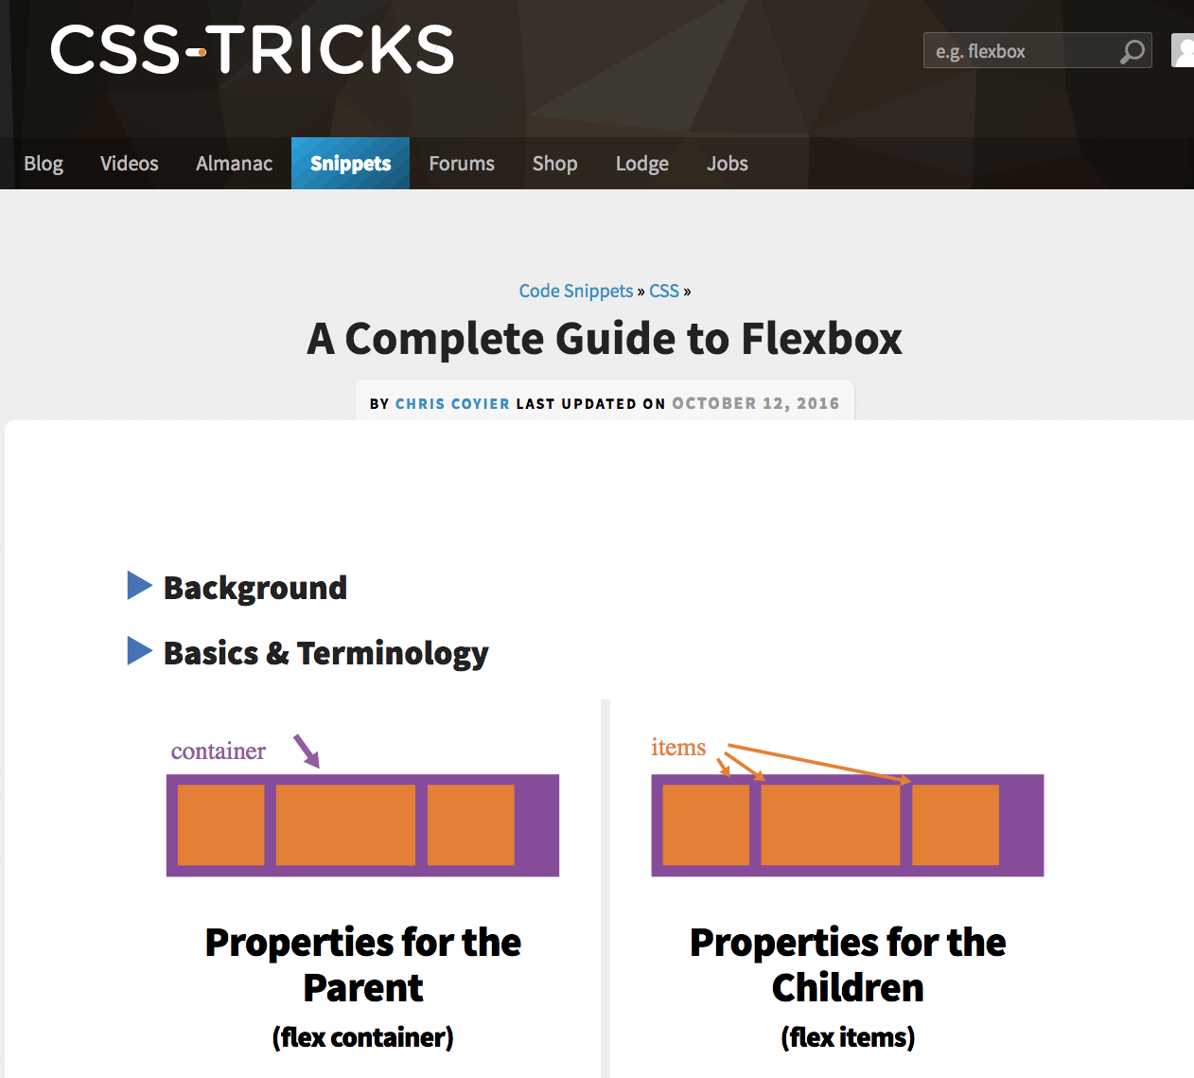

Slide 27
