Slide 1
CSS Layout Part 2
Web Development

Slide 2
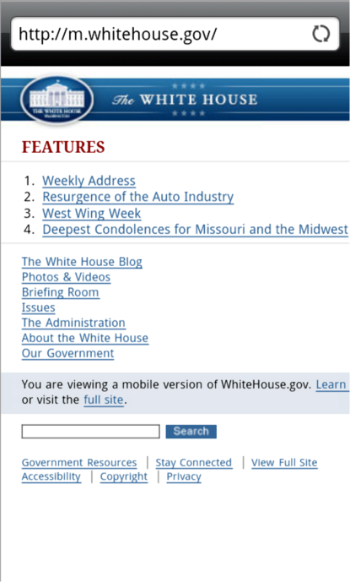
Mobile Web Design Best Practices
The global internet report by internetsociety.org states there are almost 2 billion mobile Internet users Dec 2013 http://www.internetsociety.org/sites/default/files/Global_Internet_Report_2014_0.pdf
Three Approaches to Mobile Web:
Create a separate website hosted within your current domain targeted for mobile users e.g. m.itworld.com
Use CSS to configure your current website for display on both mobile and desktop devices.
Develop a mobile app which resides on the device

Slide 3
Mobile Web Limitations
Small Screen Size
Low bandwidth
Poor connectivity
No hover states
Slow error prone typing
Less context
Inaccurate clicks
Slow hardware
Awkward controls
Limited processor and memory
http://www.whitehouse.gov
http://m.whitehouse.gov

Slide 4
Approaches to mobile web
Make web sites that work well on a variety of screens (presentation)
Adjust your content for mobile users (content)
Give your users a smooth experience even on a slow connection (performance)

Slide 5
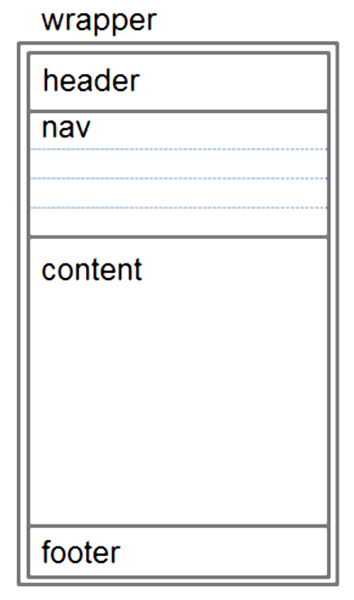
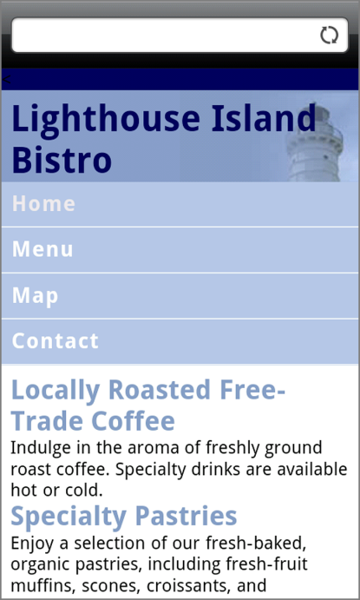
Design Techniques for Mobile Web
Single column design
Avoid floats, tables, frames
Descriptive page title
Descriptive heading tags
Optimize images
Descriptive alt text for images
Eliminate unneeded images
Navigation in lists
Em or percentage font size units
Common font typefaces
Good contrast between text and background colors
Provide “Skip to Content” hyperlink
Provide “Back to Top” hyperlink

Slide 6
Design Techniques for Mobile Web
Set most padding and margin to 0.
Background images may have to be adjusted so they have no-repeat and are positioned in the right top of the screen.
Logos may also need modifying.

Slide 7
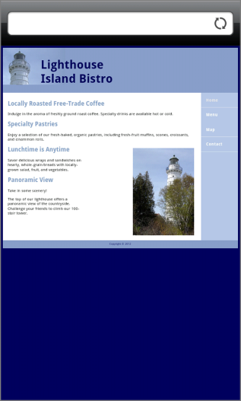
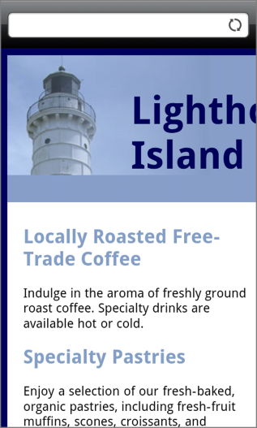
Viewport Meta Tag
Default action for most mobile devices is to zoom out and scale the web page
Viewport Meta Tag
Created as an Apple extension to configure display on mobile devices
Configures width and initial scale of browser viewport
<meta name="viewport" content= "width=device-width, initial-scale=1.0">

Slide 8
Media queries
The second part of responsive design is CSS3 media queries, which currently enjoy decent support across many modern browsers. They basically allow you to gather data about the site visitor and use it to conditionally apply CSS styles. For our purposes, we’re primarily interested in the min-width media feature, which allows us to apply specific CSS styles if the browser window drops below a particular width that we can specify.
The set of pixel widths I recommend targeting are as follows:
320px, 480px, 600px, 768px, 900px, 1200px

Slide 9
CSS3 Media Queries
Media Query
Determines the capability of the mobile device, such as screen resolution
Directs the browser to styles configured specifically for those capabilities
Example:
<link href="lighthousemobile.css" rel="stylesheet" media="only screen and (max-device-width: 480px)">

Slide 10
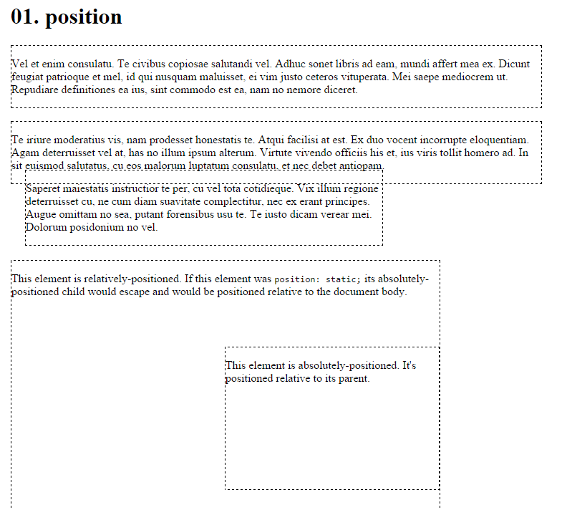
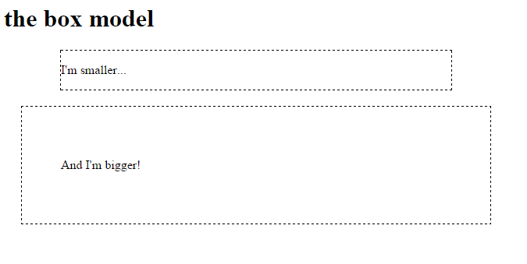
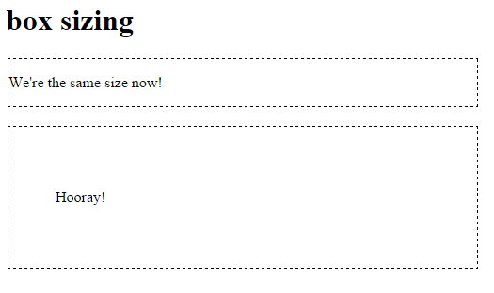
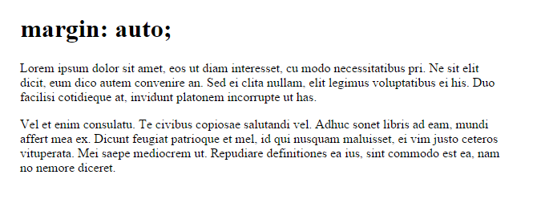
Lab 07: Learn CSS Layout Part 2

Slide 11
CSS Layout Part 2
The clearfix hack
Float layout example
Percent width
Media queries
Inline-block
Inline-block layout
Column
Flexbox

Slide 12
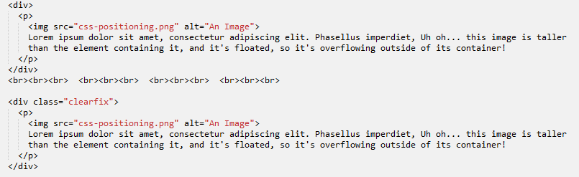
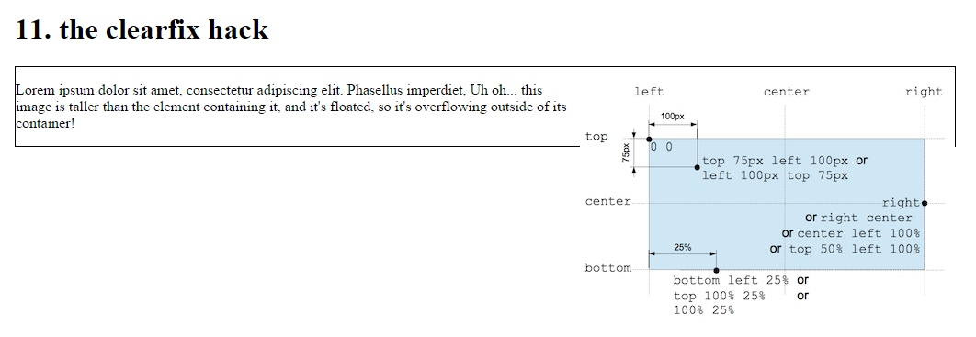


Clearfix hack
In this case an image overflows the container, we used float right for the image within the <p>, however because it is taller than the text it overflows.

Slide 13
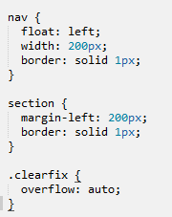
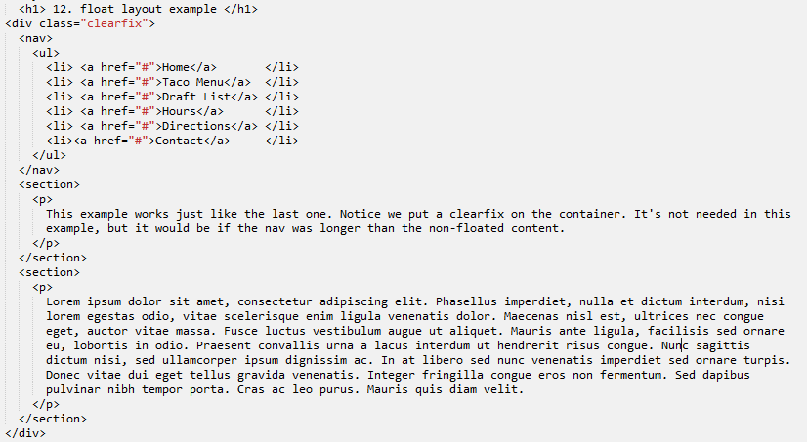
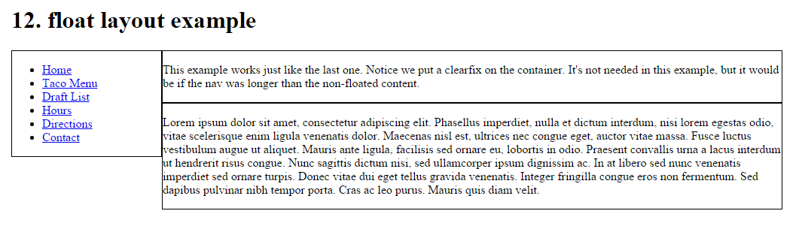
Float layout example

Slide 14
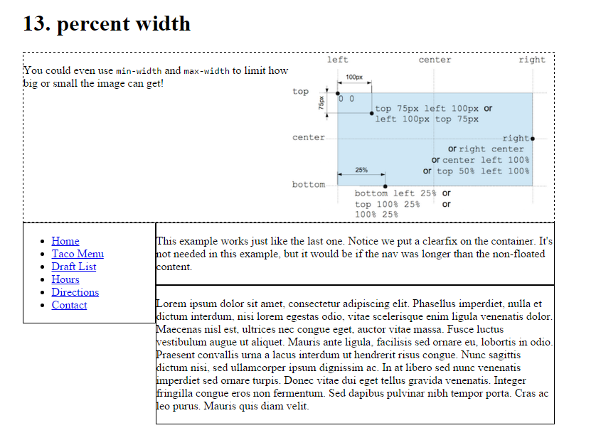
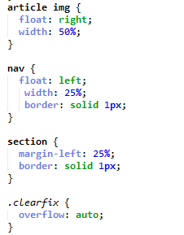
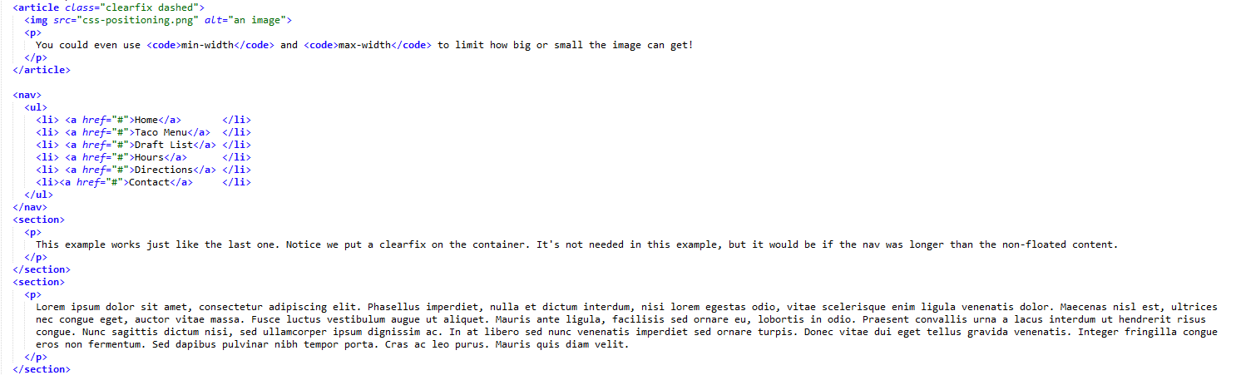
percent width

Slide 15
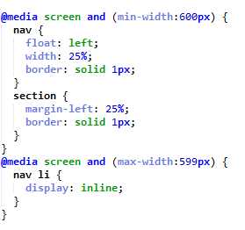
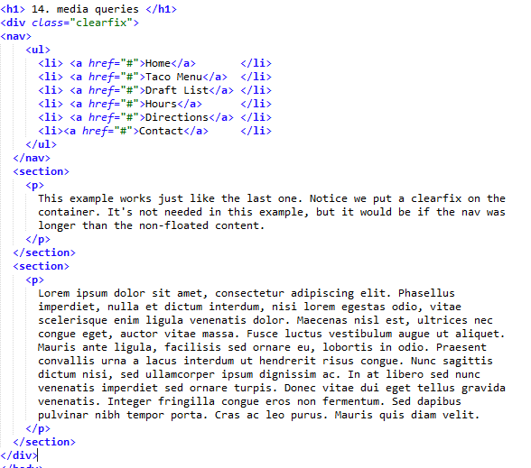
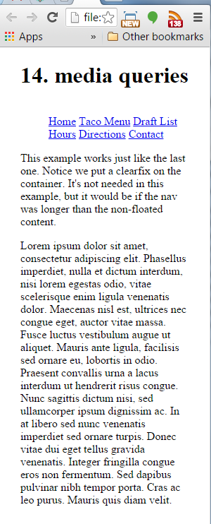
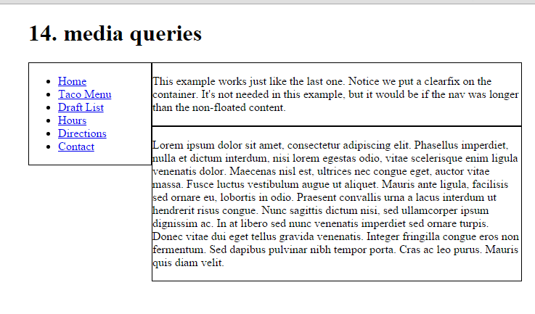
media queries

Slide 16
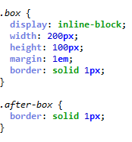
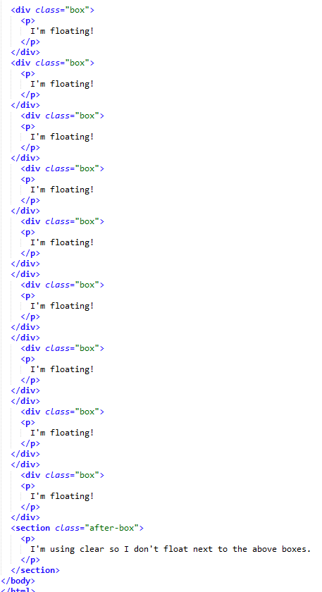
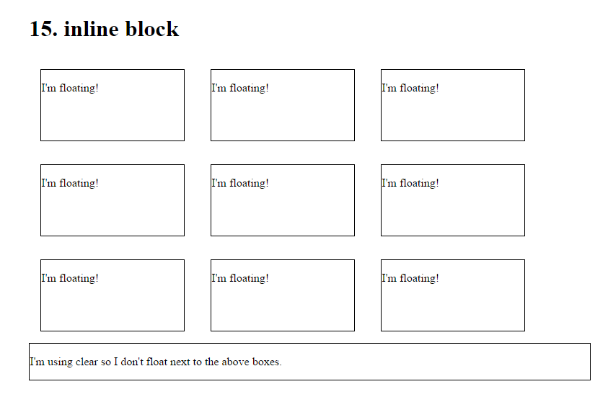
inline-block

Slide 17
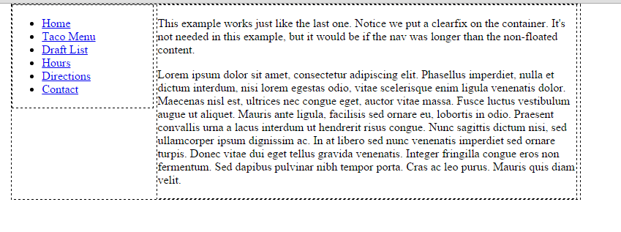
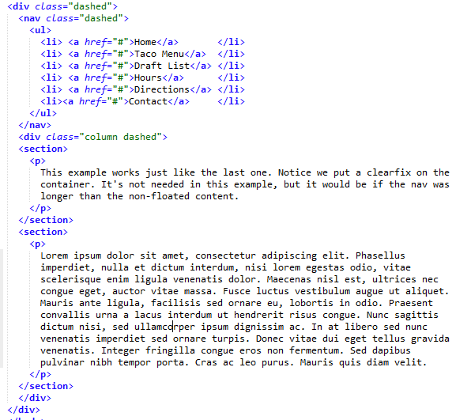
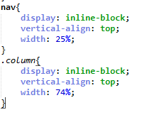
inline-block layout

Slide 18
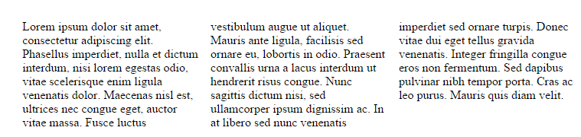
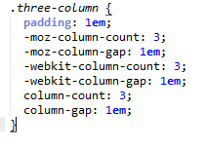
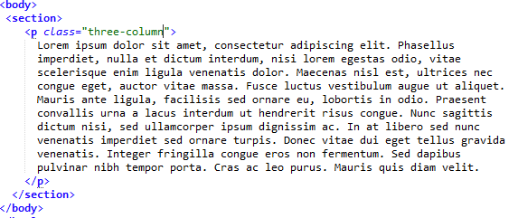
column

Slide 19
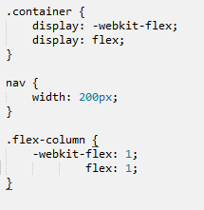
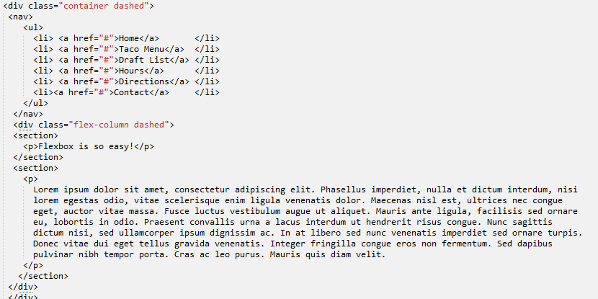
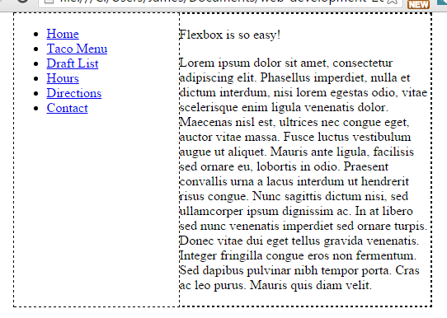
flexbox

Slide 20
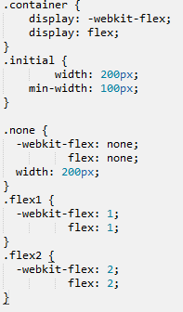
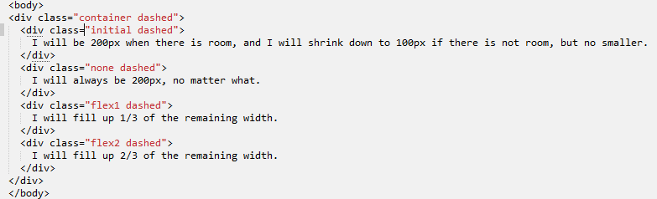
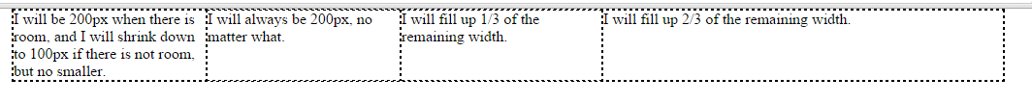
flexbox

Slide 21
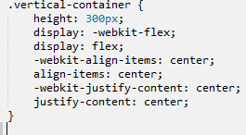
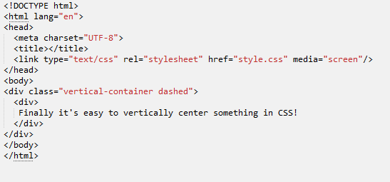
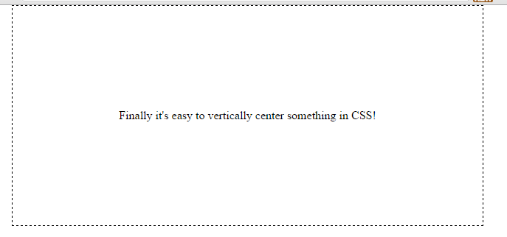
flexbox

Slide 22



Except where otherwise noted, this content is licensed under a Creative Commons Attribution-NonCommercial 3.0 License.
For more information, please see http://creativecommons.org/licenses/by-nc/3.0/

