Slide 1
CSS Futures
Web Development

Slide 2
CSS Futures
CSS3
CSS Preprocessors: SASS & LESS
CSS Frameworks

Slide 3
CSS3
CSS3 is the latest standard for CSS
Combined with HTML5, CSS3 makes it possible to create highly interactive web sites, including games
CSS3 is divided into modules, each addressing a specific aspect of CSS3, including selectors, box model, backgrounds and borders, text effects, 2D and 3D transformations, animations, multiple column layout, basic user interface, or media queries
All of these modules go through a set of maturity levels, from announced (announced but no working draft or technical information is available yet) to recommendation (endorsed by W3C)
3

Slide 4


CSS3: Borders
.squareButton
{
border:4px solid;
border-color: blue;
background: white;
width:100px;
height:40px;
}
.roundButton
{
border:4px solid;
border-radius: 25px;
border-color: blue;
background: white;
width:100px;
height:40px;
}
Custom borders and shadow effects without the need for a third-party image editing
The round border is created by defining the radius of the circle
4

Slide 5

CSS3: Shadows
Custom borders and shadow effects without the need for a third-party image editing
We can define the position of the shadow the blur distance, the spread and the color.
.shadow
{
box-shadow:5px 5px 3px 2px #C1C1C1;
}
.squareButton
{
border:4px solid;
border-color: blue;
background: white;
width:100px;
height:40px;
}
<div class = "shadow squareButton"> </div>
5

Slide 6

CSS3: Text Effects
#textShadow
{
font-size: 40px;
text-shadow: 10px 10px 10px blue;
width:500px;
}
Text-shadow: shadows are applied to the text. Values specify the horizontal and vertical shadow, the blur distance, and the colour
<div id = "textShadow"> This is a test width shadows</div>
7

Slide 7
CSS3: Fonts
CSS3 makes it possible to include fonts on your page that may not necessarily install on the clients browser
With CSS3, the developer can include the necessary font on the server where the pages are hosted
The process involved usually includes defining the font, accessing the font, and using the font in the CSS3 style sheet
8

Slide 8
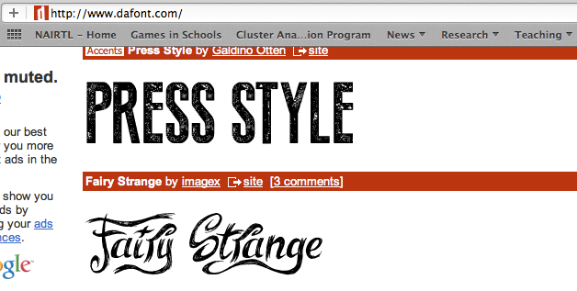

CSS3: Fonts
CSS3: Fonts
@font-face
{
font-family: lightHouse;
src: url(’lightHouse.ttf')
}
.newFont
{
font-family: lightHouse;
}
<div class = ”newFont"> Hello World </div>
9

Slide 9
CSS3: Fonts
Fonts can also be originated from google fonts, which include a wide choice of fonts to be used on the web (http://www.google.com/fonts) and the process includes:
Selecting your font, set the type of characters to be used,
Adding automatic code to link to the corresponding style sheet
Integrating the font to your CSS
10

Slide 10
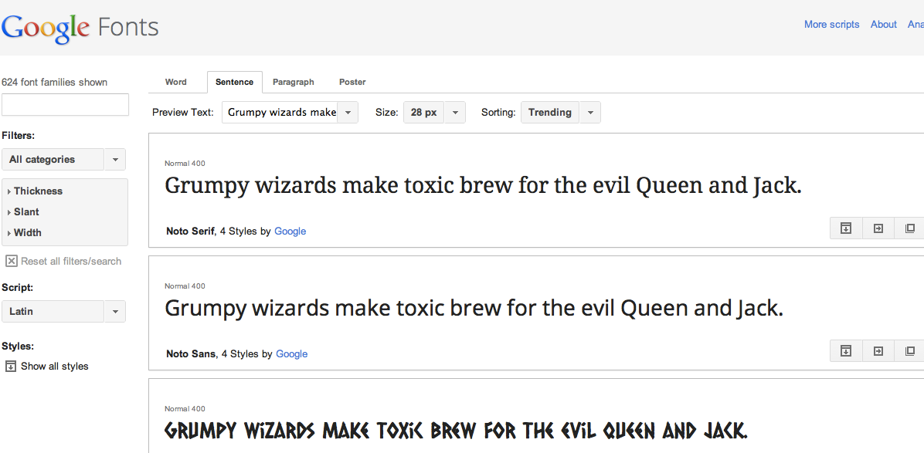

CSS3: Fonts
CSS3: Fonts
<link rel="stylesheet" type="text/css" href="http://fonts.googleapis.com/css?family=Tangerine">
.tangerineFont
{
font-family: 'Tangerine', serif;
font-size:30px;
}
<div class = "tangerineFont"> Hello World with Tangerine</div>
11

Slide 11
CSS3: Transforms
CSS3 adds the ability to apply transformations to elements, including rotating, or scaling. A node can be called a descendant node if it’s a child, grandchild, and so on, of another node.
Although this functionality is implemented for most popular browsers, some browser-specific definitions need to be applied
While the statement transform: is used to apply a transformation (as per W3c guidelines), a prefix needs to be added for some browsers
These prefixes indicate a browser-specific implementation of a CSS feature and it is good practice to include all of these in the CSS style sheet so that the page is compatible with all browsers.
12

Slide 12


CSS3: Transforms
.box
{
color: red;
background: red;
width: 50px;
height: 50px;
margin:20px;
}
.rotate45
{
transform: rotate(45deg);
-ms-transform: rotate(45deg);
-webkit-transform: rotate(45deg);
-o-transform: rotate(45deg);
-moz-transform: rotate(45deg);
}
For Firefox: use the prefix –moz-
For Internet Explorer: use the prefix –ms-
For chrome and safari: use the prefix –webkit-
For Opera: use the prefix –o-
<div class ="box">
<div class ="box rotate45">
13

Slide 13



CSS3: Transitions
.color_transition
{
background: green;
width: 100px;
height: 100px;
-moz-transition: 2s;
}
.color_transition:hover
{
background:red;
}
Transitions make it possible to apply smooth transitions to an element while between two styles
When the transition applies to several parameters, it is also possible to specify how each individual parameter will evolve overtime
1
2
.color_transition:hover
{
background:red;
width: 300px;
}
<div class = "color_transition"></div>
1
2
14

Slide 14
CSS3: Transitions
.color_transition
{
background: green;
width: 100px;
height: 100px;
-moz-transition: background 2s, width .5s;
}
.color_transition:hover
{
background:red;
}
We can also specify how long the transition for each parameter will last
.color_transition:hover
{
background:red;
width: 300px;
}
<DIV class = "color_transition"></DIV>
15

Slide 15
CSS3: Animations
CSS3 makes it possible to create animations, in a similar manner to Flash or video editing using keyframes
An animation is defined and applied to a specific element
The duration of the animation is defined along with key moments (keyframes) and the values of some parameters at these moments
An gradual change between key values creates a smooth animation
.animatedBox
{
width:100px;
height:100px;
background:red;
-moz-animation:myAnimation 4s;
}
@-moz-keyframes myAnimation /* Firefox */
{
0% {width:0px; height:0px}
25% {width:100px;height:100px}
50% {width:0px;height:0px}
100% {width:100px;height:100px}
}
<DIV class ="box rotate45 animatedBox">
16

Slide 16
CSS3: Animations
.animatedBox
{
width:100px;
height:100px;
background:red;
-moz-animation:myAnimation;
animation-duration: 5s; animation-iteration-count: infinite; animation-play-state: running;
}
@-moz-keyframes myAnimation /* Firefox */
{
0% {width:0px; height:0px}
25% {width:100px;height:100px}
50% {width:0px;height:0px}
100% {width:100px;height:100px}
}
Additional attributes for an animation include:
Animation-iteration-count: how many times the animation should be repeated (number of times to be repeated or infinite to repeat the animation indefinitely)
Animation-play-state: whether the animation is running or paused
<DIV class ="box rotate45 animatedBox">
17

Slide 17
Flexbox
The Flexbox Layout (Flexible Box) module (currently a W3C Last Call Working Draft) aims at providing a more efficient way to lay out, align and distribute space among items in a container, even when their size is unknown and/or dynamic (thus the word "flex").
Give the container the ability to alter its items' width/height (and order) to best fill the available space (mostly to accommodate to all kind of display devices and screen sizes).
A flex container expands items to fill available free space, or shrinks them to prevent overflow.
https://css-tricks.com/snippets/css/a-guide-to-flexbox/

Slide 18
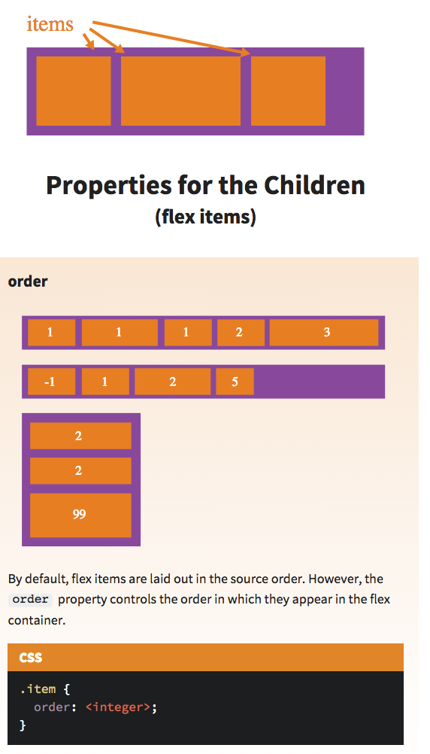
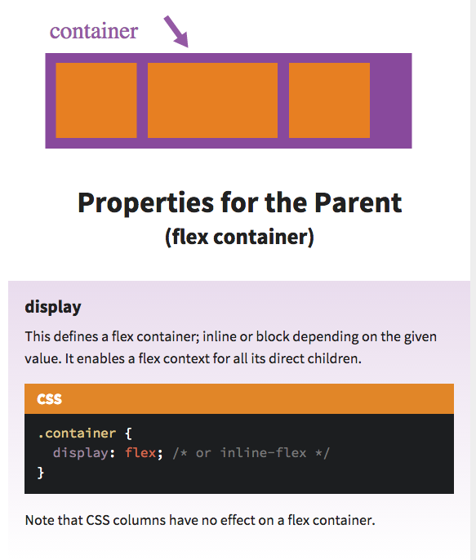

Slide 19
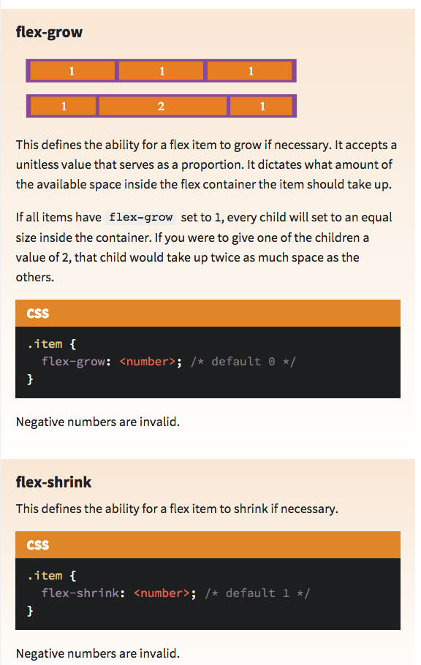
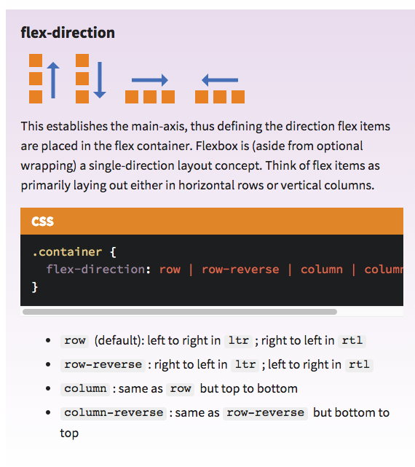

Slide 20
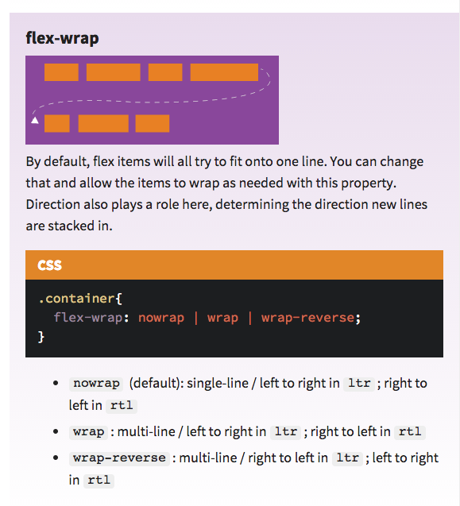
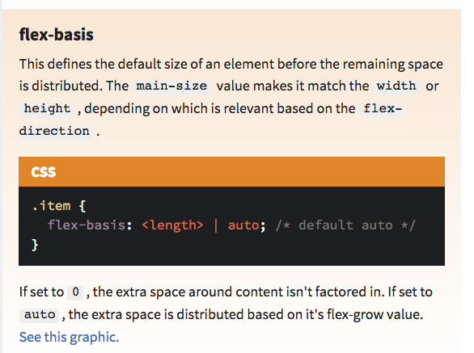

Slide 21
CSS Preprocessing languages
A CSS preprocessor helps write maintainable, future-proof code and it will seriously reduce the amount of CSS you have to write.
Where these tools shine best are in large-scale user interfaces that require huge stylesheets and many style rules.
Two candidates:
SASS
LESS

Slide 22
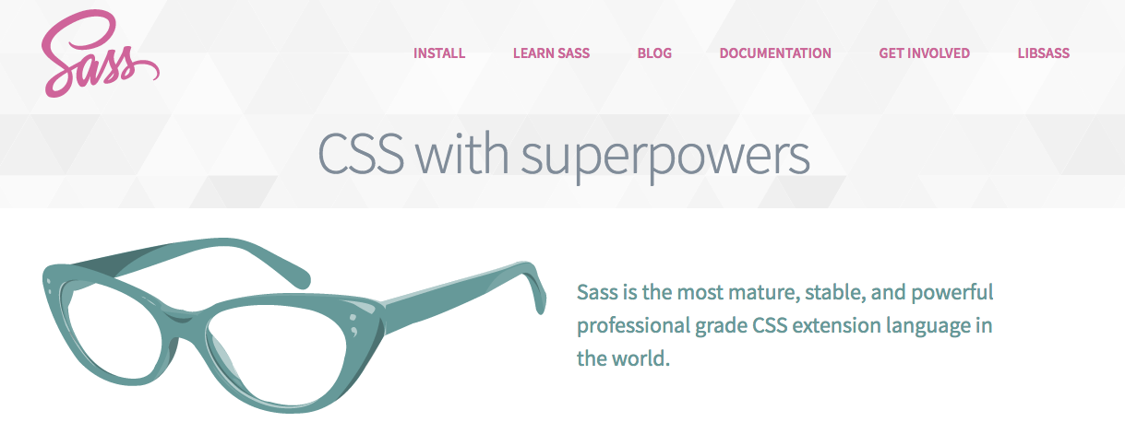
SASS

Slide 23
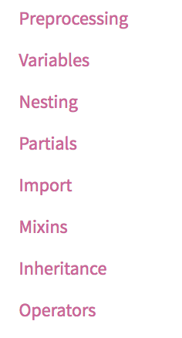
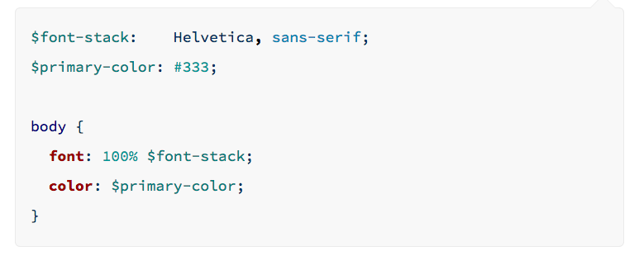

Slide 24
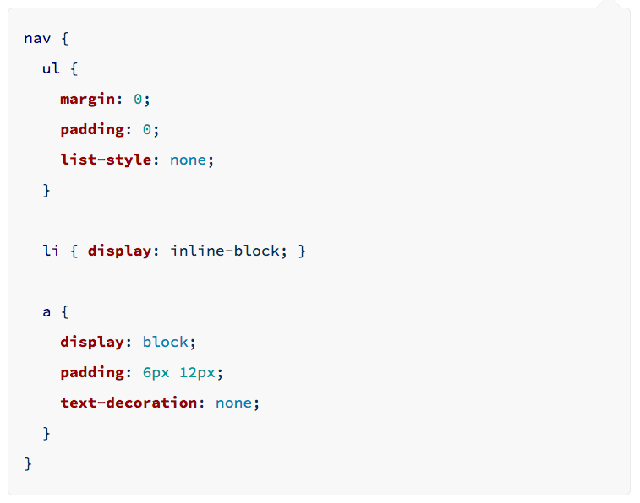

Slide 25
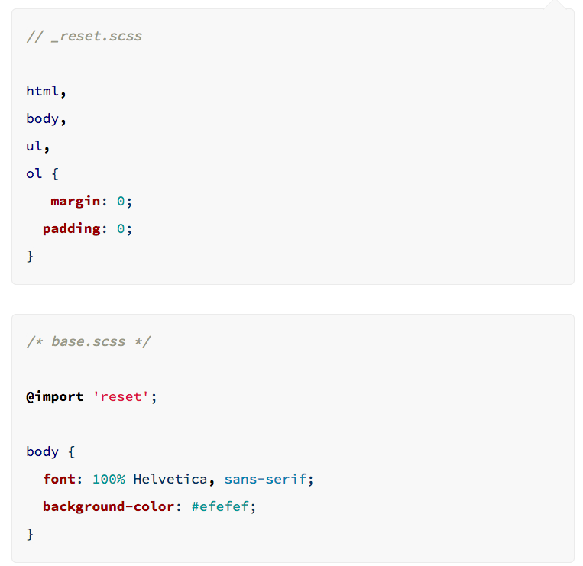

Slide 26
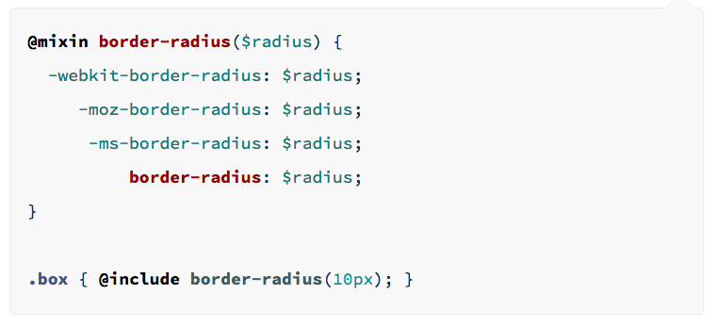

Slide 27
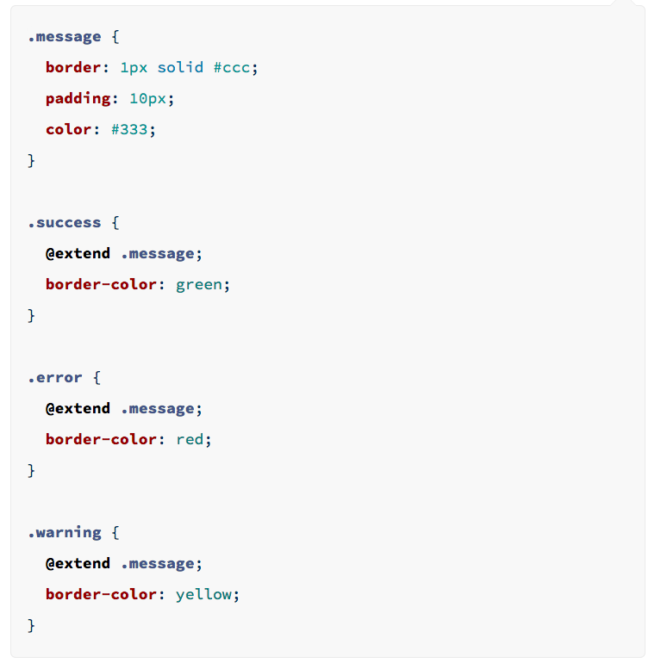

Slide 28
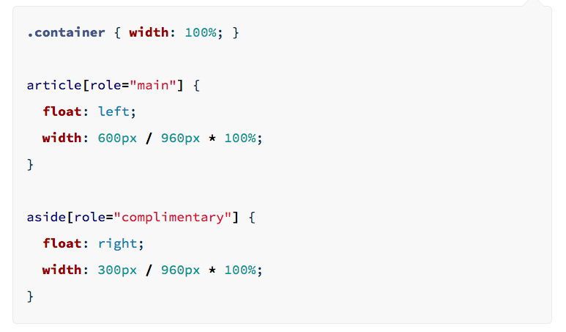

Slide 29
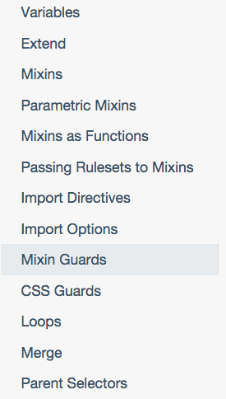
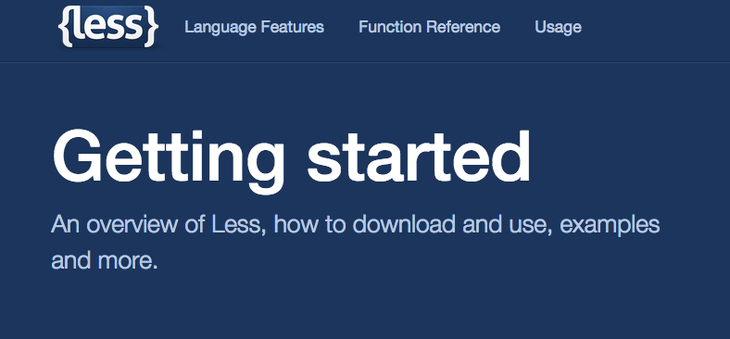
LESS
Less is a CSS pre-processor, meaning that it extends the CSS language, adding features that allow variables, mixins, functions and many other techniques that allow you to make CSS that is more maintainable, themable and extendable.

Slide 30
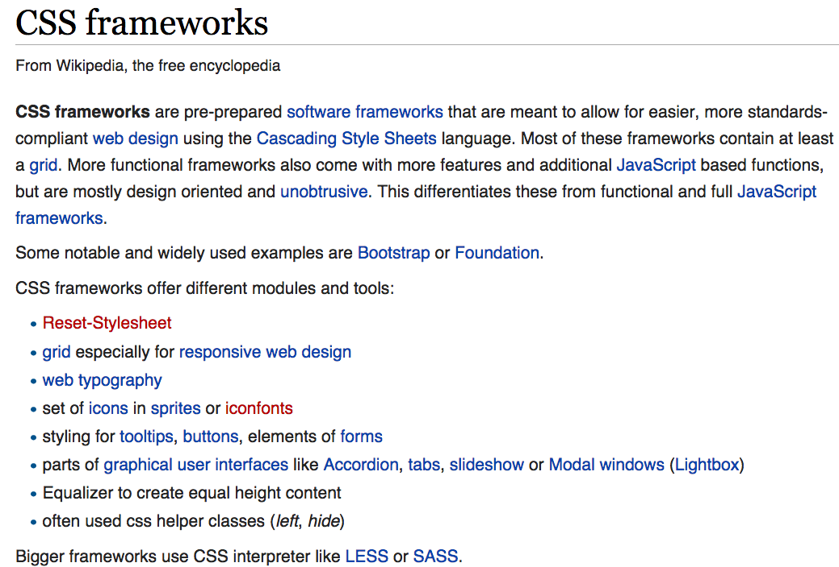
CSS Frameworks

Slide 31
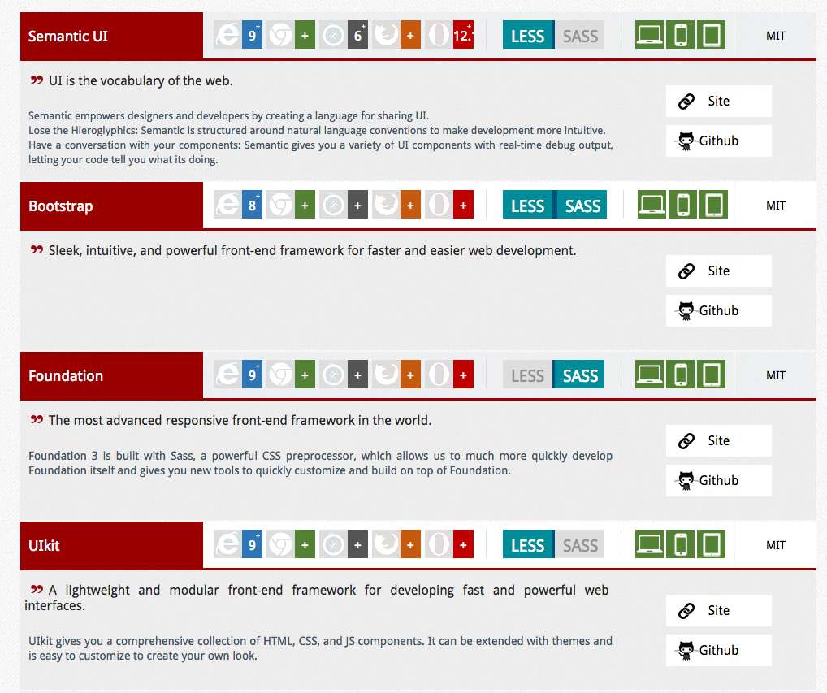
CSS Frameworks

