Slide 1
Web Development
BSc Applied Computing / Forensics / Entertainment Systems
Eamonn de Leastar (edeleastar@wit.ie)
Dr. Brenda Mullally (bmullally@wit.ie)

Slide 2
HTML Page Structure & Publishing

Slide 3
Learning Outcomes
Understand the structure of an HTML Element, and be able to recognize its variants.
Be able to read and compose a relative path, and be able to distinguish it from an absolute path.
Understand the implications of nesting of elements, and in particular be able to distinguish between correct and incorrect nesting.
Be able to differentiate between block and inline elements
Understand the general context of wireframing

Slide 4
Agenda
Elements, Attributes, & Documents
Linking
Nesting
Linebreak, Block & Inline Elements
Structuring a Page / Wireframing

Slide 5
Agenda
Elements, Attributes, & Documents
Linking
Nesting
Linebreak, Block & Inline Elements
Structuring a Page / Wireframing

Slide 6
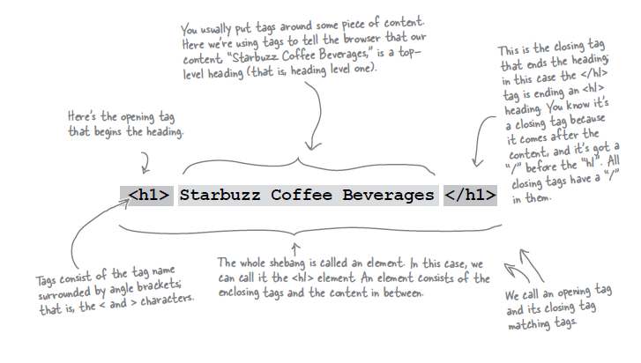
Components of an HTML Element

Slide 7
Components of an HTML Element
<ElementName >
Content
</ElementName>
Start Tag
End Tag

Slide 8
<title>
<title>My App Store</title>
ElementName: <title>
Content: My DVD Shop
ElementName: </title>

Slide 9
<p>
<p> 600 million YouTube views later, Dude Perfect is back with their most epic game yet! Go BIGGER than ever hitting mind-blowing trick shots through tons of crazy levels!</p>
ElementName: <p>
Content: 600 million YouTube views later, Dude Perfect is back with their most epic game yet! Go BIGGER than ever hitting mind-blowing trick shots through tons of crazy levels! ElementName: </p>

Slide 10
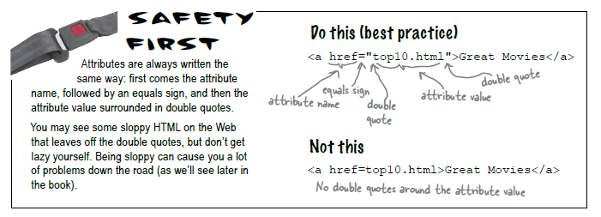
Attributes
Attributes give you a way to specify additional information about an element.

Slide 11
<a>
<a href=“apps.html”>App Store</a>
ElementName: <a>
AttributeName: href
AttributeValue: “about/directions.html”
Content: detailed directions
ElementName: </a>

Slide 12
<img>
<img src=“/images/delete.jpg”>
ElementName: <img>
AttributeName: src
AttributeValue: "../images/PJackson.jpg"
Content: empty
ElementName: none (for the moment)

Slide 13
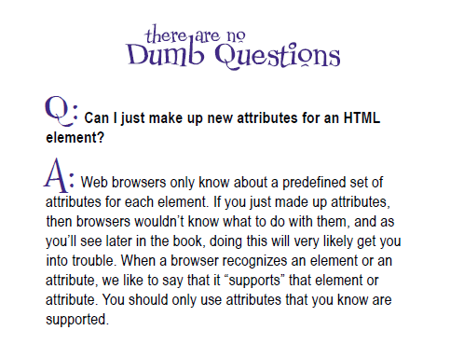
Attributes

Slide 14
HTML Document Structure
html
head
title
body
h1
ol
etc...

Slide 15
Agenda
Elements, Attributes, & Documents
Linking
Nesting
Linebreak, Block & Inline Elements
Structuring a Page / Wireframing

Slide 16
Linking

Slide 17
Links: Absolute vs Relative
Absolute
Complete path to a file on the hard disk: e.g:
/webdevlabs/lab02/imagestatoo.jpg
/webdevlabs/lab01/mydvds.html
Relative:
Trace route from “current position” to the destination
“..” means go up one level
Directory name may prefix filename

Slide 18
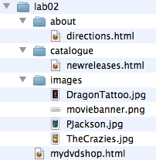
Relative Link Examples
If we are in “lab02” then “about/directions.html” is a relative link from the current folder to the catalogue folder, and to the files “directions.html” in that folder
If we are in the catalogue folder, and we wish to link to one of the images, the link “../images/pjackson.jpg” means “go up one level, and then down into the “images” folder and then link to pjackson.jpg”
Avoid absolute links!
<a href="catalogue/newreleases.html">new releases</a>
<img src="../images/DragonTattoo.jpg">
<a src="faq.html">FAQ</a>

Slide 19
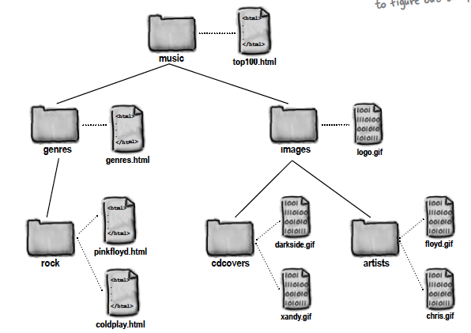
Site Example

Slide 20
Agenda
Elements, Attributes, & Documents
Linking
Nesting
Linebreak, Block & Inline Elements
Structuring a Page / Wireframing

Slide 21
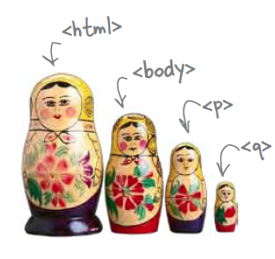
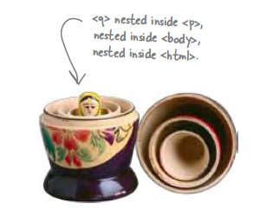
Nesting
When we put one element inside another element, we call that nesting.
We say, the <p>element is nested inside the <body>element.
We put a <body>element inside an <html>element, a <p>element inside a <body>element etc.

Slide 22
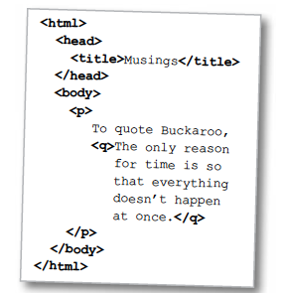
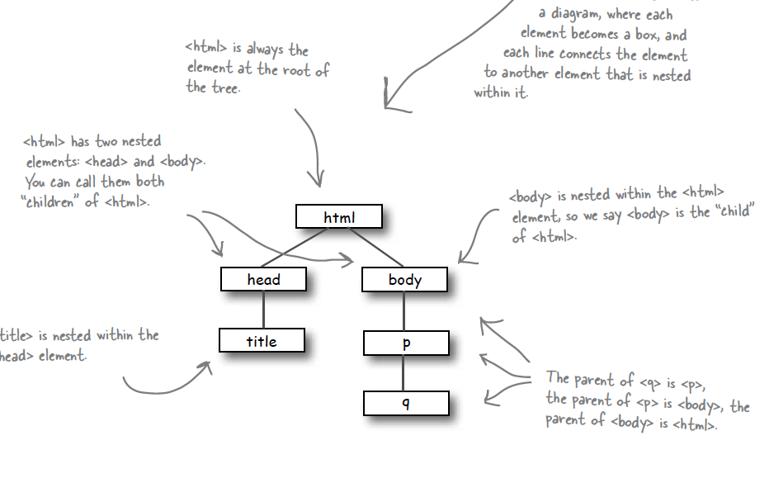
Nesting - Tree Structure
Text

Slide 23
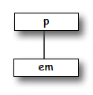
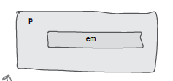
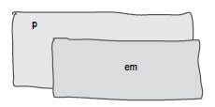
Nesting can be Incorrect!
<p>I’m so going to blog <em>this</em></p>
Good
<p>I’m so going to blog <em>this</p></em>
Bad
?

Slide 24
Agenda
Elements, Attributes, & Documents
Linking
Nesting
Linebreak, Block & Inline Elements
Structuring a Page / Wireframing

Slide 25
Line Breaks
Break: <br> </br>
An Empty element: - sometimes shortened to:
<br></br>
or just
<br>
or
<br />

Slide 26
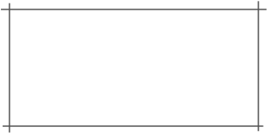
Block vs Inline Elements
Block elements are always displayed as if they have a line break before and after them
inline elements appear “in line” within the flow of the text in your page.
“Block elements stand on their own; inline elements go with the flow.”

Slide 27
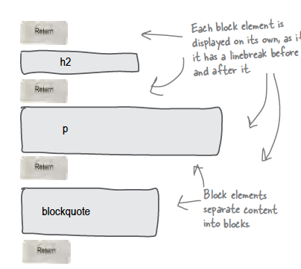
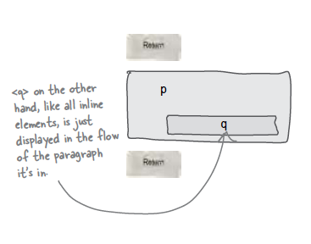
Examples
Block - h1, h2, p, blockquote
Inline - a, em, q

Slide 28
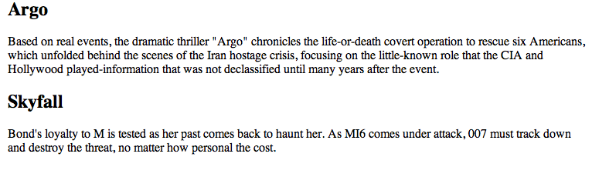
Example
<h2>Argo</h2>
<p>
Based on real events, the dramatic thriller "Argo" chronicles the life-or-death covert operation
to rescue six Americans, which unfolded behind the scenes of the Iran hostage crisis,
focusing on the little-known role that the CIA and Hollywood played-information that was not
declassified until many years after the event.
</p>
<h2>Skyfall</h2>
<p>
Bond's loyalty to M is tested as her past comes back to haunt her. As MI6 comes under attack,
007 must track down and destroy the threat, no matter how personal the cost.
</p>
<h2>Argo</h2>
block
<p>
Based on real events, the dramatic thriller "Argo" chronicles the life-or-death covert operation
to rescue six Americans, which unfolded behind the scenes of the Iran hostage crisis,
focusing on the little-known role that the CIA and Hollywood played-information that was not
declassified until many years after the event.
</p>
block
<h2>Skyfall</h2>
block
<p>
Bond's loyalty to M is tested as her past comes back to haunt her. As MI6 comes under attack,
007 must track down and destroy the threat, no matter how personal the cost.
</p>
block
linebreak
inline

Slide 29
Agenda
Elements, Attributes, & Documents
Linking
Nesting
Linebreak, Block & Inline Elements
Structuring a Page / Wireframing

Slide 30
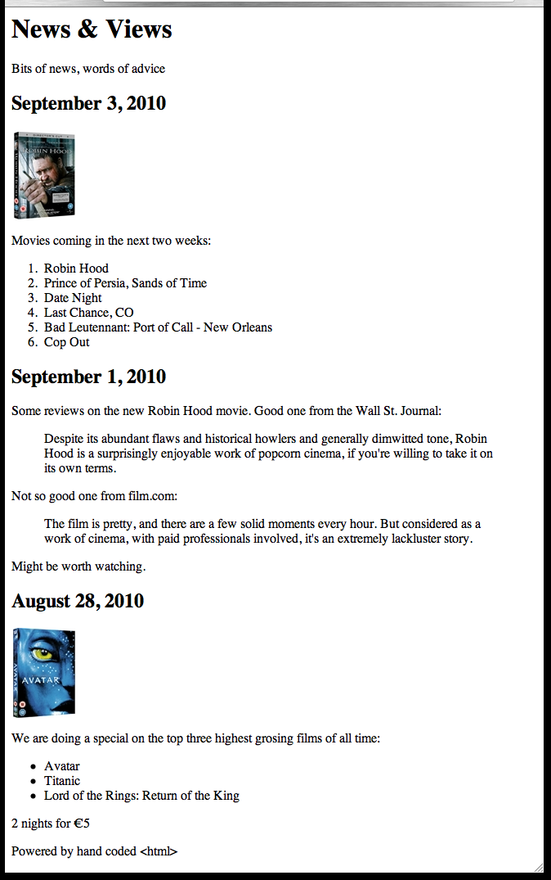
Planning a Document (1)
Visualizing End Result

Slide 31
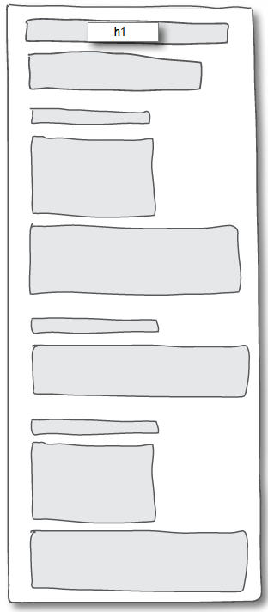
Planning a Document (2)
Identify Block Structure

Slide 32
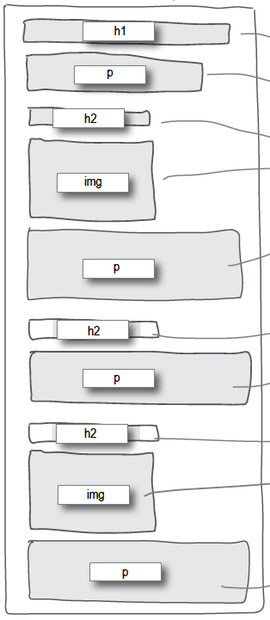
Planning a Document (3)
Select suitable elements

Slide 33
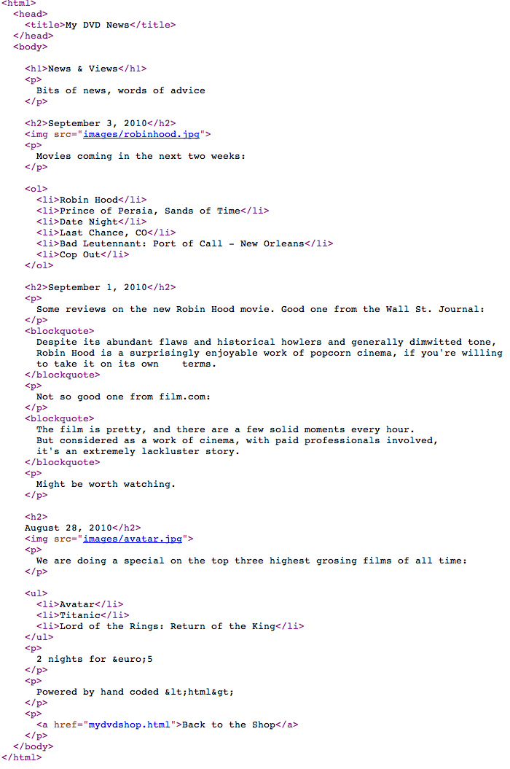
Planning a Document (4)
Build Content

Slide 34
Wire framing
A website wireframe is a basic visual guide used in interface design to suggest the structure of a website and relationships between its pages.
A webpage wireframe is a similar illustration of the layout of fundamental elements in the interface. Typically, wireframes are completed before any artwork is developed.

Slide 35
Agenda
Elements, Attributes, & Documents
Linking
Nesting
Linebreak, Block & Inline Elements
Structuring a Page / Wireframing

Slide 36
Learning Outcomes
Understand the structure of an HTML Element, and be able to recognize its variants.
Be able to read and compose a relative path, and be able to distinguish it form an absolute path.
Understand the implications of nesting of elements, and in particular be able to distinguish between correct and incorrect nesting.
Be able to differentiate between block and inline elements
Understand the general context of wireframing

