Slide 1
Web Development
BSc Applied Computing / Forensics / Entertainment Systems/ IOT
Eamonn de Leastar (edeleastar@wit.ie)
Dr. Brenda Mullally (bmullally@wit.ie)

Slide 2

Overview of forms
Forms are used all over the Web to
Accept information
Provide interactivity
Types of forms:
Search form, Order form, Newsletter sign-up form, Survey form, Add to Cart form, and so on…

Slide 3
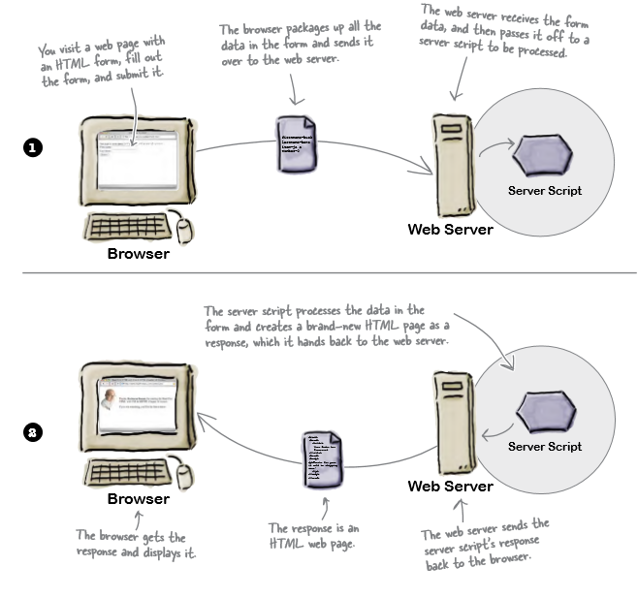
Server side

Slide 4
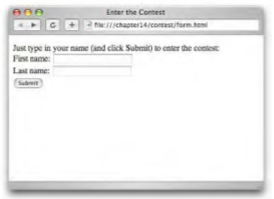
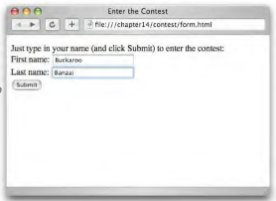
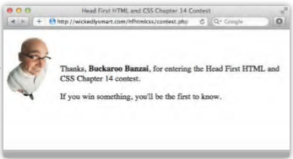
How forms work in the browser
The browser loads the page, it creates controls on the page that allow you to input various kinds of data.
You enter data, type a single line of text, click an option, checkbox control etc.
You submit the form by clicking a submit button.
The server responds by receiving the data and processing it and presenting a new html page.

Slide 5
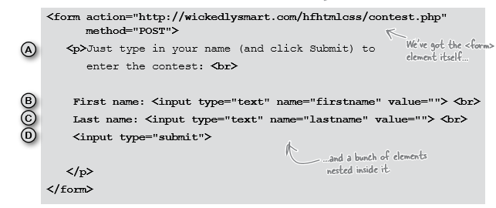
Form elements

Slide 6
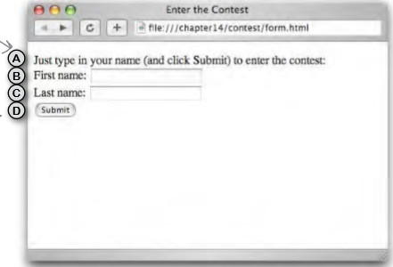
Form elements
To create a form you use a <form> element, there are a number of other elements that provide different ways for you to enter information: text boxes, checkboxes, menus of options, and more.

Slide 7
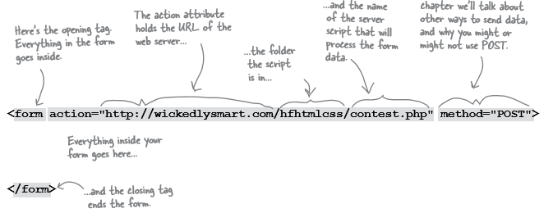
How the <form> element works

Slide 8
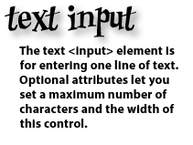
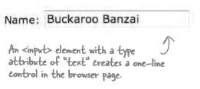
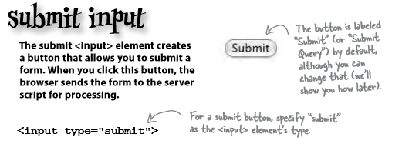
What can go on a form?

Slide 9
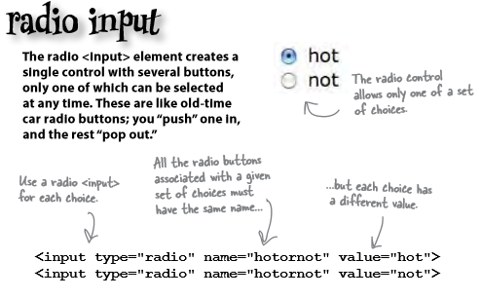
What can go on a form?
Radio buttons create a single control of several buttons of which only one can be chosen.

Slide 10
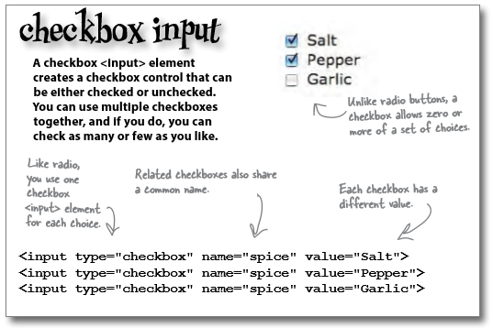
What can go on a form?
A checkbox control can be either checked or unchecked, multiple checkboxes can go together and you can check as many or as few as you like.

Slide 11
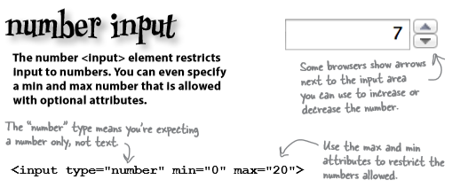
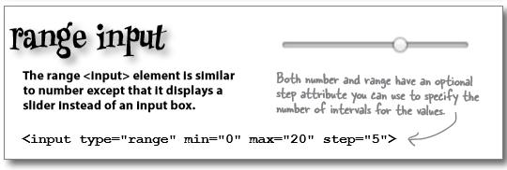
What can go on a form?
HTML5 adds more input types.

Slide 12
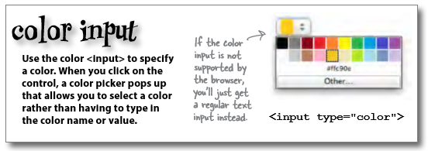
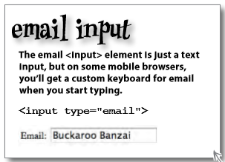
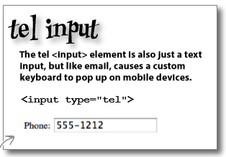
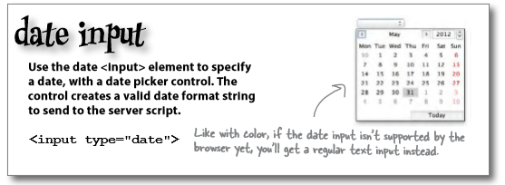
What can go on a form?

Slide 13
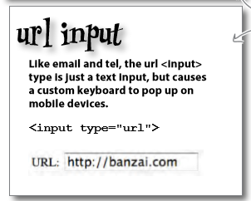
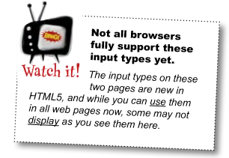
What can go on a form?
Even with these specialised types, it’s up to you to make sure you know what values the server script is expecting and use the right <input> type.

Slide 14
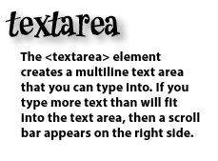
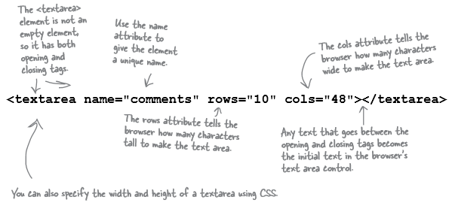
What can go on a form?
Not every form element is an <input> element there are some others for typing more than one line of text:

Slide 15
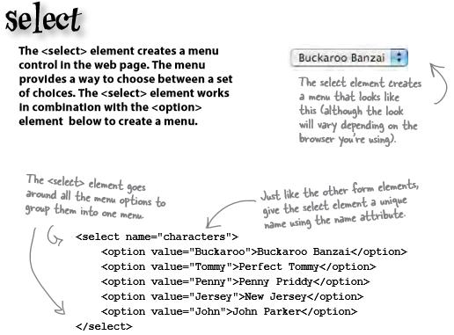
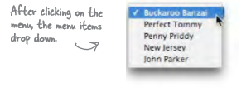
What can go on a form?

Slide 16
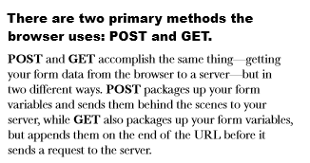
Sending the data to the server

Slide 17
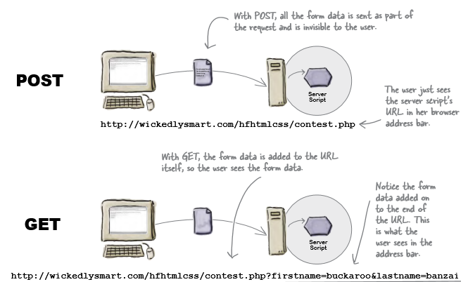
Sending the data to the server

Slide 18
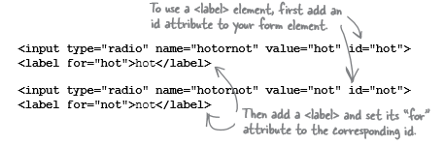
Accessibility
So far we have been labelling our form using text. We should really be using the <label> element to mark up these labels.
The <label> element provides further information about the structure of your page, allows you to style your labels using CSS more easily, and helps screen readers for the visually impaired to correctly identify form elements.
Labels don’t look any different from normal text. But they can make a big difference when it comes to accessibility.

Slide 19
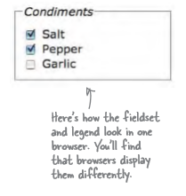

What more could go into a form?
A <fieldset> element can be used to group together common elements.
It then can also make use of an element called <legend>
The password <input> element works just like the text <input> element except that the text is masked.

Slide 20
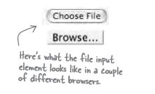
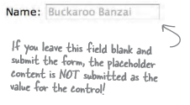

What more could go on a form?
A file input element is new. If you need to send an entire file you can set the input type to “file”, this creates a control that allows you to choose a file and the contents when the form is submitted is sent to the server.
The placeholder attribute can be used with most <input> types in a form, it gives a hint about the kind of content expected.
The required attribute forces the user to enter content. An error will show if the user leaves it blank.

