Slide 1
Web Development
BSc Applied Computing / Forensics / Entertainment Systems/ IOT
Eamonn de Leastar (edeleastar@wit.ie)
Dr. Brenda Mullally (bmullally@wit.ie)

Slide 2
CSS: The Box Model
Web Development

Slide 3
Agenda
Box Model
Box Model: Content, Padding, Border & Margin
Background images
Border Styles, Width, Colour
Layout
The DOM, HTML Parsing & Rendering
Box Model Revisited
Formatting Concepts in CSS
Multicolumn layout worked example

Slide 4
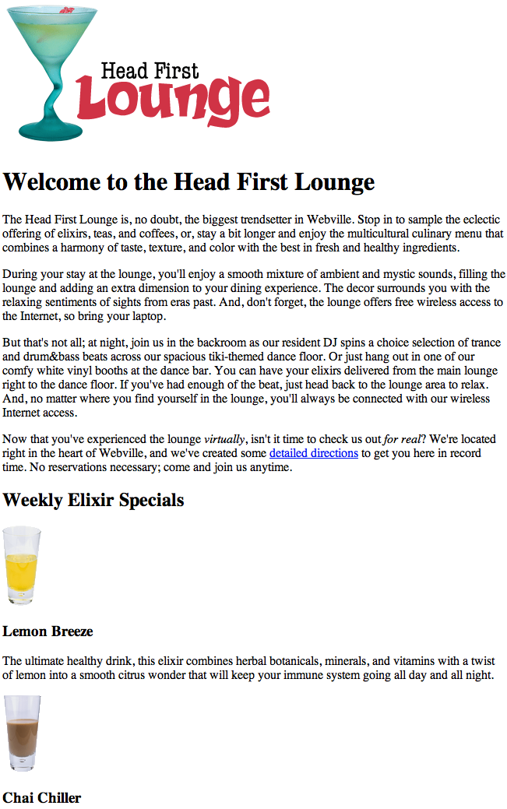
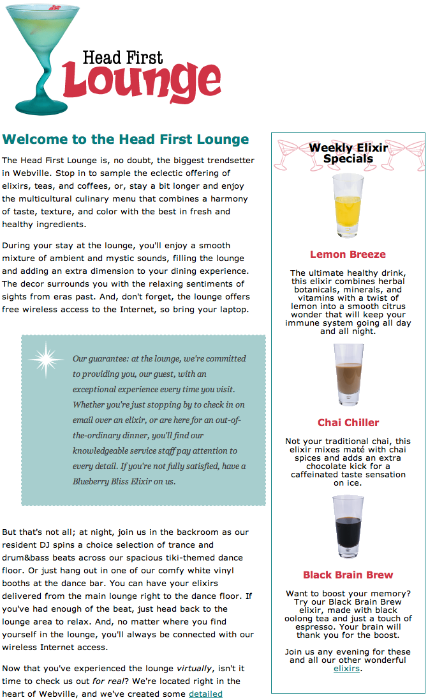

Slide 5
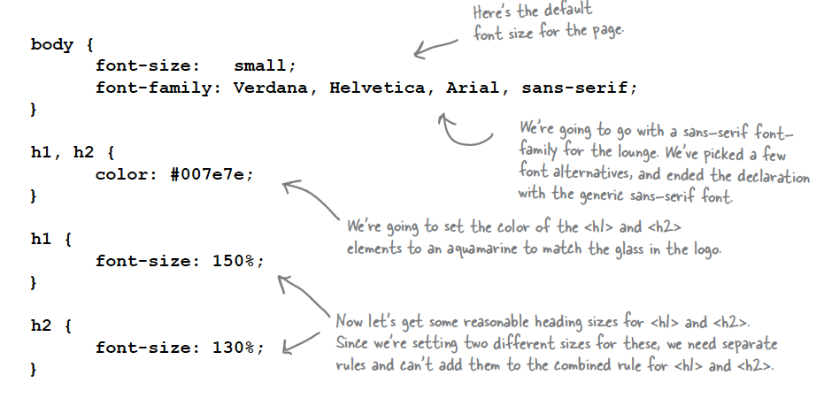

Slide 6
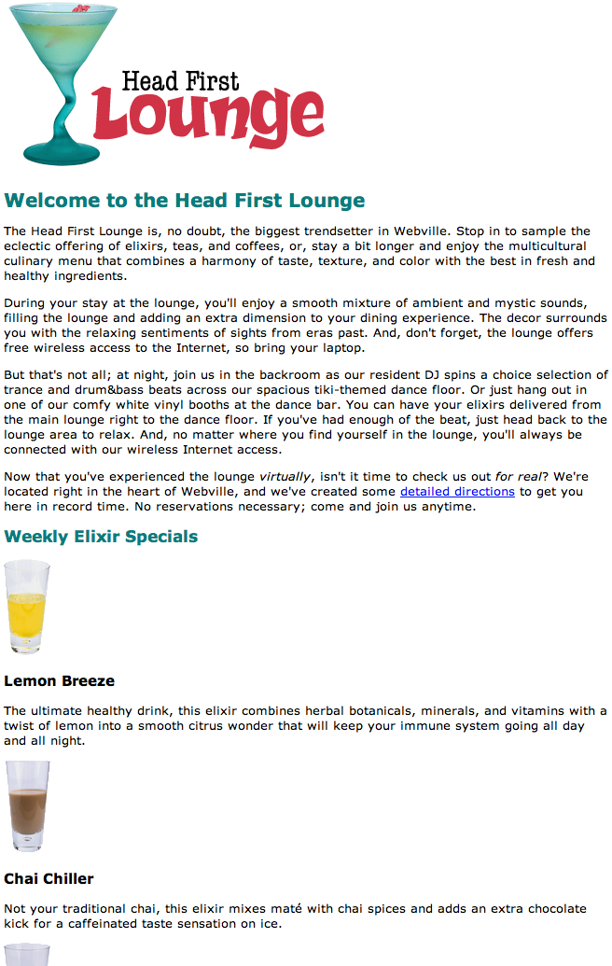

Slide 7
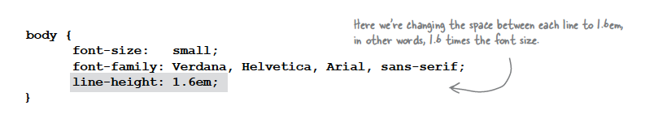
line-height
Increasing the line height of your text can improve readability. It also gives you another way to provide contrast between different parts of your page.
Fonts can be measured in absolute for relative terms:
Absolute:
px - Pixels, absolute, screen oriented
pt - Points, absolute, print oriented
Relative
em - “width of an ‘m’”, 1 = current font width
% - 100% = current font size

Slide 8
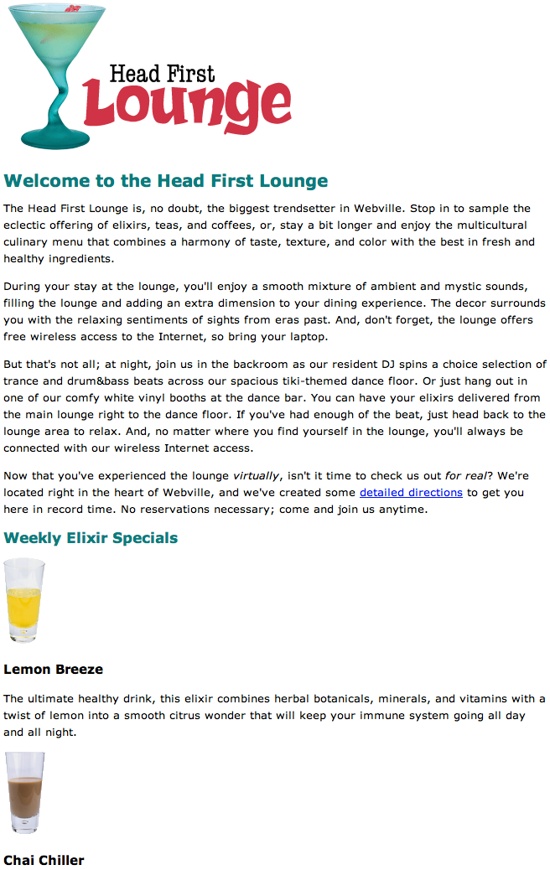

Slide 9
CSS Box Model
Boxes consist of:
Content
Padding
Border
Margin
So far, your CSS has focussed on changing simple properties of elements, like size, color, and decorations. For effective layout control, you have got to move on to the box model.
The box model is how CSS sees elements.
CSS treats every single element as if it were represented by a box.
All elements are treated as boxes: paragraphs, headings, block quotes,lists, list items, and so on. Even inline elements like <em> and links are treated by CSS as boxes

Slide 10
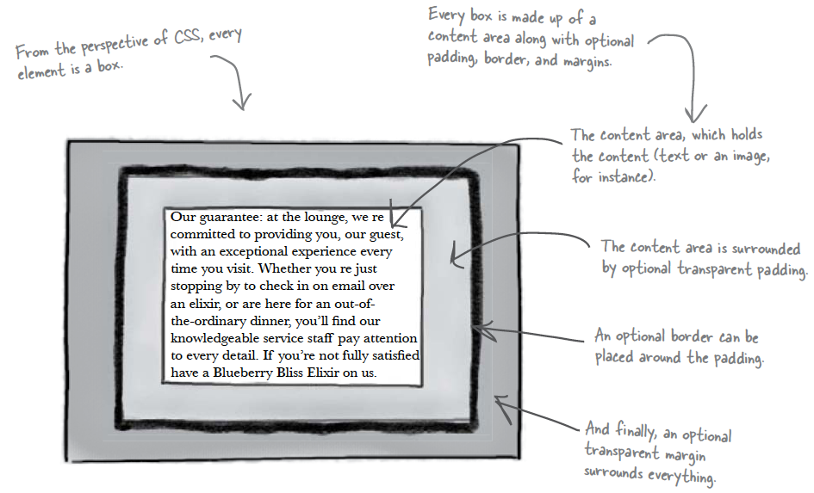

Slide 11
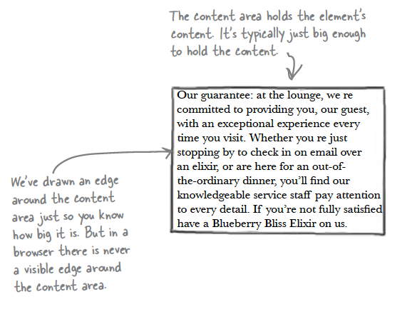
Content Area
Every element starts with some content, like text or an image, and this content is placed inside a box that is just big enough to contain it.
The content area has no whitespace between the content and the edge of the box

Slide 12
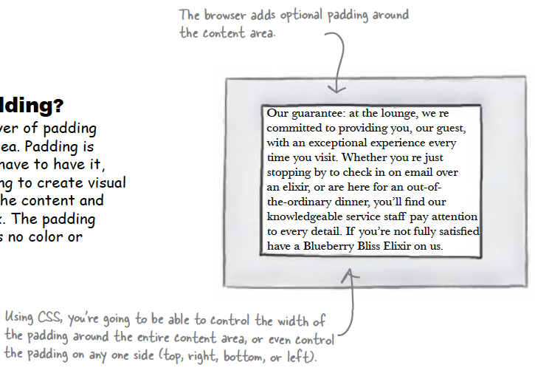
Padding
Any box can have a layer of padding around the content area.
Padding is optional, so you don’t have to have it, but you can use padding to create visual whitespace between the content and the border of the box.
The padding is transparent and has no color or decoration of its own.

Slide 13
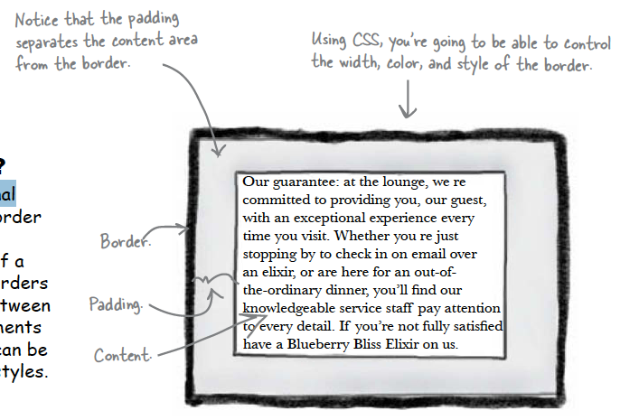
Border
Elements can have an optional border around them
The border surrounds the padding and because it takes the form of a line around the content, borders provide visual separation between content and other elements on the same page
Borders can be various widths, colors and styles

Slide 14
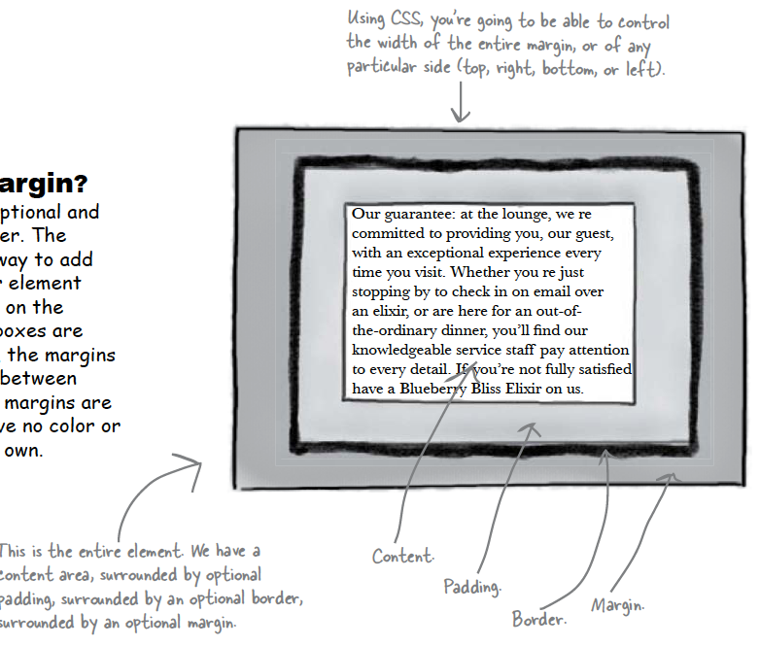
Margin
The margin is also optional and surrounds the border.
The margin gives you a way to add space between your element and other elements on the same page.
If two boxes are next to each other, the margins act as the space in between them.
Like padding, margins are transparent and have no color or decoration of their own.

Slide 15
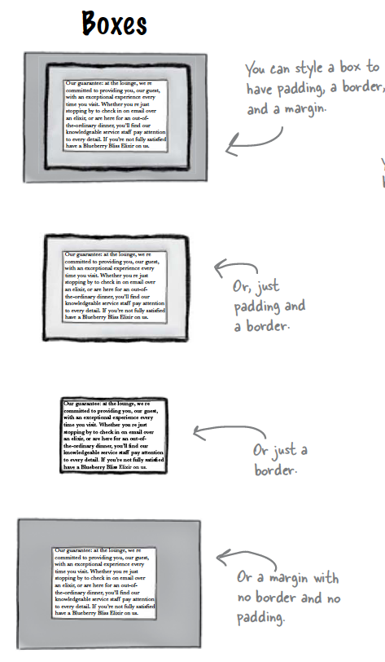
Variations: Boxes
The box model may look simple with just the content, some padding, a border, and margins.
But when you combine these all together there are endless ways you can determine the layout of an element with its internal spacing (padding) and the spacing around it (margins).

Slide 16
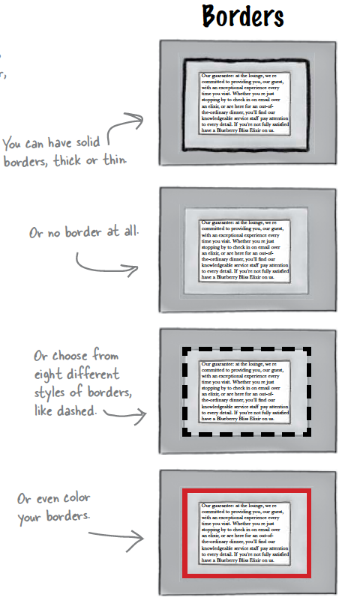
Variations: Borders

Slide 17
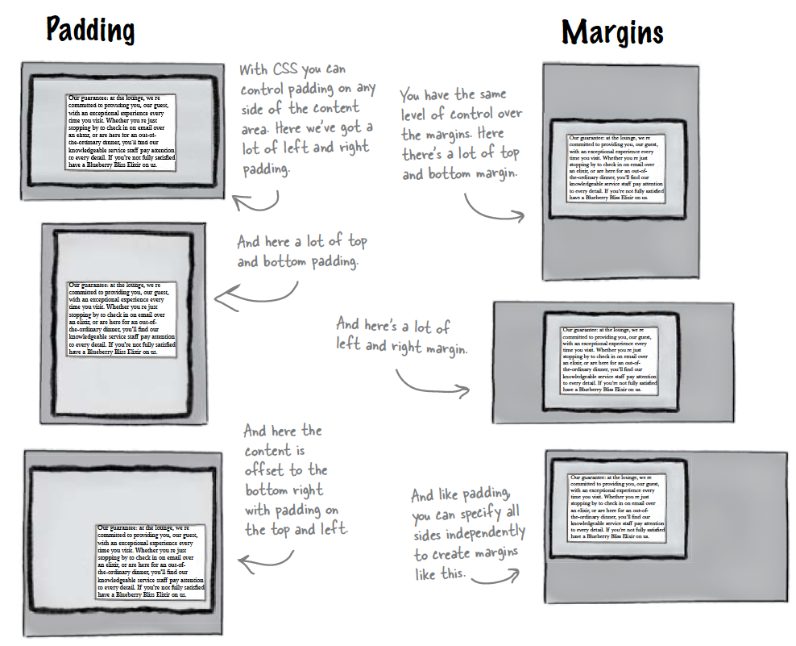
Variations: Padding & Margins

Slide 18
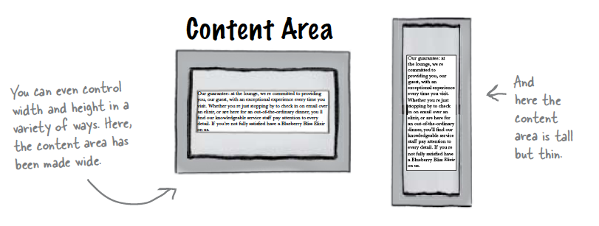
Variations: Content

