Slide 1
Web Development
BSc Applied Computing / Forensics / Entertainment Systems/ IOT
Eamonn de Leastar (edeleastar@wit.ie)
Dr. Brenda Mullally (bmullally@wit.ie)

Slide 2
HTML Page Structure & Publishing

Slide 3
Learning Outcomes
Understand the structure of an HTML Element, and be able to recognize its variants.
Be able to read and compose a relative path, and be able to distinguish it from an absolute path.
Understand the implications of nesting of elements, and in particular be able to distinguish between correct and incorrect nesting.
Be able to differentiate between block and inline elements
Understand the general context of wireframing

Slide 4
Agenda
Elements, Attributes, & Documents
Linking
Nesting
Linebreak, Block & Inline Elements
Structuring a Page / Wireframing

Slide 5
Agenda
Elements, Attributes, & Documents
Linking
Nesting
Linebreak, Block & Inline Elements
Structuring a Page / Wireframing

Slide 6
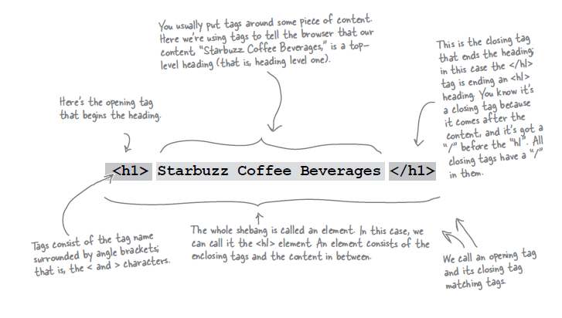
Components of an HTML Element

Slide 7
Components of an HTML Element
<ElementName >
Content
</ElementName>
Start Tag
End Tag

Slide 8
<title>
<title>My App Store</title>
ElementName: <title>
Content: My DVD Shop
ElementName: </title>

Slide 9
<p>
<p> 600 million YouTube views later, Dude Perfect is back with their most epic game yet! Go BIGGER than ever hitting mind-blowing trick shots through tons of crazy levels!</p>
ElementName: <p>
Content: 600 million YouTube views later, Dude Perfect is back with their most epic game yet! Go BIGGER than ever hitting mind-blowing trick shots through tons of crazy levels! ElementName: </p>

Slide 10
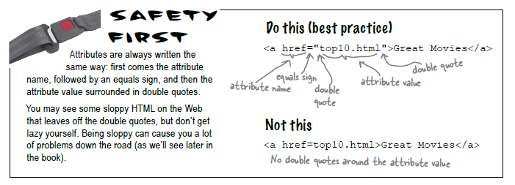
Attributes
Attributes give you a way to specify additional information about an element.

Slide 11
<a>
<a href=“apps.html”>App Store</a>
ElementName: <a>
AttributeName: href
AttributeValue: “about/directions.html”
Content: detailed directions
ElementName: </a>

Slide 12
<img>
<img src=“/images/delete.jpg”>
ElementName: <img>
AttributeName: src
AttributeValue: "../images/PJackson.jpg"
Content: empty
ElementName: none (for the moment)

Slide 13
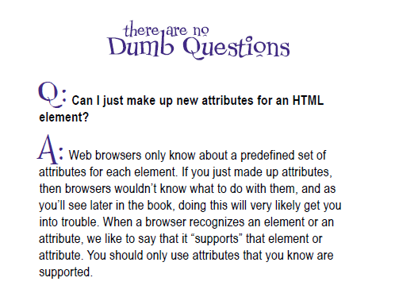
Attributes

Slide 14
HTML Document Structure
html
head
title
body
h1
ol
etc...

Slide 15
Agenda
Elements, Attributes, & Documents
Linking
Nesting
Linebreak, Block & Inline Elements
Structuring a Page / Wireframing

Slide 16
Linking

Slide 17
Linking to other pages or images
Creating links to other web pages and to image files can get confusing! If your link to a file or page is incorrect you get:
Whoops we can’t seem to find that page! (404 error )
Or
No image shows and you have a broken link to an image
See pages 60-64 in the book

Slide 18
Links: Absolute vs Relative
Absolute
Complete path to a file on the hard disk: e.g:
C:/My Documents/webdevelopment/lab01/images/xbox.jpg
C:My Documents/webdevelopment/lab01/movies.html
Relative:
/images/xbox.jpg
../apps.html
index.html
Trace route from “current position” to the destination
“..” means go up one level
Directory name may prefix filename

Slide 19
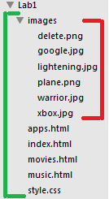
Relative Link Examples
If we are in “lab1” then “images/plane.png” is a relative link from the current folder (Lab1) to the images folder, and to the file “plane.png” in that folder
If we are in the images folder, and we wish to link to one of the web pages, the link “../movies” means “go up one level, and then find “movies.html”
Avoid absolute links!
<a href=“movies.html">Moives</a>
<img src="/images/warrior.jpg">

Slide 20
Agenda
Elements, Attributes, & Documents
Linking
Nesting
Linebreak, Block & Inline Elements
Structuring a Page / Wireframing

Slide 21
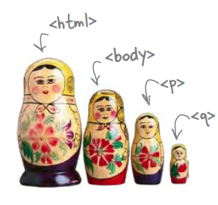
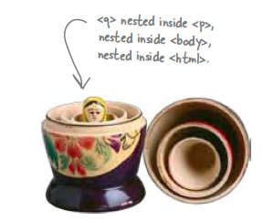
Nesting
When we put one element inside another element, we call that nesting.
We say, the <p>element is nested inside the <body>element.
We put a <body>element inside an <html>element, a <p>element inside a <body>element etc.

Slide 22
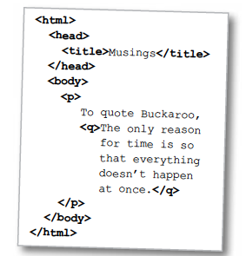
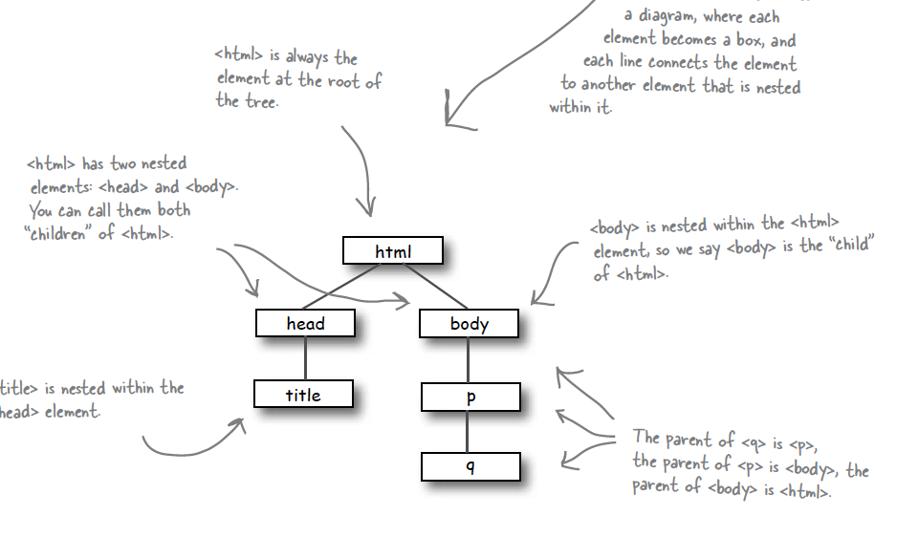
Nesting - Tree Structure
Text

Slide 23
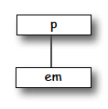
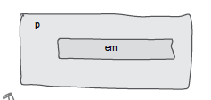
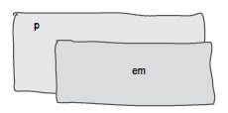
Nesting can be Incorrect!
<p>I’m so going to blog <em>this</em></p>
Good
<p>I’m so going to blog <em>this</p></em>
Bad
?

Slide 24
Agenda
Elements, Attributes, & Documents
Linking
Nesting
Linebreak, Block & Inline Elements
Structuring a Page / Wireframing

Slide 25
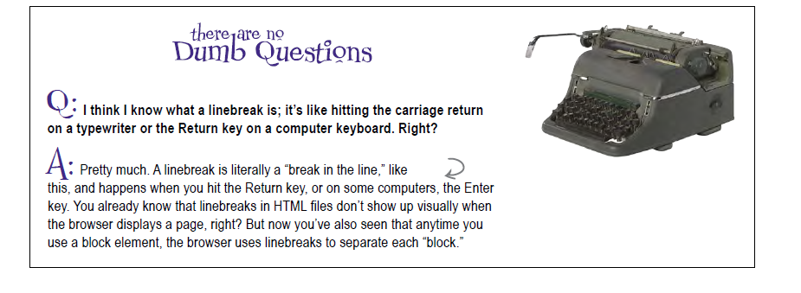
Line breaks

Slide 26
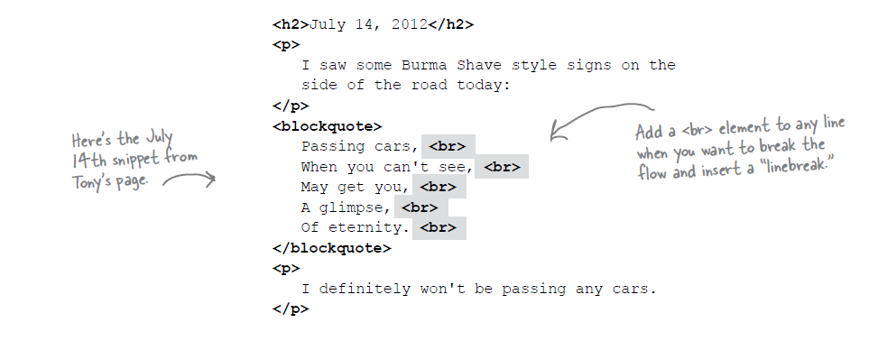
Line Breaks

Slide 27
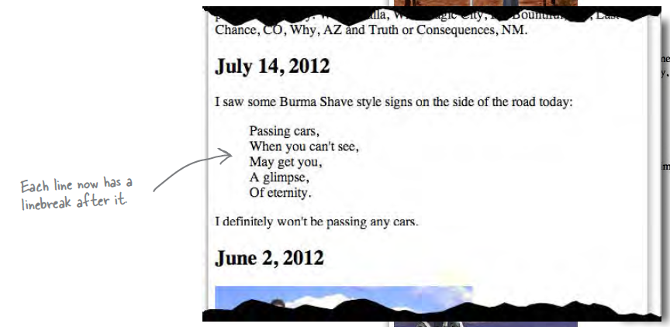
Line Breaks

Slide 28
Line Breaks
Break: <br> </br>
An Empty element: - sometimes shortened to:
<br></br>
or just
<br>
or
<br />

Slide 29
Block vs Inline Elements
Block elements are always displayed as if they have a line break before and after them
inline elements appear “in line” within the flow of the text in your page.
“Block elements stand on their own; inline elements go with the flow.”

Slide 30
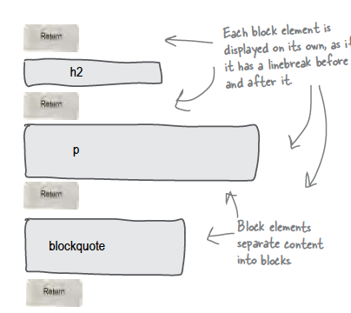
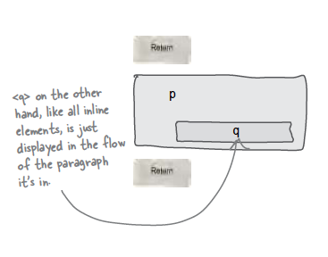
Examples
Block - h1, h2, p, blockquote
Inline - a, em, q

Slide 31
Agenda
Elements, Attributes, & Documents
Linking
Nesting
Linebreak, Block & Inline Elements
Structuring a Page / Wireframing

Slide 32
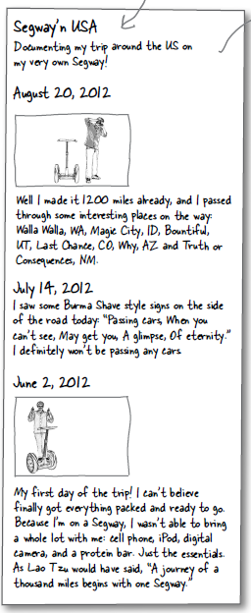
Planning a Document (1)
Visualizing End Result

Slide 33
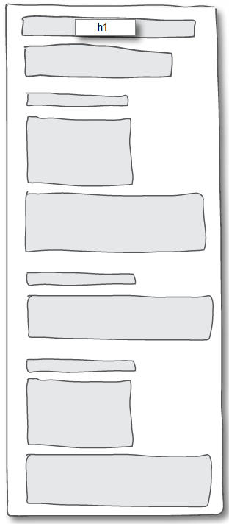
Planning a Document (2)
Identify Block Structure

Slide 34
Planning a Document (3)
Building blocks
Don’t forget <html> <head> and <body>
Translate to html
Build content

Slide 35
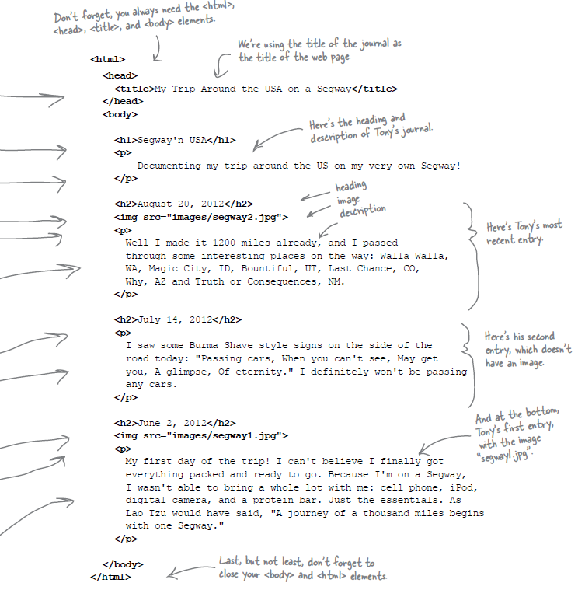
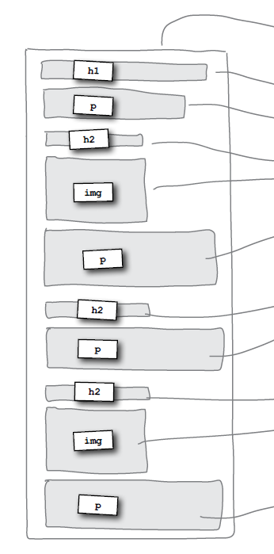

Slide 36
Wire framing
A website wireframe is a basic visual guide used in interface design to suggest the structure of a website and relationships between its pages.
A webpage wireframe is a similar illustration of the layout of fundamental elements in the interface. Typically, wireframes are completed before any artwork is developed.

Slide 37
Agenda
Elements, Attributes, & Documents
Linking
Nesting
Linebreak, Block & Inline Elements
Structuring a Page / Wireframing

Slide 38
Learning Outcomes
Understand the structure of an HTML Element, and be able to recognize its variants.
Be able to read and compose a relative path, and be able to distinguish it form an absolute path.
Understand the implications of nesting of elements, and in particular be able to distinguish between correct and incorrect nesting.
Be able to differentiate between block and inline elements
Understand the general context of wireframing

