Slide 1
CSS Layout Part I
Web Development

Slide 2
CSS Selector Examples
Choosing and applying Class and ID names requires careful attention
Strive to use clear meaningful names as far as possible.

Slide 3
CSS Selectors Summary (simple)
Selector | Applies to
p | All paragraphs in the document
.about | All elements in the document with a class value of about
#corporatehistory | The element in the document with an id value of corporate history (if present)
h1,h2,h3 | All first-, second-, and third-level headings in the document
.privacy, .copyright | All elements with a class of privacy or copyright
#header,#footer | The element assigned an id of header, and the element assigned an id of footer
p.footnote | All paragraphs assigned a class of footnote

Slide 4
CSS Selectors Summary (advanced)
Selector | Applies to
#bodycopy.usergenerated | An element that has been assigned both an id of bodycopy and a class of usergenerated
.navigation a | All links with an ancestor parent assigned a class of navigation
#primarynavigation li.current | All list items with a class of current and an ancestor parent with an id of primarynavigation
.about #bodycopy | Any element on the site with an id of bodycopy and an ancestor parent assigned a class of about
body#personalproducts, body#proproducts, body#enterpriseproducts | The body elements within the site assigned the ids personalproducts, proproducts, and enterpriseproducts
body#personalproducts #bodycopy, body#proproducts #bodycopy, body#enterpriseproducts #bodycopy | The elements assigned an id of bodycopy, within the documents suggested by the previous example
ol li ol li ol li | A list item in the third level of a nested ordered list

Slide 5
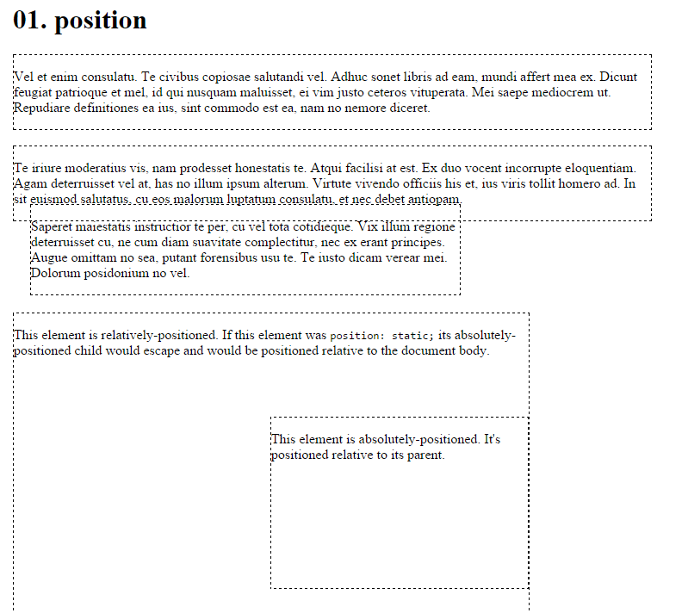
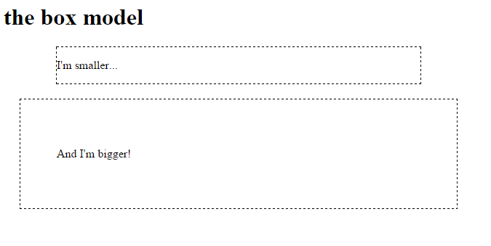
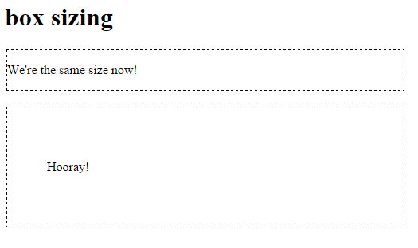
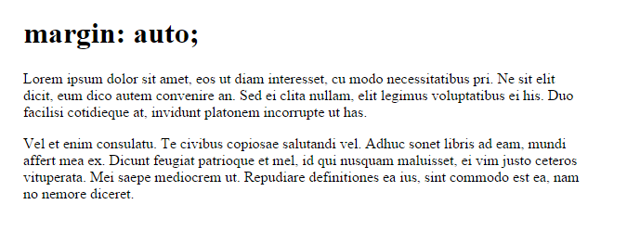
Lab 06: Learn CSS Layout Part 1

Slide 6
CSS Layout I
No layout
The “display” property
Margin: auto;
Max-width
The box model
Box-sizing
Position
Float
Clear

Slide 7
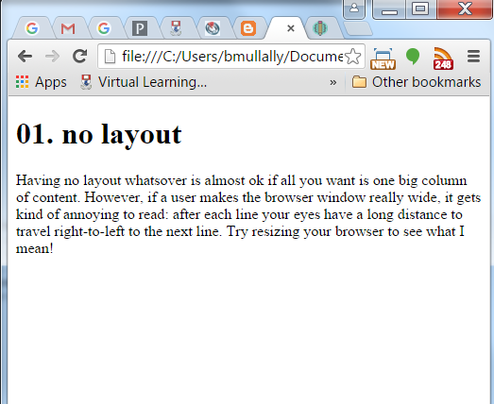
No Layout
No layout is ok if you want one big column of content.
What happens if you make the browser really wide?
Your eyes have to travel a long distance right to left to the next line.

Slide 8
“display” property
display is CSS’s most important property for controlling layout.
Every element has a default display value depending on what type of element it is. The default for most elements is usually block or inline.
block
<div> is the standard block level element. It starts on a new line and stretches to the left and right as far as it can. Others include <p> and new in HTML5 are <header> <footer> <section> and more.
inline
<span> is the standard inline element. The <a> element is the most common inline element.
none
Setting display to none will render the page as though the element does not exist.
visibility: hidden; will hide the element, but the element will take up the space it would usually.
.test-one {
display:block;
}
test-two {
display:inline;
}
test-three {
display:none;
}
.test-four {
visibility:hidden;
}

Slide 9
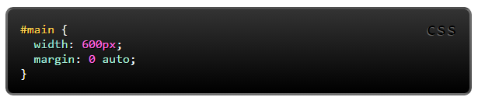
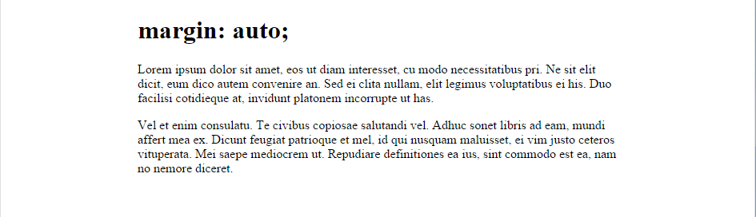
margin: auto;
Setting the width of a block-level element will stop it stretching out to the edges left and right. Then set the margin to auto left and right. This horizontally centres that element within its container.
The only problem is when the browser window is narrower than the width you set. What will the browser do?

Slide 10
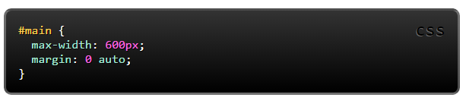
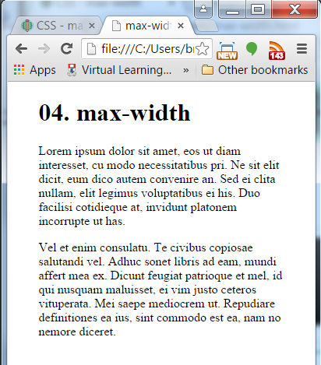
max-width
To prevent a horizontal scroll bar appearing we can use the max-width property. For a site that needs to be usable on a mobile it is important to use max-width.
max-width is supported by all major browsers including IE7

Slide 11
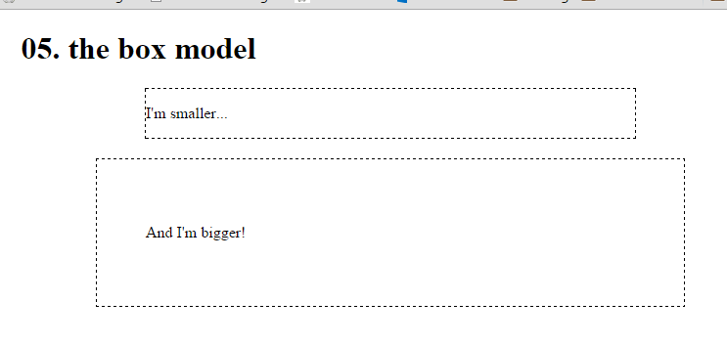
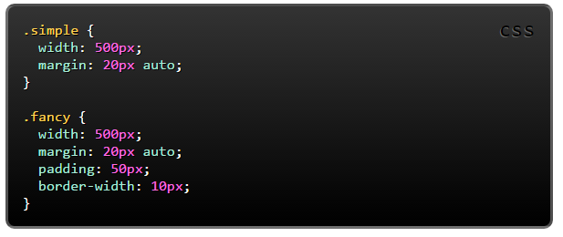
the box model
When you set the width of an element, it can actually appear bigger because of the border and padding.
These two elements have their width set the same but they end up rendered as different sizes.
The solution might be to write smaller width value than we wanted

Slide 12
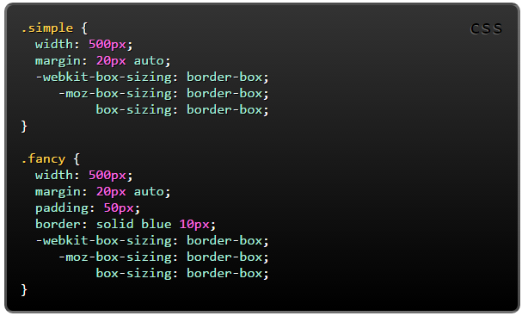
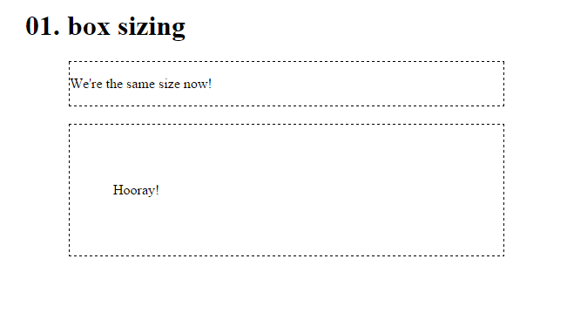
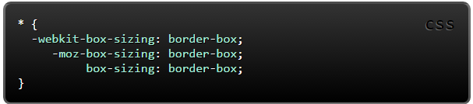
box-sizing
A new CSS property called box-sizing was created for this problem. When you set box-sizing: border-box; on an element the padding and border of that element no longer increases its width.
Here we have set the box-sizing: border-box; on both elements.
Sonme authors want all elements on their pages to work this way.
Use –webkit- and –moz- prefixes to ensure all browser engines targetted.

Slide 13
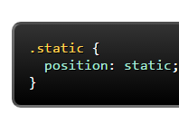
position
position property often used to make more complex layouts.
Has a range of possible values, and their name can be confusing and difficult to remember.
Static
static is the default value. An element with position: static; is not positioned in any special way.
A static element is said to be not positioned and an element with its position set to anything else is said to be positioned.

Slide 14
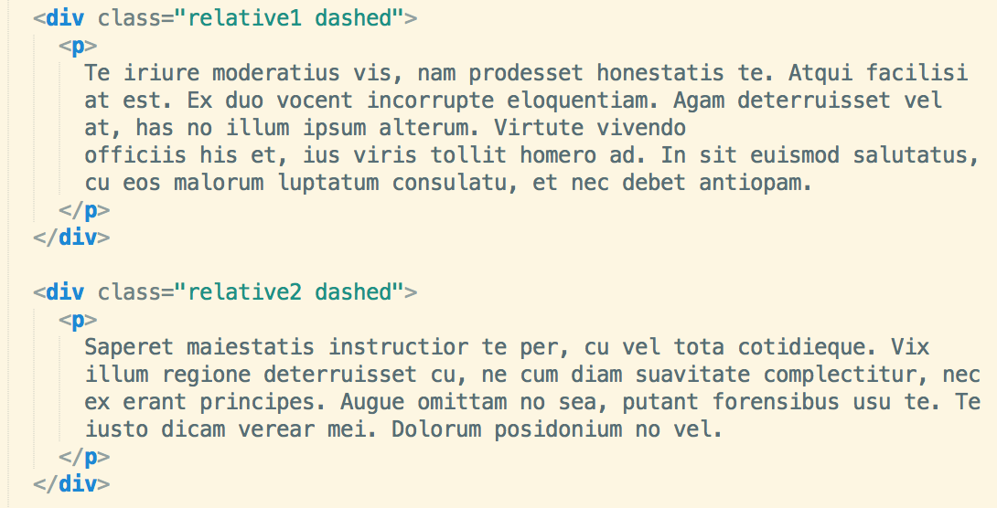
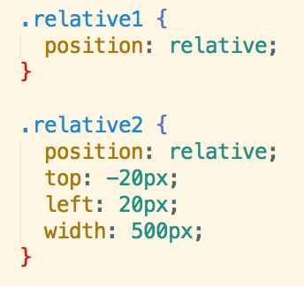
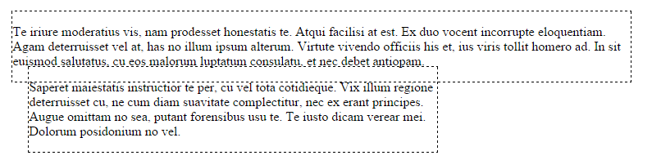
position
relative
relative behaves the same was as static unless you add some extra properties to adjust the element away from its normal position. Other content will not be adjusted to fit into any gap left by that element.

Slide 15
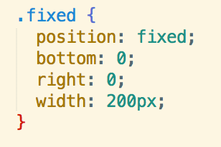
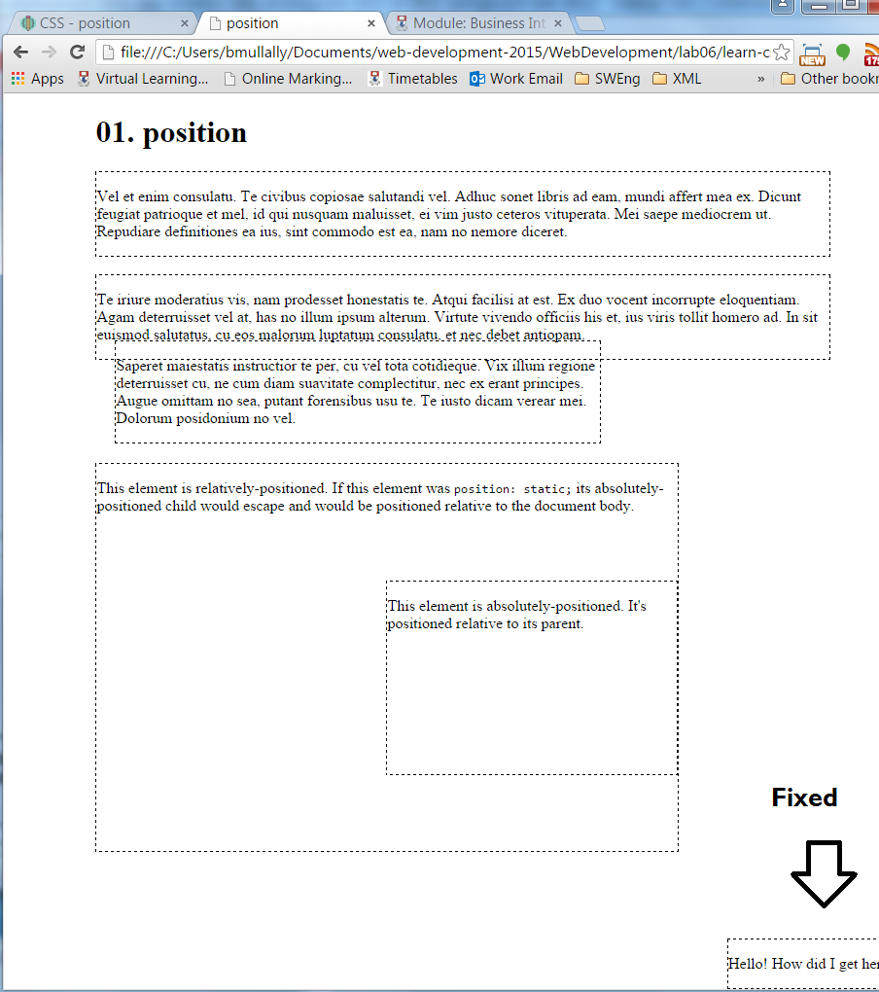
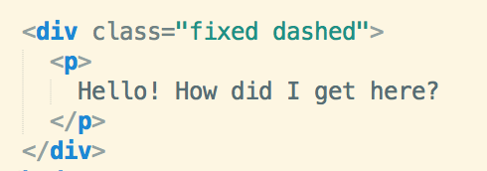
position
fixed
A fixed element is positioned relative to the viewport, which means it always stays in the same place even if the page is scrolled.
As with relative the top, right, bottom, and left properties are used.
A fixed element does not leave a gap in the page where it would normally have been located.

Slide 16
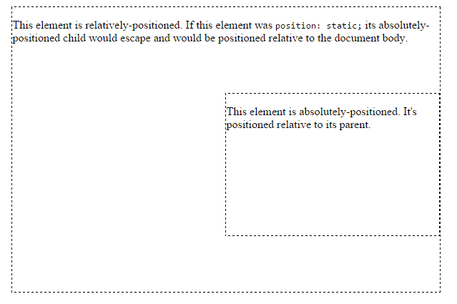
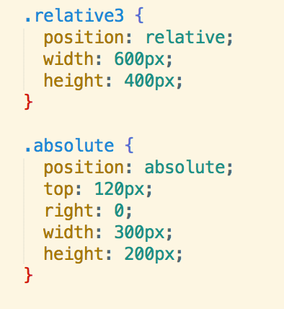
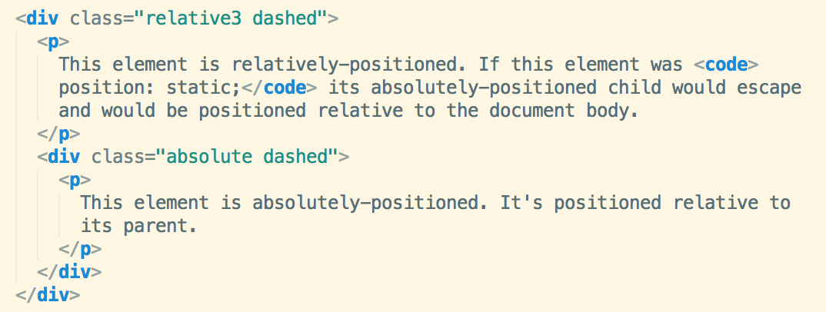
position
absolute
absolute is the trickiest position value. absolute behaves like fixed except relative to the nearest positioned ancestor instead of relative to the viewport. If an absolutely positioned element has no positioned ancestors, it uses the document body, and still moves along the page scrolling.
This is tricky, but can be important for creating sophisticated CSS layouts.

Slide 17
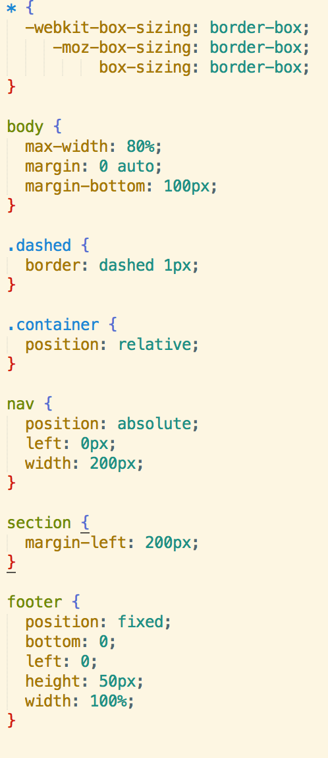
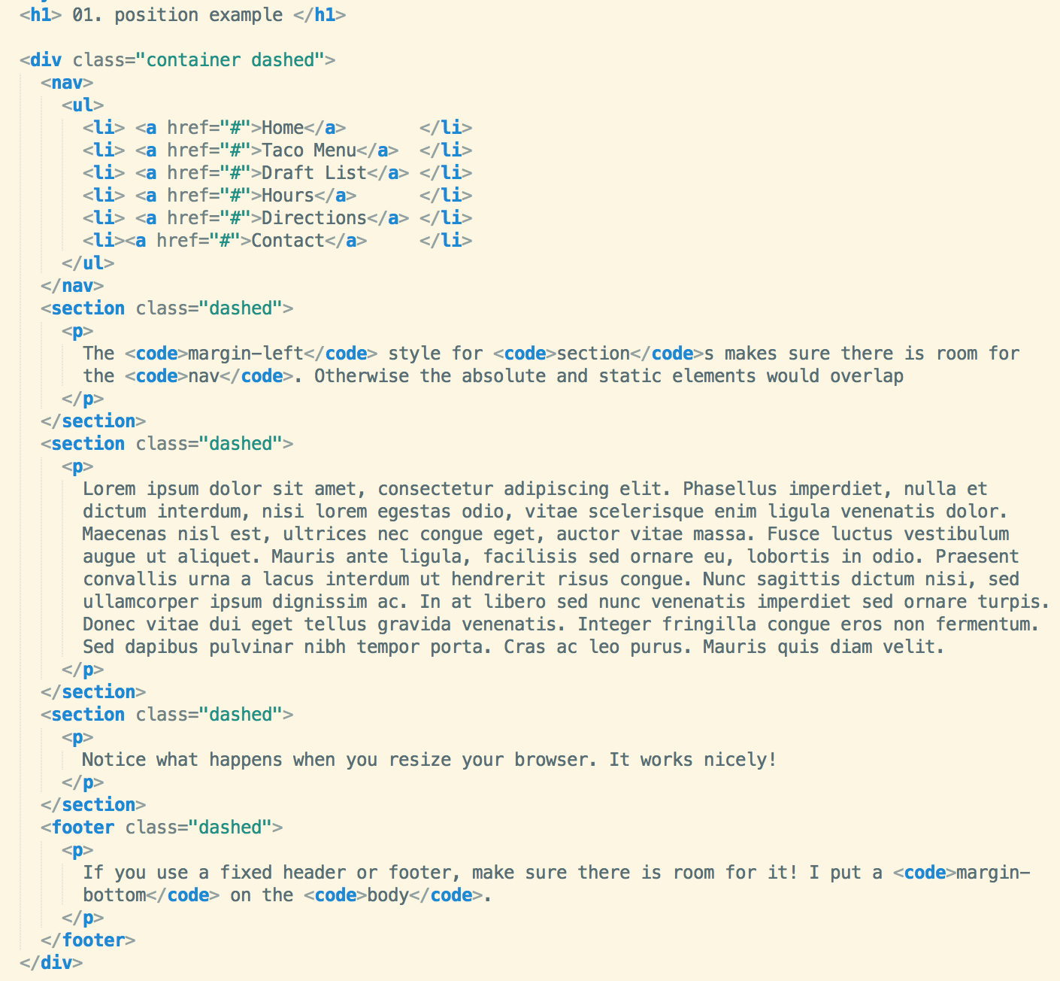
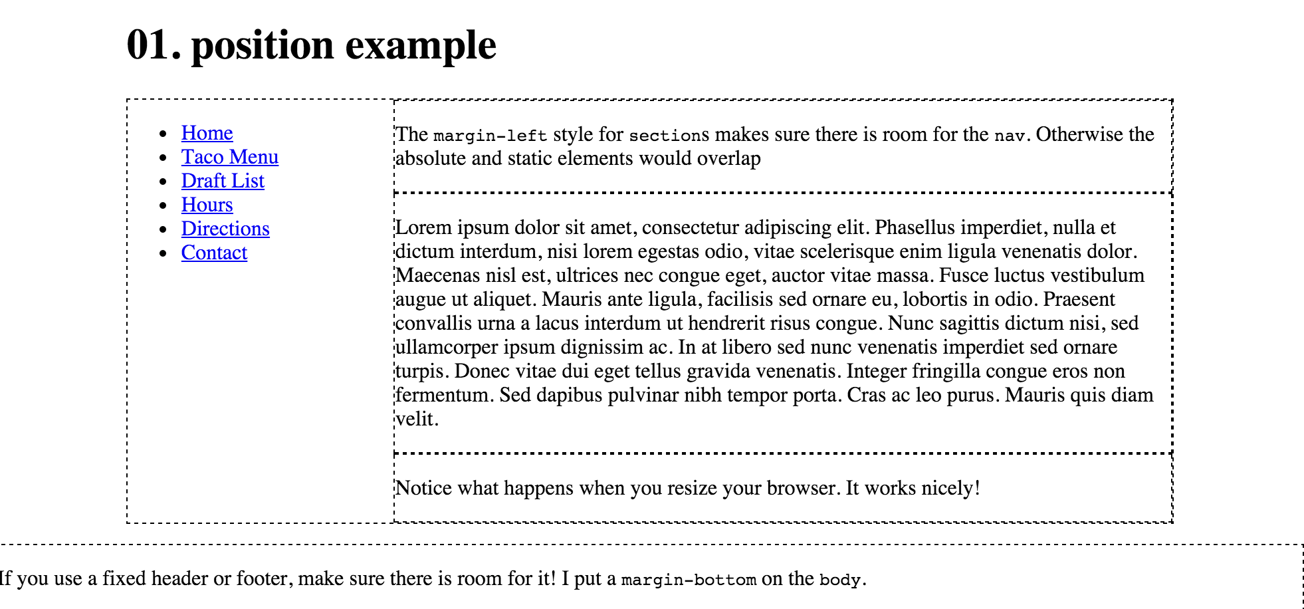
position example

Slide 18
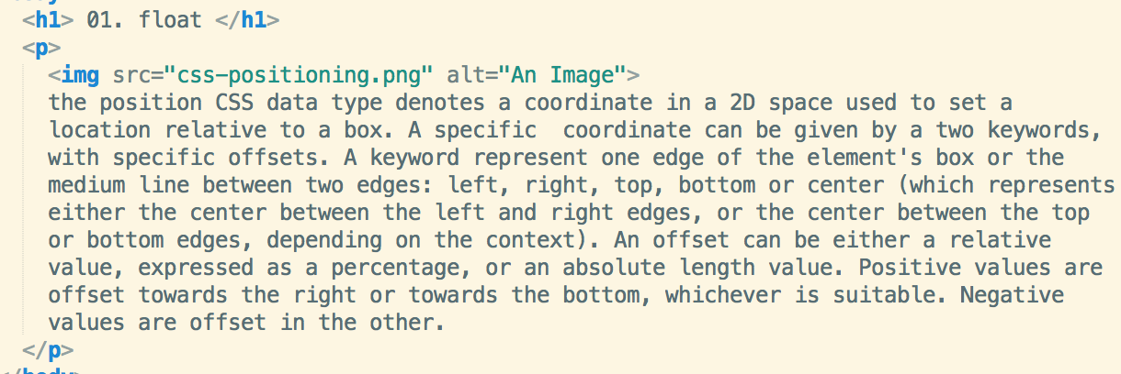
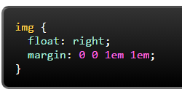
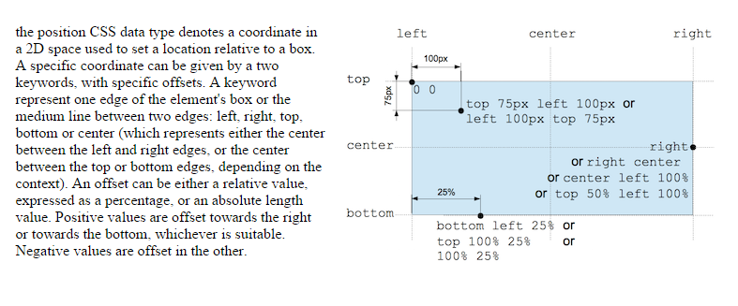
float
Float cab be used for wrapping text around images:

Slide 19
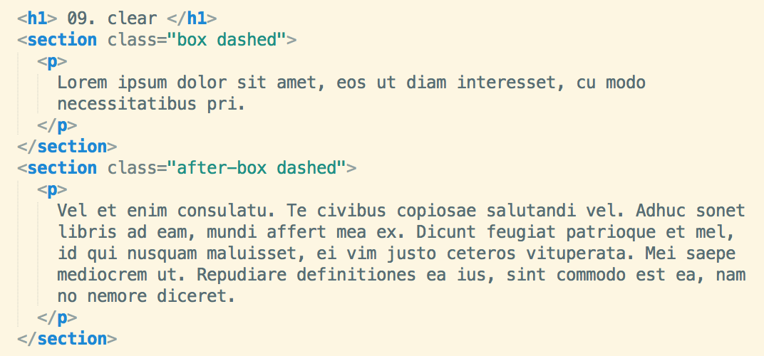
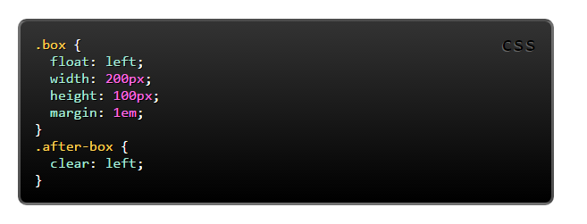
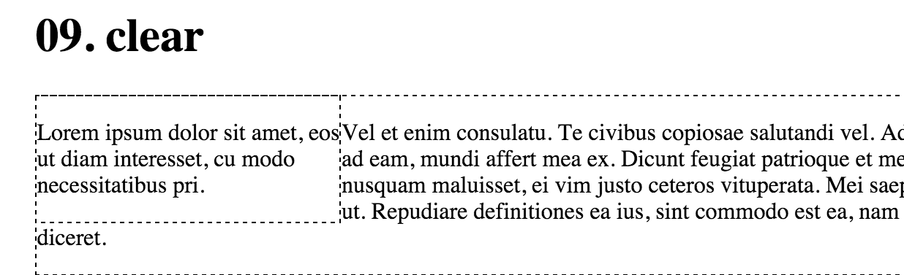
float without clear

Slide 20
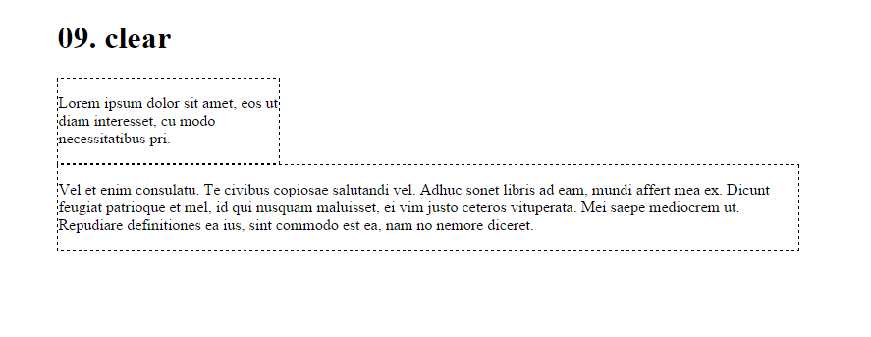
float with clear
the clear property is important for controlling the behaviour of floats.
You use the value left to clear elements floated to the left. You can also clear right and both.

Slide 21



Except where otherwise noted, this content is licensed under a Creative Commons Attribution-NonCommercial 3.0 License.
For more information, please see http://creativecommons.org/licenses/by-nc/3.0/

