Slide 1
Web Development
ICT Skills, Diploma in Computer Science
Eamonn de Leastar (edeleastar@wit.ie)

Slide 2
HTML Elements
Web Development

Slide 3
HTML Elements - Categories
Structural Elements
Head Elements
Text Formatting Elements
List Elements
Image and Media Elements
Table Elements
Form Elements
Frame and Window Elements
Deprecated Elements
Proprietary & Nonstandard Elements

Slide 4
HTML Elements - Categories
Structural Elements
Head Elements
Text Formatting Elements
List Elements
Image and Media Elements
Table Elements
Form Elements
Frame and Window Elements
Deprecated Elements
Proprietary & Nonstandard Elements

Slide 5
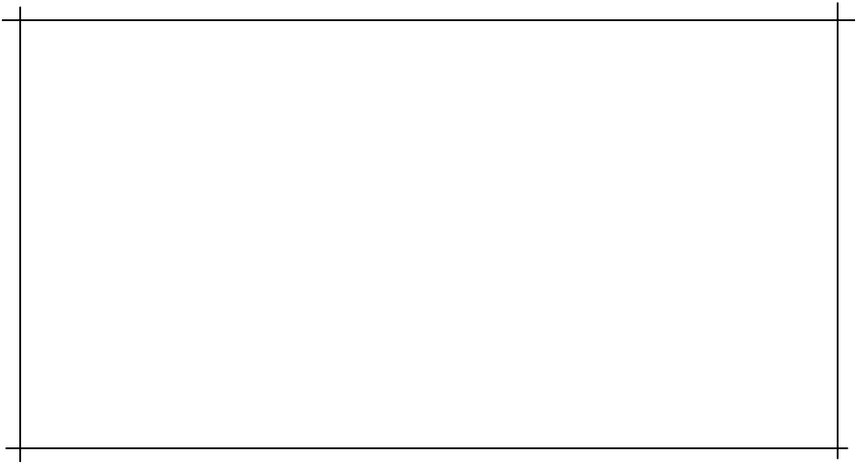
Structural Elements - <html>
The html element is the outer container for everything that appears in an HTML document.
It can only contain two elements as direct descendants, namely the head element and either a body or frameset element.
As it is the outermost element in the document, it’s also known as the root element.
This element will have a place on every single web page you ever create. There’s no case in which you would not use this element when crafting a web page.
<html>
<head> <title>Page title goes here</title> </head> <body> <!-- content goes here --> </body></html>

Slide 6
Structural Elements - <head>
The head element is the wrapper for all the head elements that:
  instruct the browser where to find style sheets,
  define relationships that the document has to others in the web site;
  provide essential meta information;
  point to or include scripts that the document will need to apply later on.
<html>
<head> <title>Page title goes here</title> </head> <body> <!-- content goes here --> </body></html>

Slide 7
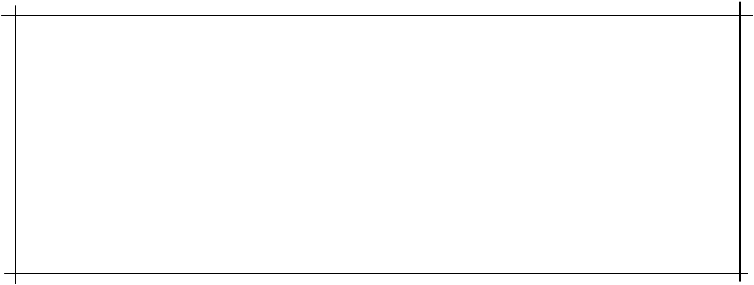
Structural Elements - <body>
The body element wraps around all of the content that will be displayed on screen.
You should not place character data (text) or inline elements such as em, or q directly into the body.
Instead, these should be contained inside block-level elements such as p elements, headings h1 - h6 and so on.
<body> <h1>101 Ways to make a paper aeroplane</h1> <p>Let's start with the basics …</p> ⋮</body>

Slide 8
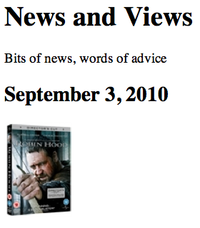
Structural Elements - <h1-h6>
The h1 element is used to indicate the most important (or highest-level) heading on the page.
There are six heading levels to—h1 to h6—to add structure to the web page.
A document’s first heading should be an h1, followed by one or more h2 headings; each of these h2 headings can then have a further series of h3 headings below them, and so on
May contain any text content, but it can’t include any block-level elements: only inline elements can be included
<h1>News and Views</h1>
<p>
Bits of news, words of advice
</p>
<h2>September 3, 2010</h2>
<p>
<img src="images/robinhood.jpg" alt="Robin Hood">
</p>

Slide 9
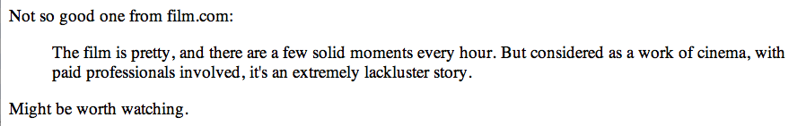
Structural Elements - <blockquote>
The blockquote element is a mechanism for marking up a block of text quoted from a person or another document or source.
It may be just a few lines, or it may contain several paragraphs - which must be marked up using nested p elements).
<blockquote>
<p>
The film is pretty, and there are a few solid moments every hour.
But considered as a work of cinema, with paid professionals involved,
it's an extremely lackluster story.
</p>
</blockquote>

Slide 10
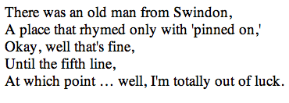
Structural Elements - <br>
Creates a line break within a block of text, leaving no padding or margins between the two blocks of text created by the line break
<p>
There was an old man from Swindon,<br>
A place that rhymed only with 'pinned on,'<br>
Okay, well that's fine,<br>
Until the fifth line,<br>
At which point … well, I'm totally out of luck.
</p>

Slide 11
Structural Elements - <p>
One of the most commonly used building blocks of HTML.
When you use the p element to begin a new paragraph in HTML, it automatically creates some space above and below the content.
Can only contain inline elements
<p>
We endeavour to give you your most wanted DVD and/or Game from your rental
queue depending on our stock situation. All DVDs and Games are posted out at noon
FIRST CLASS, and should be at your doorstep by the next morning.
When we dispatch your DVD/Game we'll send you an e-mail to advise you on which
DVD/Game was dispatched to you. There are no late fees so you can watch or play at your leisure
</p>

Slide 12

Head Elements - <title>
Displaying a title in the browser toolbar or in the task bar (on Windows)
Providing for the document a name that’s used by the browser when you add the page as a favorite or bookmark
Displaying a title of the page when it appears in search engine results
<html>
<head>
<title>
FAQ
</title>
</head>

Slide 13
Head Elements - <style>
Define style aspects of the page
Encapsulate syntax from a language different from HTML - CSS.
<style type="text/css">
body
{
background-color: #d2b48c;
margin-left: 20%;
margin-right: 20%;
border: 1px dotted gray;
padding: 10px 10px 10px 10px;
font-family: sans-serif;
}
</style>

Slide 14
Text Formatting Elements - <a>
Usually referred to as a link or hyperlink
Has a 7 possible attributes in total, of which we start with just one: href, which defines the document to which the link leads. This may be
  a web page in the same directory,
  a page somewhere else on the same server,
  a location within the current page,
  a web page—or any another kind of document—stored on another server.
In a link to another section within the same page, the destination is identified in the href attribute by a hash symbol combined with the id attribute of the destination
<a href="catalogue/newreleases.html">new releases</a>
<a href="#q1">Q.Does it matter where I live?</a>
<li>
<a id="q1">Q.Does it matter where I live?</a>
</li>
<li>
A.Our service is only available in the republic of Ireland,
we use "An Post" and deliver to all 26 counties.
</li>

Slide 15
Text Formatting Elements - <em>
The em element is used to emphasize text content, and displays in italics in all current browsers. It provides semantic meaning about the text it contains,
This week we recommend <em>the Crazies</em>.

Slide 16
Text Formatting Elements - <q>
Used for inline quotations (instead of blockquote, which sets the quotation in its own block.
It is intended that the browser should insert the necessary quotation marks, the style of which should depend on the language of the document or that section of the document, rather than the author adding quotation marks
This can sometimes cause double sets of quotation marks to appear.
<p>
Not so good one from film.com: <q>The film is pretty, and there are a few
solid moments every hour. But considered as a work of cinema, with paid
professionals involved, it's an extremely lackluster story.</q>
</p>

Slide 17
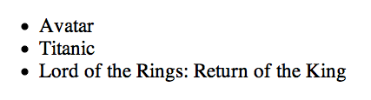
List Elements - Unordered List - <ul>
Used to group a collection of items together in a list, but in a way that doesn’t suggest an order of precedence or importance.
Individual items in the list marked with - li
<ul>
<li>Avatar</li>
<li>Titanic</li>
<li>Lord of the Rings: Return of the King</li>
</ul>

Slide 18
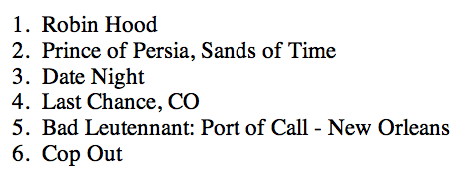
List Elements - Ordered List - <ol>
Like ul, used to group a collection of items together in a list
However, the bullets in an unordered list are replaced with a series of incrementing numbers
<ol>
<li>Robin Hood</li>
<li>Prince of Persia, Sands of Time</li>
<li>Date Night</li>
<li>Last Chance, CO</li>
<li>Bad Leutennant: Port of Call - New Orleans</li>
<li>Cop Out</li>
</ol>

Slide 19

Image & Media Elements - <img>
Provides a means for embedding an image in the document.
Has a total of 12 attributes
  src provide a link to the image to be displayed
  alt provides text to be displayed if the image cannot be retreived.
  Height & Width provide (optional) dimensions. Used to help the browser lay out images properly, and should co-inside with the actual image dimensions
<img src="images/robinhood.jpg" alt="Robin Hood">

