Slide 1
Web Development
ICT Skills, Diploma in Computer Science
Eamonn de Leastar edeleastar@wit.ie)
Dr. Brenda Mullally (bmullally@wit.ie)

Slide 2
CSS - Part 1

Slide 3
Agenda
Project One
Eclipse
Hosting & Publishing
CSS

Slide 4
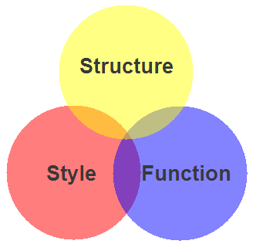
Markup, Style, Function
Markup (XHTML, HTML)
  Structure
  Content
Style (CSS)
  Style
  Presentation
  Appearance
Function (Javascript)
  Actions
  Manipulations

Slide 5
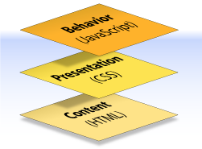
Content, Presentation, Behavior
Content comprises the information the author wishes to convey to his or her audience, and is embedded within HTML or XHTML markup that defines its structure and semantics.
Most of the content on the Web today is text, but content can also be provided through images, animations, sound, video, and whatever else an author wants to publish

Slide 6
Content, Presentation, Behavior
Presentation defines how the content will appear to a human being who accesses the document in one way or another
The conventional way to view a web page is with a regular web browser, of course, but that’s only one of many possible access methods. For example, content can also be converted to synthetic speech for users who have impaired vision or reading difficulties

Slide 7
Content, Presentation, Behavior
Behavior layer involves real-time user interaction with the document.
This task is normally handled by JavaScript.
The interaction can be anything from a trivial validation that ensures a required field is filled in before an order form can be submitted, to sophisticated web applications that work much like ordinary desktop programs.

Slide 8
Separation of Concerns
It’s possible to embed all three layers within the same document
  eg <em> and <b> can be used to control the presentation of text, and <hr> will insert a visible rule element.
  Sometimes called Presentational Markup, these types of elements embed presentation-layer information within the content layer, they negate any advantage we may have gained by keeping the layers separate.
Keeping them separate gives us one valuable advantage:
  We can modify or replace any of the layers without having to change the others.

Slide 9
What is CSS?
Cascading Style Sheets is the recommended way to control the presentation layer in a web document.
The main advantage of CSS over presentational HTML markup is that the styling can be kept entirely separate from the content.
e.g. it’s possible to store all the presentational styles for a 10,000-page web site in a single CSS file.
CSS also provides far better control over presentation than do presentational element types in HTML.

Slide 10
Advantages of CSS
All styling is kept in a limited number of style sheets.
Saving on bandwidth: The style sheet is cached (kept on client machine) after the first request and can be reused for every page on the site, it doesn’t have to be downloaded with each web page. Could reduce bandwidth usage—by more than 50% in many documented cases.
The separation of content from presentation makes it easier for site owners to reuse the content for other purposes, such as RSS feeds or text-to-speech conversion.
Separate styling rules can be used for different output media. We no longer need to create a special version of each page for printing—we can simply create a single style sheet that controls how every page on the site will be printed.

Slide 11
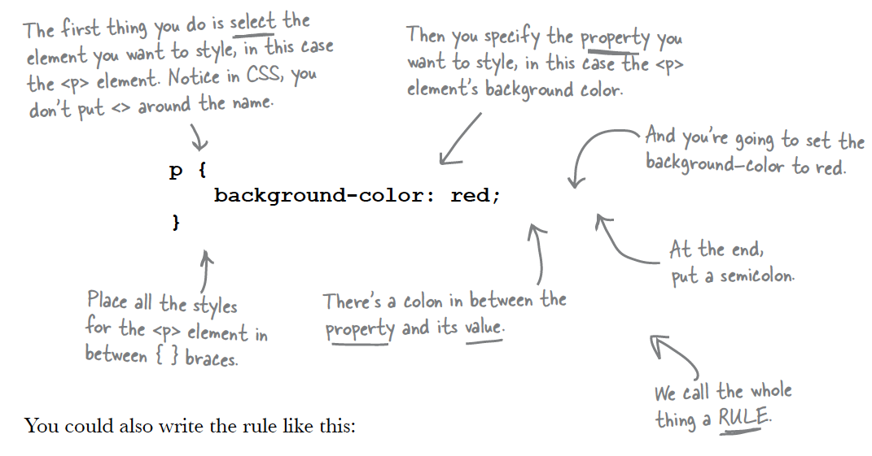
A CSS Rule

Slide 12
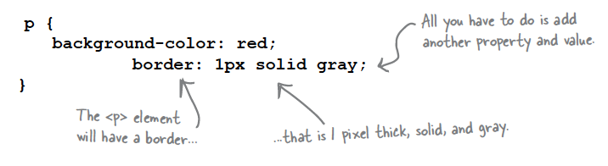
More Properties...
You can add as many properties and values as you like in each CSS rule.
To put a border around your paragraphs:

Slide 13
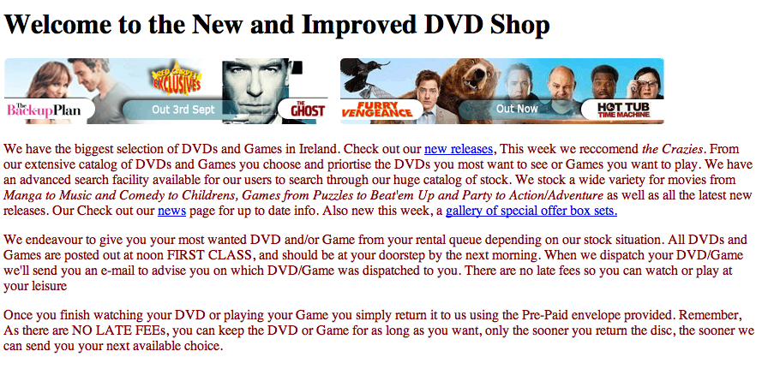
<style> head element
<html>
<head>
<title>My DVD Shop</title>
<meta http-equiv="Content-Type" content="ext/html;charset=utf-8">
<style>
p
{
color: maroon;
}
</style>
</head>
<body>
<h1>Welcome to the New and Improved DVD Shop</h1>
<p>

Slide 14
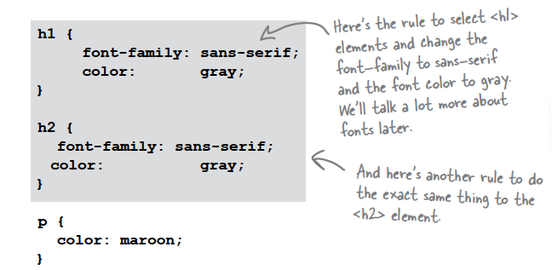
Multiple Rules

Slide 15
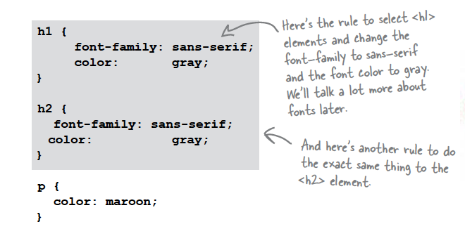
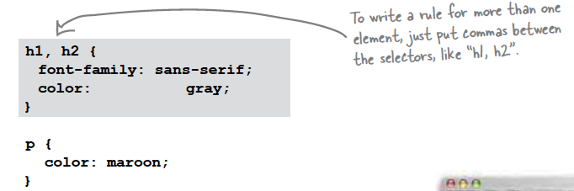
Combining Selectors (1)
Rules can be combined if they are identical

Slide 16
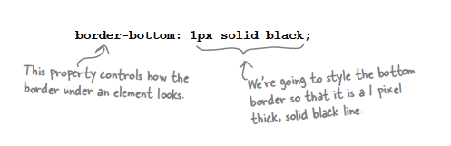
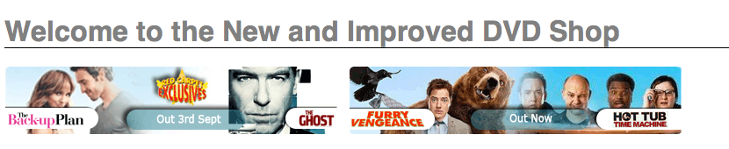
Border Styles
Placing the above rule associated with h1 “selector”, will draw a line - 1 pixel wide - under the heading in our site

Slide 17
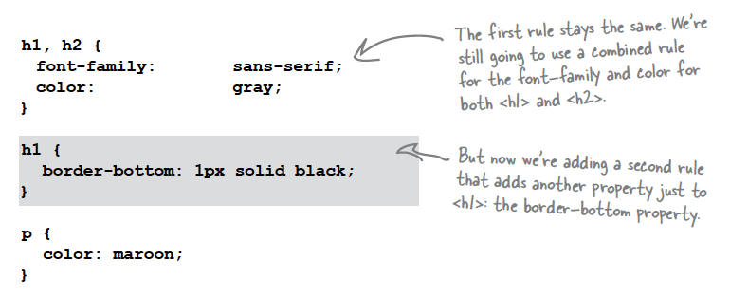
Combining Selectors (2)
Both h1 and h2 share the font-family and color attributes, however only h1 is underlined

Slide 18
Separating Style Sheets from HTML
Ideally, a site may have a single style sheet for most purposes,
  and not a repeated set of rules inside every html file
<head>
<title>My DVD Shop</title>
<style>
h1
{
font-family: sans-serif;
color: gray;
}
h2
{
font-family: sans-serif;
color: gray;
}
</style>
</head>
<body>
<head>
<title>New Releases</title>
<style>
h1
{
font-family: sans-serif;
color: gray;
}
h2
{
font-family: sans-serif;
color: gray;
}
</style>
</head>
<body>
<head>
<title>FAQ</title>
<style>
h1
{
font-family: sans-serif;
color: gray;
}
h2
{
font-family: sans-serif;
color: gray;
}
</style>
</head>
<body>

Slide 19
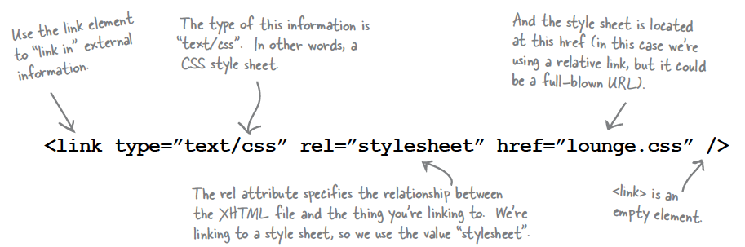
<link> element

Slide 20
One Stylesheet - Multiple html pages
<head>
<title>My DVD Shop</title>
<link type="text/css" rel="stylesheet" href="mydvdshop.css" />
</head>
<body>
<head>
<title>New Releases</title>
<link type="text/css" rel="stylesheet" href="mydvdshop.css" />
</head>
<body>
<head>
<title>FAQ</title>
<link type="text/css" rel="stylesheet" href="mydvdshop.css" />
</head>
<body>

Slide 21
Learning Outcomes
On completion of this class you should:
  Be fully briefed on you first assignment, including the source material to be employed, the general expectations and be aware of the indicative marking scheme
  Understand the role Eclipse will now play in your website development and be familiar with its major features
  Understand the motivations for using CSS in web site development
  Be able to compose simple CSS rules and incorporate them into a separate CSS file for a site.

