Slide 1

GROUP 5 (The Data Whisperers)
Key Customer Characteristics Associated With High Purchase Rates

Slide 2
Business Context and Questions
BUSINESS CONTEXT
BUSINESS WANTS TO KNOW
A bicycle retailer records customer details and whether each customer bought a bike.
The company lacks a clear view of which customer characteristics are linked to purchasing.
This analysis finds purchasing patterns and customer segments to support their initial campaign testing. For targeted marketing and sales.
What does the overall purchasing pattern look like (buyers vs non-buyers)?
Which customer characteristics are associated with higher purchase rates?
Which characteristics show the strongest associations?
Which characteristics offer the best targeting opportunities?

Slide 3
Analytical Objectives
ANALYTICAL OBJECTIVES
1 Explore the data and establish the purchasing baseline.
2 Compare purchase rates across customer characteristics.
3 Identify the strongest purchase-rate patterns.
4 Evaluate which characteristics and segments are most useful for targeting.

Slide 4
Dataset Overview
DATA DESCRIPTION
Raw data: 1,026 customer records
13 variables which comprises:
Demographic: age, gender, marital status, education
Financial and household: income, cars, home owner, children
Lifestyle: commute distance, occupation
Geographic: region (Europe, North America, Pacific)
Outcome: purchased bike (yes/no)

Slide 5
Data Preparation
DATA CLEANING AND STANDARDIZATION
Checked for missing/blank values — none identified
Checked for duplicate records
Identified 26 duplicate records
Removed duplicates → 1,000 unique customer records
Standardization: Created Age Group Categories (young adults, middle-aged, older adults, seniors).

Slide 6




Approach and Segmentation Framework
1,000
481
519
48.1%
Total Customers
Bike Buyers
Non-Buyers
Purchase Rate
BASELINE
Purchase rate is bike buyers divided by total customers within a group. The 48.1% overall rate is the baseline: groups above it buy more than the average customer, groups below it buy less.

Slide 7
Segmentation Framework
Each characteristic is compared with the 48.1% baseline, and the strongest individual characteristics are grouped into two tiers.
TIER 1: STRONGEST SIGNALS
TIER 2: SUPPORTING INSIGHTS
Cars
Region
Commute distance
Children
Education
Age group
Occupation
Marital status

Slide 8
Tier 1 Findings: Strongest Individual Signals
Cars
Region
Commute distance
Children
0 cars
Pacific
2–5 miles
1 child
61.1%
58.9%
58.6%
57.4%
purchase rate
purchase rate
purchase rate
purchase rate
+13.0 pp vs baseline
+10.8 pp vs baseline
+10.5 pp vs baseline
+9.3 pp vs baseline
247 customers
192 customers
162 customers
169 customers
These are individual associations, not evidence that the four characteristics jointly form one combined customer segment.

Slide 9
Pacific Customers Buy Most Often
KEY INSIGHT
Pacific: 58.9% purchase rate, +10.8 pp vs baseline, across 192 customers.
North America sits 4.8 pp below the baseline at 43.3%.
Europe is close to average at 49.3%.

Slide 10
A 2–5 Mile Commute Shows the Highest Rate
KEY INSIGHT
2–5 miles: 58.6% purchase rate, +10.5 pp vs baseline, across 162 customers.
0–1 miles also sits above average at 54.6%.
10+ miles is lowest at 29.7%, 18.4 pp below baseline.

Slide 11
Tier 2: Supporting Insights
EDUCATION
AGE GROUP
55.2%
Bachelor’s
306 customers
above the 48.1% baseline
54.7%
Middle-aged adults
468 customers
above the 48.1% baseline
OCCUPATION
MARITAL STATUS
54.4%
Professional
276 customers
above the 48.1% baseline
54.1%
Single
462 customers
above the 48.1% baseline

Slide 12
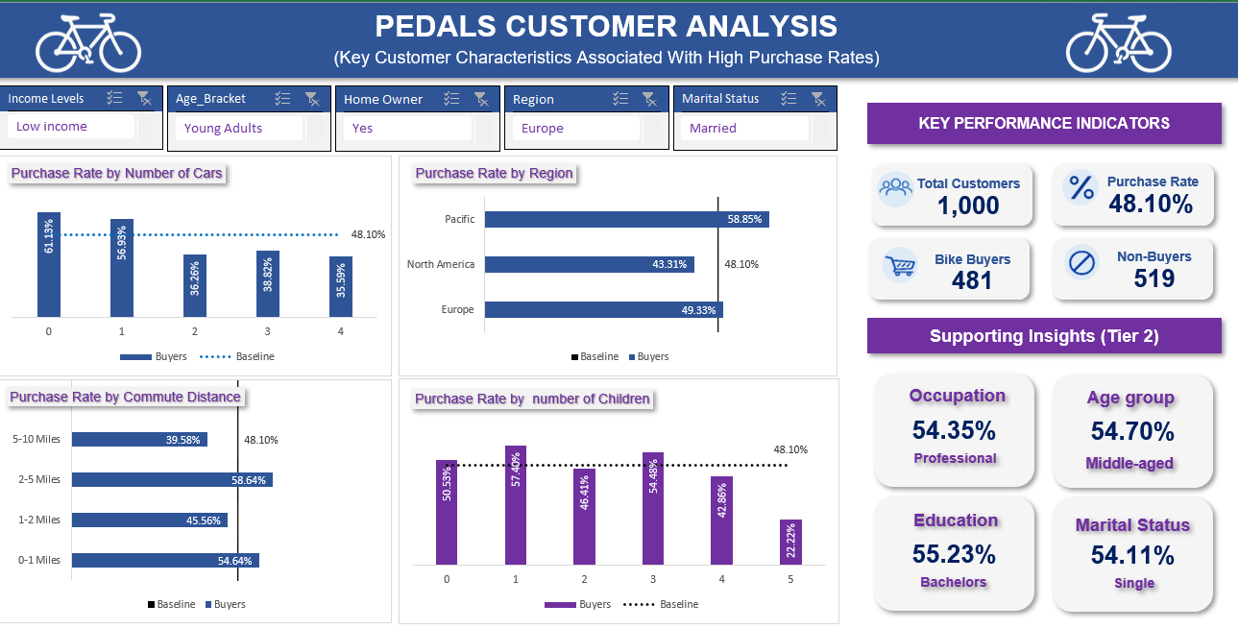

Slide 13


Recommendations
Personalize marketing strategy
Use the strongest signals to guide initial targeting and messaging:
customers with fewer cars, in the Pacific region, with a 2–5 mile commute, or with one child.
Explore higher purchase regions for potential market
Retarget potential customer
Customers who have similar characteristics to existing bike buyers who haven’t purchased can be targeted with follow-up campaigns.

Slide 14


Limitations and Next Steps
Limitations
Next Steps
Associations are identified, but causation is not established. Thus, use them to shape tests rather than as guarantees.
Smaller groups can show high or low rates by chance, so read them cautiously.
The data has no behavioural or marketing variables that could sharpen targeting.
Eg. Prices, time period etc.
Combine variables such as car ownership, age group and commute distance into multi-variable segments.
Validate any combined segment by size and further analysis before using it for targeting.
Track campaign performance, monitor metrics to determine which strategies work best.

Slide 15
CONCLUSION
The overall bike-purchase rate is 48.1%, the baseline for every group comparison.
The strongest customer characteristics are car ownership, region, commute distance and number of children.
These findings are a practical starting point for segmentation and targeted marketing; multi-variable analysis could sharpen it.
Thank you | Questions?

