Slide 1
Software Engineering
Setting up a branch to merge only after a pull request

Slide 2
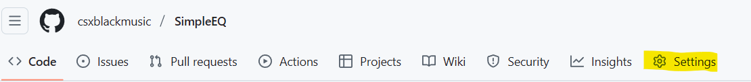
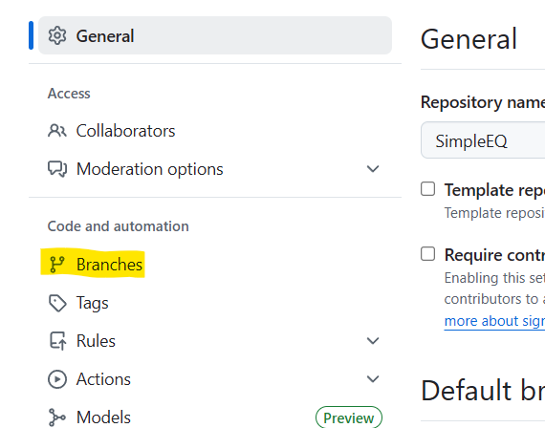
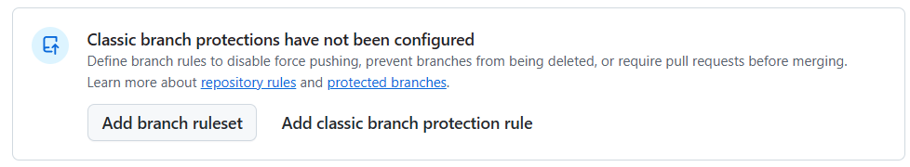
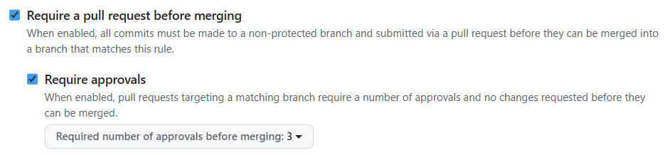
Changing your main/master to only merge after a pull request
Click on Settings->Branches
Then click on classic branch protections
(make sure you type in master or main as the branch pattern)
Make sure the following options are checked
Require at least 2 approvals before merging

