Slide 1

Topologies for LLM Training
SimAI Comparisons

Slide 2

Simulations Configurations
Models and Parameters Used
Models used:
GPT: 7,13,22,175B
Llama: 405B
World Sizes:
64
128
512
1024
2048
4096
Parallelism Methods:
Tensor Parallelism
Pipeline Parallelism
Data Parallelism
Expert Parallelism (MoE only)
Batch Size Parameters:
Global Batch Size
Micro Batch Size
Sequence Length
Architectures Compared:
MoE based (16 experts)
Densed
Topologies Compared:
Fat Tree
DragonFly+
Hyperx
Total 123 setups per architecture

Slide 3
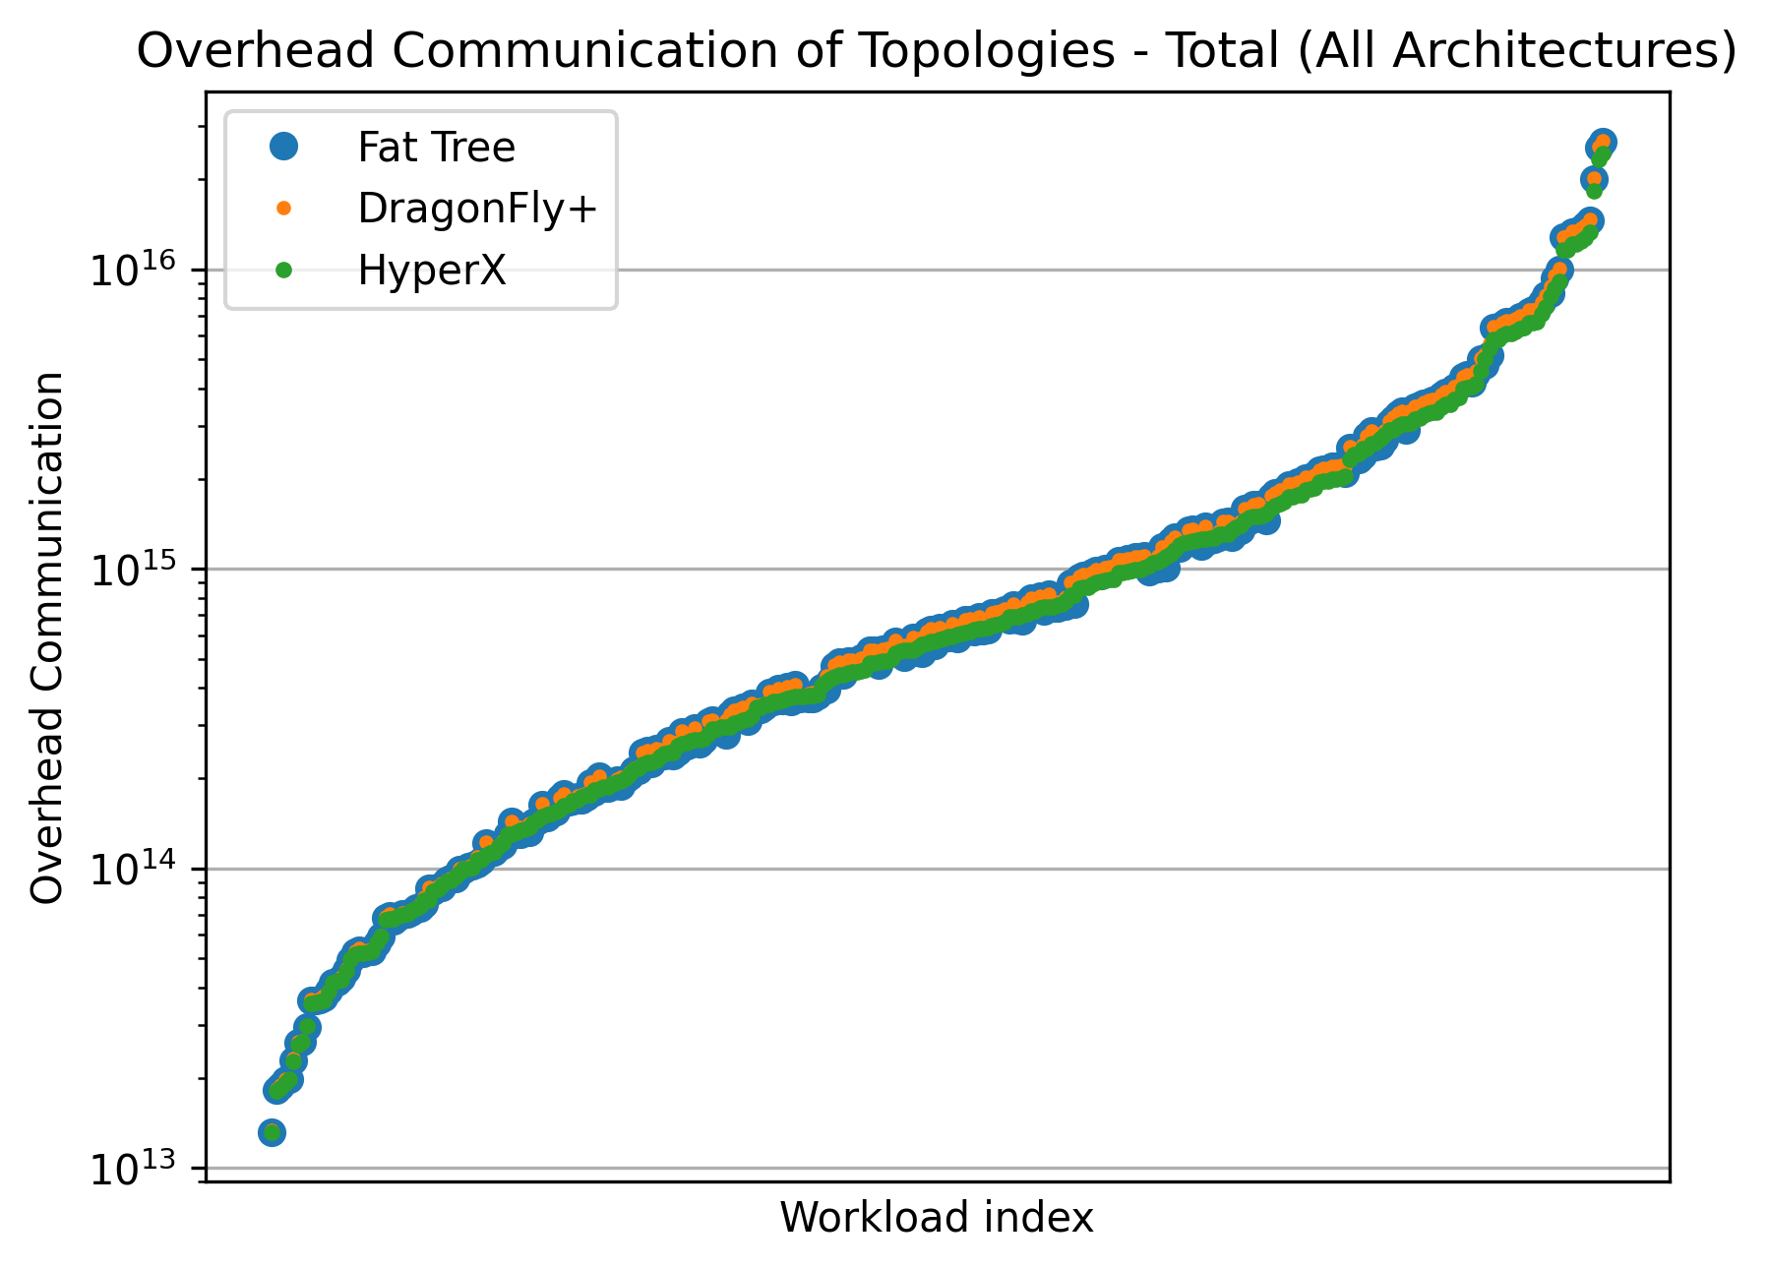
Overall Overhead Comparison
High Level Comparison of Each Topology Over Architecture Framework

Slide 4
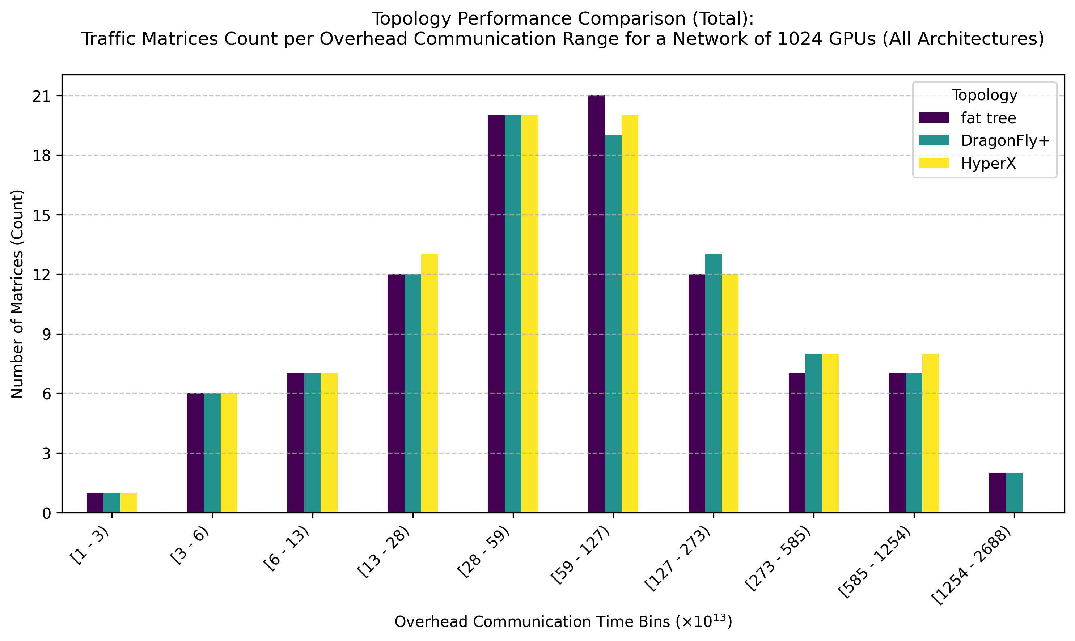
Models used:
GPT: 7,13,22,175B
Llama: 405B
World Sizes:
64
128
512
1024
2048
4096
Parallelism Methods:
Tensor Parallelism
Pipeline Parallelism
Data Parallelism
Expert Parallelism (MoE only)
Batch Size Parameters:
Global Batch Size
Micro Batch Size
Sequence Length
Overhead Distribution
Over 1024 and 2048 World Sizes

Slide 5
Link Overloading Analysis
Experiment Description
In the following experiment, we tested how the links between GPUs behaved in terms of overloading in the Fat Tree, DragonFly+ and HyperX topologies.
Each switch was built with 64 ports for both down and up linking.
Each topology held the minimal amount of switches required for its deployment.
Each source GPU overloaded the shortest path links to its endpoint according to the transport matrix.
For multiple shortest paths, we tested both overloading the first found and spreading the load equally between links.

Slide 6
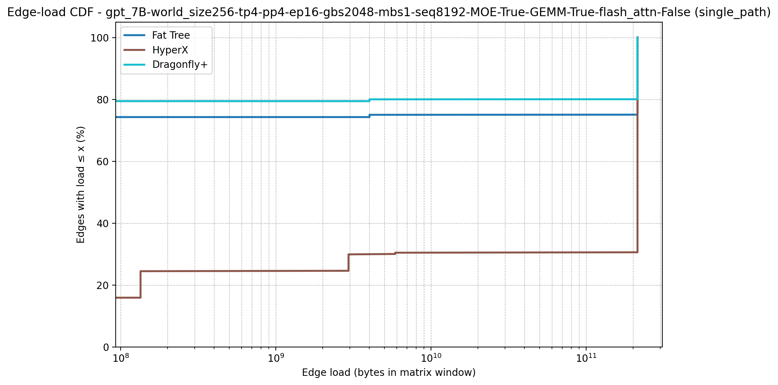
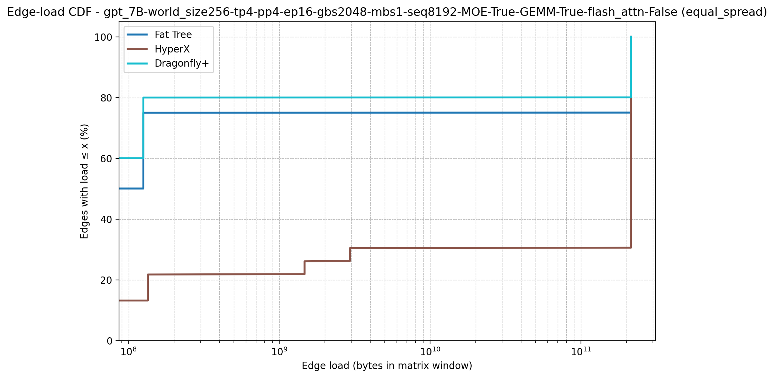
MoE Based Architecture
World Size: 256

Slide 7
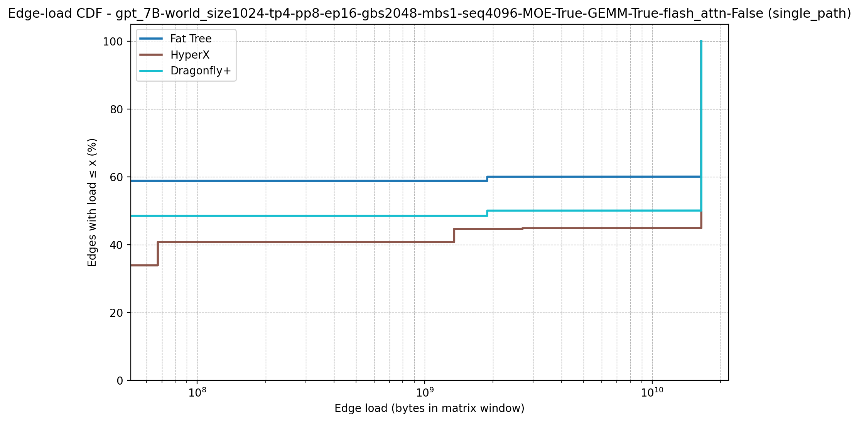
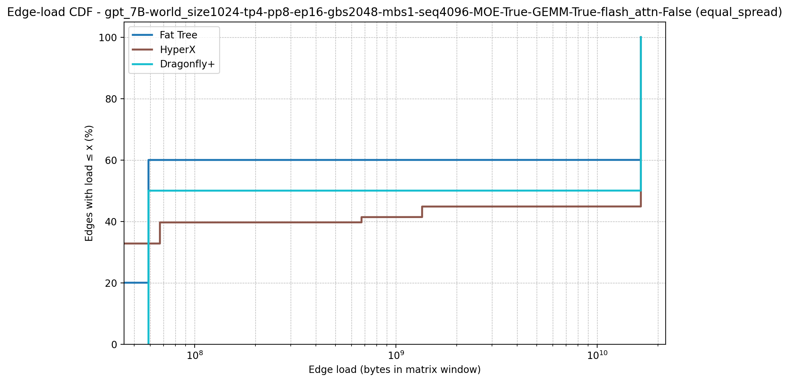
MoE Based Architecture
World Size: 1024

Slide 8
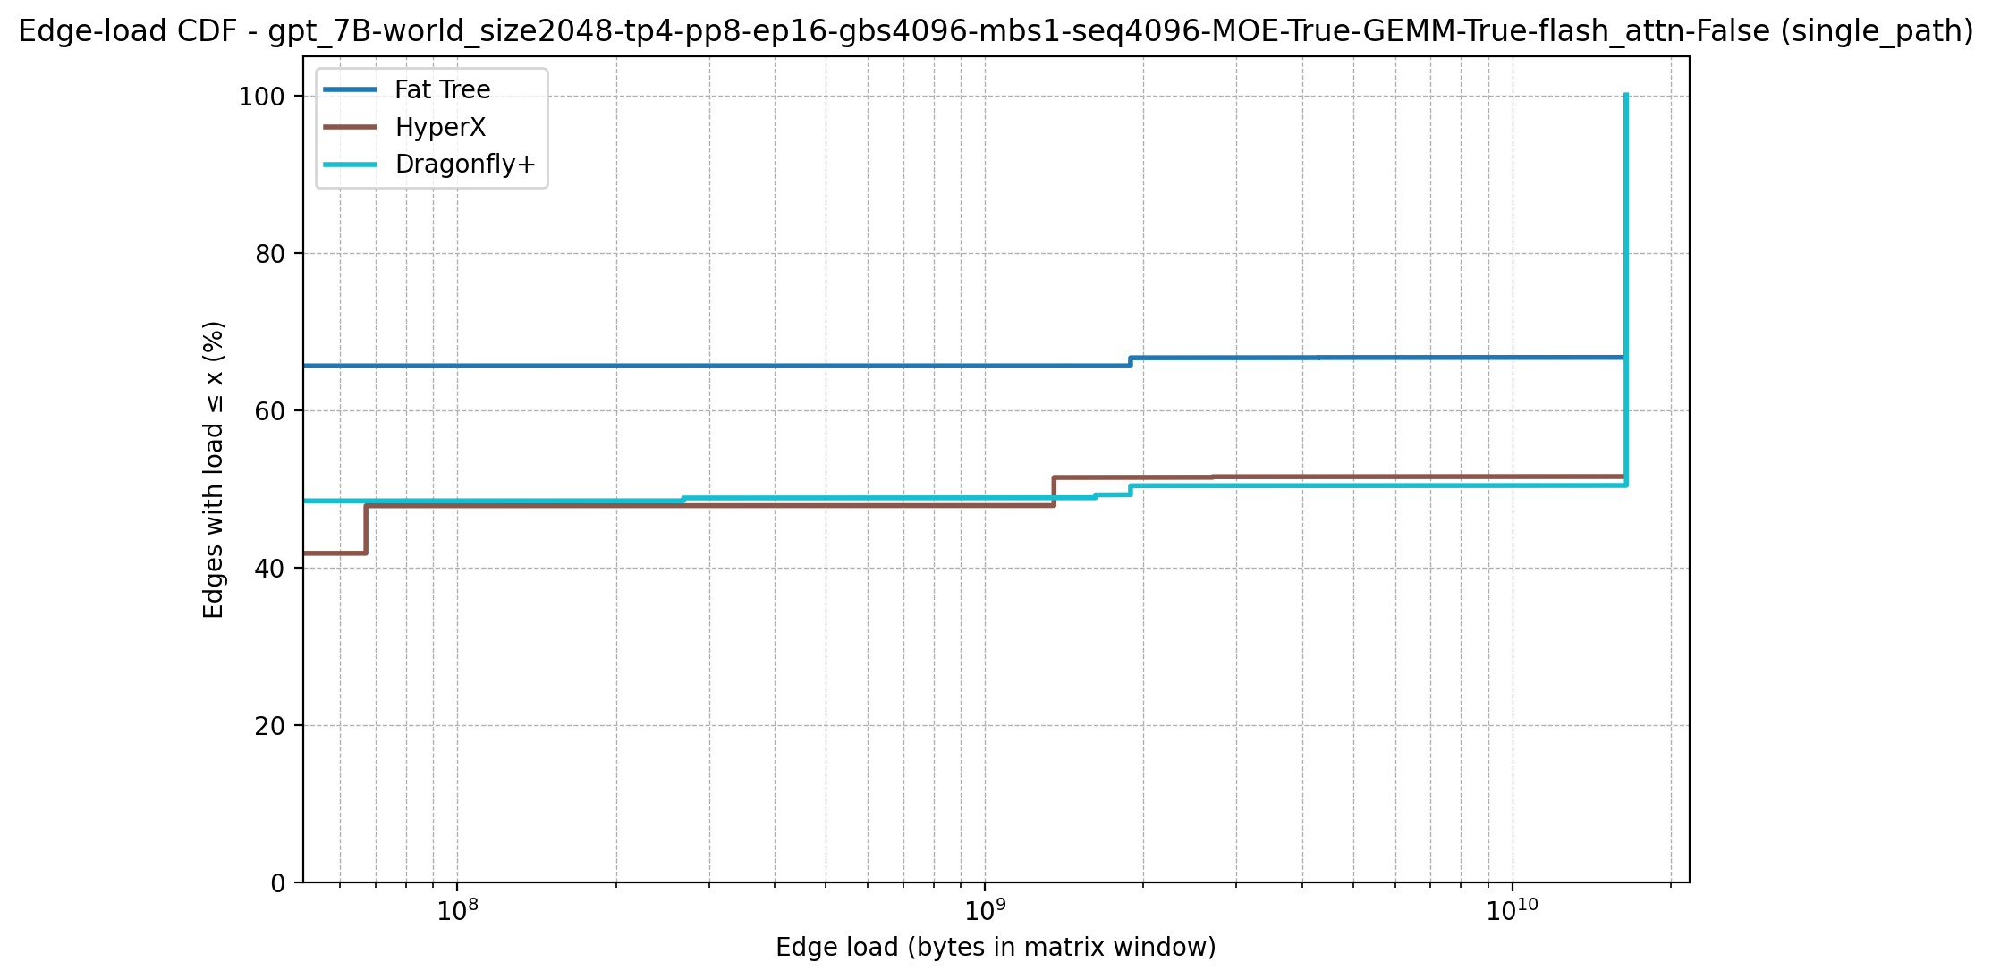
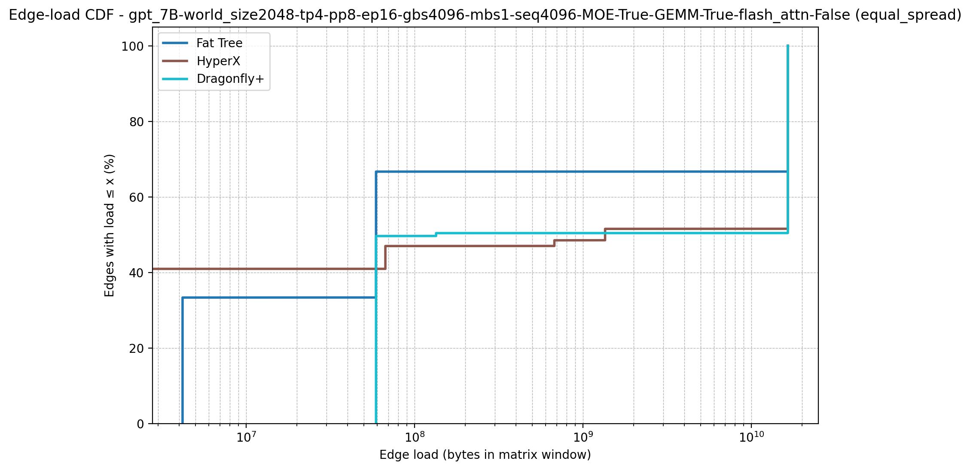
MoE Based Architecture
World Size: 2048

Slide 9
Dense Based Architecture
World Size: 256

Slide 10
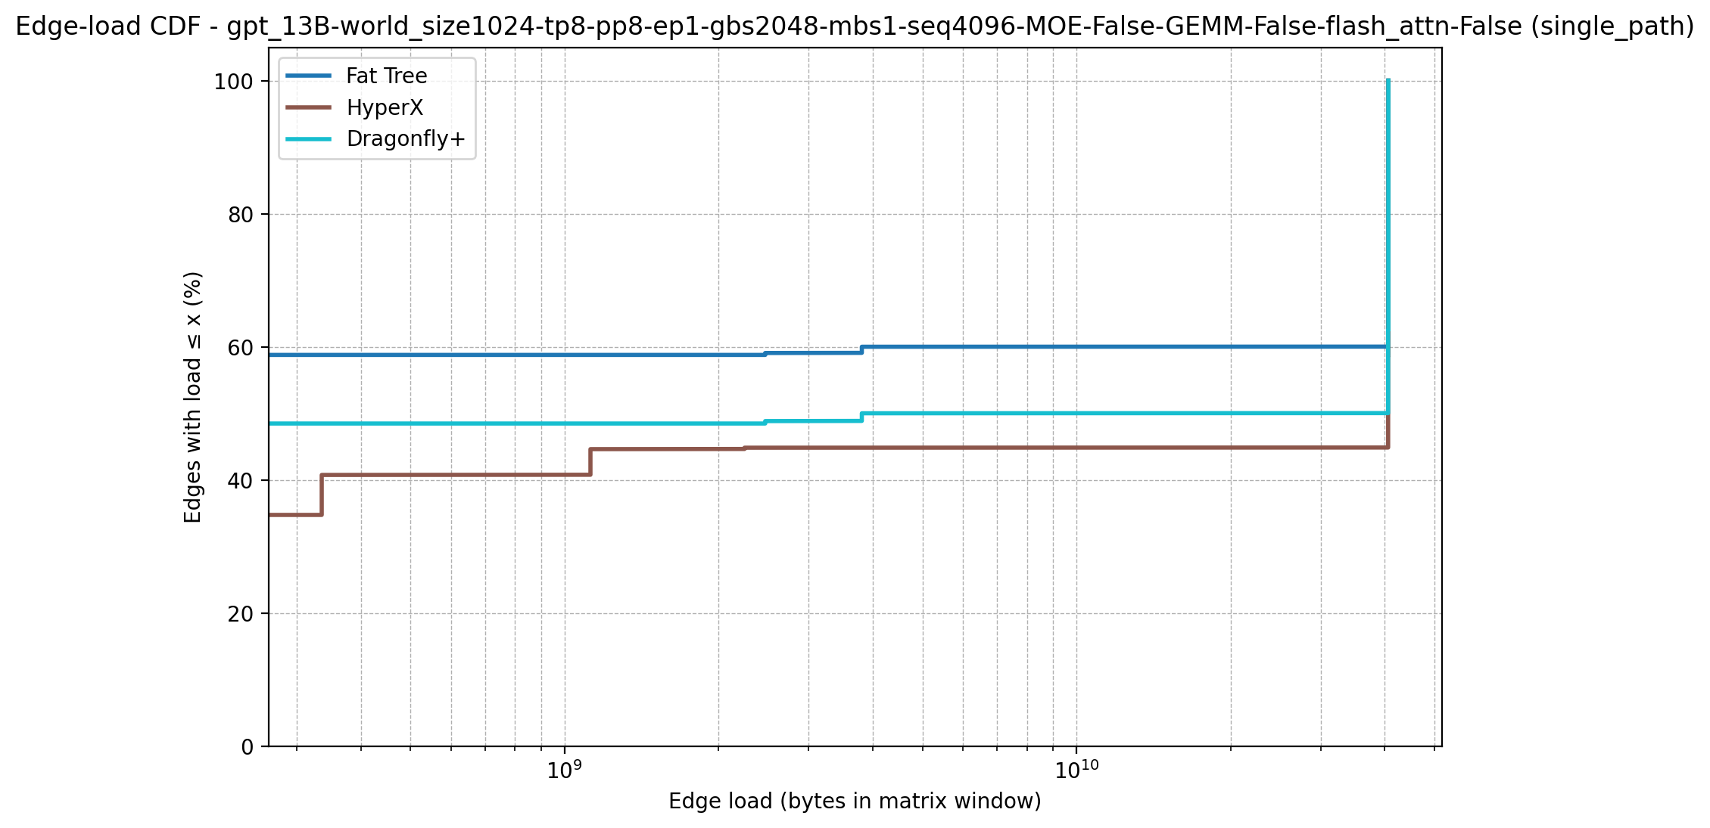
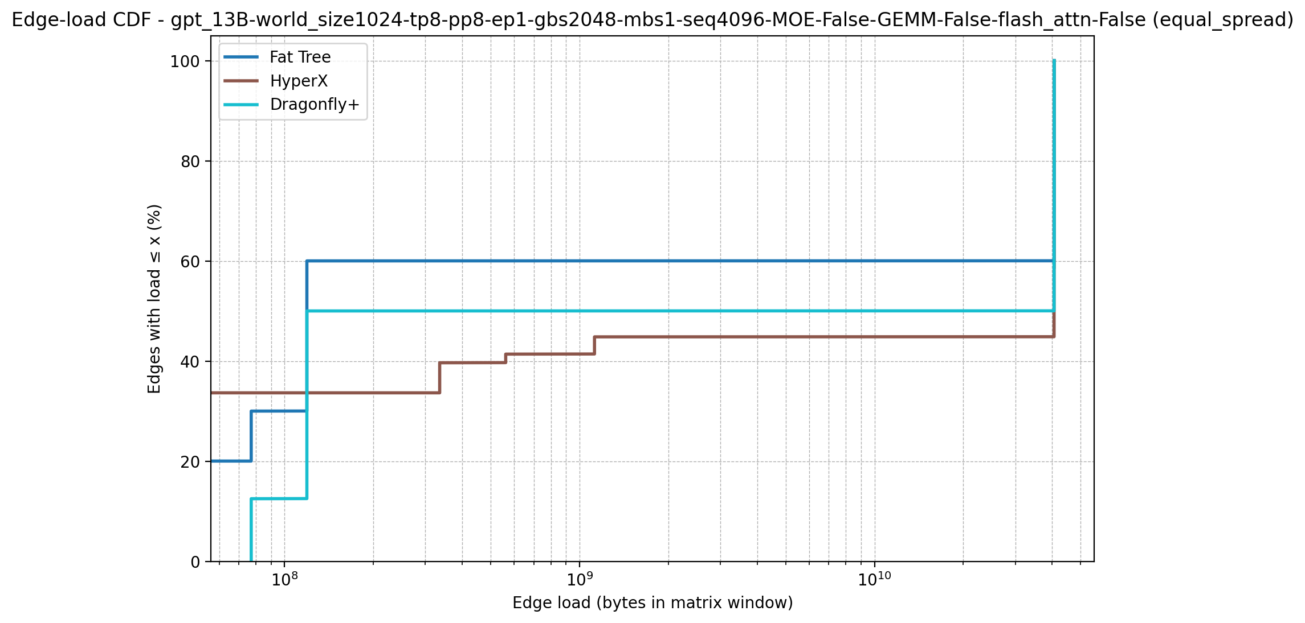
Dense Based Architecture
World Size: 1024

Slide 11
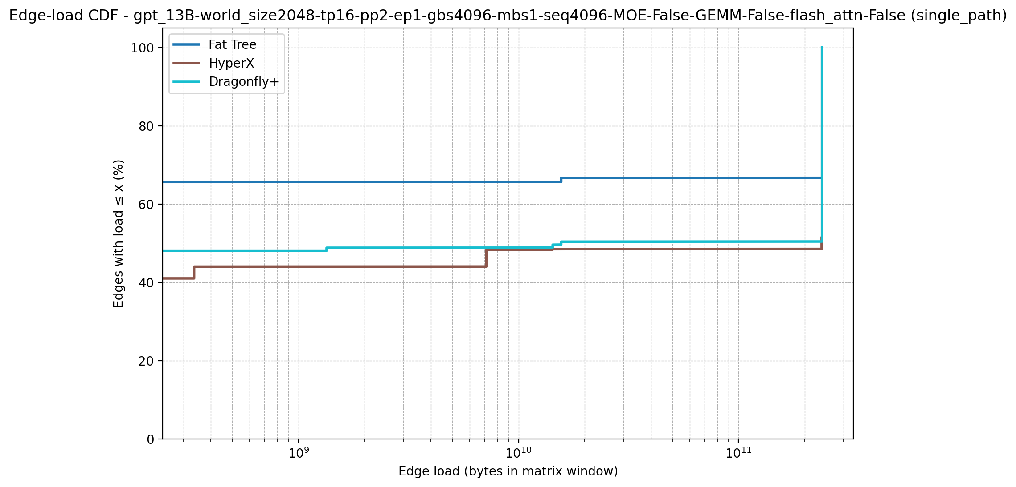
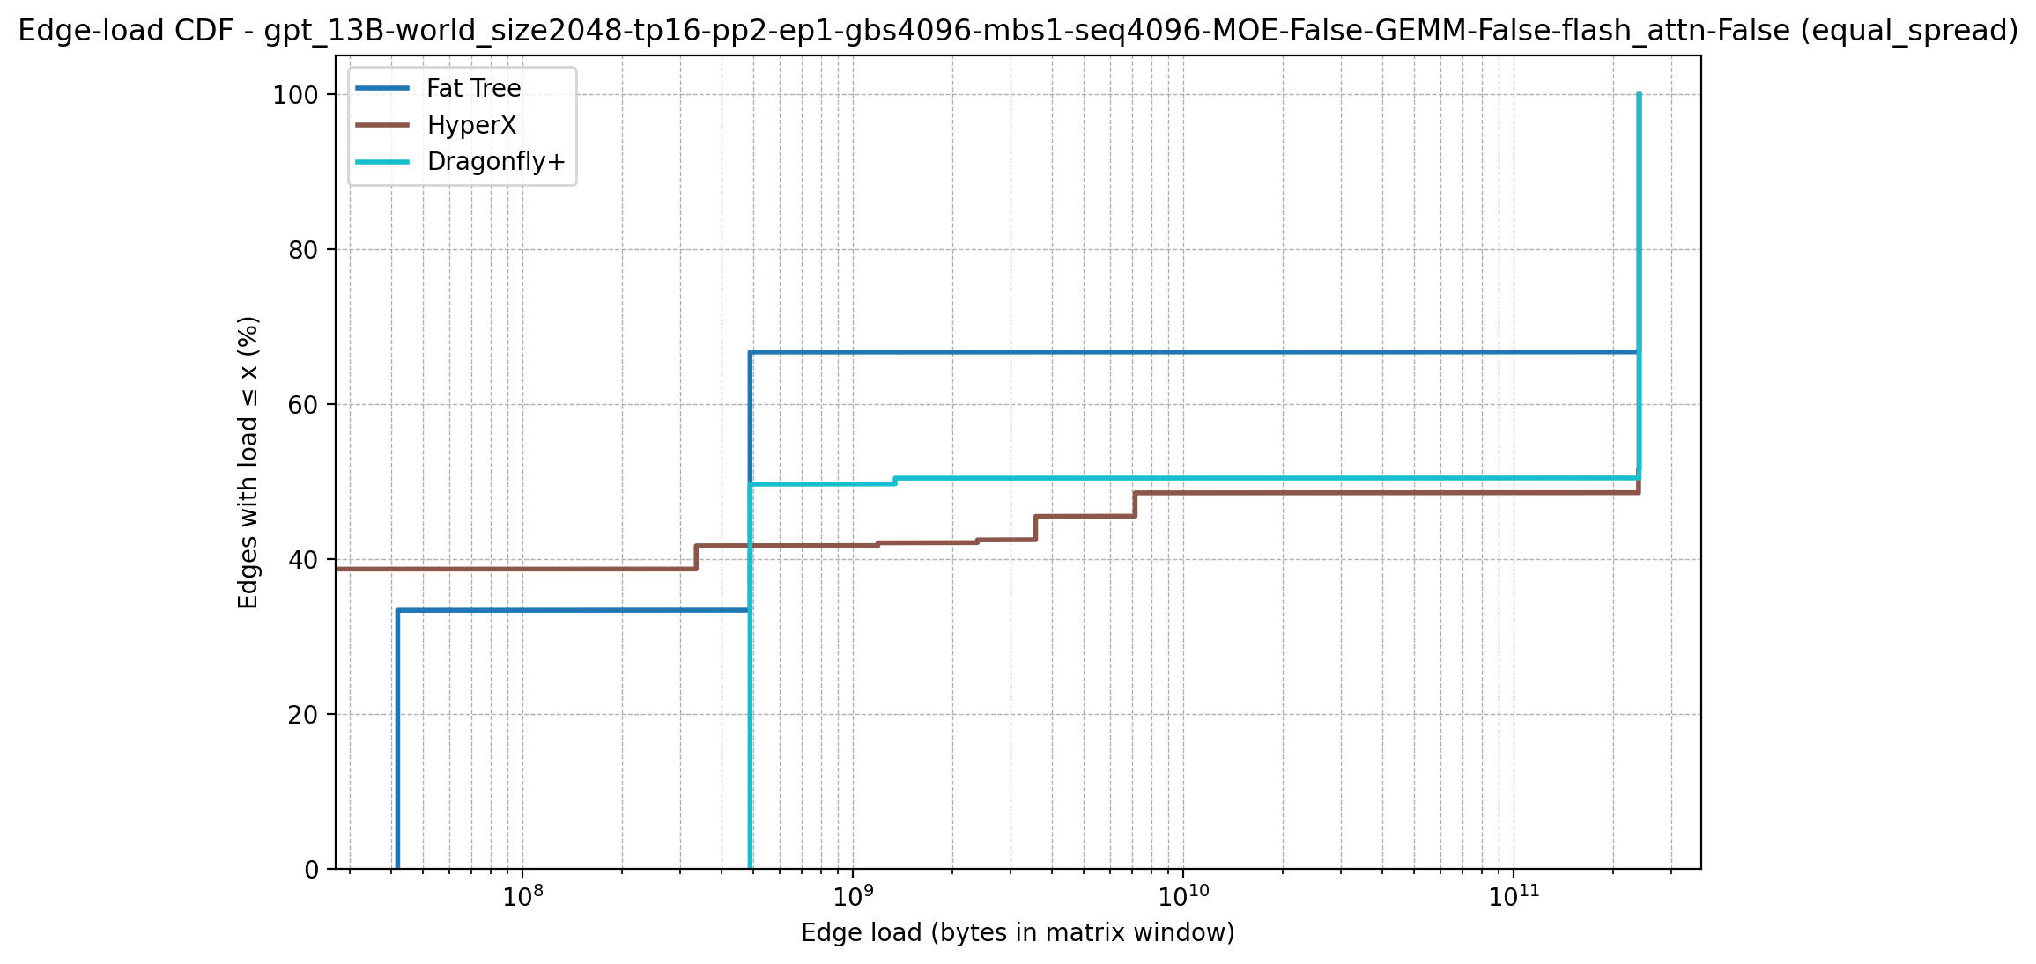
Dense Based Architecture
World Size: 2048

Slide 12
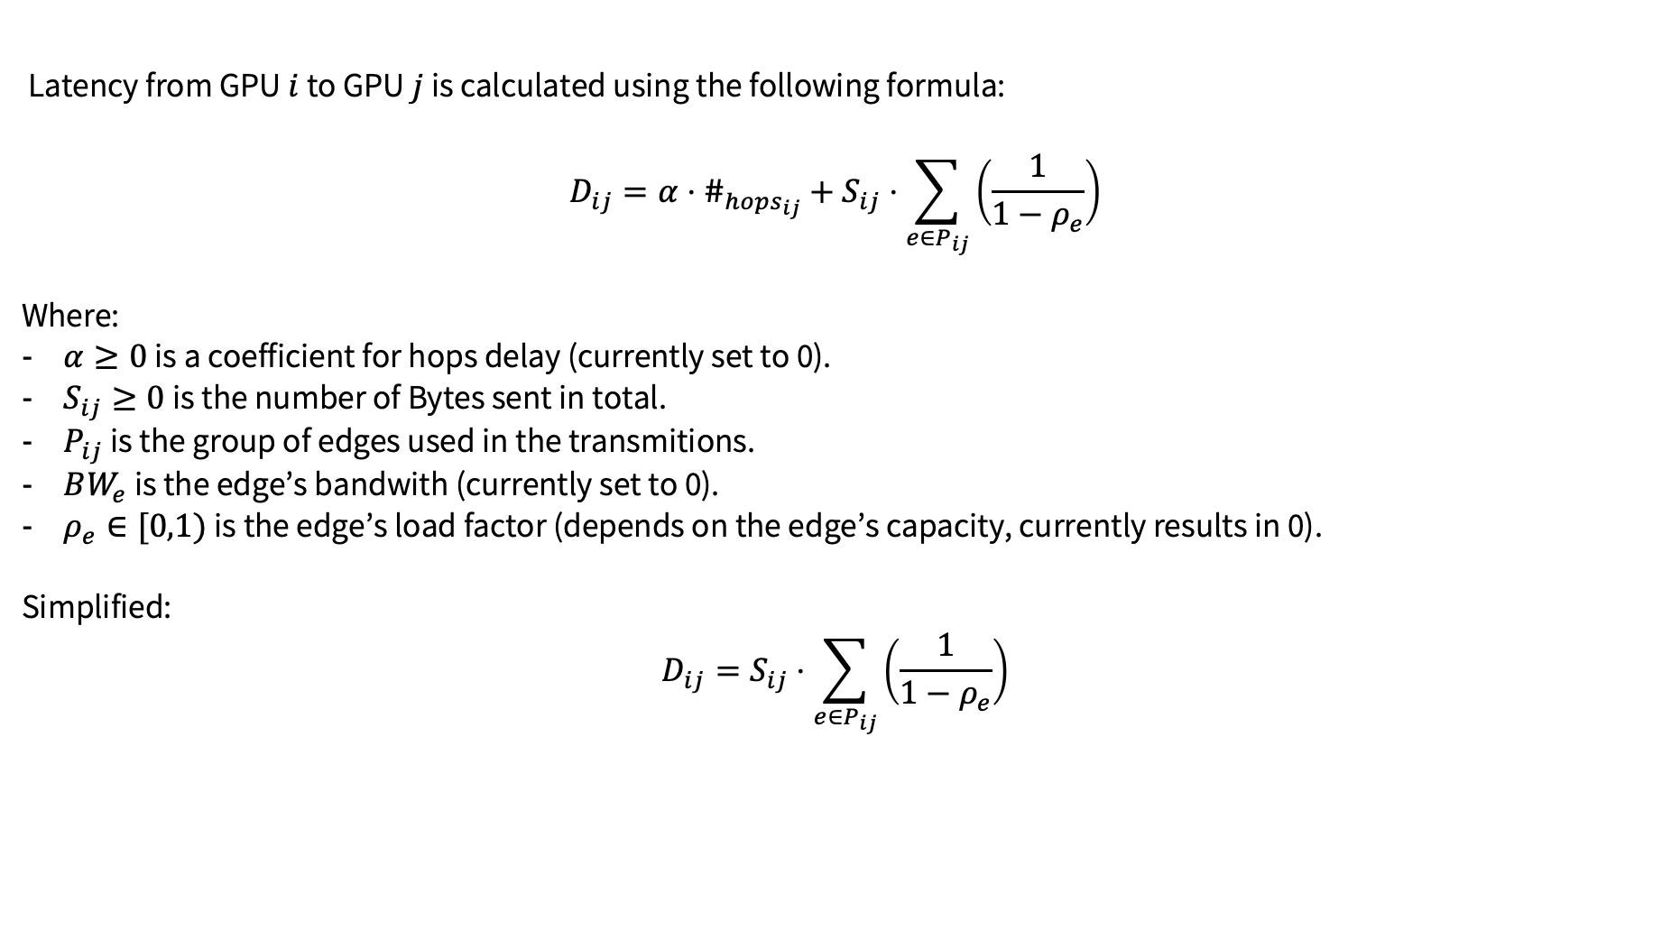
Latency Calculation
Evluating Latency by Graphs
Latency from GPU $i$ to GPU $j$ is calculated using the following formula:
$$D_{ij}=α⋅\#_{hops_{ij}}+S_{ij}⋅\sum_{e∈P_{ij}}{\left(\frac{1}{1−ρ_{e}}\right)}$$
Where:
$α≥0$ is a coefficient for hops delay (currently set to 0).
$S_{ij}≥0$ is the number of Bytes sent in total.
$P_{ij}$ is the group of edges used in the transmitions.
$BW_{e}$ is the edge’s bandwith (currently set to 0).
$ρ_{e}∈[0,1)$ is the edge’s load factor (depends on the edge’s capacity, currently results in 0).
Simplified:
$$D_{ij}=S_{ij}⋅\sum_{e∈P_{ij}}{\left(\frac{1}{1−ρ_{e}}\right)}$$

