Slide 1
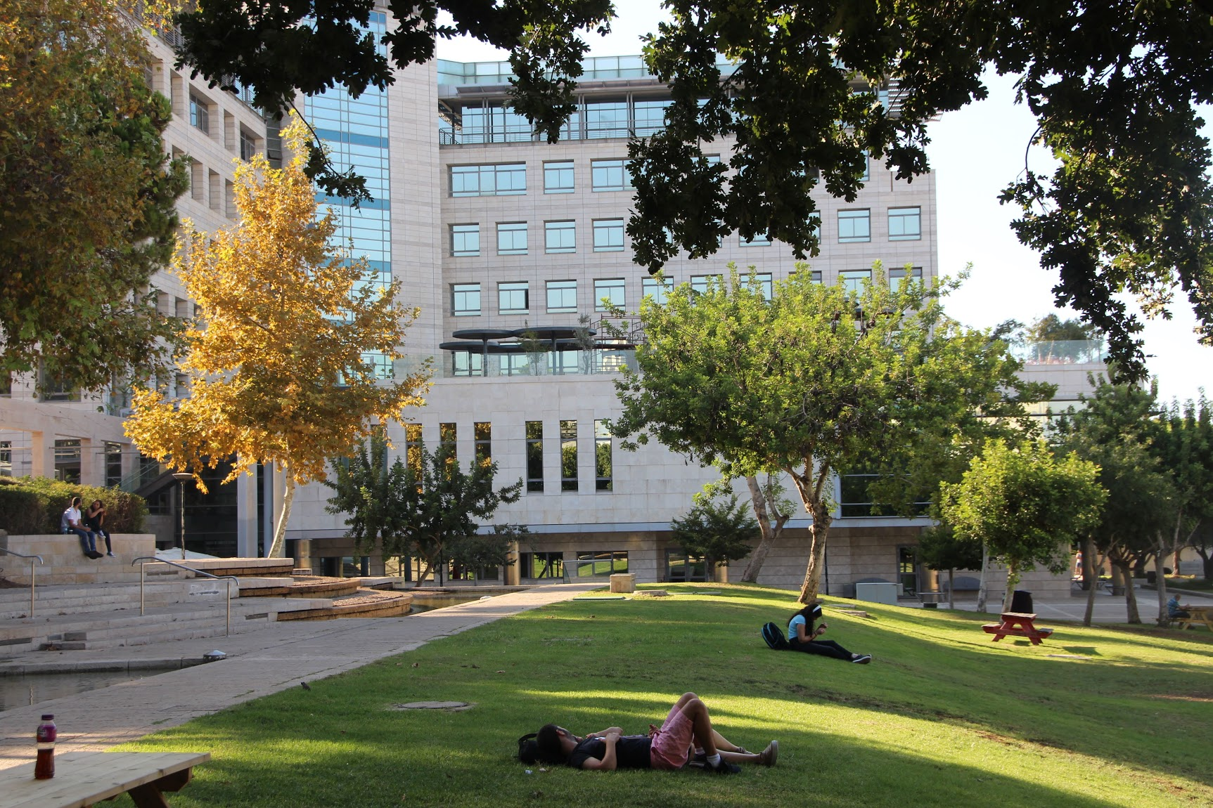
Enter title here
Enter sub-title here

Slide 2
Enter title here
Enter sub-title here

