Slide 1
Agenda
Major design change & refactoring
Resubmission plan
Dataframe
Synthetic Pthread numbers

Slide 2
Needed Kona refactoring
Proper readahead for page faults (for hints)
Facility for no-wake with pure user faults
We still acquire a single lock in kernel
Better eviction policy with hot bits
Adding flexibility of changing cores
For scaling based on demand
Comparison over other UFFD systems
But this proved a lot of headache.

Slide 3
New sharded design
Pure user fault handling per core
Also handle eviction on each core
One dedicated core
Kernel faults are still supported on this core
Remaining of the core is used for offloaded eviction
One QP per core. Maintain separate QPs?
Effort involved:
Break up Kona and merge it into Shenango
Extend RDMA to handle QPs per core

Slide 4
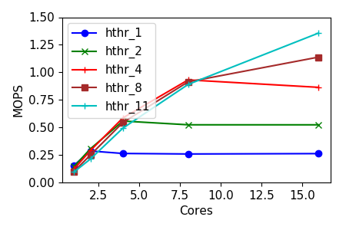
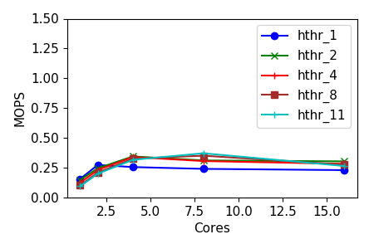
UFFD quirks

Slide 5
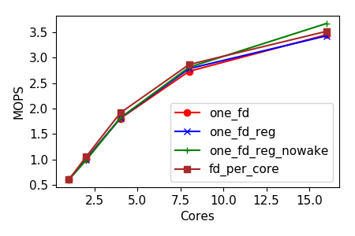
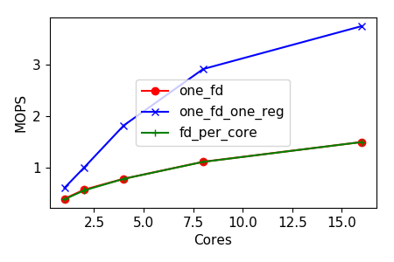
UFFD quirks

Slide 6
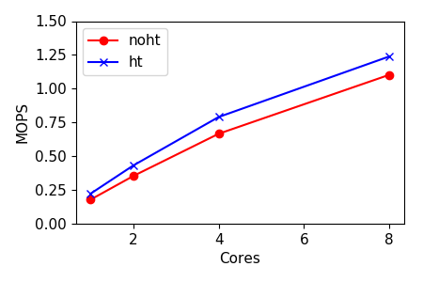
UFFD quirks

Slide 7
New design: Motivation
Scalability - allows more realistic setups & comparisons
Much superior to library UFFD systems (aka Kona, Umap)
With scheduler runtime, we overcome isolated design
With hints, we allow high scalability of UFFD
With same core handling, UFFD copy is faster!
Flexibility – allows adjusting to demand & avoids CPU waste
Adds more weight to the system/paper

Slide 8
New additions (other than Sharding)
No-wake for pure user faults
Facility for bringing multiple pages in a batch (for readahead)
Eviction on each core
Better eviction policy with hot bits
Keeping the code open to:
Facility for local memory backend
Facility for injecting additional latency
Facility for batched eviction
Extending rmem support for dynamic core addition

Slide 9
Refactoring status
Initializing Uffd, memory regions, page handling, etc.
Setting up RDMA (rcntrl & memserver)
Fault data path (kernel & user)
Eviction handling
Per-core fault & eviction handling
Malloc interception & Jemalloc integration
Notes so far
Of Kona’s 9k lines, ~3k done and 3k left (3k are utils, benchmarks and tests)
Init was very neat & streamlined because of runtime vs library

Slide 10
Plan
High-level items | Tasks | Status
Supporting Hint API | Show that hint locations are few (in progress) | PARSEC on Kona, Dataframe agree
 | Hotness tracking with Hints (in progress) | Benchmarked kona-based page checks. A simple hotness-based eviction policy was promising.
 | Read-ahead with Hints (and automatic detection of read-ahead and other smart hints like sequential faults from page fault traces) – we argue that our hints does not require broader application context (not started) | Requires Kona refactoring to asynchronize read-ahead pages and amortize uffd and other costs
 | Automatic injection of hints (not started) | Stew wrote a toy tool to that automates Sort!
Comparison with AIFM | Run Dataframes on AIFM & Kona (in progress) | Dataframes is running. AIFM in progress
 | Quantifying developer effort (in progress) | Noting AIFM changes for Dataframes
Comparison with Fastswap | Start with Synthetic & Dataframe (in progress) | Fastswap up and running
More complex benchmarks | Run SiloDB (not started)
Uthreads (Performance) | Clearly showing Pthreads overheads (in progress) | Got Synthetic data with Pthreads – analyzing
Uthreads (Flexibility) | RSS-aware scheduling for Sort (not started)
…

Slide 11
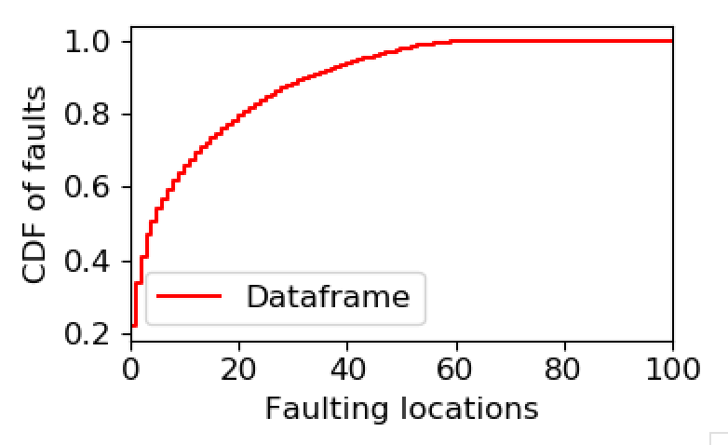
Dataframe
Runs on Kona
cloc shows 9000 total LOC

Slide 12
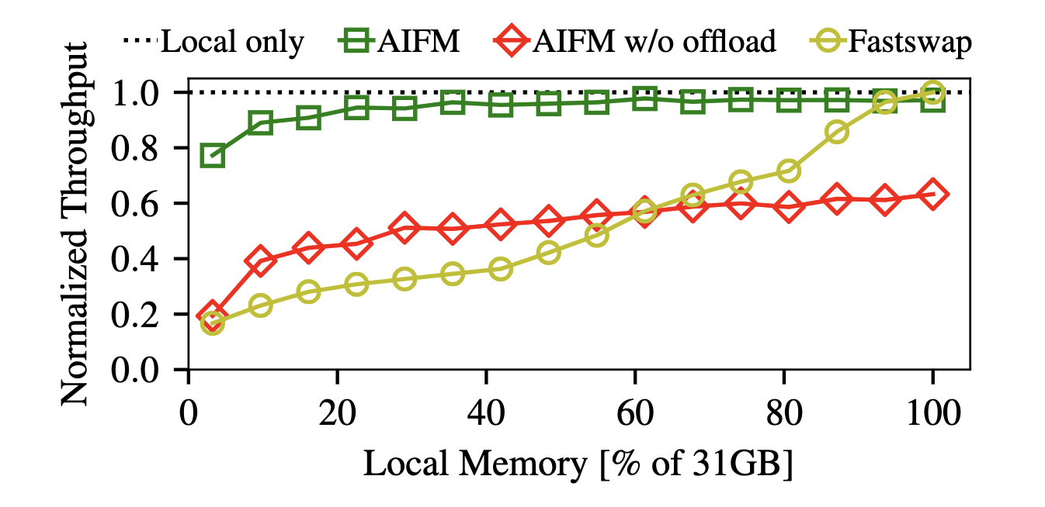
Dataframe
Runs on Kona
Still working on AIFM setup
No multi-threaded version!
Making it multi-threaded doesn’t seem wise
Dataframes library is not thread-safe
Could still show relative overhead

Slide 13
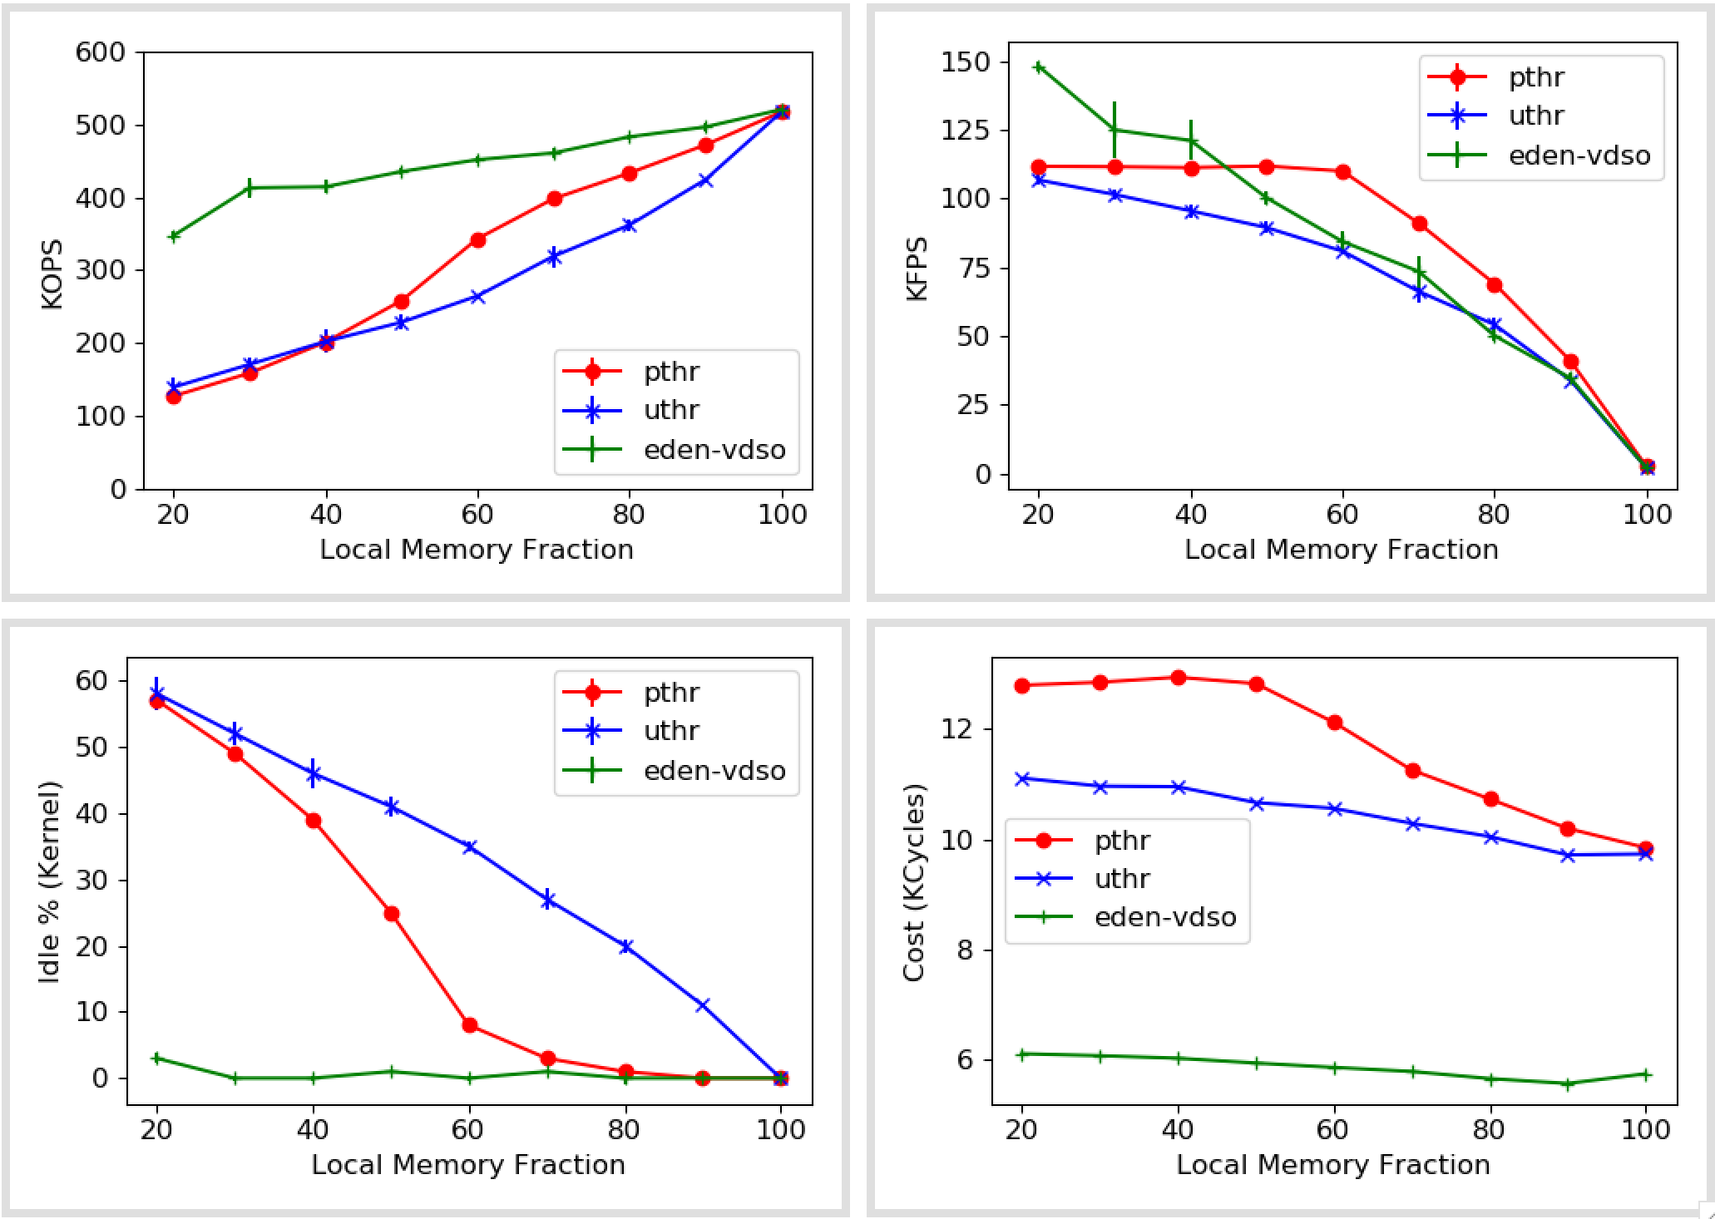
Synthetic numbers (With pthreads)
4 cores
40 threads/core
Skewed (s=1)
Missing some Eden faults before
No obvious bug in Eden fault numbers
The distribution changes with threads – but should affect pthreads too

Slide 14
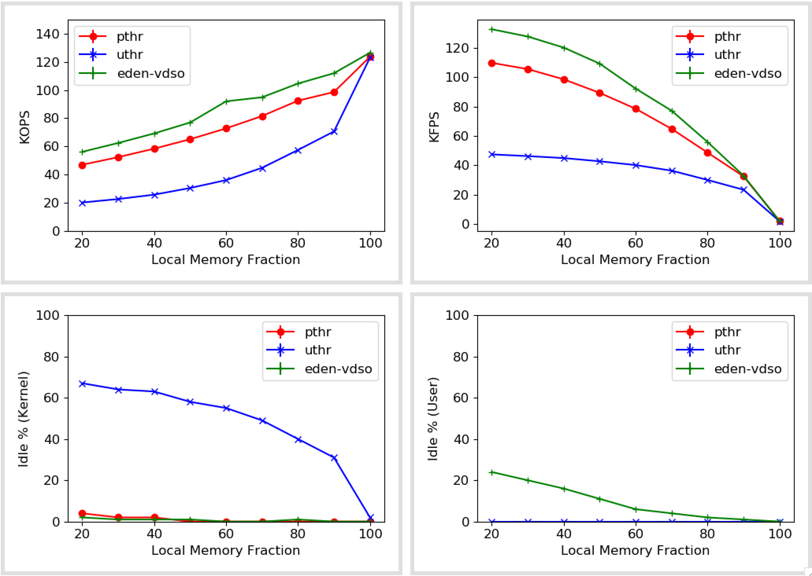
Synthetic numbers
1 core
5 threads/core
Uniform (s=0.1)

Slide 15
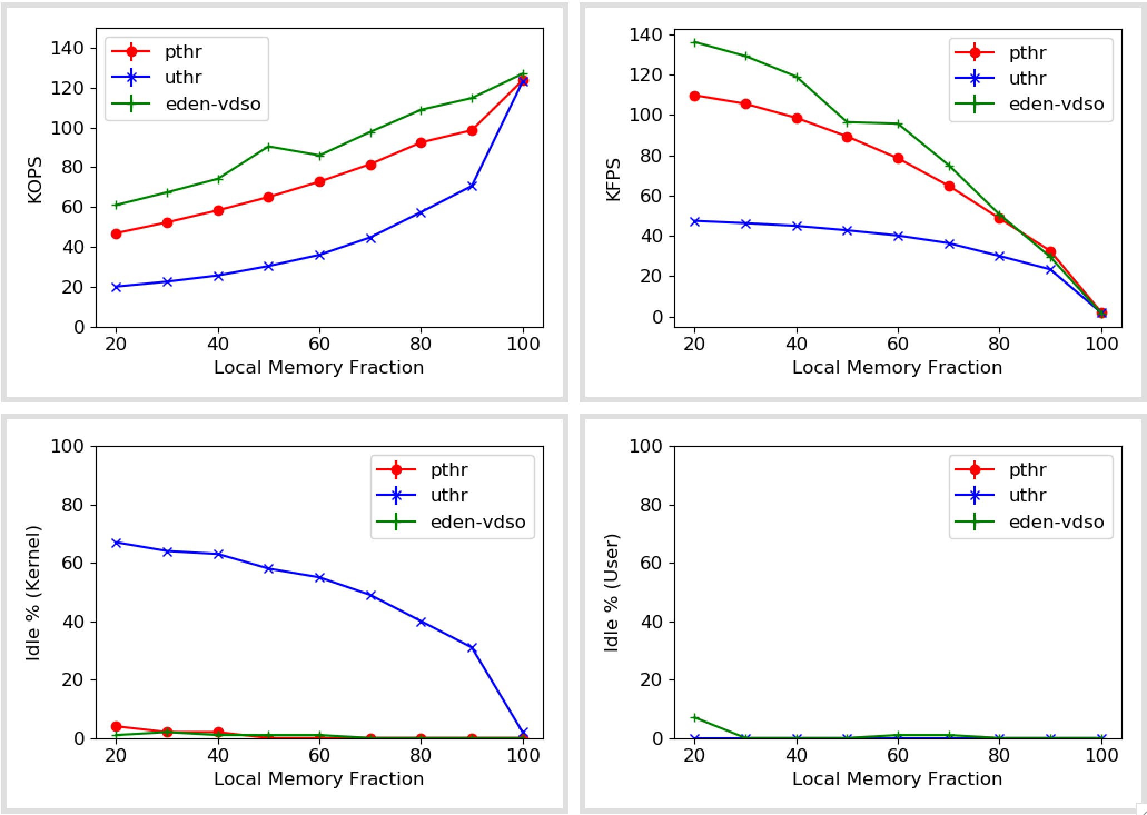
Synthetic numbers
1 core
20 threads/core
Uniform (s=0.1)

Slide 16
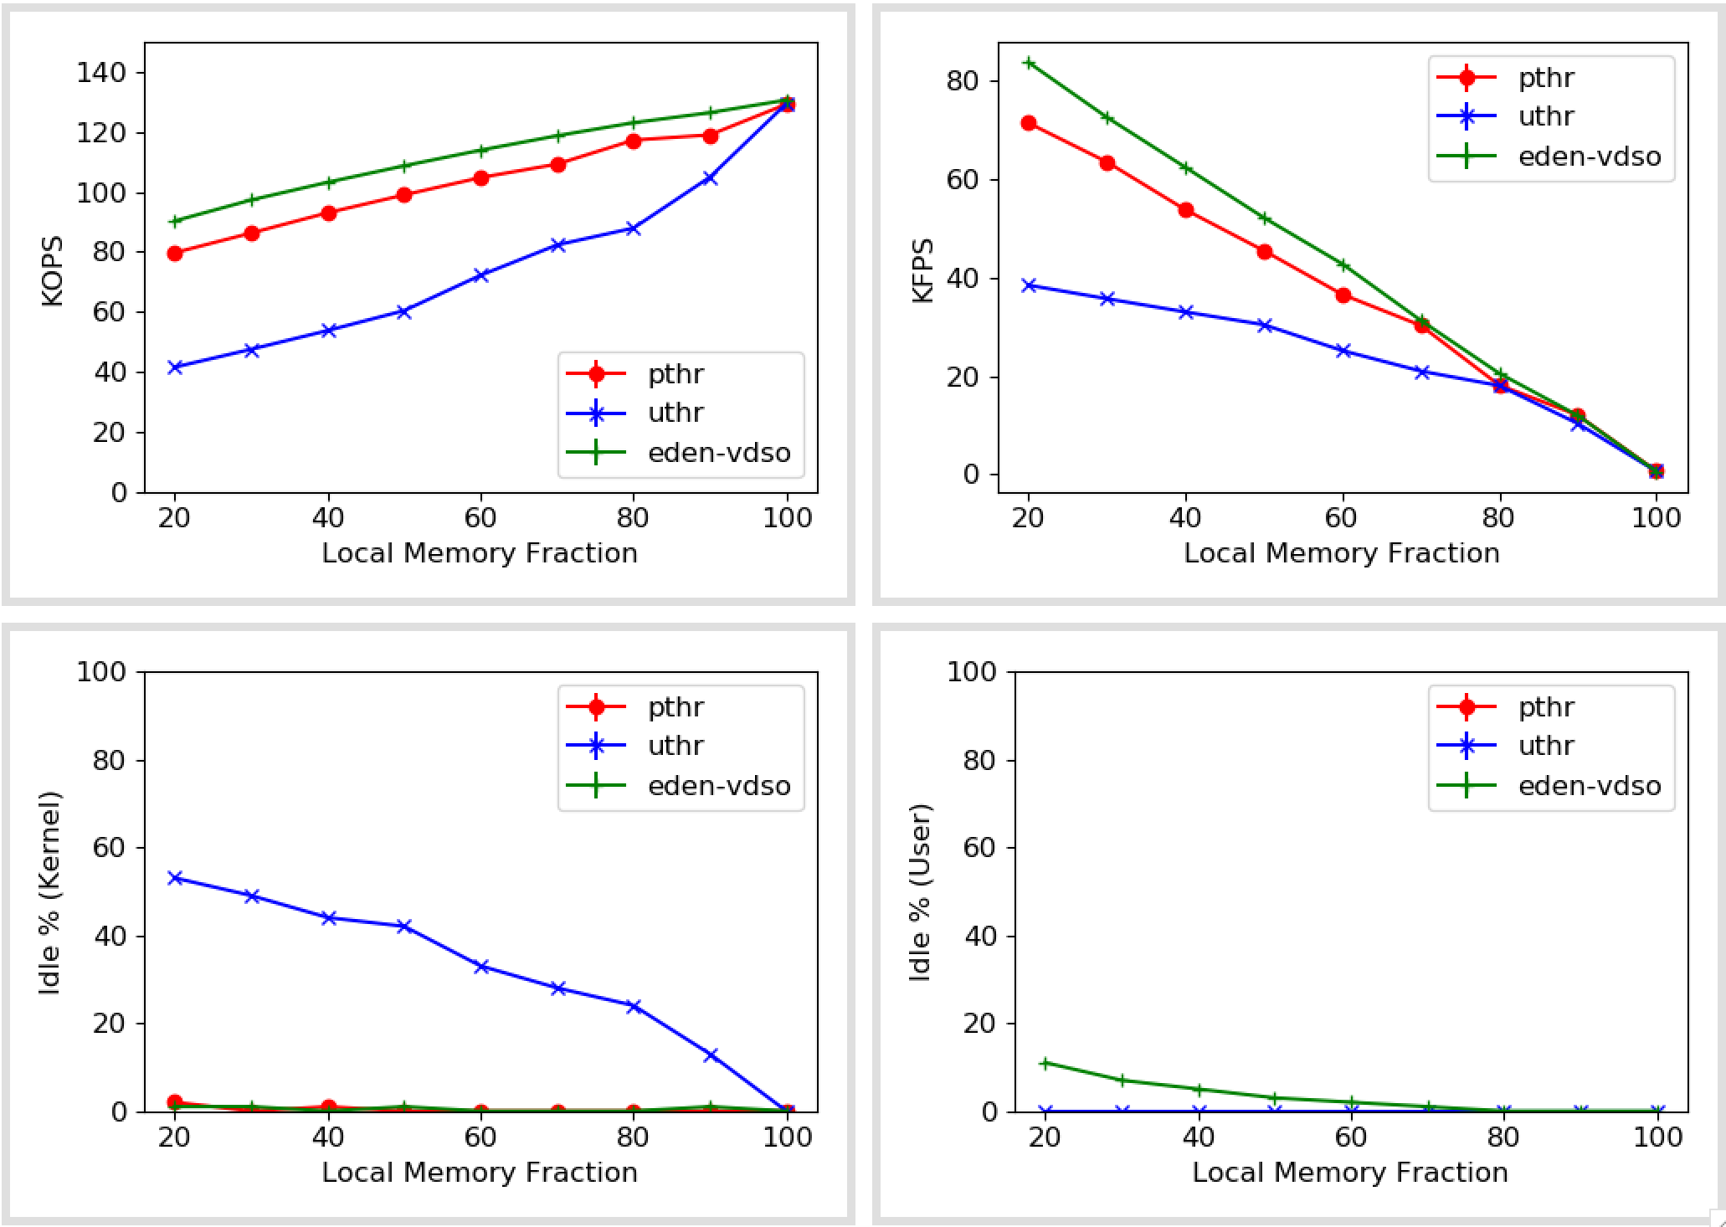
Synthetic numbers
1 core
5 threads/core
Skewed (s=1)

Slide 17
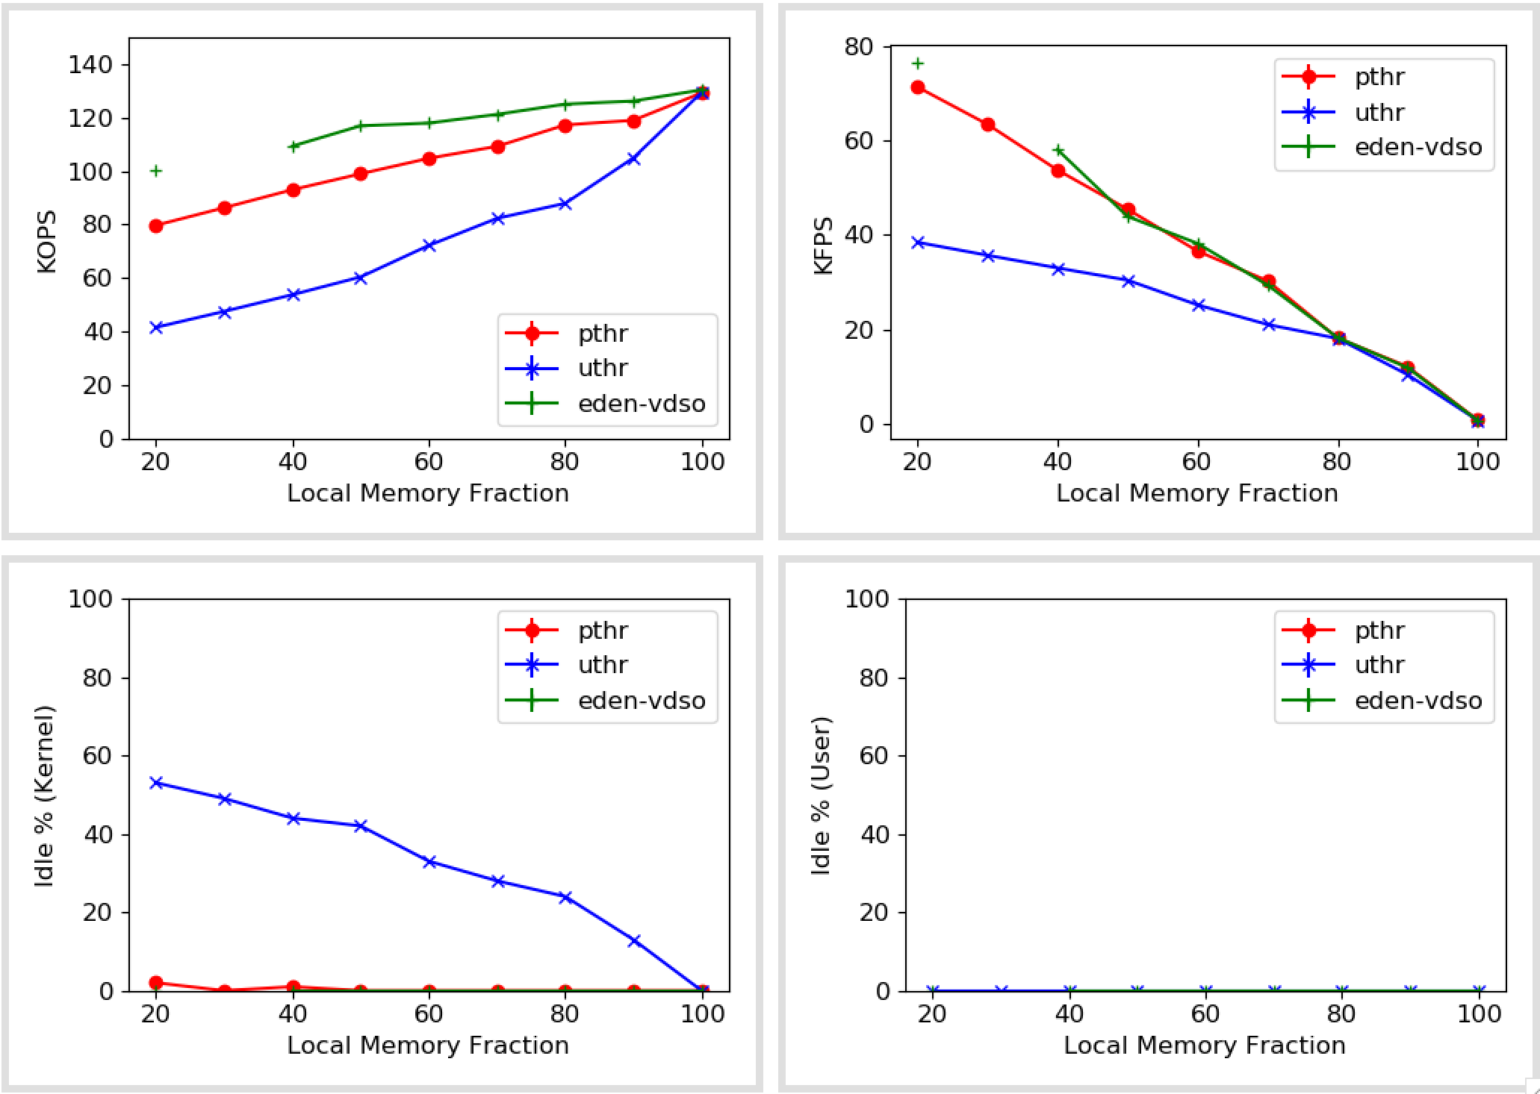
Synthetic numbers
1 core
20 threads/core
Skewed (s=1)

Slide 18
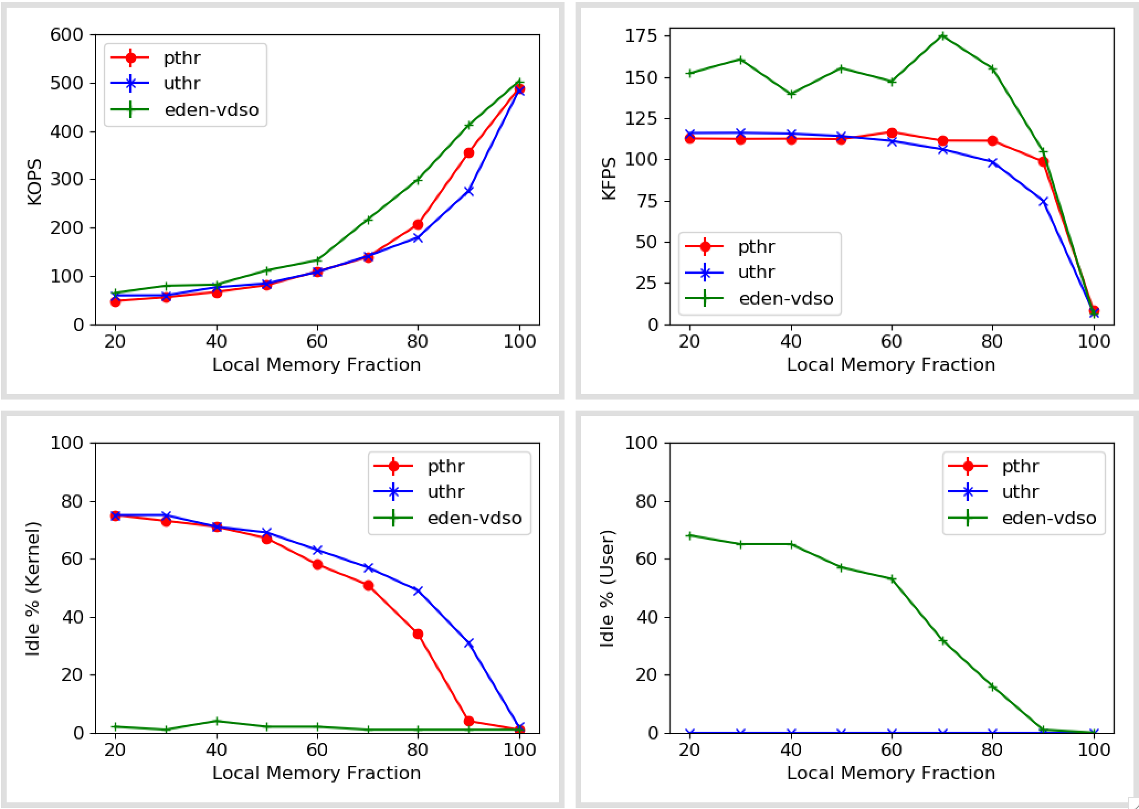
Synthetic numbers
4 cores
5 threads/core
Uniform (s=0.1)

Slide 19
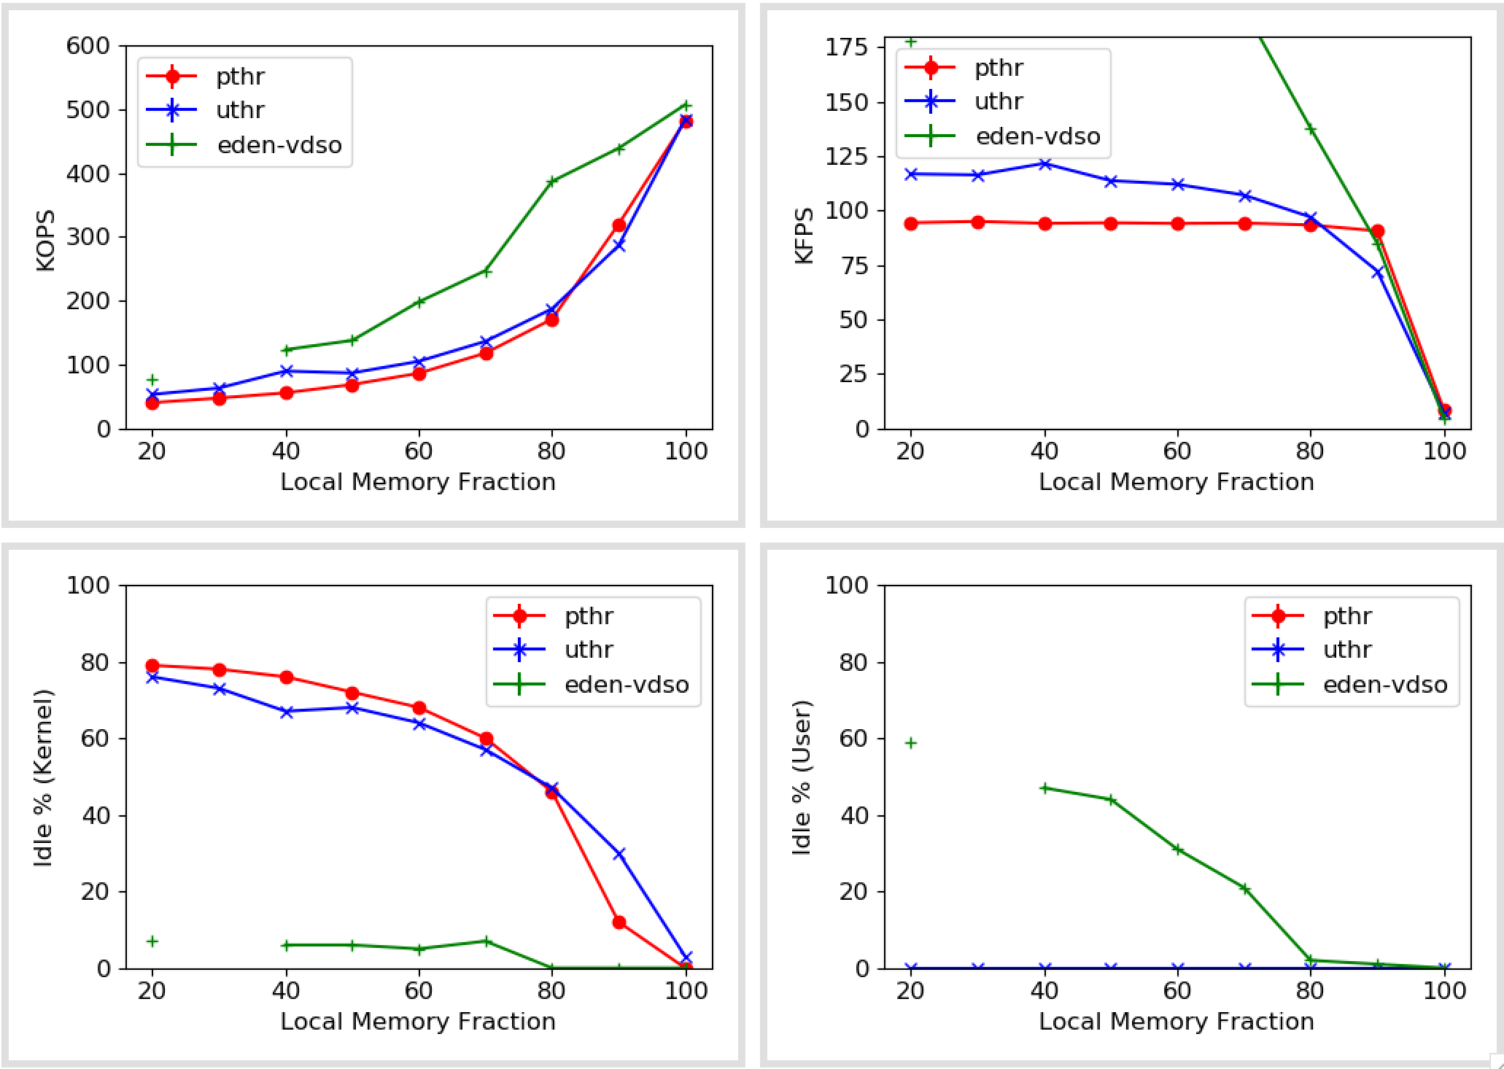
Synthetic numbers
4 cores
20 threads/core
Uniform (s=0.1)

Slide 20
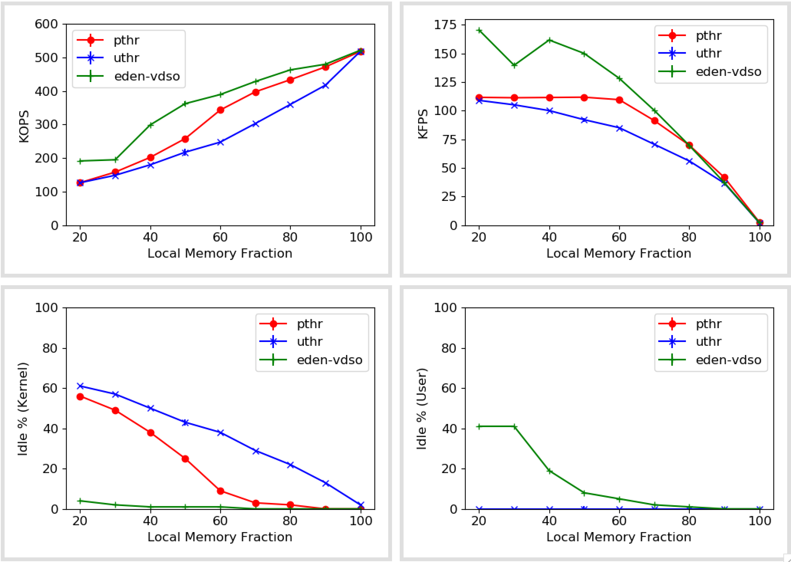
Synthetic numbers
4 cores
5 threads/core
Skewed (s=1)

Slide 21
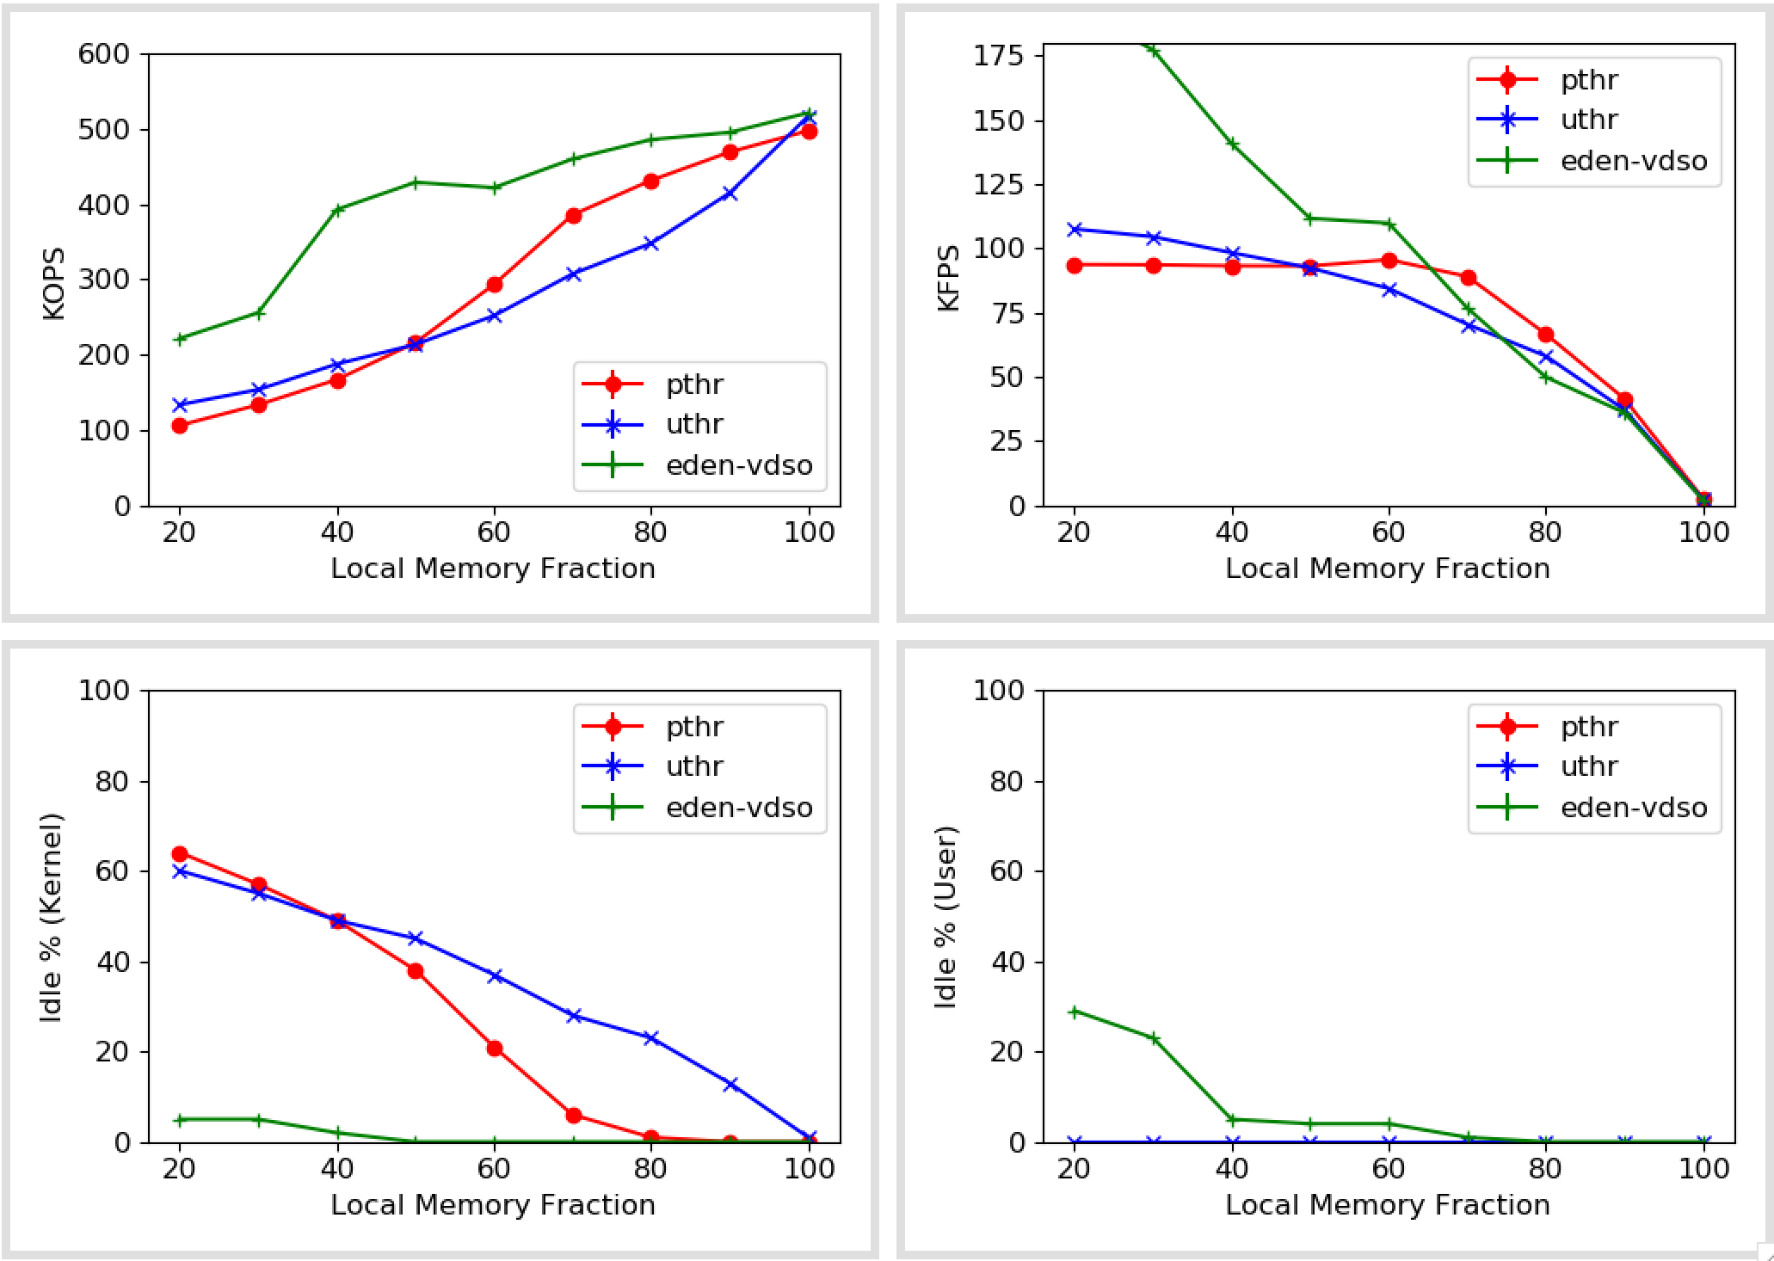
Synthetic numbers
4 cores
20 threads/core
Skewed (s=1)
Still not clear why Eden faults drop below Pthreads but Xput still remains high

Slide 22
Takeaways
More threads allow more non-faulting requests to pass through
However, Pthreads suffer more at high concurrency

Slide 23
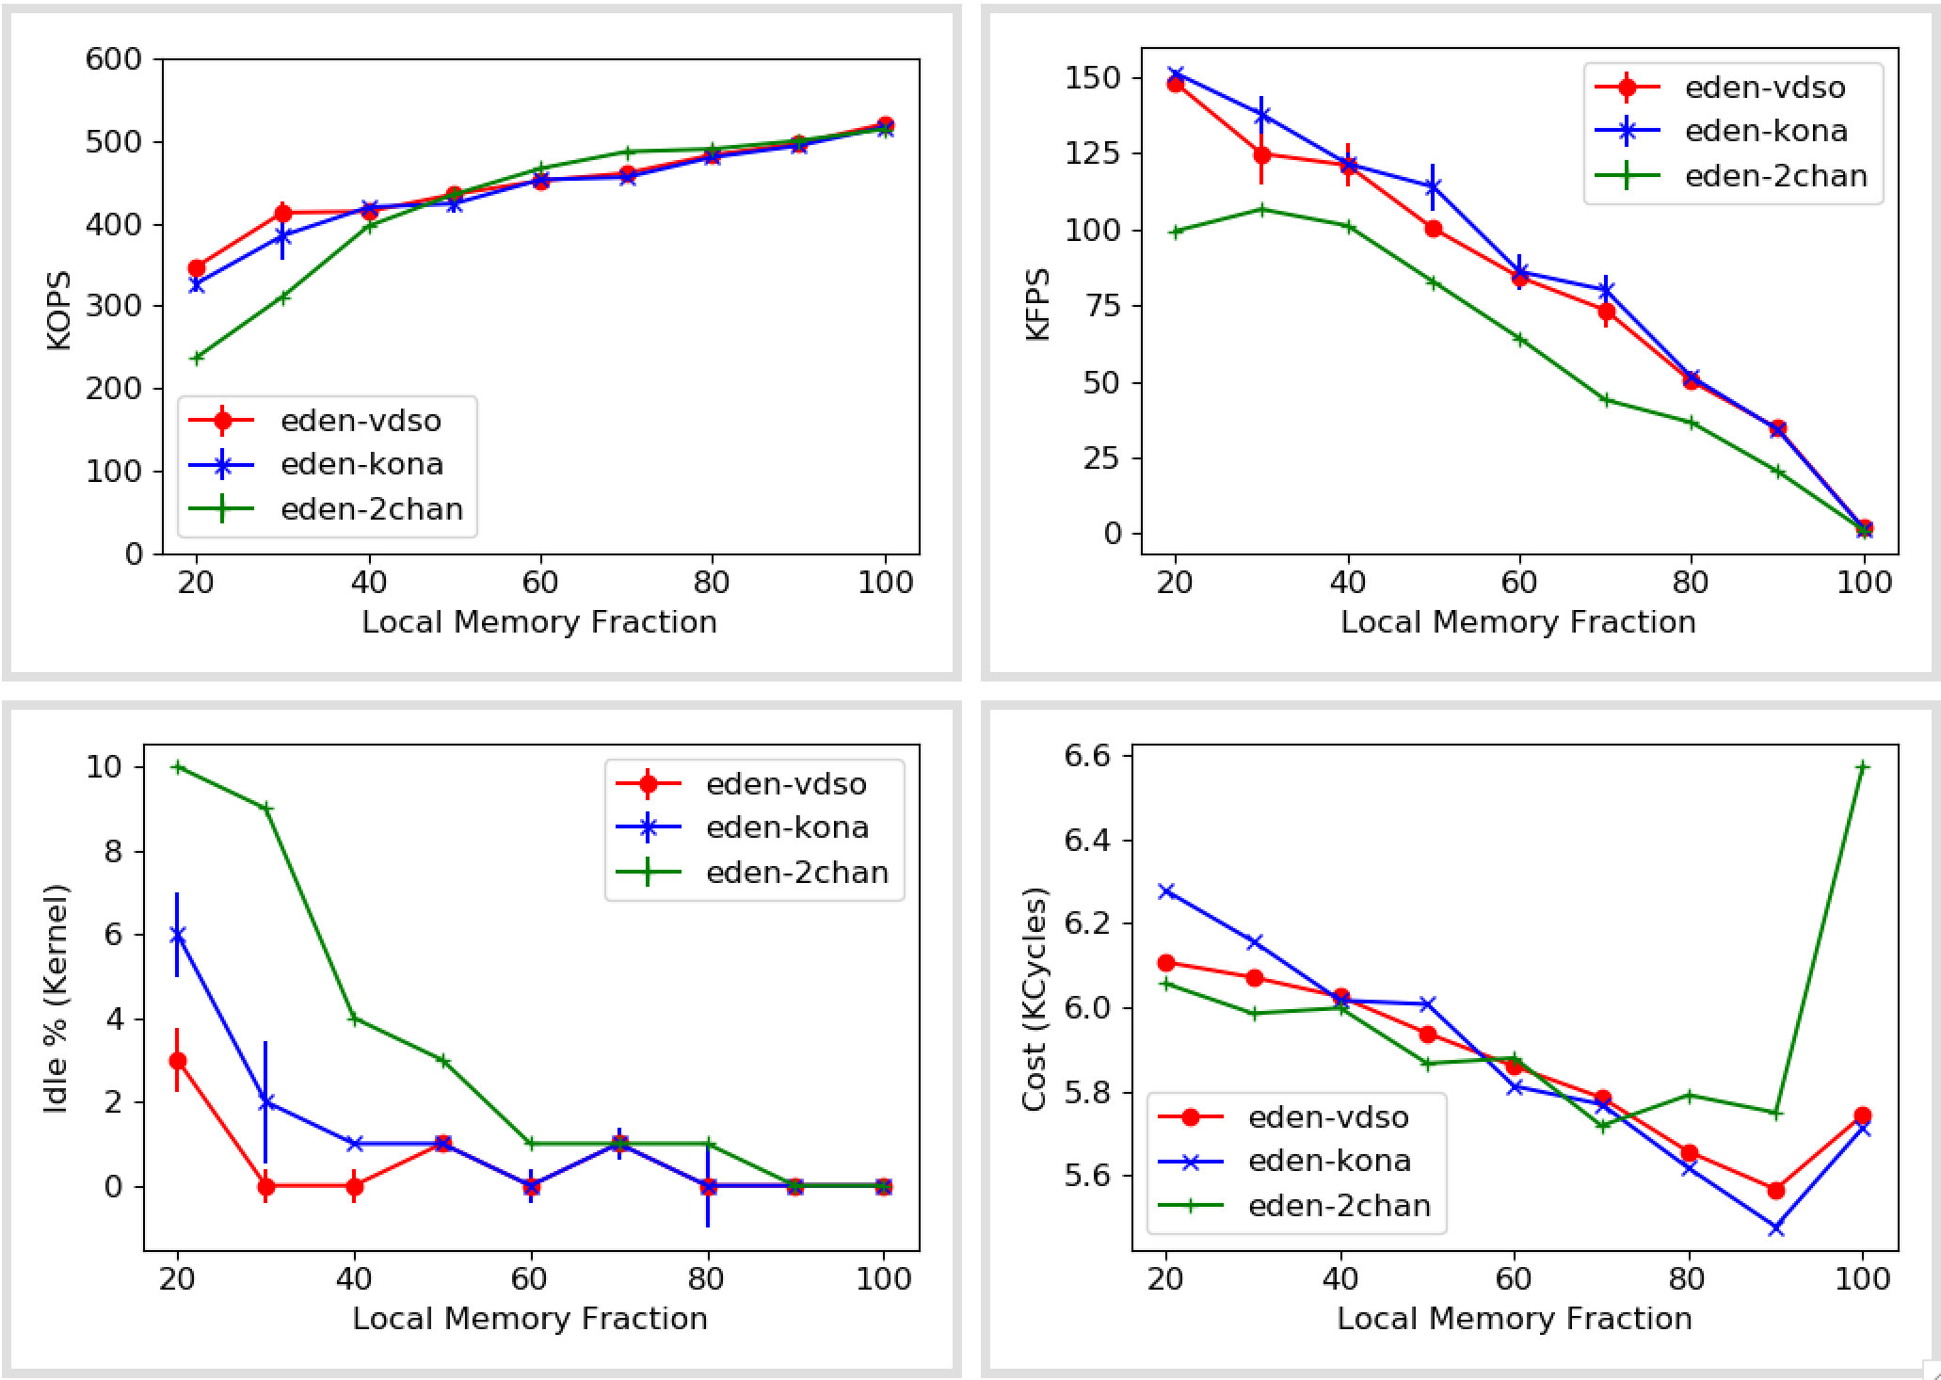
Synthetic numbers (With kona-based page checks and second-chance eviction)
Notes:
Need more work in explaining eviction

Slide 24
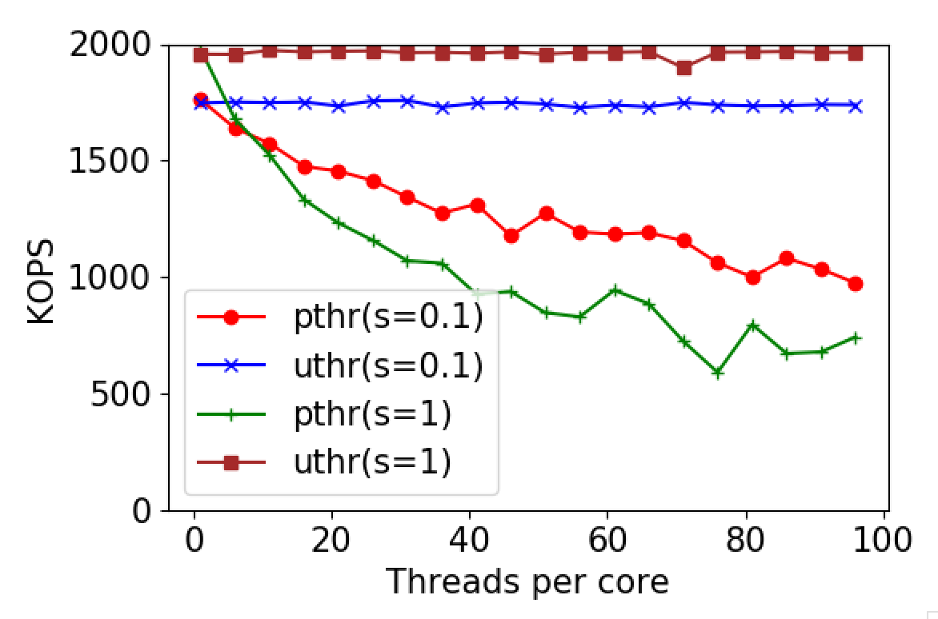
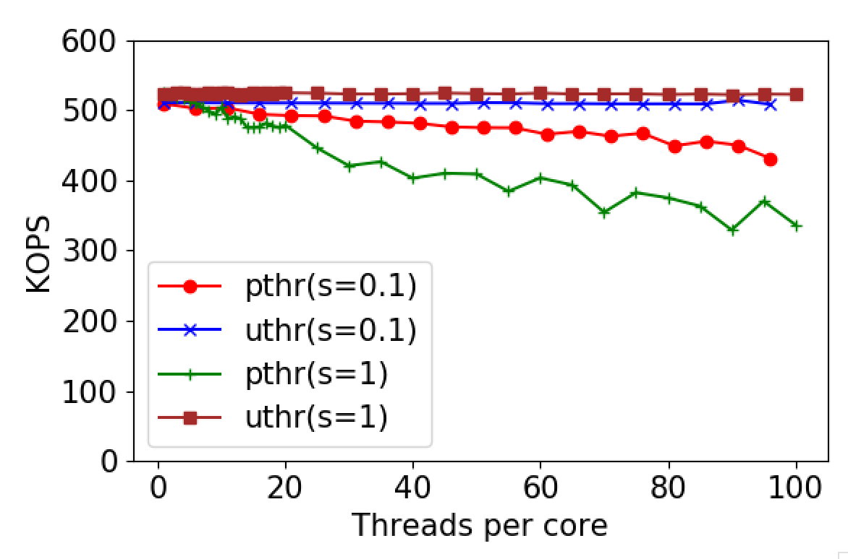
Pthreads vs Uthreads
1x Zip
5x Zip
Suspect: locking primitives
Sort doesn’t do much locking
Memcached, SiloDB, etc. wouldn’t allow comparison but can show degradation with pthreads
My guess is it’d be much worse for writes

Slide 25
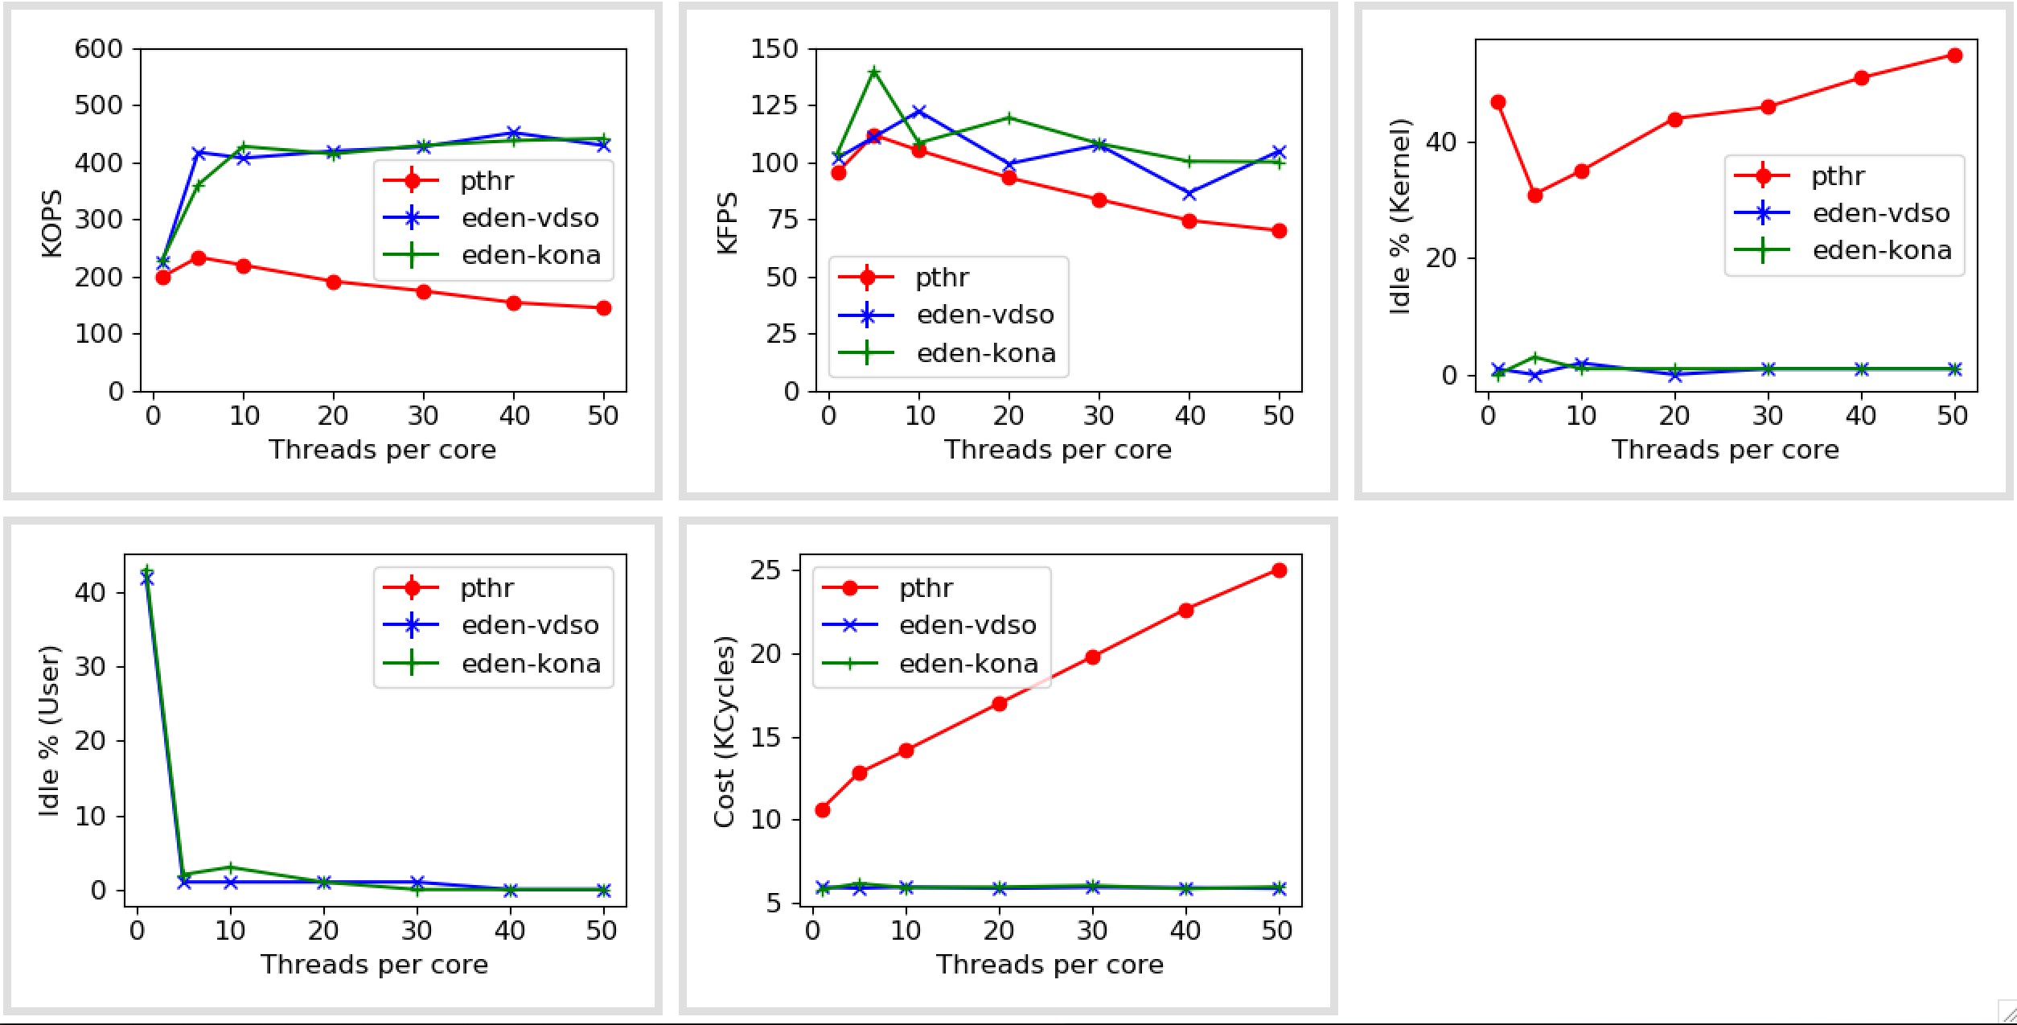
Pthreads vs Uthreads (at 50% local memory, zipfs=1)

Slide 26
In-memory databases
Databases (link) | Data model | Interface | TXN support | Known Available Benchmarks | Comments
Altibase | Relational | SQL | Yes
Hyrise | Relational | SQL | Yes |  | Research, Academic
RocksDB | KV Store | Get/Set | Yes |  | Popular
Impala | Hadoop | SQL, Other | No
Silo | Relational | Custom | Yes | TPCC, YCSB | Ported on Shenango
ClickHouse | Relational | SQL, Other | No | TPC-DS | OLAP database, Well-known
Dragonfly | KV Store | Get/Set | No
MariaDB | Relational | SQL | Yes | TPCC, TPC-DS | Commercial, Well-known
Memcached | KV Store | Get/Set | No
VoltDB | Relational | SQL | Yes |  | Only OLTP
https://dbdb.io

