Slide 1
CXL
I/O Interconnect
Accelerators and Memory devices
Multiple protocols
Typical I/O – CXL.io, like PCIe
Cache coherence – CXL.cache
Memory access – CXL.memory

Slide 2
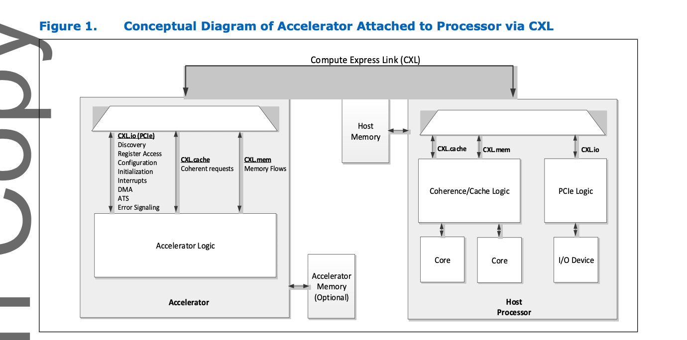
CXL

Slide 3
CXL – Is it new hardware?
Not really. Same hardware stuff as PCIe 4.0/5.0
64GBps (enough for a 400Gbps NIC) for PCIe 5.0
Couldn’t get a hold of latency numbers. Heard ~400ns.

Slide 4
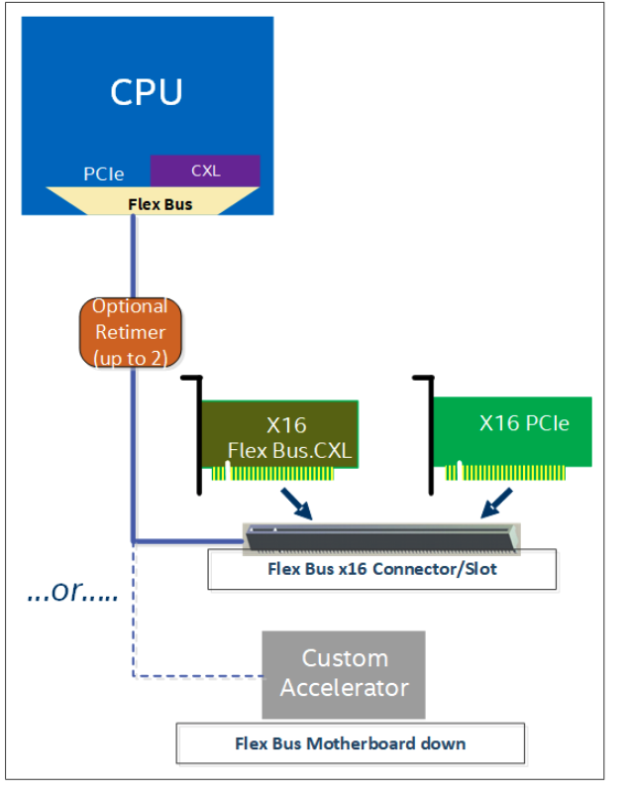
FlexBus
CXL needs new support both on the processor and device-side.
FlexBus – kinda like a PHY layer that now supports both PCIe and CXL – but only one at a time.

Slide 5
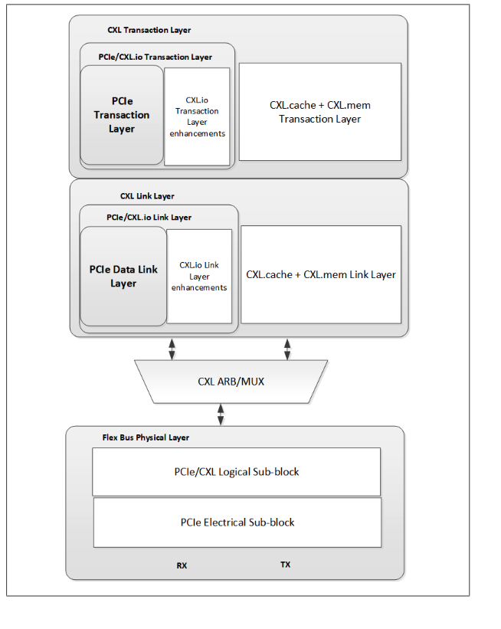
CXL Layers
Each sub-protocol has its own implementation in every layer.

Slide 6
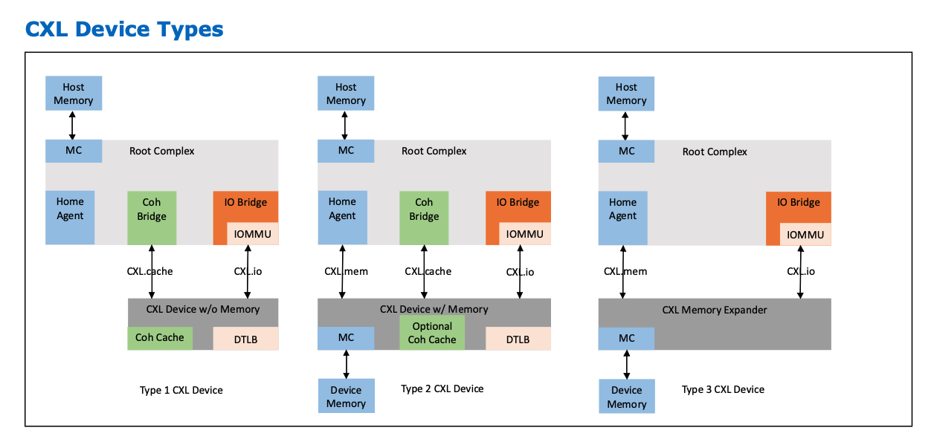
CXL Device Types

Slide 7
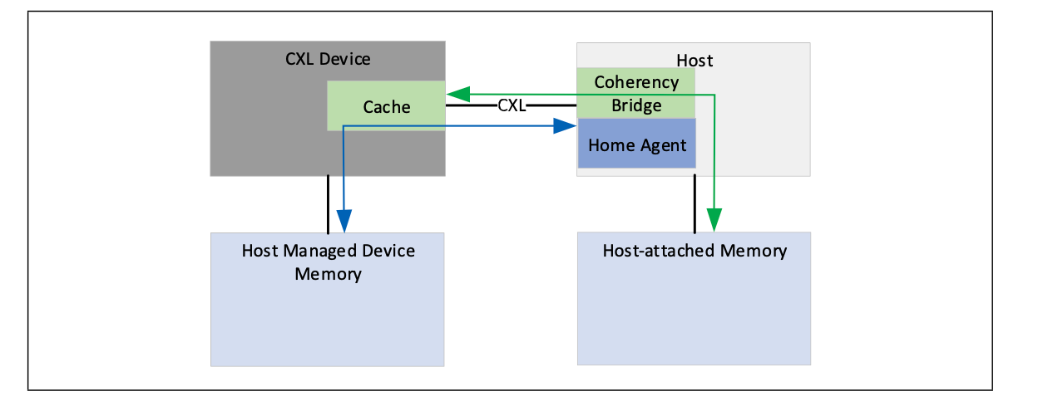
CXL.cache
Essentially another L1/L2 cache that host now needs to take care of.
Host/Device Bias mode, on page granularity
Performance?
64B transactions

Slide 8
CXL.mem
Mem read/writes while ensuring coherency
Specifies transaction flows in various situations

Slide 9
How do we use it for remote memory?
Type 2 with just CXL.mem?
Is there going to be a NIC/ethernet? – not in the later versions.
No DRAM cache
Would the usual L3 be enough to make up for increased memory latency?

Slide 10
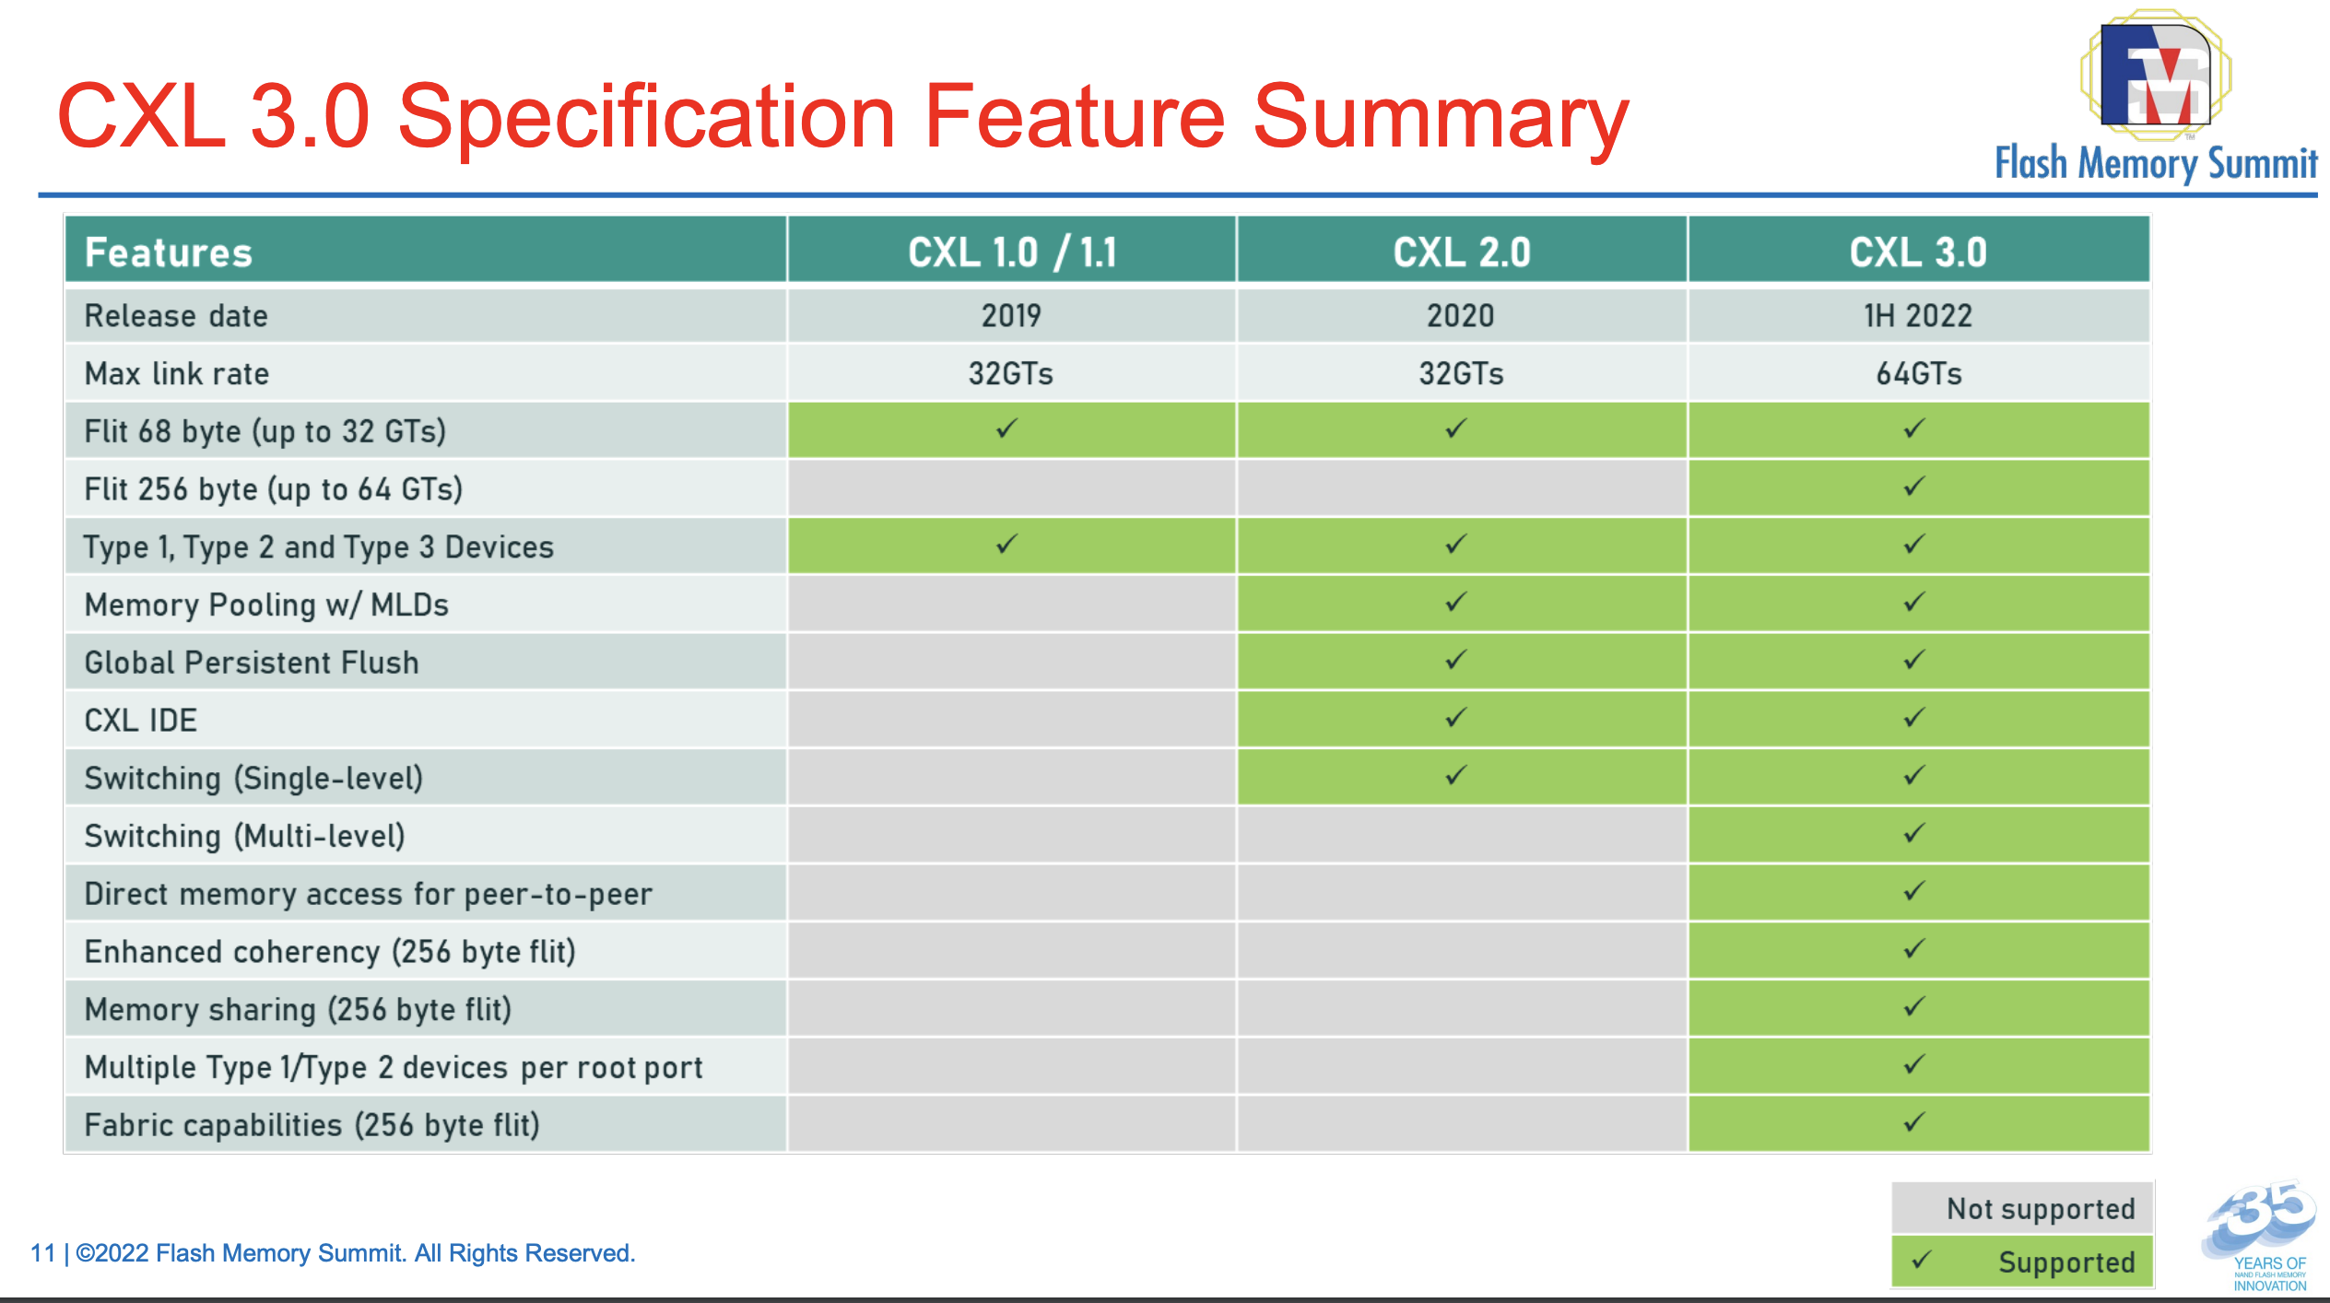

Slide 11
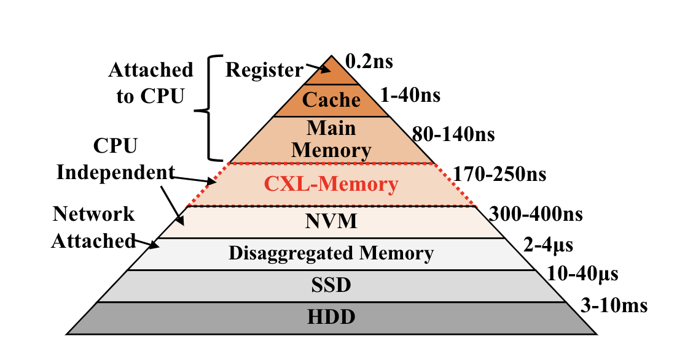
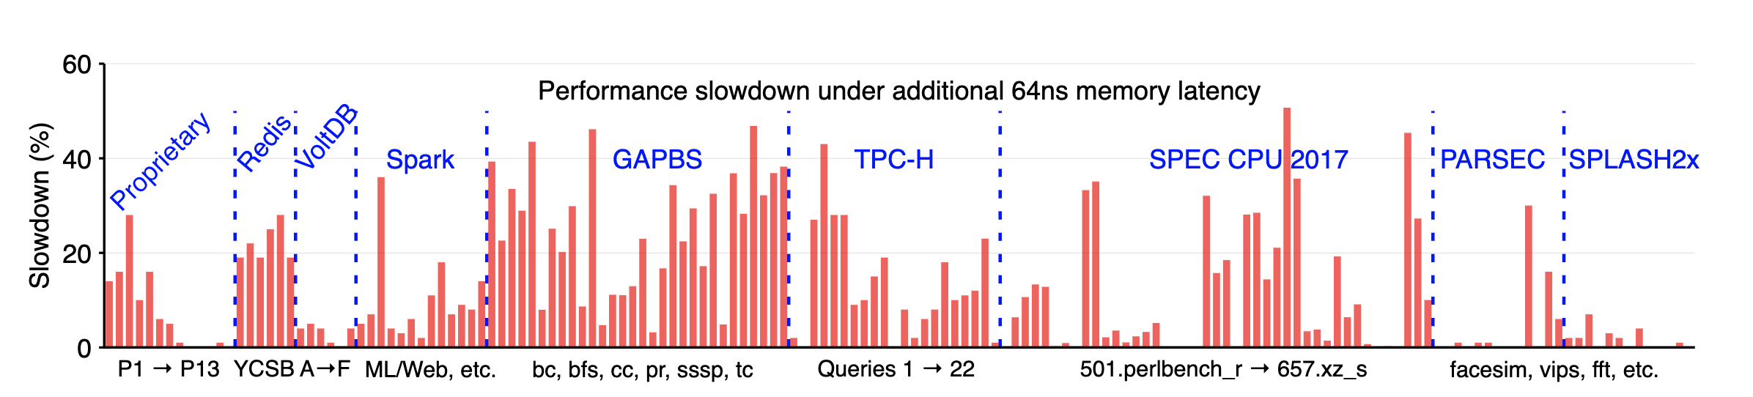
CXL Memory
2-3 times slower
App degradation could be much lower?
Notes:
CXL disaggregated memory – latencies are still debatable

Slide 12
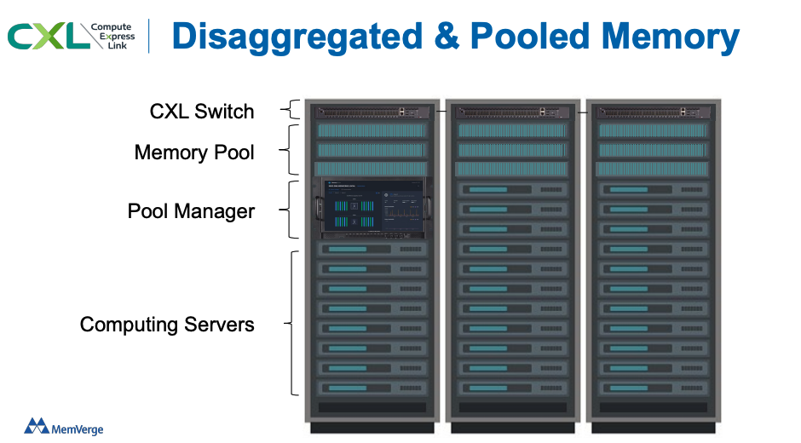
CXL Rack Setting
Memory Pooling (CXL 2.0)
Non-shared logical memory devices
How do you allocate? Mmap? Anon pages?
Tiered memory or pure CXL?
How do you migrate b/w local and CXL-backed DRAM?

Slide 13
CXL Forum

