Slide 1
Page Fault Locality and the implications for Far Memory
Anil Yelam
(Thesis Proposal Exam)

Slide 2
Far Memory
Fast Interconnect
Efficiently complementing a server’s memory with “far memory” i.e., memory from other servers:
Increases effective server capacity
Reduces memory stranding
Traditionally, the interconnect is Ethernet, but faster ones like CXL are coming up.
CPU
CPU
CPU
CPU
CPU
CPU
CPU
CPU
…
Machine Private RAM
Cluster Shared RAM
Machine Private RAM
Cluster Shared RAM
Notes:
Similar ideas for memory tiering, like using other memory technologies, exist!

Slide 3
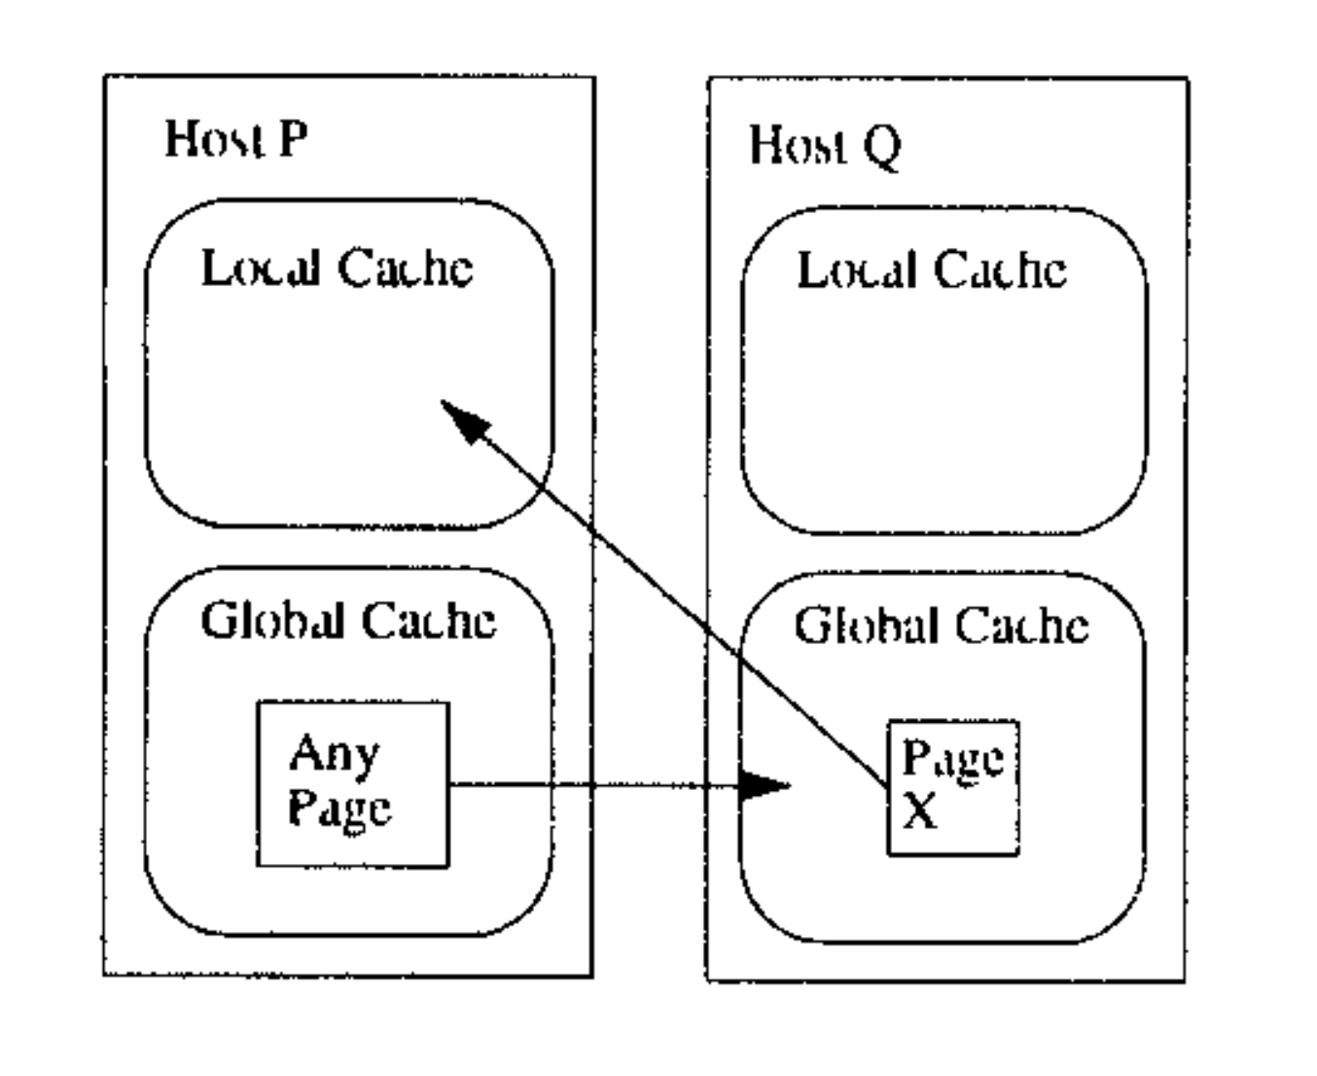
Not a new thing!
Memory pooled into global cache
Pages swapped in/out using OS paging
GMS, Network RAMDisk, etc.
Global Memory Management
(1995)

Slide 4

What’s different now?
Memory is becoming a scarce resource!
Rise of in-memory computing
Flattening cost reduction per unit
Network performance is much better today!
RDMA on Ethernet today has < 5 µs latency
For comparison, network latency in GMS (1995) was 1135 µs
DRAM latencies changed very little

Slide 5
Recent work (non-DSM)
Non-transparent Runtimes
Far-Memory
Friendly Java GC
NetworkReqs
[OSDI’16]
zSwap
[ASPLOS’19]
DilOS
[APSys’21]
AIFM
[OSDI’20]
Semeru
[OSDI’20]
Infiniswap [NSDI’17]
Leap
[ATC’20]
Hydra
[FaSST’18]
Carbink
[OSDI’22]
MemLiner
[OSDI’22]
Fastswap
[EuroSys’20]
3PO
[arXiv]
LegoOS
[OSDI’18]
Kona
[ASPLOS’21]
Fast Fault Tolerance
Transparent OS paging
New Memory
Hardware
App-agnostic
Prefetchers

Slide 6
My focus
Application-specific Runtimes
NetworkReqs
[OSDI’16]
zSwap
[ASPLOS’19]
DilOS
[APSys’21]
AIFM
[OSDI’20]
Infiniswap [NSDI’17]
Leap
[ATC’20]
Hydra
[FaSST’18]
Carbink
[OSDI’22]
Fastswap
[EuroSys’20]
3PO
[arXiv]
Generic, software solutions
Transparent paging
App-agnostic
Prefetchers

Slide 7
OS Paging is still popular!
Paging out to remote memory
Far memory access = Page fault
Fully transparent
Example: Fastswap
Paging with RDMA
Application
OS
Far Memory
Notes:
Page faults are well-studied but mostly from a transparent angle
Break-down into 3 or 4 slides

Slide 8
Challenges with OS Paging
Performance with far memory depends on:
Reducing far memory accesses
Hiding access latencies
Prefetching future accesses
+
Reclaiming coldest data
Notes:
Page faults are well-studied but mostly from a transparent angle
Break-down into 3 or 4 slides

Slide 9
Challenges with OS Paging
Performance with far memory depends on:
Reducing far memory accesses
Hiding access latencies
Prefetching future accesses
+
Reclaiming coldest data
Scheduling other work
Coarse page access information
Limited application context around accesses
No way to hint application knowledge
Inefficient due to kernel thread overheads
OS Paging-based systems
Notes:
Page faults are well-studied but mostly from a transparent angle
Break-down into 3 or 4 slides

Slide 10
Breaking transparency with AIFM
Custom API to access far memory + User-space runtime to support the API
Applications explicitly:
request far memory in variable-sized objects
use the API to request and ensure local presence of an object
Application
Far Memory
Runtime
OS

Slide 11
How does AIFM help?
Performance with far memory depends on:
Reducing far memory accesses
Hiding access latencies
Prefetching future accesses
+
Reclaiming coldest data
Coarse page access information
Limited context around accesses
Adds overhead even when not useful
Inefficient due to kernel thread overheads
OS Paging-based systems
Custom API allows:
rich access tracking
application hinting
AIFM
Employs User-level threads
Notes:
Page faults are well-studied but mostly from a transparent angle
Break-down into 3 or 4 slides

Slide 12
Custom API call example
API call to access far memory objects:
p = get-local-pointer(id, Temporary=True, Scope))
Passes control to the runtime
Allows user-space threads
Allows rich access tracking
Convey additional semantics
Tell how long you plan to use it (for correctness)

Slide 13
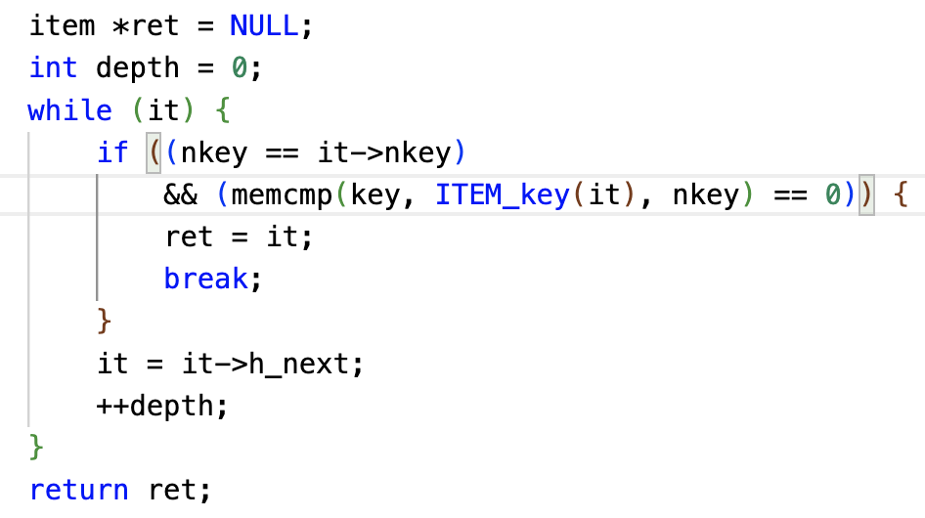
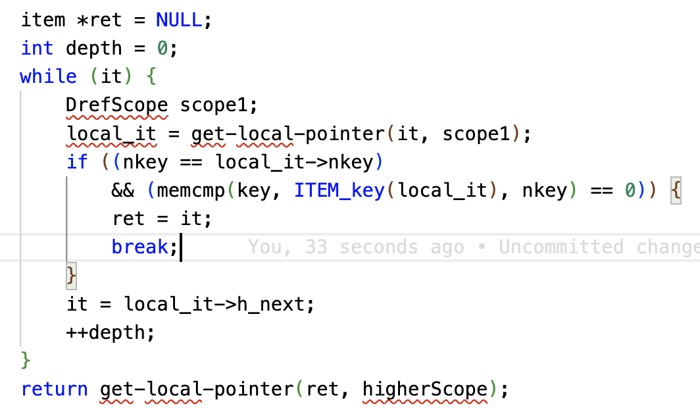
How easy is it to port existing apps?
Take Memcached:
Hash table buckets with linked list of items
Most common code path: Item search
Get object locally
Replace all local instances
Assess scope

Slide 14
How easy is it to port existing apps?
Take Memcached:
Hash table buckets with linked list of items
Most common code path: Item search
← Far from the only far memory access location
← At least 346 other code locations!
← However, this one location covers 70% of all far accesses!
Challenges
Bugs new code critical to correctness
Non-Incremental can’t annotate just the top one and leave the rest for later
Significant effort check accesses and scopes at all these locations
Notes:
Re-order
Correctness
Inremental
Bail early on

Slide 15
Is there a less intrusive solution?
Q1: Is there “hinting” interface that is less-invasive?
Incremental
Does not affect correctness
Q2: Is there a point to such an interface? Can we get away with annotating just a few locations?
For example, 95% of far memory accesses in Memcached occur at just 12 code locations
But how general is this observation?
Notes:
Our idea:

Slide 16
Thesis Statement
By adding a few hints to the pager at major page faulting* locations in the code, for most applications, it is possible to reap the performance benefits of app-guided paging policies with very low porting effort on the part of programmer
*far memory accesses = page faults,
in transparent, paging-based systems

Slide 17
Thesis work
Study on page faulting code behavior
Eden: A developer-friendly runtime for network-based far memory
Submitted
Ongoing/Proposed
Study on page faulting code behavior (Contd.)
Hints-based Runtime for CXL-based far memory

Slide 18
Thesis work
Study on page faulting code behavior
Eden: A developer-friendly runtime for network-based far memory
Submitted
Ongoing/Proposed
Study on page faulting code behavior (Contd.)
Hints-based Runtime for CXL-based far memory

Slide 19
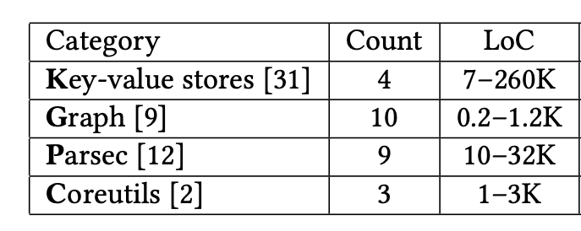
Methodology
We wrote the fltrace tool
Measures max working set
Restricts memory to a fraction of it
Obtains stack traces at all faults
Looks up code locations
Applications
Mechanism

Slide 20
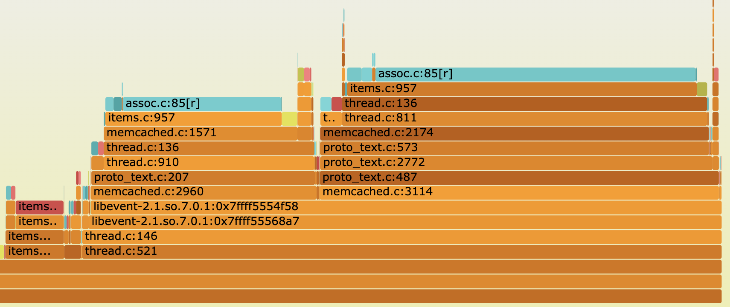
Example: Memcached Access Locations
LRU
Maintenance
Item Search
(SET path)
Item Search
(GET path)

Slide 21
How general is the locality?
We look at code locations where 100% vs 95% of page faults occur.
Notes:
Ask why this matters first?

Slide 22
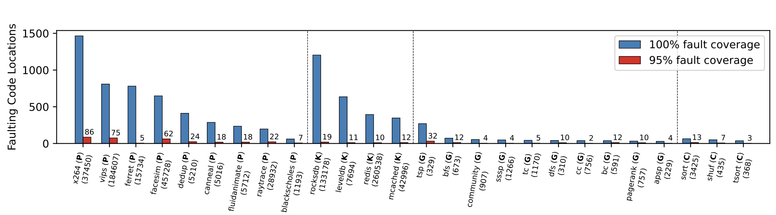
How general is the locality?
We look at code locations where 100% vs 95% of page faults occur.
Notes:
Ask why this matters first?

Slide 23
Are these locations predictable?
Do the heavy-hitters change based on runtime factors like local memory size, inputs, threads, etc.
Notes:
Ask why this matters first?

Slide 24
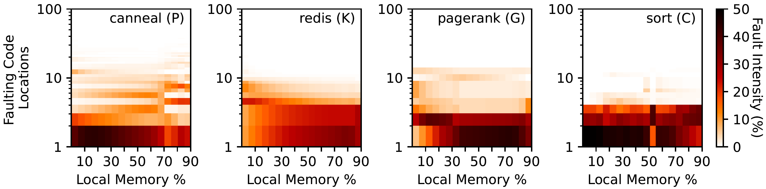
Are the locations predictable?
Do the heavy-hitters change based on runtime factors like local memory size, inputs, threads, etc.
Not much.
Notes:
Ask why this matters first?

Slide 25
Are the locations predictable?
Do the heavy-hitters change based on runtime factors like local memory size, inputs, threads, etc.
Not much.
Must be representative and hit all common code paths. We used standard benchmarks.
No, again.
Notes:
Ask why this matters first?

Slide 26
Code paths may converge in libraries
Example: most accesses in C++ vector iterator
Does the locality extend to application source code?
We excluded library code to check

Slide 27
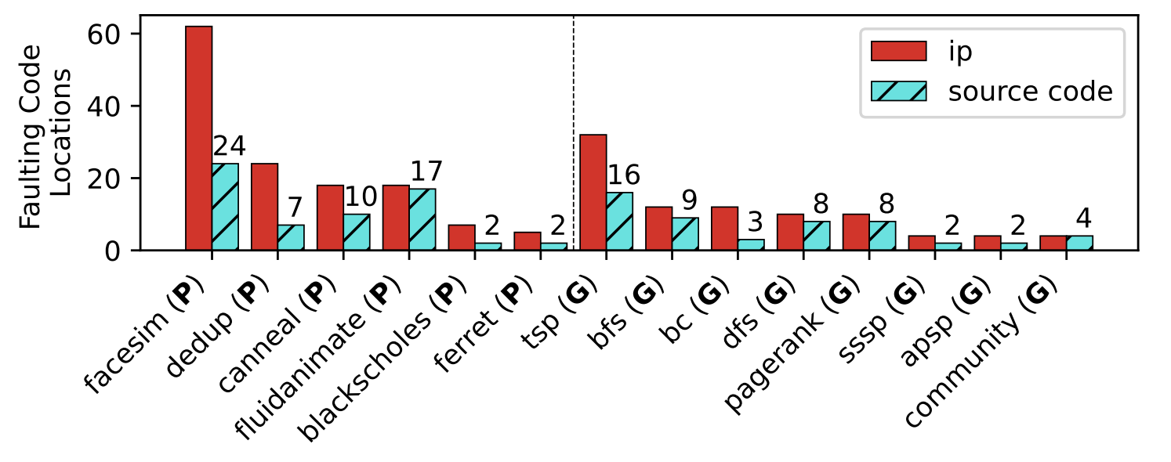
Code paths may converge in libraries
Example: most accesses in C++ vector iterator
Does the locality extend to application source code?
We excluded library code to check
95% access locations in binary vs source code
Notes:
Ask why this matters first?

Slide 28
What explains this behavior?
We think that it’s a combination of:
Dominant code paths/segments in applications
Longer page lifetimes in the larger local memory
But more research is needed to understand both the causes of this behavior and other potential applications.

Slide 29
Thesis work
Study on page faulting code behavior
Eden: A developer-friendly runtime for network-based far memory
Submitted
Ongoing/Proposed
Study on page faulting code behavior (Contd.)
Hints-based Runtime for CXL-based far memory
Notes:
Moment for questions

Slide 30
Eden: Developer-friendly, User-space Far Memory
Retains the page-based interface with a user-space pager
Employs hints to preempt page faults and pass control & info to the pager
Better performance and flexibility than traditional OS-based pagers
Up to 2x benefit over Fastswap
Application
Hints
Runtime
Far Memory
OS

Slide 31
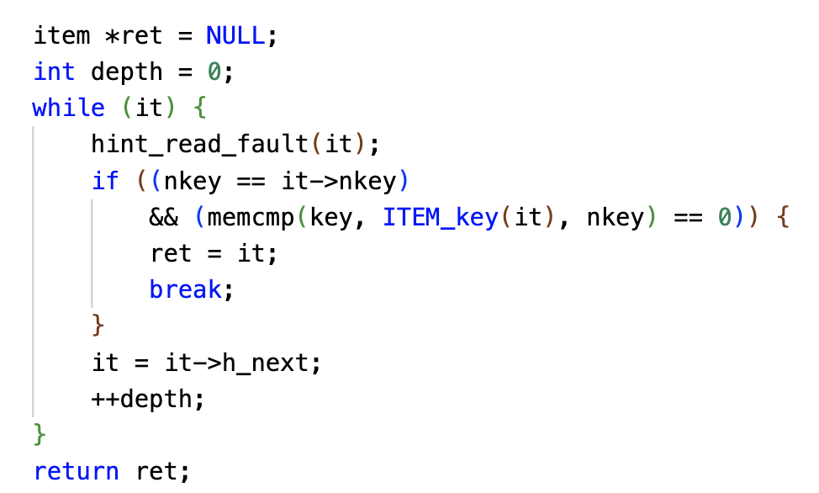
Back to Memcached Example
v.
Hint’s presence or absence doesn’t affect correctness
Can be added incrementally; we added 2 such hints
Locations pointed to by fltrace
Notes:
We added 2 hints

Slide 32
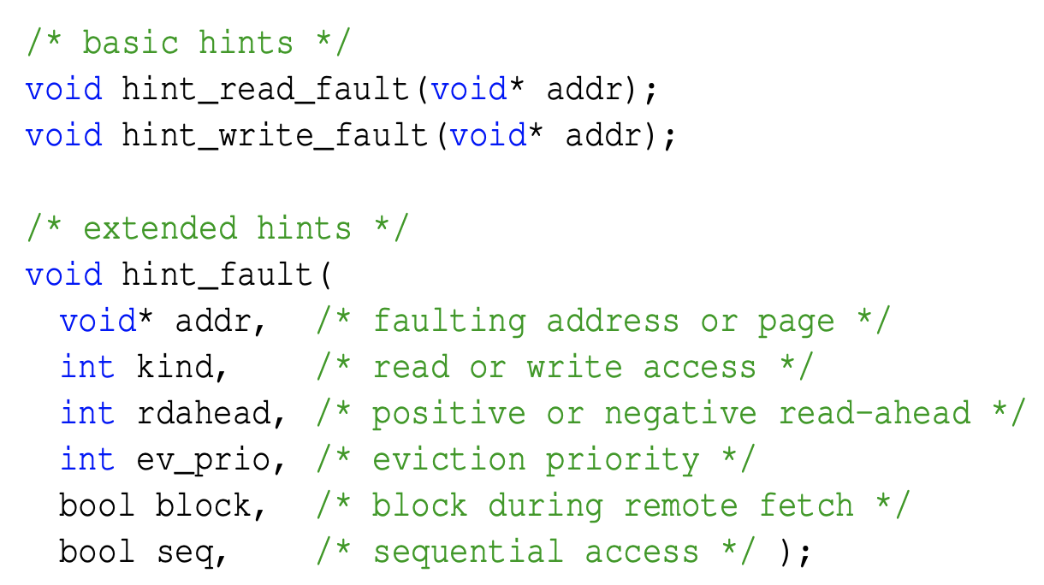
Eden’s basic hints
Trivial to add based on fltrace
Eden’s user-space runtime gets control before the kernel.
Employs Shenango threads to hide latencies, same as AIFM
Eden can record page accesses more freely e.g., access count, timestamps, etc.
Supports FIFO, SC, LRU, etc.
Parallels AIFM’s rich hotness-tracking

Slide 33
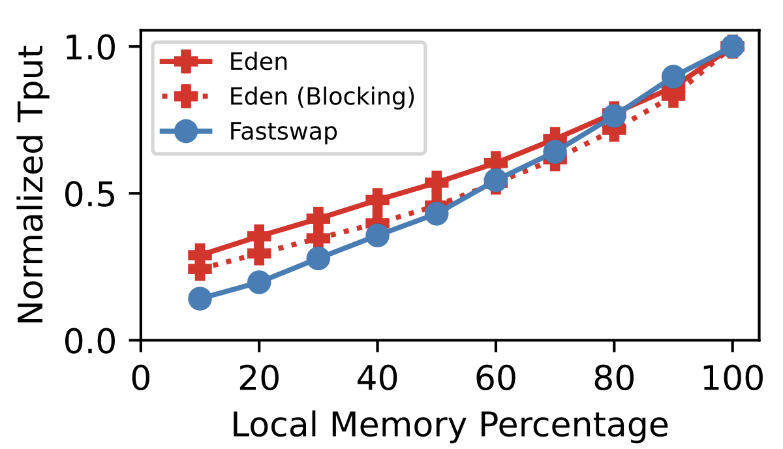
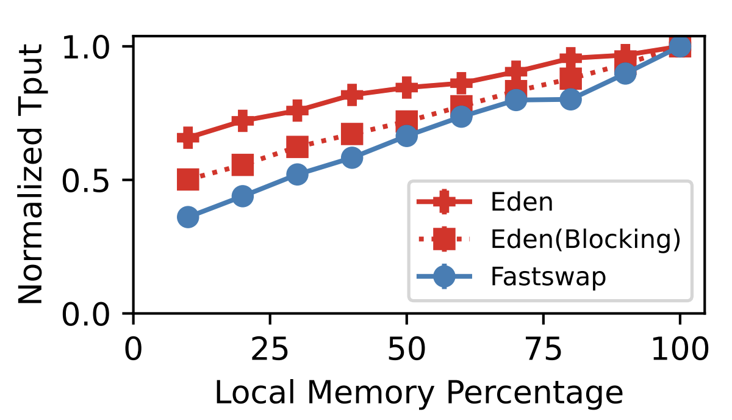
Hiding latency with Basic hints
Synthetic Web Service (more compute intensity)
Memcached
Notes:
Introduce Fastswap somewhere

Slide 34
Conveying Application Knowledge
Prefetching or reclaim policies come at an overhead
Reclaim needs to find the right candidates
Prefetchers need to look at past accesses
What if developers can help?
Examples:
Point out low-priority pages for easy reclaim (AIFM’s non-temporal access)
Hinting read-ahead where accesses are sequential

Slide 35
Extended Hints
…
Eden provides these for earlier use-cases
Require some developer input
Note that this is specific to each location!
More use-cases in future

Slide 36
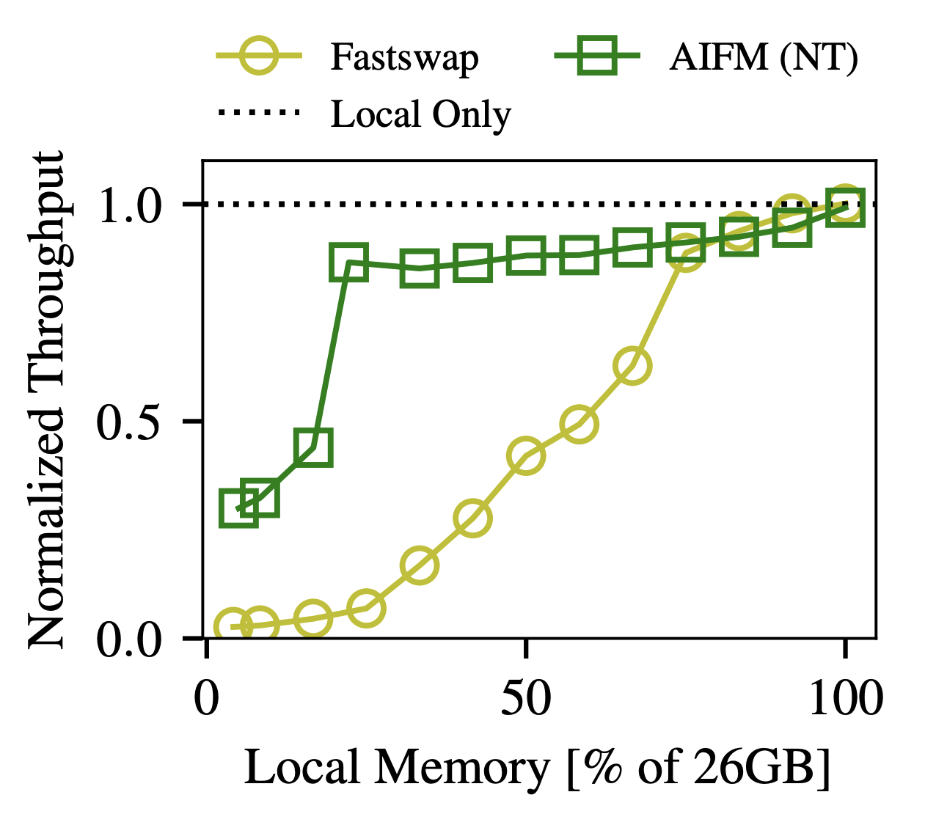
Emulating AIFM’s non-temporal access
Set objects “non-temporal” to avoid cache pollution
Segregated in the Cache
Prioritize on eviction
AIFM demonstrated with a Synthetic Web Service application
Small but perf-dominating hash table
Large-sized blob array
Sets blob array as “non-temporal” improves cache hits

Slide 37
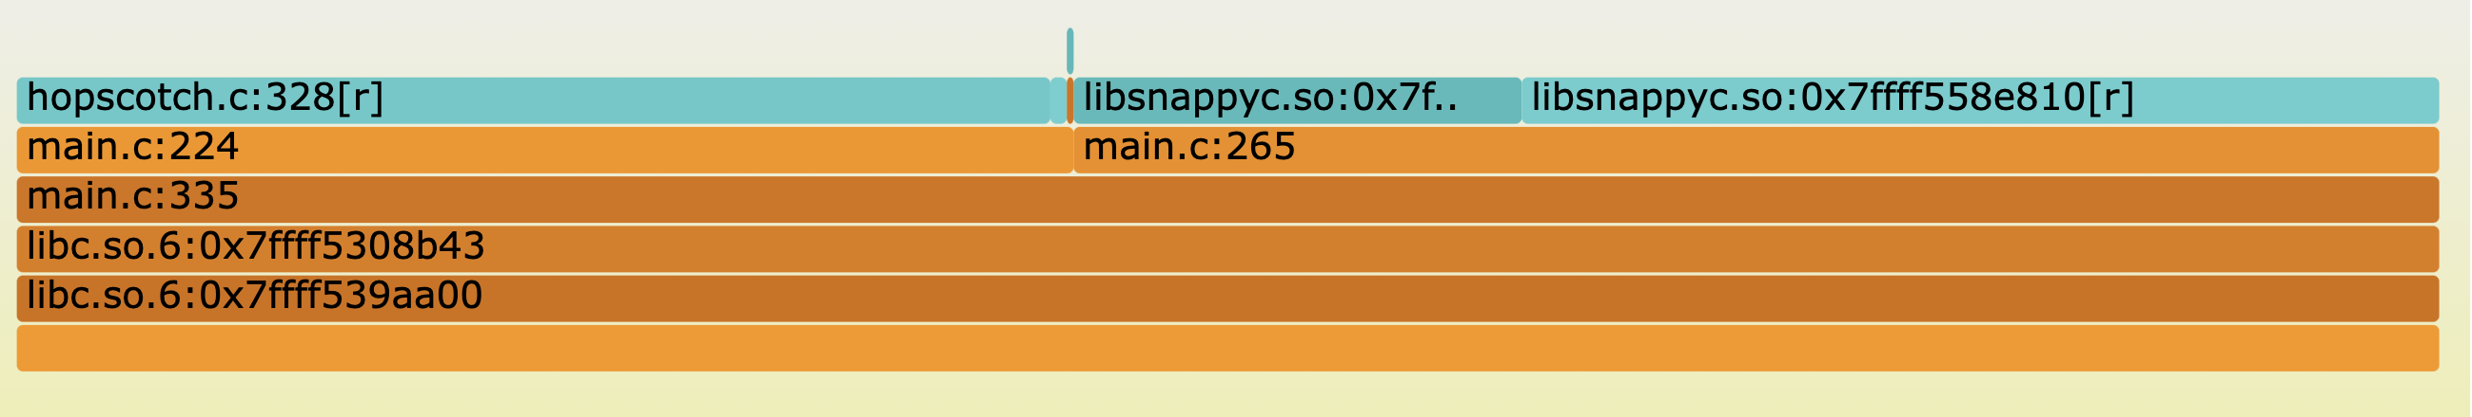
Tracing AIFM’s Web Service
Hash Table Access
Array Access

Slide 38
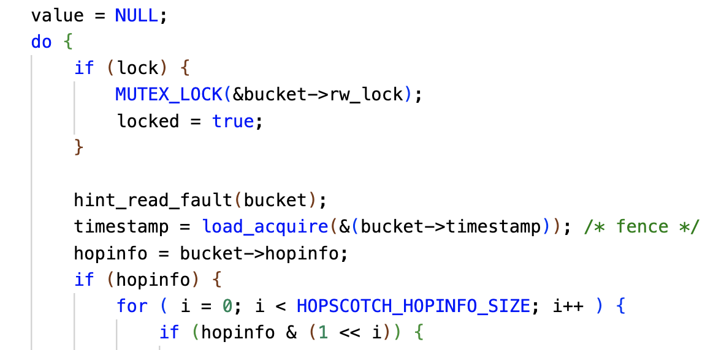
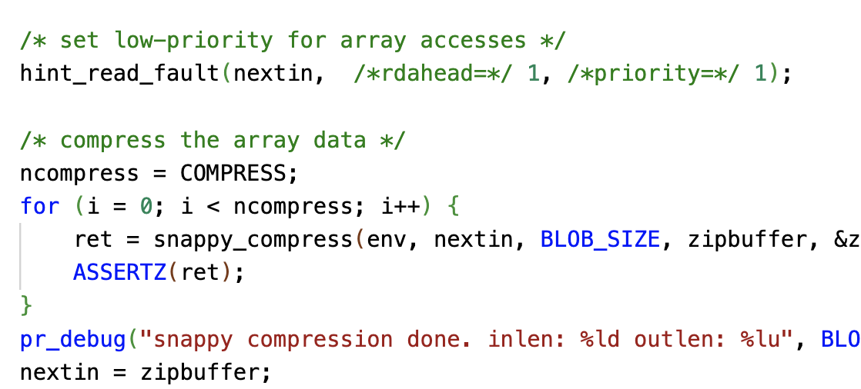
Hinting AIFM’s Web Service
Hint for blob array lookup
Low priority
Hinted Hash Table Lookup

Slide 39
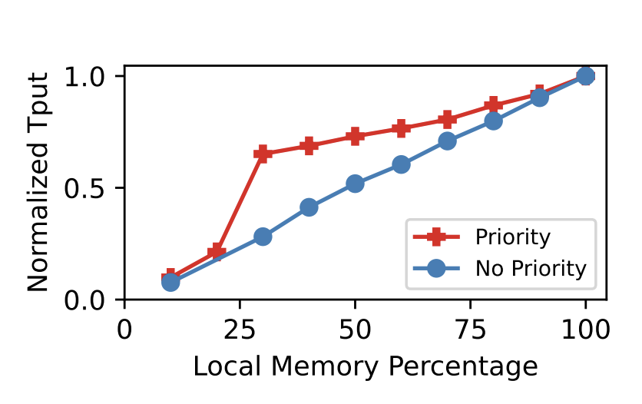
De-prioritizing Array pages
AIFM’s Web Service – Hash Table-heavy version
Notes:
Show hinting for web service app?
A general version of prioritizing metadata and keeping it local

Slide 40
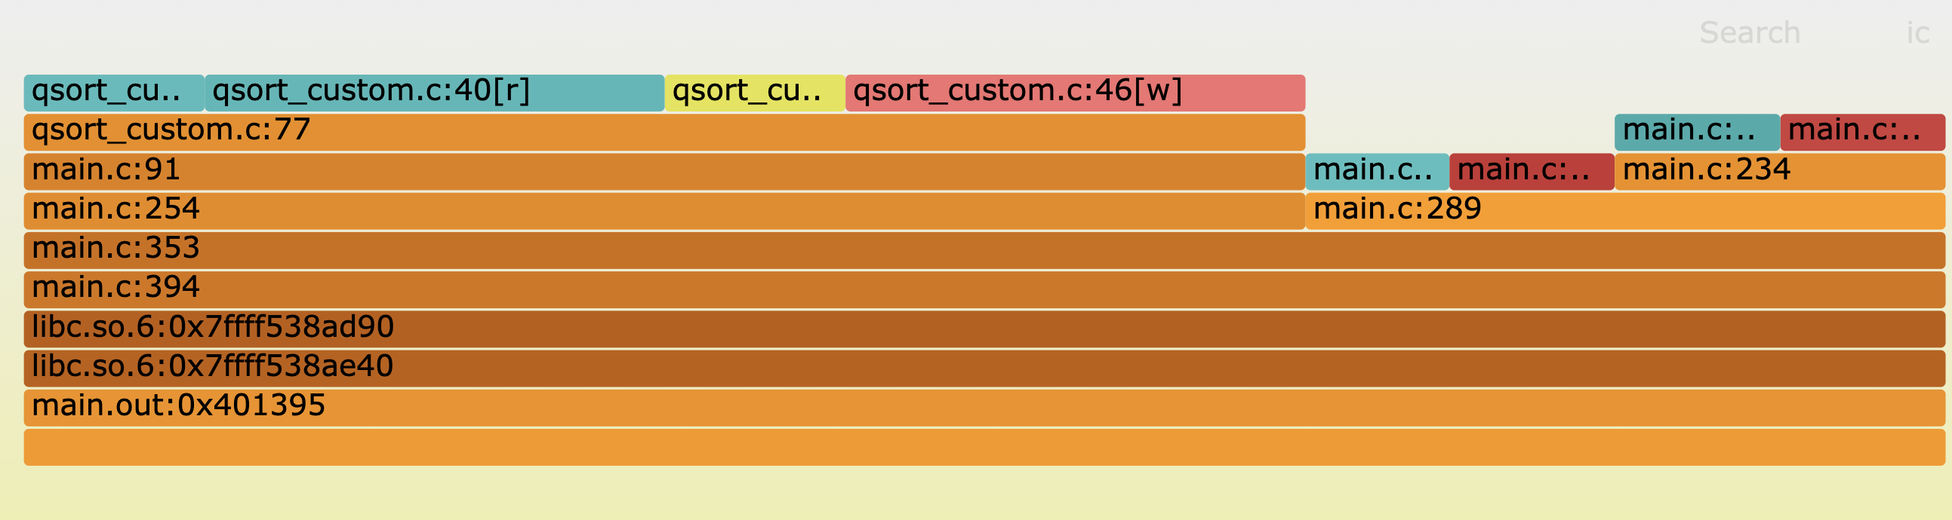
Example: Hinted Prefetching for Parallel Sort
Quick Sort Forward Access
Quick Sort Reverse Access
Merge Step
Copyback

Slide 41
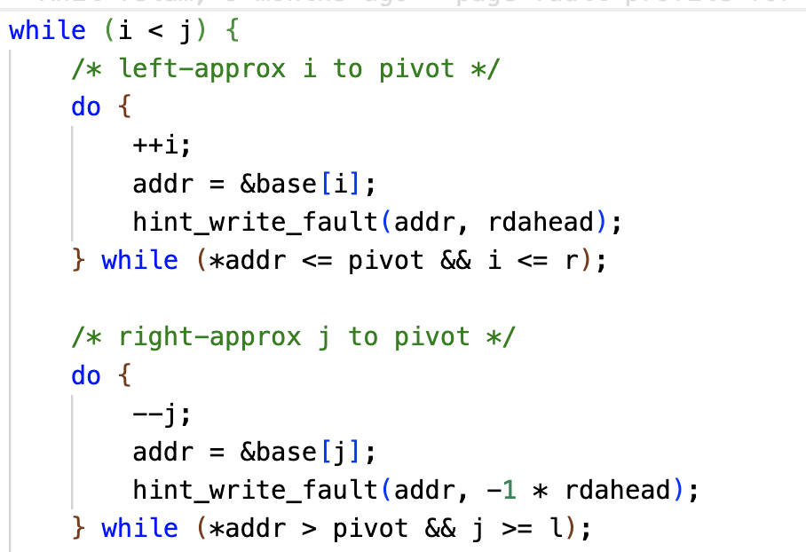
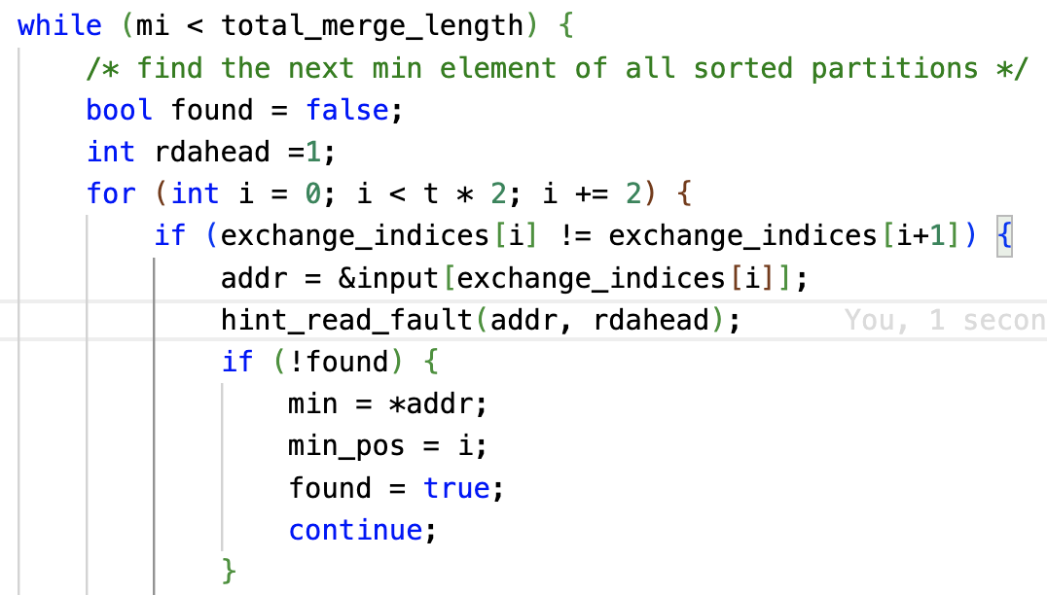
Hinting read-ahead for Parallel Sort
Merge Sort Forward Access
Quick Sort Accesses

Slide 42
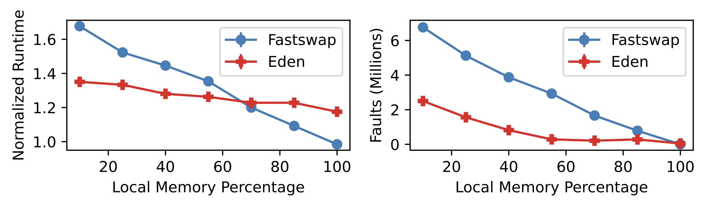
Hinting read-ahead for Parallel Sort
Eden uses per-hint read-ahead, Fastswap uses system-wide readahead
Eden’s read-ahead amortizes software overheads too
Highlights the advantage of the “certainty” of app-provided information

Slide 43
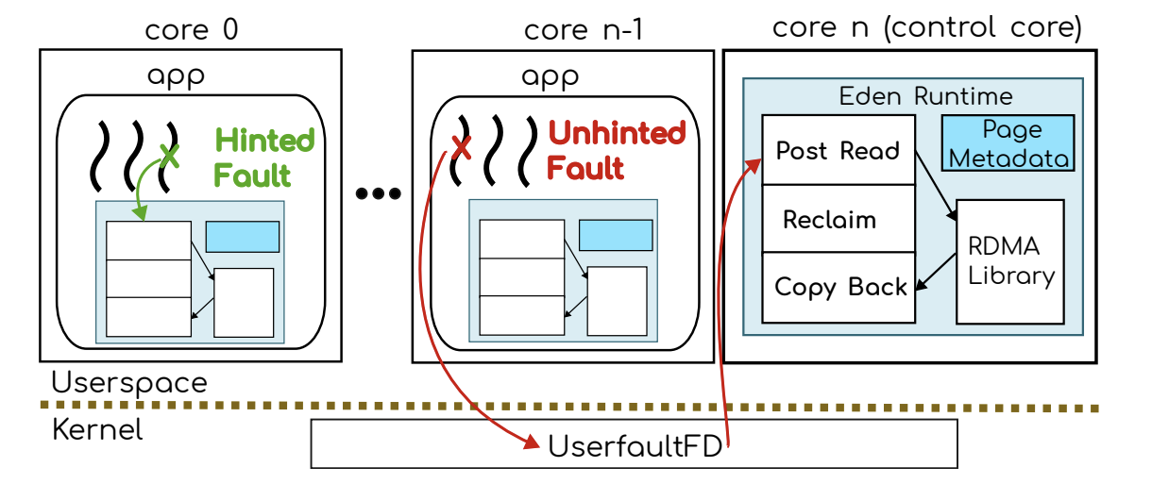
Eden Overview
Process
Notes:
Be very specific…

Slide 44
Eden Summary
A new point in far memory design space
Sacrifices little transparency for performance benefits of highly intrusive runtimes
This work is under review
AIFM
Eden
Performance
Fastswap
Less intrusive Interface

Slide 45
Thesis work
Study on page faulting code behavior
Eden: A developer-friendly runtime for network-based far memory
Submitted
Ongoing/Proposed
Study on page faulting code behavior (Contd.)
Hints-based Runtime for CXL-based far memory
Notes:
Moment for questions

Slide 46
Further study on faulting locations
Understanding the factors behind the locality behavior
Concretely working out the reasons
Helps explain where systems like Eden would or would not work!

Slide 47
Further study on faulting locations
Understanding the factors behind the locality behavior
Concretely working out the reasons
Helps explain where systems like Eden would or would not work!
Exploring the limits of annotating these locations
So far, the applications we hinted were not very complex
What if a location falls in utility code e.g., list iterator?
Such a location no longer reflects a specific code path(s)
How does one annotate such location?
Helps with the process of automating the hinting process
Argues for the practicality of Eden, and future systems like my next work :-)

Slide 48
Thesis work
Study on page faulting code behavior
Eden: A developer-friendly runtime for network-based far memory
Submitted
Ongoing/Proposed
Study on page faulting code behavior (Contd.)
Hints-based Runtime for CXL-based far memory
Notes:
Moment for questions

Slide 49
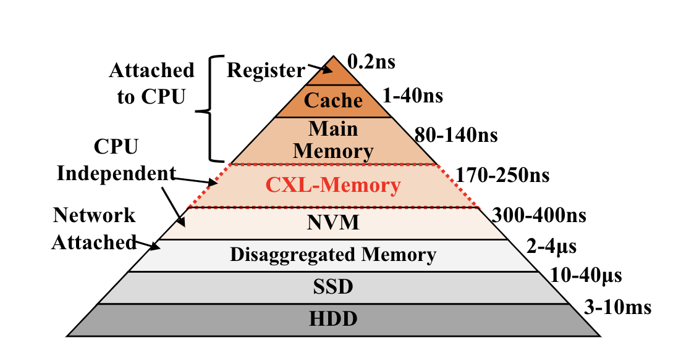
CXL Primer
New Interconnect based on PCIe 5.0
CXL 2.0 enables memory pooling
CXL 1.0 prototypes exist, 2.0 expected in near future
Expected latency: few 100 ns
Expected position in the latency pyramid
[TPP, ASPLOS’23]

Slide 50
How is it different?
Key differences
Cache-line based access i.e., no page faults
Smaller far memory latencies
CPU
CPU
LLC
LLC
LLC Miss
Local Memory
Far Memory
Page
Faults
(On-path)
Local Memory
CXL-attached Memory
Page
Promotion
(Async)
Paging-based
CXL-based

Slide 51
Implications for System Design
Asynchronous, calculated page promotion instead of page faults
→ Not every far page needs to be promoted
→ Only promote a page if the benefit exceeds promotion and reclaim costs (~20µs)
“Page temperature” – number of cache lines used in a page – is also important
Need more fine-grained page access information for better decisions
But such information is not available or existing sampling mechanisms like PEBS may be prohibitive at runtime

Slide 52
A profile-guided CXL runtime through hinting
Faulting locations still capture first accesses in dominant code paths
Hinting at these locations provides cheaper way to convey statically-profiled page information to the runtime
For example, hints can encode:
Custom priority for pages, like in Eden
Profile-guided page “temperature”
Cache lines to prefetch for later accesses in the page
Other such static, app-specific information

Slide 53
Conclusion
I showed that concise hinting can provide a simpler alternative to custom, invasive interfaces in enabling application-guided far memory.
My on-going work focuses on understanding the limits of our hinting process, and extending it to guide page promotion in CXL-based far memory
I plan to defend my thesis by Winter 2024.

Slide 54
Authored Papers
Thesis work
Eden: Developer-friendly Userspace Far Memory (Under review)
Anil Yelam, Stewart Grant, Nadav Amit, Amy Ousterhout, Radhika Niranjan Mysore, Marcos K. Aguilera and Alex C. Snoeren
Limited Access: The Truth Behind Far Memory (Under review)
Anil Yelam*, Stewart Grant*, Enze Liu, Radhika Niranjan Mysore, Marcos K. Aguilera, Amy Ousterhout and Alex C. Snoeren
Others
SmartNIC Performance Isolation with FairNIC: SIGCOMM’20
Stewart Grant*, Anil Yelam*, Maxwell Bland and Alex C. Snoeren
Coresident Evil: Covert Communication in the Cloud With Lambdas, WWW’21
Anil Yelam, Shibani Subbareddy, Keerthana Ganesan, Stefan Savage and Ariana Mirian

Slide 55
Questions

Slide 56
Backup slides

Slide 57
Fltrace tool
Page fault tracing
Based on Userfaultfd and Memory lib interposition
LD_PRELOAD: no changes to app
Signal handler to back-trace stack state during a fault
Log processing
Remove page allocation faults
Building code with nopie and get source code locations
Notes:
Backup

Slide 58
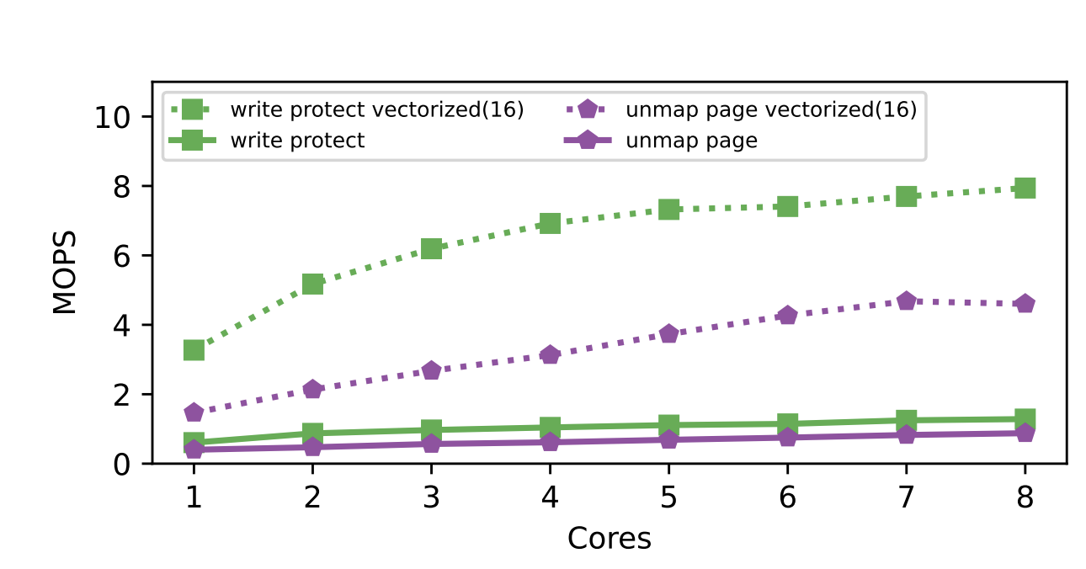
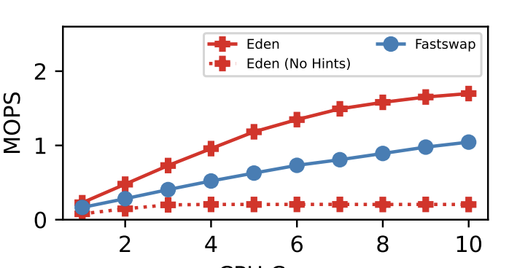
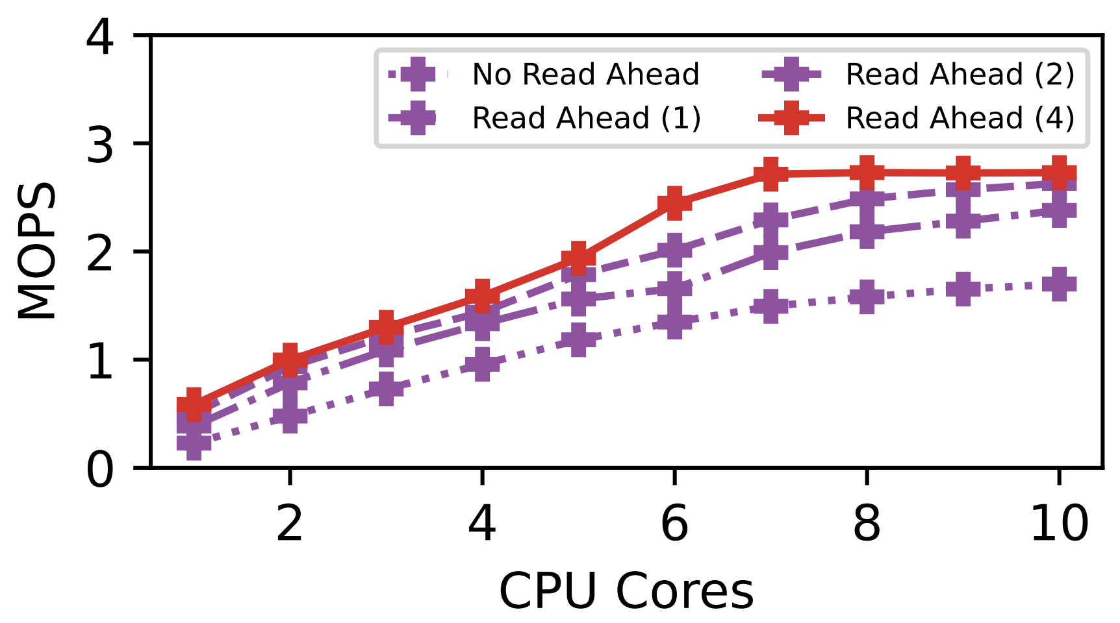
Eden Microbenchmarks
Vectorized Operations
Basic Paging Throughput
Read-ahead Benefits

Slide 59
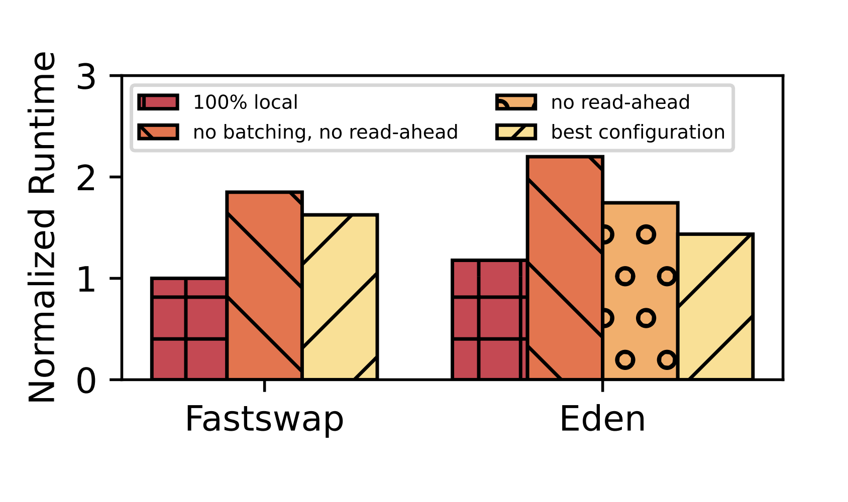
Extended hints: Read-ahead
Breakdown

