Slide 1
Status
Vectored write-protect
Eviction
Trade-off between hint overhead, eviction overhead & eviction efficacy
Multiple eviction levels, ability to bump between lists
Options: Default, Second-chance and (approximate) LRU
Knobs: epoch length, number of levels
Fastswap setup
4.15 has different numbers even for plain read/writes
Vanilla read: 1M vs 24M
Vanilla write: 0.5M vs 1M

Slide 2
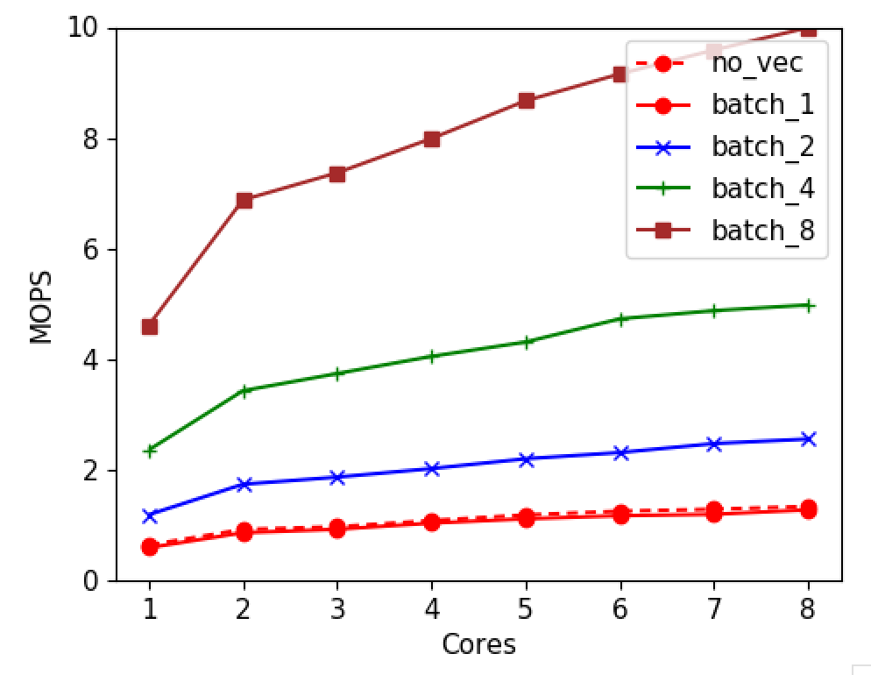
Vectored WriteProtect
One more TLB flush
Consolidating into one syscall seems challenging

Slide 3
Agenda
Faults performance – one more bottleneck
Fault read-ahead performance
Eviction batching
Requires two syscalls with TLB shootdowns
WP syscall: no batched call yet
Madv syscall: Process_madvise for both syscall & TLB batching
TLB shootdowns discussion

Slide 4
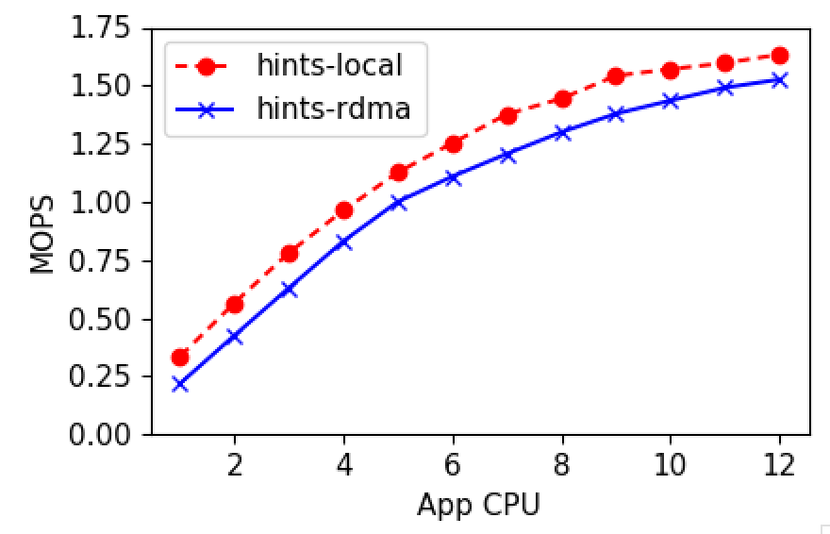
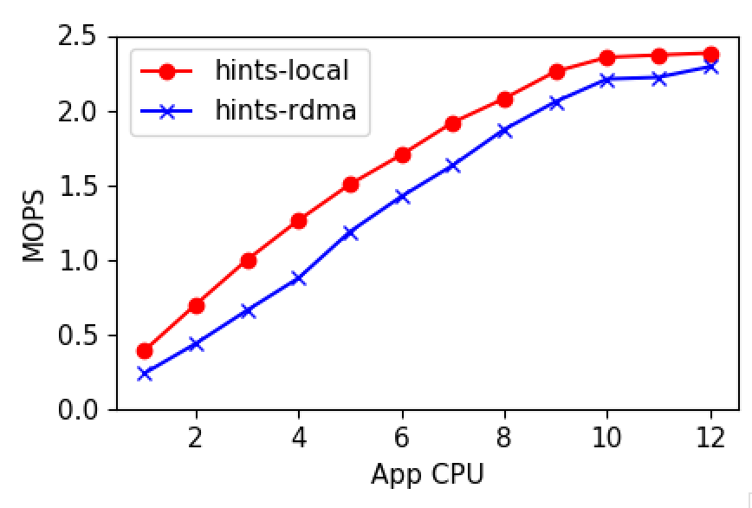
Faults performance
Adding page to the page list – taking a lock on the list causes final taper
Notes:
Check Bimodal TODO

Slide 5
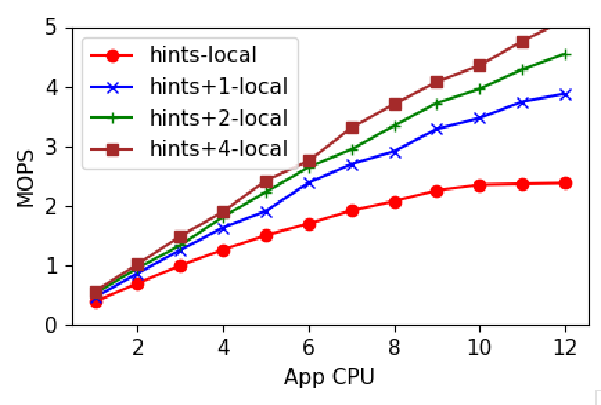
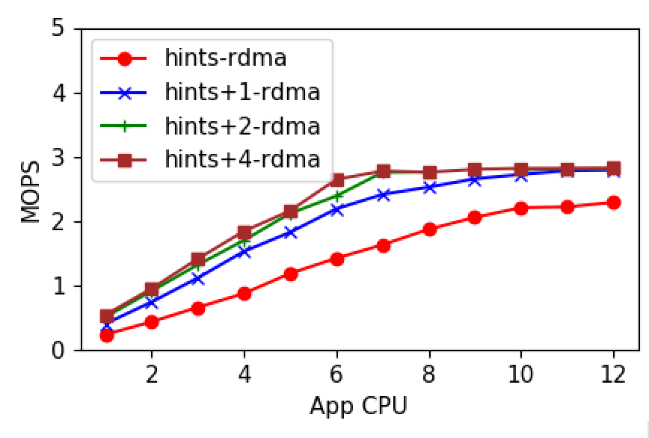
Fault read-ahead performance
Local
Remote

Slide 6
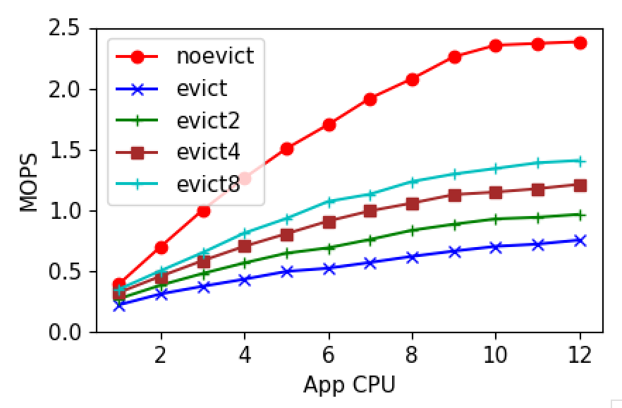
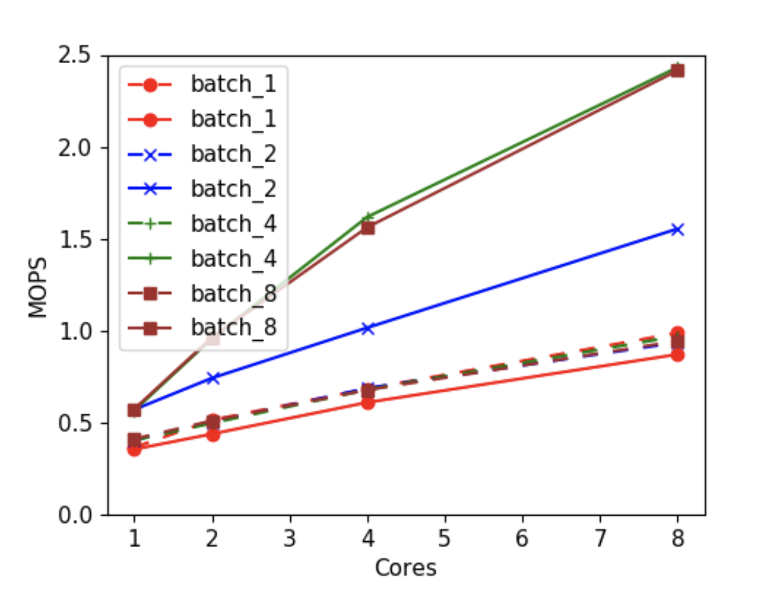
Eviction batching
Micro-benchmark
Eden Eviction (no write-back)

Slide 7
TLB shootdowns
All paging systems, not just Eden
At least one shootdown/flush (on all cores) per eviction
Either individual shootdowns or flush
Trade-off Scalability vs Application Performance
What if we flush every 100 pages? High tail latencies

Slide 8
Eviction policy
Hot, warm, cold lists
When to bump?
Synchronously during the hint
Asynchronously bump between lists based on hot flags
Does synchronous yield an advantage?

Slide 9
MG-LRU

Slide 10
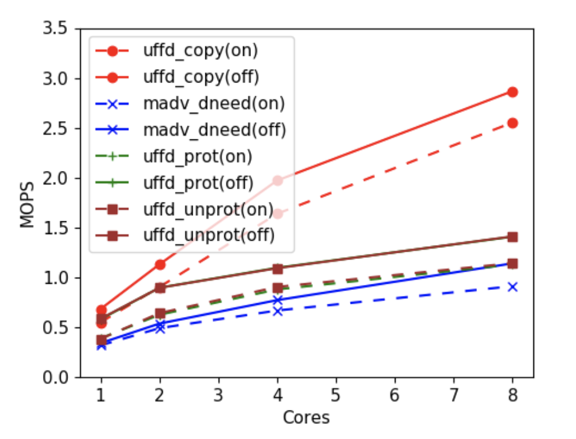
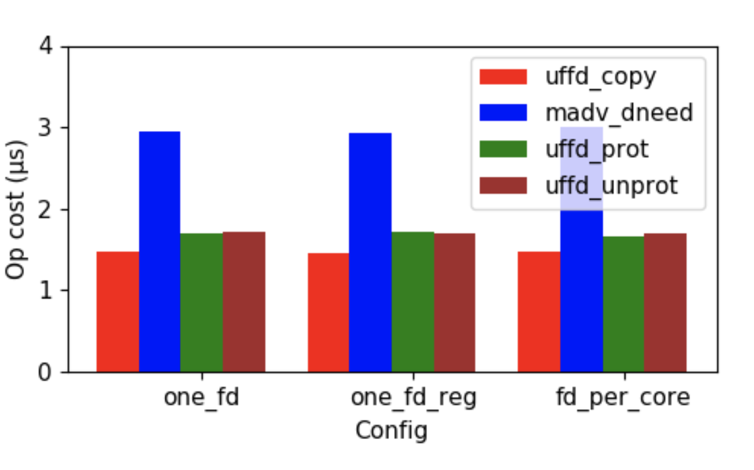
UFFD Ops Performance

Slide 11
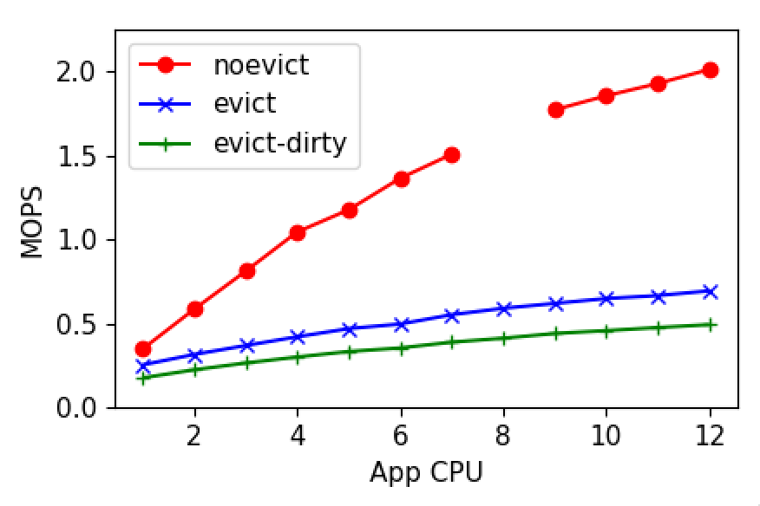
Eviction- two syscalls
Notes:
Scalability affected by TLB shootdowns

