Slide 1
Status
Vectored write-protect numbers
Eviction policy
Trade-off between hint overhead, eviction overhead & eviction efficacy
Base capability: multiple eviction levels, ability to bump between lists
Options: Default, Second-chance and (approximate) LRU
Knobs: epoch length, number of levels
Fastswap setup
4.11 has different baseline numbers
Plain read: 1M vs 24M, plain write: 0.5M vs 1M. Will get page fault numbers, updating benchmark
Update to 5.15; rebased & installed changes – yet to test.

Slide 2
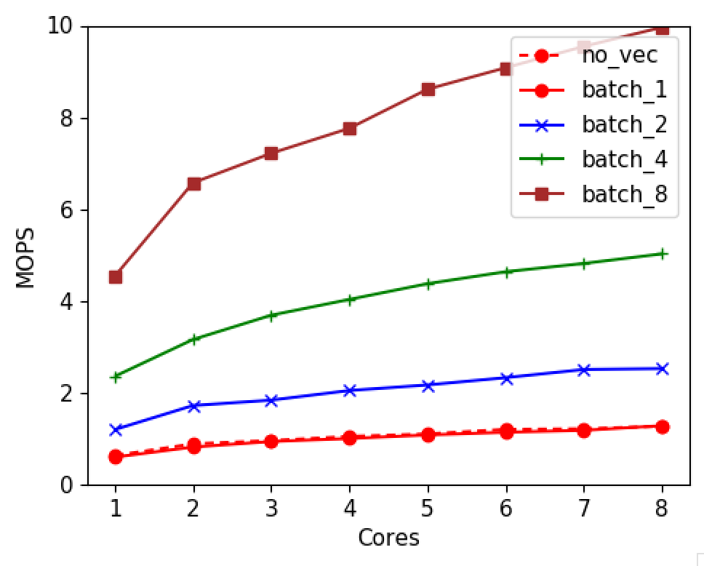
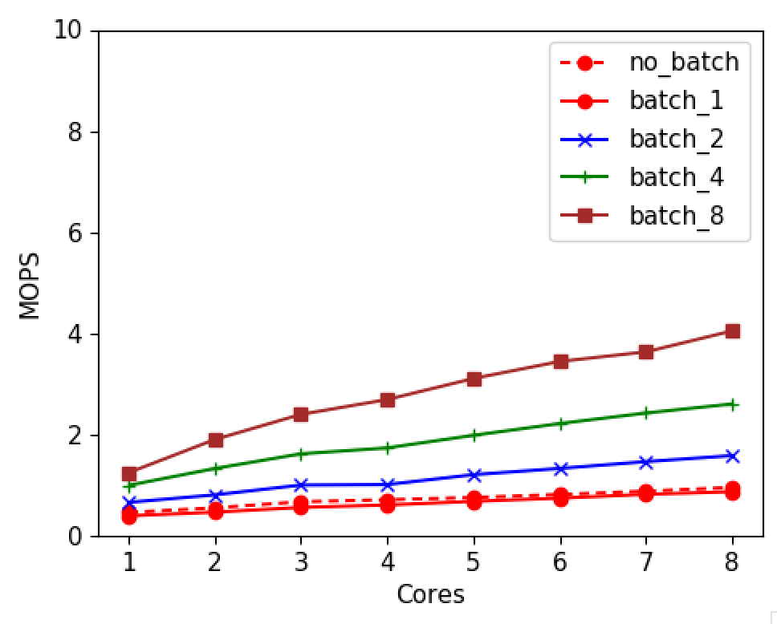
Vectored WriteProtect
Vectored Mprotect
Vectored Madvise
(from last week)

Slide 3
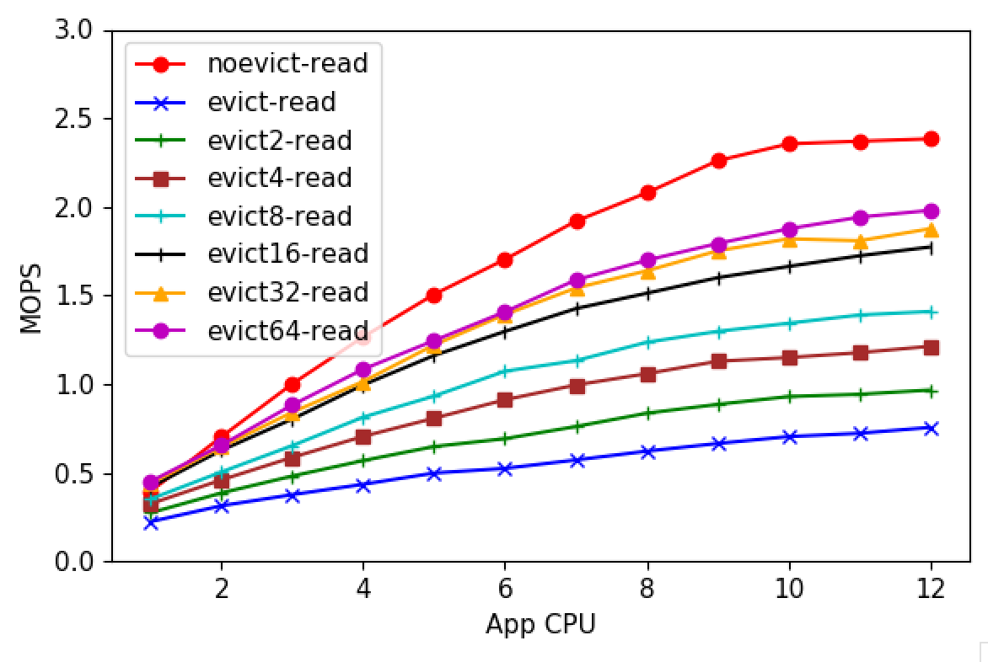
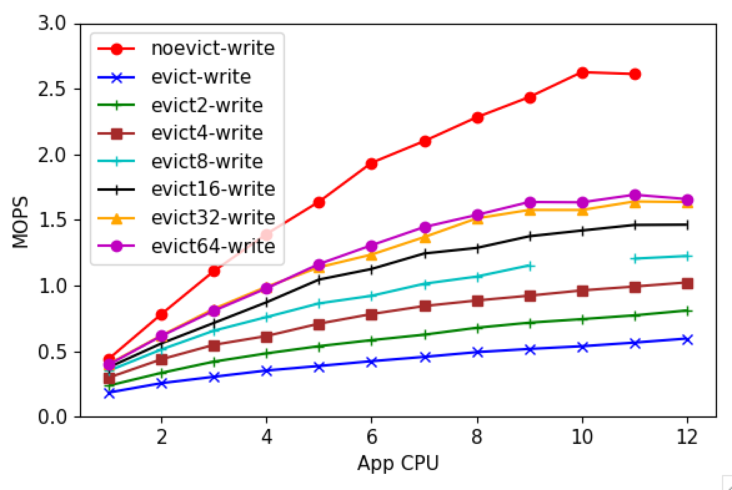
Eviction Batching
No write-back
Write-back

Slide 4
Next
Fastswap 5.15
Eden with synthetic benchmark
OSDI manuscript by next meeting

Slide 5
Misc

Slide 6
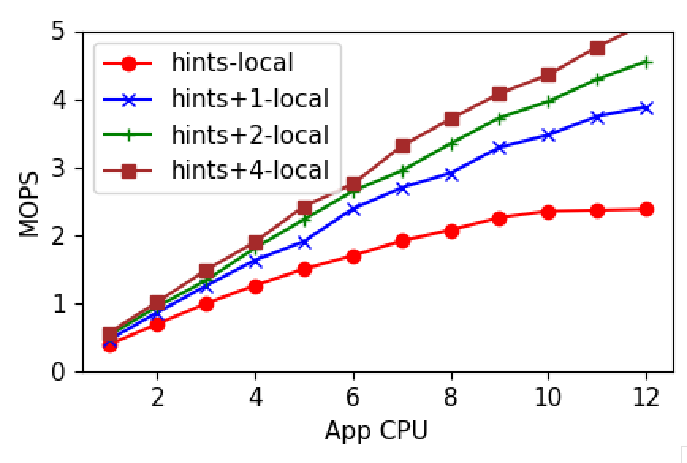
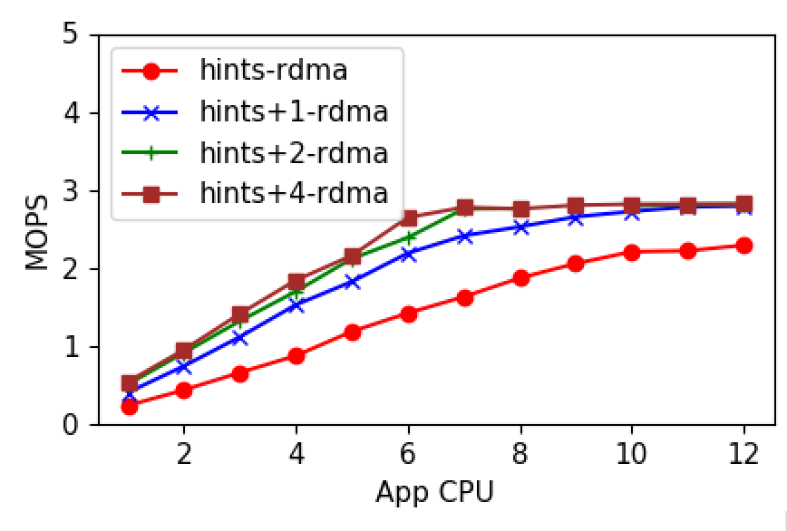
Fault read-ahead performance
Local
Remote

Slide 7
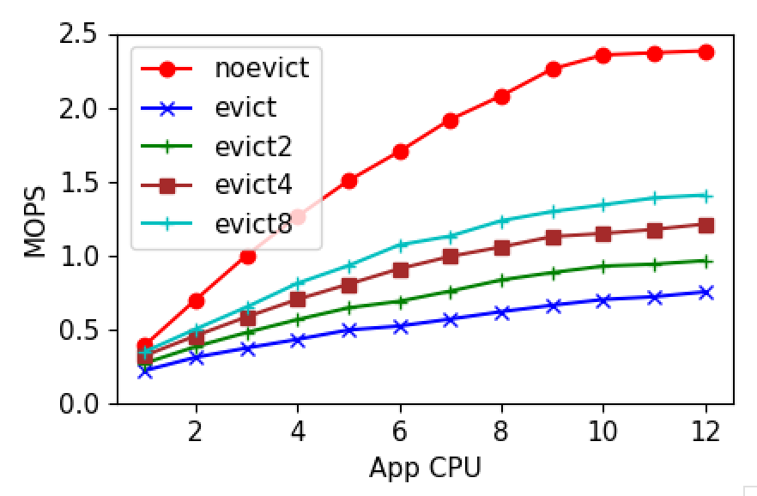
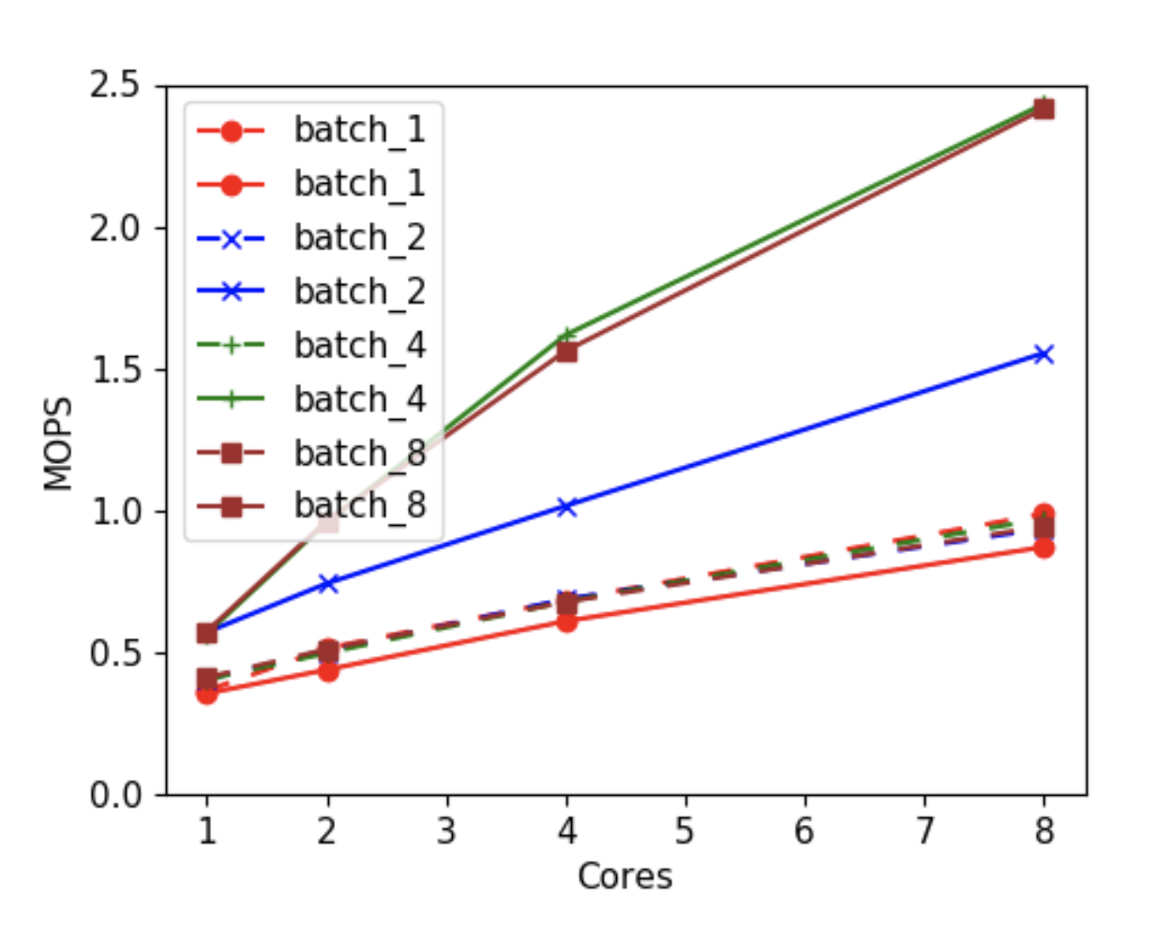
Eviction batching
Micro-benchmark
Eden Eviction (no write-back)

Slide 8
TLB shootdowns
All paging systems, not just Eden
At least one shootdown/flush (on all cores) per eviction
Either individual shootdowns or flush
Trade-off Scalability vs Application Performance
What if we flush every 100 pages? High tail latencies

Slide 9
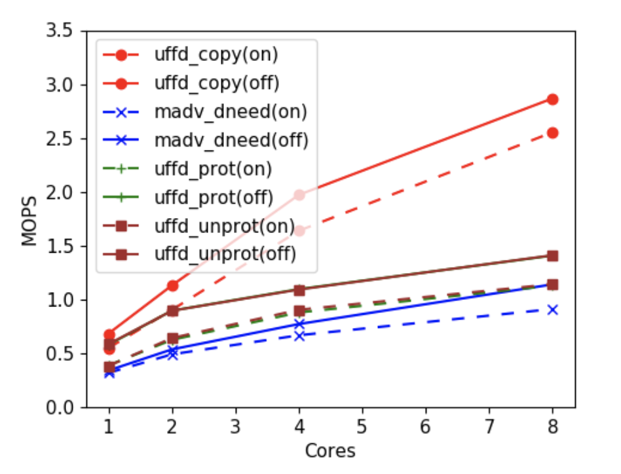
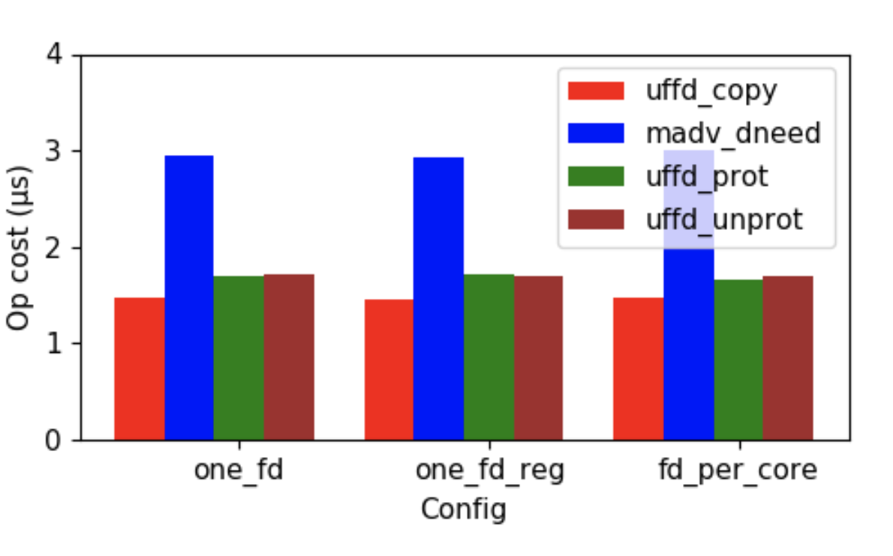
UFFD Ops Performance

Slide 10
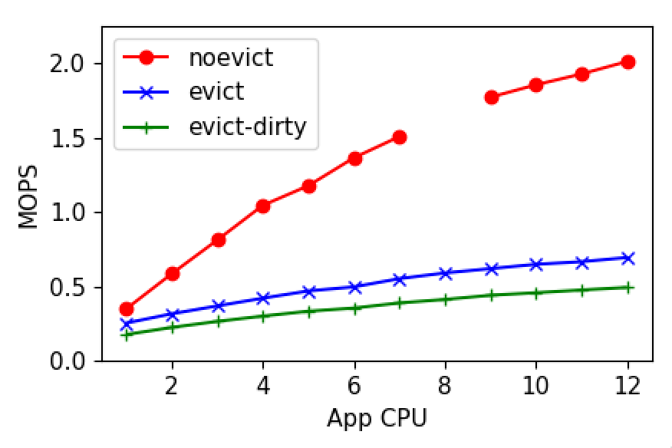
Eviction- two syscalls
Notes:
Scalability affected by TLB shootdowns

